Slide 1
Managing Collections in the Networked Environment: New Analytic Approaches
OCLC Research Webinar
9 September 2010
Constance Malpas, OCLC Research
Zack Lane, Columbia University
Helen Look, University of Michigan
Jacob Nadal, University of California, Los Angeles

Slide 2
Context
Making library data “work harder”
Decision support: where should limited institutional resources be directed?
New skill sets, professional cohort emerging
Highlight significant work at RLG partner institutions
Identify shared research priorities, methodologies
Staffing and infrastructure requirements, organizational development

Slide 3
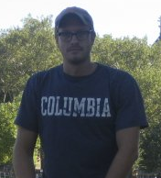
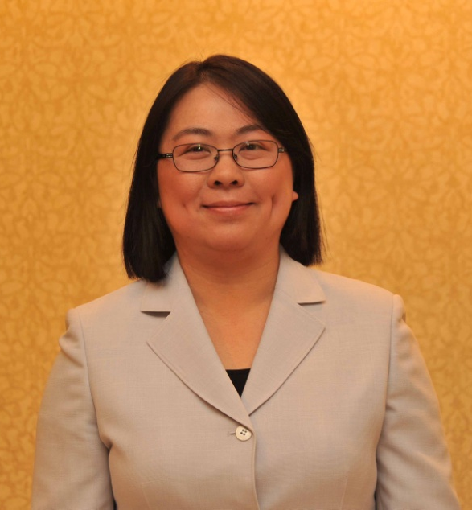

Today’s Panelists
Zack Lane
ReCAP Coordinator
Columbia University
Zl2114@columbia.edu
Helen Look
Collection Analyst
University of Michigan
hlook@umich.edu
Jacob Nadal
Preservation Officer
UCLA
jnadal@library.ucla.edu

Slide 4
Circulation Data at Columbia University Libraries
Zack Lane
ReCAP Coordinator
Columbia University

Slide 5
Project: Look at System-wide Circ Data
Several data categories
Many ways to slice
Tip of the iceberg

Slide 6
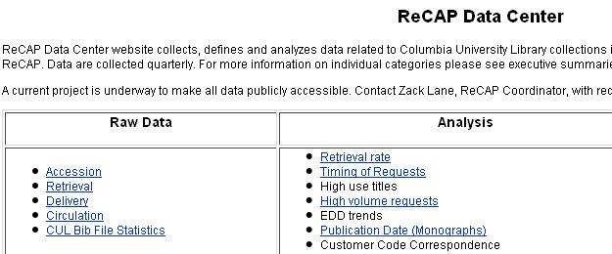
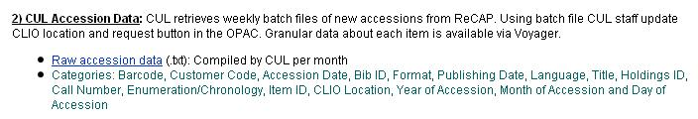
Lots of Amazing (Granular) Data
Main categories: accessions, retrieval, delivery and circulation

Slide 7
Multi-dimensional Analyses

Slide 8
Circulation Analysis Project: Spring 2010
Identify bright and capable intern: Steve Zweibel!
Locate data sets
Understand data sets
Working with Systems staff to improve data
Reformatting Data
Manipulating data with Excel 2003/2007 (Pivot tables)
Presenting data with Power Point
Rethink, rework and refine

Slide 9
Big Numbers: 18% decline in circ over 7 years

Slide 10
What’s to Gain?
Data set is clean and compact
Categories apply to both on-site and off-site collections
Low barrier of entry for library school intern
Everyone has access; no-one is looking
Improves understanding of circ system, patron behavior, staff habits, data analysis tools and system-wide trends
Staff somewhat surprised that circulation data analysis was system-wide not ReCAP-specific

Slide 11
Big Numbers: Revisited
4 main patron groups: Grad Students, Faculty, Undergrads and Visitors

Slide 12
Zack’s Deep Thoughts
Trend of total charges is downward due to use of e-resources
Leveling off indicates that use of print copy is still strong and critical
Faculty charges have increased due to more Grads serving as adjunct faculty (with OFF privileges)
Grads peak a month before Undergrads because of course requirements (tilted towards written papers instead of tests)

Slide 13
What Else Did Steve Discover?
Patrons renew when they must renew

Slide 14
Patron Group Habits:
Charge/Renewal ratios are consistent with staff perceptions
Faculty are more likely to hold onto the books that they have than charge out new ones
Undergraduates have little need to renew with extended loan period
Grad students charge a lot of material and hold it for more than one term
Visitors hold books longer since obtaining OPAC renewal permission

Slide 16
Relevant to Other Issues
Access Services considering changes to Hold policy:
Holds have limited duration
Data indicates that most Holds expire
Should Hold duration be extended?
Should Holds (via OPAC) be eliminated?
Enter Circ data analysis…

Slide 17
Overall Holds are half that of Recalls
Online Holds are one-eighth that of Recalls

Slide 18
Moving Forward
Bring data to staff; don’t expect staff to come to data
Learn from the intern
Query, pressure and improve data
Congratulations Steve Zweibel! Part-time professional cataloging position at NYU and part-time reference at Hunter College Health Sciences Library

Slide 19
Post-digitization Use of Print Collections
Helen Look
Collection Analyst
University of Michigan

Slide 20
Background
Study of post-digitization use of print collections at the University of Michigan
University of Michigan digitization efforts
HathiTrust Digital Library - http://www.hathitrust.org

Slide 21
Access to Institutional Resources
Harmonizing data from different sources
Working with different staff to gather the data
Consulting with internal and external colleagues

Slide 22
Methodology
Top 500 accessed titles in HathiTrust Digital Library by the University of Michigan community in 2009
Title-level online usage was compared to title-level print usage
Print circulation for the sample was compiled for 2008, 2009 and total circulation history

Slide 23
Low Usage of the Print
98% (489) of the titles had zero circulation
2% (11) of the titles circulated
2009 circulation for the 11 titles was equal to or less than the 2008 circulation

Slide 24
Increased Discoverability of the Content
39% (193) of the titles had not circulated
61% (307) of the titles had circulated
Hidden treasures

Slide 25
Subject Distribution

Slide 26
Patterns in the Overall Online Usage

Slide 27
Lessons Learned
Improved our understanding of the use of online and print materials made accessible through mass digitization
Learned from the process about what data is available and where better metrics are needed
Identified some potential patterns for further study

Slide 28
“The temptation to form premature theories
upon insufficient data is the bane of our profession.”
– Sherlock Holmes

Slide 29
Data-based Preservation Decision Making
Jacob Nadal
Preservation Officer
UCLA Library

Slide 30
Preservation Theory and History:
Medicine, Zoos and Fortresses
Controversial assertion: What libraries call preservation is more like conservation at scale, and it’s still not to scale.
20th century preservation was effectively local. We tried to protect or repair the items in the collection
  Rigid, comprehensive security and environmental standards
  Fortification of item (library binding, deacidification)
  Replacement of weak items with hardened versions (library editions, microfilm, facsimiles)
Libraries are more like zoos than fortresses
Preservation was trying to deal with public health problems in the metaphorical emergency room

Slide 31
Preservation Theory at UCLA:
Public Health, Flood Control & Habitats
Preservation works from the collection down
Conservation works from the item up
At UCLA, one strategy governs both approaches
  Every activity has a:
  1) Method of analysis or evidence-gathering
  2) Treatment proposal & outside review
  3) Hedge or fail-safe option
We’re operating a dam or flood control channel, not manning a wall under siege
  You can make your LA River jokes now… ha, ha…
As our program matures, the watchword is habitat:
  Habitats are flexible and adaptable
  Habitats are sustainable or not, depending on certain pressures
  Habitats have local versions of global types

Slide 32
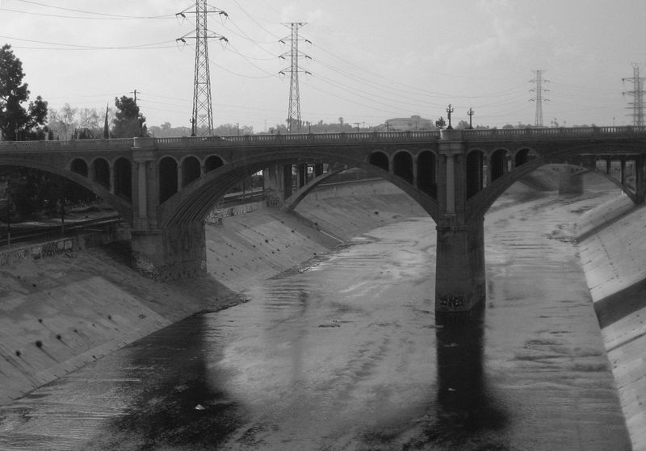
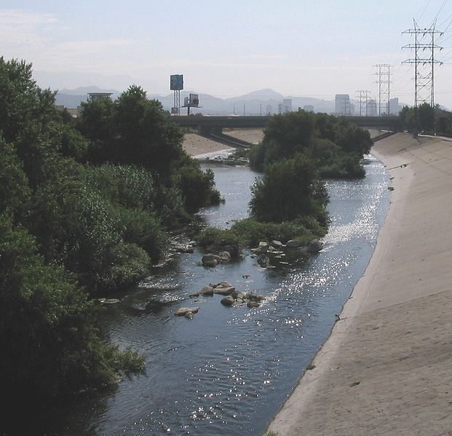
The Los Angeles River
The natural river is less work and functions better.
A model worth emulating!
The concrete bottom reduces the effectiveness for flood control, creates a bad habitat for wildlife, and ruins its recreational value.
All that effort for nothing!
More about the River: http://www.lariver.org and http://folar.org/

Slide 33
From Theory towards Practice:
Habitat, Sure, but Who Lives There?
UCLA, like all big RLs, has some really shabby books.
These “brittle books” are frustrating.
  Repair is not the answer: little structural integrity means they’re irreparable or require “heroic” conservation
  Reformatting is costly: fragile, poor contrast materials, so scanning has to be careful and high-quality
And yet, we’re obligated to preserve certain things:
  Materials with high Los Angelocity
  Scarce within the UC system, California, or the world
  Signature collections, future classics, academic emphases
Everything else, we want you to do for us
  kthanksnextslide!

Slide 34
From Practice to Practicalities
So, how does that dam/wall/habitat thing address the problem of lots of individual shabby books, in the context of a globally-intended collection of record?
Push decisions from the item to the network context
Holdings review is the first step
  Holdings data parsed into global (Worldcat), regional (CA/350 miles of zip code 90095), and system (Worldcat Local/NGM)
  HathiTrust status checked (Portico, (C)LOCKSS, JSTOR to come?)
These data are placed into a risk assessment model
Series of automated recommendations are made

Slide 35
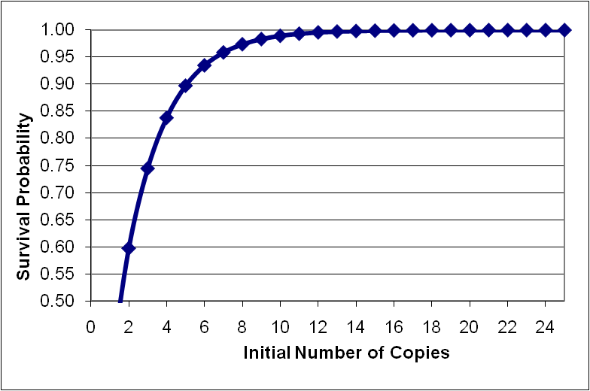
Risk Assessment Model
From Candace Yano (UC Berkeley/Ithaka)
Initial number of copies | Survival probability
1 | 36.6032%
2 | 59.8085%
3 | 74.5199%
4 | 83.8464%
5 | 89.7592%
6 | 93.5076%
7 | 95.8841%
8 | 97.3906%
9 | 98.3457%
10 | 98.9513%
11 | 99.3351%
12 | 99.5785%
13 | 99.7328%
14 | 99.8306%
15 | 99.8926%
16 | 99.9319%
17 | 99.9568%
18 | 99.9726%
19 | 99.9827%
20 | 99.9890%
21 | 99.9930%
22 | 99.9956%
23 | 99.9972%
24 | 99.9982%
25 | 99.9989%
26 | 99.9993%
12 copies is where the curve is asymptotic
26 is derived from past decisions by UCLA

Slide 36
Basic Scenario for Preservation Review
Three outcomes:
  Keep if [<12 global] OR [<3 CA] OR [0 UC]
  Withdraw if [> 26 global]
  Else Review
Data is collected (point 1) then a proposed treatment gets external review by coll. managers (point 2) and all decisions are hedged by the network (point 3)
  “Keep” implies that preservation will see to it that the content remains in the collection
  “Withdraw” really means withdraw
  “Review” means we need a genuine person to make a decision (and people are both slow and idiosyncratic, so…)

Slide 37
Alternate Scenarios
Decision making starts with the basic scenario.
We’ll fine-tune that as we collect decision data
  Seeking best match between collection managers decisions and automated indicators
  After a designated review period, may use a more risk-tolerant scenario to decide on materials lingering in “review” status
At present, we have a known unknown regarding artifactual value
  Conservation screens materials and routes to preservation review. Conservators are eagle-eyed about artifactual value
  Preservation officer reviews all “withdraws” and, for better or worse, yours truly has a mild case of bibliomania

Slide 38

The Hedgerow
#1 OR, Retain First
#3 AND, Retain First
#2 OR, with Hathi, Retain First
#4 AND, with Hathi, Retain First

Slide 39
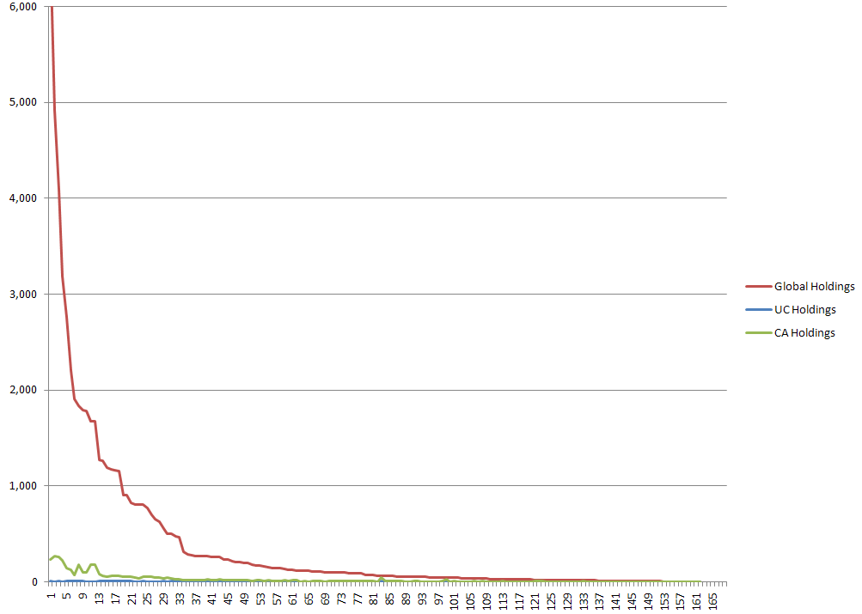
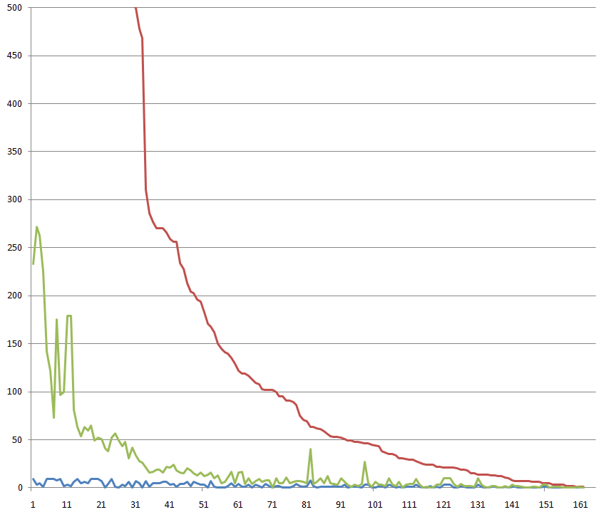
The Long Tail

Slide 40
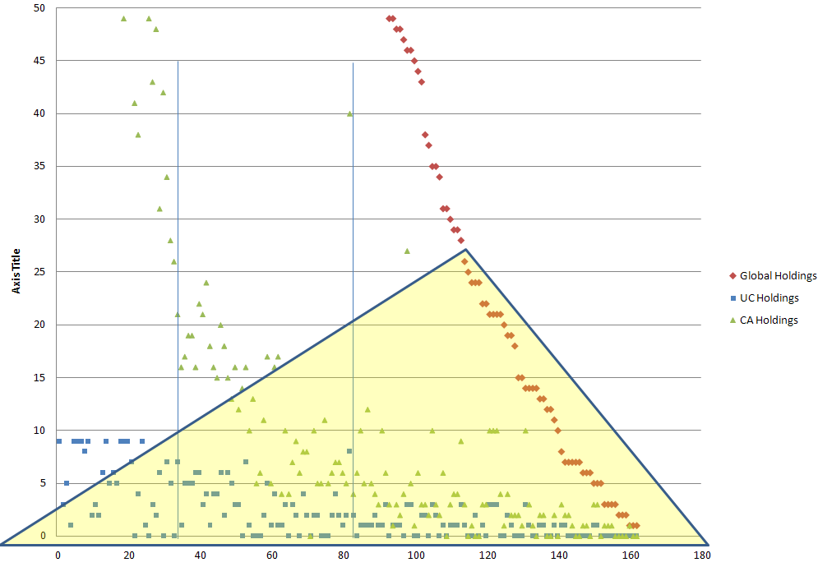
The Los Angeles Triangle
Inside this zone, we have
a stewardship obligation,
driven by preservation,
a general good
Outside, we have options,
driven by an institutional
intention

Slide 41
Acknowledgements and Next Steps
What made this possible
  Annie Peterson – summer intern in the UCLA Library preservation office, from UIUC GSLIS. What made it possible
  Willingness by all to try a “Cynefin” style of work -- gradual sense-making and continuous process improvement
What would make it easier
  In-house statistics expertise and research support
  Longer stretches of uninterrupted time
  Better serials data – Communal 583 + Local Holdings Records
What comes next
  More of the same, to refine and test our process
  Application to other activities: gifts & exchange, replacements and preservation-driven acquisition, preservation survey & audit

Slide 42
For More Information
ReCAP Data Center (Columbia University)
  Zack Lane & Colleen Major “Impact Theories: Trends in Off-site Shelving Facility Use” (ACRL, 2008)
  HathiTrust Digital Library
    Helen Look "Mass Digitization: Analyzing Online vs. Print Usage at a Large Academic Research Library" (ARL, 2010)
UCLA Library Preservation Blog
  Jake Nadal and John Riemer “Preservation Actions, MARC 21 Field 583, and Communal Local Holdings in OCLC WorldCat” (CONSER, 2009)

Slide 43
Questions, Comments?
Zack Lane - zl2114@columbia.edu
Helen Look - hlook@umich.edu
Jacob Nadal - jnadal@library.ucla.edu
http://www.oclc.org/research/events/webinars.htm
http://itunes.apple.com/podcast/oclc-research-podcasts-webinars/id284764834

