Slide 1
The Book is Dead!
Long Live the Book!
Roy Tennant

Slide 2
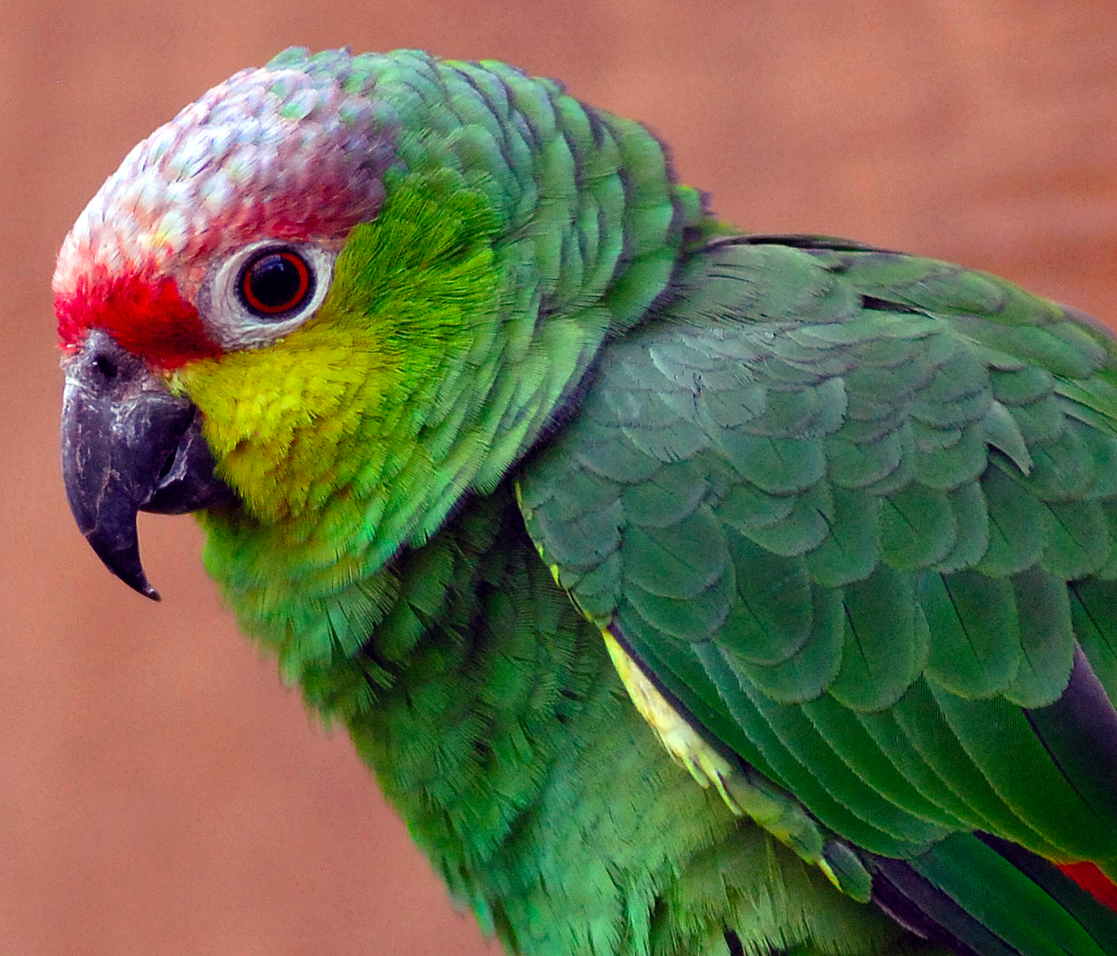

http://www.flickr.com/photos/pokerbrit/3459937296/

Slide 3
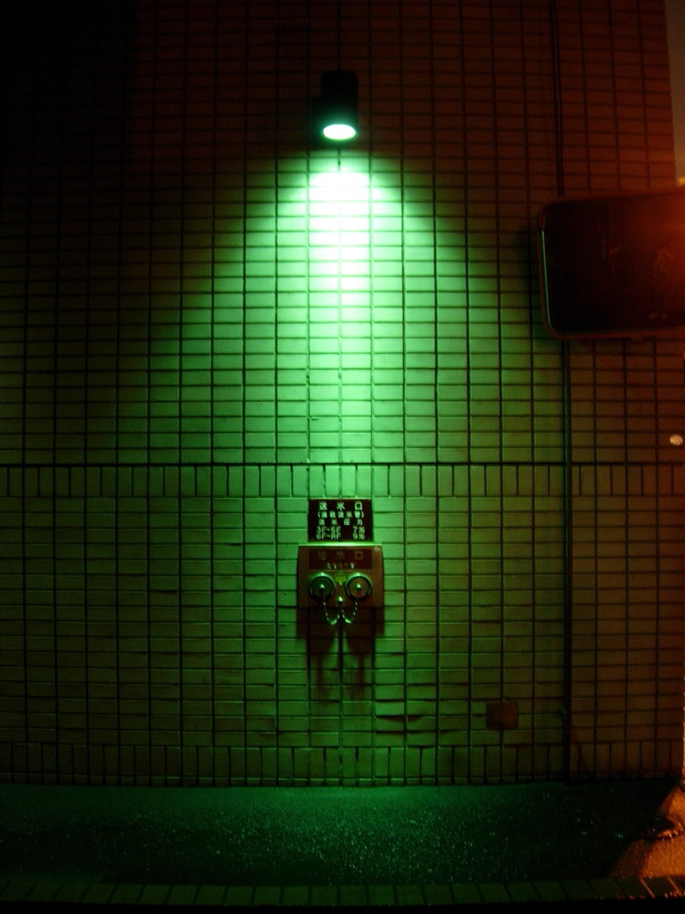

http://www.flickr.com/photos/trektrack/24583555/

Slide 4
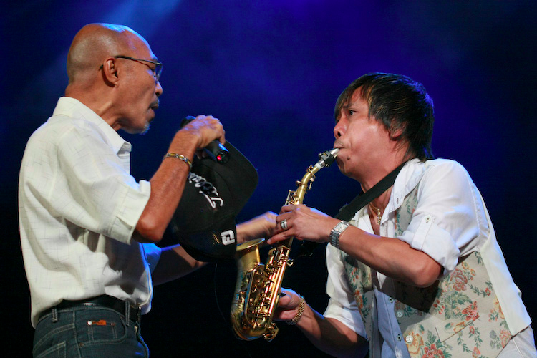
http://www.flickr.com/photos/rachdian/3962331058/

Slide 5
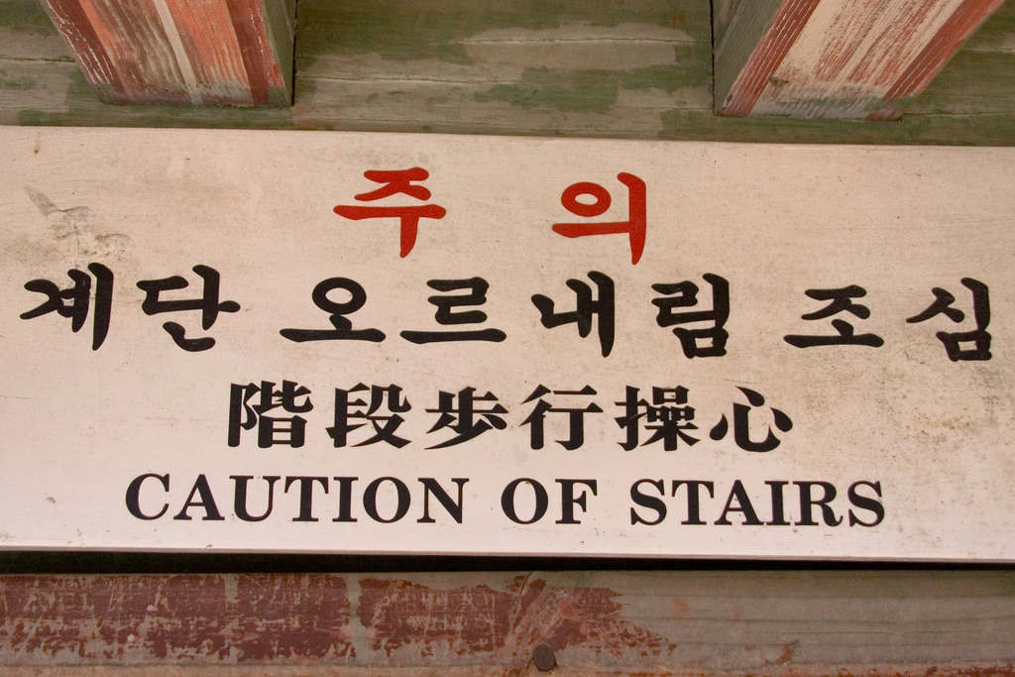

http://www.flickr.com/photos/90354616@N00/2241010837

Slide 6
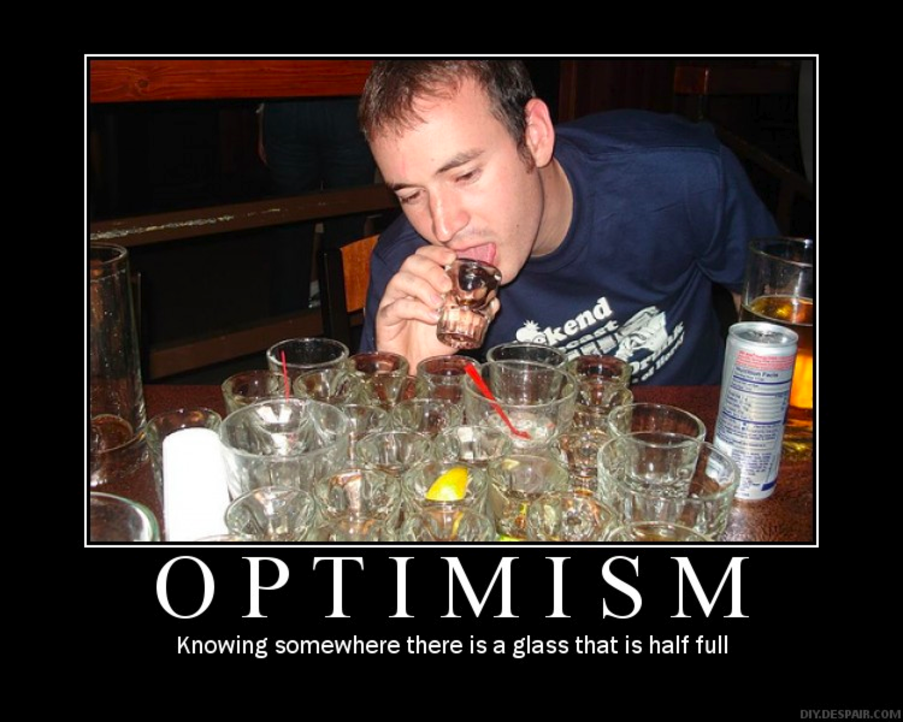
I’m an Optimist
Thanks to lolmatt.com and diy.despair.com

Slide 7
But

Slide 8
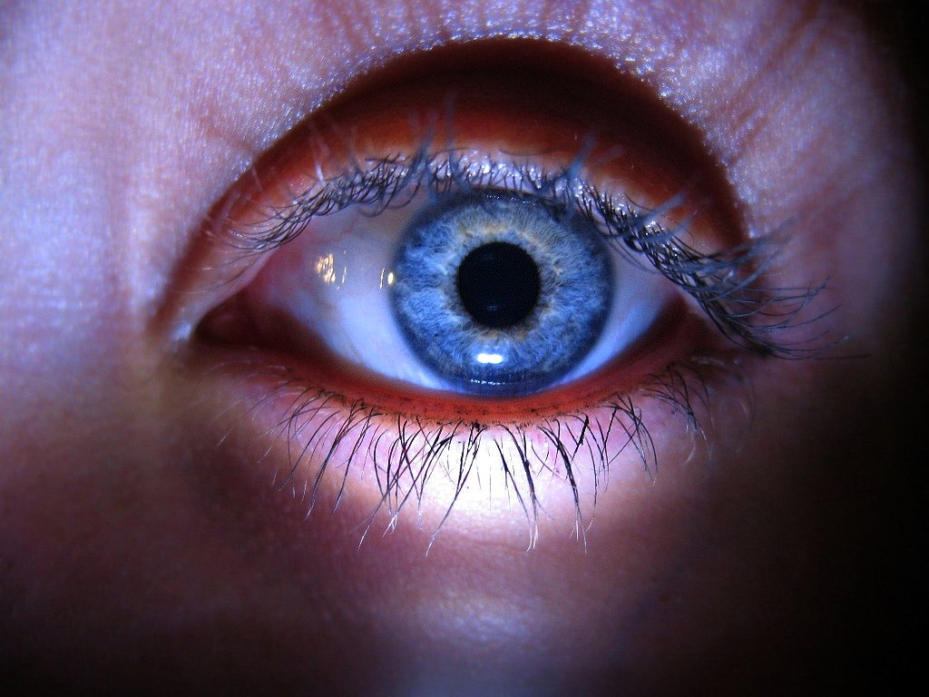

I may be your WORST NIGHTMARE
http://www.flickr.com/photos/sciain/1812919259/

Slide 9
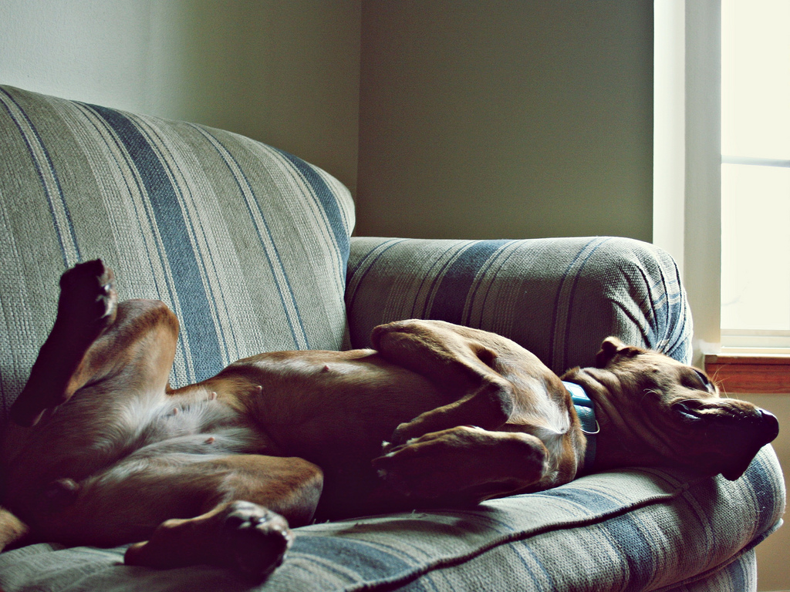
If we do nothing….
http://www.flickr.com/photos/riotjane/3085714116/

Slide 10


And in some cases, even
IF WE WORK HARD
http://www.flickr.com/photos/ethnocentrics/213319771/

Slide 11
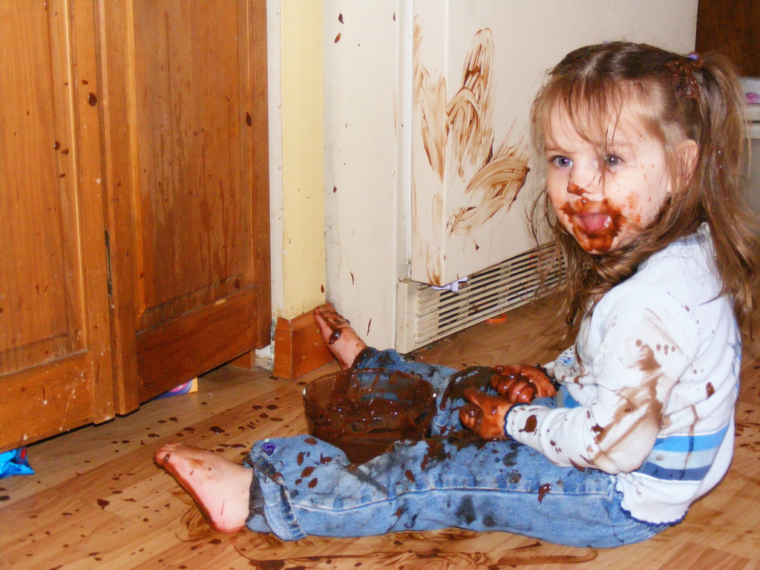
It may be the
WRONG THING
http://www.flickr.com/photos/ripizzo/2310929170/

Slide 12
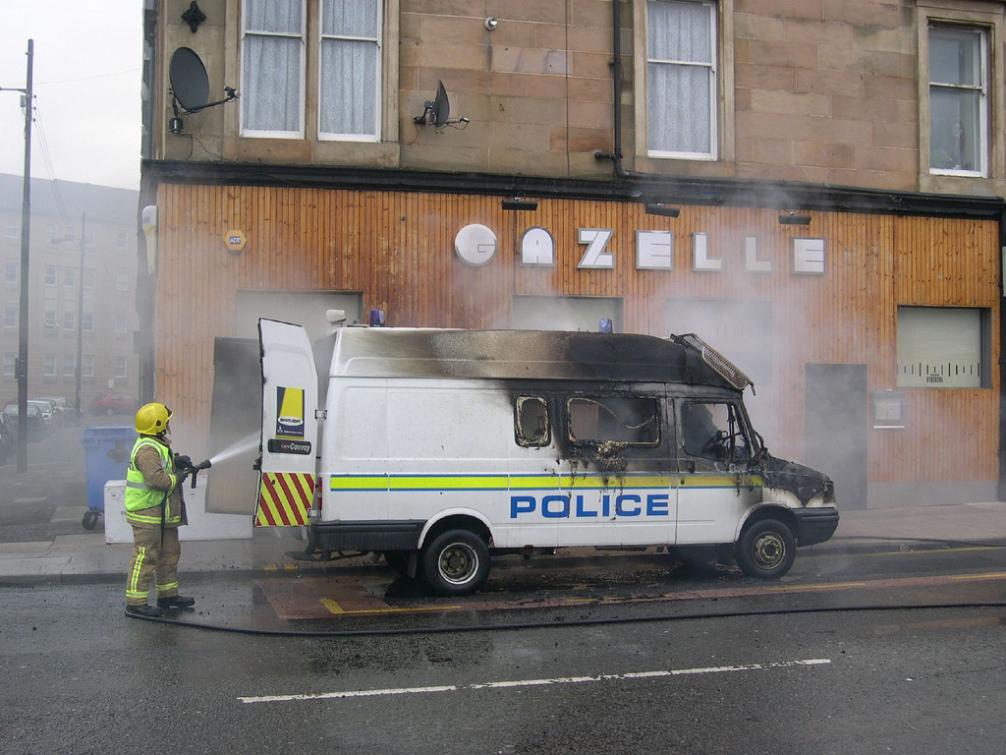

Or TOO LATE
http://www.flickr.com/photos/og2t/206670766/

Slide 13
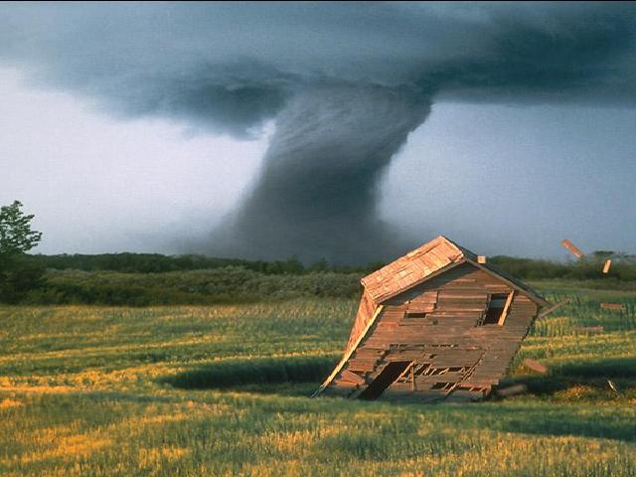

Libraries are in
IMMINENT DANGER
http://www.flickr.com/photos/indigente/798304/

Slide 14
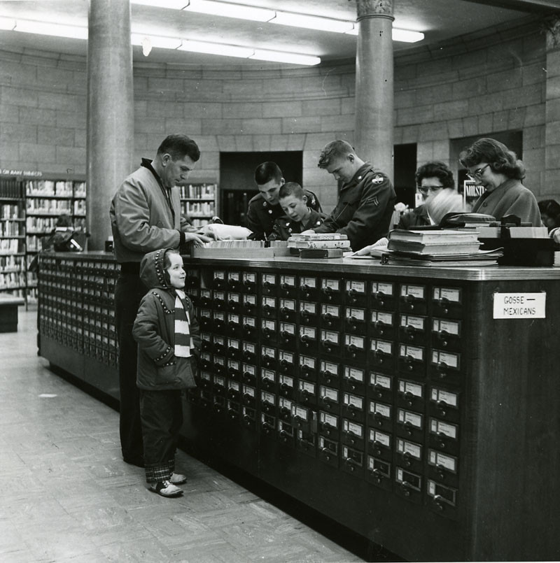

Slide 15

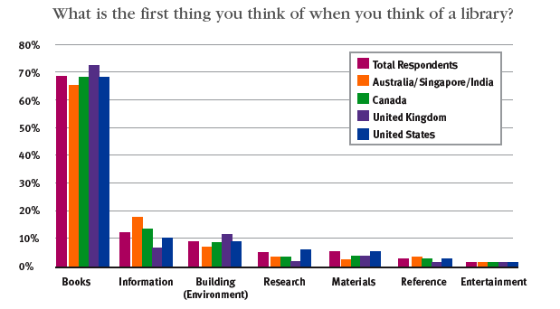

Slide 16
Scarcity

Slide 17
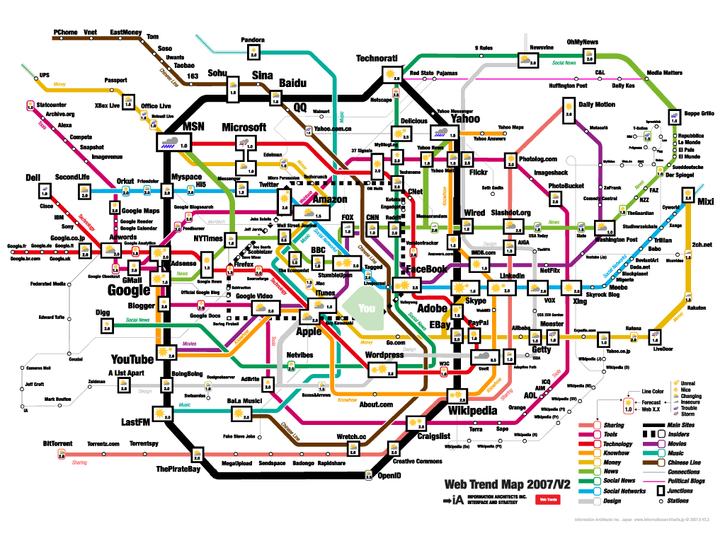

Slide 18
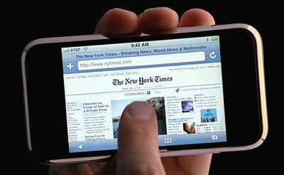

Slide 19
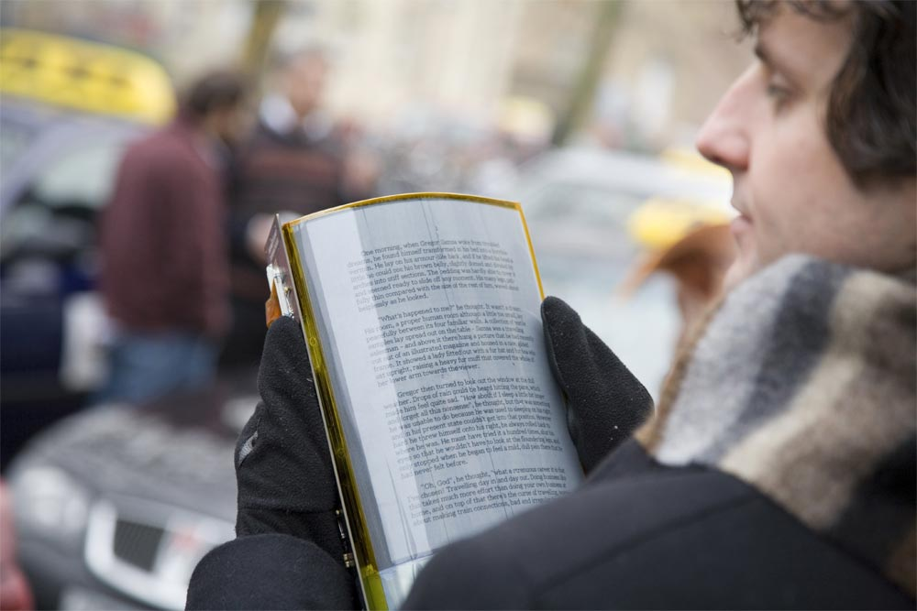

Slide 20
Ubiquity

Slide 21
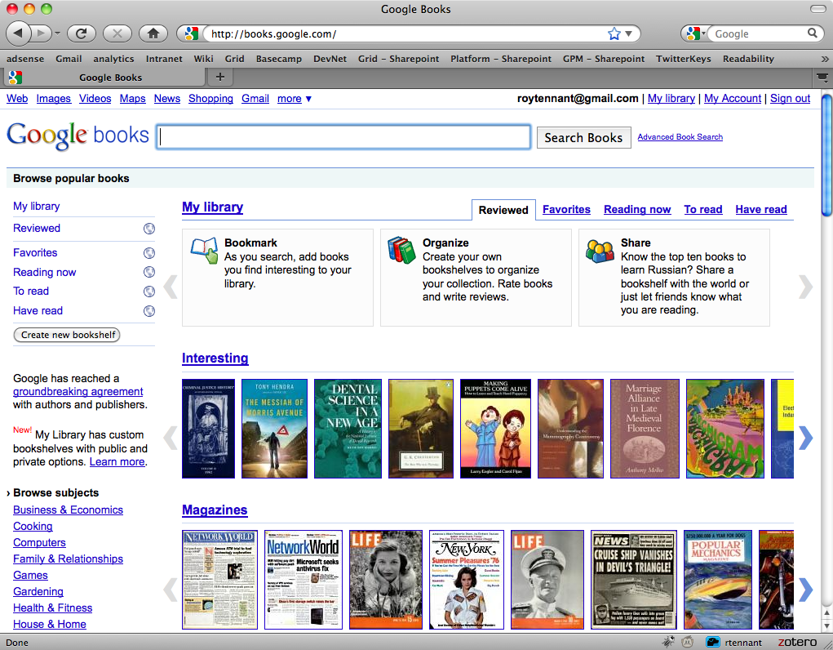

Slide 22
“The Attention Switch”
Then:
Resources scarce
Attention Abundant
Now:
Attention scarce
Resources Abundant

Slide 23
Adrian Johns

Slide 24
The “3 Ps”
Places
Practices
Publics

Slide 25
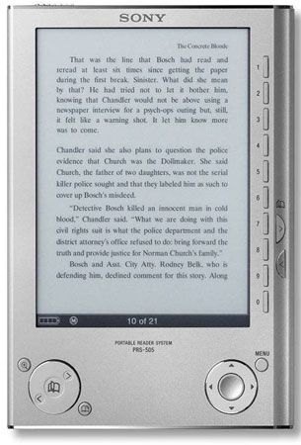


Slide 26
Michael Cairns

Slide 27
The Publishing Industry
Confusion
Change
Subdued
Dislocation
Speed
Jealous
Technology
Anxious

Slide 28
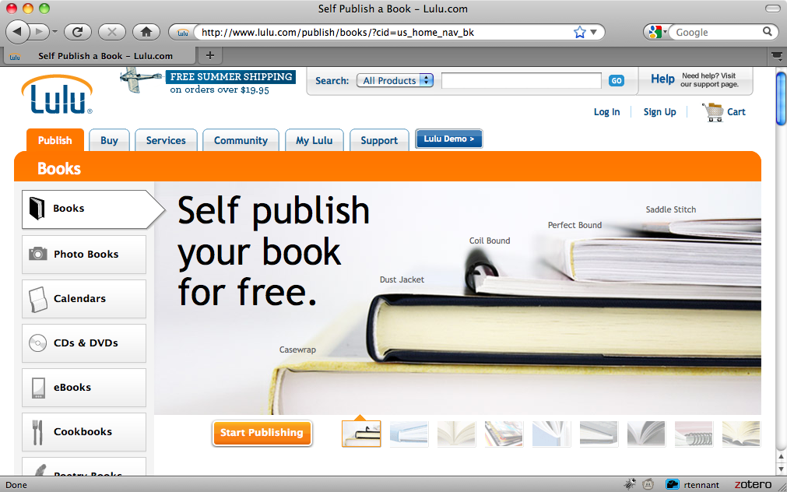
Impact of Self-Publishing

Slide 29
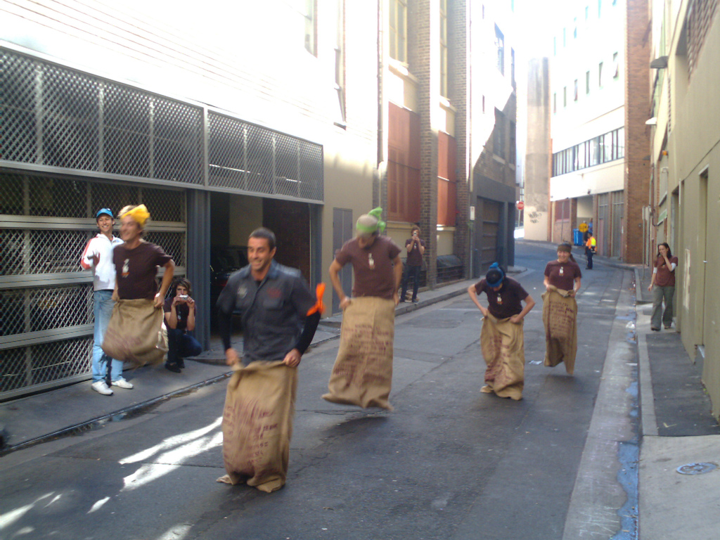

The (Sack) Race to Digital
Amazon
& Apple
Trade
Education
Libraries
Information.
http://www.flickr.com/photos/bigiain/142469085/

Slide 30
Print Books
Will never go away entirely
Will be more adaptable
And more shaped by the consumer

Slide 31
Carol Mandel

Slide 32


Space Matters
Space Matters
…a lot!
http://www.flickr.com/photos/45025094@N00/4299079683/

Slide 33
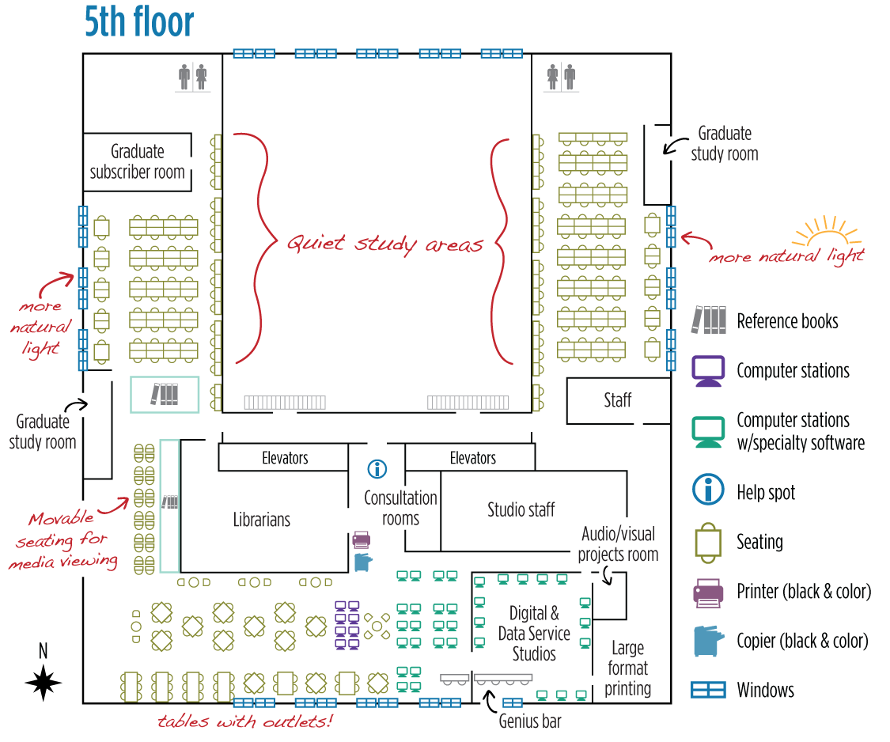

Slide 34
Think Collectively
Onsite stacks
Shared print repository
Shared acquisitions
Predict low use print
Print packaged with e-book licenses
Shared digital repository

Slide 35
Carol Mandel
We can build new and better models for:
  Shared print repositories
  Shared acquisitions
  Access to digital book content
  Interdependent collections
  Optimal user space

Slide 36
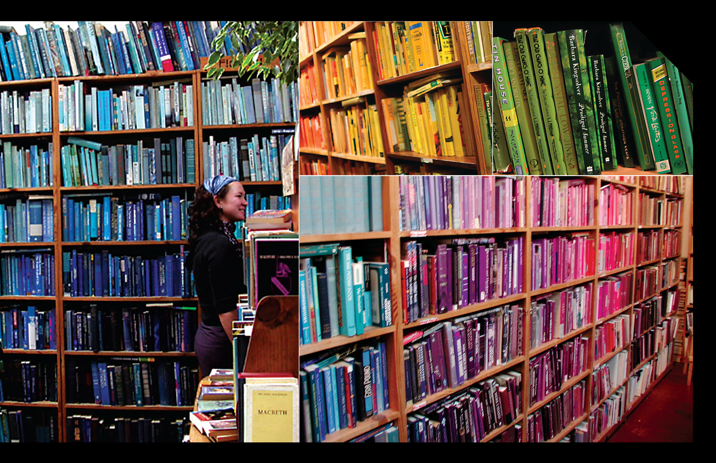
“Think Different”

Slide 37
Constance Malpas

Slide 38

An end to magical thinking
The books have already left the building.
>70 million volumes off-site
30% of Columbia’s collection
40% of UC Berkeley’s
50% of UCLA’s
+50% of Harvard’s, etc.
No evidence that loss of browsing has adversely affected scholarship or institutional reputation
6 editions held by 1,116 libraries

Slide 39
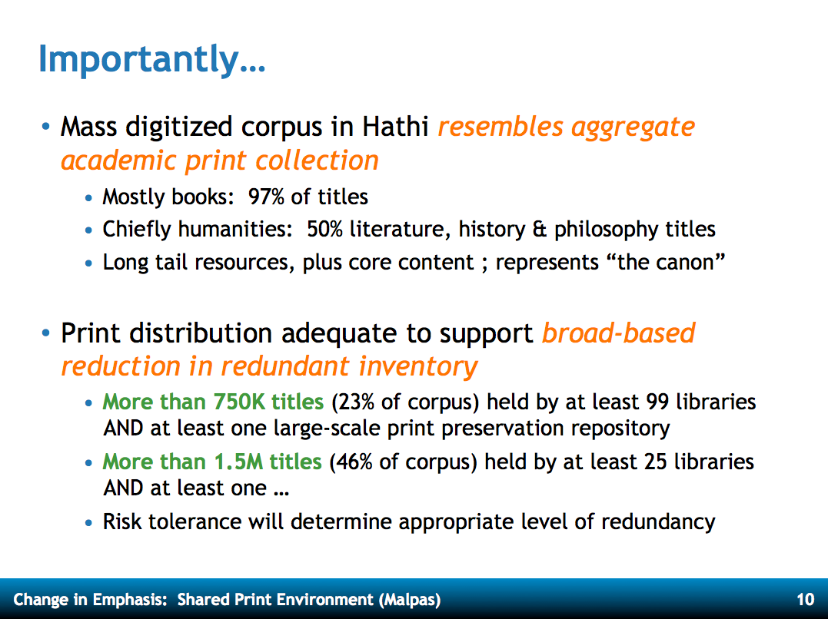

Slide 40
Bob Wolven

Slide 41
Metadata Creation & Management
Environment moving from access mediated by metadata to full-text searching; therefore, purpose for metadata is changing
Moving from homogenous environments to heterogeneous
Must move from focus on discovery to focus on access
Apply expertise based on mission, not ownership

Slide 42
Richard Luce

Slide 43
Our Challenges
Reduced resources vs. expanded info universe
We have prime real estate, what’s the ROI?
Collections fundamentally different: data, media, born digital, etc.
Budget and staffing currently unbalanced to present and future needs; the inhibitor is culture
How do we measure impact?
We’re missing agile analytical skills

Slide 44
Our Opportunities
Focus on what’s unique — manuscripts, archives, rare books, born digital
Provide the “workflow layer” for research and scholarship
Different kinds of staffing
New partnerships — Outside in and Inside Out

Slide 45
The Input of Others & Concluding Comments
The
End

Slide 46
Jim Michalko: Research Library Risk Clusters
Value Proposition
Human Resources
Durable Goods
Legacy Technology
Intellectual Property

Slide 47
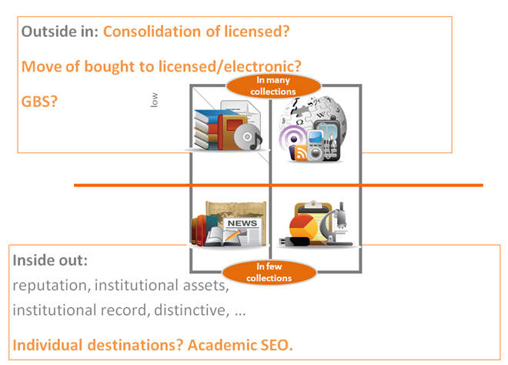
Turning Ourselves Inside Out
Push out institutional
content w/metadata
payloads
http://orweblog.oclc.org/archives/002102.html

Slide 48
Lynn Connaway:
OCLC/JISC Paper
Discovery is not the issue, access is
Convenience rules
“Squirreling” of downloads — very little time spent consuming content
We must be a seamless part of the online discovery and delivery environment…
…much of which we do not own or control

Slide 49
Karen Calhoun:
The New World of Metadata
Professionally Produced:
  Libraries
  Publishers
Author/User Contributed
  Metadata from institutional repositories
  Reviews, tags, etc.
Mined
  Facets
  FRBR Worksets
  WorldCat Identities

Slide 50
Traditional Library Tasks
Selecting
Acquiring
Organizing
Providing Access
Preserving
  — The glory days of selecting are gone
  — Large aggregations (Google Books, Hathi Trust, then on demand)
  — Completely new metadata processes, formats, etc.
  — Metadata more focused on delivery than discovery
  — Much still to do here

Slide 51
Some Strategies to Consider
Consider the “switches” and their impact:
  Workflow, Supply, and Space
Seek out what you can stop doing or do more logically:
  Reduce service points/branches/on-site collections
  Reconfigure existing space
  Reduce differences in service point hours and policies
  Stop doing ready reference, subject web pages
Lay off more staff than you actually need to
Collaborate regionally, nationally, internationally

Slide 52
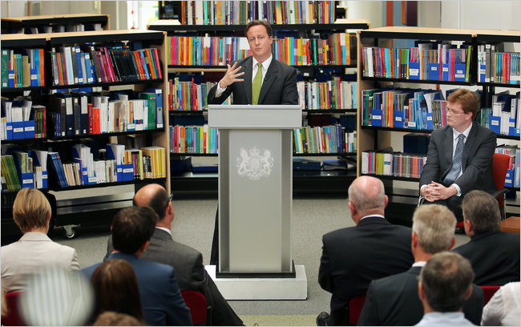
David Cameron: Our budget is much worse than previously thought

Slide 53


Slide 54

This is not a time
to be TIMID…

Slide 55


…or to PANIC…
http://www.flickr.com/photos/lunadirimmel/2886049368/

Slide 56
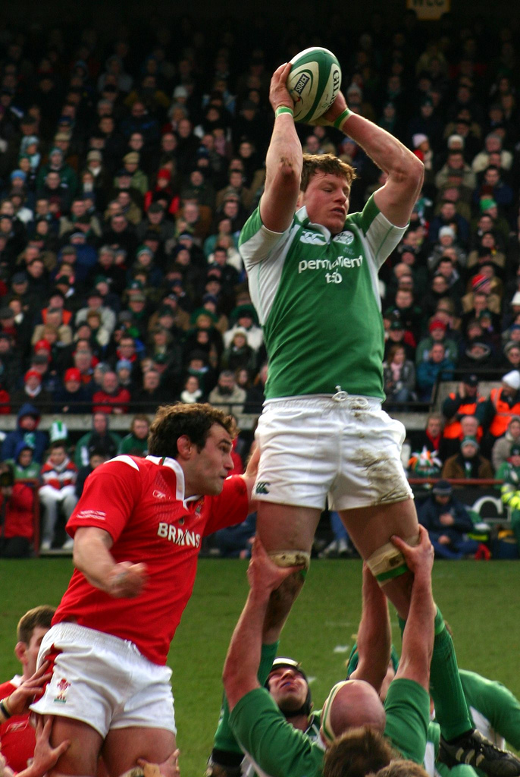

…but to
SEIZE our opportunity…
http://www.flickr.com/photos/bohane/110637863/

Slide 57
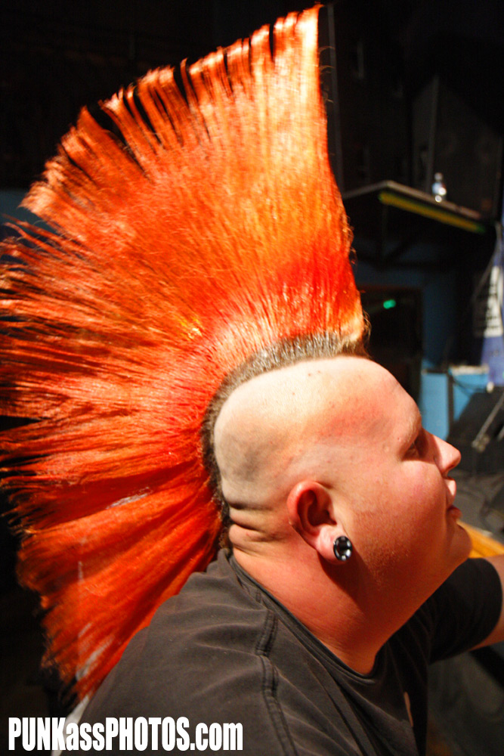

http://www.flickr.com/photos/punkassphotos/2657230555/
…to deserve a DESTINY of our own making
http://www.flickr.com/photos/punkassphotos/2657230555/

Slide 58
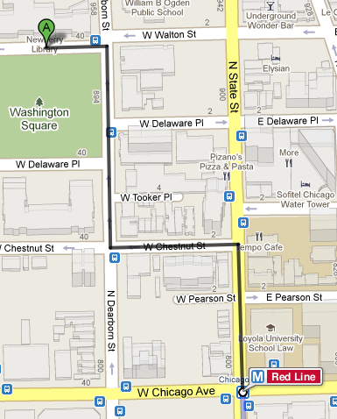
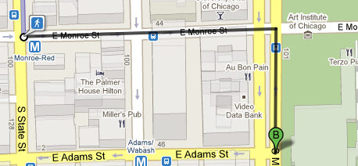
Art Institute Tour
Meet Jack Brown in the Michigan Avenue lobby at 4pm (111 South Michigan Avenue, at E Adams Street)
The tour will be tailored to your interests, ask questions!
After the library tour, explore the galleries at your own pace until closing time at 8pm
It’s a 2.5 mile cab ride or take the Red Line to Monroe stn., then walk [http://bit.ly/articTour]

