Slide 1
Change in Emphasis:
Shared Print Environment
Constance Malpas Program Officer, OCLC Research
RLG Partnership Symposium “When the Books Leave the Building” Chicago, June 2010
20RLG Partnership Annual Symposium: When the Books Leave the Building
Chicago, June 2010
Notes:
I have had the rare pleasure and privilege over the last year to work with Carol Mandel and Bob Wolven on a project examining the feasibility of increasing institutional reliance on shared print repositories, focusing in particular on retrospective book collections. This represents a ‘change in emphasis’ insofar as most discussion around shared print management has focused on print journal backfiles, and not on books. It has been a challenging and rewarding experience and I look forward to sharing some of the key findings from our analysis with you this morning, especially as they relate to near-term opportunities for collective action within the research library community.
But first I want to offer some general remarks on the theme of this symposium, touching (obliquely) on some issues raised by Adrian and Michael.

Slide 2

An end to magical thinking
The books have already left the building.
>70 million volumes off-site
30% of Columbia’s collection
40% of UC Berkeley’s
50% of UCLA’s
+50% of Harvard’s, etc.
No evidence that loss of browsing has adversely affected scholarship or institutional reputation
6 editions held by 1,116 libraries

Slide 3
It’s not about space, but priorities
If the physical proximity of print collections had a demonstrable impact on researcher productivity, no university would hesitate to allocate prime real estate to library stacks
In a world where print was the primary medium of scholarly communication, a large local inventory was a hallmark of academic reputation
We no longer live in that world

Slide 4
Has History changed?
(The long narrative)
(The shallows)
“The truth is, I have become something of a dinosaur.”
“Nowadays, researchers don’t need to read early printed books from cover to cover…”
“…much of what it has taken me a lifetime to build up by painful accumulation can now be achieved by a moderately diligent student in the course of a morning.”
Keith Thomas on the historical method “Diary” LRB vol. 32 no. 11 (10 June 2010) [via Lorcan Dempsey]

Slide 5
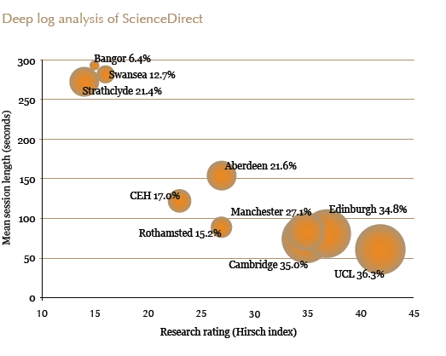
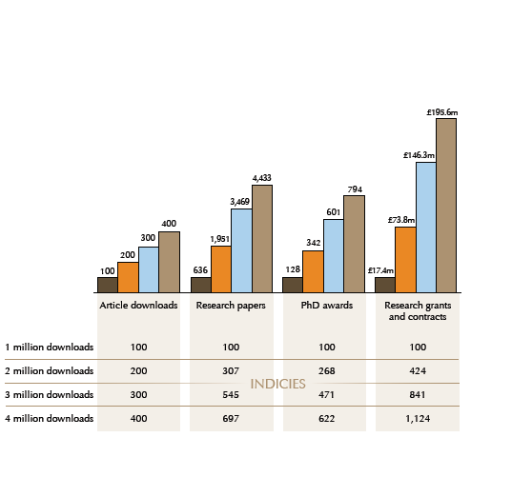
E-Formats: Increase in Research Productivity?
Session length & gateway access
… a correlation between e-format consumption and institutional research reputation
A different kind of reading
Journal spend, use & research outcomes
Source: (UK) Research Information Network E-journals: their Use, Value and Impact (2009)

Slide 6
Shared Infrastructure: Journals v. Books
Confidence gap -- much greater for books than journals?
Source: Portico, Growth of Archive

Slide 7

Dematerialization of the Scholarly Record
Scholarly journals: ~26,000 titles in 2010
i.e. refereed academic journals in
Ulrich’s knowledge-base
  Est. 80-90% titles online (Cox, 2008)
ARL book collection: ~50M titles in 2010
  i.e. titles held by one or more ARL
  member library
Est. 6-7 million (12-14%) titles digitized
(extrapolated from analysis of Hathi
archive and based on current estimates
of 12 million volumes scanned by
Google, February 2010)
Rosamond Purcell “Foucault’s Pendulum”
from Bookworm (2006)
Implications for print book collection?

Slide 8
Moving Collections “to the Cloud” (2009/10)
Premise: emergence of large scale shared print and
digital repositories creates opportunity for strategic
externalization* of core library operations
  Reduce costs of preserving scholarly record
  Enable reallocation of institutional resources
  Model new business relationships among libraries
* increased reliance on external infrastructure and service platforms in response to economic imperative (lower transaction costs)

Slide 9
Key Findings
Scope of mass-digitized corpus in Hathi is already sufficient to replace at least 30% of most academic print book collections
  Ratio of replaceable inventory independent of collection size
~75% also held in trusted print repositories with preservation and access services (CRL, UC Regional Library Facilities, ReCAP, Library of Congress)
  Distribution of resource still suboptimal for shared service model
If limited to titles in the public domain, shared service offering may not be sufficient to mobilize significant resources
  Fewer titles, smaller audience: demand is low

Slide 10
Importantly…
Mass digitized corpus in Hathi resembles aggregate academic print collection
  Mostly books: 97% of titles
  Chiefly humanities: 50% literature, history & philosophy titles
  Long tail resources, plus core content ; represents “the canon”
Print distribution adequate to support broad-based reduction in redundant inventory
  More than 750K titles (23% of corpus) held by at least 99 libraries AND at least one large-scale print preservation repository
  More than 1.5M titles (46% of corpus) held by at least 25 libraries AND at least one …
  Risk tolerance will determine appropriate level of redundancy

Slide 11

Top 10 Categories of Public Domain Content in the Hathi Digital Library
Total public domain titles: 410,321
Data current as of April 2010

Slide 12
What about the rest?
Can circulation trends in system-wide print collection tell us something about aggregate demand for the in-copyright titles?
Data current as of April 2010

Slide 13
Circulation by Subject Area in Aggregate Academic Print Book Collection
Worth investigating
*
*
*
N=27M items
Ed O’Neill, OhioLINK Aggregate Analysis (2007/8)

Slide 14
Cloud Library: impact, in concrete terms
Average US academic research library could achieve:
space recovery of at least 20,000 ASF
a new research commons
cost avoidance of ~$1M for new high-density storage
capital campaign diverted to commons
cost avoidance of ~$1M per year for on-site mgt
funds to be redirected to cloud providers
ongoing space reductions sufficient to achieve steady state in campus collection
Assumes libraries retain locally any digitized title held by <100 libraries; sustained growth in Hathi and Shared Print repositories; excludes top 12 ARL institutions.

Slide 15
Some (surmountable) obstacles
Political
In-copyright titles will require a print supply chain for foreseeable future
Cultural
Shared print supplier role more socially acceptable than shared print consumer role
Technical
Structural
Bi-lateral agreements (one consumer, one supplier) won’t produce sufficient value
Print preservation infrastructure latent, not explicit or actionable

Slide 16
The librarian’s dilemma: what will go?
“Our library, like many, is in danger of losing space to other university needs like classrooms and collaborative spaces. […] they are moving out as much as they can to off-site storage. I have resisted letting my collection go – claiming that I hadn’t finished retrospective conversion and that people really needed to browse the collection. But even I might have to give in soon. I know that Harvard, Columbia and many of the big guys have been doing this battle for a long time.”
[via Karen Smith-Yoshimura]

Slide 17
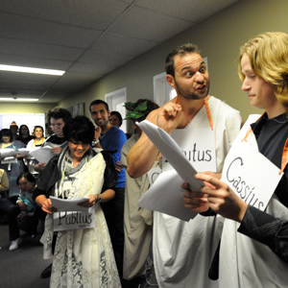
The humanist’s lament: betrayal of values
Disdain for “…a culture of managerialism that threatens the quality of research and puts extra pressure on academic staff to increase their output”
This man
is not your friend
loss of power, prestige embodied in dislocation of library print collection
ANU students demonstrate against the reorganising of humanities courses and increasing pressure on academic staff. Photo: RICHARD BRIGGS, Canberra Times (May 2010)

Slide 18




judgment of peers

Slide 19

New inscription devices; old descriptive categories
A born-digital monograph?
A print book with e-option?
A computer file?
Something else?
Library uncertainty about the nature of this book reflected in variable cataloging practice
10 editions, held by 985 libraries

Slide 20
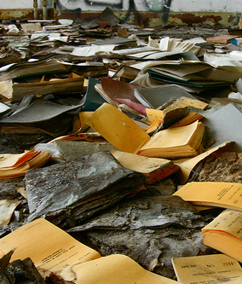
Academic print: it’s not the end . . .
but it’s no longer the means
Ongoing redefinition of scholarly
function and value of print
will entail some loss
and some gain in library relevance
“Archive of the available past” by Joguldi.
Abandoned books at the Detroit Central
School Book Depository (6 May 2009)

