Slide 1
Transitioning from and Beyond MARC
Karen Smith-Yoshimura
2010 RLG Partnership Annual Meeting
Chicago, IL
10 June 2010

Slide 2
Where we are
Where we want to go
How do we get there?

Slide 3
Now: Managing MARC and non-MARC metadata
RLG Partners use same staff to create both
MARC and non-MARC metadata?
Yes | 64 | 66%
No | 33 | 34%
RLG Partners create non-MARC metadata
as part of routine workflows?
Yes | 86 | 80%
No | 22 | 20%
What We’ve Learned from the RLG Partners Metadata Creation Workflows Survey, 2009
Notes:
An RLG Partner working group (Leighann Ayers, U. Michigan; Beth Picknally Camden, U. Pennsylvania; Lisa German, Pennsylvania State University; Peggy Johnson, U. Minnesota; Caroline Miller, UCLA) conducted a survey in 2008 of department heads or directors in the RLG Partnership responsible for creating at least some non-MARC metadata, either solely or in addition to MARC metadata. We received 134 responses from 67 RLG Partner institutions, of which 121 created at least some non-MARC metadata. Only 22 of those (18%) created non-MARC metadata only.

Slide 4
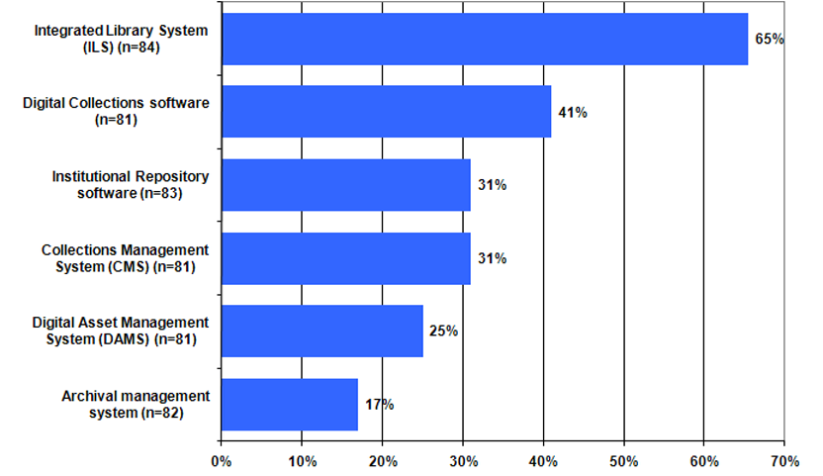
Metadata Description Tools
RLG Programs Descriptive Metadata Practices Survey Results: Data Supplement 2007
Notes:
This is from an earlier survey conducted in 2007 of 18 RLG Partner institutions in the US and UK that had “multiple metadata creation centers” on campus that included libraries, archives, museums and had some interaction among them. Each head of a unit responsible for creating metadata to describe information resources that a researcher, student, or teacher would want to access was requested to respond.

Slide 5
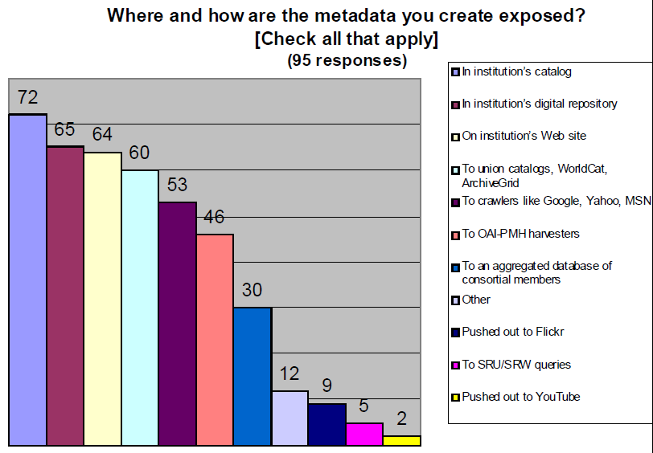
What We’ve Learned from the RLG Partners Metadata Creation Workflows Survey, 2009

Slide 6
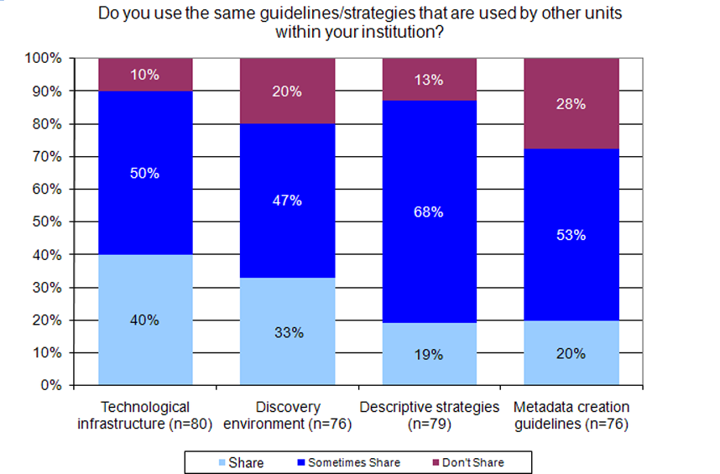
RLG Programs Descriptive Metadata Practices Survey Results: Data Supplement 2007
Notes:
Although the 2007 survey targeted institutions that already had interaction among libraries, archives, and museums, it turns out that metadata creation guidelines were the least likely to be shared across workplace environments.

Slide 7
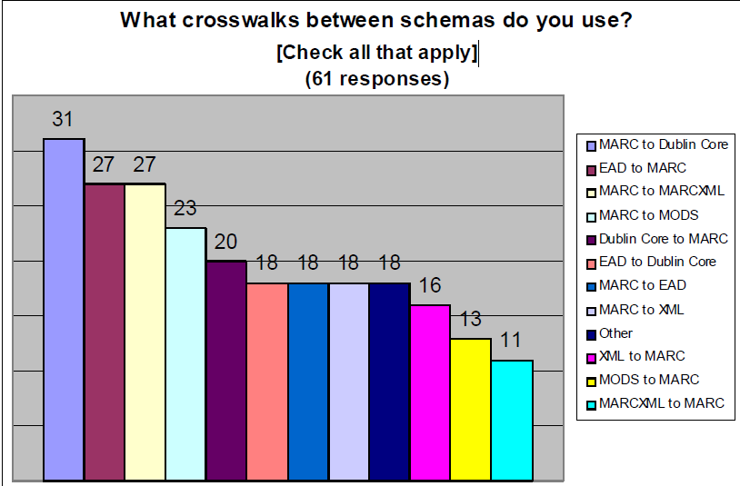
What We’ve Learned from the RLG Partners Metadata Creation Workflows Survey, 2009
Notes:
In the 2008 survey of RLG Partners, 70% reported that they had tools to convert between MARC and non-MARC formats. Only 11 schemas were used by 18% or more of 61 respondents. More people used cross-walk schemas from MARC to something else than schemas to MARC.

Slide 8
Moving between old and new paradigms
Non-MARC elements
MARC record
Subject
Publisher
Identifier
Contributor
ISBD punctuation
Physical description
AACR2 encoding
Notes:
On the left is a schematic representation of non-MARC metadata streams such as ONIX or Dublin Core Terms. They are designed to be taken apart, enhanced, and merged as processing needs change in a supply chain.
On the right is a schematic view of a MARC record. When we create a crosswalk, we are mapping pairs of elements. But MARC has additional packaging that can get in the way, making the mapping task more complex, more brittle, and less generic.

Slide 9
Example: Physical descriptions in ONIX and MARC
Carol Jean Godby, “Mapping Bibliographic Metadata”, NETSL Annual Spring Conference, 2010-04-15
Leader jm
007 sdfsngnnmmned
245 $a #1 Puccini album
$h [sound recording]
Over-specified relationship
Redundant information
Maps between coded & textual information unreliable
<ProductForm>AC </ProductForm>
<Title>
<TitleType>01</TitleType>
<TitleText>
#1 Puccini Album
</TitleText>
</Title>
Notes:
Here’s the worst example that my colleague Jean Godby encountered in a recently published study of the relationship between ONIX and MARC. This is a snippet of a record that describes an audio CD of arias from Puccini’s operas.
In ONIX, the ProductForm ‘AC’ identifies this description as a an audio CD
AACR2 encoding requires that fields in the Leader, 007, and 300 fields be populated.
The values in the 007 subfields indicate that the object being described is a mass-produced plastic-and-metal sound disc containing a digitally stored digital recording that can be played at the constant linear velocity of 1.4 meters per second.
Problems:
The relationship is overspecified.
Information is redundant.
Maps between coded values and textual values are not reliable.
The relationship is actually many-many because ONIX has additional information in <ProductFormDetail> and MARC has values in the 300 field. This messy relationship implies that the underlying concepts have not been clearly modeled.

Slide 10
Some problems with crosswalking MARC
Extra effort is required to add, validate, and dismantle ISBD and AACR2 rules.
The ISBD and AACR2 layers are not a worldwide standard.
Vocabulary and semantic concepts are different.
Differences in punctuation and formatting require crosswalks to peek at the data. As a result:
  The mappings are brittle.
  Duplicate detection is difficult.
Carol Jean Godby, “Mapping Bibliographic Metadata”, NETSL Annual Spring Conference, 2010-04-15

Slide 11
2%
4%
6%
9%
15%
65%
39 tags (of 199 total) 5% or more occurrences
100% | 001, 008, 040, 245
20% - 99% | 020, 100, 260, 300, 500, 650, 700
10% - 19% | 007, 010, 016, 043, 050, 082, 250, 440, 490, 504, 710
5% - 9% | 015, 024, 041, 084, 110, 246, 502, 505, 520, 533, 600, 610, 651, 653, 830, 856, 880
Notes:
For the Implications of MARC Tag Usage on Library Metadata Practices published earlier this year, we analyzed WorldCat when it had 145 million bibliographic records. Local and OCLC-specific fields were excluded. More than half of all tags occur in less than 1% of all WorldCat records. There are only 39 tags that occur in 5% or more of all records.

Slide 12
Some MARC fields are more heavily used in
specific formats than WorldCat as a whole…
Mixed Materials: Greatest Variances | Mixed % | WorldCat %
520 Summary, Etc. | 68.18 | 5.95
655 Index term - genre/form | 52.79 | 4.27
545 Biographical or historical data | 33.87 | 0.38
555 Cumulative index/finding aids note | 28.56 | 0.30
541 Immediate source of acquisition note | 19.25 | 0.49
351 Organization and arrangement of material | 14.82 | 0.14
524 Preferred citation of described materials note | 14.13 | 0.15
583 Action note | 13.13 | 0.26
580 Linking entry complexity note | 10.91 | 0.82
561 Ownership and custodial history | 10.17 | 0.37
Implications of MARC Tag Usage on Library Metadata Practices Webinar 2010-03

Slide 13
OCLC no.
Leader/06 | p | p | p
Leader/07 | c | c | c
001 | ü | ü | ü
005 | ü | ü | ü
008/00-05 | ü | ü | ü
008/06 | i | i | i
008/07-10 | 1800 | 1835 | 1889
008/11-14 | 1865 | 1913 | 1920
008/15-17 | xxu | cau | cau
008/23 MX | r
008/35-37 | eng | eng | ger
008/39 | d | d | d
040 | a b | a b | a b
043 | a | a
100 | a d | a | a d
245 | a b f | a f | a f
300 | a c | 3 a b | a
500 |  |  | a
506 |  |  | a
520 | a | a | a b
530 |  | a
533 | 3 a
535 |  | a
545 |  |  | a
555 |  | a
600 |  |  | a d v
610 |  | a
650 | a x v | a z v | a z v y
651 | a x v | a x v
655 |  | a 2
700 | a d | a d | a d
Mixed material
(3 records)
Catherine Argus (NLA)
comparison of MARC fields
indexed in Amicus, COPAC,
Libraries Australia, WC.org
and FirstSearch
Colour Key
Searching in All databases
Searching in 4 databases
Searching in 3 databases
Searching in 2 databases
Searching in 1 database
Searching in no databases
Limiting in any database
Implications of MARC Tag Usage on Library Metadata Practices Webinar 2010-03
Notes:
For the Implications of MARC Tag Usage on Library Metadata Practices Working Group, Catherine Argus of the National Library of Australia compared the search, limit, and sort options in five different aggregated bibliographic databases, using a sample of 52 MARC records in different formats. This is from the Webinar we conducted last March. She found that all databases offered at least one search option not offered by the others, and at least one MARC field not indexed by the others. The fields that are most in common match closely to the ones that are most frequently occurring in WorldCat: ISBN/ISSN, main/added entries, title/variant title, series, subject.

Slide 14
Some implications
MARC data cannot continue to exist in its own discrete environment. It will need to be leveraged and used in other domains to reach users in their own networked environments.
MARC is a niche data communication format approaching the end of its life cycle.
Future systems need to take advantage of linked data to meet users’ needs. MARC is not the solution.
Future encoding schemas will need to have a robust MARC crosswalk to ingest millions of legacy records.
Implications of MARC Tag Usage on Library Metadata Practices , 2010
Notes:
Here are some of the highlights from the working group’s recently published report, Implications of MARC Tag Usage on Library Metadata Practices. The working group had expected that these statements would be provocative when we presented them in our March 2010 Webinar – we were surprised that we received no pushback at all.

Slide 15
We’re already repurposing the metadata
we have

Slide 16
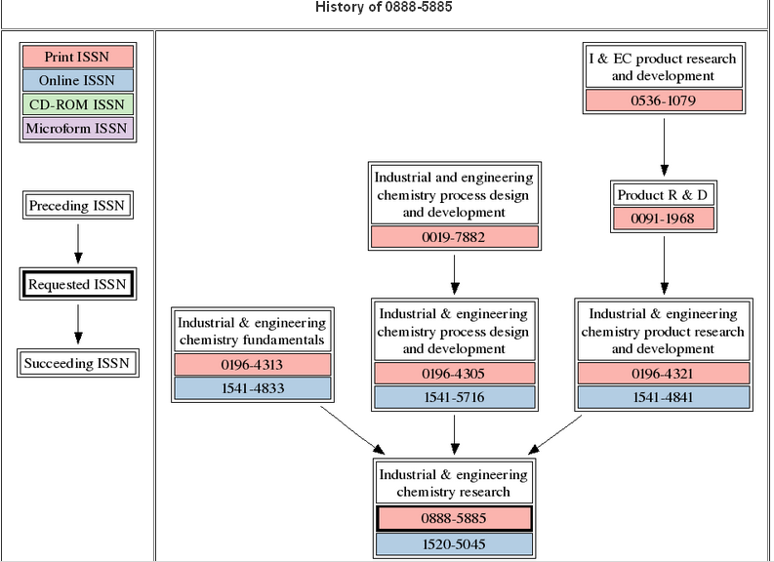
OCLC’s xISSN Web Service
xissn.worldcat.org/

Slide 17
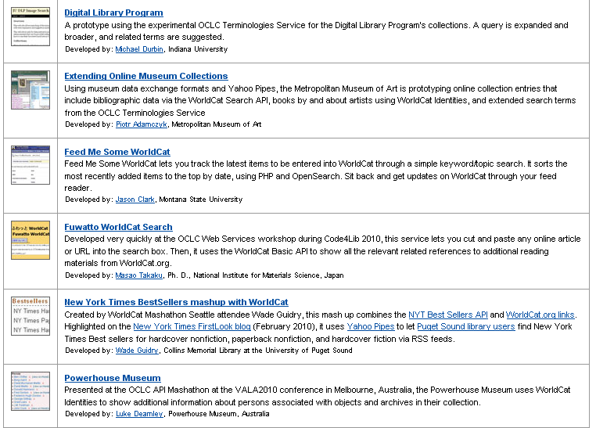
OCLC Web Services’ Application Gallery
oclc.org/applicationgallery/

Slide 18
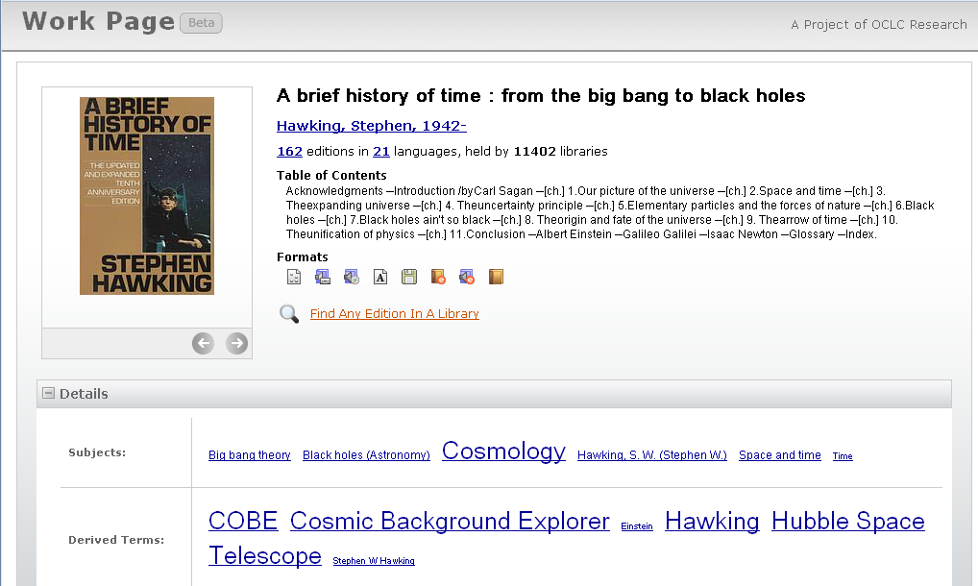
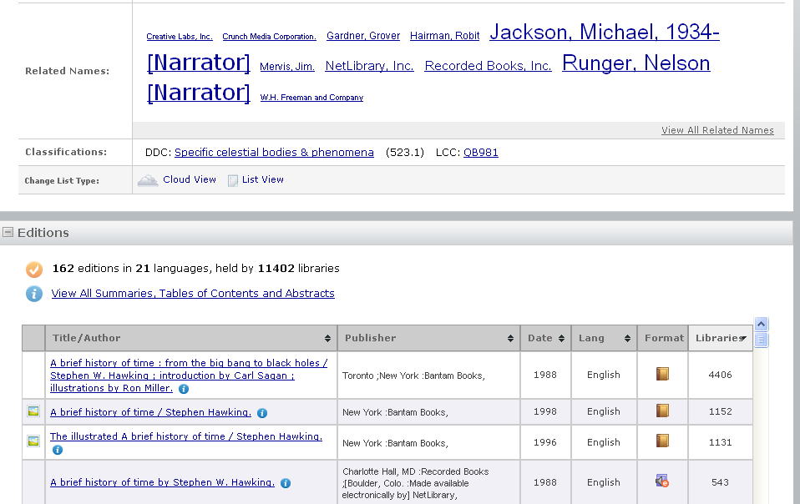
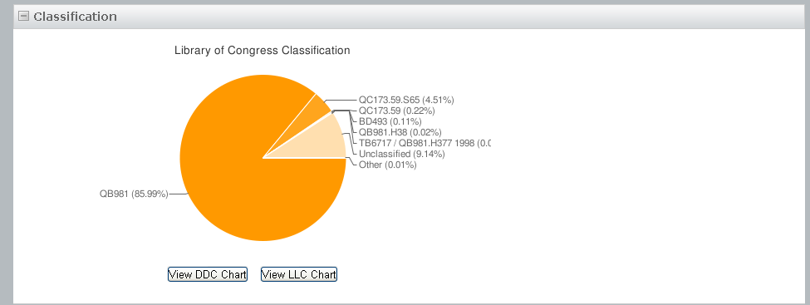
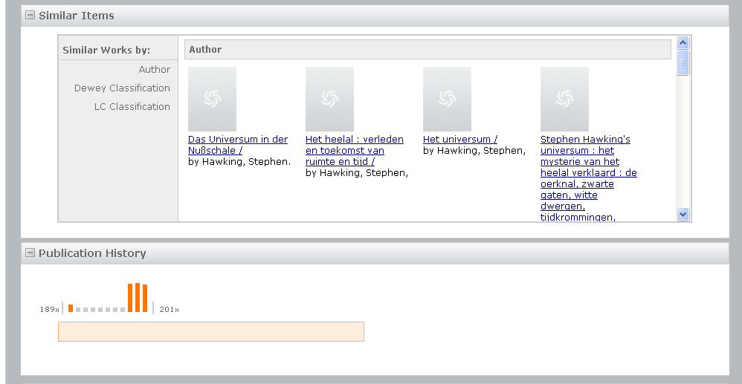
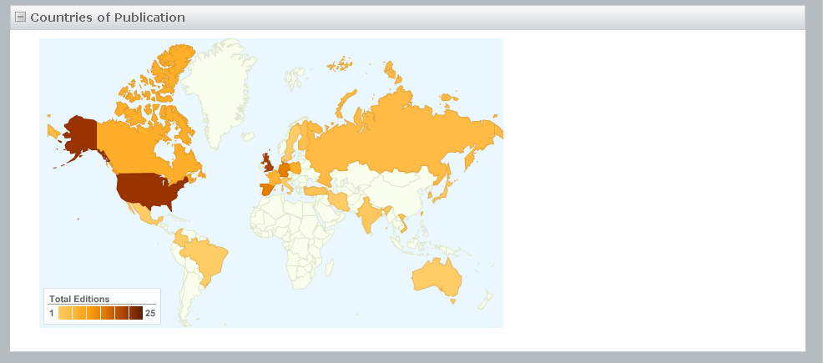

Slide 19
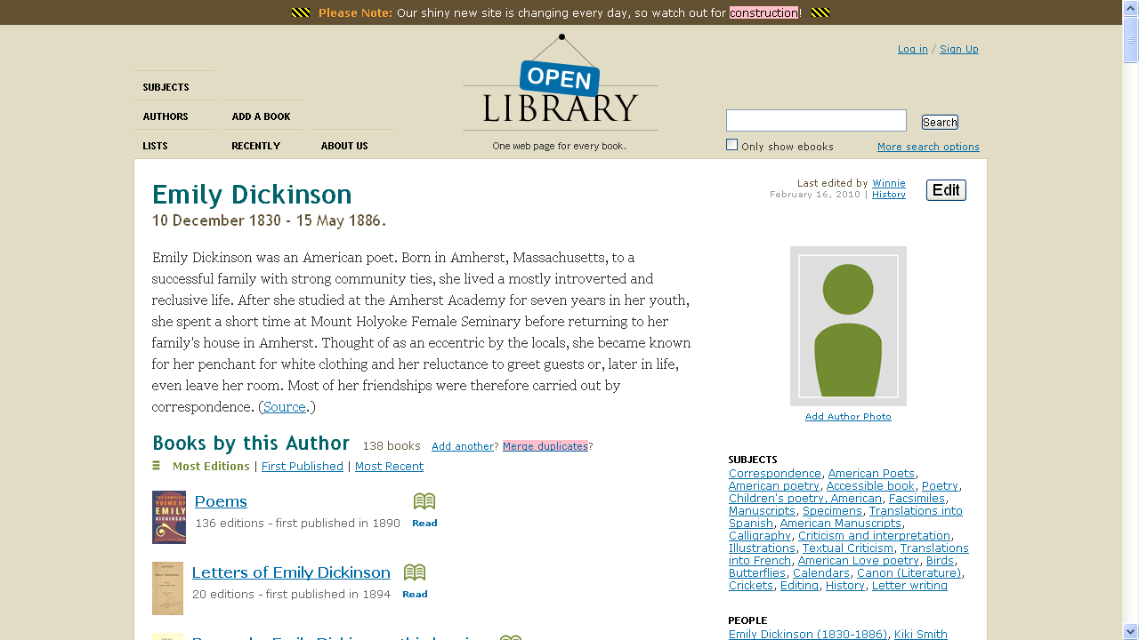
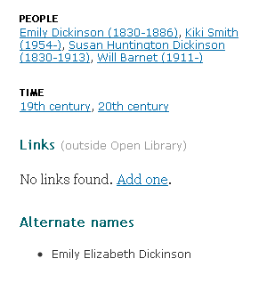
Notes:
The Open Library has pulled together information about authors from bibliographic data. (The brief biography comes from Wikipedia). It also presents (click) some information about related persons, a time frame, and alternate names, but not as much as WorldCat Identities…

Slide 20
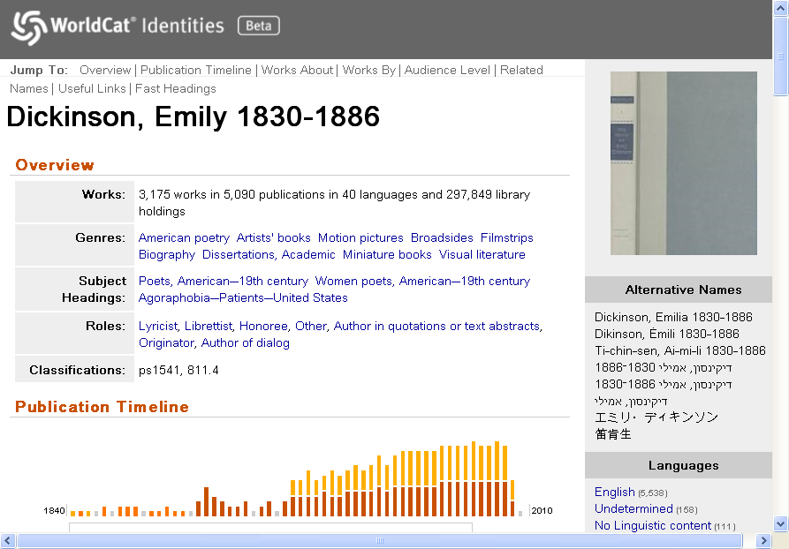
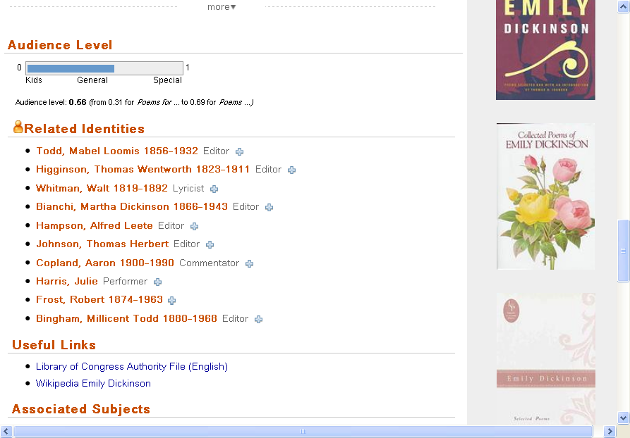
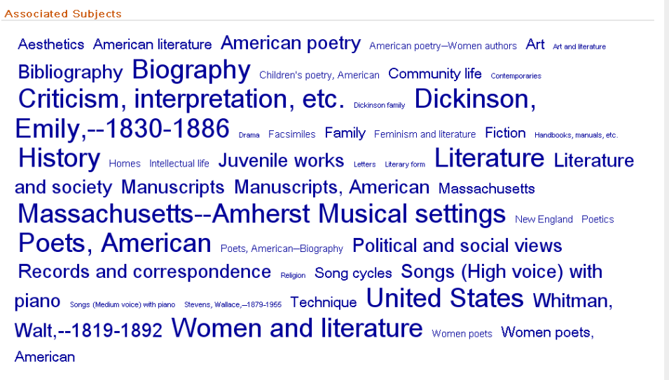
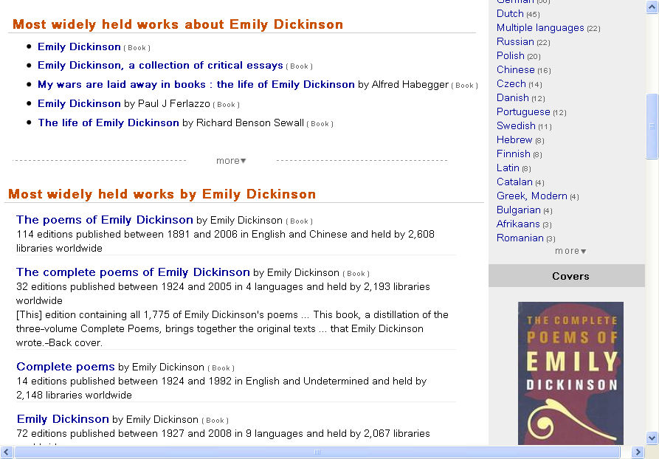
Notes:
WorldCat Identities has compiled information for 30 million people, organizations, fictional characters datamined from WorldCat. The publication timeline is based on the publication dates of all the publications represented in WorldCat. The works are FRBRized from the contents of WorldCat (with a long list of different translations); audience level based on the types of libraries that hold the works, related identities pulled from the bibliographic records, links to authority files, and (click) a Tag cloud of the subjects assigned to all her works.

Slide 21
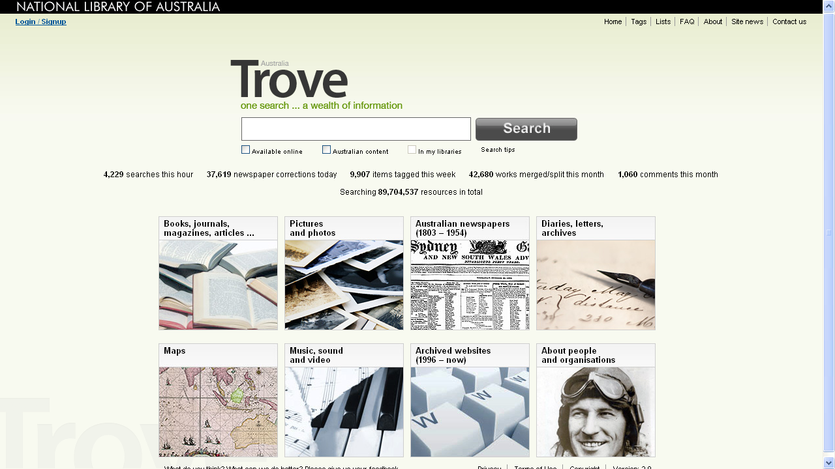

Slide 22
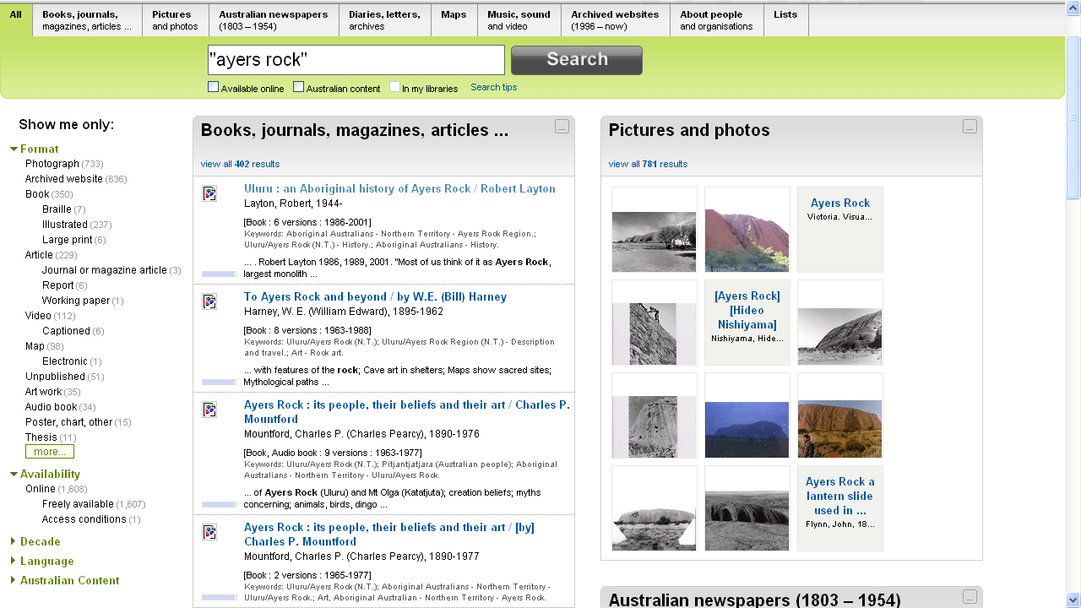
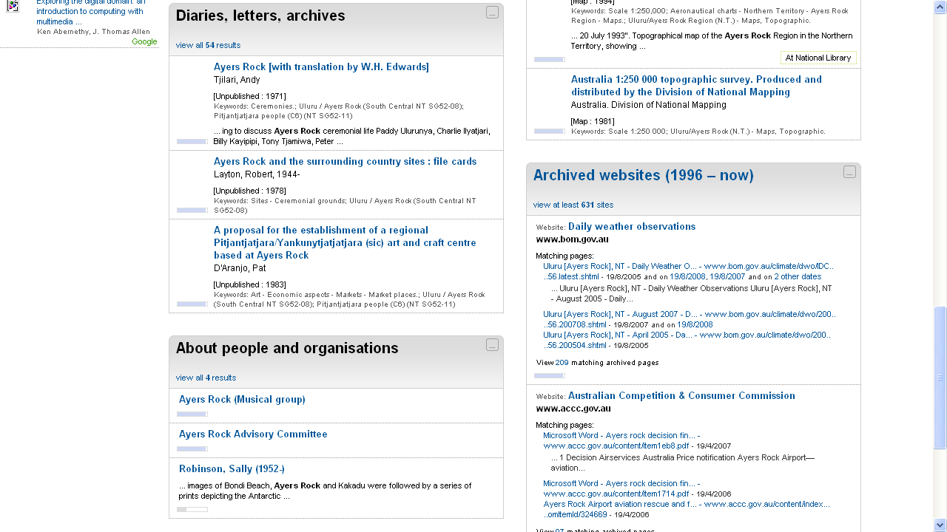
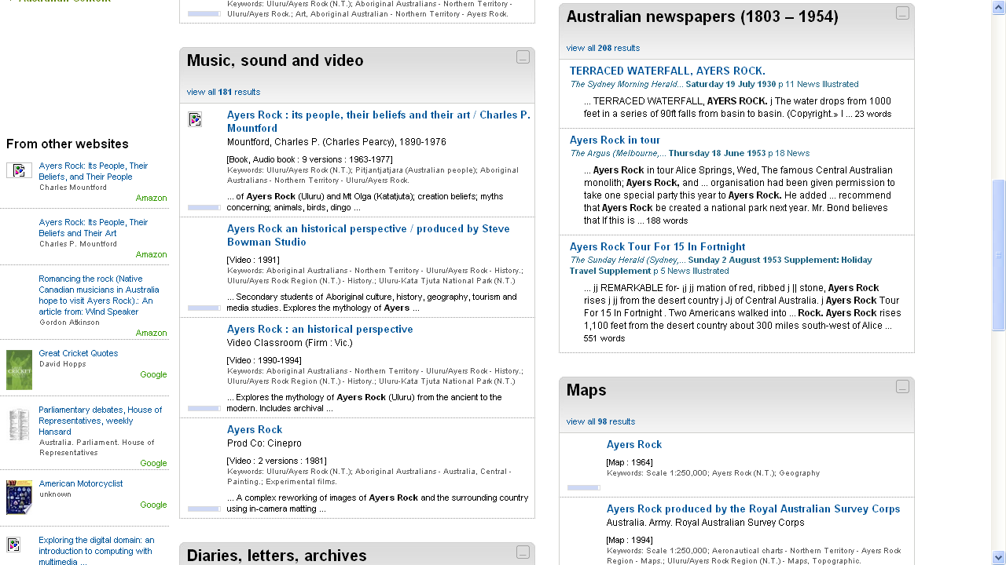
Notes:
A search on Ayers Rock retrieves records from all resources. Note that the books results are “FRBRized” – six editions for the same item have been grouped together. You can also limit your results to those that are “freely available”. Scrolling down (click) you see results for audio and videos; australian newspaper articles, map – with links to other Websites, and (click) archival materials, people and organizations, and archived Websites.

Slide 23
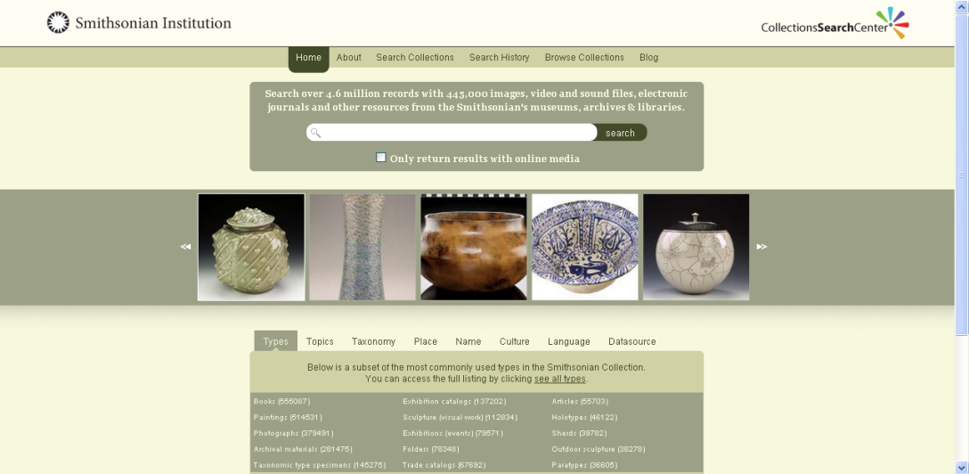
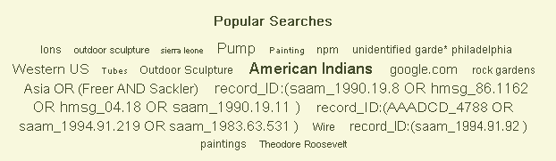

Slide 24
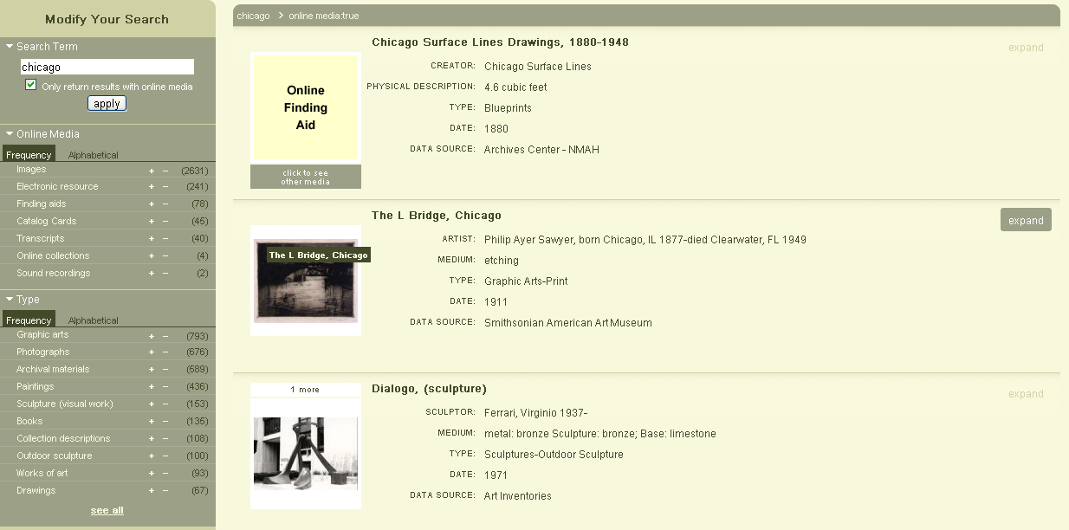

Slide 25
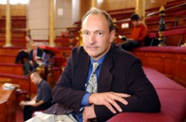
Where we want to go: The Semantic Web
“I have a dream for the Web [in which computers] become capable of analyzing all the data on the Web – the content, links, and transactions between people and computers.”
—Tim Berners-Lee

Slide 26
Where we are
Where we want to go
Creating MARC and non-MARC metadata, often redundantly.
Limited reuse outside the library domain.
Metadata created by libraries generally hidden or buried in Web results.
Create metadata once, and reuse in different contexts.
Expanded reuse of metadata from variety of sources for own context.
Contribute own metadata to the Semantic Web for discovery and metadata creation.

Slide 27
How do we do it?
Define data elements in an actionable way
Define controlled lists in an actionable way
Assign identifiers that will be unique on the web
Create the data using these elements and lists
Share the data
Karen Coyle, “Directions in Metadata”, TechSource Webinar, 2010-04
Enable users/machines to combine selected data elements as they need them.
Notes:
Diane Hillmann in 2010-01-18 presentation on “Introduction to Application Profiles”: Rethink our roles; “less one-at-a-time creation and more data design, data improvement, data evaluation”

Slide 28
How we get there
Move beyond “records” and converse with rest of the networked world.
Aggregate “records” from statements when we need them.
“Statement-based” data can be managed and improved more easily than record-based data
Statement-based data can carry provenance for each statement.
Diane Hillmann, “Application Profiles”, ALA ALCTS: CCDA 2010-01-18
Link data instead of copying it.

Slide 29

Linked data
“… a method of exposing, sharing, and connecting data via dereferenceable URIs on the Web.”
—Wikipedia
Bridges the gap between our technologies and the rest of the world’s

Slide 30
Why linked data?
Share data in a non-library-centered exchange format.
  MARC not popular with the Web community
  Dublin Core not semantically rich
Provide a framework for sharing semantically rich data in a Web-friendly way.
Participate in the Semantic Web.

Slide 31
Semantic Web Syntax: RDF
Resource Description Framework: Markup syntax exposing semantic richness of MARC21 and structural richness of AACR2
For everything you want to talk about
  Give it a URI (Universal Resource Identifier)
  Provide useful information at that URI
Talk about things
  Not just descriptions of things
  Use structure (e.g. metadata)
  Link to other resources
Notes:
Resource Description Framework (RDF)
Links between Web resources
The links themselves are described with URLs

Slide 32
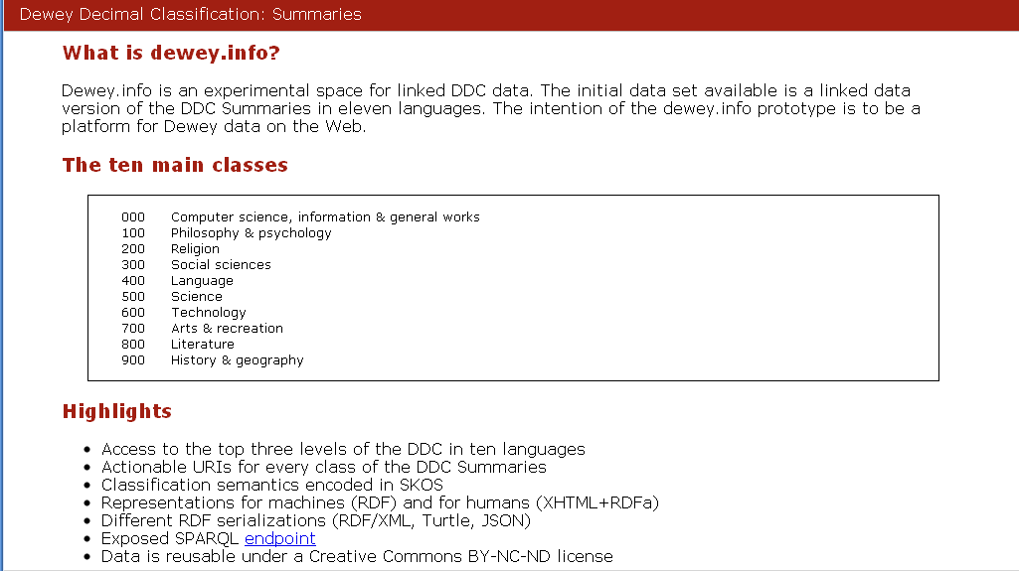

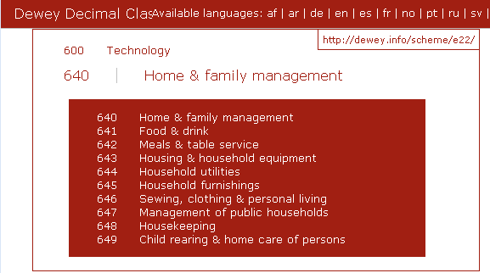

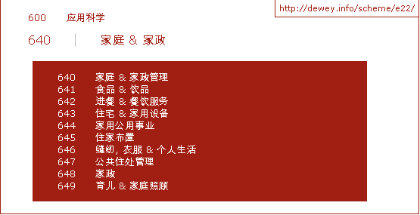

Vocabularies available in RDF
dewey.info

Slide 33
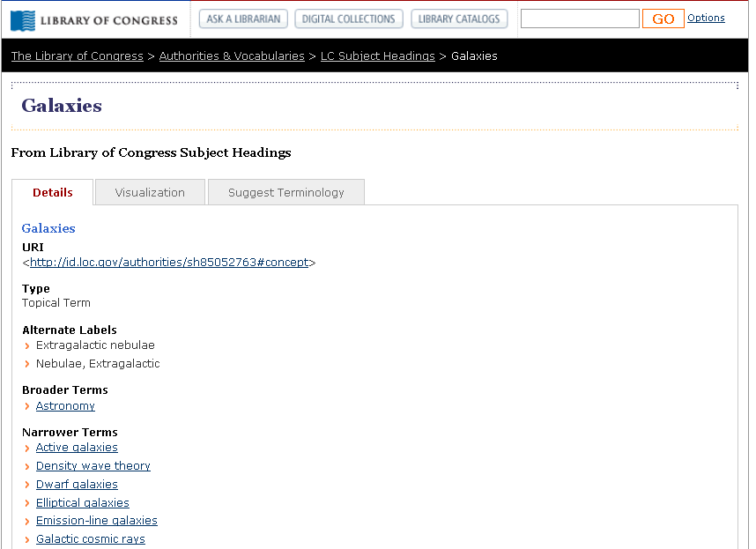
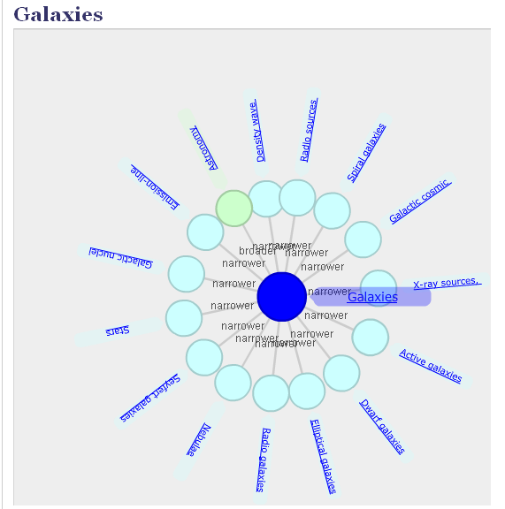
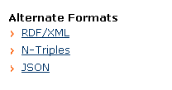
id.loc.gov/authorities
Notes:
The intent of the “authorities and vocabularies” offered by the Library of Congress is to provide human and programmatic access to commonly found standards and vocabularies developed by LC, such as Library of Congress Subject Headings, shown here. Every term is assigned a URI, using the structure shown here with the LC control number, and provides the information in different foramts, including RDSF/XML. The AquaBrowser visualization tool shows the links to narrow and broader terms.

Slide 34
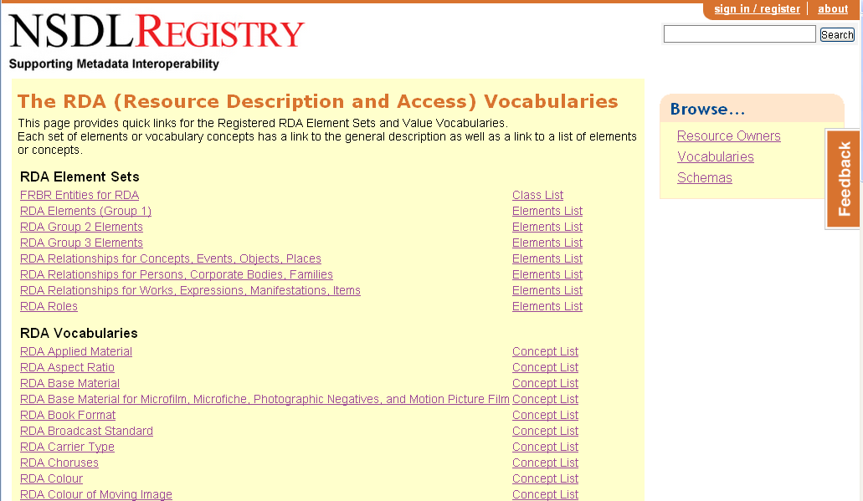
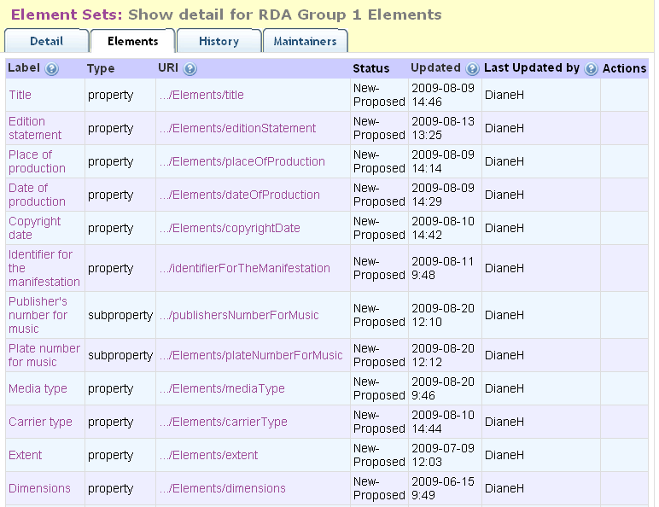
  http://metadataregistry.org/rdabrowse.htm
Notes:
The creators of RDA are making the controlled vocabularies freely available on the Web through Metadata Registry so third party providers and Web applications can easily access and make use of the data. <click> This is the list of element sets for RDA Grou 1 elements, with the data elements we’re familiar with like title, edition statement, place and date of production, etc.

Slide 35
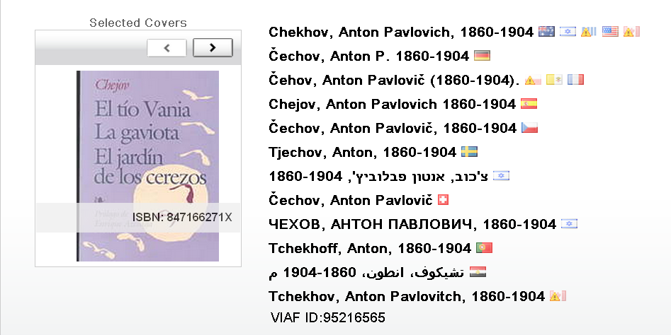
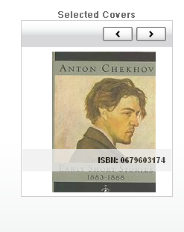
Virtual International Authority File (VIAF)
Application/RDF as xml:
http://viaf.org/viaf/95216565/rdf.xml
http://viaf.org/viaf/95216565
Notes:
VIAF is all about creating links between existing files of names – 20 national authority files, currently representing 13 million personnas The result is a VIAF record that shows information derived from the cluster of linked name records and associated bibliographic records. We have made it available as linked data with URIs for everything and content designation for different data formats, including a view of a “cluster” as rdf in xml.

Slide 36
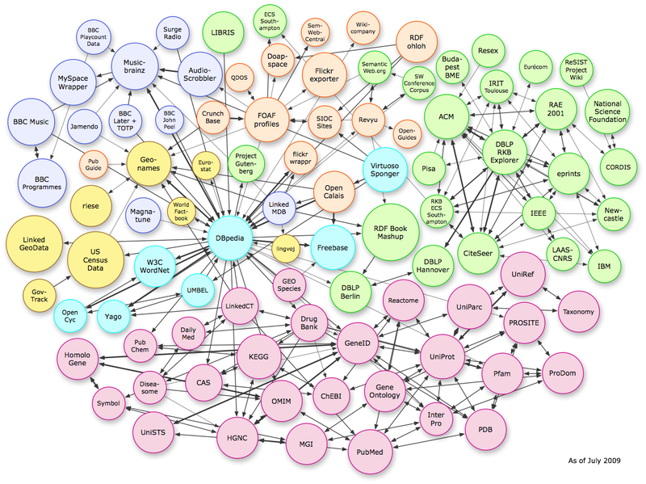
Taking off?
VIAF
National Library of Sweden
LCSH
R|D|A
Notes:
DBpedia is a community effort to extract structured information from Wikipedia and to make this information available on the Web. DBpedia allows you to ask sophisticated queries against Wikipedia, and to link other data sets on the Web to Wikipedia data. This will make it easier for the amazing amount of information in Wikipedia to be used in new and interesting ways, and might inspire new mechanisms for navigating, linking and improving the encyclopaedia itself as well as the linked data, including connections to library data – <click> here showing the link to the database at the National Library of Sweden. This image shows the links as of last July and there are now many more – for example, <click> VIAF, the Library of Congress Subject Headings, and the RDA vocabularies. According to their online site as of last November, the DBpedia knowledge base describes more than 2.9 million things, including persons, places, music, films, names of diseases and species, organizations and more, in 91different languages.

Slide 37
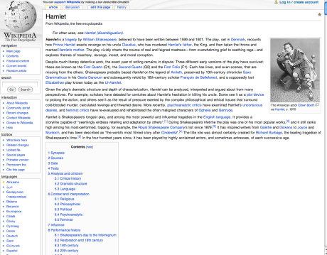
RDA Linked Data
Stoppard
Shakespeare
Derivative
works
Hamlet
Rosencrantz & Guildenstern
Are Dead
Romeo and
Juliet
English
French
Text
Movies
…
German
Spanish
Subject
México, D.F. 2008
Library of Congress
Copy 1
Green leather binding
Barbara Tillett, “Building Blocks for the Future: Making Controlled Vocabularies Available for the Semantic Web”, NETSL, 2010-04-15
Notes:
37
The vocabulary for the controlled names of languages, used in RDA to identify the expression, can be displayed using a linked URI from data in the bibliographic or authority/VIAF records – and depending on the user’s view – it can be displayed in English as shown here, or any other language, such as

Slide 38
Switching Languages
Shakespeare
Stoppard
Hamlet
Obras
derivadas
Rosencrantz & Guildenstern Are Dead
Inglés
Romeo y
Julieta
Francés
Texto
Películas …
Alemán
Materias
Español
México, D.F. 2008
Library of Congress
Copia 1
Encuadernación en piel color verde
Barbara Tillett, “Building Blocks for the Future: Making Controlled Vocabularies Available for the Semantic Web”, NETSL, 2010-04-15
Notes:
in Spanish. By having the elements identified and the various language equivalents registered, the displays can be appropriate to the context – a user’s profile can alert the system which language/script should be displayed.

Slide 39
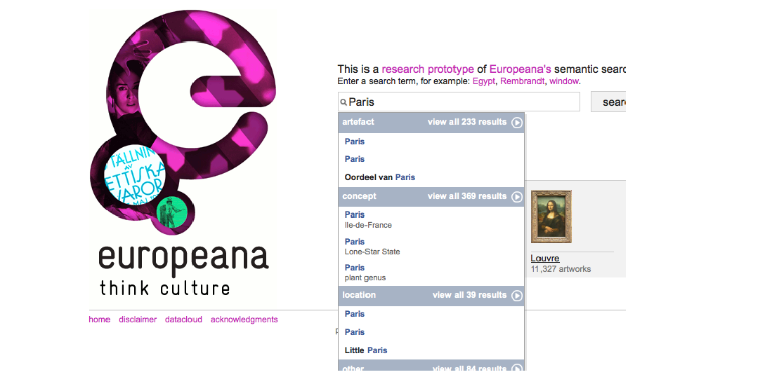
Prototype from Europeana’s “Thought Lab” of a semantic
search engine
eculture.cs.vu.nl/europeana/session/search
Notes:
Europeana’s “Thought Lab” has recently started prototyping a semantic search engine for its aggregate of 6 million digital items from organizations across Europe.

Slide 40
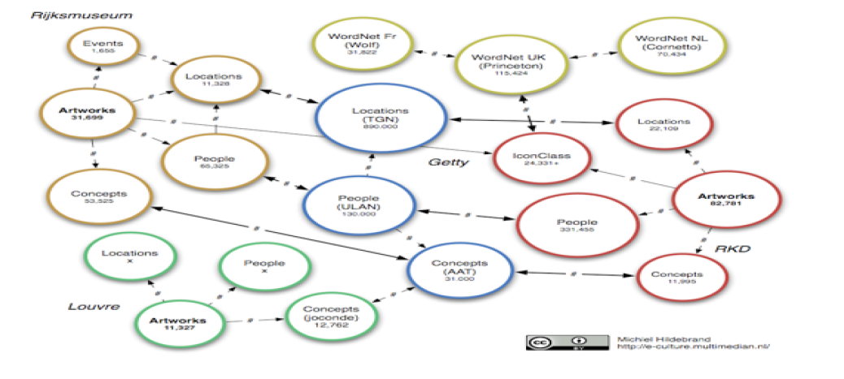
Europeana’s “Thought Lab” data cloud
version1.europeana.eu/web/europeana-project/whitepapers
Notes:
This is from the first Europeana White Paper, “Knowledge = Information in Context: on the Importance of Semantic Contextualisation in Europeana” by Professor Stafan Gradmann dated April 2010. It shows the environment on which the prototype was built, from representations from three museums, the Louvre, Rijksmuseum, and the Netherlands Institute for Art History (RKD), some of which is owned by the institutions, licensed (mostly from the Getty Institute), and some of which, like WordNet, is part of the Linked Open Data world.

Slide 41
Discussion
What ideas do you have for “next steps” to transition beyond MARC and have our metadata part of the semantic Web?

Slide 42
Next up
3:30
Collections Futures
David Lewis, Indiana University-Purdue University Indianapolis
Buckingham

