Slide 1
Report on the RLG activity:
Introduce Balance in Rights Management
Ricky Erway, Senior Program Officer
OCLC Research
RLG Partnership Annual Meeting
June 10, 2010

Slide 2
What lies ahead
Where the project came from (you)
An overview of the Undue Diligence seminar
Discussion of the resulting document
Discussion of next steps
Notes:
We were asked to make these sessions about half and half presentation and discussion. I have at least achieved that on this slide.

Slide 3
When last we talked
Annual RLG Partnership Meeting, June 1, 2009
“Beyond Copyright: risk, benefit, and charting a course for action”
Merrilee Proffitt & Ricky Erway, OCLC Research
A plan
  Assemble the right people
  Forge consensus on reasonable practice
  Get community buy-in
  Digitize those special collections!
Notes:
The RLG/SAA Digitization Matters Symposium explicitly excluded copyright from its scope, but there was interest in pursuing it. Last year at the RLG annual meeting, we brought you up-to-date on RLG/OCLC activities in the rights arena (mostly having to do with books) and then we discussed rights and special collections.
You told us that unpublished materials were a big problem and were getting less attention than published works (more straight-forward + GBS and orphan works discussions)
You told us that the cost of securing permissions was so great as to derail some digitization plans. It was also said that librarians say no more than rights-holders – and in some cases even more than their legal counsel!
You (Susan Allen) said that we need community standards for due diligence. Tell us the three things that suffice, unless the owner comes forward and asks to have it taken down.
And we asked, What is realistic exposure? What is the likelihood of a Bad Thing happening….
You said we need to find the intersection between risk and use.
So we came up with a plan.

Slide 4
Advisory Group
Joanne Archer, University of Maryland
Jeanne Boyle, Rutgers University
Eli Brown, Cornell University
Sharon Farb, University of California, Los Angeles
Elizabeth Smart, Brigham Young University
Jenny Watts, Huntington
Notes:
After the annual meeting, we assembled an advisory group. They helped us to plan the event, form the agenda, and identify speakers

Slide 5
Advisory Group
Joanne Archer, University of Maryland
Jeanne Boyle, Rutgers University
Eli Brown, Cornell University
Maggie Dickson, North Carolina State University
Sharon Farb, University of California, Los Angeles
Georgia Harper, University of Texas
Peter Hirtle, Cornell University
Rebekah Irwin, Yale University
Melissa Levine, University of Michigan
Elizabeth Long, University of Chicago
Aprille McKay, University of Michigan
Elizabeth Smart, Brigham Young University
Jenny Watts, Huntington
Jennifer Waxman, New York University
Notes:
The advisory group grew to include the speakers and interested others and together we crafted a strawman document to be discussed during the seminar.

Slide 6
Undue Diligence: Seeking Low Risk Strategies for Making Collections of Unpublished Materials More Accessible
An amplified event
“Studio” audience (about 25) in the San Mateo auditorium
Remote audience (about 40) via WebEx and teleconference
Speakers in auditorium + 1 remote via WebEx and teleconference
Recorded via WebEx and MP3 recorder
Durable goods
3 WebEx recordings (slides and audio)
8 podcasts (audio)
PowerPoint presentations
Resulting document
Notes:
And we put on the event on March 11, 2010.
In part this seminar was interesting because it was our first amplified day-long meeting, in the height of travel budget woes.
24 people from 9 institutions attended in person
41 people from 28 institutions attended remotely averaging almost 4 hours of the 5 hour program (some had other colleagues with them)
We did a survey to see how effective it was – 32 people responded
60% of the people who attended in person said that even if it had required air and hotel, they would have attended in person; they all thought the experience was richer for them than for the remote attendees. Only 40% said that having a remote speaker detracted from the experience.
40% of the remote participants had up to 6 other people in the room with them. About 65% felt they were able to contribute effectively to the discussions.
78% of the attendees plan to review presentation materials afterward and 91% plan to review the resulting document.

Slide 7
Twitter
Hashtag: #UndueD
Twapper Keeper
194 original tweets during program
+ retweets and tweets before and after the event
20 active tweeters, 40 total tweeters
Notes:
Twitter was another way we amplified the meeting. We had free wifi and told people about the Twitter hashtag. Merrilee set up TwapperKeeper so we could manage the tweets.

Slide 8
Selected tweets
Courts consider community's “tradition of use” in fair use cases, so let’s establish our own tradition
Risk assessment has to include harm done by *not* digitizing / displaying works
Under the law, you don't have to be right - just reasonable
Thoughtful policy is like having insurance
If you can't identify or find owners, chances are they won't find you
The more we know about or guide researchers in their use, the more trouble we can get into
Notes:
The tweetstream gives a sense of what others thought of as the gems of the day’s discourse

Slide 9
Praise
One tweeter said he was “Awed and intimidated by the #UndueD conference”
Another said, “The #UndueD speakers are so good. I highly recommend watching/listening to audio & webEx when they're available.”
Peter Hirtle said “This was the best copyright meeting I’ve ever been to.”
Notes:
And this last one, from one of our speakers – was said before he spoke.

Slide 10
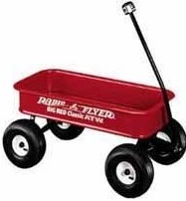
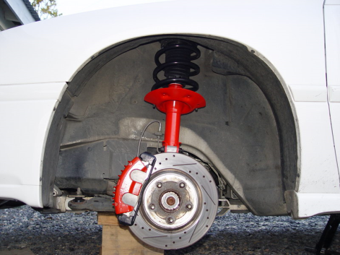
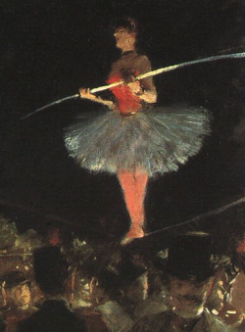
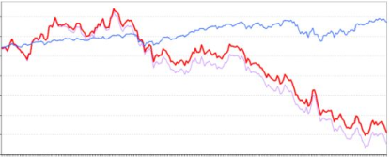

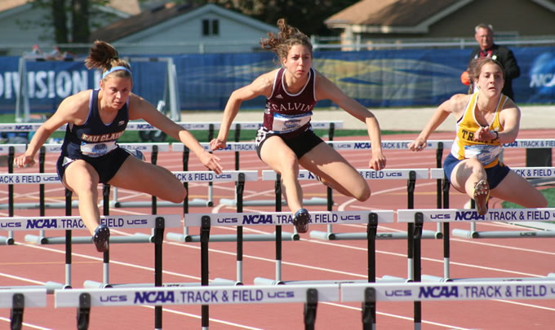
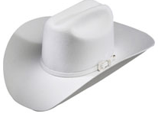
Colorful language
Fair use is a tough wagon to get a ride on
Lawyers are like brakes on car – you gotta have ‘em, but don't put them in charge
if privacy torts were a stock, their performance over the last century would not be deemed impressive.
…on a tightrope balancing
precaution and production
Community privacy standards are a moving target; make sure fig-leaves move accordingly
Don’t damage your reputation (or muss your white hat) in the rush to digitization
It’s about risk management & overcoming Hirtles!
Notes:
But much of the most colorful language came from our speakers
This last one, however, was a tweet.

Slide 11
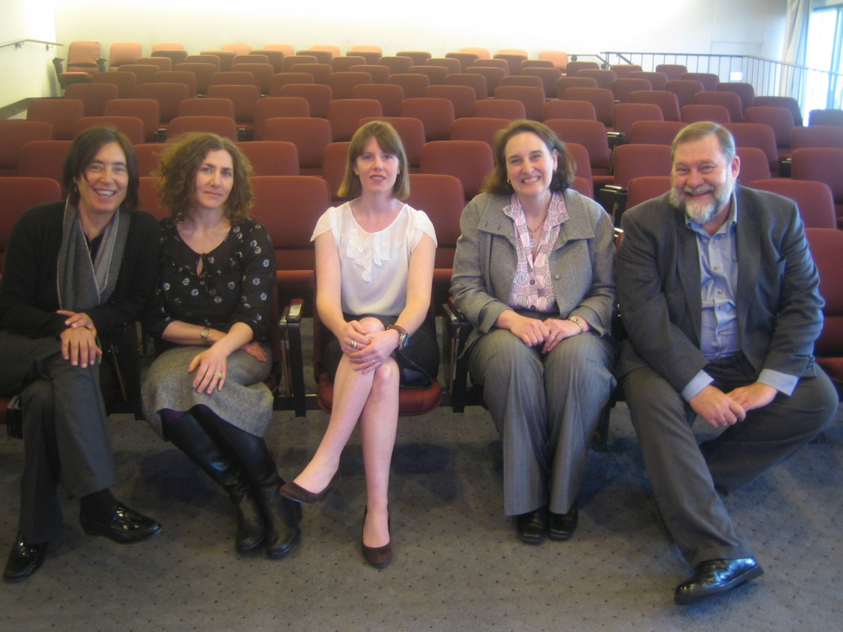
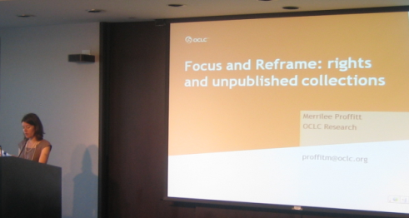
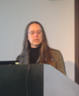
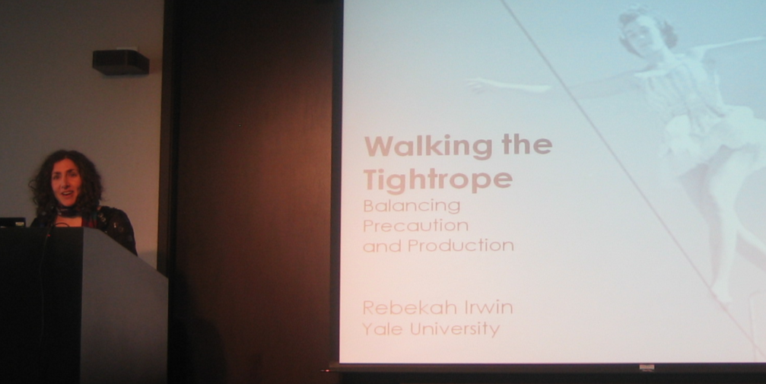
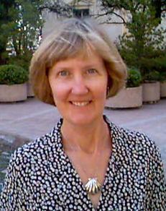
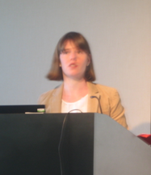
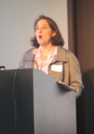
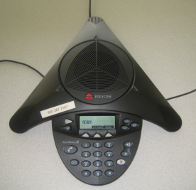
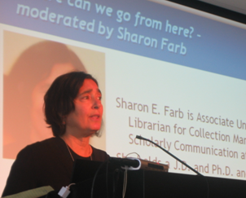
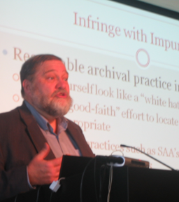
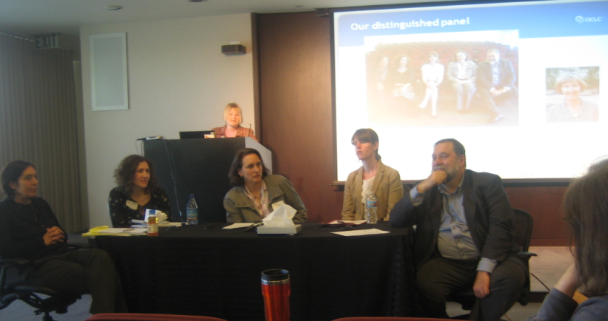
Notes:
And this is so you can feel as though you were there….

Slide 12
Undue Diligence
10:00 Welcome and Introduction – Merrilee Proffitt
Where are we now, moderated by Jennifer Schaffner
10:30 Rights and unpublished works, Aprille Cooke McKay
11:00 What it takes to be thorough, Maggie Dickson
11:30 Walking the tightrope, Rebekah Irwin
12:00 Discussion
Where can we go from here? – moderated by Sharon Farb
1:30 Factoring the case for fair use, Georgia Harper
2:00 Coloring outside the lines, Peter Hirtle
2:45 Discussion of community of practice, Ricky Erway
Notes:
Here’s the program. I’ve selected portions of the slides to give you an idea of the day.

Slide 13
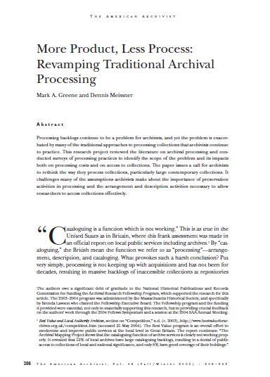
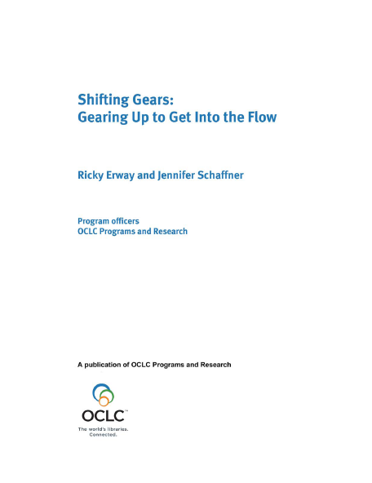
More Product, Less Process, 2005
“We need to articulate a new set of … guidelines that 1) expedites getting collection materials into the hands of users; 2) assures arrangement of materials adequate to user needs; 3) takes the minimal steps necessary to physically preserve collection materials; and 4) describes materials sufficient to promote use.”
“In a world where it is increasingly felt that if it’s not online it doesn’t exist, we need to make sure that our users are exposed to the wealth of information in special collections.”
Shifting Gears, 2007
Notes:
Merrilee set the stage with a look back at a couple of influential documents that argue for increased access to special collections.
The Greene Meissner report calls for expediting processes to get information into the hands of users, using words like adequate, minimal, and sufficient.
The RLG Shifting Gears report said that increasingly, if it’s not online it doesn’t exist.

Slide 14
Archival Code of Ethics
III “Archivists should exercise professional judgment in acquiring, appraising, and processing historical materials….”
VI “Archivists strive to promote open and equitable access to their services and the records in their care without discrimination or preferential treatment...”
IX “Archivists must uphold all federal, state, and local laws.”
Notes:
Merrilee also reminded us of the archivists’ code, which highlights exercising professional judgment to both promote open access and uphold the law.

Slide 15
Lucky to be an archivist
No statutory damages available if:
  Infringer an employee of non-profit educational institution, library or archives acting within scope of employment OR
  Is such an institution, library or archives AND
  The infringer believed and had reasonable grounds for believing that the use was a “fair use.”
Notes:
Aprille Cooke McKay asked what’s the worst that can happen?
If you work for an archives or library and are doing your job or had reasonable grounds for believing a use was fair, there can be no statutory damages awarded.

Slide 16
Fair use factors
A
B
 | Likelier yes + | Likelier no -
Purpose | Non-Profit Transformative use, creativity | Commercial No new work, or to supersede original
Nature | Reference, non-fiction, Published | Fiction, art, unpublished
Amount | Small amount, relative to the whole original | Complete work, heart of work
Market | Doesn’t hurt market for the original | Hurts market or potential market of original
Notes:
Aprille also laid out the four fair use factors We’ll return to them in a bit, but for now, note that it’s not a straight yes or no, but rather the more you have in column A, the better.

Slide 17
Publication of private facts
True information about a person that is highly offensive and not of legitimate public concern
  Sexual activity, health, economic status
Community standards have changed
  Pre-marital sex, out-of-wedlock births, race of parents, sexual orientation
  Means that case law is not always relevant
Notes:
We also addressed privacy rights. This is an area of the law that states regulate.
Community standards define what is highly offensive to a reasonable person. Social norms change through time, and some things that used to be offensive aren’t anymore.

Slide 18
Advice
Make the case that you have undertaken a thoughtful analysis.
Consider asking for consent when reasonable
Argue that you serve the public interest, mitigated damage by prompt takedown, and acted as a “reasonable archivist”
Notes:
Aprille offered this advice:
Make the case that you have undertaken a thoughtful analysis. What would a reasonable archivist do? And document your analysis.
Consider asking for consent if there is a large amount of material in the collection related to a few individuals
Argue that you serve the public interest, mitigated damage to the complainer by prompt takedown, and acted as a “reasonable archivist”

Slide 19
Strict interpretation of copyright statute
Identify all authors/creators
Determine their death dates
Locate descendants of those who died after 1939
Contact those descendants
Request and obtain permission to use materials
Notes:
Maggie Dickson told us what it takes to cross all the Ts and dot all the Is
For a correspondence series of 7.5 linear feet (15 archival boxes), she followed all the steps

Slide 20
Obtaining copyright permissions
Request for permission letters and forms sent via certified mail to four addresses
Three of four forms returned
Explicit permission obtained to use the letters of:
  Upton Sinclair
  Hamlin Garland
  Miles Poindexter
Notes:
Out of 3300 names in the correspondence, 21% were out of copyright, 27% were judged to be still in copyright. For those from whom they sought permission, they could only identify contact info for four of them. And they got permission from three.

Slide 21
Cost analysis, total study
450 hours over nine months
Total cost $8,000
  > $1,050 per linear foot
Permission obtained to display 4 letters online
Return-on-investment = $2,000 per document
Notes:
She demonstrated quite clearly that this was not a reasonable return on investment.

Slide 22
Other solutions?
Use existing description found in the finding aid to target potential copyright risks
In our case, this method would have yielded nearly the same results as the intensive method
Notes:
And she demonstrated that taking a lighter-weight approach would have resulted in a similar outcome. They put it all up and no one has complained

Slide 23
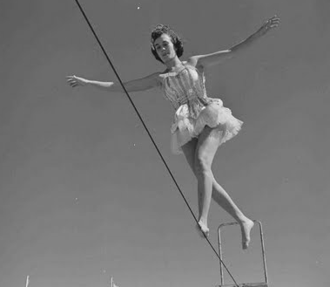
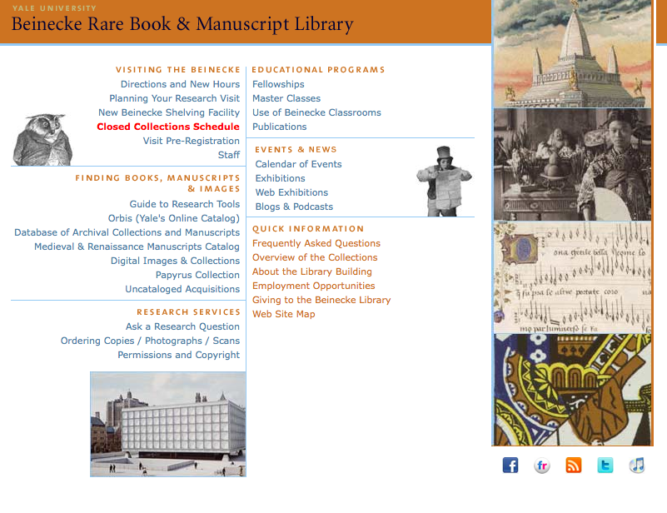
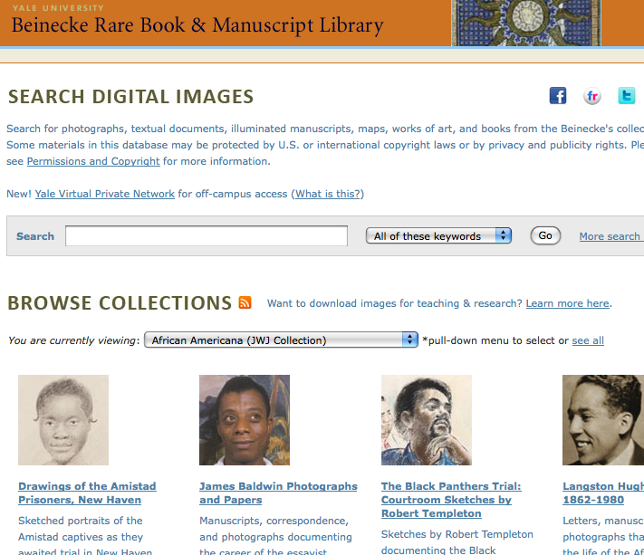
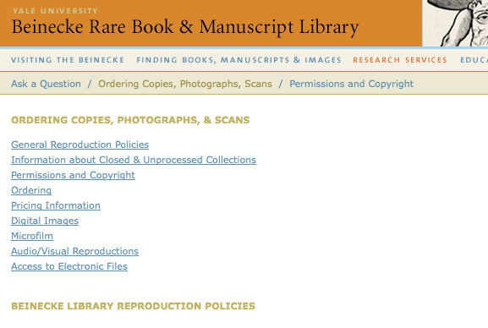
Notes:
Rebekah Irwin talked with us about how to document rights status

Slide 24

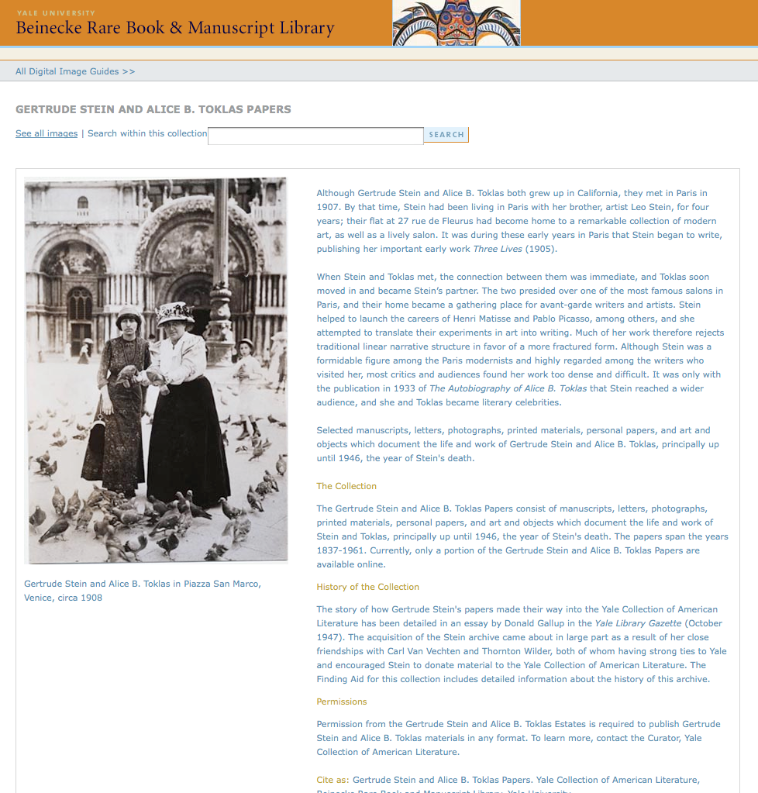
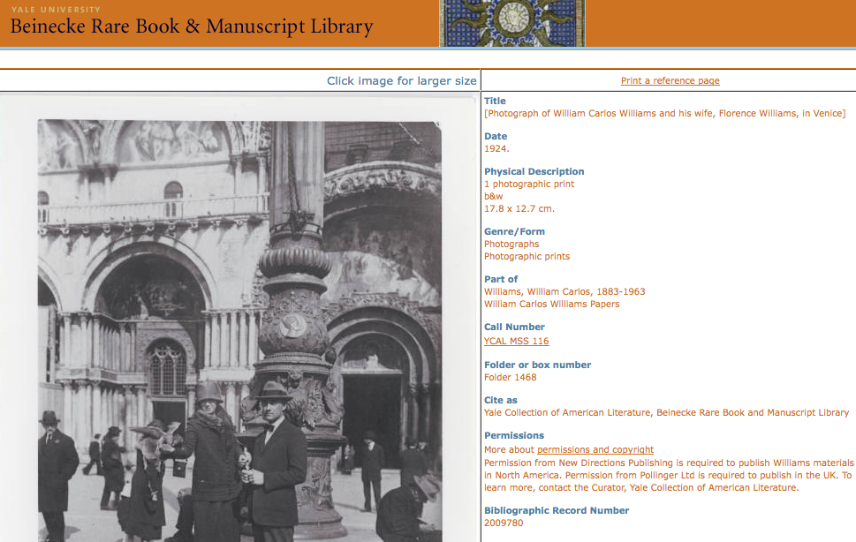
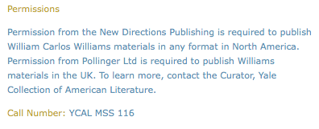
Notes:
And help our users with their responsibilities

Slide 25
NEW, MORE ROBUST LANGUAGE
The Beinecke Library is committed to providing broad access to its collections for teaching, learning, and research. The Beinecke's website, catalog records, finding aids, and digital images enhance discoverability and promote use of both the digital and the original object. The Beinecke does not warrant that use of the text, images, and content displayed on our website will not infringe the rights of third parties not affiliated with the Beinecke. By downloading, printing, or otherwise using text and images from this website, you agree to comply with the terms and conditions detailed here.
Contact the Library with information about an item
Whenever possible, the Beinecke provides factual information about copyright owners and related matters. If you have more information about an item you've seen on our website or if you are the copyright owner and believe our website has not properly attributed your work or has used it without permission, please contact beinecke.library@yale.edu.
Notes:
And provided us with an example of wording for a disclaimer and for an invitation for rights-holders to step forward.

Slide 26
Fair use: First factor
Transformative uses
  Providing context
    Curation
    Providing commentary
    Inviting commentary
  Facilitating creative uses by scholars, educators and researchers
Notes:
Georgia Harper looked at Fair Use factors in detail.
Uses of copyrighted material can be characterized as strongly transformative, when you provide the materials to users in contexts dramatically different from those in which they originated, and when they are accompanied by extensive value-added support (including commentary, the addition of search tools, and so forth). In other words, selecting, organizing, and adding context adds value to cultural materials.

Slide 27
Fair use: Second factor
Unpublished nature of the work
  Congress in 1992: it’s just one factor
  Matters most when work has publication potential or implicates privacy concerns
  Courts more likely find fair use in unpublished works after 1992
    But keep in mind: no cases based on facts like ours – and facts make a difference in fair use
Notes:
It used to be thought the unpublished works were not covered by fair use, but more recently it’s been judged a part of the formula.

Slide 28
Fair use: Third factor
Amount of Work
  Have an internal policy that correlates the amount of a work to be displayed or performed with the type of use to which it will be put
  The entire work is usually the relevant and reasonable amount for scholars, educators and researchers
Notes:
This one is the most surprising. Many people believe that fair uses can only be those that borrow a small amount of a work, but even the Supreme Court has acknowledged that using the entire work can be fair. It depends on the use to which you’re putting the work. Educators take this into account all the time. Sometimes they need students to study something in its entirety, sometimes a small part will do. So long as there’s a reasonable relationship between the objective you have and the amount you use, this factor does not have to be a stumbling block.

Slide 29
Fair use: Fourth factor
Minimizing economic harm to copyright owner
  It can no longer be assumed that a work’s availability online undermines its commercial potential
  There will be major qualitative differences between an archival copy and a work based on it, with value-added by an author and publisher
  Generous take-down policies
Notes:
Experience is proving that different versions of a work, both free online versions and commercially available ones, can co-exist.
It’s doubtful that raw source materials can threaten the commercial potential of more refined works based upon them. Authors, their editors and publishers add value to raw materials. But this is where sensitivity to commercial potential comes in. A generous take-down policy may assure that where a copyright owner desires his or her work not be available online, the organization can be responsive.

Slide 30
Collaboratively establish community norms
The thoughtful policy is insurance, in the absence of clear legal guidance
  Elements of a reasonable approach to placing unpublished materials online will be established by communities of practice
Notes:
And this slide really spoke to the goal of the meeting.
Elements of a reasonable approach to placing unpublished materials online will be established by communities of practice

Slide 31
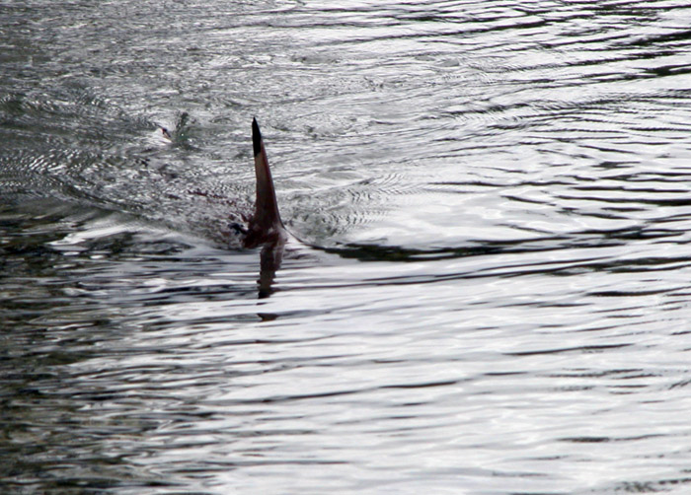
You are entering an area of
great legal uncertainty
Notes:
Then just as we were feeling it was safe to go back into the water, Peter Hirtle’s dorsal fin appeared on the horizon.
He told some scary stories – but none of them involved putting digitized collections of unpublished materials online for increased access.
({{Information |Description={{fr}} Aileron de requin. Shark dorsal fin. |Source=http://www.flickr.com/photos/nothing/8459216/ |Date=April 3, 2005 |Author=[http://www.flickr.com/people/nothing/ Tom Burke (Morgan Hill, CA, USA)] |Permission=cc-by-2.0 }}{{cc)

Slide 32
But you take risks all the time
You take risks when you are
  making textual copies for users
  making photographic copies
  making preservation copies
  contracting out microfilming
You are at risk with every copy you make
Notes:
Then he showed how we are constantly taking risks – nearly every time we make copies
Does this mean we give up?
No – we mange our risks.

Slide 33
Elements that Minimize Risk
Potential risks and damages are small
Fair use exemption from some damages
Federal actions are expensive
To date, almost no actions have been taken against archives
Notes:
he further calmed us down saying
Potential risks and damages are small if the work is unregistered.
He reminded us of the Fair use exemption from statutory damages
Because federal actions are expensive, it’s more likely that you’d get a Cease and desist” – then you can decide how to respond
To date, almost no actions have been taken against archives – and unless anyone tells me differently, I think no actions have been taken in cases where libraries or archives have put digitized collections of unpublished materials online for increased access.

Slide 34

Our distinguished panel
Georgia Harper
on the phone
Sharon Farb, Rebekah Irwin, Maggie Dickson,
Aprille McKay, Peter Hirtle
And our local and remote participants
Notes:
Then the final portion of the day was given over to discussion of community practice. We arrived at some consensus and then the advisory group continued to mull it over and we now have a document….
I’d like to spend the rest of our time talking about it.

Slide 35
Well-intentioned practice for putting digitized collections of unpublished materials online
Preamble
The primary responsibilities of cultural materials repositories - stewardship and support for research and learning - require us to provide access to materials entrusted to our care. This document establishes a reasonable community of practice that increases and significantly improves access to collections of unpublished materials by placing them online for the purpose of furthering research and learning. Although it promotes a well-intentioned, practical approach to identifying and resolving rights issues that is in line with professional and ethical standards, note that this document does not concern itself with what individuals who access particular items may do with them. While the document was developed with US law in mind, it is hoped that the spirit of the document will resonate in non-US contexts.
If your institution has legal counsel, involve them in adopting this approach; after the approach has been adopted, only seek their advice on specific questions.
Notes:
Preamble
Our mission requires us to provide access to materials entrusted to our care.
This is a well-intentioned, practical approach to identifying and resolving rights issues that is in line with professional and ethical standards
It does not concern itself with what individuals who access particular items may do with them.
It was developed with US law in mind, it is hoped that the spirit of the document will resonate in non-US contexts.
Most importantly it says
If your institution has legal counsel, involve them in adopting this approach; after the approach has been adopted, only seek their advice on specific questions.
Your counsel does not have to weigh in on every decision. And remember your counsel’s job is to advise on the risks. Your job is to decide the appropriate course of action.
People have asked, “What about the smaller institutions that don’t have counsel?” “Keep quiet and you may be able to keep it that way.”

Slide 36
Select collections wisely
Keep your mission in mind and start with a collection of high research value or high user interest.
Assess the advantages and risks of relying on fair use (in the US) to support public access.
Some types of materials may warrant extra caution when considering rights issues, such as
  Contemporary literary papers
  Collections with sensitive information, such as social security numbers or medical data
  Materials that are likely to have been created with commercial intent (because they are more likely to have economic value)
  Very recent materials that were not intended to be made public
If research value is high and risk is high, consider compromises, such as making a sensitive series accessible on-site only, until a suitable time has passed.
Notes:
Select collections wisely
Start with a collection of high research value.
Assess the fair use possibilities.
Use extra caution for
Contemporary literary papers
Collections with sensitive information
Materials created with commercial intent
Recent materials not intended to be made public
Initially we thought we’d say take these off the table, but one of the lawyers in the room said risks need to be weighed. So we ended up with:
If research value is high and risk is high, consider compromises, such as on-site access or a time embargo.

Slide 37
Use archival approaches to make decisions
Check donor files and accession records for permissions, rights, or restrictions.
Assess rights and privacy issues at the appropriate level, most often at the collection- or series-level.
Attempt to contact and get permission from the rights-holder, if there’s an identifiable rights-holder at that level.
Include what you know about the rights status in the description of the collection, including if the collection is in the public domain, if the institution holds the rights, or if the rights-holder has given the institution permission to place the digitized collection online.
Document your processes, findings, and decisions and share them with your professional community.
Notes:
Use archival approaches to make decisions
Check donor files.
Assess issues at the appropriate level, most often at the collection- or series-level.
Attempt to get permission from the rights-holder, if there’s an identifiable rights-holder at that level.
Include what you know in the description of the collection.
Document your findings and decisions and share them with your peers.

Slide 38
Provide take-down policy statements and disclaimers to users of online collections
Adopt a liberal take-down policy, such as: “These digitized collections are accessible for purposes of education and research. We’ve indicated what we know about copyright and rights of privacy, publicity, or trademark. Due to the nature of archival collections, we are not always able to identify this information. We are eager to hear from any rights owners, so that we may obtain accurate information. Upon request, we’ll remove material from public view while we address a rights issue .”
Use an appropriate disclaimer at the institutional level, such as “[Institution] makes digital versions of collections accessible in the following situations:
  They are in the public domain
  The rights are owned by [institution]
  [institution] has permission to make them accessible
  We make them accessible for education and research purposes as a legal fair use, or
  There are no known restrictions on use
  To learn what your responsibilities are if you’d like to use the materials, go to [link]”
Notes:
Provide take-down policy statements and disclaimers to users of online collections
Adopt a liberal take-down policy, indicating you are eager to hear from any rights owners and upon request and will remove material from public view while you address an issue.”
Use an appropriate disclaimer at the institutional level, such as “[Institution] makes digital versions of collections accessible in the following situations:
And letting them know that they have responsibilities too

Slide 39
Prospectively, work with donors
Identify possible intellectual property issues and get relevant contact information.
Ask donors to state any privacy concerns and identify sensitive materials that may be in the collection.
Suggest that donors transfer copyright to the institution or license their works under a Creative Commons CC0 license.
Include statements in your collecting policies and in your deeds of gift or transfer documents that:
  ensure that no restrictions are placed on content that is already in the public domain,
  grant license to digitize the materials for unrestricted access even when donors retain the rights,
  and guard against limitations or restrictions on fair use rights.
Notes:
Prospectively, work with donors
And then there’s the component to help us avoid these problems in the future
Identify possible issues and get contact information.
Ask about privacy concerns
Suggest that donors transfer copyright
ensure that no restrictions are placed on content in the public domain,
grant license for unrestricted access
and guard against limitations on fair use rights.

Slide 40
Next Steps
    Support from the community
    Then….
Notes:
So we’re wondering about the process of getting support from the community. Very good response (in the US)
Endorsement, testimonial, statement of support, ….
Is there an obvious next thing to do? Born digital?

Slide 41
Next Up
3:30
Collections Futures
David Lewis
Indiana University-Purdue University Indianapolis
Buckingham

