Slide 1
An environmental glance
Lorcan Dempsey
@lorcanD
RLG Partnership Meeting
Chicago
June 2010

Slide 2
Overview

Slide 3
Prelude: a building, a cloud and a college …

Slide 4
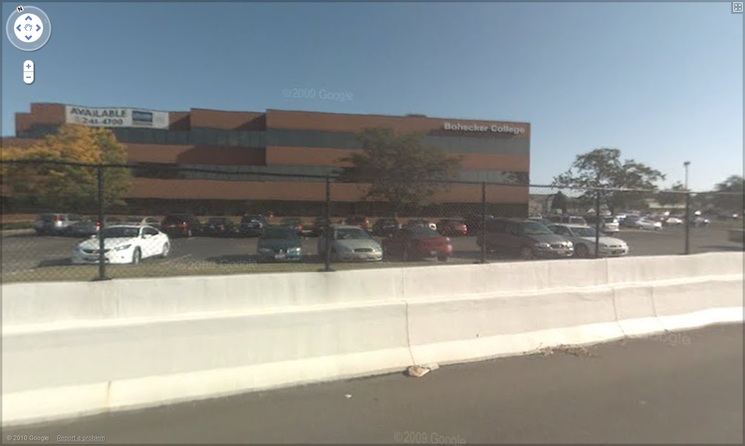


Slide 6
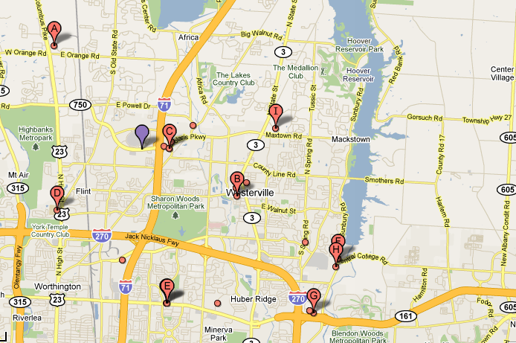











71
270

Slide 7


Slide 8
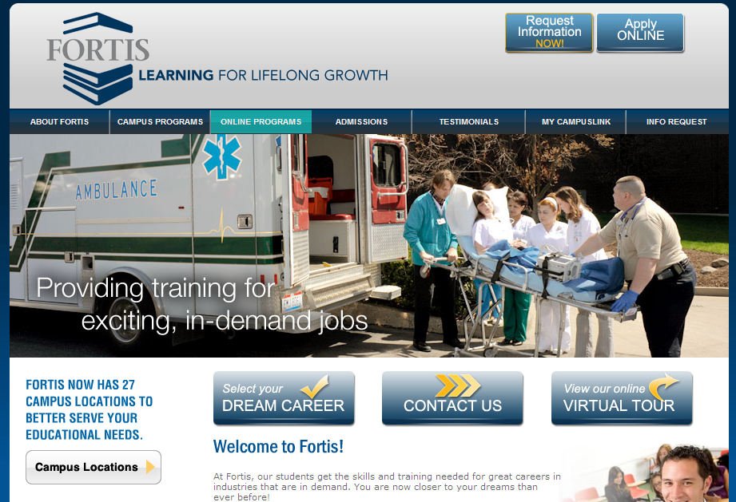

Slide 9
A glance at education ….

Slide 10
Colleges have three basic business models for attracting and keeping students. Two will continue to work in the next decade, and one almost certainly will not. Chronicle of Higher Education

Slide 11

Research/elite (Strong brand, connected to international network of science and scholarship; educate many of the political and business elite; flagship),
Convenience (community colleges and for-profit providers, focused on preparation for further education or for a career) Education as a service.
The mixed middle (broad education. Not kept up with distance and convenience agendas, high overhead, limited research funding, value of 4 year immersive experience, …).
(vocabulary adapted - LD)

Slide 12
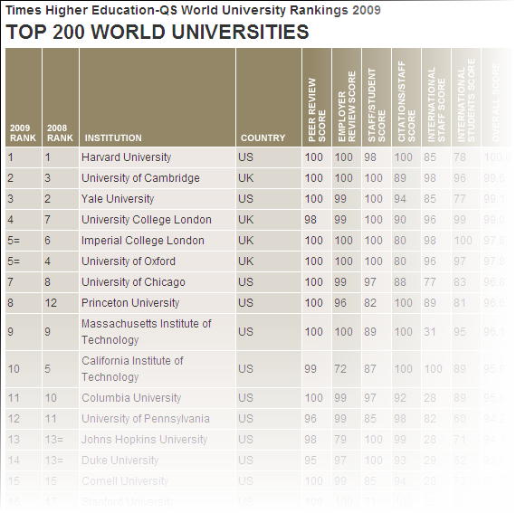

“Emerging global model”

Slide 13
1.A scientific (vs a more humanistic) approach to the study of all things, particularly as applied to fields that are seen as directly related to social and economic progress, dominate the prestige hierarchy.
2. Academic departments that embrace scientific methods to some degree, even in social sciences and humanities, are winners within individual universities.
4. Graduate education, where human capital formation (instruction and teaching) and knowledge production (research) are seen as complementary rather than competitive, is easier to fit into the EGM compared with programs that demand difficult choices between these two fundamental goals of higher education.
5. Disciplines that are seen as immediately useful/practical by the general public, government officials, and other decision makers are privileged over other fields. Faculty in these disciplines are often able to garner financial resources from society, thus enabling them to carry out substantial scholarly agendas greater than what can be mounted only with governmental and institutional support.
The Research University in Transition: The Emerging Global Model
Kathryn Mohrman, Wanhua Ma and David Baker
Higher Education Policy (2008) 21, 5–27. doi:10.1057/palgrave.hep.8300175

Slide 14
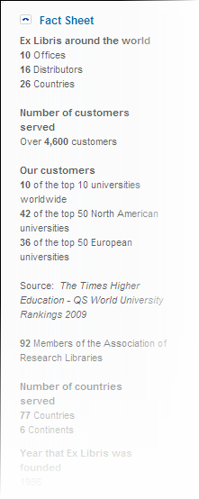
Research
Middle
Convenience

Slide 15
Libs in ‘convenience’ sector
An infrastructure cost
ROI
Make learning more effective
Focus on ‘packaged digital’ and integration with learning process
Organizational integration with learning and student support
Focused on institutional goals not on ‘community of libraries’.

Slide 16
‘Middle’ academic
Make research and learning more productive
Selective local engagement around creation and curation of scholarly and learning materials
Retrospective print collections will be managed as a pooled resource and physically consolidated in large regional stores
80+% of library materials spending will be directed toward licensed electronic content distributed by a small number of large aggregators
Strong downward pressure on costs will push towards library consolidation, more ‘instrumental’ resource sharing, and a move to outsourced services.

Slide 17
Research libs
A note on resources. Libraries that support doctoral education
  <20% US academic libraries but account for ..
  >50% library spending and …
  >75% of expenditures on information resources.
Digital infrastructure.
Preservation mandate: the scholarly record. Comprehensive collections?
Support for scholarly resources.
  Arxiv, Portico, …
New forms of support for digital scholarship

Slide 18
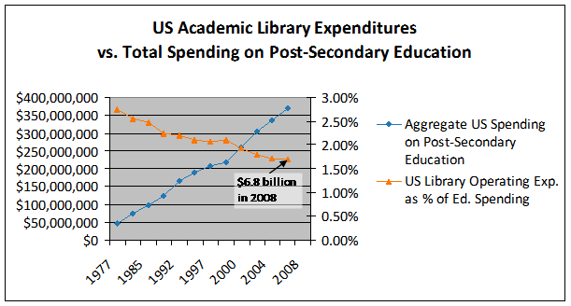
Analysis based on NCES data: Constance Malpas

Slide 19
A glance at network services …

Slide 20
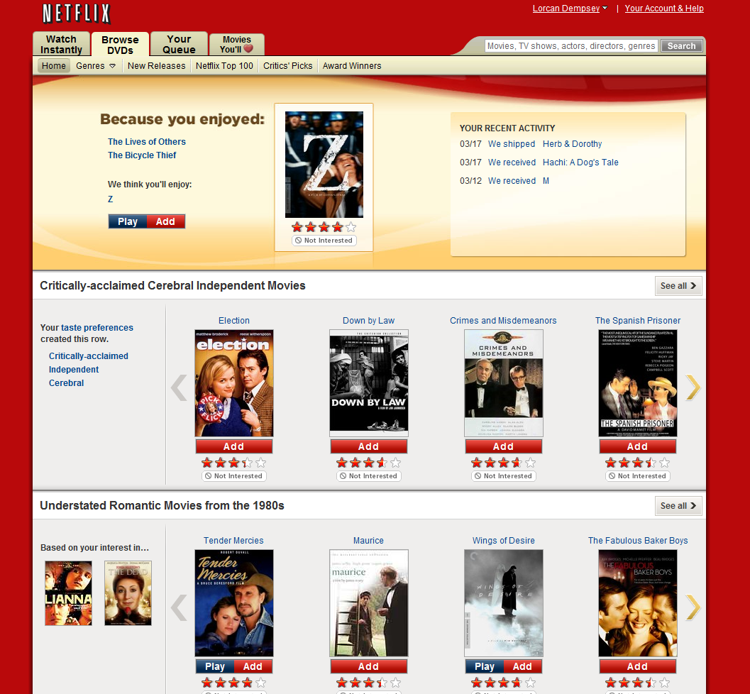

Slide 21
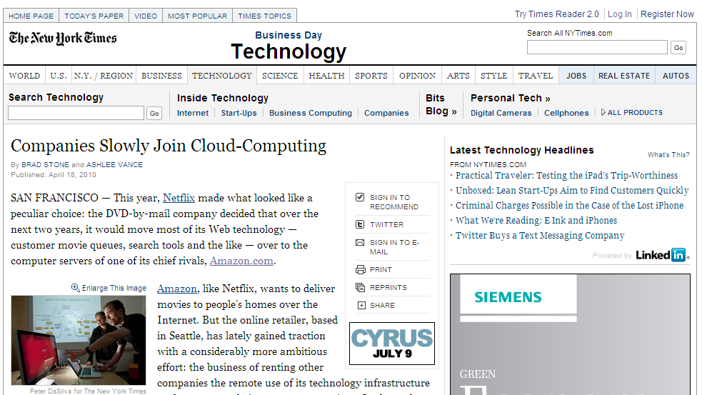

Slide 22
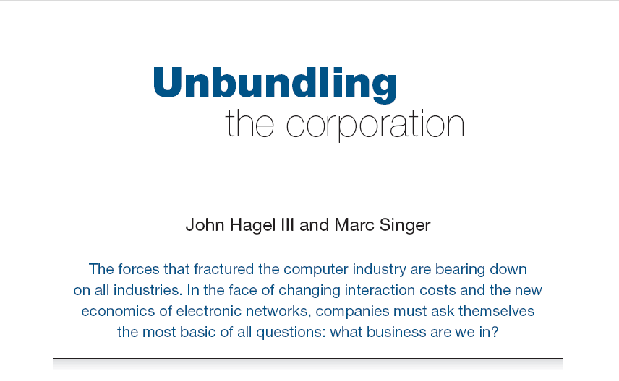
Unbundling the corporation
Harvard Business Review (1999)

Slide 23
Core components of a firm
Attracting and building relationships with customers
“Service-oriented”, customization
Economies of scope important
Develop new products and
services and bring them to
market
Speed/flexibility important
Customer
Relationship
Management
Product Innovation
Infrastructure
Back office capacities that
support day-to-day operations
“Routinized” workflows
Economies of scale important

Slide 24
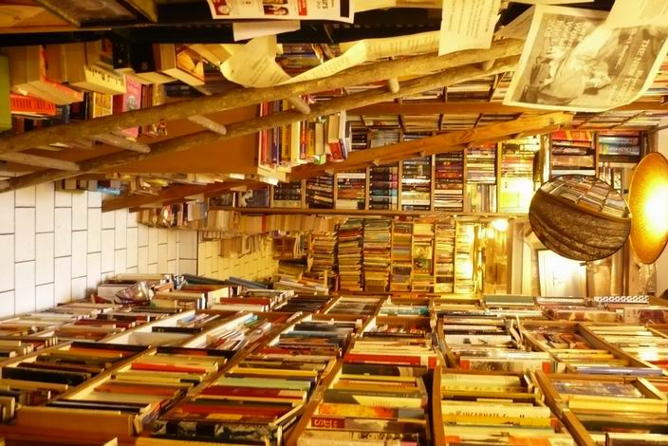








http://www.bookstoreguide.org/2009/07/
independent-bookstores-in-danger-of.html

Slide 25
Consolidation at scale
Network encourages efficiencies of scale
Amazon and Netflix: network companies
  Phase 1: discovery and request: electronic
  Phase 2: discovery, request, fulfilment: electronic
  Disrupted business areas
Context and community: rich analytics drive richer experiences
“The scalability of access”: stronger gravitational attraction at network level

Slide 26
"The 20th century was about sorting out supply," Potter says. "The 21st is going to be about sorting out demand."
Attention switch
Then: Resources scarce; attention abundant.
Now: Attention scarce; resources abundant.
Consumption
gives way to
consumption, creation, context

Slide 27
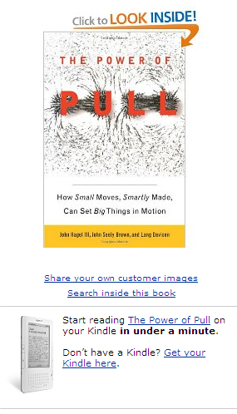
But we haven’t ever had the scalability of access that we have today.
Consider how, pre-Internet, if you were looking
for a particular book passage, but couldn’t
remember which book it appeared in, you
could only flip through the books on the shelf
hoping to come across it. If you couldn’t find what you were seeking in your own books, you might have walked next door to see if your colleague had it. From there your search might have taken you don the hall to the common library maintained by your department or function. Failing to find it there, you’d have then headed off for the library across town, where the librarian might have been able to help you out.

Slide 28
Huh!!??
Such a scenario almost seems quaint now. It’s easy to forget just how different things were prior to the advent of search engines. And not all of our practices have caught up. Just the other day one of us had the odd sensation of waking to the office bookshelves, trying to find an elusive passage, and suddenly recalling, as he stood there staring at the spines of all the many books, that there was a search function he could use to make the tasks easier: It was the one to be found back on the desk, Google Books. Soon he was staring at the passage on the computer screen as the hardcover itself gathered more dust across the room.

Slide 29
That’s what we mean by the scalability of access. We’re no longer limited simply to the 150 people we can maintain physical-world relationships with, to the books on the shelf across the room, or even those at the local library.

Slide 30
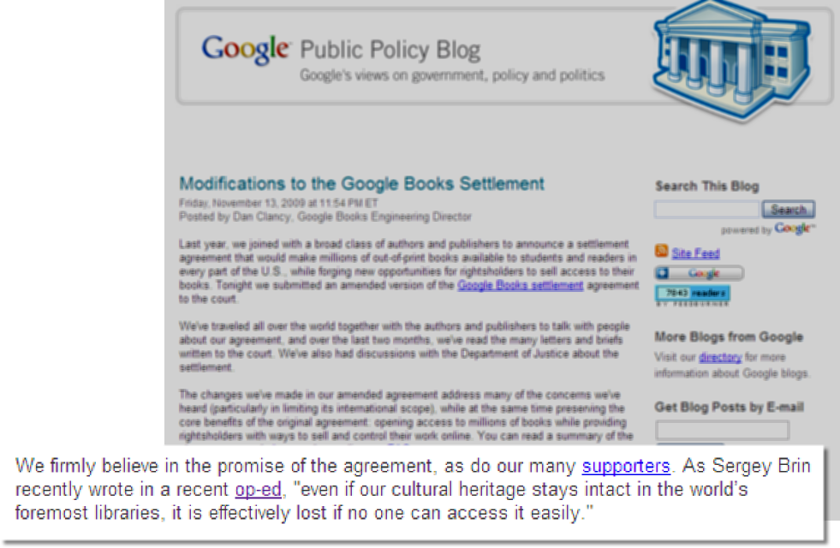

Slide 31
In an environment of scarce attention high
transaction costs equals
low/no availability?

Slide 32
Specialization: what business are you really in?
Vertical disintegration
Specialise where can make an impact
Externalise to other specialist providers:
  Where is not core to impact
  Where ‘best’ is available elsewhere.
  E.g. Discovery happens elsewhere?

Slide 33
A glance at libraries …

Slide 34
a Coasian view of the academic library
Universities find it useful and
economical to internalize a
bundle of information-related
activities in the library
As the pattern of transaction costs change, so too will the boundaries of the library.
Researchers/learners have more options – network.

Slide 35
A glance at collections …

Slide 36




COLLECTIONS GRID
Stewardship/
scarcity
high
low
Low-High
Books & Journals
Newspapers
Gov Documents
CD & DVD
Maps
Scores
In many collections
Low-Low
Freely-accessible web resources
Open source software
Newsgroup archives
low
Uniqueness
High Stewardship
Low Stewardship
High-High
Special Collections
Rare books
Local/Historical Newspapers
Local History Materials
Archives & Manuscripts
Theses & dissertations
High-Low
Research & Learning Materials
Institutional records
ePrints/tech reports
Learning objects
Courseware
E-portfolios
Research data
Prospectus
Insitutional website
high
In few collections

Slide 37
Outside in: Consolidation of licensed?
Move of bought to licensed/electronic?
GBS?
In many collections
low
Inside out:
reputation, institutional assets,
institutional record, distinctive, …
Individual destinations? Academic SEO.
In few collections

Slide 38
Libraries
Provision of study & social spaces
Interpret learning and research needs
Personalized research assistance
Marketing and assessment
Customization/personalization
Acquire/develop new information
resources and services to support
evolving research and learning
workflows
Customer
Relationship
Management
Product Innovation
Infrastructure
Physical space,
Physical inventory,
Repository
Systems infrastructure
Online services, etc.

Slide 39
Infrastructure challenge
Reduce outside-in footprint
Print increasingly collaborative:
  Collaborative arrangements for print
  Collaborative arrangements for digital
Licensed materials:
  Reduce cost of management through shared arrangements
Systems
  Consolidation of traditional management environment
  Consolidation and externalization of discovery
Develop inside-out capacity
Institutional research and learning materials:
  Selective investments; leave to others where appropriate
  Search for collaborative solutions where possible
  Relationship management
Systems infrastructure
  Selective local investment in digital infrastructure
  Collaborative and third party cloud offerings
  Innovation ….

Slide 40
Scale
 | Institution | Group | Webscale
Peer (collaborative) | HathiTrust; DuraSpace | Orbis Cascade | Repec.org
Public (state/national) |  | Jisc; OhioLink
Third party | Locally procured systems and services | Worldcat Cataloging | Flickr Commons, Google Scholar, Worldcat.org
Source

Slide 41
‘Customer relationship management’ challenge
A natural partner in research and learning activities
Understand and support new forms of scholarship
Consultative
Data-driven understanding
Support for information-related activities is being peeled away from the collections ….
If libraries want to be seen as experts, their expertise must be seen …

Slide 42
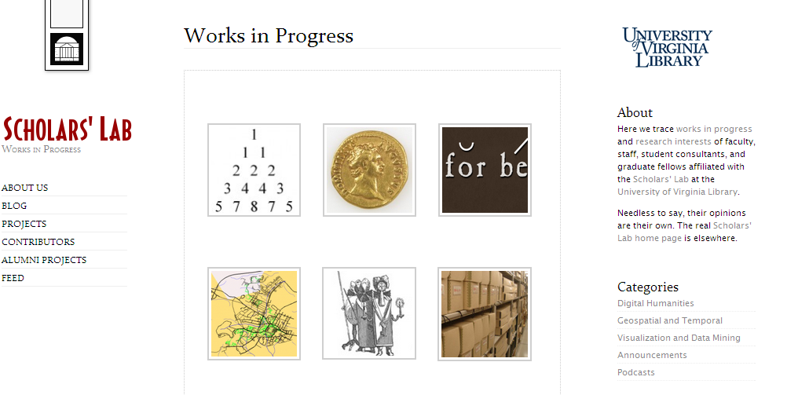

Slide 43
The innovation challenge
Organizational
Investment choices
Appropriate forums to collaboratively source new approaches?

Slide 44
Next up
Update Sessions, Round 2 • 2:00
"Special Delivery": New Modes of Access to Special Collections • Dennis Massie, Jennifer Schaffner, Paul Constantine and Jon Shaw • Renaissance South
Leveraging Names with Linked Data • Karen Smith-Yoshimura and Ralph LeVan • Renaissance North
Supporting Research Dissemination • John MacColl and James Toon • Sienna
Cloud Sourcing Research Collections • Constance Malpas •
Venetian

