Slide 1
Extracting names and resolving identities in unstructured text
Carol Jean Godby
Research Scientist
OCLC Research

Slide 2
Three problems in automated name extraction
Recognize
  Distinguish names from non-names.
  Assign the name to a broadly recognized category.
Cluster
Associate variants of the same name.
Assign an identity… or the name’s real-world referent
  Select the canonical form of a name.
Extracting names and resolving identities
Notes:
2

Slide 3
An example
The Justice Department has officially ended its inquiry into the assassinations of John F. Kennedy and Martin Luther King Jr, finding “no persuasive evidence” to support conspiracy theories, according to department documents. The House Assassinations Committee concluded in 1978 that Kennedy was “probably” assassinated as the result of a conspiracy involving a second gunman, a finding that broke from the Warren Commission's belief that Lee Harvey Oswald acted alone in Dallas on Nov. 22, 1963.
[ORG The Justice Department] has officially ended its inquiry into the assassinations of [PER John F. Kennedy] and [PER Martin Luther King Jr.] , finding “no persuasive evidence” to support conspiracy theories, according to department documents. [ORG The House Assassinations Committee] concluded in 1978 that [PER Kennedy] was “probably” assassinated as the result of a conspiracy involving a second gunman, a finding that broke from the [ORG Warren Commission]'s belief that [PER Lee Harvey Oswald] acted alone in [LOC Dallas] on Nov. 22, 1963.
Extracting names and resolving identities
Notes:
In text, the names of different entities can be written in very ambiguous ways.
On one hand, the names of the same entity can be written in different ways. For example, John F. Kenney, Kennedy, and Sen. John F. Kennedy actually refer to the same person.
One the other hand, the names of different entities can be written in very similar or identifical ways. For example, the first ‘Kennedy’ here is `John F. Kennedy’, but the second one is ‘Kennedy’ refer to a different person.
Identifying entities from these names is a hard problem, especially when they are in different documents.
JEAN: I found a picture of David Kennedy the poet – so that’s why there’s a different picture than what was in the previous presentation. But I also thought: why not keep that picture of David Kennedy, son of Robert F. Kennedy? However, maybe this would complicate the content in succeeding slides? I’ll leave it up to you as to whether we should keep or remove the picture of RFK’s son.

Slide 4
Types of text
Unstructured text
Structured text
Hi Larry,
Here is my section of the draft. I’m still plugging away, so look for another version sometime later today or tomorrow.
<salutation>
<greeting>Hi</greeting>
<person>Larry</person>
</salutation>
<body>
Here is my section of the draft. I’m still plugging away, so look for another version sometime later today or tomorrow.
</body>
resources the beyond desk wife honor florida report siemens about dropped is deck November building called American buy children companies food could
Semi-structured text
To: Larry
From:Jean
Hi Larry,
Here is my section of the draft. I’m still plugging away, so look for another version sometime later today or tomorrow.
Bag of words
Extracting names and resolving identities

Slide 5
Project Goals
Lower the barrier of access to high-end named entity recognition (NER) tools.
Build bridges to identity resolution research.
Create tools for open use.
Demonstrate use of the tools in digital library applications.
Make recommendations for future collaboration between pure and applied research.
Extracting names and resolving identities

Slide 6
Uses for automatically extracted names in library applications
Index e-resources and make the results available to a browse or search function in a user interface.
Assemble e-resources about a particular named entity from a database search.
Catalog e-resources with authoritative forms of names.
Use names harvested from unstructured text to:
  Create name lists or gazetteers.
  Populate future versions of authority files.
Create dedicated services that:
  Anonymize names.
  Create robust links between structured and unstructured texts.
Extracting names and resolving identities
Notes:
Transposing the boxes from the previous slide onto a list of commonly mentioned use cases for a named entity extractor in library applications, I made an educated guess about what is the smallest problem that must be solved in the named entity extraction space to make a valuable contribution to a given application.
For those that have been assigned light-colored boxes, there is a human in the loop who can resolve the identity. Surprisingly, many library applications would benefit from access to work that is already mature in the NLP community.
The most difficult problem, but the one with the greatest payoff, would be an automatic assignment of identities that link information in different applications (an example follows). I assigned this one a dark green box because standards for accuracy are high since data has to be modified.

Slide 7
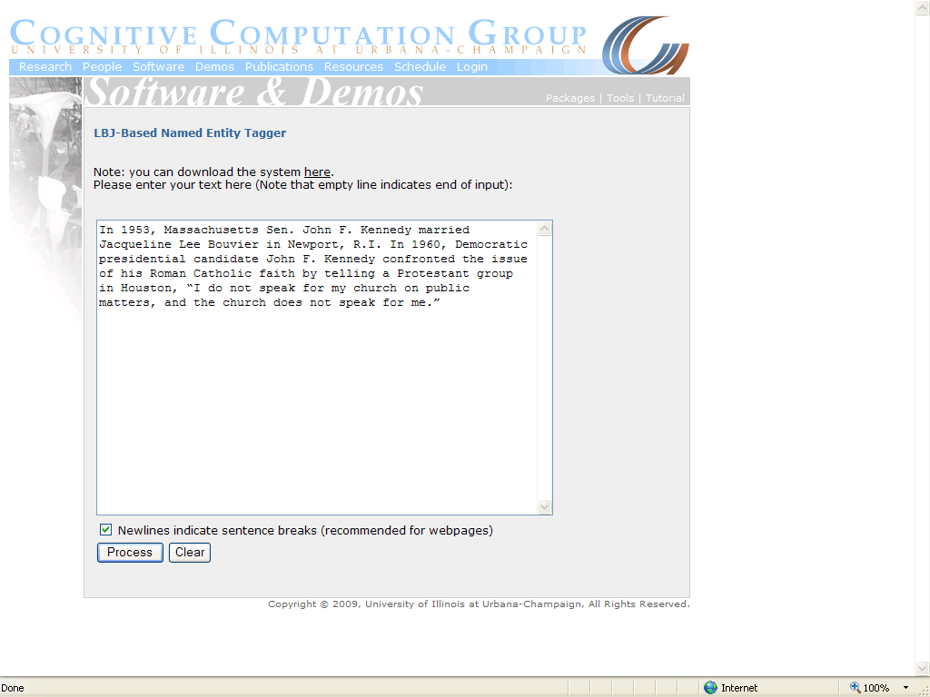
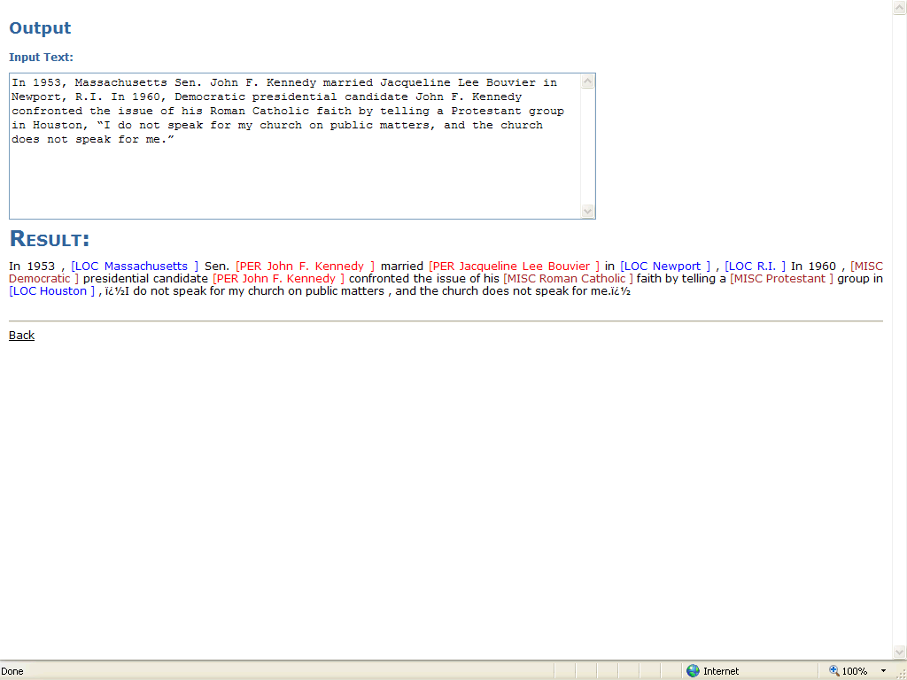
The Named Entity Recognizer
DHCS 2009
Who's Who in Your Digital Collection? Developing a Tool for Name Disambiguation and Identity Resolution
7
Notes:
The first step is to identify the names. In our hypothetical application, where we want to distinguish among the different “Kennedys” in different documents, our primary interest is in personal names. They are shown in pure red here.
This is the output of applying the NER tool to one of the articles about John F. Kennedy.
As trained, it recognizes four categories of names: Locations, Organizations, Personal Names, and Miscellaneous. Miscellaneous names are somewhat ill-defined, but in this tagging scheme, they refer to names of human-created artifacts.
Evaluation studies conducted by our project partners at the University of Maryland compare the output of the UIUC tool to commonly available alternatives (Stanford NER and Clear Forest Gnosis). Trained on News text, the systems have comparable precision, but the UIUC tool has recall scores that that are at least 30% higher. This data will be discussed in more detail in the paper. Our Maryland colleagues are also preparing a separate article on the subject of NER evaluation.

Slide 8
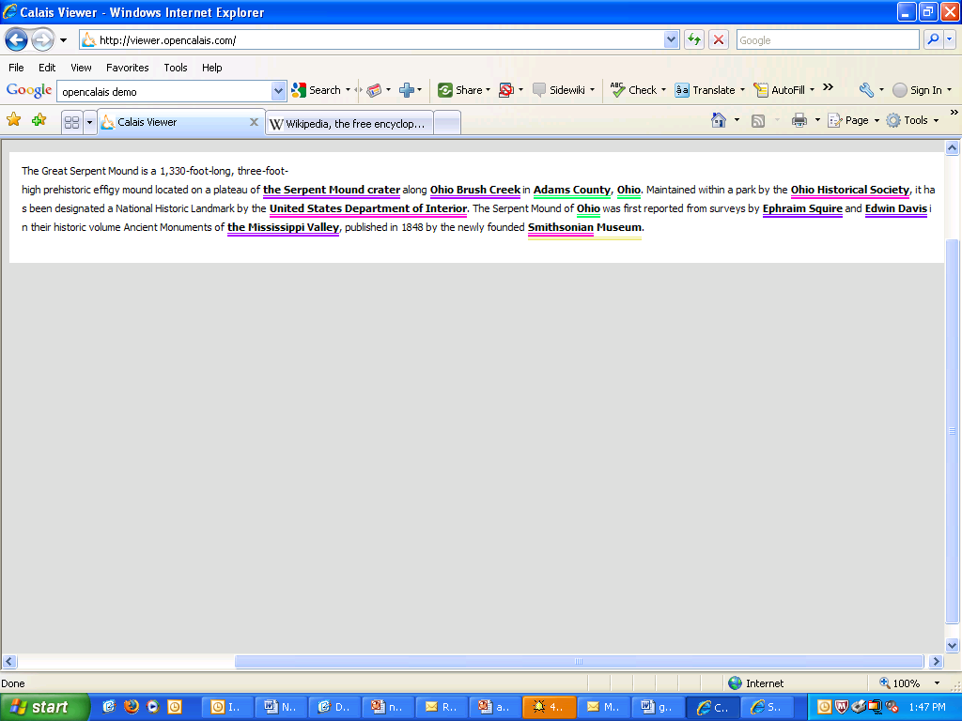
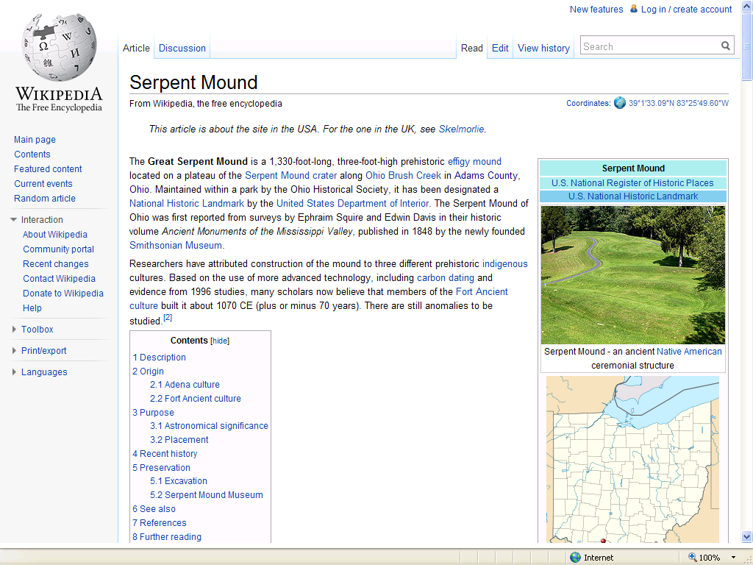
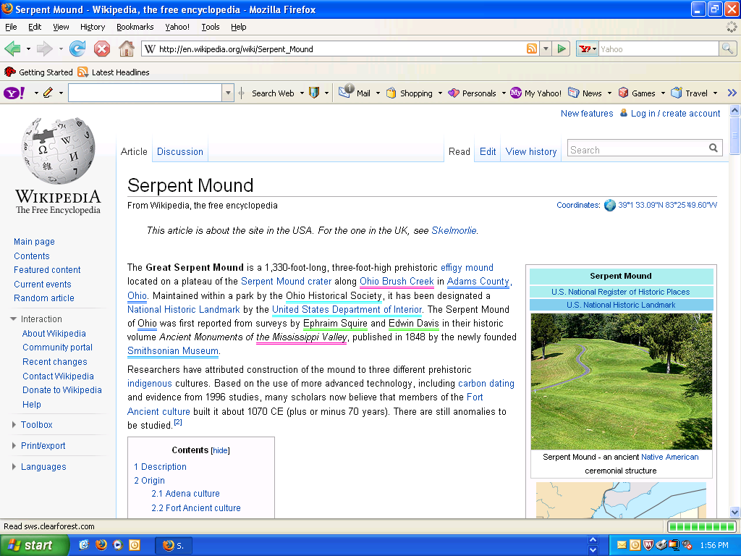
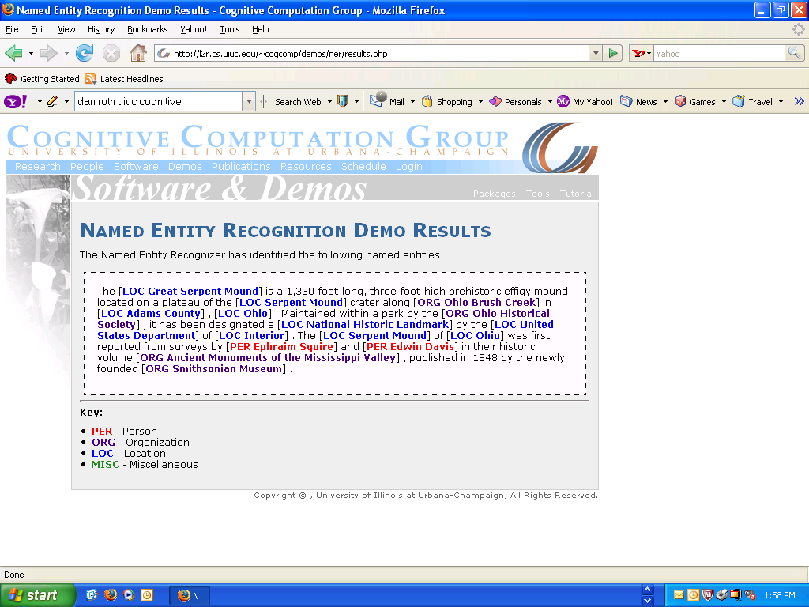
Facility
State or province
Organization
Person
Natural feature

Slide 9
How the UIUC NER tagger works
Identifies the four categories the standard CoNLL scheme
  [ORG] – Any temporary or permanent collection of people, such as Google, Ohio Division of Natural Resources, Democratic Party Meetup
  [PER] – Personal names. Includes fictional names and supernatural beings.
  [LOC] – Any physical or human-built landmark. Kentucky, Empire State Building, Gulf of Mexico.
  [MISC] – A catchall. World War I, Kleenex, Abstract Expressionism, and Jewish are all [MISC] names.
Does not assign internal structure
  New York Times XXX [ORG [LOC New York] Times]
Recognizes names using perceptrons
  A machine-learning algorithm that makes minimal assumptions about category definitions, but recognizes patterns from training data.
Extracting names and resolving identities
Notes:
Define CONLL

Slide 10
An EAD record
Papers of Gennaro M.Tisi, noted clinical and research specialist in the area of pulmonary medicine and a founding member of the School of Medicine, University of California, San Diego. Author of over 100 original articles, chapters, and abstracts, Tisi's research interests included the staging of lung cancer, medical-pulmonary education, pulmonary physiology and mechanics, and clinical research in pulmonary disease. Arranged into six series, the collection contains research notes, correspondence, manuscripts, administrative memos, committee agendas and minutes, and photographs documenting Tisi's professional life from 1964 to his death in 1988.
Gennaro Michael Tisi (September 26, 1935-February 18, 1988), was a pulmonary specialist, both as a clinician and teacher. He earned a B.S. in chemistry, biology, and philosophy from Fordham University in 1956 and a M.D. from Georgetown University Medical School in 1960. He was a founding member of UCSD's medical school, where he worked from 1968…
Extracting names and resolving identities

Slide 11
Tagging results
Segmentation error
Papers of [PER Gennaro M. Tisi], noted clinical and research specialist in the area of pulmonary medicine and a founding member of the School of [MISC Medicine], [ORG University of California], [LOC San Diego]. Author of over 100 original articles, chapters, and abstracts, [PER Tisi]'s research interests included the staging of lung cancer, medical-pulmonary education, pulmonary physiology and mechanics, and clinical research in pulmonary disease. Arranged into six series, the collection contains research notes, correspondence, manuscripts, administrative memos, committee agendas and minutes, and photographs documenting [PER Tisi]'s professional life from 1964 to his death in 1988.
[PER Gennaro Michael Tisi] (September 26, 1935-February 18, 1988), was a pulmonary specialist, both as a clinician and teacher. He earned a [LOC B.S.] in chemistry, biology, and philosophy from [ORG Fordham University] in 1956 and a M.D. from [ORG Georgetown University Medical School] in 1960. He was a founding member of [ORG UCSD]'s medical school, where he worked from 1968 until his death in 1988 of a cerebral hemorrhage at the age of 52.
Category error
Extracting names and resolving identities

Slide 12
Results on government documents
Segmentation error
Category error
46 | 2009-2010 [ORG Illinois] [MISC Blue Book]
96th [ORG General Assembly]
Office of the [MISC Senate President]
The [MISC Senate President] is the presiding officer of the state [ORG Senate] , elected by and among the members of the [ORG Senate] to serve a two-year term. The [MISC Illinois Constitution], statutes and rules define the functions and responsibilities of the office.
The [MISC President] appoints [ORG Senate] members to standing committees and permanent and interim study commissions, designating one member as [MISC chair]. The [MISC President] also appoints the [MISC Majority Leader] and [MISC Assistant Majority Leaders], who serve as officers of the [ORG Senate].
Passed by the [ORG Senate] are in accordance with [ORG Senate] rules.
Missed
Segmentation
46 | 2009-2010 [ORG Illinois] Blue Book
96th General Assembly
Office of the [ORG Senate] President
The [ORG Senate] President is the presiding officer of the state [ORG Senate] , elected by and among the members of the [ORG Senate] to serve a two-year term. The [ORG Illinois Constitution] , statutes and rules define the functions and responsibilities of the office.
The President appoints [ORG Senate] members to standing committees and permanent and interim study commissions, designating one member as chair. The President also appoints the Majority Leader and Assistant Majority Leaders, who serve as officers of the [ORG Senate] .
Passed by the [ORG Senate] are in accordance with [ORG Senate] rules.
Segmentation
Gold error
Missed
Extracting names and resolving identities

Slide 13
Some genres in government documents
Legislation
Requirements, Codes, Regulations, and Laws
Oversight Reports
Special Topical Reports
Budgetary Material
Audits
Legal Proceedings
Contractual Material
Forms and Instructions
Children’s Material
Directories
Website Locator and Navigation Webpages
Social Media and Interactive Communication Facilities
State Academic Institutions
Extracting names and resolving identities

Slide 14
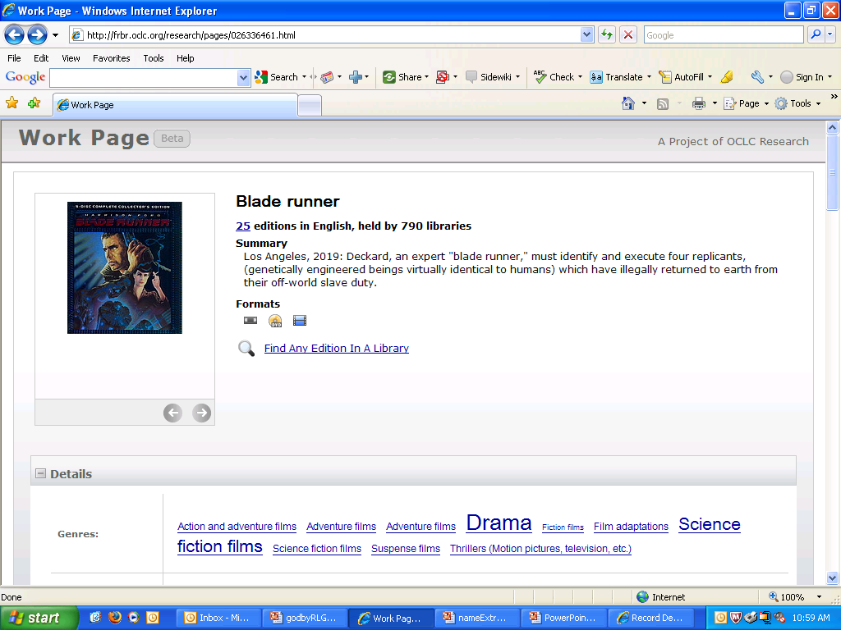
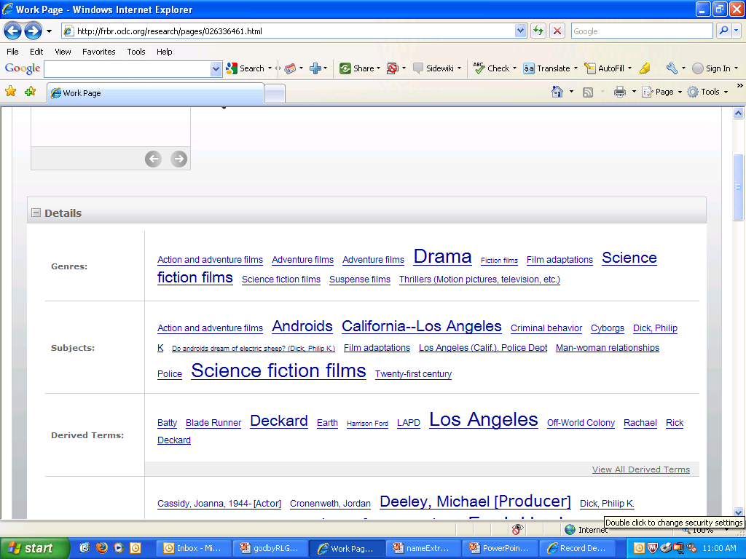
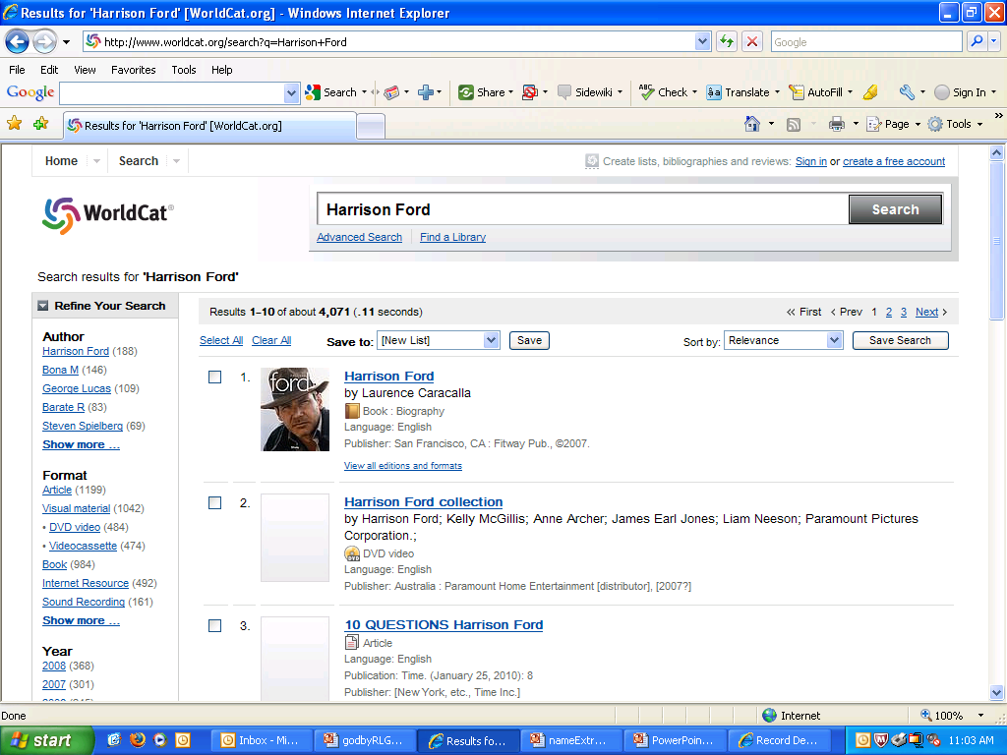

Slide 15
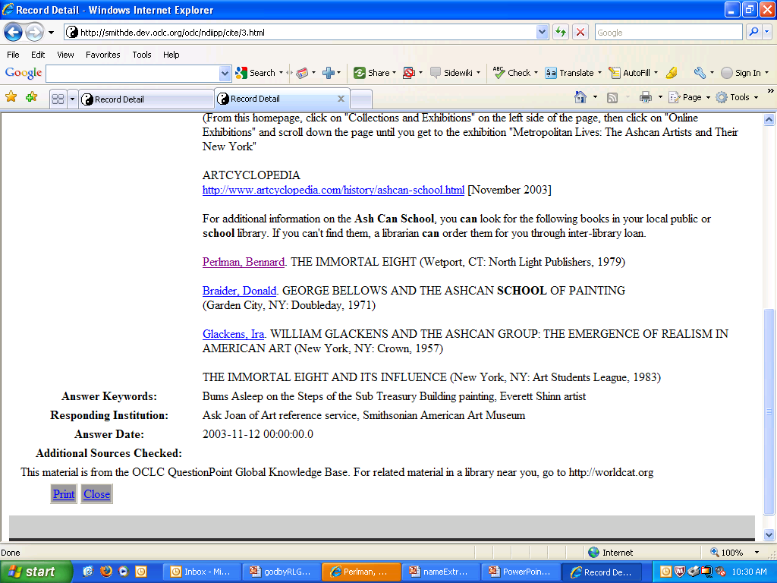
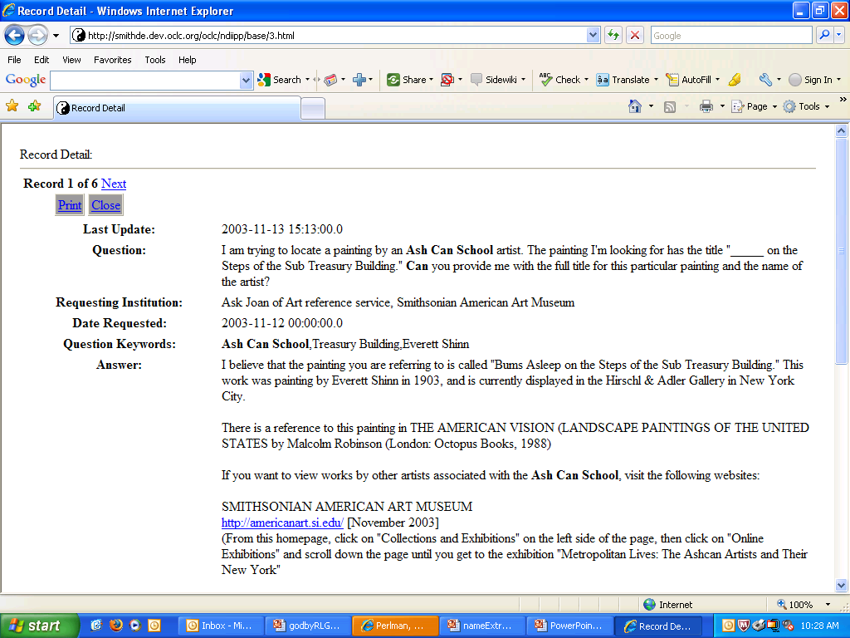
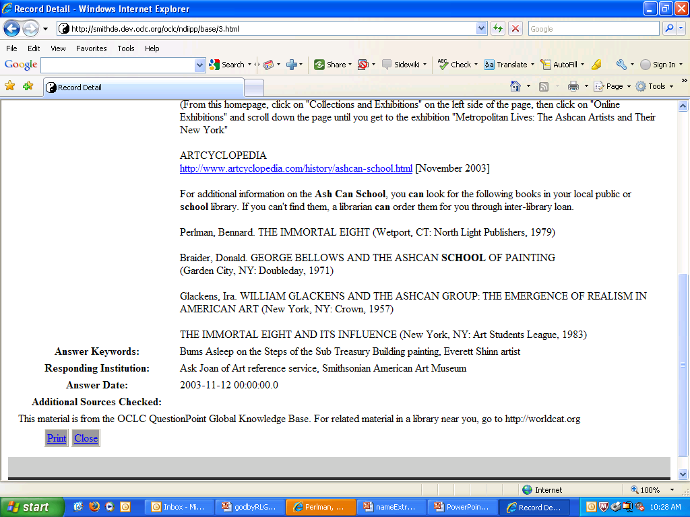

Slide 16
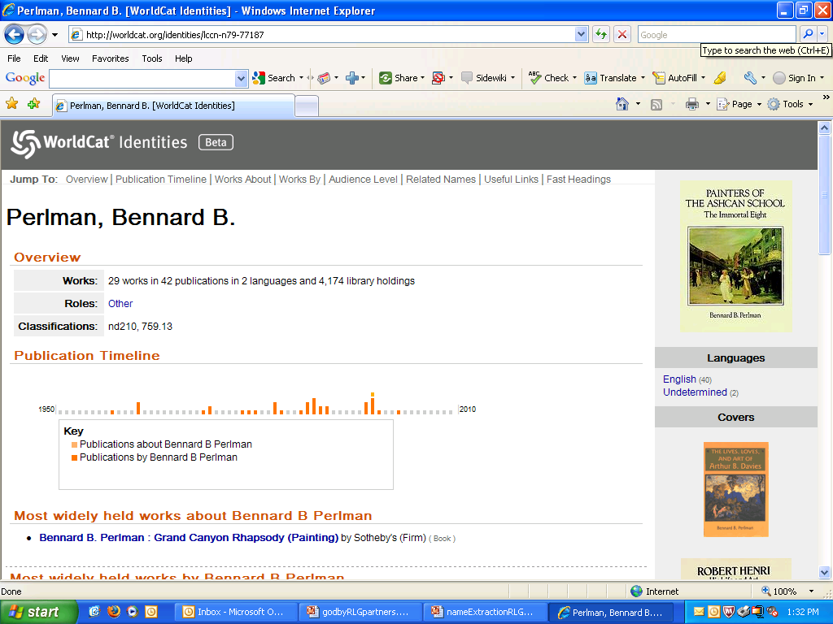
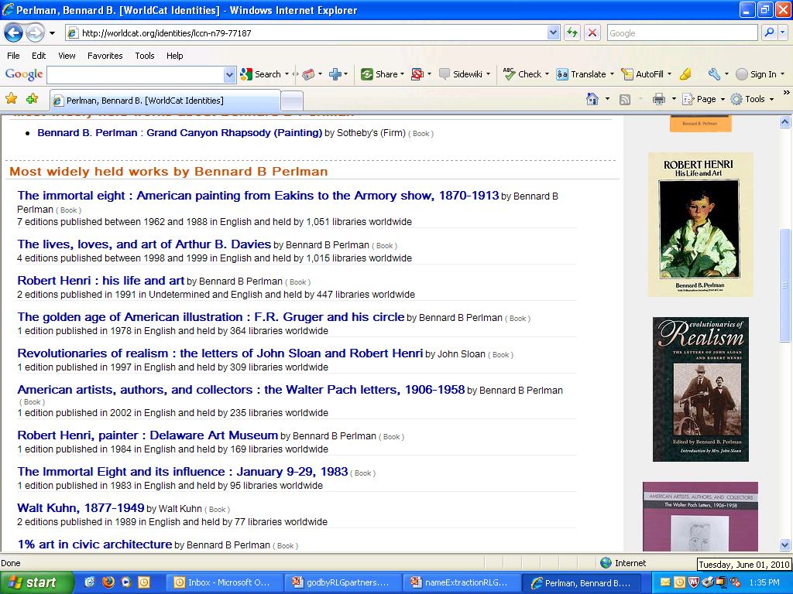

Slide 17
Scoring
Gold text
Wrong label and segmentation error
[ORG The Justice Department] has officially ended its inquiry into the assassinations of [PER John F. Kennedy] and [PER Martin Luther King Jr.], finding “no persuasive evidence” to support conspiracy theor,ies according to department documents. [ORG The House Assassinations Committee] concluded in 1978 that [PER Kennedy] was “probably” assassinated as the result of a conspiracy involving a second gunman, a finding that broke from the [ORG Warren Commission]'s belief that [PER Lee Harvey Oswald] acted alone in [LOC Dallas] on Nov. 22, 1963.
Segmentation error
Missed this one
The [MISC Justice Department] has officially ended its inquiry into the assassinations of [PER John F]. [PER Kennedy] and Martin Luther King Jr., finding “no persuasive evidence” to support conspiracy theories, according to department documents. [ORG The House Assassinations Committee] concluded in 1978 that [PER Kennedy] was “probably” assassinated as the result of a conspiracy involving a second gunman, a finding that broke from the [ORG Warren Commission's] belief that [PER Lee Harvey Oswald] acted alone in [LOC Dallas] on Nov. 22, 1963.
NER-tagged text
F-Measure: Precision/Recall
Extracting names and resolving identities
Notes:
In text, the names of different entities can be written in very ambiguous ways.
On one hand, the names of the same entity can be written in different ways. For example, John F. Kenney, Kennedy, and Sen. John F. Kennedy actually refer to the same person.
One the other hand, the names of different entities can be written in very similar or identifical ways. For example, the first ‘Kennedy’ here is `John F. Kennedy’, but the second one is ‘Kennedy’ refer to a different person.
Identifying entities from these names is a hard problem, especially when they are in different documents.
JEAN: I found a picture of David Kennedy the poet – so that’s why there’s a different picture than what was in the previous presentation. But I also thought: why not keep that picture of David Kennedy, son of Robert F. Kennedy? However, maybe this would complicate the content in succeeding slides? I’ll leave it up to you as to whether we should keep or remove the picture of RFK’s son.

Slide 18
Some outcomes
F-scores ranked by tag type:
    PER > LOC > ORG > MISC
[PER] and [LOC] are most robust categories across different document collections.
[MISC] and [ORG] are highly dependent on the corpus and subject domain.
Training on a corpus for one purpose cannot be reused on a different corpus without a degradation in performance.
Extracting names and resolving identities
Notes:
Names of offices, names of publishers, Time Magazine, New York Times, names of divisions:
Division of Computing Services for Medical Education and Research, Irma and Paul Milstein Division of United States History, Local History and Genealogy, British Army, Google

Slide 19
Issues with tagging
Tag definitions
  Only four categories are defined: [MISC], [ORG], [PER], [LOC]
  [MISC] – is a grab bag.
  [ORG]
    Doesn’t have a librarian’s definition.
    Has no predictable structure.
Names with internal structure
  Advisory Committee on Appellate Rules of the Judicial Conference of the United States
    [ORG Advisory Committee] on [MISC Appellate Rules] of the [ORG Judicial Conference] of the [LOC United States ]
  Trustees of Wheaton Seminary
  Fred Steiner Papers
  L. Tom Perry Special Collections
Extracting names and resolving identities

Slide 20
What type of name is:
What type of name is….
Prayer Service
Swearing-in
Barbecue
Illinois Constitution
University Archives Reference Desk
Extracting names and resolving identities

Slide 21
Conceptual issues with named entity recognition
Ambiguous elements
  [PER H.N. Abrams] or [ORG H.N. Abrams]?
  [PER Currier] & [PER Ives] or [ORG Currier & Ives]?
  [MISC White House] or [LOC White House] or [ORG White House]?
Conjunction reduction
  “Translated by Jacques and Jean Duvernet.”
    [PER Jacques] and [PER Jean Duvernet]
    [PER Jacques Duvernet] and [PER Jean Duvernet]
Anaphora
  Mr. Duvernet, Duvernet, he, the translator
Naming vs. describing
  [ORG American Museum of Natural History], [ORG Field Museum]
  [ORG Natural History] museum, [ORG Chicago] museum]
  The Appelate Rules conference, that Appelate Committee, Bill’s committee
Extracting names and resolving identities
Notes:
In the context of an EAD article on an architect. Their work included laboratories for industry, the [LOC Texaco Research Center], [LOC St. Elizabeth Hospital] and twin dormitory towers for the
University of Houston, among buildings for six universities.
Advisory Committee on Appellate Rules of the Judicial Conference of the United States

Slide 22
In sum…
Named entity tagging is a complex psycholinguistic task that challenges even mature, sophisticated readers.
The tagging task can only be approximated with a model that recognizes just three broadly-defined categories, plus a fourth category with limited utility, none of which can be assigned any internal structure.
LIS researchers who wish to apply this technology must:
  Define tasks that can be carried out successfully with the current state of the art.
  Lower their expectations.
  Identify realistic directions for future enhancements.
Extracting names and resolving identities

Slide 23
Training is error-prone and time-consuming.
  The need to train is a potential deal-killer for the adoption of named-entity recognition software.
  Training requires:
    Criteria for applying the markup that can be articulated and consistently applied to the data;
    Markup that falls within the scope of the tagging scheme produced by the NER tagger;
    Patterns that cannot be easily discovered by simpler means, such as regular-expression matching;
    A corpus that is large enough to change the behavior of the NER tagger.
Extracting names and resolving identities

Slide 24
Some recommendations
For NER clients
  Take advantage of the most successful and mature categories – for personal names and locations.
  Work with semi-structured or edited text.
  Build out named entity recognition modules with other sophisticated tools that classify text and do localized special processing.
For NER tool developers
  Use the perceptron model to define “placeholder” categories that can be trained on the unique name types in a collection.
  Develop more detailed models for the most mature categories.
Extracting names and resolving identities

Slide 25
Next steps
Next steps
Grant responsibilities
  Complete formal experiments on library data.
  Finish final report, which is due on June 30.
OCLC work
  Outline steps required to beyond “interesting examples” to mature research prototypes.
  Publish our study of named entity tagging on library data.
  Engage with:
    …researchers in the machine learning to improve precision and recall of named entity recognition tools.
    …practitioners in the library community to apply and evaluate this technology.
Extracting names and resolving identities

Slide 26
For more information
ReferenFf\\ces
The Cognitive Computation Group at the University of Illinois
Functional genre in Illinois State Government digital documents
Name this! Automating metadata extraction through a named entity recognition tool.” Poster for the 2009 NDIIPP Partners’ Meeting.
“Who’s who in your digital collection: Developing a tool for name disambiguation and identity resolution.” To appear in the Chicago Colloquium for Digital Humanities and Computer Science Journal.
Extracting names and resolving identities

Slide 27
Questions?
Extracting names and resolving identities

Slide 28
Next up
Extracting names and resolving identities
Lunch and then…
1:00
Framing Libraries and the Environment
Lorcan Dempsey, OCLC Research
Buckingham

