Slide 1

The Researcher of the Future
Lynn Silipigni Connaway, Ph.D.
Senior Research Scientist
OCLC Research
2010 Annual RLG Partnership Meeting
June 9-11, 2010
Chicago

Slide 2

The Digital Information Seeker:
Report of findings from selected OCLC, RIN and JISC User Behaviour Projects
Funded by JISC
Analysis of 12 user behaviour studies
  Conducted in US and UK
  Published within last 5 years
  Synthesis
    Better understand user information-seeking behaviour
    Identify issues for development of user-focused services and systems

Slide 3

Common Findings:
Disciplinary Differences
Disciplinary differences exist
  Similarities “more striking than the differences”
D2D services
  Sciences most satisfied
  Social Sciences & Arts & Humanities have serious gaps
    Foreign language materials
    Multi-author collections
    Journal back files
    Lack of specialist search engines
Behaviours vary by discipline
  Historians more likely to use Google & publisher platform search tools than life sciences
E-book use varies by discipline
  Higher user in business than engineering
Notes:
Several studies indicate that some disciplinary differences do exist in researcher behaviours, both professional researchers and students.
Researchers and discovery services, 2006
Some disciplinary differences exist
E-journals, 2009
Behaviours also vary by discipline
JISC national e-books, 2009
Students’ use varies by discipline

Slide 4

Common Findings:
E-Journals
Journal articles central type of resource
High value placed on e-journals
Powerful part of academic libraries
Article downloads have doubled
ROI considered very good for e-journals
E-journal use strongly correlated with
  Publications
  PhDs awarded
  Grants
  Contracts
Notes:
The evidence suggests the increasing importance of e-journals to researchers.
Researchers and discovery services, 2006
Journal articles central type of resources
Researchers use of academic libraries, 2007
Researchers place a very high value on electronic journals
E-journals, 2009
E-journals are a powerful part of academic libraries
Article downloads have nearly doubled
ROI considered very good for e-journals
User downloads 47 articles a year
Strongly correlated with papers published, number of PhD awards, research grants, contracts income

Slide 5

Common Findings:
Google
Search engines
  Dominant place to begin
  Preferred over libraries
Search engines first choice
Rate search engines better lifestyle fit than libraries
Heavy reliance on Google & other web sources
Notes:
Even more evidence exists for the increasing centrality of Google and other search engines in researchers’ behaviours
Perceptions of libraries, 2005
Search engines dominant place to begin
Search engine as lifestyle fit
Search engines are preferred over libraries
College students’ perceptions, 2006
Search engines overwhelming first choice for an information search
94% lifestyle fit
Sense-making, 2006
Heavy reliance on Google and other web information sources

Slide 6

Common Findings:
Google, cont.
Simple tasks with other sources
Majority British Library visits from search engines
  40% school-age visits via image search
Prefer natural-language searching
Trust Google to understand
Notes:
A 71-year old from the United States, stated, “…also, the internet as now put all the librarys of the world [at] your fingertips.” (De Rosa 2005, p. 1-13)
Researchers and discovery services, 2006
Common tools include general search engines, specialist search engines
Google is often used for relatively simple tasks in conjunction with other sources
Researcher of the future, 2008
Majority of BL visits were from search engine
Prefer natural-language searching and trust Google to understand them
40% of school-age visits to the BL visits were via an image search

Slide 7
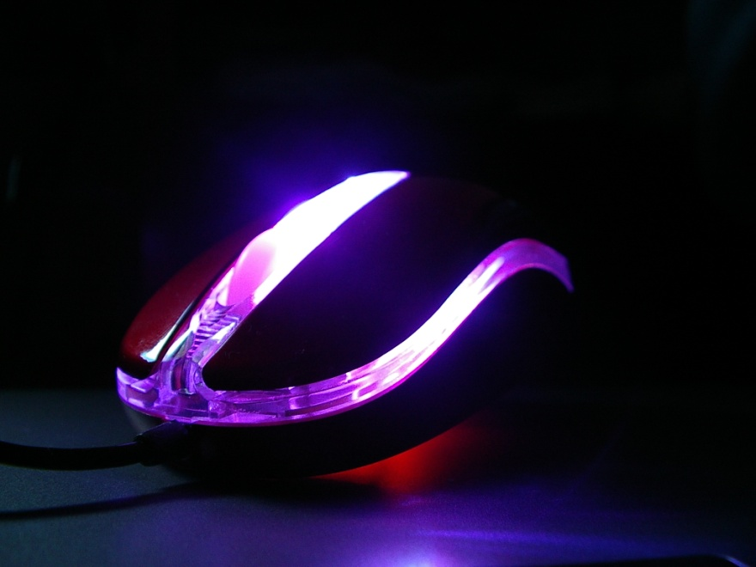
Common Findings:
Locate and Access E-Journals Via Google
Ignore publishers’ platforms
1/3 traffic via Google
Notes:
A graduate student focus group interview participant, “Google, I don’t have to know, I go to one spot.” (Connaway, Prabha, and Dickey, p. 11)
Google is often used to locate and access e-journal content, and other library resources, both by students and by professional researchers.
Sense-making, 2006
Some evidence for use of Google in this way
E-journals, 2009
Users are tending to ignore publishers’ platforms
A third of the traffic to this content now is via Google

Slide 8

Common Findings:
Discovery to Delivery
Permeable boundary between resources & discovery services
Satisfaction with availability of discovery services
Delivery as important as discovery
Notes:
A life science researcher with 5-10 years experience stated, “The most irritating thing is to eventually find the right paper and then find you need to have a subscription to read it.” (Research Information Network, p. 71)
The entire Discovery-to-Delivery process needs to be supported by information systems, including increased access to resources; a large number of studies identified particular problems with platforms, and noted that the boundary between discovery and actual access to resources is increasingly permeable.
Researchers and discovery services, 2006
Boundary between resources and discovery services is permeable
General satisfaction with the availability of discovery services
Online catalogs, 2009
User’s experience of delivery is as important, if not more important, than discovery experience

Slide 9

Common Findings:
Discovery to Delivery, cont.
Confused by variety of platforms
Student complaints about unavailable print resources decreasing
Database interfaces difficult
E-book access a problem
Notes:
“I don’t always know which is the most appropriate [database].” (Wong et al., p. 63)
JISC national e-books, 2009
Users do tend to be confused by a variety of platforms for discovery and delivery
Level of student complaints about print resources being unavailable is dropping
Students’ use of research content, 2009
Accessibility is seen as a secondary (but still important) criterion
User behaviour in resource discovery, 2009
Users are finding access hindered by the difficulty of using database interfaces
Access is a problem, both for e-books and for moving from e-books to locating print volumes

Slide 10

Common Findings:
Journal Access
“The main problem is access to free journal articles once I have discovered they exist. Our library does not subscribe (electronically or in print) to all the journals I consult.” (Research Information Network, p. 11)
Notes:
Life sciences researcher with 10-20 years experience stated, “The main problem is access to free journal articles once I have discovered they exist. Our library does not subscribe (electronically or in print) to all the journals I consult.” (Research Information Network, p. 11)
One area of special concern arose: journal backfiles are particularly and routinely problematic in terms of access.
Researchers and discovery services, 2006
Problems arise when it comes to accessing identified materials
Gaps in access included journal backfiles
User behaviour in resource discovery, 2009
Journal backfiles are a frustration in terms of access

Slide 11

Common Findings:
Speed and Convenience
Search engines preferred over libraries for speed, convenience
Fast is key criteria in choices
Value convenience
Once taught to use database,
always use
– Familiar & convenient
Notes:
It is clear that regardless of age or experience, academic discipline, or context of the information need, speed and convenience are important to users are factors when selecting discovery tools and resources.
Perceptions of libraries, 2005
Search engines preferred over libraries for speed, convenience
Key criteria in choices include fast
Sense-making, 2006
User value convenience

Slide 12

Common Findings:
Speed and Convenience, cont.
Convenience
Little time to locate item
Immediate answer preference not unique to their generation
Notes:
“Looking and reading an entire book takes too long when the specific information can be gained online in a matter of minutes,” stated a 38-year-old from the United States (De Rosa 2005, p. 3-14).
Researchers’ use of academic libraries, 2007
Convenience is a major factor
Users expect not to spend much time locating the actual item
Researcher of the future, 2008
Preferences for immediate answer may not be unique to their generation
Users demand 24/7 access, instant gratification, and “the answer”

Slide 13

Common Findings:
Speed and Convenience, cont.
Users demand
  24/7 access
  Instant gratification
  “The answer”
Convenience major factor for choosing VRS and e-books
Notes:
“E-books are now part of the academic mainstream.” (JISC and UCL, p. 5)
21-year old from the United States explained, “My schedule rarely fits their [libraries] schedule.” (De Rosa, p. 3-29)
Seeking synchronicity, 2008
Convenience is the most important factor for choosing virtual reference services
JISC national e-books, 2009
Convenience is a major factor in e-book usage
Researcher of the future, 2008
Preferences for immediate answer may not be unique to their generation
Users demand 24/7 access, instant gratification, and “the answer”

Slide 14
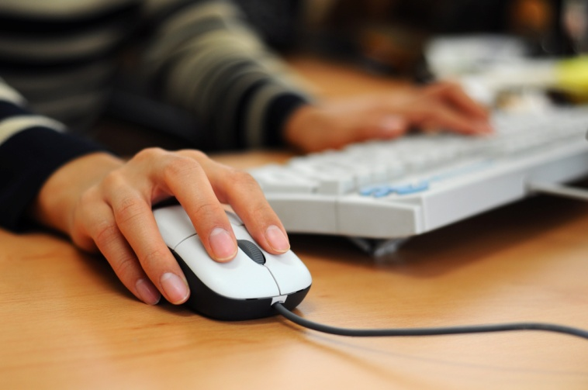
Common Findings:
Desktop Access
“The majority of researchers in all disciplines have adapted readily to the widespread availability of digital content, accessible directly from their desktops.” (CURL, p. 23)
Notes:
Researchers particularly appreciate desktop access to scholarly content, from e-journals to VRS
Researchers and discovery services, 2006
Valuation of the convenience of desktop access
Researchers' use of academic libraries, 2007
Immediate access from desktop computer is taken for granted
Seeking synchronicity, 2008
VRS' convenience is from home computer
Students' use of research content, 2009
Home computer is main way they gain access

Slide 15
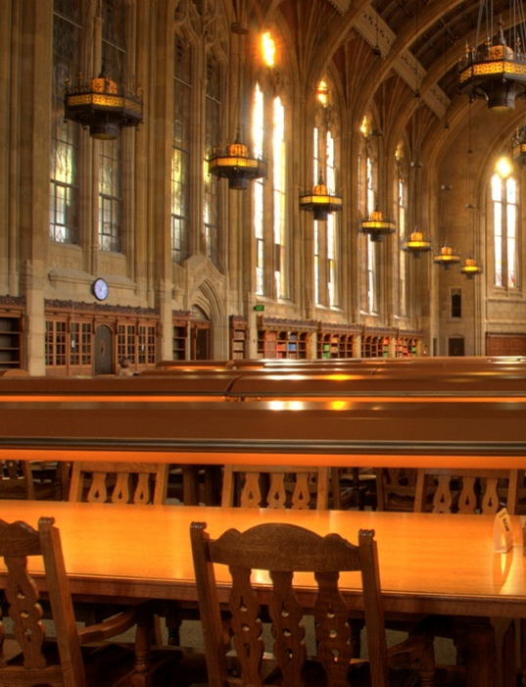
Common Findings:
Convenience over Library
Use library less since began using Internet
Sharp fall in institution’s library visitation
Convenience dictates choice between physical and virtual library
Notes:
Users also appreciate the convenience of electronic access over the physical library, with several studies marking decreased visitation of the library.
College students' perceptions, 2006
Use the library less since they began using the Internet
Researchers' use of academic libraries, 2007
Sharp fall in the number of researchers who visit their institution’s library
Seeking synchronicity, 2008
Convenience often dictates choices between physical and virtual library

Slide 16
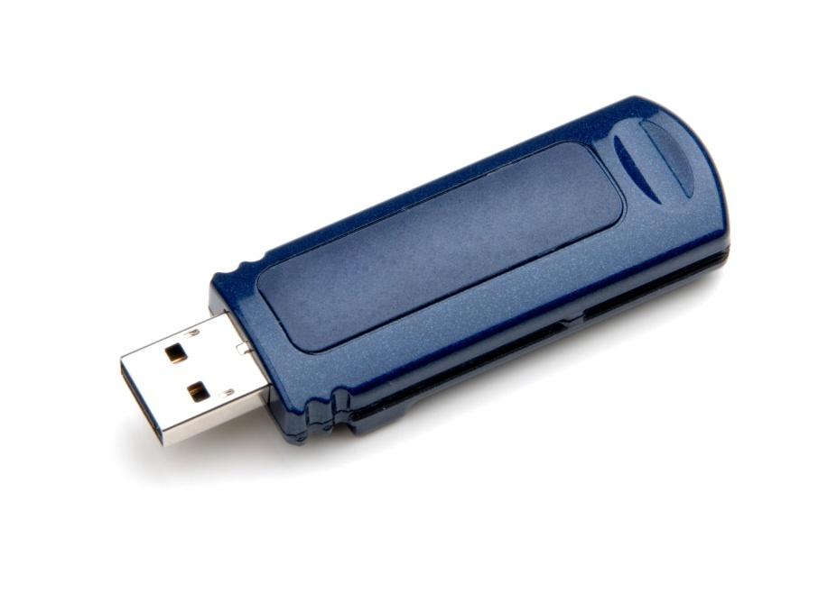
Common Findings:
User Behaviours
Very little time using content
“Squirreling” of downloads
Prefer quick chunks of information
Visit only a few minutes
Use basic search
Notes:
User behaviours in this electronic environment tend toward quick views of a few pages, and “bouncing” between resources. This seems to contradict the notion of the hard-core researcher but supports the need for more user behaviour research addressing situation and context.
Researcher of the future, 2008
Very little time using content, “squirreling” of downloads by academic users
All users preferring quick chunks of information
E-journals, 2009
Users are visiting only a few minutes
User behaviours vary but demonstrate shorter sessions, using basic search, and viewing fewer pages

Slide 17
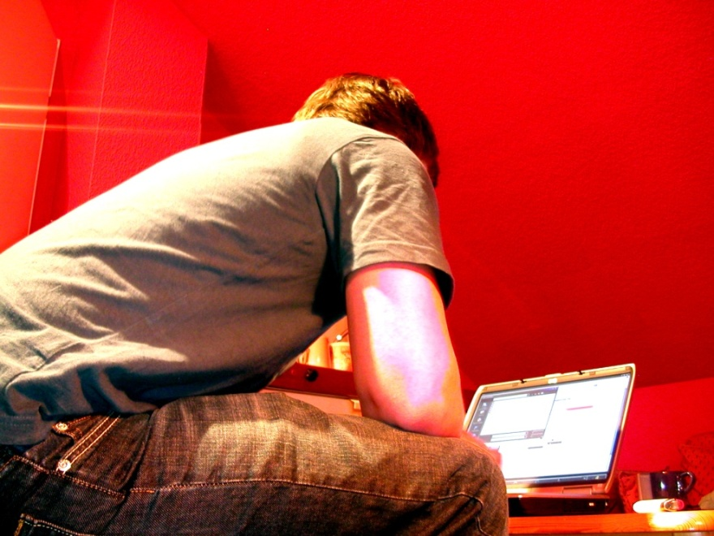
Common Findings:
User Behaviours, cont.
Use snippets from e-books
View only a few pages
Short visits
Simple searching of Google-like interfaces
Power browsing
Notes:
“Make it as easy as a Google Book Search,” one survey respondent requested when discussing the catalogue. (Calhoun et al., p. 14)
JISC national e-books, 2009
Users tend to use e-books quickly, viewing only a few pages
User behaviour in resource discovery, 2009
Users make short visits, with simple searching of Google-like interfaces; power browsing for snippets of information

Slide 18
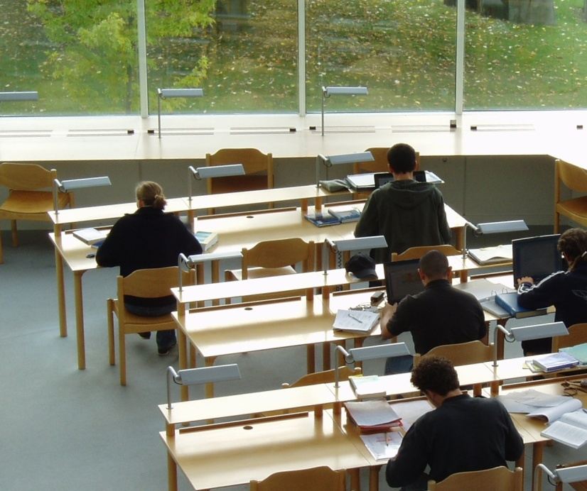
Common Findings:
Enhanced Functionality
Re-envisioning library services and spaces
Irrelevant results
Fear of missing items
Improve usability
Notes:
“Have to actually go to the library Takes a lot of time to search through all the books,” stated an 18-year-old undergraduate from the UK (De Rosa 2006, p. 2-9).
One survey respondent suggested, “I wish the results page would list a short blurb (one line) about the book similar to the way Google shows you a tiny bit about what a site link is about.” (Calhoun et al., p. 17)
Users are beginning to desire enhanced functionality in library systems, to assist in managing large result sets.
Sense-making, 2006
Users re-envision library services and spaces
Researchers and discovery services, 2006
Key problem of irrelevant results and the fear of missing items
User behaviour in resource discovery, 2009
Improve usability of library and publisher systems

Slide 19
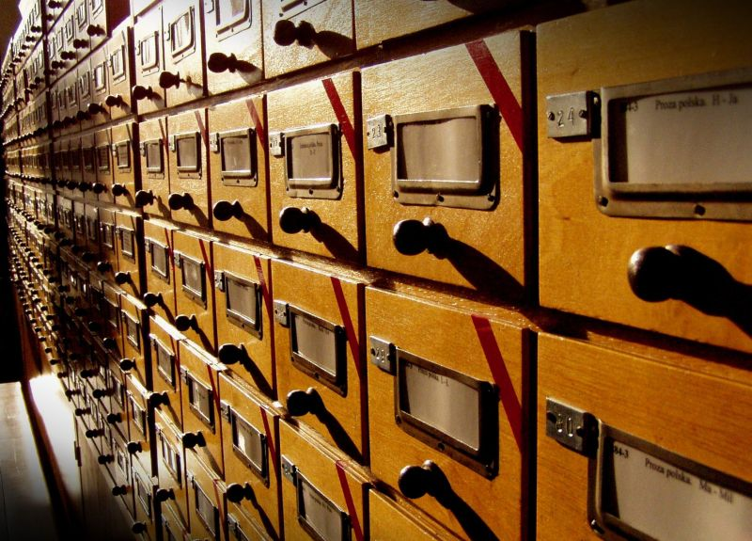
Common Findings:
Enhanced Functionality, cont.
Search results
  Must be obviously relevant
  Must contain helps
Advanced search options help refine searches and manage large results
Mixed reaction to social features
Notes:
Online catalogs, 2009
List of libraries that own the item is essential
Search results must be obviously relevant and contain helps to the user for navigation/evaluation
Advanced search option and facets help end users refine searches and manage large results
Participants offered mixed reaction to social features

Slide 20

Common Findings:
Enhanced Content
Links to online content/full text helpful
Rely on and expect enhanced content
Notes:
Users also desire enhanced content to assist them in evaluating resources.
Online catalogs, 2009
Links to online content/full text was helpful change
End users rely on and expect enhanced content

Slide 21
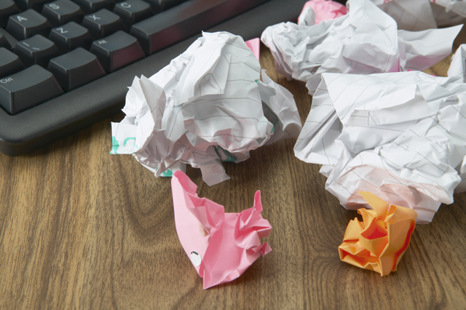
Common Findings:
User Confidence
Satisfied with their search
Trust results the same as results from libraries
Adept at doing searches for personal needs
Self-taught but confident
Notes:
Both professional researchers and younger people do seem generally confident in their own ability to use information discovery tools.
Perceptions of libraries, 2005
Respondents are satisfied with their search; tend to trust results the same as results from libraries
College students’ perceptions, 2006
Students are satisfied with their search
In determining quality, users judge based upon their own knowledge or common sense
Sense-making, 2006
Users are adept at doing searches for personal needs
Researchers and discovery services, 2006
Researchers are self-taught but remain confident in their own skills

Slide 22

Common Findings:
User Confidence, cont.
Big gap between performance and self-estimates
Virtual Reference Services
  Getting answer was cited most often for success
  Relational and content facilitators contributing to perceptions of success
Notes:
Researcher of the future, 2008
Big gap between performance and self-estimates
Seeking synchronicity, 2008
Getting an answer was cited most often for success
A mixture of relational and content facilitators contributing to perceptions of success

Slide 23

Common Findings:
Information Literacy
Estimate quality based on
  Own knowledge
  Common sense
  Institutional reputation
  Cross-checking with other websites
Acknowledge value of databases and other online sources
Notes:
A Social Sciences student, “Some of it [internet information] is interesting but some is waffle.” (Hampton-Reeves et al., p. 39)
Information literacy has not necessarily improved with users’ digital literacy.
Perceptions of libraries, 2005
College students' perceptions, 2006
In determining quality, users judge based upon their own knowledge or common sense, institutional reputation, cross-checking, and recommendations
Cross-checking most often involves other websites
Sense-making, 2006
Participants acknowledge the value of databases and other online sources

Slide 24
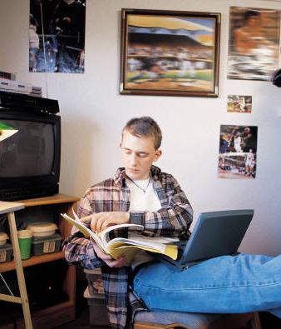
Common Findings:
Information Literacy, cont.
Refine large result list
Low awareness of OA issues
Not expert searchers
Spend little time evaluating search results
Do not find library resources intuitive
Teachers not passing literacy skills to pupils
Notes:
“Digital literacies and information literacies do not go hand in hand.” (CIBER, p. 20)
Researchers and discovery services, 2006
Most common search strategy is refining down from a large list of results
Researchers' use of academic libraries, 2007
Researchers’ awareness of OA issues is low
Researcher of the future, 2008
They are not expert searchers
Tend to spend little time, little effectiveness in evaluating search results; prefer natural-language searching and trust Google; do not find library resources intuitive
Teachers not passing literacy on to the pupils

Slide 25

Common Findings:
Information Literacy, cont.
Assess content based on relevance to assignment
Aware of difference between formal research & basic internet content
Lack information literacy skills
  Not kept pace with digital literacy
Increased use of quality resources with higher level information literacy & domain knowledge
Notes:
Student said, “You can’t trust everything on the internet, anyone can publish something.” (Hampton-Reeves et al., p. 39)
Students’ use of research content, 2009
Users assess content based on its relevance to their assignment
Students are aware of difference between formal research and basic internet content
User behaviour in resource discovery, 2009
Information literacy skills are lacking; they have not kept pace with digital literacy
When level of information literacy and domain knowledge increases, increased use of quality resources

Slide 26
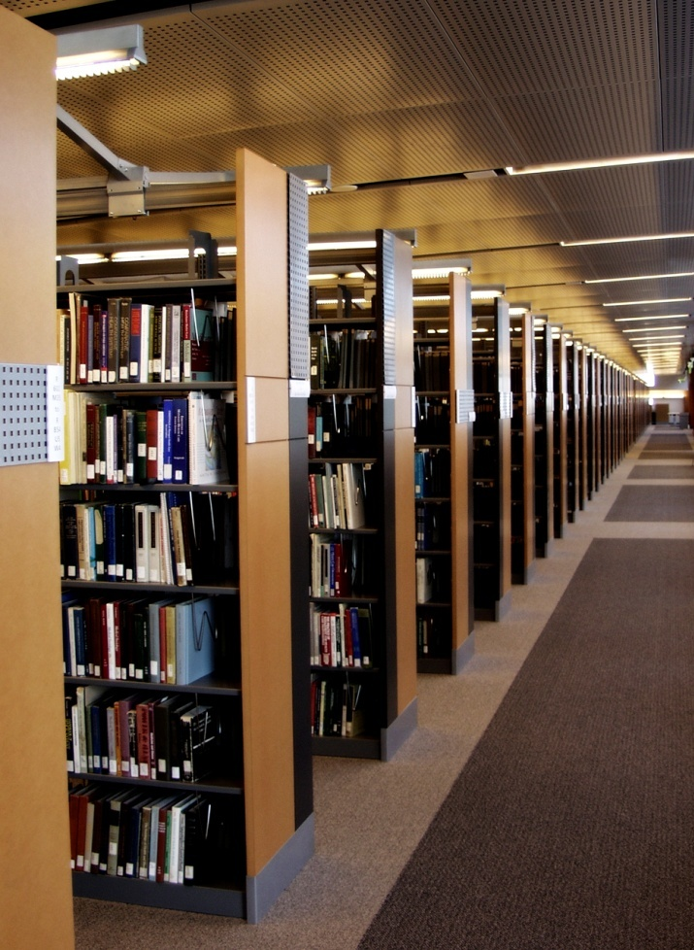
Common Findings:
Metadata
Satisfactory information search
  Quality of information
  “Worthwhile” information
Quality metadata essential for discovery
Inadequately catalogued resources result in underuse
Notes:
One important finding related to this is that high-quality metadata is becoming even more important for discovery of appropriate resources.
Perceptions of libraries, 2005
Quality of information a determinant of satisfactory information search
Other key criteria determining satisfaction include “worthwhile” information
Researchers' use of academic libraries, 2007
Need to provide good metadata
Many resources under-used because inadequately catalogued

Slide 27
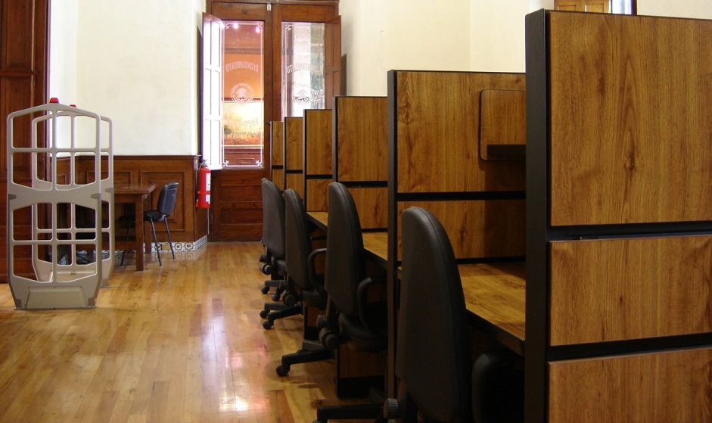
Common Findings:
Metadata, cont.
Library ownership of sources essential data element
Differences exist between the catalogue data quality priorities of users and librarians
Notes:
Online catalogs, 2009
List of libraries that own the item is essential data element
Differences exist between the catalogue data quality priorities of users and librarians

Slide 28
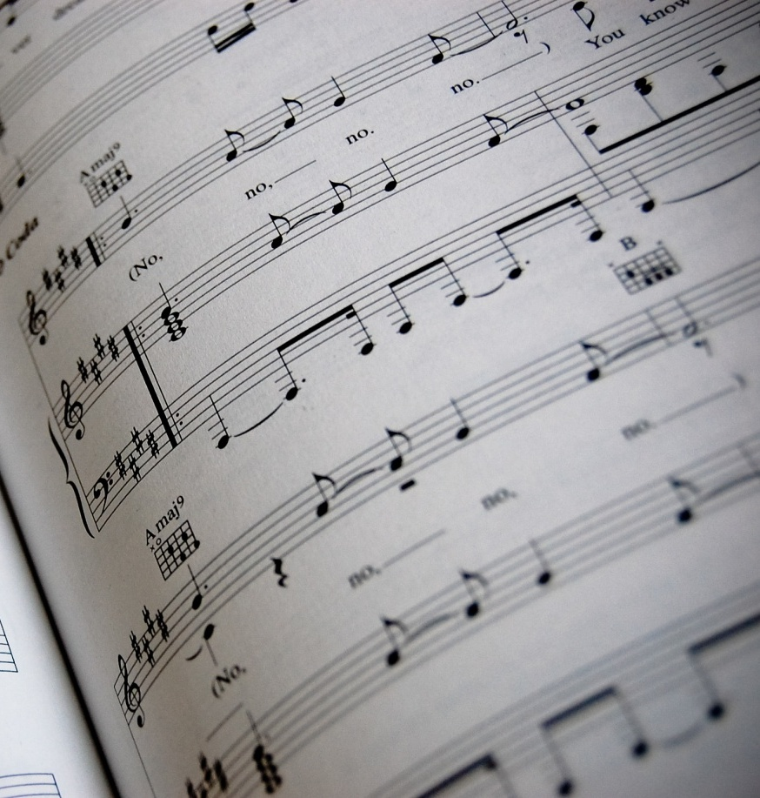
Common Finding:
Digital Content
Desire more digitized sources, including older literature, sheet music, art images
Prefer to have everything available in digital form
Libraries key player in e-book market
Notes:
In several studies, more digital content of all kinds and formats is almost uniformly seen as better.
Sense-making, 2006
Desire more digitized sources, including digitization of older literature, sheet music, art images
Researchers' use of academic libraries, 2007
Respondents would prefer to have everything available in digital form
JISC national e-books, 2009
Libraries are a key player in the market for e-books

Slide 29

Common Finding:
Library as Place
Libraries = Books
Value library as space - Browsing
Homework/study most common library activity
Notes:
A 41-year-old Canadian respondent said, “Books, books, books, rows and rows of books, stacks of books, tables filled with books, people holding books, people checking out books. Libraries are all about books.” (De Rosa 2005, p. 3-31)
People still tend to think of libraries as collections of books; this is evident in several OCLC-sponsored studies of larger populations. They do not think of libraries as providing electronic resources.
Perceptions of libraries, 2005
Libraries viewed as being about books
College students' perceptions, 2006
Most common activity in the physical library is do homework/study
Sense-making, 2006
Users value traditional browsing, praise library as space for information

Slide 30
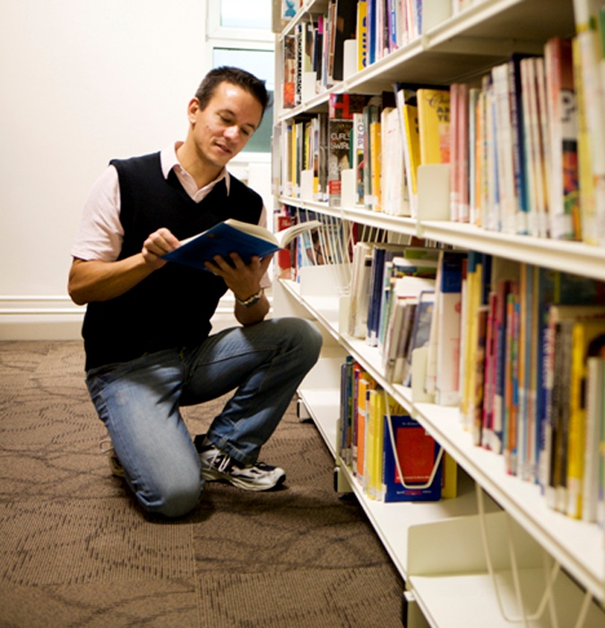
Common Findings:
Library as Place, cont.
Researchers stress importance of library
Satisfied when visit library
Notes:
Researchers' use of academic libraries, 2007
Researchers retain a sense of the importance of the library
Seeking synchronicity, 2008
Those who visit the library continue to experience satisfaction

Slide 31

Common Findings:
Human Resources
Human resources important
  Family
  Friends
  Colleagues
  Teachers/Professors
Notes:
In addition, several studies indicated that despite the increasing prominence of digital research and electronic resources, researchers also value human resources such as colleagues, peers, family, friends, and teachers, in their information-seeking.
Researchers and discovery services, 2006
Colleagues and peers are an important resource
Sense-making, 2006
Human resources (family, friends, colleagues, teachers) very common

Slide 32

No Consensus:
Range of Tools
E-books for leisure or study
Print and e-versions complementary, not substitutes
E-textbooks are valuable back-up
Keyword searches on a mixture of tools
Library catalogue for formal research
Wider variety of sources, subscription and open internet
Notes:
JISC national e-books, 2009
E-books either for leisure or study
Print and e-versions of course texts are complementary, not substitutes
E-textbooks are valuable back-up
Students' use of research content, 2009
Keyword searches on a mixture of tools
The library catalogue
User behaviour in resource discovery, 2009
A wider variety of sources, subscription and the open internet

Slide 33

Mixed Evidence:
Formal Training
High use of both library & electronic sources
OPACs difficult to use
Notes:
There is evidence both in favour and against formal training in electronic searching.
Perceptions of libraries, 2005
Tend to score higher on both library use and electronic source use
Sense-making, 2006
Participants believe that library OPACs are difficult to use
Focus group participants indicated that once a librarian taught them to use a database, etc., and they found relevant information, they always used it even though it was not appropriate to the current, specific information need
Researchers and discovery services, 2006
Researchers tend to be self-taught

Slide 34

Contradictory Finding
Some students prefer library catalogues to search engines for academic assignments
Notes:
From Haptom-Reeves, Students’ use of research content in teaching and learning.
In situations of formal research for these students, this leads them to the library catalogue first and to use it more.

Slide 35
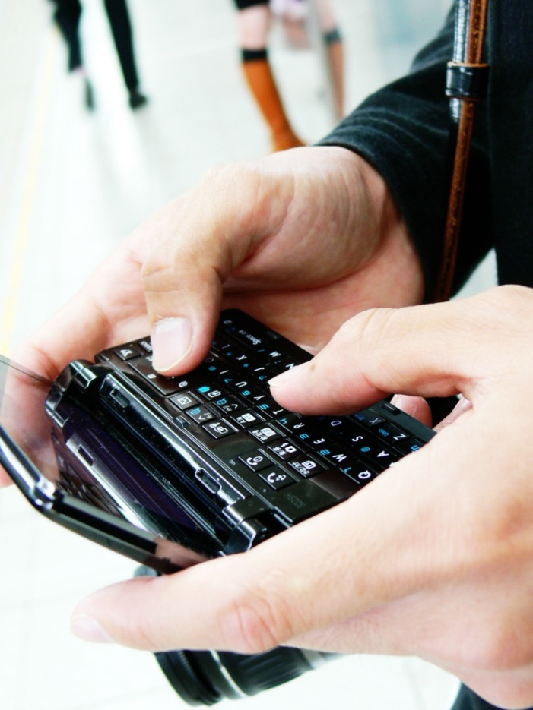
Contradictory Findings:
Range of Tools
Wide variety of information resources
Familiar with different types of resources
Use every type of electronic resource
10% claim library website only resource needed
Notes:
In some cases, the studies reviewed included findings which seem to contradict one another, and for which evidence may be mixed. In terms of the range of tools used in information-seeking, there is evidence for both broad and narrow ranges of tools.
Perceptions of libraries, 2005
A wide variety of information resources
Familiarity with different types of resources
Search engines still dominant
College students' perceptions, 2006
Using every type of electronic resource
10% claimed that the library website was the only resource they needed

Slide 36

Contradictory Findings:
Range of Tools, cont.
Very few sources were found to be unhelpful
Use range of resource discovery tools
  Both general & specialist search engines
  Internal library portals
  Monographs
Notes:
Sense-making, 2006
Very few sources were found to be unhelpful
Researchers and discovery services, 2006
Foreign language materials, multi-author collections, short journal backfiles, specialist search engines
Researchers are using a range of resource discovery tools
General search engines, specialist search engines, and internal library portals; Journal articles; Monographs
Expertise of individuals is also important

Slide 37
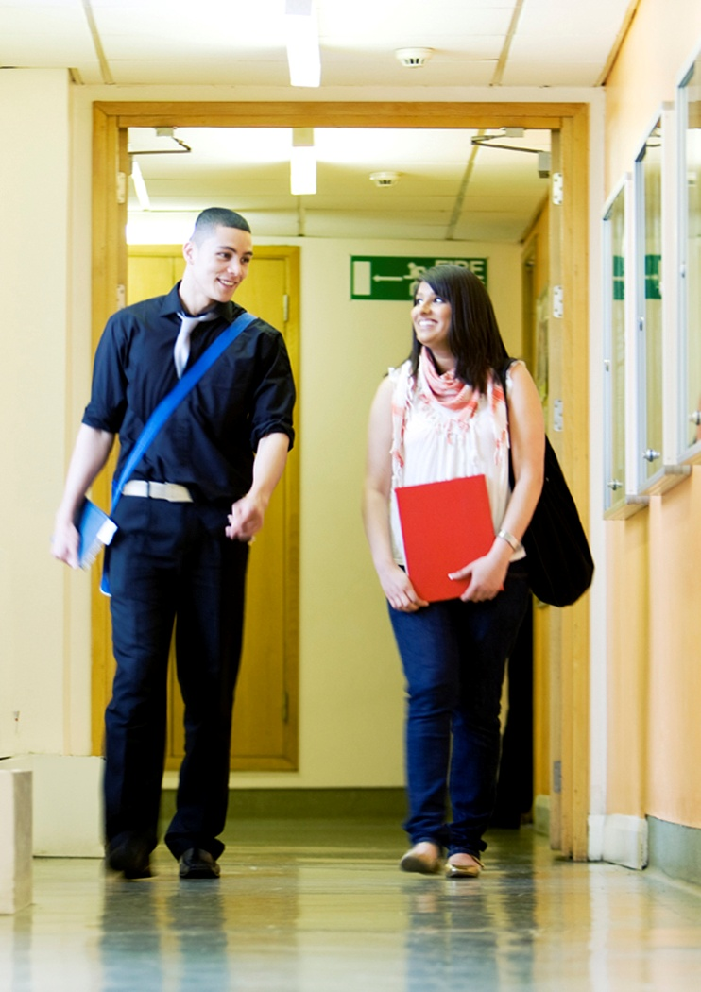
Contradictory Findings:
Formal Training
Librarians believe information literacy teaching will remain a core role
Amateur young searchers over-confident
“Teachable moments” in VRS show librarians engaged in bibliographic instruction
Notes:
Researchers' use of academic libraries, 2007
Librarians believe that information literacy teaching will remain a core role
Researcher of the future, 2008
Amateur young searchers are over-confident
Seeking synchronicity, 2008
“Teachable moments” in transcripts show librarians engaged in bibliographic instruction

Slide 38

Contradictory Findings:
Recommendations and Social Networking
Use recommendations to judge quality
Suggest these enhancements for library systems
Notes:
Several studies addressed the question of whether recommendations, in the form of recommender systems, and social media are having an impact on information seeking, again, with mixed conclusions.
Perceptions of libraries, 2005
In determining quality, 28% of the respondents cited using recommendations
College students' perceptions, 2006
In determining quality, collegiate users more often judge quality based upon credible recommendations (68%)
Sense-making, 2006
Participants also speak of enhancements and changes to the library’s electronic resources

Slide 39

Contradictory Findings:
Recommendations and Social Networking, cont.
Unlikely to participate in social networking features provided by library
Mixed reactions to social features
Little evidence of impact
Notes:
Researcher of the future, 2008
College students are unlikely to participate in social networking features provided by the library
Seeking synchronicity, 2008
Recommendations by peers are an important part of the marketing of VRS
Online catalogs, 2009
Mixed reaction to social features
Students' use of research content, 2009
Little evidence of impact found

Slide 40

Common Preconceptions Exposed
Media claims about “Google generation” may not be supported
Speed may not be the most important factor
Little support for advanced search options in OPACs
Notes:
In a few cases, the above findings from the studies under review offered evidence that runs counter to popular perceptions of the current information scene.
Many popular media claims about the “Google generation” may not be supported by all the evidence.
In choosing among search engines, some evidence indicates that speed may not be the most important evaluative factor.
The studies that addressed library OPACs provide little support for the advanced search options which are still popular in these systems.

Slide 41

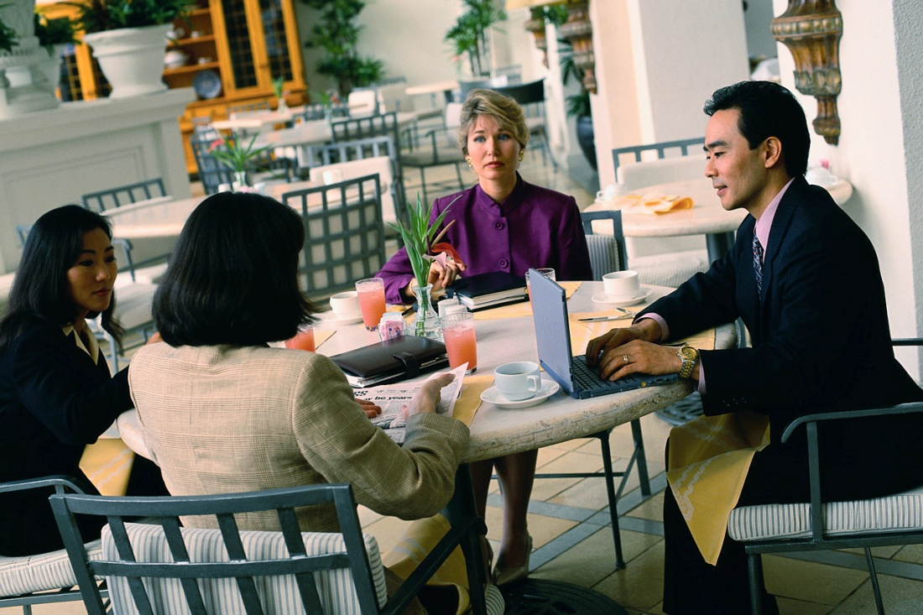
Implications for Libraries
Different constituencies = Different needs and behaviors
Notes:
Implication: Different Constituencies
The library serves many constituencies, with different needs and behaviours.
Researchers and discovery services, 2006
Some disciplinary differences exist
E-journals, 2009
Behaviours vary by discipline
JISC national e-books, 2009
Students’ use varied by discipline
Students’ use of research content, 2009
Students need “more guidance and clarity on how to find research content and on how to assess its worth as well as its relevance.”
User behaviour in resource discovery, 2009
Increase information literacy instruction for users

Slide 42

How Can Librarians Meet User Needs?
Offer different formats and content
Increase digital collections
  Build e-journal collections - good investment
  Provide more e-book content
Enhance electronic resources
Build virtual research environments
Notes:
“Get more copies of current and classic bestsellers, then sell off the books to reduce inventory when they are no longer in as high demand.” (De Rosa 2005, p. 4-7)
Implication: Variety of Resources
Librarians must increasingly consider a greater variety of digital formats and content.
Perceptions of libraries, 2005
Libraries can offer different formats and content
Libraries advised to increase their collections
Sense-making, 2006
Users speak of enhancements and changes to electronic resources
Users blamed the lack of sources
Researchers' use of academic libraries, 2007
Growth in VREs and digital research must be met by librarians

Slide 43

How Can Librarians Meet User Needs?
Improve access to
  Open source materials
  Journal backfiles
  Repositories
Provide seamless access to resources
More direct links
Look/function like search engines/popular web services
Notes:
Digital Information Seekers Briefing Paper
Library systems must do better at providing seamless access to resources such as pull text e-journals, online foreign-language materials, e-books, a variety of electronic publishers’ platforms, and virtual reference desk services.
Library catalogues need to include more direct links to resources and more online content.
Libraries should provide more digital resources of all kinds, from e-journals to curated data sets, as well as emerging services such as virtual research environments (VREs), open source materials, non-text-based and multimedia object, and blogs.
Library systems need to look and function more like search engines (eg., Google) and popular web services (eg. Amazon.com) as these familiar to users who are comfortable and confident in using them.

Slide 44

How Can Librarians Meet User Needs?
Adapt to changing user behaviours
Provide high-quality metadata
Enable power browsing
Offer guidance & clarity for researchers
Advertise library brand
Notes:
Digital Information Seekers Briefing Paper
Library systems must be prepared for changing user behaviours, which include advanced search options, demands for immediate access, and quick perusal of resources.
High-quality metadata is becoming more important for discovery of appropriate resources.
Librarians must now consider the implications of power browsing behaviours.
Students need more guidance and clarity on how to find content and how to assess its worth as well as its relevance.
The library must advertise its brand and its resources better to academics, researchers and students, demonstrating its value clearly and unambiguously.

Slide 45

What Can Librarians Do to
Encourage Use of Library Services?
System development
  Respond to different user preferences
  Personalized interfaces
Emphasize personal service
  Build positive relationships FtF, phone, or online
  Become more e-consumer-friendly
Notes:
Vital if we are going to remain relevant in their universe.
Need to ensure that we have a wide range of options – email, chat, IM, text, ftf, phone, etc.
Dwell on positive – what we CAN do rather than what we CAN’T do

Slide 46

Future Research
Roles of social networking, mobile technology, & texting
How people get information
Why people make their information choices
  Determine whether age is major factor or one of many
How people adopt and use information technology

Slide 47
End Notes
Connaway, L.S., & Dickey, T.J. (2010). Towards a profile of the researcher of today: The digital information seeker: Report of findings from selected OCLC, RIN, and JISC user behavior projects. [Available: http://www.jisc.ac.uk/media/documents/publications/reports/2010/digitalinformationseekerreport.pdf]
Funded by JISC
Project Web Site URL:
  http://www.jisc.ac.uk/publications/reports/2010/digitalinformationseekers.aspx

Slide 48

Questions & Discussion
Lynn Silipigni Connaway
connawal@oclc.org

