Slide 1
Taking Our Pulse
The OCLC Research Survey of Special Collections and Archives
Jackie Dooley
Consulting Archivist
RLG Partnership Annual Meeting
Chicago, June 2010

Slide 2
Agenda
Survey population
Project objectives
Data
A few starter questions
Commentary: Alice Schreyer
Action Items
  … and discussion
What’s next?
Your questions?

Slide 3
Survey population
Libraries surveyed: 275
Rate of response: 61% (169)
Five membership organizations
  ARL
  CARL
  IRLA
  Oberlin
  RLG

Slide 4
Project objectives
Obtain current data to determine changes across the ARL libraries since 1998
Expand ARL’s survey population to include four additional membership organizations
Enable institutions to place themselves in the context of norms across the community
Provide data to support decision making and priority setting
Make recommendations based on survey results

Slide 5
Data

Slide 6
What’s wrong with this picture?
Overall collections size is growing … a lot
Too many materials remain “hidden”
Some backlogs continue to grow
Staffing is not increasing
75% of library budgets have been cut

Slide 7
“Your three most challenging issues” **
  Space
  Born-digital materials
  Digitization
** Money and staffing were disallowed.

Slide 8
Collections
Acquisitions
  57% of books are purchased
    50/50 institutional and special funds
  20% of archival formats are purchased
Lots of new collecting directions
  #1 reason: gift
  #2 reason: new institutional direction
Cooperative collection development
  Most is informal, regional
  Very few formal arrangements
Preservation: audiovisual materials “code blue”

Slide 9
User services
Use of all formats has increased
  Archives and manuscripts: 88%
  Visual materials: 76%
  Books: 50%
Number of users
  Mean: 4,200
  Median: 1,500
Access to materials in backlogs: 90%
Interlibrary loan
  Loan of reproductions of originals: 44%
  Loan of original rare books: 38%

Slide 10
Cataloging and metadata
Online catalog records
  Books: 85%
  Maps: 42%
  Archival formats: 50% or less
Archival finding aids
  Online: 44%
  Print-only or in local silos: 30%
Backlogs
  Decreased: more than 50%
  Increased: 25-40%

Slide 11
Archival collections management
Simplified processing techniques: 75%
Finding aids tools are not standardized
Institutional archives
  Reports to library: 87%
  Responsible for records management: 70%

Slide 12
Digital special collections
Digitization
  One or more projects completed: 78%
  Large-scale project completed: 38%
  Content licensed to commercial firms: 26%
Born-digital archival materials
  Undercollected
  Undercounted
  Undermanaged
  Inaccessible

Slide 13
Staffing
No change in FTE is the norm, except:
  Technology and digital services: increased
  Public services: biggest decrease
Retirements expected within five years: 9%
Top four educational needs
  Born-digital materials
  Information technology
  Intellectual property
  Cataloging and metadata
Multiple special collections units/depts: 25%

Slide 14
A Few Starter Questions

Slide 15
Is dramatic growth of collections sustainable? If not, what should change?
Why are formal collaborative collection development partnerships still so rare?
Why are so many backlogs continuing to increase?
Why hasn’t the emphasis on sustainable methodologies had more payoff?

Slide 16
Does the level of use of special collections justify the resources being expended?
What is the nature of the large-scale digitization projects?
What would best help us to make progress with born-digital archival materials more quickly?

Slide 17
And now ….
Commentary
Alice Schreyer
Director
Special Collections Research Center
University of Chicago Library

Slide 18
Action Items
(trial balloon version)

Slide 19
Big picture
Challenge your institution, membership organizations, and professional societies to engage with the issues raised and decide for which ones to become responsible.
Develop and promulgate metrics to enable standardized measurement of collections, use, metadata, and other key elements of special collections management.

Slide 20
Collections
Develop best practices for collaborative collection development. Identify barriers. Define key characteristics and desired outcomes of an effective collaboration.
Take collective action to establish shared facilities for cost-effective preservation of audiovisual materials.

Slide 21
User services
Develop best practices for access policies that facilitate rather than inhibit the use of rare and unique materials.
Develop best practices that will facilitate rather than inhibit interlibrary loan of special collections materials.

Slide 22
Cataloging and metadata
Design and implement collaborative projects to decrease important backlogs of cartographic and audiovisual materials.
Aggregate and disseminate a slate of replicable, sustainable methodologies for cataloging and processing of special collections. Draw on those already developed by CLIR “hidden collections” grantees and others.

Slide 23
Archival collections management
Convert legacy finding aids, using inexpensive methodology, to enable Internet access.
  Do not upgrade or expand the data prior to conversion.
  Use PDF or another simple technology to convert print-only finding aids.
  Develop generic tools to facilitate conversion from local databases.

Slide 24
Digitization
Determine the scope of the existing corpus of digitized rare books that have open-source access. Identify the most important gaps and implement collaborative projects to rectify.
Develop models for large-scale digitization of special collections, including methodologies for selection of appropriate collections, security and safe handling, sustainable approaches to metadata creation, and ambitious productivity levels.

Slide 25
Born-digital archival materials
Define the characteristics of born-digital materials that warrant management as “special collections.”
Determine why/whether/when the skills held by special collections librarians and archivists are necessary for essential activities such as:
  identifying materials of permanent value
  negotiating ownership
  resolving legal issues
  identifying any restrictions
  establishing context
  ensuring authenticity
  determining any necessary organization of files
  creating collective metadata

Slide 26
Born-digital archival materials
Document a reasonable set of basic steps for initiating an institutional program for responsibly selecting, acquiring, accessioning, describing, managing, and securely maintaining born-digital archival materials.
Develop generic use cases and cost models for selection, management, and preservation of archival born-digital materials.

Slide 27
Education and training
Utilize professional guidelines for core competencies to identify key areas in which education and training are not adequate. Exert pressure on appropriate organizations to provide it.

Slide 28
Discussion of action items
Which ones are important?
Which ones aren’t?
What’s missing?
Who should do what?
  Which ones should OCLC Research do on your behalf?

Slide 29
What’s next?
Seminar @ RBMS: next week
Publication: July
Webinar: July/August

Slide 30
Your questions?

Slide 31
Next up
Lunch, and then…
1:00
Framing Libraries and the Environment
Lorcan Dempsey, OCLC Research
Buckingham

Slide 32
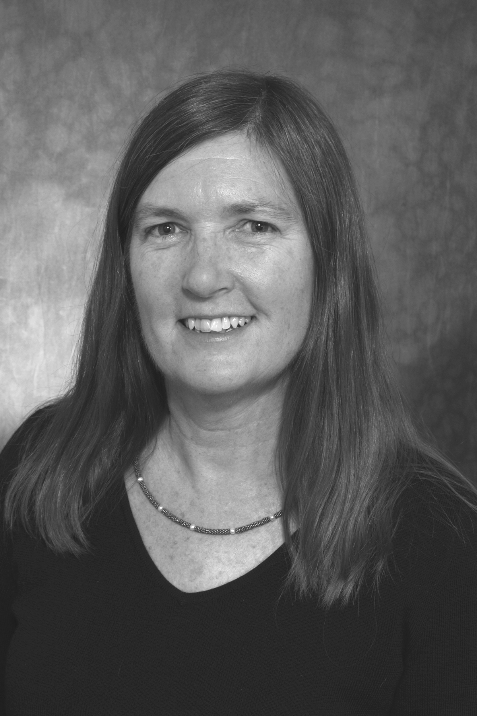
Thank you!
Jackie Dooley
dooleyj@oclc.org

