Slide 1
What are virtual researchers up to? VREs and their users
Meeting the Needs of Tomorrow’s Researchers: Messages for Institutions
  Lynn Silipigni Connaway, Ph.D.
  Senior Research Scientist
  OCLC Research
Technology: At the Heart of Education and Research
JISC Conference
13 April 2010
Notes:
1

Slide 2
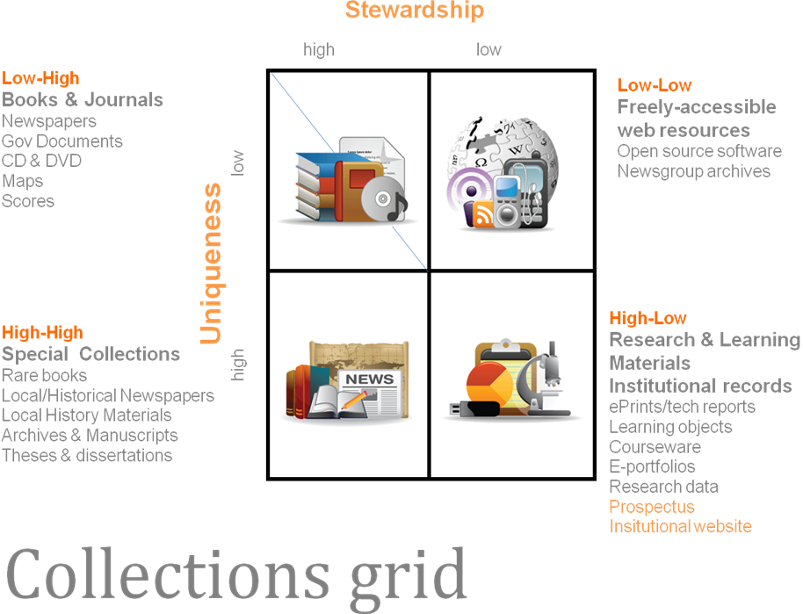
Changing Patterns of Library Investment
Notes:
This short briefing provides some context for the above remark by outlining a variety of materials types using the grid. It breaks down ‘locally-curated digital and special collections’ and relates it to the traditional bought and licensed material in a general pattern. It is provided as background for discussion and does not propose OCLC positions at this stage.

Slide 3

Research Goals
Evaluate JISC-funded virtual research environment (VRE) and digital repository projects
  Goal to develop products and technologies
Develop portrait of virtual researcher
Notes:
Determine if there is sufficient evidence from JISC-funded virtual research environment (VRE) and digital repository projects to develop a portrait of the virtual researcher in the current virtual environment. The focus was not to identify specific user behaviors, but to develop products and technologies to embed into the workflows of scholars within specific disciplines.
No conscientious effort to query large random sample of scholars within different disciplines. There wasn’t enough empirical data to develop a portrait of the virtual researcher using the evidence from these projects. However, after interviewing and reviewing interview transcripts of 4 digital repository project managers and 7 VRE project managers, as well as reviewing of project reports, papers, presentations, and collected data, some common themes have emerged.
3

Slide 4
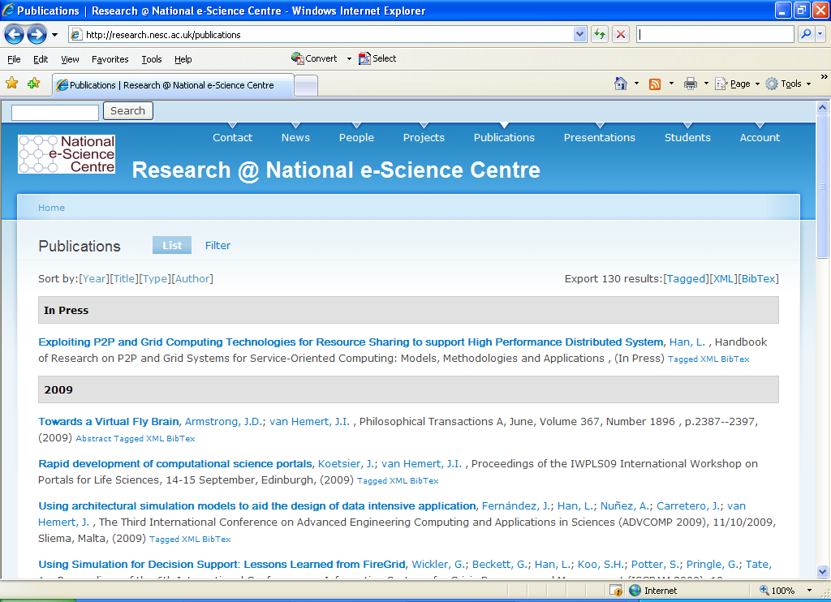
Notes:
Institutional repositories are a bit more common in today’s academia, but…
[Example is the repository Boon Low and Lorraine Patterson are studying. It began in April 2009]
National e-Science Centre, based at School of Physics and Astronomy, University of Edinburgh
JISC funded-project is to “enhance the digital library,” especially the user interface
Project will incorporate social networking into the repository, to encourage greater use

Slide 5
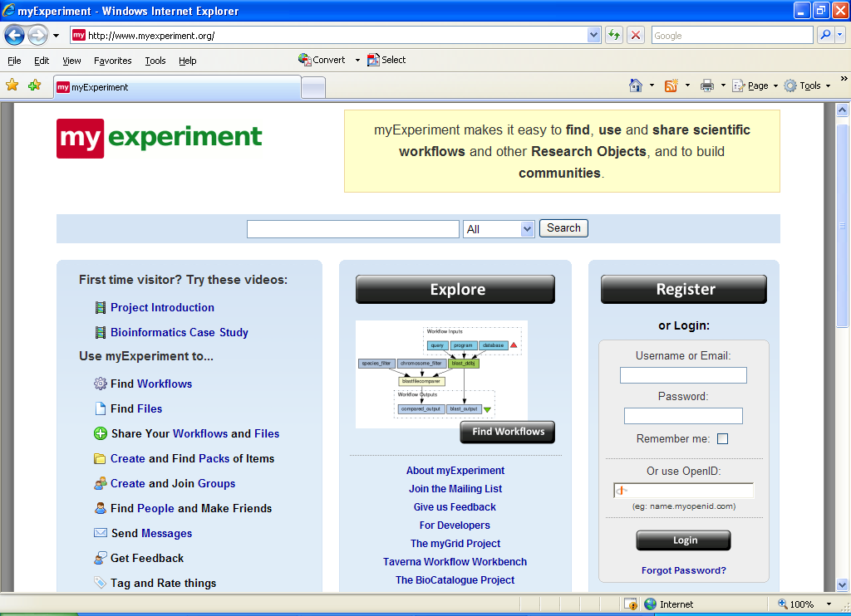
Notes:
Virtual Research Environments (VREs) are rarer in many disciplines.
MyExperiment.org is:
a social networking site for scientists, where they can collaborate and – especially – share ideas for experimental workflows with others in their own or related disciplines.
Begun as a “MySpace for scientists”
Specific users are users of Taverna software, in use by life sciences researchers
Scientists exchange methods, rather than data
They also can share powerpoint slides and data logs

Slide 6
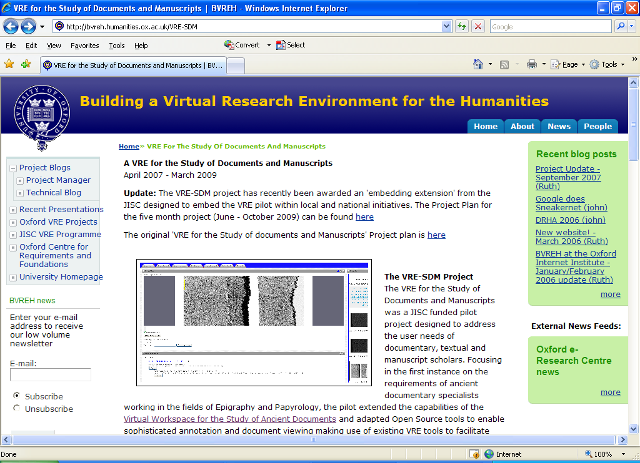
Notes:
VRE for the Study of documents and manuscripts at Oxford
A personalized and collaborative workspace for working with digital images of papyri and other ancient manuscripts
Includes the capacity to
annotate,
search language reference tools (gazetteers, dictionaries, lexographies), and
compare other manuscript sources.
Designed for a small community of specialists, who are digitizing, analyzing, and transcribing ancient documents.
The version includes the ability to share annotated documents among dispersed scholars.
VERY SPECIFIC TO THE DISCIPLINE.

Slide 7
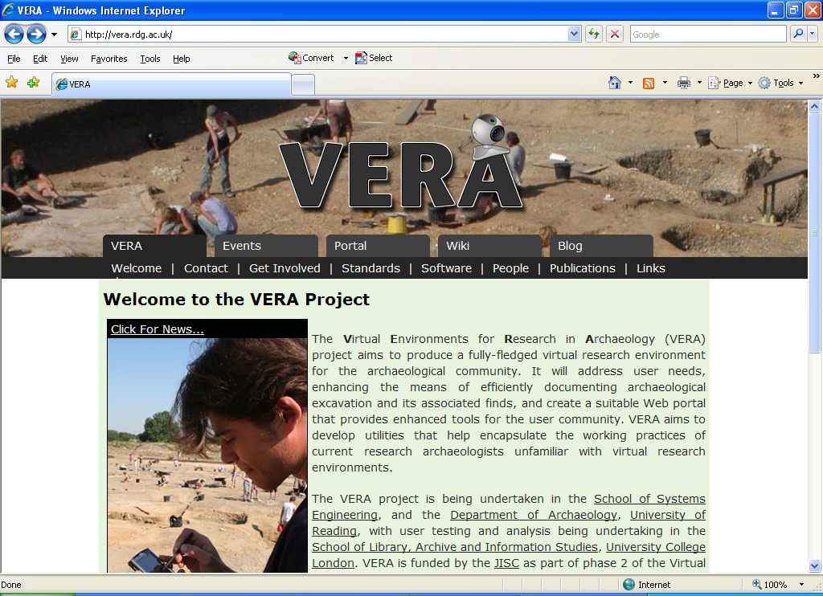
Notes:
Virtual Environments for Research in Archaeology (VERA) project, University of Reading
Builds on prior JISC project: “Silchester Roman Town” a research and training expedition to the archaeological site
VERA project is embedding IT into the archaeological research process
Provides training and digital devices for the on-site recording of finds at the dig
All finds are thus brought into a database, with coordinates and metadata for immediate study

Slide 8
Project Managers’ Perceptions
Scientists more apt to already use digital repository or VRE systems
Those in other disciplines less inclined to use
Need evidence of benefits
Notes:
Most of the project managers believed that scholars in the science disciplines were more apt to already be using some type of digital repository and VRE systems. They believed those in other disciplines were less inclined to be involved in these activities. They needed more encouragement and evidence that involvement will benefit them.
8

Slide 9
Project Managers’ Perceptions
Attitudes toward adoption vary
  Age
  Discipline
  Years of Experience
Notes:
There were several major themes expressed. The scholars’ attitudes toward adoption and integration of VREs and digital repositories into their workflows will likely vary by age, discipline and years of experience.
9

Slide 10
Project Managers’ Perceptions
Critical factors
  Ease of use
  Embed into workflows
Difficult to accomplish
Reluctant to use new technologies
  Time consuming to learn
  Do not know they exist
Notes:
Ease of use and the need to embed the systems into the scholars’ workflows are critical, yet can be difficult to accomplish. The scholars were reluctant to use new technologies not because they were not interested in these new technologies, but because it would take time to learn the new systems and processes. The scholars stated they did not have the time to input data and materials into the systems.
10

Slide 11

Project Managers’ Perceptions
Concern about privacy
Want to limit shared data
  Different levels of access
Need to create a safe environment for researchers
Notes:
The scholars expressed concerns about privacy and limiting the data that are shared. One of the digital repository project managers stated, “The concept of a safe environment as far as security on the web was an issue. If we were going to set up a social network, we would need to create a safe environment, which was very important to the researchers.”
RIN, Patterns of information use and exchange: case studies of researchers in the life sciences, Nov. 2009
“…individual researchers wish to chose what to share, with whom, and when.” Executive summary
11

Slide 12
Project Managers’ Perceptions
Very little knowledge of repositories
Need for advocacy, promotion, publicity and marketing
Notes:
Most of the project managers stressed the need for advocacy, promotion, publicity, and marketing of the systems to the scholars. One of the project mangers said, “Many interviewees had very little knowledge of the repositories;” another echoed with, “They had very low levels of awareness of what we are offering.”
RIN, Patterns of information use and exchange: case studies of researchers in the life sciences, Nov. 2009
“Most of them [researchers] have very little contact with institutional library and information services.” Executive summary
12

Slide 13
Project Managers’ Perceptions
Need to identify benefits
  Access
  Easier dissemination
  Broader exposure – greater impact
  Greater workflow efficiency
Notes:
This promotion and publicity should identify how and why the systems can provide greater access and easier dissemination of research. Since the research has a broader exposure, it can generate more citations, which can mean a greater impact for the work. The systems also have the potential to increase the efficiency of the workflow by providing a centralized management system for sharing research data, materials, results, and outputs.
13

Slide 14
Common Themes:
Digital Repository Projects
Lack understanding
  Copyright issues
  Publisher and publication agreements
  Dissemination agreements
Need for better document management
Notes:
Most of the digital repository project managers said the scholars lacked an understanding of copyright and the issues of copyright compliance. Many of the scholars did not understand or could not remember or retrieve the agreements that were signed with publishers for the publication and dissemination of their work.
The scholars who participated in the Personal Engagement with Repositories through Social Networking Applications (PERSoNA) project were asked to describe how they used the web for research and teaching. “People talked about data bases specific to their discipline and view these as authoritative resources. They would do a Google search to find academic papers, etc. before they went to databases… Almost all said that they came across resources that they could not access. So issues came up with open access to research and copyright.” (Quoted from one of the project members)
There was consensus among the digital repository managers that there is a need for better management of scholarly documents. One of the digital repository project managers stated, “The open access goal is altruistic. The stake holders for the resource management emerged as the project went on.”
14

Slide 15
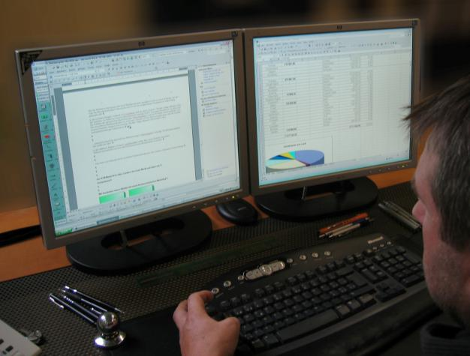
Common Themes:
Digital Repository Projects
Distrust open web
Need accurate metadata
Want safe environment
Need better feedback from users to developers
Notes:
Having accurate metadata associated with the documents is very important to the scholars. They often did not have the time to provide accurate metadata for their papers in the digital repositories; therefore, this creates a need for more accurate and consistent processes for including and adding accurate metadata. Some of the scholars expressed a distrust of the open web and identified a need for a safe online environment. The digital repository project managers also mentioned the need for better feedback from the users of the system to the developers of the system.
Librarians not only need to be embedded in the process but also involved as the catalyst for strategic planning.
RIN, Patterns of information use and exchange: case studies of researchers in the life sciences, Nov. 2009
“…the groups…express a strong desire for information support, located close to them and if possible closely integrated with research teams and laboratories.” Executive summary
15

Slide 16

Common Themes:
VRE Projects
Use different language
Express things in different ways
Language used by developers and researchers at the different academic levels is different
Still able to discuss between different groups
Notes:
The ENGage project managers learned that that the language used by developers, researchers at the Ph.D. and associate levels, and researchers at the professor level is different.
RIN, Patterns of information use and exchange: case studies of researchers in the life sciences, Nov. 2009
“Differences in the intensity and character of the information practices we found within research groups reflect divisions of labour, expertise, and responsibility.” Executive summary
They use different language and express some things in a different way, but that still can be discussed between the different groups.
Model of interaction between research developers and bioscientists. The project based on a regular cooperation between the bioscience and computer science team. The project consortium included bioscientists who knew enough computing to act as a bridge between the two teams and would strongly recommend that in future projects such personnel are incorporated into early discussion of the problem. Even having these bioscientists, at first, it took time to transfer the ideas we had into workflows and to understand the system constraints. Both teams realised early on that in each others fields we are novices and often we do not speak the same language. Nevertheless, by discussing what we actually wanted and hearing explanations of the constraints and possibilities made use of in future work led us to form a cohesive working group. [From the evaluation on the NGS PGRADE portal in biosciences.]
16

Slide 17
Common Themes:
VRE Projects
Confusion about varying requirements of data security
Social scientists
  Private or constrained data
Scientists
  No private data
Health Sciences Researchers
  Need secure system
    Delicate nature of data
Notes:
The project identified that there still is “confusion about the varying requirements of data security between social scientist and sciences. Social science researchers need processing of private or constrained data. Science does not have these private data.”
17

Slide 18
Common Themes:
VRE Projects
Bioinformatics Researchers
  No concerns with sharing
  Open professional culture
Notes:
Sharing of data and procedures was not an issue with bioinformatics researchers. Anecdotal evidence claims they enjoy an open professional culture. However, there are different attitudes within different subcultures.
RIN, Patterns of information use and exchange: case studies of researchers in the life sciences, Nov. 2009
“There are marked differences in the patterns of information use and exchange both within and between different groups of life science researchers.” Executive summary

Slide 19
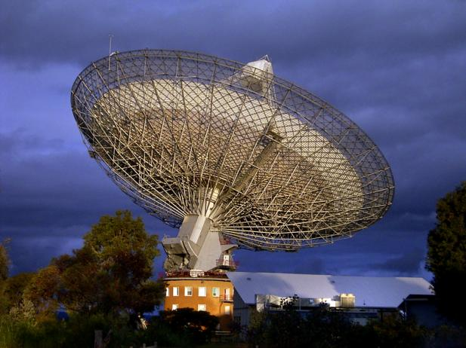
Common Themes:
VRE Projects
Astronomers
Community agreement
    First 6 months
      Data belong to individual or group
    After 6 months
      Data are open to others
Notes:
Astronomers have an agreement in place within the community that for six months the data belong to the individual or group but after six months the data are open to others.
19

Slide 20
Common Themes:
VRE Projects
Chemists
Very interested in community hierarchy
  Ph.D. supervisors want access to what
    those beneath them access
    Ph.D. students are doing
Notes:
Chemists were very interested in the community hierarchy. They demanded that Ph.D. supervisors always have access to what people beneath them could access and that they had access to everything the people beneath them (Ph.D. students) were doing.
20

Slide 21
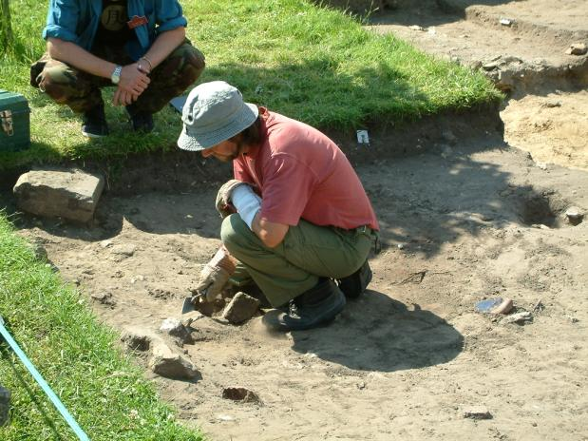
Common Themes:
VRE Projects
Users’ age is factor in adopting new systems and technologies
Archeology faculty and students were provided different electronic devices
Notes:
Age also is a factor in adopting new technologies, systems, and tools. The VRE in Archaeology project provided different electronic devices for the project participants to use for their work on archaeological digs.
21

Slide 22
Common Themes:
VRE Projects
“The students had been using different devices, such as MP3 players, text messaging on mobile phones, etc. and quickly adopted the devices. The professors were older and reluctant to use these devices.”
Notes:
A project member said, “The students had been using different devices, such as MP3 players, text messaging on mobile phones, etc. and quickly adopted the devices. The professors were older and reluctant to use these devices.” The professors became more invested in using these devices after the project team worked with them to demonstrate the benefits of using the devices to work more efficiently.
22

Slide 23

Common Themes:
VRE Projects
Twittering during meetings was very popular with computer scientists
Notes:
CREW conducted several meetings with both social scientists and scientists and provided a twitter-type system for the attendees, which enabled them to tweet during a meeting. “It was very popular with the scientists (computer science)…”
23

Slide 24

Common Themes:
VRE Projects
Initial difficulty engaging some scholars in VRE chat sessions, blogs, social networks
Notes:
Some of the project managers believe the science and mathematics scholars involved in the VRE projects were more apt to use the software and systems than the humanities scholars who participated in the projects. There also was discussion about the initial difficulty associated with engaging some scholars in the VRE chat sessions, blogs, and social networks and communities.
24

Slide 25
Common Themes:
VRE Projects
Social scientists
Left laptops in hotel
Provided loaner laptops at sessions
  Still reluctant to open laptops during sessions
Notes:
“…Social scientists were reluctant to open their laptops during sessions and left their laptops in their hotel rooms. We began providing loaner laptops to social scientists at the sessions. They were very different cultures.”
25

Slide 26
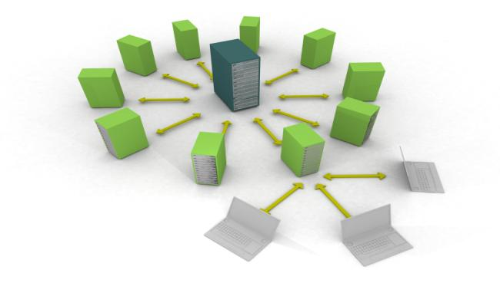
Common Themes:
VRE Projects
Different levels of need between disciplines
“Some domains could use the infrastructure more than others…
  all believe the sustainability is important…
  they do not agree who should be responsible for the sustainability or who should pay for it.”
Notes:
There are different levels of need between the disciplines for the infrastructure. The project manager stated, “Some domains could use the infrastructure more than others. There also are varying attitudes to what is desired in longer term sustainability of software that people use. Both the developers and end users of the software wish for the software to be maintained. All are working within the academic environment and all believe sustainability is important. However, they do not agree who should be responsible for the sustainability of the software or who should pay for it”
26

Slide 27
Common Themes:
VRE Projects
Time constraints for different types of people involved in project were very different
Notes:
They also found that time constraints on the different types of people involved in the project were very different.
Developers and researchers need large blocks of times to write code and analyze data and write papers – cannot stop for several hours in the middle of work to meet
Developers often had responsibilities to the institution or organization and could not make VRE project a priority
Difficulty scheduling time with researchers and developers for interviews and meetings was a common theme for most VRE projects. One project manager stated, “It was difficult to get time from some of the people because of teaching and marking commitments. We had difficulty getting time with developers who had different blocks of time based on projects. It also was difficult to get time with the IT service providers within institutions; therefore, it was very important to get institutional buy-in. We had to raise the level of these projects and identify the benefits the IT providers (computing services) would get from the project, which was very difficult.”
27

Slide 28
Conclusions
Is there a difference between VREs and digital repositories?
  Should there be a difference?

Slide 29
Conclusions
Attitudes vary
  Demographics
    Age
    Discipline
    Years of Experience
No time to learn or add processes to current workflows
Technology
  Needs to be easy to use
  Embedded in workflows
Notes:
Although it was not possible to develop a portrait of the scholar in the current virtual research environment, common themes can be identified from the data collected from the digital repository and VRE interviews and the review of the project data. These findings can be the catalyst for improving digital repositories and VREs as well as for future research in the adoption and use of these tools and systems.
Whether discussing digital repositories or VREs, the scholars want the software and technology to be easy to use and to be embedded in their workflows. They do not have time to learn new software and systems, nor do they have time to add processes to their current workflows. Attitudes toward the adoption of the systems vary by demographics, such as age, discipline, etc. However, some scholars do come to understand the benefits these systems offer them in terms of increased efficiency and better sharing and dissemination of their work.
One the project managers stated, “The technologies enabled the researcher to work faster, not necessarily to work better.”
29

Slide 30
Conclusions
Systems need to allow for varying levels of sharing
  Thoughts
  Ideas
  Data
  Reports
  Formal Papers
Notes:
The systems and software need to allow for varying levels of sharing, whether it is thoughts, ideas, workflows, data, reports, or formal papers.
30

Slide 31
Conclusions
Not all disciplines and researchers want to share all with everyone
Privacy and copyright - important and misunderstood
Notes:
The disciplinary differences in adoption level and buy-in recurred throughout the JISC evaluations. Does this mean that VREs will not be accepted in some entire disciplines? Perhaps, but the projects do include some in the social sciences and humanities. It may instead be the case that technology merely offers different disciplines different opportunities.
Privacy and copyright also are important to scholars working in the virtual environment.

Slide 32
Conclusions
Institutional buy-in
Promote systems
  Simplify workflows
  Wide dissemination of work
Notes:
The project managers of the digital repository and VRE projects expressed a need for promoting the systems and for making the scholars aware of how the systems and tools can simplify their workflows and more widely disseminate their work.
ADVOCACY!

Slide 33
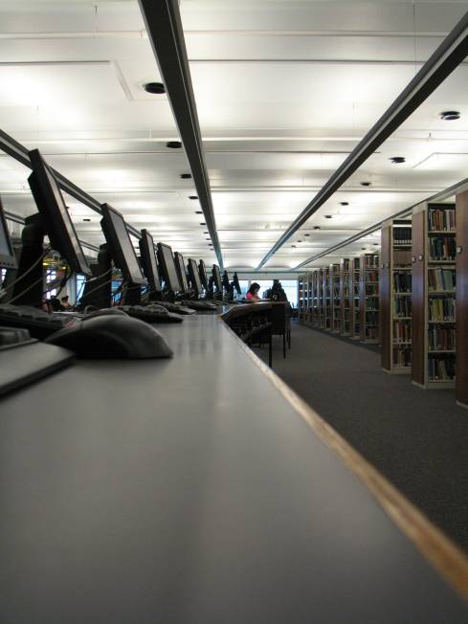
Effective VREs and Digital Repositories
Scholars
  Know about services and systems
  Aware of benefits
Dialogue between information professionals and research communities
Information professionals
  Involved in policy development
  Lead creation and maintenance of metadata
Notes:
The DSpace institutional repository at MIT has been quite successful. Fedora (Flexible Extensible Digital Object Repository Architecture) and DSpace merged May 12, 2009 and formed a new organization called DuraSpace. This is attributed to the librarians who are responsible for the creation and maintenance of the metadata associated with the digital repository as well as involved in policy development. In order to adopt these services, scholars must know there are advantages for them – either for making their work processes more efficient or for the dissemination and access of relevant information sources.

Slide 34
Questions & Discussion
Lynn Silipigni Connaway, Ph.D.
connawal@oclc.org

