Slide 1
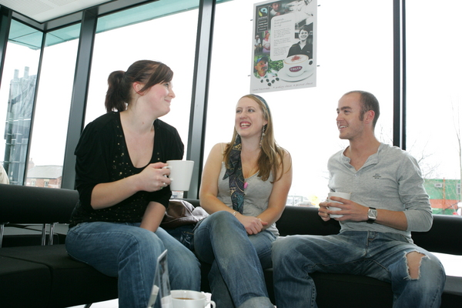
Visitors and Residents: What Motivates Engagement with the Digital Information Environment?
Lynn Silipigni Connaway, Ph.D.
Senior Research Scientist
OCLC Research
David White
Co-Manager Technology Assisted Lifelong Learning
University of Oxford
Donna Lanclos, Ph.D.
Associate Professor for Anthropological Research
University of North Carolina, Charlotte

Slide 2
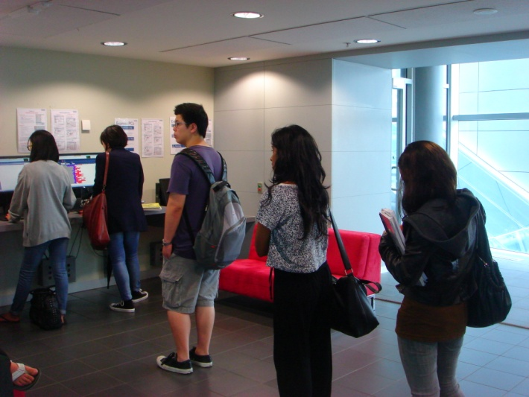
“I think that lots of like companies and people away from my generation think that we rely and we’re obsessed with gadgets and gizmos and everybody has to buy the newest iPhone and iPad and newest everything. At the end of the day, as a student, are you really know is that is what the internet is for. How you get to it – it doesn’t matter if you don’t own a computer and you have to come to the library to use it. Um…like it’s available to you and you don’t care like how you get it.”
(WorldCat.org Focus Group Interview UKU4th year university student)
Notes:
Devices are the connection – US and UK
2

Slide 3

“Perfect thing, I think it would be that all the useful, accurate, reliable information would like glow a different colour or something so I could tell without wasting my time going through all of them”
(Participant UKS2)
CC: konradfoerstner http://www.flickr.com/photos/konradfoerstner/4168966589/
Notes:
3

Slide 4

“…a lot of the times teachers say don’t use .com or don’t use Wikipedia, they like hate when we use Wikipedia. But Wikipedia is always right, so I always use that.” (Participant USU6)

Slide 5

“The problem with Wikipedia is it’s too easy. You can go to Wikipedia, you can get an answer, you don’t actually learn anything, you just get an answer.”
(Participant USU6 quoting a tutor)
CC Aunt Owwee http://www.flickr.com/photos/aunto/1045796179/
Notes:
5

Slide 6


Information Literacy
Skills lacking
Not kept pace with digital literacy
Researchers self-taught & confident
Notes:
“Digital literacies and information literacies do not go hand in hand.”
Centre for Information Behaviour and the Evaluation of Research. 2008. Information behaviour of the researcher of the future: A CIBER briefing paper. London: CIBER, p. 20

Slide 7
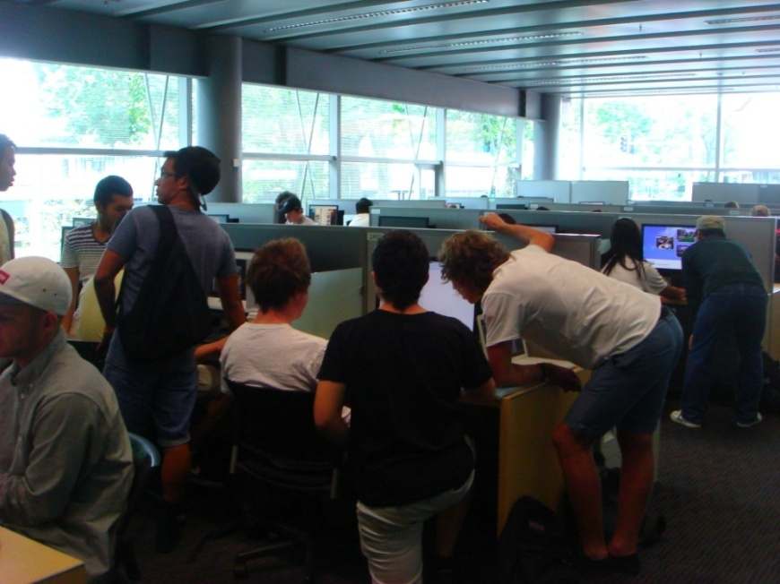
Visitors and Residents:
What motivates engagement with the digital information environment?
Funded by
JISC
OCLC
  Lynn Silipigni Connaway, Ph.D.
Oxford University
  David White & Alison Le Cornu Ph.D
University of North Carolina, Charlotte
  Donna Lanclos, Ph.D.

Slide 8
Why Visitors and Residents Project?
If we build it, they will NOT come.
Shifting changes in engagement with information environment
  Effect of larger cultural changes influenced by Web?
  New attitudes towards education?
Gap in user behaviour studies – need for longitudinal studies
Understand motivations for using and expectations of technologies and spaces in information environment
Inform project & service design to improve engagement & uptake
http://www.oclc.org/research/activities/vandr/
Notes:
At this slide, we’re thinking about doing the interactive part of the presentation, using the matrix in the next slide.

Slide 9
Video: goo.gl/wW1oB
First Monday Paper: goo.gl/RFSLz
Notes:
Discuss Prensky and how this is an attempt to move away from Native/Immigrant metaphor:
‘The digital natives/digital immigrants distinction is dead or at least dying’. So proclaims Doug Holton in his blogpost. He continues: ‘Unfortunately, the idea is still uncritically accepted even in some journal articles, and perhaps used as an excuse or crutch too often for poor or ineffective teaching practices’. Holton is not alone in his criticism. McKenzie (2007) writes strongly against Prensky’s (2001a, b) typology identifying a number of ‘thinly supported claims’, while Kennedy, et al. (2010) demonstrate through an empirical research project that Prensky’s age–related hypothesis is very much less clear–cut than the Natives and Immigrants dichotomy implies.
Our intention is to propose an alternative, which we have termed ‘Visitors and Residents’.
http://www.firstmonday.org/htbin/cgiwrap/bin/ojs/index.php/fm/article/view/3171/3049

Slide 10
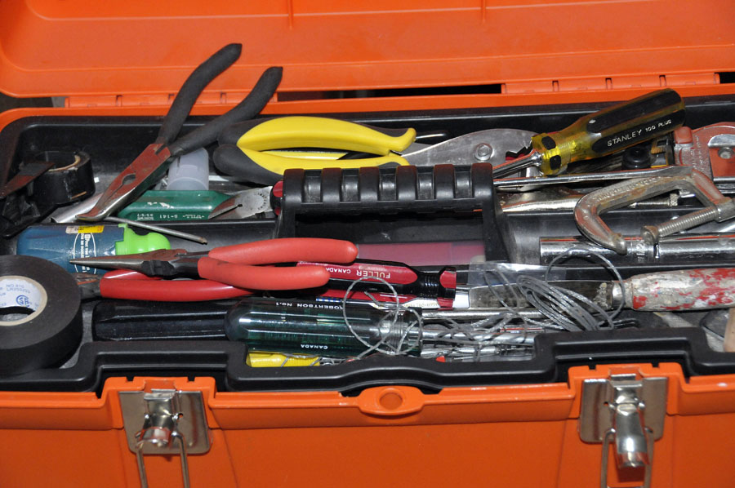
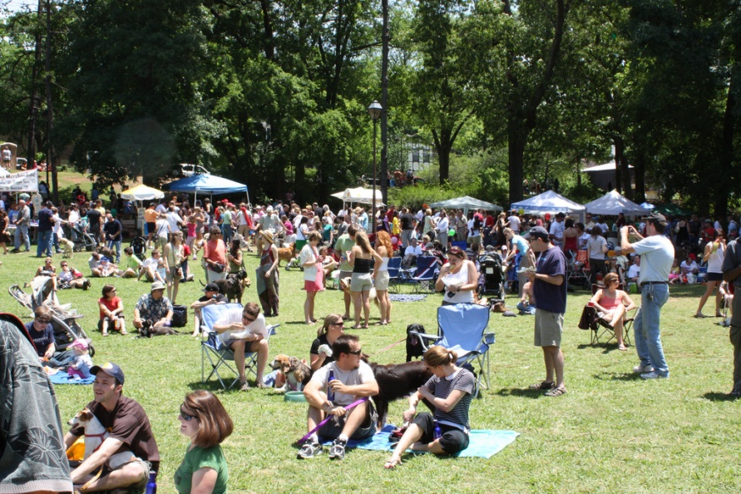

Slide 11
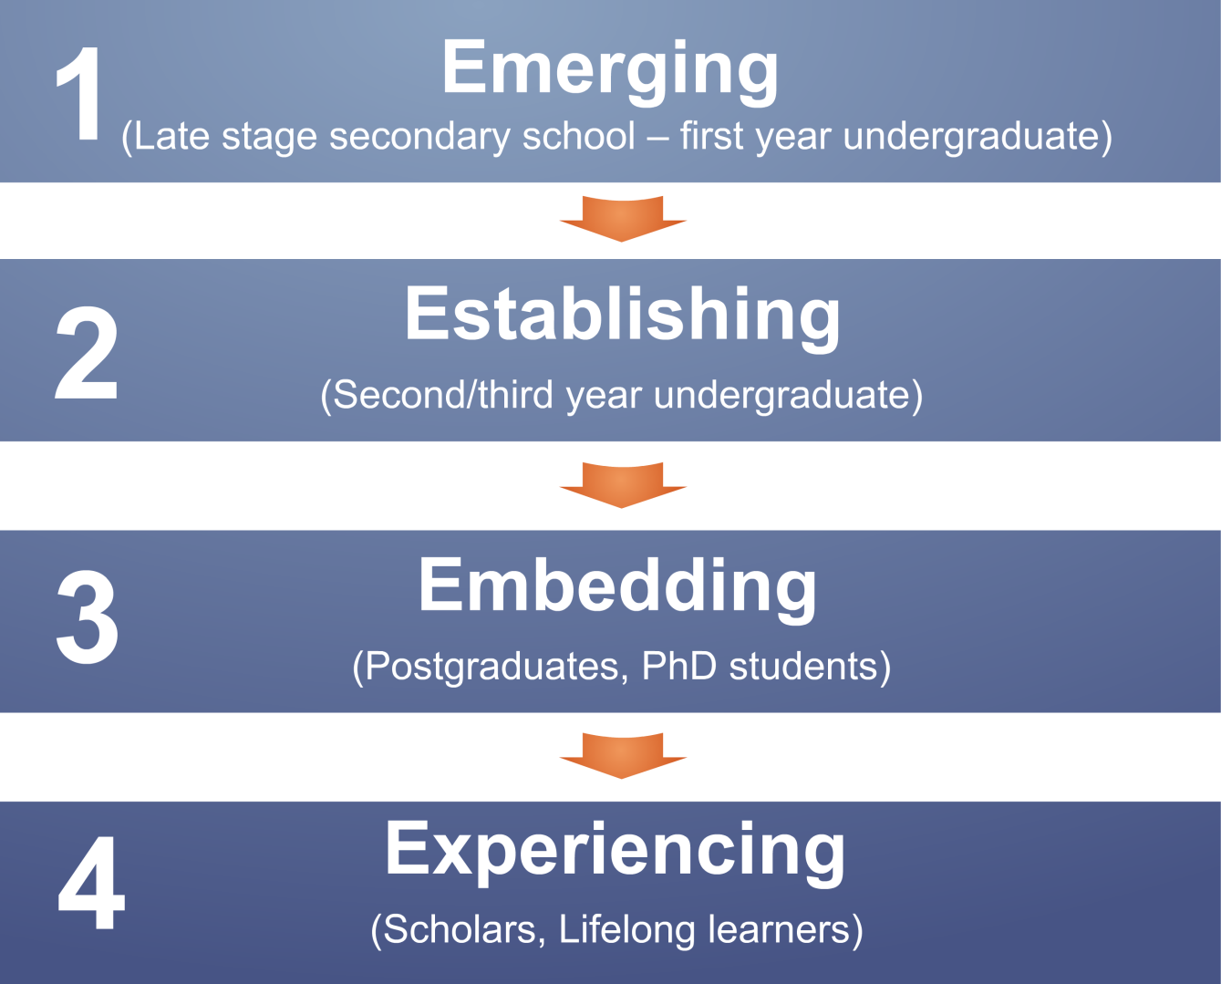
Visitors and Residents Study

Slide 12
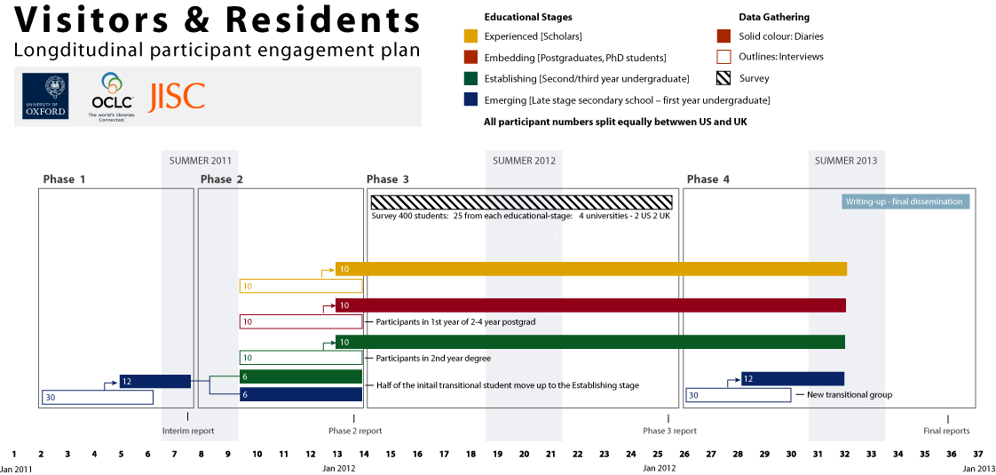

Slide 13
Objectives
Problematize and examine assumed links between age and technological engagement
More completely describing the social network in which digital and analog information-seeking strategies are embededded
Inform the JISC Developing Digital Literacies strand of projects. - “Discovering Digital Literacies”
Create a matrix of implementation options
Notes:
The findings will be used to create a matrix of implementation options allowing those designing and delivering digital platforms and services to make informed decisions relative to engagement and motivation for individuals at each of the educational stages.
Work as an interdisciplinary team, bringing to bear our relative expertises in Educational Technology, Library Information and Science/Research Methodology (User behavior), and Anthropology (Ethnography)

Slide 14
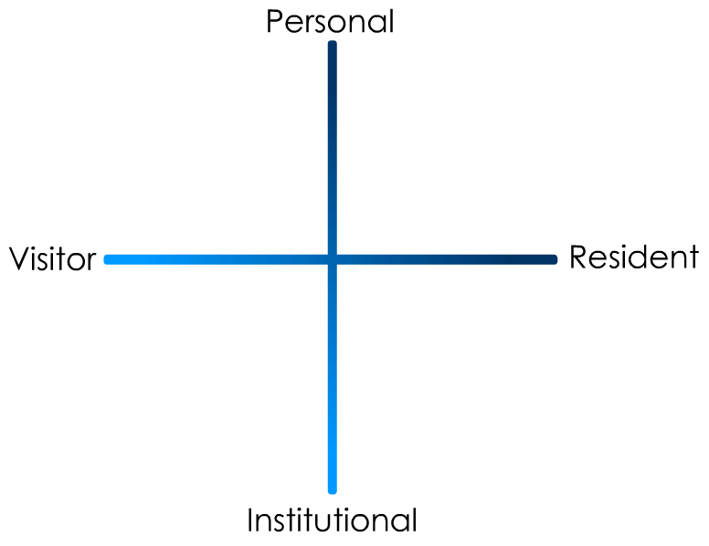

Slide 15
Research Questions
Do individuals develop personal engagement strategies which evolve over time and for specific needs and goals, or are the educational contexts the primary influence on their engagement strategies?
Are modes of engagement shifting over the course of time, influenced by emergent web culture and the availability of ‘new’ ways to engage, or are the underlying trends and motivations relatively static within particular educational stages?
Notes:
The 3-year, 4-phased study is based on the following key research questions:
What are the most significant factors for novice and experienced researchers in choosing their modes of engagement with the information environment?
Talk here about methodology
Why we picked the structured interview, what we decided the diaries could do for us (give us longitudinal data).
How the questions were developed.
The structured interview allowed us to standardize the kinds of approaches we took with the wide variety of informants, while still allowing for variation within that same group. Especially in the early phases, we saw the structured interviews as a way to get the most information out of the short period of time that we had to complete Phase 1.
We thought the diaries, in addition to giving us longitudinal data, also would provide additional insight into the lives of the informants.

Slide 16
Phase 1 Pilot stage: Months 1-6
Emerging educational stage
30 participants
  15 in the US
  15 in the UK
Quantitative data: Demographics, number of occurrences of technologies, sources, and behaviors.
Qualitative data: Themes and direct quotes.
Notes:
The initial 6-month pilot stage has focused on the Emerging educational stage to refine the research methodology and to establish the value of the work to the stakeholders. In the US the project worked in close partnership with the University of North Carolina, Charlotte (UNCC) to recruit participants, from different socio-economic groups from both private and public secondary schools as well as first-year university students. In the UK participants were drawn from Oxford Brooks University, Warwick University and secondary schools in Oxford and Leicester.
Thirty individuals in the Emerging Educational Stage (late stage secondary/high school and 1st year university) were recruited -15 in the US and 15 in the UK.
Of the 30 participants recruited 6 in the US and 6 in the UK were asked to document their information seeking activities for a 3-month period. They were closely facilitated through this process and communicated with the research team in the medium of their choice over this period.
The quantitative data include demographics; number of occurrences for different types of technologies, sources, and behaviours.
The qualitative data provide themes that identify behaviours and sources for different contexts and situations and include direct quotes and behaviours.

Slide 17
Phase I Participant Demographics
30 participants
19 females, 11 males
21 Caucasian, 3 African-American, 1 Caucasian-Thai, 1 Hispanic, 4 unidentified
15 secondary students
15 university students
Notes:
Economic class:
We recorded the residential post-code/ zipcodes for the participants as a way to identify broad socio-economic categories (given what we knew about socio-economic homogeneity in the cities in which we were working).
Attempts were made to recruit secondary students from schools with a wide range of socio-economic backgrounds. This is basically a convenience sample of students—those who were willing to be interviewed by us, in institutions that allowed us entry.
We also asked questions about parents’ educational backgrounds, and current/past vocations, to enrich our picture of interviewee backgrounds.

Slide 18
US vs. UK Participant
Notes:
Need to have samples from UK and US to try to get a better fix on why the behaviours look the way they do.
Are they because of the technology?
Culture?
Living in town? Living in suburbs?
Living in US/UK?
Going to College?
US (15 of 30)
8 Females
7 Males
UK (15 of 30)
11 Females
4 Males

Slide 19
US vs. UK Participant Ages
Notes:
US (15 of 30)
5 are 17 years-old
2 are 18 years-old
7 are 19 years old
1 is 28 years old
UK (15 of 30)
1 is 16 years old
6 are 17 years old
1 is 18 years old
4 are 19 years old
1 is 34 years old
1 is 36 years old
1 is 57 years old

Slide 20
US vs. UK Participant Ethnicity
Notes:
US (15 of 30)
3 African American
11 Caucasian
1 Hispanic
UK (15 of 30)
1 Caucasian/Thai
10 Caucasian
4 Undeclared

Slide 21
US vs. UK Participant University Majors
US (8 of 15)
5 Engineering
1 Political Science
1 Pre-Business
1 Undeclared
UK (7 of 15)
3 Teaching
1 Chemical Biology
1 Chemistry
1 History
1 Languages
Notes:
This was done to give us the potential to discuss behaviors in context
Are there certain things they do because they are engineers? Because they are education students?
If not, why not?

Slide 22
Participant Interview Questions
1. Describe the things you enjoy doing with technology and the web each week.
2. Think of the ways you have used technology and the web for your studies. Describe a typical week.
3. Think about the next stage of your education. Tell me what you think this will be like.
Notes:
For faculty, these are being slightly edited to ask about their preconceptions of academic life before the stage they currently occupy, as well as what they think the future might hold.

Slide 23
Participant Interview Questions, cont.
4. Think of a time when you had a situation where you needed answers or solutions and you did a quick search and made do with it. You knew there were other sources but you decided not to use them. Please include sources such as friends, family, teachers, coaches, etc.
5. Have there been times when you were told to use a library or virtual learning environment (or learning platform), and used other source(s) instead?
6. If you had a magic wand, what would your ideal way of getting information be? How would you go about using the systems and services? When? Where? How?
Notes:
These questions come from previous research
Institute for Museums and Library Services Research Grant, 2003-2005. “Sense-making the Information Confluence: The Hows and the Whys of College and University User Satisficing of Information Needs,” Brenda Dervin, Ohio State University, Principal Investigator; Lynn Silipigni Connaway and Chandra Prabha, Co-Investigators. $480,542, plus matching from OCLC and OSU. Project Website URL: http://www.oclc.org/research/activities/past/orprojects/imls/default.htm)
2. Institute for Museums and Library Services Research Grant, 2005-2007. “Seeking Synchronicity: Evaluating Virtual Reference Services from User, Non-User, and Librarian Perspectives.” Lynn Silipigni Connaway and Marie L. Radford, Rutgers University. Co-Principal Investigators. $684,996, plus matching from OCLC and Rutgers: $405,078. Project Website URL: http://www.oclc.org/research/activities/synchronicity/default.htm

Slide 24
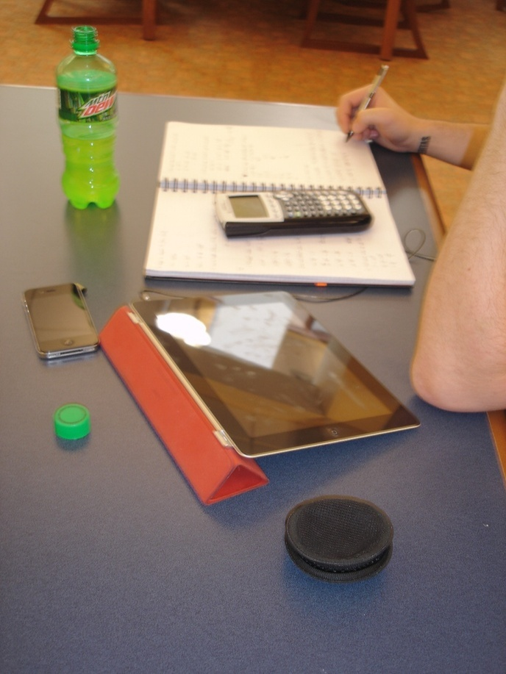
I. Place
A. Internet
1. Search engine
a. Google
b. Yahoo
2. Social Media
a. FaceBook
b. Twitter
c. You Tube
d. Flickr/image sharing
e.. Blogging
B. Library
1. Academic
2. Public
3. School (K-12)
C. Home
D. School, classroom, computer lab
E. Other
Codebook
Notes:
The codebook was created with a grounded analysis of the interviews of the Emerging group, and is to date one of our most significant research findings.
There was significant back and forth among researchers about the content of the codebook, via emails and Skype conversations. We started writing the codebook in May, and the final version came about in mid-September.
The content of the codebook reveals the priorities and practices of the Emerging group, but can also be used to analyze the remaining groups we have yet to interview. (for instance, we can use the codebook to analyze faculty interviews even if we don’t have a code for LinkedIn)
Discuss the content of the codebook.

Slide 25
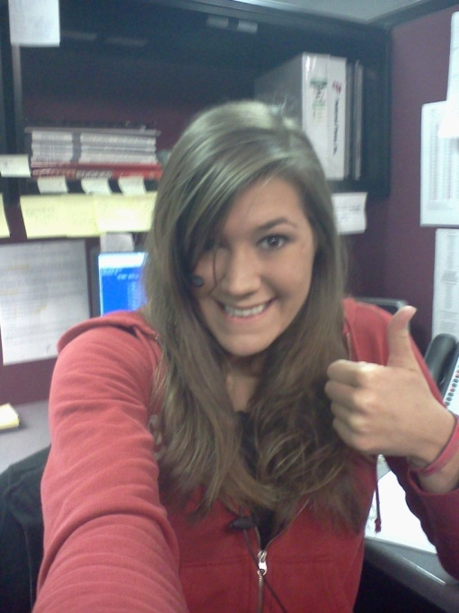
II. Sources
A. Human
1. Mother
2. Father
3. Extended family (siblings, cousins, relatives, children, spouses)
4. Experts/Professionals
5. Friends/Colleagues (‘mates’)
6. Teachers/Professors
        7. Peers (school, university colleagues but not ‘friends’)
        8. Librarians
        9. Other
B. Digital
        1. E-books
        2. Online textbooks
        3. Databases
        4. Websites
Codebook
Notes:
How we used the codebook:
First: the 3 researchers and research assistant coded the same two transcripts, one US and one UK (both secondary school).
We met and re-met and coded and re-coded until there was agreement.
THEN we went our separate ways to code. BUT we still communicate with each other in our coding processes, because of the remote nature of our collaboration.
Coding is done on paper, for the most part, and then the codes are entered into word, or scanned and sent to research assistants, who enter the coding into NVivo9. When the research assistants are entering the coding, they notice discrepancies, document them, and generate a discussion about what was intended, and what should the final coding be.
This continuous communication provides more consistency in coding across the researchers.
We will, once all of the coding is input, measure inter-coder reliability as well.

Slide 26
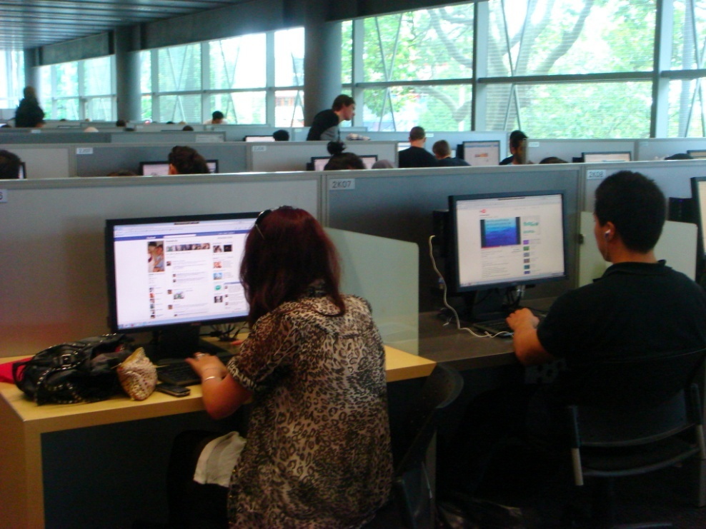
Facebook is for administration & social communication
Notes:
“…he was the only one who received it and the teacher told him to pass it on. And he sent a message to everyone in the calls on Facebook, so that helped.” (UKS1 00:12:22)
“Very important. I mean, it seems like everyone has a Facebook these days. I mean, even my mother-in-law has a Facebook.” (USU7)

Slide 27

Notes:
“I just type it into Google and see what comes-up…” (UKS2 00:16:21)
“I simply just type it into Google and just see what comes up” (UK4 00:13:36)
I always stick with the first thing that comes up on Google because I think that’s the most popular site which means that’s the most correct. (USS1 0:21:57) “I just type it into Google and see what comes-up…” (UKS2 00:16:21)
“I knew that the internet wouldn’t give me a wrong answer.” (UKS4 00:24:10)

Slide 28
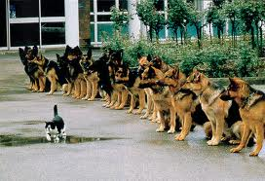
Are they as confident as they say?
Notes:
“That’s the only problem, just knowing what information to use and why.” (UKS1 00:24:05)
“Perfect thing, I think it would be that all the useful, accurate, reliable information would like glow a different colour or something so I could tell without wasting my time going through all of them.” (UKS2 00:37:09)

Slide 29



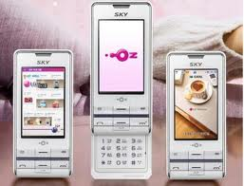
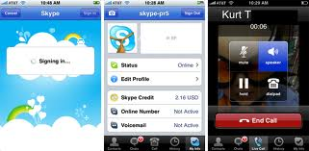
Diaries
6 US and 6 UK emerging stage students
Share information-seeking situations each month
Communicate them in any format

Slide 30
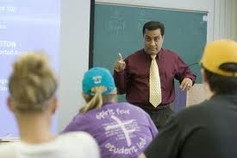
Diaries
All selected EMAIL
        Why?
“It’s for formal communication”
Notes:
We are currently coding the diaries—more info TBA!

Slide 31
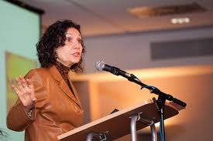
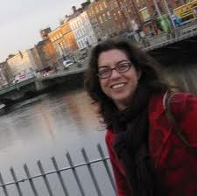

Current Project Status
Completed 30 interviews Emerging Stage students
Collected 12 diaries for 3 months
Developed code book
Analyzed 30 interviews
Begun 30 interviews
  Establishing Stage students
  Embedding Stage students
  Experienced scholars
Collecting 30 diaries for 4-6 months
Notes:
Establishing Stage students = second/third year undergraduate
Embedding Stage students = postgraduate/graduate students and Ph.D. students
Experienced scholars = scholars and researchers

Slide 32
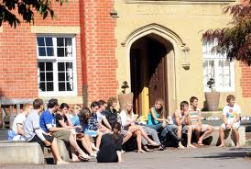
Future Phases
Phase 2: Months 7-12
  Establishing, Embedding, and Experienced
  Add 15 to original 30 = 45 participants
Phase 3: Months 13-24
  Track 24 participants
  Online survey of 400 students and scholars
Phase 4: Months 25-36
  Emerging
  6 students

Slide 33
Selected Readings
Beetham, Helen, Lou McGill, and Allison Littlejohn. Thriving in the 21st Century: Learning Literacies for the Digital Age (LLiDA Project). Glasgow: The Caledonian Academy, Glasgow Caledonian University, 2009. http://www.academy.gcal.ac.uk/llida/LLiDAReportJune2009.pdf.
Bullen, Mark, Tannis Morgan, and Adnan Qayyum. “Digital Learners in Higher Education: Generation is Not the Issue.” Canadian Journal of Learning and Technology 37, no. 1 (Spring 2011). http://www.cjlt.ca/index.php/cjlt/article/view/550/298.
Centre for Information Behaviour and the Evaluation of Research. Information Behaviour of the Researcher of the Future: A CIBER Briefing Paper. London: CIBER, 2008. http://www.jisc.ac.uk/media/documents/programmemes/reppres/gg_final_keynote_11012008.pdf.
Connaway, Lynn Silipigni, and Timothy J. Dickey. The Digital Information Seeker: Report of the Findings from Selected OCLC, RIN, and JISC User Behaviour Projects. 2010. http://www.jisc.ac.uk/media/documents/publications/reports/2010/digitalinformationseekerreport.pdf.

Slide 34
Selected Readings
Connaway, Lynn Silipigni, Timothy J. Dickey, and Marie L. Radford. “‘If it is too inconvenient I’m not going after it:’ Convenience as a Critical Factor in Information-seeking Behaviors.” Library & Information Science Research 33, no. 3 (2011): 179-90.
Connaway, Lynn Silipigni, and Marie L. Radford. Seeking Synchronicity: Revelations and Recommendations for Virtual Reference. Dublin, OH: OCLC Research, 2011. http://www.oclc.org/reports/synchronicity/full.pdf.
Institute for Museums and Library Services Research Grant. Seeking Synchronicity: Evaluating Virtual Reference Services from User, Non-User, and Librarian Perspectives. Lynn Silipigni Connaway and Marie L. Radford, Rutgers University. Co-Principal Investigators. 2005-2007. http://www.oclc.org/research/activities/synchronicity/default.htm.
Institute for Museums and Library Services Research Grant. Sense-making the Information Confluence: The Hows and the Whys of College and University User Satisficing of Information Needs. Brenda Dervin, Ohio State University, Principal Investigator; Lynn Silipigni Connaway and Chandra Prabha, Co-Investigators. 2003-2005. http://www.oclc.org/research/activities/past/orprojects/imls/default.htm.

Slide 35
Selected Readings
Nicholas, David, Ian Rowlands, and Paul Huntington. Information Behaviour of the Researcher of the Future: A CIBER Briefing Paper. London: CIBER, 2008. http://www.jisc.ac.uk/media/documents/programmes/reppres/gg_final_keynote_11012008.pdf.
Warwick, Claire, Isabel Galina, Melissa Terras, Paul Huntington, and Nikoleta Pappa. “The Master Builders: LAIRAH Research on Good Practice in the Construction of Digital Humanities Projects.” Literary and Linguistic Computing 23, no. 3 (2008): 383-96. http://discovery.ucl.ac.uk/13810/.
White, David, and Lynn Silipigni Connaway. Visitors and Residents: What Motivates Engagement with the Digital Information Environment. 2011. Funded by JISC, OCLC, and Oxford University. http://www.oclc.org/research/activities/vandr/.
White, David S., and Alison Le Cornu. “Visitors and Residents: A New Typology for Online Engagement.” First Monday 16, no. 9 (2011). http://firstmonday.org/htbin/cgiwrap/bin/ojs/index.php/fm/article/view/3171/3049.

Slide 36
The researchers would like to thank Dr. Alison LeCornu and Erin Hood for their assistance in keeping the team organized, scheduling and conducting interviews, analyzing the data, and disseminating the results.

Slide 37
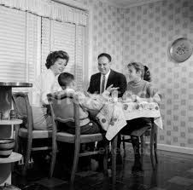
Discussion
Lynn Silipigni Connaway
connawal@oclc.org
David White
david.white@conted.ox.ac.uk
Donna Lanclos
dlanclos@uncc.edu

Slide 38
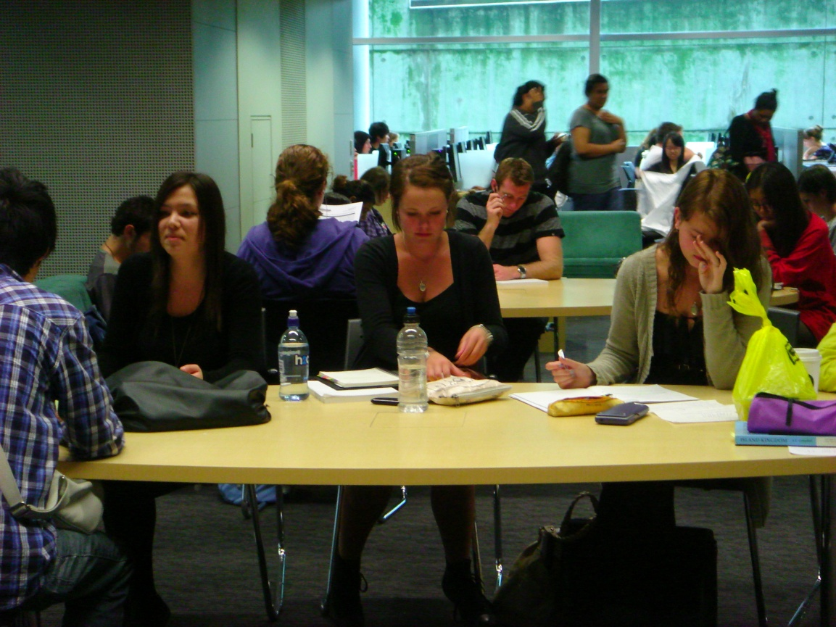
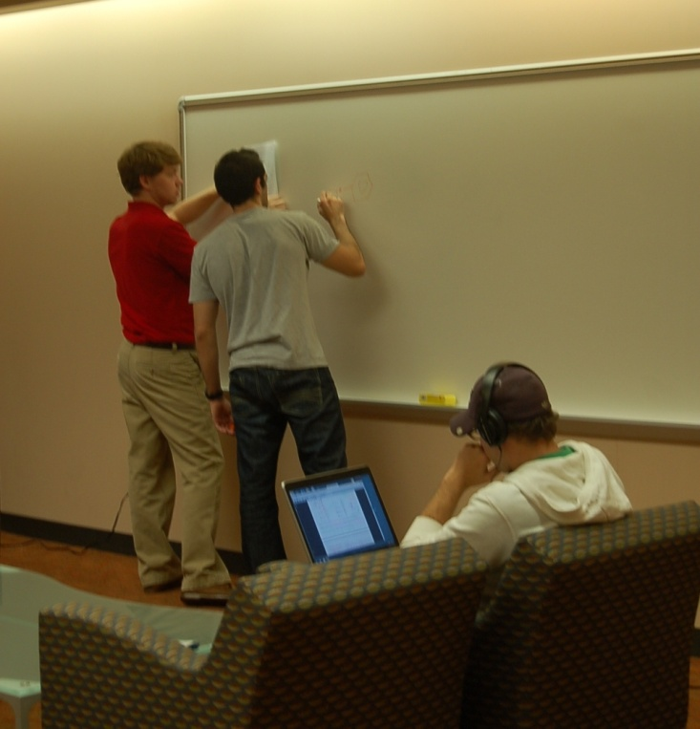
“…our generation isn’t technology orientated. I think it’s always a stereotype.”
(Participant UKS4)

Slide 39


=
Notes:
Screenagers in focus group interviews in 2008 said that “email is for old people.”
In interviews with last year secondary school/first year university students we are told that email is for “formal communication.”

Slide 40
Don’t mention Wikipedia!
English
The Free Encyclopedia
3 642 000+ articles
日本語
フリー百科事典
750 000+ 記事
Deutsch
Die freie Enzyklopädie
1 233 000+ Artikel
Español
La enciclopedia libre
761 000+ artículos
Français
L’encyclopédie libre
1 106 000+ articles
Русский
Свободная энциклопедия
714 000+ статей
Italiano
L’enciclopedia libera
803 000+ voci
Português
A enciclopédia livre
685 000+ artigos
Polski
Wolna encyklopedia
802 000+ haseł
Nederlands
De vrije encyclopedie
688 000+ artikelen
Notes:
Interviewer: ‘Do they actually fail you?’
‘They don’t fail you but you get ridiculed in front of everyone for sourcing Wikipedia.’ (USS3)
“It’s like a taboo I guess with all teachers, they just all say – you know, when they explain the paper they always say, “Don’t use Wikipedia.”” (USU7)

