Slide 1

Chattin’ ‘bout My Generation: Virtual Reference Use from Millennials to Boomers
Marie L. Radford, Ph.D.
Associate Professor
Rutgers, The State University of New Jersey
Lynn Silipigni Connaway, Ph.D.
Senior Research Scientist
OCLC
Reference Renaissance 2010, August 8-10, 2010
Notes:
Note: An earlier and much shorter version of this presentation was given at LIDA, 2010 conference.
Radford, M. L. & Connaway, L. S. (2010). Digital natives meet digital libraries: Discovering their behaviors and preferences for information seeking Libraries in the Digital Age (LIDA) 2010, Zadar, Croatia, May 24-28, 2010. [Available: http://web.ffos.hr/lida/datoteke/lida_2010_proceedings.pdf]

Slide 2

Seeking Synchronicity: Evaluating VR Services from User, Non-User, & Librarian Perspectives
IMLS, Rutgers, OCLC funded
  Focus group interviews
  Transcript analysis (850)
  Online surveys (496)
  175 VRS librarians, 184 VRS non-users, 137 VRS users
  Telephone interviews (283)
  100 VRS librarians, 107 VRS non-users, 76 VRS users
Notes:
We did not set out to study screenagers or Millennials at all, just VRS users and non-users.

Slide 3

The Millennials
Born 1979 - 1994
    Net Gen
    EchoBoomers
    Gen Y
75 million people
Socially networked environment
Different communication & information-seeking behaviors
Notes:
Soon will outnumber Baby Boomers (born 1946-1964). There are approx 79 million Baby Boomers
May be most studied generation in history

Slide 4

Screenagers/Digital Natives
Youngest of Millennials
Born 1988 -1994
Technology affinity
Expect instant access
Notes:
Screenagers subset of Millennials
Term Screenagers from Rushkoff (1996)
Most are digital natives, can’t remember life without computers
From MR
Insatiable appetite for screens: moving text and images
No car is complete without GPS and DVD player (maybe two)
Preferred mode of communication? Texting, cell phones and IM.
“No awkward silences” and “Many friends at once”
Raised when they can’t remember life w/o computers, vaguely remember pre-Google (pre 1999).
Approach tech, info seeking, libraries, librarians, print resources… very differently than prev generations

Slide 5

Focus Groups with Screenagers
Prefer
Google
Other search engines
Browse web
Ask friends
Or find information themselves
Notes:
“Yeah, cause I wouldn’t really trust my librarian. I trust Google.” (FG4)
“Um, like, I find something on Google and there’s enough information on it and it seems logical, I’ll just go with it.” (FG4)
“I’ve just never thought they any [sic] useful. I’d rather do it on my own.” (FG4)
Prefer to use Google, other search engines, browse web, ask friends, or find information themselves, rather than ask a librarian for help.
Google is seen as easier and more convenient than library subscription-based databases.

Slide 6

Focus Groups with Screenagers - More
Never used phone to call a librarian for homework help
Unaware that their library had phone reference service
None would ever email a librarian
Notes:
Although the majority carried mobiles, they had never used their telephones to call a librarian for homework help and were largely unaware that their library had a phone reference service.
None of the teens would ever email a librarian.

Slide 7

Focus Groups –
Reasons For Not Using VRS
IM for socializing, not for serious pursuits
Unaware VRS existed
Fear chat librarians would ignore them, not understand or not care about their information needs
Serious privacy & security concerns
Notes:
“Plus I think the IMing kind of gives it a cold feeling to it like, you know. They really don’t care. They’re just doing their job. When you can actually sit and talk to someone face-to-face you kind of can see if they care of not, you know. If they don’t care, you’re like ‘Well, you’re not going to help me very much anyway’ and you can move on. But the IM, you can keep trying to ask the same person the same question like over and over. And if they don’t care, they’re just going to keep ignoring you.” (FG4)
“A librarian’s trying to do like 15 of those conversations at once they’re going to mix up replies…” (FG4)
“I don’t usually like to talk to like people I don’t know on the internet.” (FG6)
“I’m not going to go get tutored on the Internet by somebody who I personally don’t know who might be some psycho serial killer out there when I could get personal help from my home and people in my community.” (FG4)
Reasons For Not Using VRS
Participants used IM for socializing, not for serious pursuits like homework help.
One reason teens did not used VRS was that they were unaware that these services existed.
Some feared that chat librarians would not understand, would ignore them, or would not care about their information needs.

Slide 8

Online Survey Results – VRS Users & Non-Users
Notes:
Focus Group results were used to construct online surveys. One theme that emerged from FG was that F-t-F interactions were seen as intimidating. So in the surveys we asked directly about intimidation with interesting results!!

Slide 9
Chat Least Intimidating to VRS Users
Millennials (N=49) Older Adults (N=88)
Notes:
User Online Survey Net Gens (N=49) Adults (N=88)
Both Millennials and OlderAdults found chat to be the least intimidating form of reference
“Yes. It makes the librarians easier to approach and you can find out while you are still connected whether their advice yields the results you are looking for.” (UOS-64280) Millennial

Slide 10

Recommendation Important to VRS Users
Millennials (N=49)
Used VRS because recommended
Recommended VRS more than older adults
Notes:
“Would you recommend chat reference services to someone else? Why or why not?”
“Definately - they're almost as good as asking the teacher herself/himself.” (UOS-51182) Millennial
“I'd absolutely recommend this service to everyone.” (UOS-25984) Millennial

Slide 11

Why Users Don’t Always Choose VRS
Millennials (N=49)
Unhelpful answers
Non-subject specialists
Slow connections
Scripted messages
Cold environment
Notes:
11
Unhelpful answers
"The librarian found the same results and webpages I found just by googling the item requested. The librarian basically accomplished what I had." (UOS-69642)
Age 15-18
Non-subject specialists
“It was for a more complex project for biology. I needed some information on restriction enzymes …I felt like the librarian did not understand my question, and could not completely help me with my research.” (UOS-18658) Age 12-14
“I was looking for specific information about comparing two pieces of literature…The librarian has only read one of those pieces of literature, and was only slightly familiar with the other piece.” (UOS-95403) Age 15-18
Slow Connections
“The librarian got disconnected, and when I got connnected to a new one, the connection was really slow, and then she got disconnected.” (UOS-85575) Age 19-28

Slide 12

What Would Attract Users to VRS More Frequently?
Millennials (N=49)
Faster & easier software
Personalized interface
More service hours
Kiosk & cybercafe access
Experienced, friendly, tech-savvy librarians
Notes:
12
Faster and easier software
“I would love it if you fixed up the software so that there would not be as many technical difficulties as I usually get.” (UOS-22916) Millennial
“Please make the chat references more stable and faster.” (UOS-96361) Millennial
More experienced and tech-savy librarians
"It was late at night and I was trying to download an ebook, but was not permitted to by the website. I was left still unable to view the books, and I did not recieve an answer becasue the night librarians apparently are not trained to the extent of the daytime librarians." (UOS-91166) Age 19-28
“I would like it if in the future the chat references provided more intelligent experiecned librarians. Some of them can't find answers when you ask for them.” (UOS-91507) Millennial

Slide 13

Why Don’t Non-Users Choose VRS?
Millennials (N=122)
Don’t know it is available
Believe librarian couldn’t help
Lack of 24/7 service
Satisfied w/ other info sources
Notes:
No knowledge that it was available
“The knowledge that they exist. I had no idea they existed until I took this survey.” (NOS-30765) Millennial
“I feel like my grammar school library education, which consisted primarily of the organization of the dewey decimal system (which is now obsolete, right?) failed me miserably. I feel like there are many library services out there I don't know about or know how to use well.” (NOS-16378) Millennial
Beliefs that the librarian could not help them
“I've never used this type of service and never knew it was available -- that's probably why I never tried it. Also, in my everyday life I don't run accross the need to research something in depth (the internet usually has enough information) so I don't really have a need to chat with someone for reference help.” (NOS-35191) Millennial

Slide 14
Face-to-Face Preference (FtF)
Non-Users Online Survey (N=184)
Notes:
When VRS non-users asked about their preferences 81% (N=50) of adults and 71% (N=87) of Millennials were partial to FtF.

Slide 15
FtF vs. Other Formats:
Non-Users Online Survey
Millennials (N=122)
Notes:
Non-users online survey
49% (60) of Millennials enjoyed FtF above email (27%, 33), phone (12%, 14), or texting (12%,15) for reference.

Slide 16
“The Library is convenient”
Non-Users Online Survey (N=184)
Notes:
Responding to the statement: “The library is convenient,” 76 (87%) of the 87 Millennials and 40 (78%) of the 51 older adults answered positively. However, some participants commented that online sources are more convenient.

Slide 17
“Remote access is important”
Non-Users Online Survey (N=184)
Notes:
Non-users online survey
Reacting to the statement, “Remote access is important,” 95% (39) of the Millennials and 85% (11) of the older adults answered positively.

Slide 18
Personal Relationships Important
Value Interactions with Specific Librarians
Non-Users Online Survey (N=184)
Notes:
Personal relationships with librarians were considered to be more important for adults 43% (22) (N=51) than Millennials 24% (21) (N=86). Older adults 51% (26) were more likely to value interactions with specific librarians than Millennials 24% (24).

Slide 19
Librarian Friendliness
& Politeness Valued
Non-Users Online Survey (N=184)
Notes:
69% (28) of the Millennials (N=41), and 29% (4) of older adults (N=14), valued the FtF librarians’ friendliness and politeness.

Slide 20

Reasons for Not Choosing VRS
Non-users Online Survey
Fear questions might annoy librarian
Don’t believe librarian can help
Didn’t know VRS existed
Satisfied with other sources
By Flickr® user RodBegbie http://www.flickr.com/photos/groovymother/3970469139/
Notes:
Reflecting the Millennial’s high level of comfort in the IM environment, 35% (N=43) of 122 Millennials and 53% (N=33) of 62 older adults agreed with the statement, “Chat reference might be too complicated.”
More older adults (35% 22) were concerned their typing was not adequate compared to 16% (19) of Millennials.
Millennials (29%, 35) more concerned their questions might annoy librarian and some worried about “bothering” the librarians.
“The librarian I asked seemed too occupied with other matters to pay any attention to my question, and she made me feel stupid and intrusive for even asking her such a thing.” (Millennial)
Some did not believe a librarian could help, others did not know VRS existed:
“I do not see myself using chat reference services because in the absence of having a reference librarian help me locate an appropriate or required source, I have friends in the LIS discipline with exemplary reference/research skills who could help me. Additionally, because I am in research, I have cultivated my own knowledge base of where/how to track down information. The only time I could ever imagine using chat reference is if I were incapacitated or unable to physically be in a library or if I were unable to reach one of my LIS colleagues. Otherwise, I see myself as a self-sufficient researcher who relies on her own social network and knowledge to locate reference material.” (Adult)
Both cohorts did not use VRS because of satisfaction with other information sources (e.g., family, friends, colleagues, teachers, the Web):
“I choose to go FTF because I’m not lazy, and I can get a more accurate answer FTF not on chat reference. And I can be there to get the books I want, and not waste a librarian’s time on the computer.” (Millennial)
“Why use VRS when phone, face-to-face, or even e-mail could be more convenient?” (Millennial)

Slide 21

Reasons to Use VRS
Non-Users Online Survey
Non-users might try VRS
  If they could receive information quickly
  24/7/365
By Flickr® user mag3737 http://www.flickr.com/photos/mag3737/452838421
Notes:
Non-users thought they would try VRS if they could receive information quickly and around the clock, 24/7/365:
“If it is available 24/7 I’ll try it.” (Millennial)

Slide 22

Reasons for Not Choosing VRS
Non Users Phone Interviews
Unaware VRS existed or how to access:
“I think I am unfamiliar with it… I stray away from the unknown I guess.” (Millennial)
“I don’t know how to access computer library service. When I need to look something up I use Google.” (Older Adult)
Notes:
N=107 non-users
When asked why they did not use VRS, 82% (24) of 34 interviewees responded that they were unaware that it existed.
When asked what alternatives to the library they chose:
43% (45) of participants said they used the Web.
45% (33) of the Millennials mentioned the Internet as an alternative to the library and 28% (20) said they used the internet for “personal convenience.”
38% (12) of the older adults mentioned the Internet as an alternative resource to the library.
Google was mentioned by 15% (11) of Millennials and 3% (2) of older adults.

Slide 23
Reasons to Use VRS
Non-Users Phone Interviews
Notes:
Confirmed as Non-User Telephone Interview, however the number for Immediate answer needs to be fixed, its (N=32, 30%).
When asked what might convince them to ask for help from VRS, convenience again was mentioned, including 24/7 access to librarians. Thirty percent (32) of respondents cited immediate answers and 17% (18) appreciated home access.

Slide 24

Summary of Results
Online Surveys & Phone Interviews
Most important for success
Accuracy
Correct answers
Convenience
Delivery
Highly Valued
Knowledgeable
Positive attitude
Communication skills
Notes:
Although accuracy and correct answers and the delivery of specific content were reported as the most important factors of successful reference interactions, non-users of VRS also value librarians who are knowledgeable about information sources and systems, display a positive attitude, and demonstrate good communication skills.

Slide 25

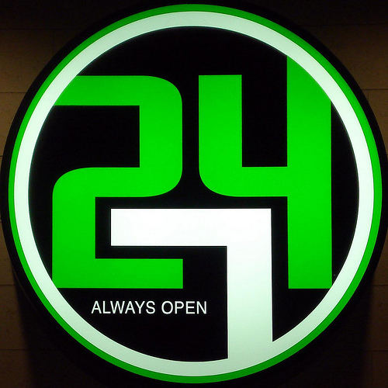

Discussion & Implications
Unaware of service
Convenience important
Prefer FtF
Online sources more convenient
Satisfied with other sources
May use if available 24/7
Notes:
Non-users of VRS are not aware that the service is available. Results from both interviews and surveys reveal that they consider convenience to be a major factor when choosing how to get their information. Respondents prefer to interface with friendly librarians and to develop ongoing relationships with them. The majority used FtF as well as telephone and email reference services. They found email reference to be the least intimidating mode of communicating with a librarian for a reference query, but most preferred FtF because they felt the interaction was more personal, more efficient, and enabled them to better communicate with the librarian. Although most preferred FtF reference services and believed the library is convenient, some said online sources are more convenient than physical library materials because of remote access.
Many of the non-users did not believe a librarian could help them or know that VRS was available. Both Millennials and adults were satisfied with other information sources; therefore, did not need to use VRS. Human resources, such as family, friends, teachers, and colleagues were identified as prime information sources. The Web was identified as an alternative for the library and was used for “personal convenience.” The non-users might use VRS if it were available 24/7 and if they could receive information quickly.

Slide 26


Discussion & Implications
Millennials vs. Older Adults
  Millennials
  Value convenience & online access (sources & services)
  Value friendliness
  Concerned questions annoying
  Older Adults
  Chat too complicated
  Typing skills not adequate
Notes:
Some differences in communication and information seeking behaviors were found between Millennials and adults. A personal relationship with a librarian was more important to Millennials who also valued the librarians’ friendliness and politeness in interpersonal communications more than adults. A greater number of adults than Millennials believed that chat reference would be too complicated; therefore, chose not to use it. The adults were concerned that their typing skills were not adequate to communicate with a librarian via chat. On the other hand, Millennials were more concerned than the adults that their questions would annoy or bother the librarians.

Slide 27

Encourage Future Users –
What We Can Do
Creative marketing
  Promote range of options & convenience
  Teach VR in Info. Literacy
Observe their use patterns
System development
Notes:
Vital if we are going to remain relevant in their universe.
Need to ensure that we have a wide range of options – email, chat, IM, text, ftf, phone, etc.
Dwell on positive – what we CAN do rather than what we CAN’T do

Slide 28

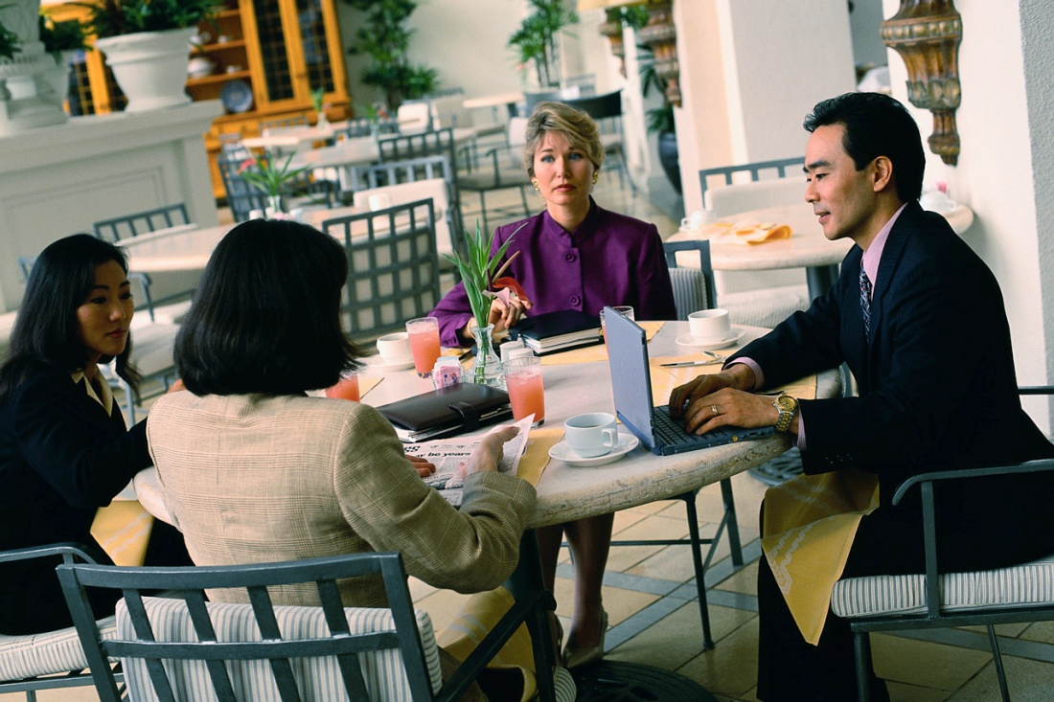

Recognize & Respond to User Differences & Preferences
Different generations = different behaviors
Personalized interfaces
Emphasize personal service
  Build positive relationships FtF, phone, or online
Notes:
Note: this slide partially adapted from findings reported at LIDA 2010, Radford & Connaway, 2010. See title slide for citation.
The Digital Information Seeker: Report of Findings from Selected OCLC, RIN and JISC User Behaviour Projects
Funded by JISC – Joint Information Systems Committee
Project Web Site URL:
http://www.jisc.ac.uk/publications/reports/2010/digitalinformationseekers.aspx
Project Report URL: http://www.jisc.ac.uk/media/documents/publications/reports/2010/digitalinformationseekerreport.pdf

Slide 29
End Notes
This is one of the outcomes from the project
  Seeking Synchronicity: Evaluating Virtual Reference Services from User, Non-User, and Librarian Perspectives
Funded by IMLS, Rutgers University, & OCLC Online Computer Library Center, Inc.
Project web site: http://www.oclc.org/research/activities/synchronicity/default.htm
Notes:
29

