Slide 1

Extending Our Virtual Reach:
A Longitudinal Study of Query Type & Accuracy in Live Chat & IM Reference
ALISE Conference
Dallas, TX
January 17-20, 2012
Marie L. Radford, Ph.D., Rutgers University
Lynn Silipigni Connaway, Ph.D., OCLC

Slide 2
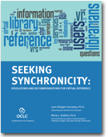
Seeking Synchronicity: Evaluating VRS from User, Non-User, & Librarian Perspectives
$1,090,072 project, 2005-2008, funded by:
  Institute of Museum & Library Services (IMLS) $684,996 grant
  Rutgers, The State University of New Jersey & OCLC, Inc.
    $405,076 in kind contributions

Slide 3
Longitudinal Comparison
Live Chat Transcripts 2004-2006 (QP1)
  8/2004 to 10/2006
  Total QuestionPoint & 24/7 = 651,687
  850 randomly selected (550 QP & 300 24/7)
Live Chat & Qwidget Transcripts 2010 (QP2 & QW)
  6/2010 to 12/2010
  Total QP2 & QW = 296,797
  560 randomly selected (350 QP2 & 210 QW)
Notes:
For 2010 sample Total = 296,797 (QP 221,158 & QW 75,639)

Slide 4

Types of VR Questions
Subject Search
Ready Reference
Procedural
No Question
Holdings
Research
Inappropriate
Directional
Reader’s Advisory
Notes:
Our study draws on categories for questions defined by Katz (1997) and enhanced by Arnold & Kaske (2002, 2005).

Slide 5

Subject Search Defined
(aka Specific Search)
A search on a topic. “Almost always takes the form of giving the user a document, for example, a list of citations, a book, or a report” (Arnold & Kaske, 2005).
  can you help me find poems by Maya Angelou and criticism on them? (QP 1 – 230)
  Where can i find information about ADHD? (QP2 – 005)
  How was the labeling theory important in deinstitutionalization? (QW – 023)
Notes:
Arnold and Kaske called this “Specific Search,” we are calling it “Subject Search”.
Note that all quotes are verbatim and have not been corrected if there are errors.

Slide 6

Ready Reference Defined
“These are the typical ready-reference or data queries that require only a single, usually uncomplicated, straightforward answer...Who? What? When? Why? Where?” (Arnold & Kaske, 2005).
  Who was Bentonville, NC named after?
  (QP1 – 147)
  How do i cite a political talk show in
  MLA format? (QP2 – 013)
  who won the world cup game between
  south africa and france? (QW – 024)

Slide 7
Procedural Defined
“Questions pertaining to the policies or procedures within the library system” (Arnold & Kaske, 2005).
  Can I get summer long term renewals online? How? (QP1 – 004)
  need access logon info to lexis from scool library website (QP2 – 027)
  what is the max for checkout on blu ray dvids? (QW – 033)

Slide 8

Holdings Defined
“Questions about specific holdings of a library in print or digital form” (Arnold & Kaske, 2005).
  Do you have any books on Paris Hilton? (doing a project on her) (QP 1 – 195)
  I was wondering if you have textbooks to rent for an hour or 2? (QP2 – 172)
  hi there; i was wondering if you guys have Moby Dick in stock? (QW – 014)

Slide 9

Research Defined
“Research questions… involve trial-and-error searching or browsing… [and] are usually identified as coming from an adult specialist who is seeking detailed information to assist in specific work” (Arnold & Kaske, 2005).
  Hi, I am trying to find out information on how the Learn Direct initiative was started, the criteria that was set and if local government had to be involved in the first stage. (QP 1 – 155)
  Looking for information on national traffic survey and incident reports. (QP2 – 169)
  Hi I’m looking for studies similar to one I’ve already found. How do I go about this? (QW – 013)

Slide 10

Inappropriate Defined
“Questions which are not appropriate for a reference service including personal questions” (Radford, 2005).
  How do I have sex? (QP1 – 159)
  WAT DOES it mean when a guy said he like me more as a friend doesnt it mean like a gf? (QP2 – 153)
  Are
  You
  Typing
  War
  and Peace (QW – 020)
Notes:
Bring transcript QP2 - 153

Slide 11

Directional Defined
“The general information or directional question is of the information booth variety…” (Arnold & Kaske, 2005)
  Where is the 67th street library? Is it on the west or east side? (QP1 – 387)
  what is the URL for the summer reading program for teens? (QP2 – 032)
  I heard that you have adapted book kits for ESL speakers. Where can I find these online? (QW – 008)
Notes:
Includes virtual directions like 2nd example asking for URL

Slide 12
Reader’s Advisory Defined
Reader’s Advisory questions are “focused on helping readers find materials they want to read, listen to, or view for pleasure“ (Ross, Nilsen, & Radford, 2009).
  Hello I am looking for recommendations for the author jonathan kellerman. (QP1 – 218)
  I was wondering if u would happen to know any good fantasy books… (QP2 – 050)
  Hi, my 7 year old son is looking for a copy of the Hobbit suitable for children, but we can’t seem to find anything in the library catalogue. Can you please offer any advice? Thanks. (QW – 120) (from Australia)

Slide 13

Notes:
Total N for 2004-2006 is 915 questions (not transcripts)
Subject Search (n=293, 32%)
Ready Reference (n=243, 27%)
Procedural (n=162, 18%)
No Question (n=104, 11%)
Holdings (n=77, 8%)
Research (n=23, 3%)
Inappropriate (n=10, 1%)
Directional (n=2, <1%)
Reader’s Advisory (n=1, <1%)

Slide 14
Notes:
575 is actual number of questions from 560 transcripts (includes both QP and QW)
Subject Search (n=97, 17%)
Ready Reference (n=179, 31%)
Procedural (n=181, 31%)
No Question (n=25, 4%)
Holdings (n=49, 9%)
Research (n=19, 3%)
Inappropriate (n=4, <1%)
Directional (n=15, 3%)
Reader’s Advisory (n=6, 1%)

Slide 15
Notes:
2004-2006 vs. 2010
n = 915 questions vs. 575 questions
Subject Search (n=293, 32%) vs. (n=97, 17%)
Ready Reference (n=243, 27%) vs. (n=179, 31%)
Procedural (n=162, 18%) vs. (n=181, 31%)
No Question (n=104, 11%) vs. (n=25, 4%)
Holdings (n=77, 8%) vs. (n=49, 9%)
Research (n=23, 3%) vs. (n=19, 3%)
Inappropriate (n=10, 1%) vs. (n=4, 1%)
Directional (n=2, <1%) vs. (n=15, 3%)
Reader’s Advisory (n=1, <1%) vs. (n=6, 1%)
QP2:
N=366
Directional (n=7, 2%)
Ready Reference (n=127, 35%)
Subject Search (n=74, 20%)
Research (n=16, 3%)
Procedural (n=99, 27%)
Holdings (n=25, 7%)
No Question (n=11, 3%)
Inappropriate (n=4, 1%)
Reader’s Advisory (n=3, 1%)
QW2
N=209
Directional (n=8, 4%)
Ready Reference (n=52, 25%)
Subject Search (n=23, 11%)
Research (n=3, 1%)
Procedural (n=82, 39%)
Holdings (n=24, 11%)
No Question (n=14, 7%)
Inappropriate (n=0, 0%)
Reader’s Advisory (n=3, 1%)

Slide 16
Query Type 2010: Live Chat (QP2) vs. Qwidget (QW)
Notes:
Total n= 575 questions
QP2:
N=366 questions
Directional (n=7, 1%)
Ready Reference (n=127, 22%)
Subject Search (n=74, 13%)
Research (n=16, 3%)
Procedural (n=99, 17%)
Holdings (n=25, 4%)
No Question (n=11, 2%)
Inappropriate (n=4, 1%)
Reader’s Advisory (n=3, 1%)
QW2
N=209
Directional (n=8, %)
Ready Reference (n=52, 9%)
Subject Search (n=23, 4%)
Research (n=3, 1%)
Procedural (n=82, 14%)
Holdings (n=24, 4%)
No Question (n=14, 2%)
Inappropriate (n=0, 0%)
Reader’s Advisory (n=3, 1%)
Total
N=575
Directional (n=15, 3%)
Ready Reference (n=179, 31%)
Subject Search (n=97, 17%)
Research (n=19, 3%)
Procedural (n=181, 31%)
Holdings (n=49, 9%)
No Question (n=25, 4%)
Inappropriate (n=4, 1%)
Reader’s Advisory (n=6, 1%)

Slide 17
Ready Reference Questions (2004-2006 vs. 2010)
Received by Type of Chat Service
Notes:
Note: this chart shows the chat service that received the questions as initially submitted by the user (e.g., user submitted to this type of service).
Referred to/Answered would be a different number.
2004-2006 (n=162 ready reference queries)
Public (n=59, 36%)
Consortium (n=45, 28%)
Academic & Law (n=34, 21%)
National (n=20, 12%)
Other (n=4, 2%) breakdown State (n=3), K-12 (n=1)
2010 Total (n=168)
Public (n=33, 20%)
Consortium (n=68, 40%)
Academic & Law (n=65, 39%)
National (n=1, <1%)
Other (n=1, <1%)

Slide 18
Total Questions Received by Service
Notes:
Total (n=555) – This number is different from previous slide (n=575) because it is by number of transcripts…should probably delete this slide
Public (n=127, 23%)
Consortium (n=174, 31%)
Academic & Law (n=241, 43%)
National (n=11, 2%)
Other (n=4, <1%)

Slide 19
Ready Reference Questions (QP2 vs. QW)
Received by Type of Chat Service
Notes:
Total (n=168)
Public (n=33, 20%)
Consortium (n=68, 40%)
Academic & Law (n=65, 39%)
National (n=1, <1%)
Other (n=1, <1%)
QP2 (n=118)
Public (n=22, 19%)
Consortium (n=63, 53%)
Academic & Law (n=32, 27%)
National (n=1, <1%)
Other (n=0, 0%)
QW Total (n=50)
Public (n=11, 22%)
Consortium (n=5, 10%)
Academic & Law (n=33, 66%)
National (n=0, 0%)
Other (n=1, 2%)

Slide 20

Accuracy in VR Ready Reference?
How accurate are VR librarians/staff in answering ready reference questions?
Do we see the 55% rule in effect?
(Hernon & McClure, 1987)

Slide 21
Accuracy: 2004-2006 vs. 2010
Notes:
This chart compares the Accuracy for 2004-2006 to 2010.
2004 – 2006 (n=180 ready reference questions only)
Correct: n=141, 78%
Incorrect: n=36, 20%
Other: n=3, 2%
2010 (n=168 ready reference questions for both QP2 and QW)
Correct: n=151, 90%
Incorrect: n=7, 4%
Other: n=10, 6%
Also: note that referred questions are not counted in either 04-06 or 10 dataset.

Slide 22
Accuracy: Correct 2004-2006 vs. 2010
Notes:
2004-2006 (n=180 ready reference, for correct ones n=141)
Correct with citation: 125, 69%
Correct w/o citation: 9, 4%
Correct no citation needed: 7, 5%
2010 (n=168 ready reference, for correct ones n=151)
Correct with citation: 114, 75%
Correct w/o citation: 21, 14%
Correct no citation needed: 16, 11%
Example for Correct (w/ citation)
QP2 011 what is the proper measurement unit for an amoeba?? Librarian sends:
http://nanosense.org/activities/sizematters/sizeandscale/SM_Lesson2Student.pdf
Which has the correct answer. Micron (1 micron, p. 2-S3) or
Example for Correct (no citation needed)
QW2 030 Hi. I'm looking for the disc about a rat that becomes a celebrated French chef. It"s all computer animation, of course. Could you help me with the name of this film so I can look up its availability?
No citation needed because it’s in popular culture, general knowledge. Answer: Ratatouille (2007) Disney film. See http: disney.go.com/disneypictures/ratatouille/

Slide 23
Accuracy– Correct & Incorrect: QP2 vs. QW 2010
Notes:
Updated
QP (n=118 ready reference questions)
Correct: n=106, 90%
Incorrect: n=6, 5%
Other: n=6, 5%
QW (n=50 ready reference questions)
Correct: n=45, 90%
Incorrect: n=1, 2%
Other: n=4, 8%
Examples of “Other”
QP2 199 The user asks a simple reference question: who is selena? then signs off.
QW2 003. User asks for info about an animal? then answers the librarian’s follow up question what animal?? with ?a short tail weasel?. Then the user signs off.
Incorrect Examples
We only have three incorrect in our data, two of them the librarian sent a web page with information related and was still searching when the user sign off and they are not able to finish answering the question.
(QP2 009 & QP2 012)
QP2 013 is probably the best example. The user asks ?How do i cite a political talk show in MLA format??
It’s later verified they want a TV show (rather than radio) and the librarian sends them to:
http://www.ehow.com/how_4450289_cite-radio-program-using-mla.html
This site doesn’t give a complete example, they should have been sent to http://owl.english.purdue.edu/owl/resource/747/09/
Where it shows how to site published interviews (print or broadcast) or Broadcast Television.

Slide 24
Accuracy - Correct: QP 2 vs. Qwidget 2010
Notes:
Accuracy for Ready Reference only
QP (n=118 ready ref questions)
Correct with citation: n=88, 75%
Correct w/o citation: n=13, 11%
Correct, no citation needed: n=5, 4%
Incorrect with citation: n=2, 2%
Incorrect w/o citation: n=0, 0%
Incorrect, no citation needed: n=4, 3%
Other: n=6, 5%
QW (n=52 ready reference questions)
Correct with citation: n=26, 52%
Correct w/o citation: n=8, 16%
Correct, no citation needed: n=11, 22%
Incorrect with citation: n=0, 0%
Incorrect w/o citation: n=1, 2%
Incorrect, no citation needed: n=0, 0%
Other: n=4, 8%
Total (n=168)
Correct with citation: n=114, 68%
Correct w/o citation: n=21, 13%
Correct, no citation needed: n=16, 9%
Incorrect with citation: n=2, 1%
Incorrect w/o citation: n=1, 1%
Incorrect, no citation needed: n=4, 2%
Other: n=10, 6%

Slide 25
Incorrect ready reference answers that don’t have to be…
Notes:
Updated
2004-2006 (n=180, n=36, 20% for incorrect)
Incorrect w/o specific…: n=27, 15%
Incorrect w/ citations: n=6, 3%
Incorrect w/o citation: n=3, 2%
2010(n=168, n=7, ~4% for incorrect)
Incorrect w/o specific…: n=4, 2%
Incorrect w/ citations: n=2, 1%
Incorrect w/o citation: n=1, 1%

Slide 26
How much is the owner of Ed Hardy worth?
L | {Welcome to [chat consortium], thank you for your question. Let me read your question, I'll be back in a moment...}
U | ok
L | http://en.wikipedia.org/wiki/Don_Ed_Hardy
U | thats him
L | ChatLibrarianEnded;.
Notes:
Note that this is about the worth of the owner of the Ed Hardy company.

Slide 27
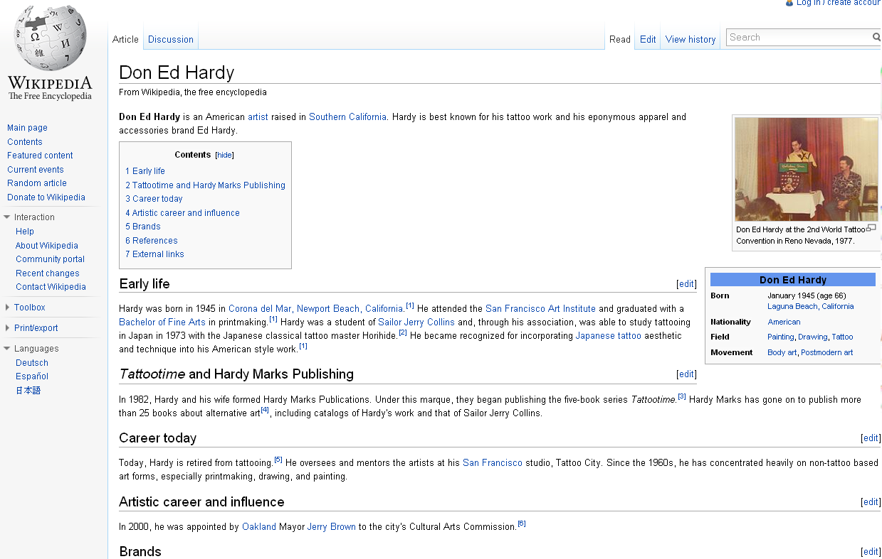
Notes:
http://en.wikipedia.org/wiki/Don_Ed_Hardy

Slide 28
Upon Closer Look…
In 2004, Christian Audigier licensed the rights to produce the Ed Hardy clothing line, which is based on Hardy's imagery. Prior to the Ed Hardy clothing line, Audigier was the Head Designer at Von Dutch Originals, which marketed the imagery of Kenny Howard.
BUT THE USER’S QUESTION REMAINS…
HOW MUCH is the OWNER of Ed Hardy (the company) worth???
Notes:
Christian Audigier is actually the owner of the company.

Slide 29
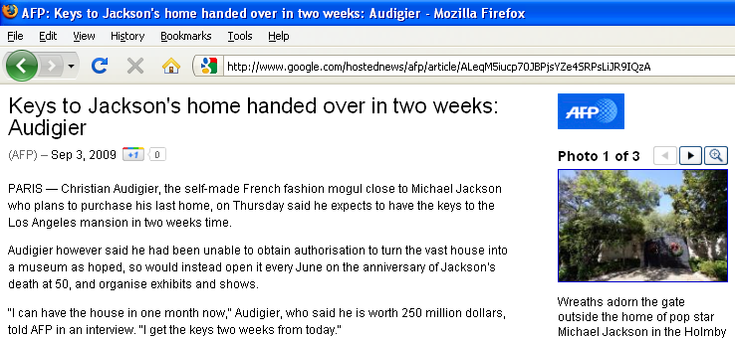
This site answers how much but was never sent
(Audigier is worth $250 million)
http://www.google.com/hostednews/afp/article/ALeqM5iucp70JBPjsYZe4SRPsLiJR9IQzA
Notes:
URL: http://www.google.com/hostednews/afp/article/ALeqM5iucp70JBPjsYZe4SRPsLiJR9IQzA

Slide 30
A Simple Way to Increase Accuracy
For 2004 –2006, accuracy would rise from 78% to 90% if VR librarians only…
  -Answered specific question asked!
Seeking Synchronicity urged VRS librarians
  -Before pushing a general info page make sure it has specific & exact answer to user’s question!
2010 sample included far fewer with this error accuracy 90% (perhaps b/c of recommendation?)
Notes:
Other suggestions to improve accuracy:
Check for broken links before sending URLs
Make sure all questions & all parts of questions are answered

Slide 31
Future Directions
Cyber Synergy: Seeking Sustainability through Collaboration between Virtual Reference and Social Q&A Sites
New grant - amount of $250,000 for ’11-’13
Funded by IMLS, OCLC, & Rutgers University
Co-PIs Marie Radford (RU), Lynn Silipigni Connaway (OCLC), & Chirag Shah (RU)
Notes:
Chirag will be in the room, so need to acknowledge him.

Slide 32
Cited References
Arnold , J., & Kaske, N. K. (2005). Evaluating the quality of a chat service. portal: Libraries and the Academy, 5(2), 177-193.
Connaway, L. S. & Radford, M. L. (2011). Seeking Synchronicity: Revelations and Recommendations for Virtual Reference. Dublin, OH: OCLC Research. Available: http://www.oclc.org/reports/synchronicity/default.htm and in print.
Hernon, P., & McClure C.R. (1987). Library reference service: An unrecognized crisis- a symposium. JAL, 13, 69-80.
Janes, J. (2003). What is reference for? RSR, 31(1), 24.
Katz, W. A. (1997). Introduction to reference work. (7th ed.). New York: McGraw-Hill.
Radford, M. L. (2005). Virtual dialogs: Relational communication in chat reference encounters. Online proceedings of the International Communication Association 55th Annual Conference. NY, NY, May 26-30, 2005.
Ross, C.S., Nilsen, K., & Radford, M. L. (2009). Conducting the reference interview: A how-to-do-it manual for librarians. (2nd ed.) NY: Neal-Schumann.

Slide 33
End Notes
This is one outcome from the project Seeking Synchronicity: Evaluating Virtual Reference Services from User, Non-User, & Librarian Perspectives, Marie L. Radford & Lynn Silipigni Connaway, Co-Principal Investigators, & Cyber Synergy: Seeking Sustainability through Collaboration between Virtual Reference and Social Q&A Sites, Marie L. Radford, Lynn Silipigni Connaway, & Chirag Shah.
Funded by IMLS, Rutgers University, and OCLC, Inc.
Special thanks to Erin Hood, Susan Wengler, Lisa DeLuca, Jaqueline Woolcott, Stephanie Mikitish, Alyssa Darden, Jocelyn DeAngelis, Patrick Confer, Timothy Dickey, David M. Dragos, Mary Anne Reilly, Susanna Sabolcsi-Boros, Julie Strange, & Janet Torsney.
These slides will be available at project websites: http://www.oclc.org/research/activities/synchronicity/default.htm
http://www.oclc.org/research/activities/synergy/default.htm

Slide 34
Photo Credits
Slide 4-http://www.internetblog.org.uk/post/574/574/
Slide 6-http://debrawarren.com/lessons-from-your-english-teacher-about-social-media-marketing
Slide 10-http://www.lifecoach1000.com/Youth.html
Slide 20-http://triquatrotritecale.hungrypeasant.com/index.php/2010/07/20/its-too-accurate-more-undocumented-uses-of-nextstages-evolution-technology/
Slide 26 http://media.photobucket.com/image/ed+hardy+logo+/hoppshop/Ed%20Hardy%201/Bulldog-LOGO.jpg
Slide 30-http://bbapply.com/
Slide 31- (Shah)http://comminfo.rutgers.edu/~chirags/
(Radford)http://comminfo.rutgers.edu/~mradford/

