Slide 1
Mapping Bibliographic Metadata
ALA
OCLC Update
June 28, 2010
Carol Jean Godby
Research Scientist

Slide 2
The problem
My records are in this format…
...but they need to be in this other format.
Notes:
Start here. Walk through a few examples of what we have done well and get to the leading edge. The main obstacle: how do we deal with non-MARC metadata?

Slide 3
What is a crosswalk?
“Crosswalks are used to ‘translate’ between different metadata element sets. The elements (or fields) in one metadata set are correlated with the elements of another metadata set that have the same or similar meanings. This is also sometimes called ‘semantic mapping.’”
Source: Canadian Heritage Information Network (http://www.chin.gc.ca/English/)
Notes:
So I’ve used that word crosswalk a couple of times already. What is it? Here is a definition we like.
Key points:
Human input
Assertions of equivalence, between elements or element composites.
Equivalence may be tight or loose – whatever is deemed adequate for getting a certain job done.

Slide 4
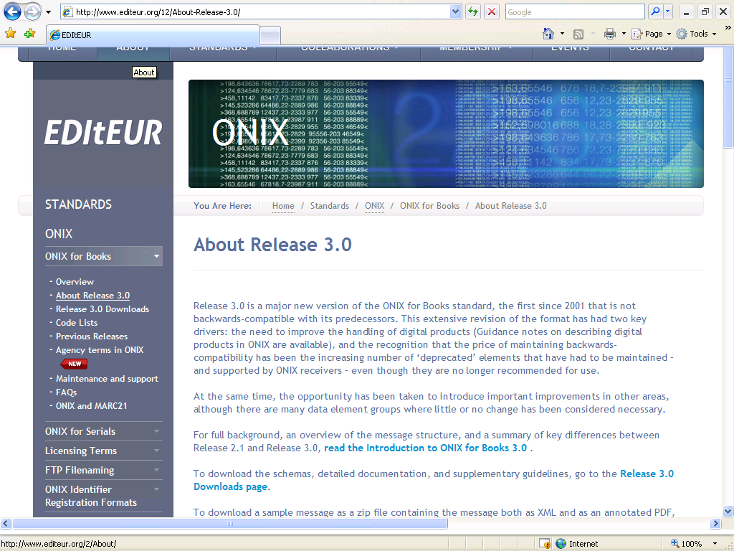
ONIX is the international standard for the book industry
Notes:
During the past two years, we have been devoting attention to the relationship
The homepage for EDITEUR – the agency that maintains ONIX.
ONIX stands for Online Information Exchange.

Slide 5
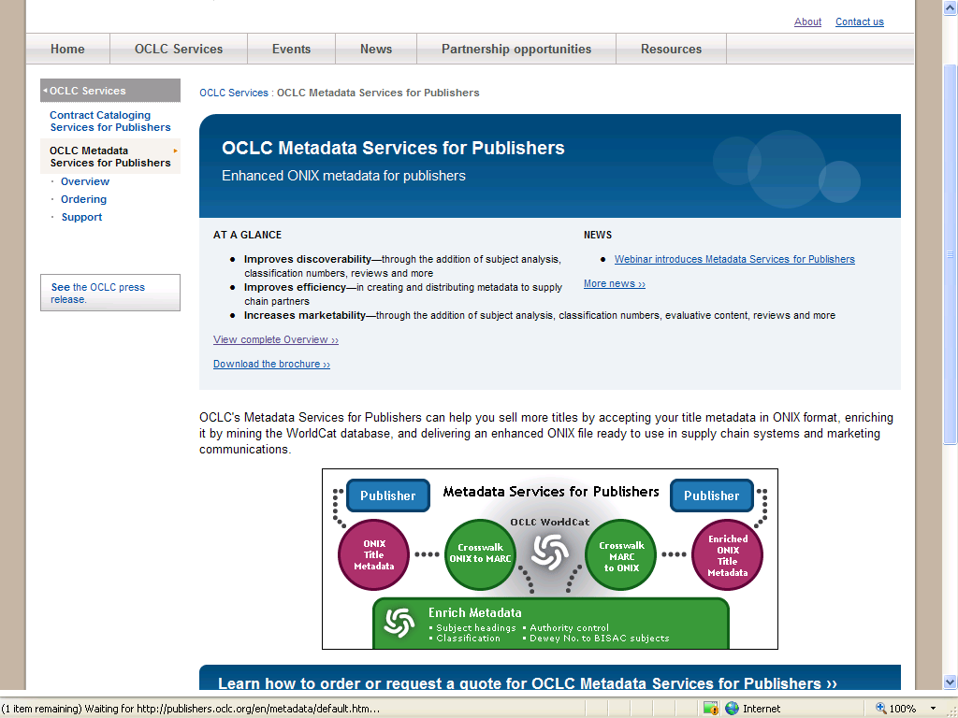
Notes:
We are using it in the recently released Metadata for Publishers product, which attempts to streamline the management of bibliographic metadata in the library and publishing communities.
ONIX records are obtained from publishers and mapped to MARC.
If a match is found in WorldCat, fields from the corresponding MARC record are applied to it.
If no match is found, the record is populated from fields in the closest FRBR cluster.
The result is mapped back to ONIX to be delivered to publishers. It is also made available to the library community as an enhanced MARC record.

Slide 6
ONIX and MARC records
<Product>
<RecordReference>0892962844</>
<ProductIdentifier>
<ProductIDType>02</>
<IDValue>0892962852</>
</ProductIdentifier>
<ProductForm>BB</>
<Title>
<TitleType>01</>
<TitleText>McBain’s Ladies</>
</Title>
<Contributor>
<ContributorRole>A01</>
<PersonNameInverted>Hunter, Evan</>
</Contributor>
<Subject>
<SubjectSchemeIdentifier>02</>
<SubjectHeadingText>
Policewomen--Fiction.
Leader 00000 jm a22000005 4500
008 g eng
020 $a 0892962852
100 $a Hunter, Evan
245 $a McBain’s ladies
260 $b Mysterious Press $d 1988
300 $a 320 p.
650 #2 $a Policewomen -- Fiction
Notes:
Why do we do this?
Here’s a snippet of a record in ONIX – the international standard for metadata descriptions in the publishing community. ONIX is an acronym for Online Information Exchange.
Now here is the corresponding MARC record. The blue text is just the structure of the the two records—fields, subfields, indicators, elements, composites. The green text is coded data. The red text is the visible data in the record.
It’s obvious even to the casual observer that these two records contain the same information. If we could map the structure and the coded data, we could express this equivalence. Then:
Records could be shared across communities.
Information a record in one community could be applied to a record in the other. In other words, the metadata streams could be merged.
It’s now an overused word, but we create a crosswalk between ONIX and MARC to increase interoperability between the two standards.

Slide 7
Some maps between ONIX and MARC
ONIX path | ONIX code
ProductIdentifier / ProductIDType | IDValue=2
Title / TitleText = 01 | TitleType=1
Subject / SubjectHeadingText | SubjectSchemeIdentifier=02
MARC element | MARC i1,i2
020 $a
245 $a
650 $a | 2
Notes:
The relationships shown in those two records can be distilled into a crosswalk that looks like this. ONIX elements qualified by particular codes are mapped to MARC.
It shows three examples:
An ISBN
A primary title
Library of Congress subject heading
The entire map from ONIX to MARC is publically available.

Slide 8
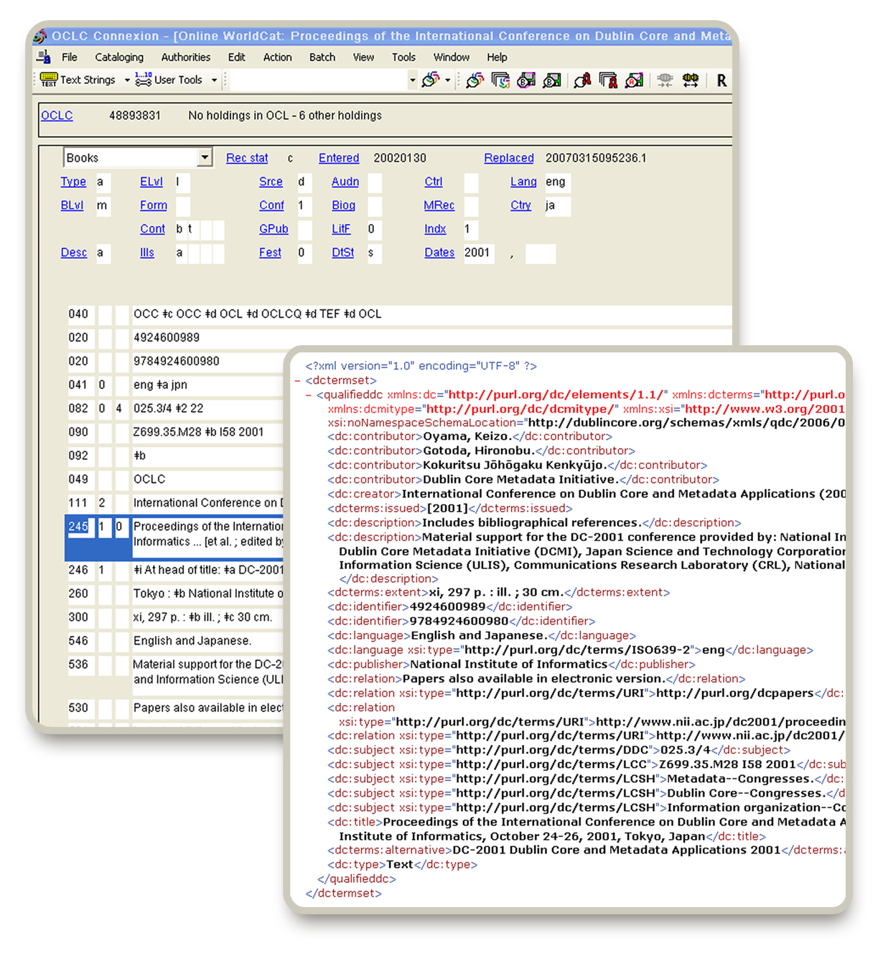
Notes:
Here’s another example:
This is a screenshot of the Connexion Browser, which shows a record exported in Dublin Core Terms. (Records are collected into a Save file.)
The translation to DC-terms is state-of-the-art. The translation and the feature in Connexion are underutilized. It has generated interest among member libraries in central Europe, who are developing crosswalks to DC-Terms to promote interoperability among various flavors of MARC and non-MARC metadata such as ONIX.

Slide 9
Some maps between Dublin Core and MARC
DC Simple | DC Terms | MARC tag | MARC subfields
dc: subject | dcterms: subject | 650 | a
 | dcterms: Audience | 521 | a
dc: coverage | dcterms: Spatial | 522 | a
Notes:
A portion of the crosswalk looks like this. It’s deceptively simple.
Here’s a snapshot of the crosswalk. It is completely machine-processable. The metadata subject matter expert maintains the table. When it changes, it is fed into software that produces the executable translation logic.
This table shows the essential relationships among three elements: MARC, DC-Terms, and DC-Simple.
The first row—DC-Subject is the same in DC and DC-terms. They map to 650 a.
The second row—DC-terms adds the concept audience and maps it to 521 a
The third row—DC terms overrides the general DC concept ‘coverage’ with a more specific term—Spatial and maps it to 522 a.
This table lets us process many kinds of records, including
Pure MARC records, Pure Dublin Core records, and Dublin Core records with DC-terms extensions, which are produced by Connexion.

Slide 10
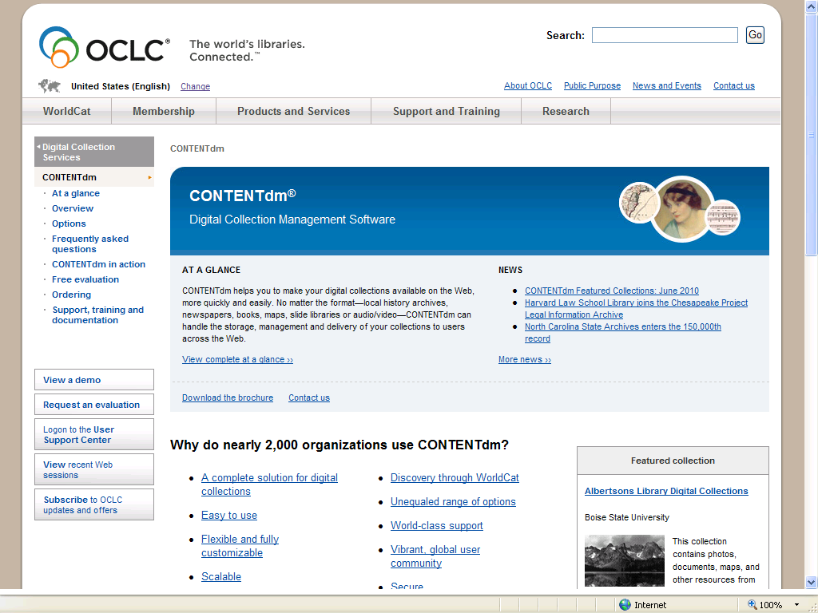
CONTENTdm
Notes:
The final example is from CONTENTdm, OCLC’s software for managing collections of digital resources. To make the collections accessible to WorldCat.

Slide 11
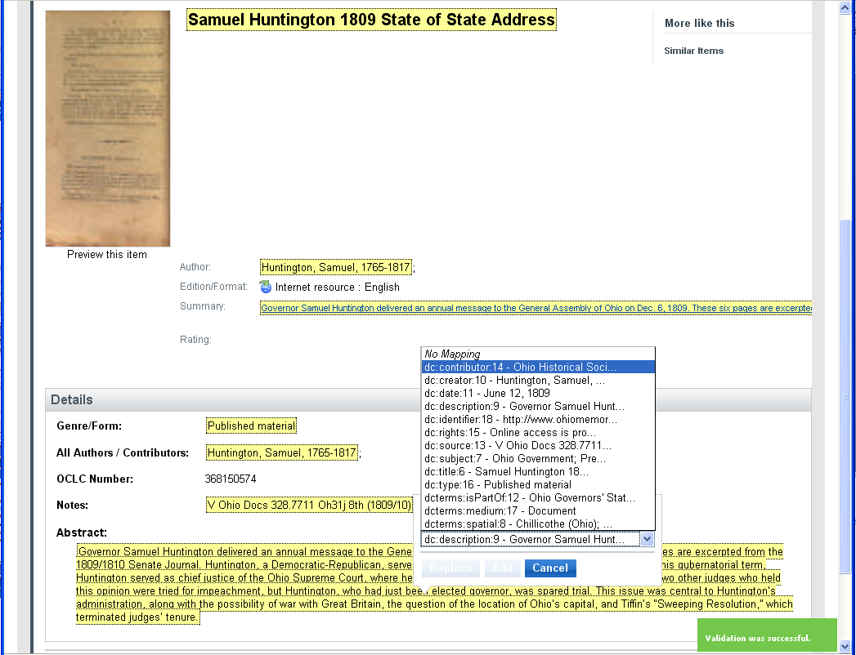
You can adjust where source metadata
fields appear in the WorldCat.org display
Notes:
The Digital Collection Gateway synchronizes the metadata from your CONTENTdm collection with WorldCat. The starting point is a Dublin Core to MARC crosswalk that is a subset of the one used in Connexion. But local practice in the management of digital collections varies. So each mapping can be customized.
You use the Digital Collection Gateway to adjust the display of your source metadata (from your CONTENTdm collection) to the best places in the WorldCat display.
Using pull-down menus you can alter which source DC fields are associated with different aspects of the WorldCat.org display.
Changes in this association are carried across every record in your collection. The final map you create is stored in a Profile for the collection in the Digital Collection Gateway.
11

Slide 12
In sum:
What we have learned to do pretty well
Manipulate MARC and MARC-like formats.
Manage variation in structure and character encoding.
Manage different versions.
Reduce and (almost) eliminate data processing silos.
Automate what is systematic and regular.
Reuse software and metadata subject matter expertise.
Notes:
This is a good place to pause and reflect on what we have learned to do pretty well.

Slide 13
But…
We must move toward new paradigms for metadata creation and maintenance that permit:
  Greater interoperability and shared metadata.
  Mechanisms for allowing metadata to “grow up” over time.
Notes:
Given what we have accomplished, why is this task so difficult?

Slide 14
The old and new paradigms
Non-MARC elements
MARC record
Subject
Publisher
Identifier
Contributor
ISBD punctuation
Physical description
AACR2 encoding
Notes:
One problem:
We are dealing with two paradigms in metadata processing. On the left is a schematic representation of non-MARC metadata streams such as ONIX or Dublin Core Terms. They are designed to be taken apart, enhanced, and merged as processing needs change in a supply chain.
On the right is a schematic view of a MARC record. When we create a crosswalk, we are mapping pairs of elements. But MARC has additional packaging that can get in the way, making the mapping task more complex, more brittle, and less generic.
Extra effort is required to add, validate, and dismantle ISBD and AACR2 rules, adding complexity to the metadata translation/conversion problem space.
For example, AACR2 introduces concepts that the other standards don’t have.
Another example: The ISBD and AACR2 layers are not a worldwide standard.
These additional layers create challenges for mapping, creating FRBR clusters, other processes involving MARC records:
Physical descriptions.
Sets and series
Collections vs. items.

Slide 15
The two paradigms
MARC records
Record-oriented
Tailored to applications in the library community
Designed for storage
Stable
Modern non-MARC records
Element or field-oriented
Agnostic about how the data will be used.
Designed for transmission
Dynamic
Notes:
Record-oriented: The fields contain valuable data that is meaningful in isolation (Titles, subjects), but AACR and other semantic standards turn them into a package/The other standards don’t have this packaging. They can be taken apart and recombined more easily.
For applications: Designed to facilitate discovery and display in library databases/The other standards need to be enhanced to support library applications. But they support commercial transactions, data mining.
Designed for storage.
Static. MARC records can be edited, of course. But if the goal is an archival-quality description of an item in a library collection, at some point the description is good enough and doesn’t need to change anymore. ONIX records are fundamentally different. They are in flux as they pass through the supply chain. Different players add subjects, identifiers, descriptions, reviews, links to websites, They change prices, and availability status. There is no sense that the record is evolving toward perfection, just that the ONIX standard provides a platform for supplying the information that is needed at the moment.

Slide 16
Where we are
Where we want to go
Creating MARC and non-MARC metadata, often redundantly.
Limited reuse outside the library domain.
Metadata created by libraries generally hidden or buried in Web results.
Create metadata once, and reuse in different contexts.
Expand reuse of metadata from variety of sources for our own context.
Contribute our own metadata to the Semantic Web for discovery and metadata creation.
Notes:
16

Slide 17
And…
We’ll need crosswalks to get there.
They are a critical tool for leveraging the investment that the library community has made in the creation of high-quality metadata.

Slide 18
For more information
Carol Jean Godby. 2010. “Mapping ONIX to MARC.”
  http://www.oclc.org/research/publications/library/2010/2010-14.pdf.
EDItEUR. http://www.editeur.org/.
Karen Smith-Yoshimura, Catherine Argus, Timothy J. Dickey, Chew Chiat Naun, Lisa Rowlison de Ortiz, and Hugh Taylor. 2010. “Implications of MARC tag usage on library metadata practices”
  http://www.oclc.org/research/publications/library/2010/2010-06.pdf

