Slide 1
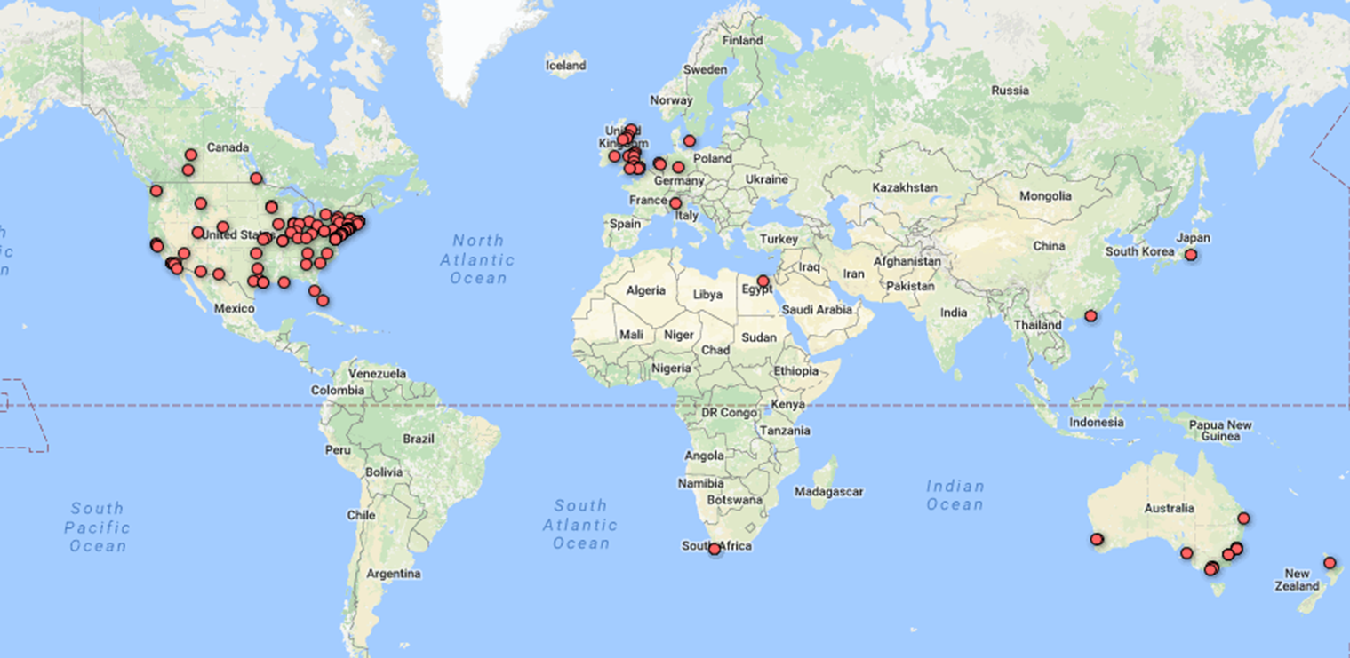
February 2017
The OCLC Research Library Partnership
Karen Smith-Yoshimura
Senior Program Officer
OCLC Research

Slide 2
Objective
  Scale and accelerate library learning and innovation through collaboration
Notes:
This is the overall objective of the OCLC Membership and Research Division

Slide 3
OCLC Research Library Partnership
Develop a shared understanding about current trends and future directions among the OCLC Research Library Partnership
Address challenges jointly and take steps towards realising that shared view

Slide 4
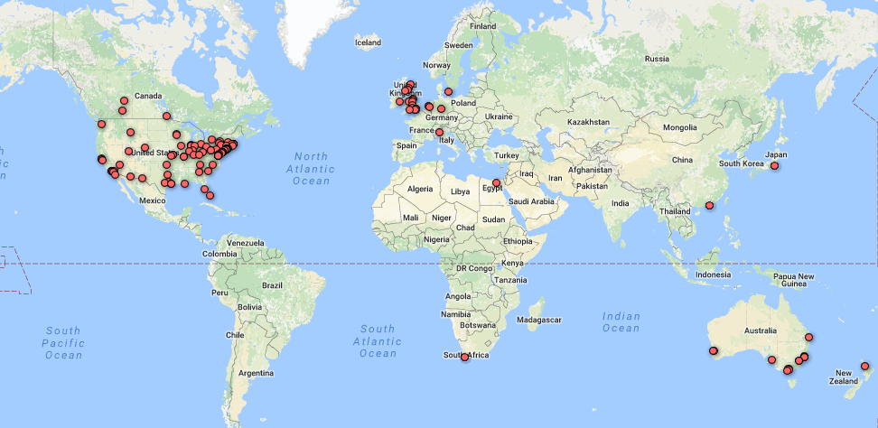
The Partnership
25 of top 30 universities in Times Higher Education Ranking
Notes:
Of the 160 or so institutions affiliated with the OCLC Research Library Partnership, one-third are located outside the United States.

Slide 5
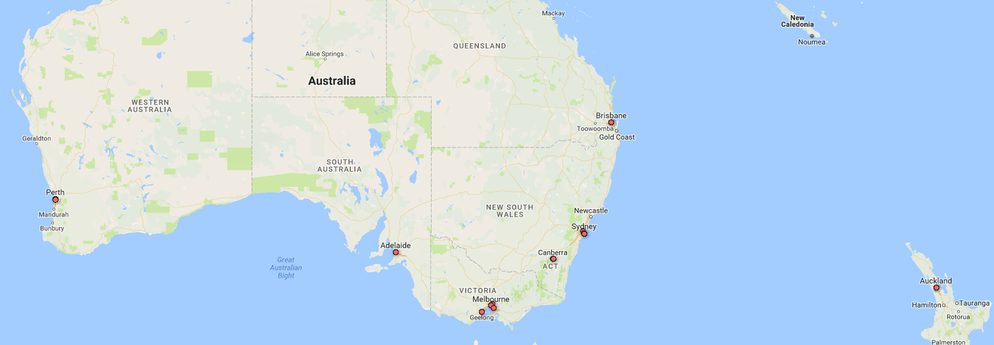
14 Partners in Australia & New Zealand

Slide 6
Methods
Outputs:
Publications
Webinars (recorded)
Presentations
Working Groups
Webinars, WebEx discussions
“Works in Progress” Webinars featuring Partners
Face-to-face meetings
Prototypes
Notes:
The OCLC Research Library Partnership is part of the “Membership and Research” division at OCLC. I am focusing today on the work program officers do in collaboration with working groups drawn from the OCLC Research Library Partnership.

Slide 7


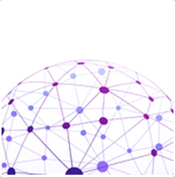
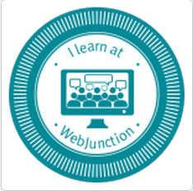

Themes oclc.org/research/themes/
Research Collections and Support
User Studies
Understanding the System-wide Library
Scaling Learning
Data Science
Notes:
We’ve categorized all our activities under these five themes:
Research collections and support: under this theme, our work informs current thinking about research collections and the emerging services that libraries are offering to support contemporary modes of scholarship. With regards to research collections the focus is on a) institutional research assets and outputs, b) digitized special collections as raw materials of scholarship, and c) archival, including born-digital, collections.
2) Understanding the system-wide library: this theme looks at library networks and cooperative networks with other stakeholders, with a focus on resource sharing. The research aims to improve our understanding of the factors that guide institutions in their sourcing and scaling choices as they seek maximum impact and efficient provision of library collections and services. Inter-library loan networks is an obvious example.
3) Data Science: this theme is devising new ways a) to transform traditional library data into data that integrates better into the Web through linked data and b) to mine bibliographic records and extract new meaning and insights, and enrich the data.
4) User Studies: this theme looks at the ways in which individuals engage with technology; how they seek, access, contribute, and use information; and how and why they demonstrate these behaviors and do what they do. We're collaborating with librarians to ensure that the design of future library services puts the user in the centre.
5) Scaling Learning: The WebJunction platform delivers learning at scale. Over its 15 years, it has delivered on-line training programs, self-directed study, peer-to-peer knowledge and facilitated communities of practice. It currently delivers learning experiences to over 45,000 participants each year.
The following slides highlight some activities under each of the 5 themes, with a focus on those involving OCLC Research Library Partners. There are too many activities to be exhaustive in this brief presentation.

Slide 8
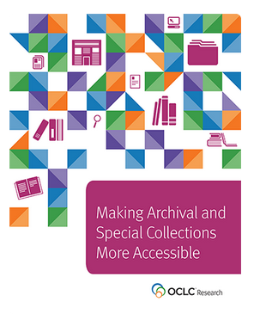
Research collections & support
  Mobilize unique materials.
  Encourage interlending of physical items from special collections for research.
  Reveal hidden assets to a global audience of researchers, enhancing the reputation of the steward.
Archival Collections Assessment Working Group
EAD Implementation Working Group
Working Group on Streamlining Photography and Scanning
Sharing Special Collections Working Group
Notes:
This is about research collections, in particular the unique and special collections (rare books, archival materials, local cultural heritage collections, etc.).
It looks at new ways to valorize paper-based collections, through improved access and through digitization.
It also looks at born-digital collections, which require handling-skills and practices similar to those of traditional archival materials (record-keeping process, authenticity, etc.).
You can read about our research work in this area in the Report: Making Archival and Special Collections More Accessible.
The Report is a consolidation of 7 years of work and provides conclusions and recommendations, and represents the output of multiple Partner working groups listed here.
From Tiers for fears highlights:
Key findings:
Lending physical items from special collections is now more common than not, at least within consortia.
A sense of good will exists in the ILL community toward institutions that are willing lend special collections.
Sometimes only the loan of physical items from special collections can satisfy a request.
The rareness and condition of an item significantly impacts the lending decision.
Risk is the most common reason for not sharing returnable special collections.
The dominant factor in determining the level of lending effort and overhead is attitude toward risk.
A tiered approach to streamlining workflows associated with lending special collections can be invoked based on the material, the request and the risk tolerance of curators and administrators.
Trust must exist not only between borrowing and lending institutions but also between ILL and Special Collections.

Slide 9
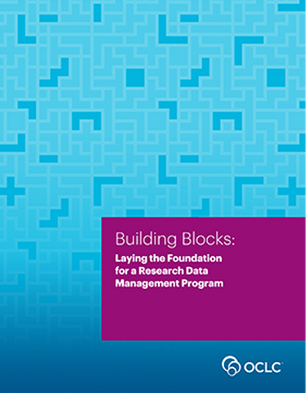

Research collections & support
Role of libraries in data curation
Increasing role for libraries in data curation
Need resources to sustain
Pros & cons of 7 possible funding sources, situations in 7 countries
Low overhead-ways to start management program
Services libraries may offer
Data Curation Funding Working Group
Data Curation Building Blocks Working Group
Data Curation Policy Working Group
Notes:
Both of these reports were published last year. The Funding report includes in its appendix the situation in Australia and New Zealand.
Highlights from Building Blocks:
Public funding agencies increasingly are requiring that research grant recipients make their data publicly accessible, which exposes valuable university assets.
The library is well situated to manage activities such as outreach, data deposit, metadata creation, and preservation; some university libraries are directed to do so, while others proactively offer their services.
Libraries that are beginning to design a program need foundational guidance in areas such as needs assessment, outreach and training for researchers and library staff, preparation of data management plans, and legal issues.
Libraries that have an active program in place need more detailed guidance, which comprises Part 2 of Building Blocks.
The published literature in this area is already extensive, and Building Blocks includes more than 100 citations to material addressing all aspects of data management planning.
This work also benefitted from three Partner working groups. Leo Konstantelos (U. Melbourne) and Fei Yu (U. Queensland) served on the Funding Working Group and Anna Shadbolt (U. Melbourne) served on the Data Curation Policy Working Group, resulting in the 2013 preceding report, Starting the Conversation: University-Wide Research Data Management, which identified campus stakeholders and topics for libraries to raise about the advantages of a campus-wide policy.

Slide 10
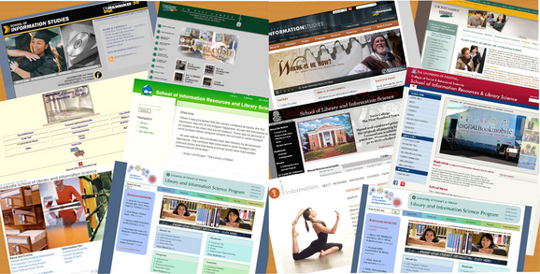
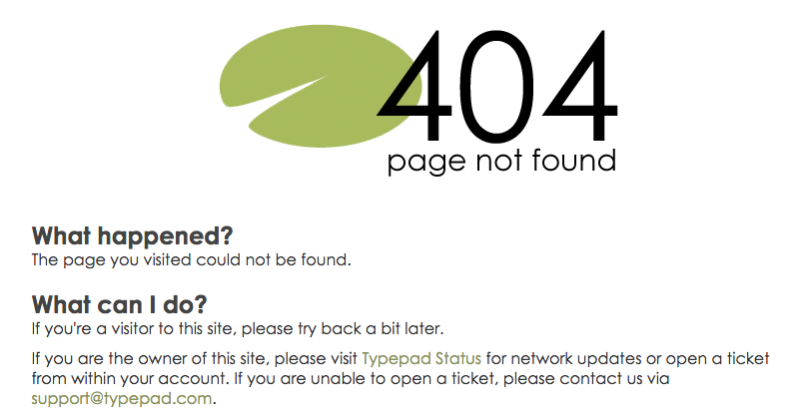
Research collections & support
Web Archiving Metadata Working Group, 2016-
Evaluate approaches to descriptive metadata
Synthesize user needs and behaviors
Recommend community- and output-neutral best practices for metadata that meet user needs
Develop data dictionary
Evaluate available tools
Notes:
““Web archiving operates at the frontier of capturing and preserving our cultural and historical record.” – British Library web archive blog, 2016-09-14
A 2015 survey of members of the OCLC Research Library Partnership revealed the lack of descriptive metadata guidelines as the biggest challenge related to website archiving among this cohort. The second most-cited challenge is to learn about the needs of users who seek to use website content in their work.
The Working Group conducted two literature reviews: identified and gathered about 33 (user needs) and 23 (metadata) articles, reports, blog posts, conference presentations, and social media exchanges that were related to user needs and/or metadata issues for web archives.
From abstracts they created synthesis of findings based on some main topics that emerged from readings.
Studying users’ needs is a necessary prelude to developing metadata best practices. Noted that users are not often aware that libraries harvest and archive web content. Working Group focused on who uses web archives, how and why do they use them, and what can libraries do to support users’ needs. Users of web archives are – academic researchers, legal researchers, digital humanists, data analysts, web and computer scientists. They have different uses and needs of web archives: reading specific web pages/sites; data and text mining; technology development.
The recommended best practices for web archiving metadata also need to ensure discoverability and consistency. The working group is developing a data dictionary – a set of data elements with the scope of each defined.

Slide 11
Preliminary findings
User Needs
Lack discovery tools
Provenance critical: Why & when was a website created and collected?
Libraries & archives need to teach users how to find and use archives and available tools
Metadata Issues
No best practices exist
Elements vary widely
Level of description varies
Tools have few or no metadata-related features; metadata must be created manually

Slide 12

Some dilemmas specific to Web content
Who is Website creator/publisher?
What title should be recorded?
Which dates are important?
What role should be assigned to the harvesting institution?
What does provenance mean here?
Coming in 2017: Three reports
Tools evaluation, with evaluation grid
User needs, with annotated bibliography
Best practices guidelines, with evaluation grid
Notes:
Is the website creator the publisher? Author? Subject? All three?
Should title be … transcribed verbatim from the head of the site? Edited to clarify the nature/scope of the site? Should acronyms be spelled out? Should it begin with "Website of the …"
Which dates are both important and feasible? Beginning/end of the site's existence? Date(s) of capture by the repository? Date of the content? Copyright?
Is the institution that harvests and hosts the site the … repository? creator? publisher? selector?
Does provenance refer to …the site owner? the repository that harvests and hosts the site? ways in which the site evolved?

Slide 13
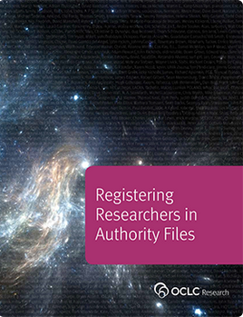
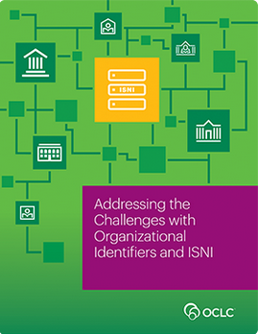
Research collections & support:
Identifiers
Need for identifiers in library workflows to support research information management – and linked data.
Importance of correct scholarly affiliations
Models organizations that can be adapted by others
Registering Researchers in Authority Files Task Group
Representing Organizations in ISNI Task Group
Notes:
University libraries increasingly register the researchers affiliated with their own university and the outputs they produce.
We are working with OCLC Research Library Partners and others to explore new modes of tracking and registering researcher identifiers and compiling their scholarly output.
Registering researchers in some type of authority file or identifier system is becoming more important. The report presents functional requirements and recommendations for different stakeholders (researchers, funders, university administrators, librarians, publishers, etc.). It also provides an overview of the researcher identifier landscape, changes in the field, emerging trends, and opportunities. It is written in collaboration with 14 experts from the field.
More recently, we have looked at organisational identifiers that are needed to validate the affiliation of researchers and that can help disambiguate researchers’ names. The Partner Task froup on Representing Organizations in ISNI identifier also documented the overall challenges in assigning identifiers to organizations; the modeling done can be adapted by others. Kate Byrne (then at UNSW Australia) and Roderick Sadler (La Trobe University) served on the task group.
As a result of OCLC Research’s work in this area and also in the area of linked data, OCLC as an enterprise has gained better insight in the needs of libraries for person reconciliation services.

Slide 14
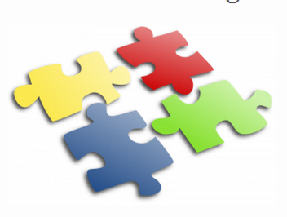
Research collections & support
Research Information Management
Aggregate, curate and use information about research output
Understand impact of research
Increase research visibility
Increasing library involvement
Two new working groups, 2016-
Survey research institutions to gauge RIM activity
Institutional requirements and activities for RIM adoption
Notes:
Research support is about university libraries supporting their own parent institution and their own researchers, in a local university setting. This effort follows the previous work mentioned earlier about research data curation.
Support services include: helping with data management policies and plans; helping register research information and the university’s output; helping with the metrics to measure university impact and highlight research reputation; etc. We recently launched this new program, with two new working groups.
For a more detailed overview, see Rebecca Bryant’s 2017-01-16 HangingTogether blog post, An increasing role for libraries in research information management,
http://hangingtogether.org/?p=5794
Roxanne Missingham (Australian National University) and Simon Huggard (La Trobe University) are serving on the Institutional requirements and activities working group.

Slide 15
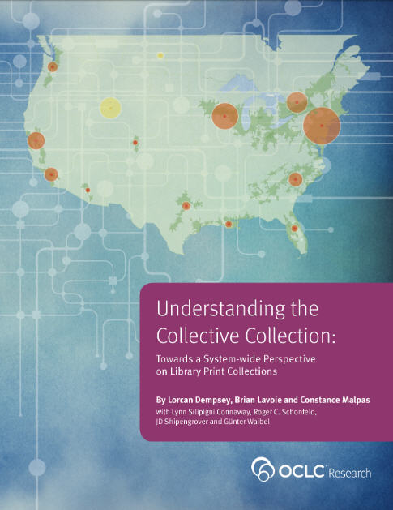
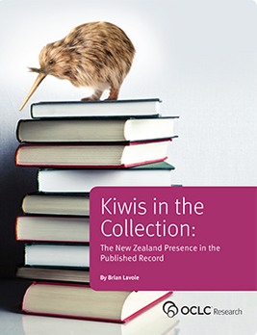
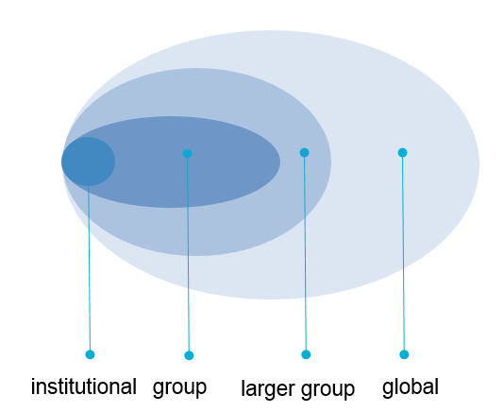


Understanding the system-wide library
Notes:
Understanding the system-wide library is another strand of research activities. It looks at library cooperation in an increasingly complex network of information supply and demand. It aims to help libraries to better understand sourcing and scaling choices of collaboration. The “System-wide" refers to the scale of the collaboration: whether the system is consortial, regional, national or global.
Under this strand of activities, we look at library collection aggregates and their characteristics, to inform library shared print policies. Libraries are beginning to evolve arrangements that facilitate long-term shared management of the print literature as individual libraries begin to manage down their local capacity.
We are helping library consortia and the OCLC Cooperative gain insight in the landscape of print collection aggregates. We call this work, the “Collective Collection Studies”.
Sharing data in WorldCat makes it possible to look at the aggregates of library collections (e.g. the aggregate of the ARL-libraries in the US, of the RLUK libraries in the UK) and to analyze their characteristics and derive intelligence about the “collective collection” represented by the aggregate. We are doing several such studies to help libraries take a system-wide perspective and to enable them to take well-informed policy decisions.
We look at characteristics of collective collections at variety of scales: in comparison with other/smaller or larger groups
We look at size, distinctiveness, distribution, material types, languages, duplication rates, publication dates, …
You can do more in the context of WC than you can in a local catalogue, a national union catalogue or a regional catalogue. The research studies provide broad insights into the nature of collective collections in different geographies and library segments.
We have also looked at the “Scope and Diffusion of National Presence in the Published Record”. Our 2014 report by colleague Brian Lavoie describes the size and scope of the New Zealand presence (works published in New Zealand, created by individuals born in New Zealand, or are about or set in New Zealand) and its diffusion around the world.

Slide 16

Understanding the system-wide library SHARES
Trusted network of 85 Partners in 9 countries, 4 continents
Consider each request
Below market rates
Expedited delivery
Lend returnables overseas
Reciprocal on-site access
Share expertise!
SHARES Executive Group
SHARES Best Practices Working Group
Notes:
SHARES is the longest-running standing Partnership group, active for over 30 years, available only to institutions affiliated with the OCLC Research Library Partnership. Participants agree to no “blanket restrictions” but consider each request, including normally non-circulating materials.
SHARES Executive Group:
Governing body of SHARES, the resource sharing consortium for OCLC Research Library partnership member institutions. 8 executives serve 2 years terms, with 4 rotating off each year. Three of the seats are reserved for a law library, and museum library, and a non-US library. Group nominates peers, and folks can self-nominate. SHARES liaisons for each institution vote on nominees, with 4 “running” for 4 slots each year. Liaisons have the option of writing in candidates.
SHARES Best Practices Working Group:
Since 2014, working to develop a hierarchical set of collection sharing best practices, flowing down from the SHARES statement of purpose, with four columns representing: 1) abstract principles; 2) granular operational best practices; SHARES-specific best practices (such as “Lend any class of material you would be willing to borrow on behalf of your own patron”); to a red column filled with worst practices. Size of the group has varied from 6-12 at various times, all from Partnership institutions.

Slide 17
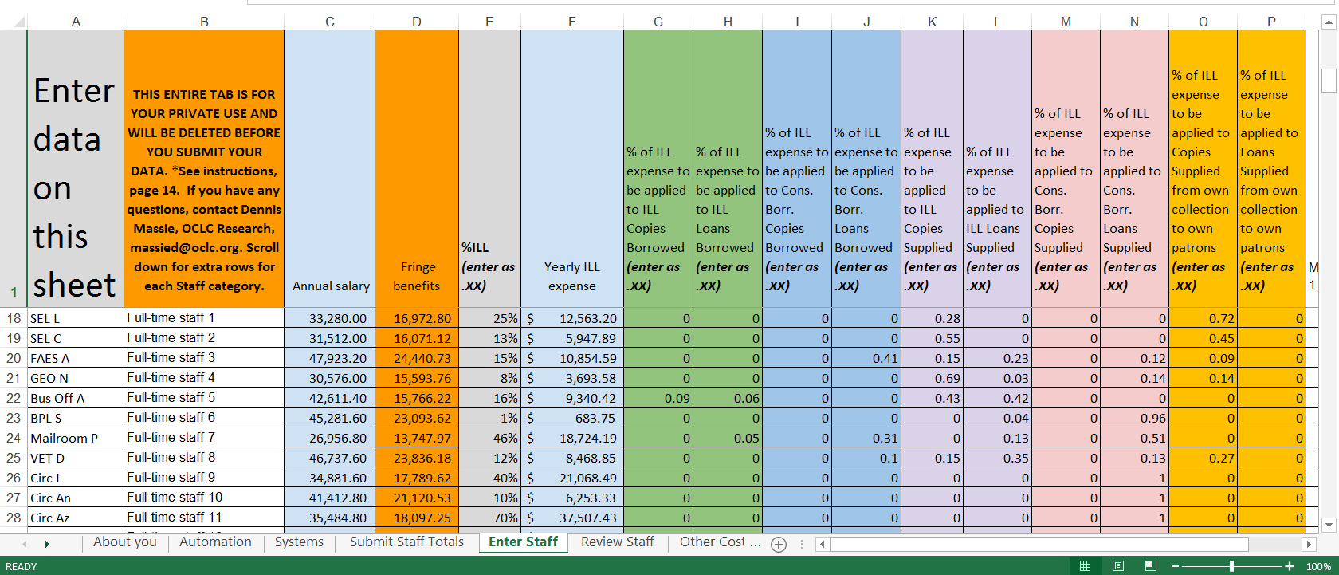
ILL Cost Calculator
Provide fresh data about current models
Help establish best practices
Facilitate comparison with anonymized peers
Support evidence-based decision making
Use cases:
Know resource sharing costs
How costs evolve over time
How costs compare with peers
Project financial impact of automating a process, buying new equipment, implementing new document delivery service
Notes:
Public reports will show high-level average costs but only those who contribute data can access the advanced, privileged reports showing detailed costs and “what-if” scenarios and do custom querying.
Guiding principles:
Make data entry simple and easy
Minimize collection of confidential or sensitive data
Aggregate and anonymize data in reports
Use existing functionality where possible
Aim to produce actionable intelligence, not satisfy curiosity

Slide 18
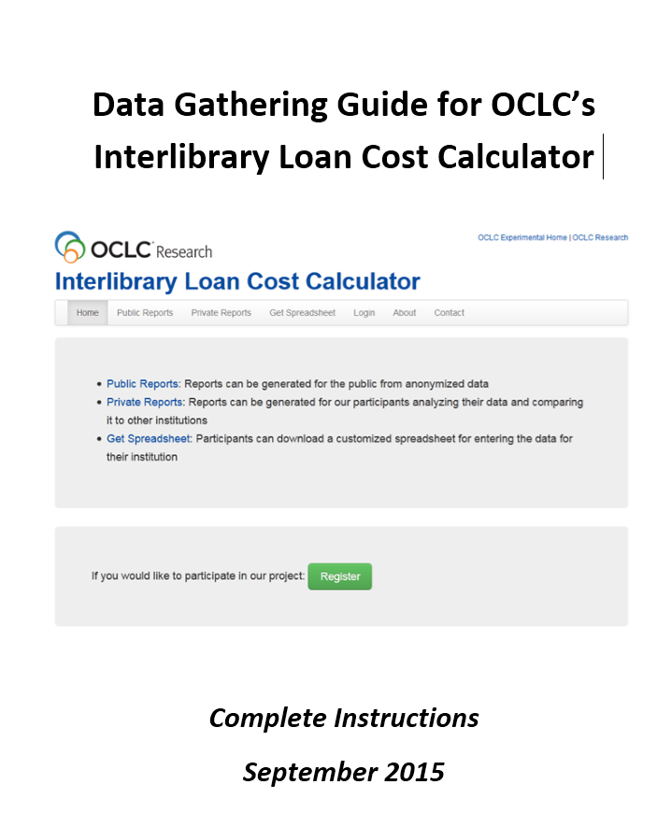
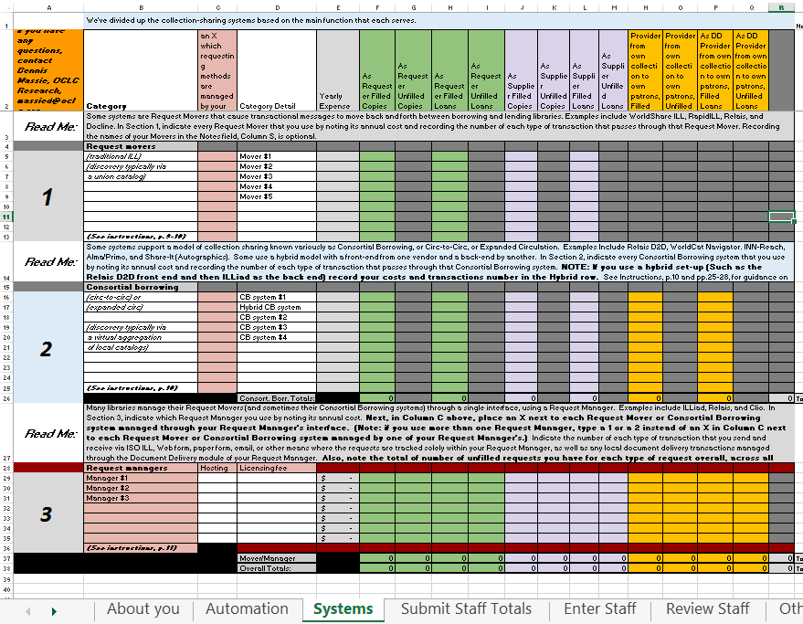
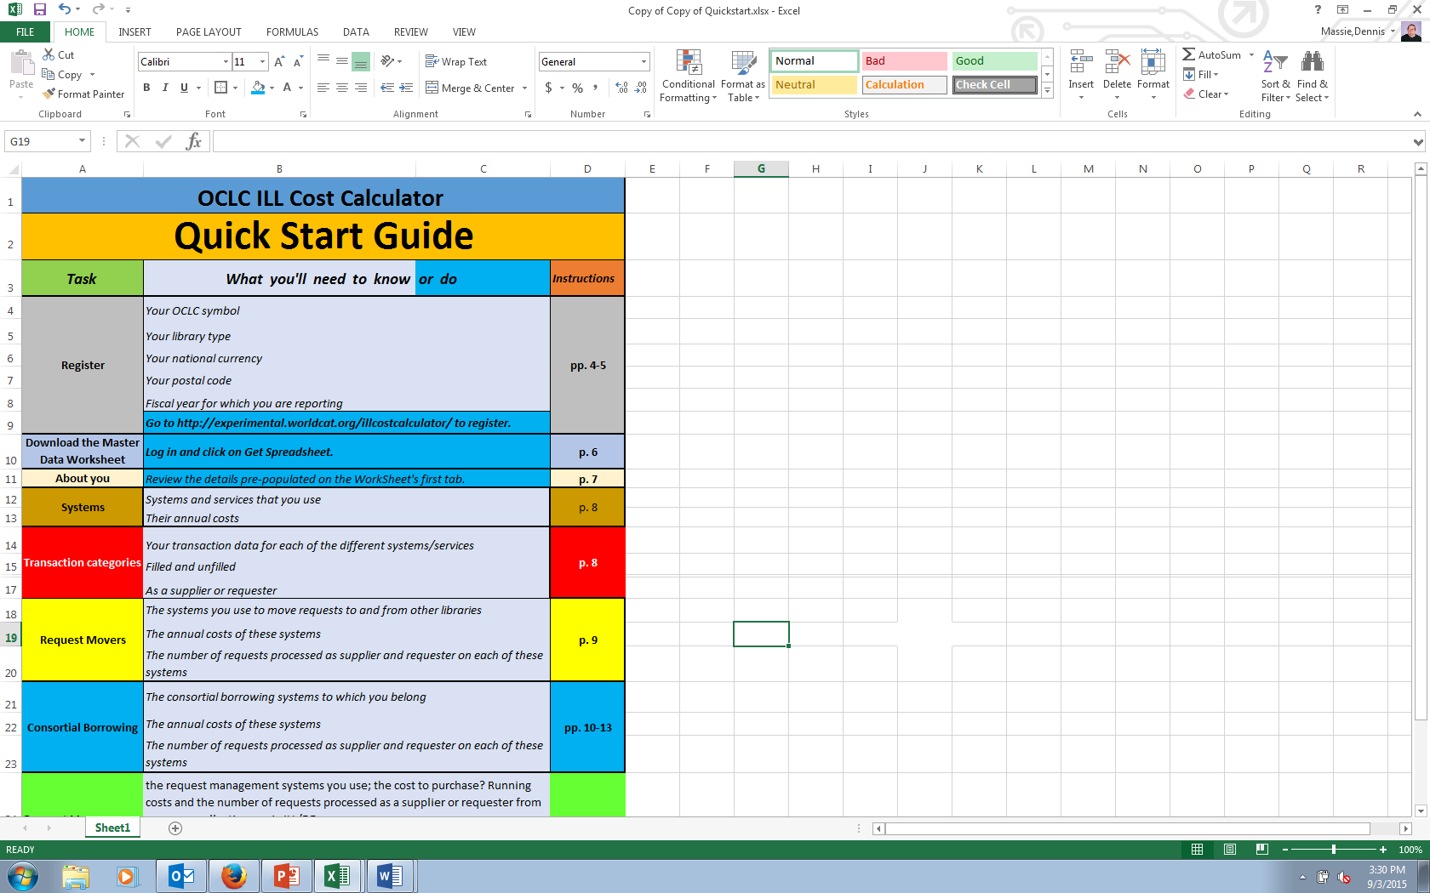
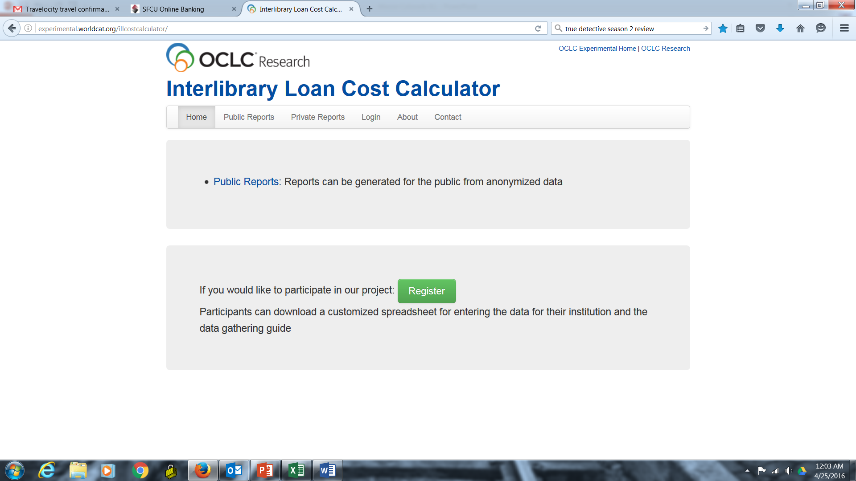
ILL Cost Calculator
ILL Cost Calculator Working Group 2011 -
ILL Cost Calculator Beta Testers 2015 – 2017 (beta phase to end June 2017)
Notes:
ILL Cost Calculator Working Group:
Three staff members from Partner institutions have worked with fellow Program Officer Dennis Massie since 2011 to design a tool that, when completed, will function as a real-time ILL cost study.
ILL Cost Calculator Beta Testers:
Group of eleven collection-sharing experts who since 2015 have been beta testing the registration, data-gathering, and data submission functions of the ILL Cost Calculator, with significant input on overall design questions and on what the reports will contain and look like. We expect this beta phase to end by June 2017, with a fully-functional tool open for early adopters. Eventually will be available to everyone.
Margarita Moreno of the National Library of Australia has been serving on both groups.

Slide 19
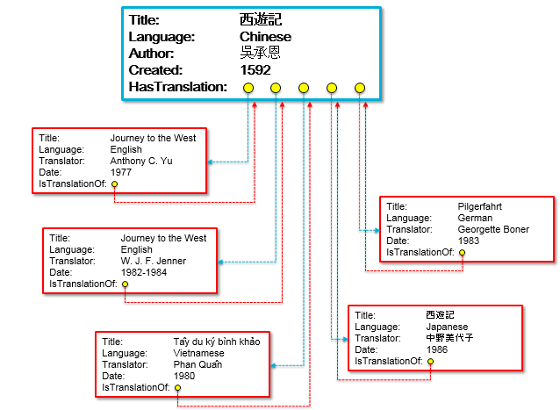
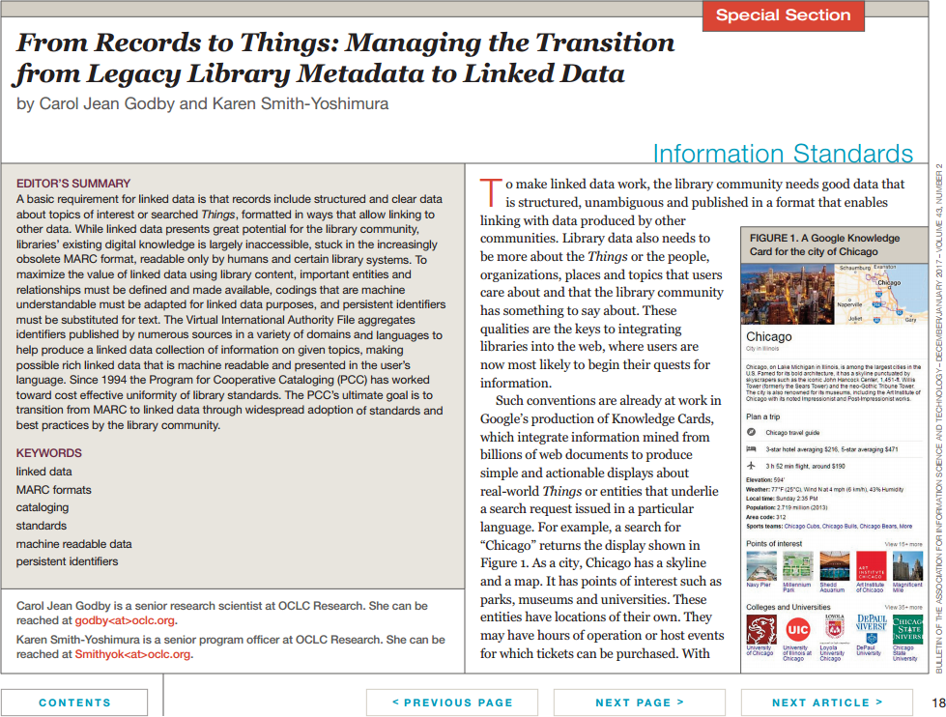
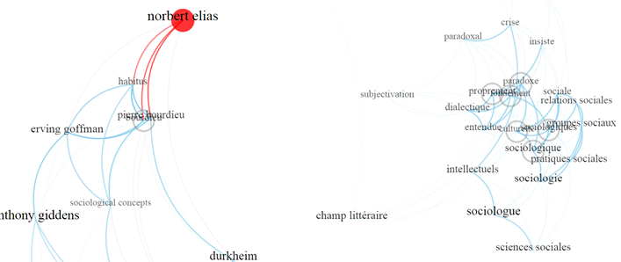
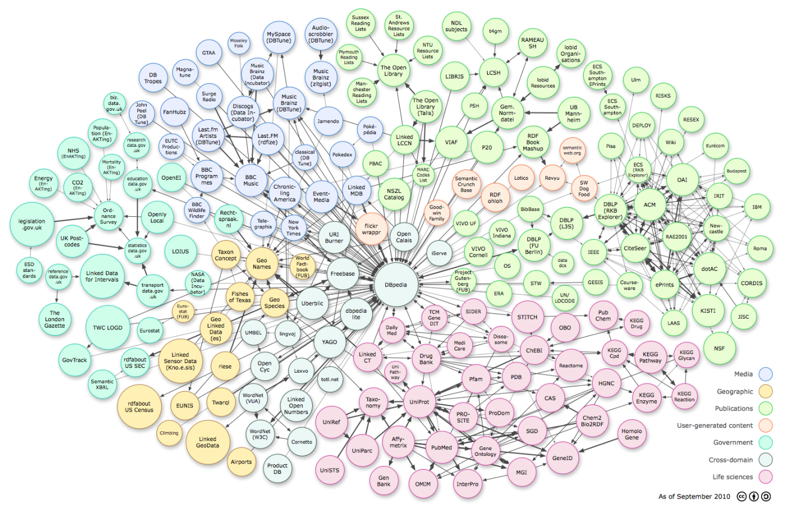
Data Science
Notes:
Much of the work of our research scientists have been in transform and expose the bibliographic data on the web as Linked Data). My colleague Jean Godby and I have made presentations on moving from a MARC to linked data environment, and wrote an article in the December/January 2017 issue of the ASIS&T Bulletin on “From Records to Things.” Our work includes data modeling to highlight relationships among entities in MARC records (such as translations) and visualizing the bibliographic data – we’re working with the University of Amsterdam (an OCLC Research Library Partner) now for visualizing works and translations in philosophy for a June 2017 workshop on “Visualizing Digital Humanities” with data extracted from WorldCat and marked up as linked data.

Slide 20
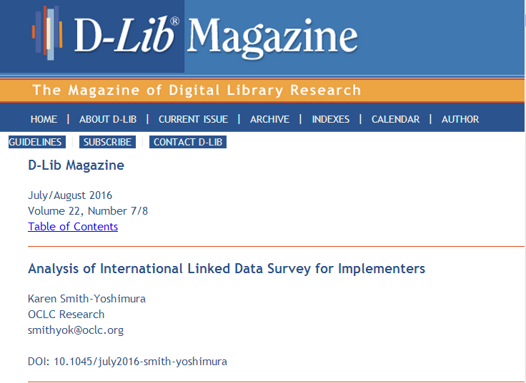

Data Science
International Linked Data Surveys for Implementers 2014 & 2015
OCLC Research Library Partners Metadata Managers Focus Group discussions (summarized in HangingTogether posts)
Notes:
Linked data in particular has been a hot topic among the OCLC Research Library Partners Metadata Managers Focus Group. Indeed, they were the ones who first suggested we do a landscape survey of all linked data implementations (the results of the 2015 survey published in D-Lib Magazine). The Focus Group has had several discussions about linked data topics – what it means for metadata services, identifiers, impact on authority workflows, for example.

Slide 21
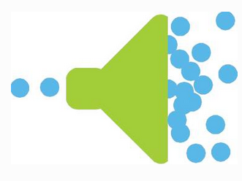
OCLC RLP Metadata Managers Focus Group
Representatives from 51 Partners in nine countries responsible for creating and managing metadata
Share information about common issues
Identify potential new projects, working groups
Provide feedback on data science projects
Funnel to other communities
Upcoming WebEx discussions:
New skill sets for metadata management
Metadata for archival collections
Use cases for local identifiers
Notes:
Researcher and organizational identifiers work mentioned earlier were the direct result of the Focus Group’s discussions on those topics. They also shared their issues regarding metadata for archiving websites, which served as background for the Web Archiving Metadata Working Group. We hold face-to-face meetings in conjunction with the American Libraries Association but then hold WebEx discussions with focus group members who can’t attend the face-to-face meetings – one session on each topic is scheduled to be time-zone friendly for Australia and New Zealand. These WebEx sessions are also recorded. All discussions are then summarized in HangingTogether blog posts.
The focus group’s discussions on local identifiers and authority workflows led to an IMLS (Institute of Museum and Library Services) grant headed by Cornell, in cooperation with OCLC, Library of Congress, Program for Cooperative Cataloging, ORCID, Coalition for Networked Information, SNAC (Social Networks and Archival Context Cooperative), University of California, Davis’ BIBFLOW, Stanford and Harvard to hold a national forum last year on “Shareable Authorities” to guide future work in the community.
We’ll be holding WebEx discussions in March- April on the following topics we discussed in our January face-to-face meeting <click>
Last year’s topics:
Faceted vocabularies
Sharing digital collections workflows
Metadata reconciliation
Metadata for research data management
Metadata for archived websites
Impact of identifiers on authority workflows
Six Partners in Australia and New Zealand are currently represented on the Focus Group:
Roxanne Missingham, Australian National University
Laura Iseman, La Trobe University
Catherine Argues, National Library of Australia
Ksenija Obradovic, U. Auckland
Helen Morgan, Heather Todd, and Fei Yu, U. Queensland
Jennifer Langenstrass, U. Sydney

Slide 22
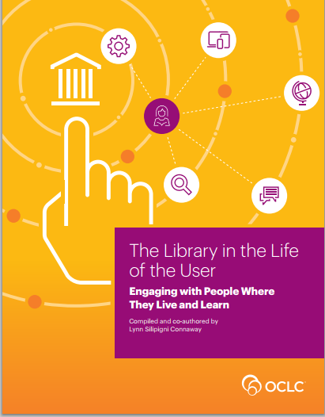
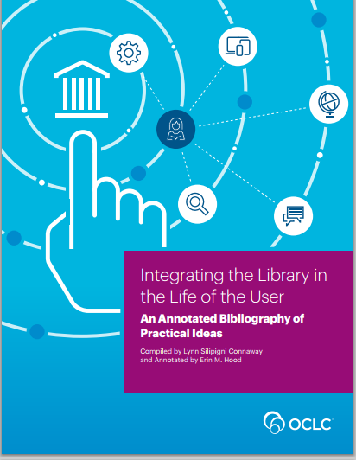
User Studies
“
“Many information seekers, regardless of
demographics, make heavy use of … Wikipedia and
Google.”
Notes:
This area should actually be listed as the first area, because the users and non-users are the ones who help us understand the reason why library services are successful or unsuccessful.
This is where all research should start.
We consolidated our user behavior research findings in the compilation, “The Library in the Life of the User: Engaging with People Where They Live and Learn”.
This report is useful to library and information professionals as they think about new ways to provide user-centered library services and to conduct research that will inform practice in ways to engage and build relationships with users and potential users. “The context and situation of the information need often dictates how people behave and engage with technology.”
Our User behaviour studies are more than “just conducting a survey” and different from user satisfaction studies around a specific library product or service.
Our studies are longitudinal and follow users over longer periods-of-time, to detect behavioral patterns and shifts in the patterns. We use social science methods and techniques like semi-structured interviews, focus-group interviews to collect qualitative data and we use anthropological observational skills and methods to follow users in the spaces where they collect, use and share information.
Our research shows that by taking a broader perspective, we can collectively, as libraries, start to better understand the behaviour of readers and how to re-position our serices in the global Web-ecosystem.

Slide 23
User Studies
Digital Visitors and Residents
Notes:
The Digital Visitors & Residents research, which looks at individuals and how they engage with technology, is an example of how we develop user research methods and make them applicable for practical library purposes.
We are enabling others to replicate such methods and thereby allow to compare results from multiple countries.
We have trained researchers and librarians in Europe to replicate our data collection methods. Together with the libraries, we analyse the results, which help them assess their services and determine which changes are necessary. We even developed an application for this information gathering.

Slide 24

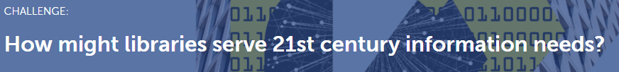
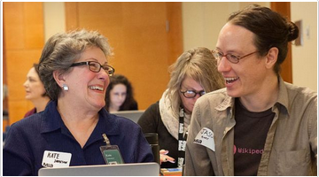
Scaling learning
Improve access to knowledge and
empower citizens: Amplify libraries
and communities through Wikipedia
Library staff will learn to contribute to Wikipedia, engage their community
members, and better leverage collections
https://www.newschallenge.org/challenge/how-might-libraries-serve-21st-century-information-needs/winning/
improve-access-to-knowledge-and-empower-citizens-amplify-libraries-and-communities-through-wikipedia
Notes:
As noted earlier, students make heavy usage of Wikipedia – even if they search a topic on Google, it leads them to Wikipedia
and they copy and paste references into their own paper. Wikpedia is the sixth most popular website globally. (The National Library of Australia ranks 14,152 globally; the British Library 14,759.)
In June 2016, OCLC won the Knight News Challenge to deliver a national training program in the US for US public librarians to build up their Wikipedia skills and amplify the role of libraries as information literacy leaders in their communities. The Wikimedia Foundation also provided funding for a Wikipedian in Residence (we’re interviewing now) who will develop learning objectives and a curriculum, forge connections with Wikipedians and provide guidance to librarians. A key element of the project is to make library resources more visible to Wikipedians .

Slide 25

Scaling learning
Wikipedia + Libraries: Better Together
Curriculum and teaching materials designed specifically for librarians
Test online synchronous training as model for scaling community engagement
Expose librarians to how Wikipedia works – and expose Wikipedians to the value of library resources
oc.lc/oclc-wikilib
Notes:
Although the project is targeted to public libraries in the United Stattes, its deliverables could be adapted by academic libraries elsewhere.

Slide 26

Engagement opportunities
Join standing Partner groups of your peers:
  SHARES
  Metadata Managers Focus Group
Watch out for new working groups soliciting members on the OCLCRLP-ANNOUNCE-L list
Participate in Partners-only Webinars and events
Share your own “Work in Progress” in a Webinar
Join a Partner email list
Guest blog on HangingTogether.org
Contact your liaison, Roy Tennant (tennantr@oclc.org)

Slide 27
Topic-specific Partner email lists
www.oclc.org/research/partnership/lists.html
Art & Architecture
Heads of Systems
Primary Sources
Metadata Management Interest Group
Research Information Management Interest Group
Web Archiving

Slide 28






Channels to keep abreast
http://www.oclc.org/research
https://twitter.com/OCLC/lists/oclc-research
https://www.facebook.com/OCLCResearch
http://www.slideshare.net/oclcr
http://hangingtogether.org/
http://youtube.com/oclcresearch

Slide 29

Acknowledgements
My fellow OCLC Program Officers who contributed to this overview:
Rebecca Bryant
Jackie Dooley
Dennis Massie
Merrilee Proffitt
Titia van der Werf
Under the leadership of our new Executive Director, Rachel Frick

Slide 30
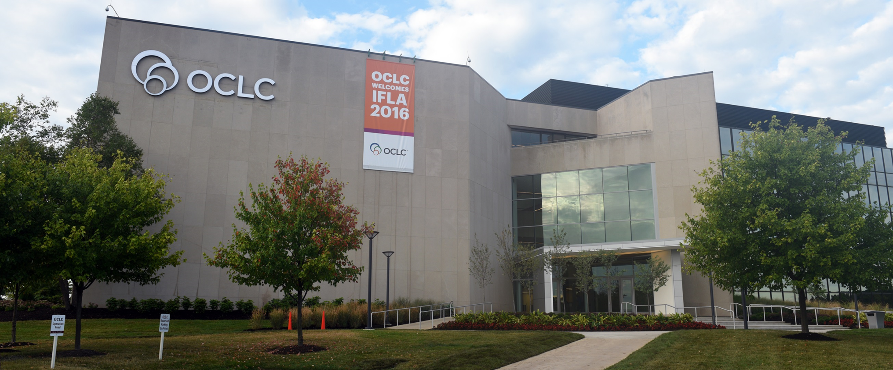

February 2017
Thank you!
Karen Smith-Yoshimura
@KarenS_Y
smithyok@oclc.org
©2017 OCLC. This work is licensed under a Creative Commons Attribution 4.0 International License. Suggested attribution: “This work uses content from ‘The OCLC Research Library Partnership’ © OCLC, by Karen Smith-Yoshimura, used under a Creative Commons Attribution 4.0 International License: http://creativecommons.org/licenses/by/4.0/.”
Notes:
Picture of OCLC Headquarters in Dublin, Ohio.

