Slide 1
OCLC Research & Collective Insight Webinar, October 21, 2014
Wikipedia and Libraries: increasing your library’s visibility
Cindy Aden; Merrilee Proffitt; Jake Orlowitz ,et al
OCLC Business Development & Research,
Director, Wikipedia Library
With panelists from Rutgers University and Montana State University

Slide 2
Panelists
Jake Orlowitz, Wikipedia editor (Ocassi) and Director, Wikipedia Library
Merrilee Proffitt, Senior Program Officer, Research, OCLC
Lily Todorinova, Undergraduate Experience Librarian, Rutgers University
Yu-Hung Lin, Metadata Librarian, Rutgers University
Kenning Arlitsch, Dean of the Library, Montana State University
Cindy Aden, Director of Partner Program , Business Development, OCLC

Slide 3
Program Outline
Setting the scene: research overview
Wikipedia: background
Rutgers University: research on undergraduate behavior
Montana State University: creating library visibility
Connecting to library content: OCLC KB API
Conclusion: questions and follow-up

Slide 4
Merrilee Proffitt

Slide 5
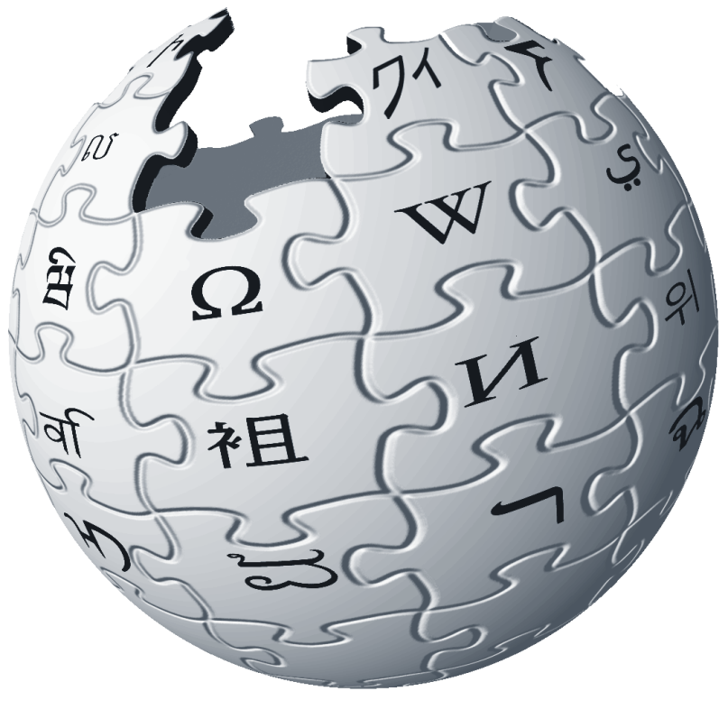
“Discovery happens elsewhere…” Lorcan Dempsey, OCLC Research

Slide 6
Why Wikipedia?
Highly ranked (#6 in global traffic via Alexa)
Starting point for research
Learning black market and GWR Google > Wikipedia > References
Ideologically aligned with library mission
Access to knowledge – for free
Shared appreciation of quality sources
Notes:
talk about why Wikipedia is important to libraries (highly ranked, ideologically aligned)

Slide 7
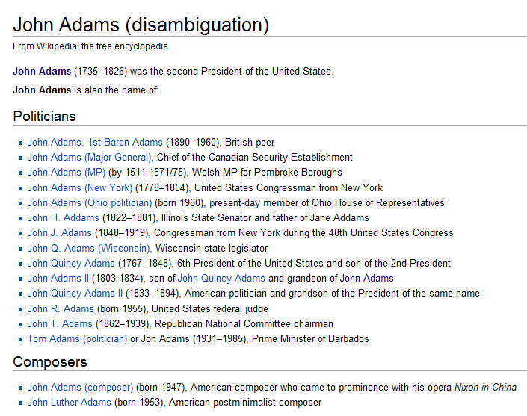
Shared challenges!
Disambiguation is important!
Wikipedia articles utilize Authority Control
Notes:
Whenever I talked to someone who was invovled with Wikipedia, it turned out that disambiguation, for names in particular, is really important. Just as it is for libraries. There was is a growing recognition of the importance of library name authorities, and some Wikipedia articles have started incorporating authority control into articles. Not surprisingly, the German language Wikipedia had already started to add in authority control, and xxx articles has name authority data. But the English language Wikipedia has only 4k articles with authority data (on perhaps 1m articles about people – kind of difficult to tell).

Slide 8
http://webempires.org/wikirank/top/
Notes:
Further challenges – library resources are pretty invisible, even to the earnest community of Wikipedia editors. Despite preference for free sources of information, it’s easy to link to free sites.
Worldcat comes in at #81 on this list, Hathi Trust not even in top 100.

Slide 9
Special challenges
In order to collaborate, negotiate with… who?
Community of editors is
Distributed and virtual
Pulled in by heterogeneous interests
Culture of combating “link spam”
Notes:
But there are challenges for working with such a dispersed, heterogeneous (in terms of interests) and virtual communities
Sarah will mention link spam challenges

Slide 10
Jake Orlowitz

Slide 11
Librarypedia
The Future of Libraries and Wikipedia
@JakeOrlowitz, User:Ocaasi
Notes:
Jake Orlowitz, my past future (seeds) political science at Wesleyan, academic tutor, self-organizing community governance, alternative medicine and political movements, help guides, new editor outreach, partnerships with organizations. TWL Head, an internet citizen, a wikipedian, a digital humanitarian, a project manager. but not a library expert. DBSS. FISB. Invite to explore.
1 mission, 5 goals, 11 ideas. Obstacle-path-steps (OPS), Share the story. Explore the ideaspace.

Slide 12
Librarypedia
The Future of Libraries and Wikipedia
@JakeOrlowitz, User:Ocaasi
Notes:
Jake Orlowitz, my past future (seeds) political science at Wesleyan, academic tutor, self-organizing community governance, alternative medicine and political movements, help guides, new editor outreach, partnerships with organizations. TWL Head, an internet citizen, a wikipedian, a digital humanitarian, a project manager. but not a library expert. DBSS. FISB. Invite to explore.
1 mission, 5 goals, 11 ideas. Obstacle-path-steps (OPS), Share the story. Explore the ideaspace.

Slide 13
Wikipedia’s mission
Imagine a world in which every person on the planet shares in the sum of all human knowledge.
Notes:
In 2001 Jimmy Wales had a radical idea. A bold, awesome, inspiring radical idea. Imagine a world in which every person on the planet shares in the sum of all human knowledge. Most radical, is that it’s happening.

Slide 14
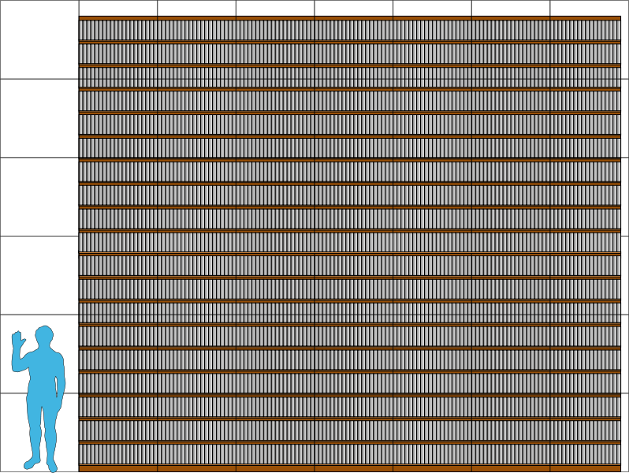
Wikipedia’s scale
30 million articles
286 languages
2 billion edits
8000 views per second
500 million monthly visitors
5th most popular website
2000x larger than Brittanica
Notes:
30 million articles in 286 languages cobbled together by 2 billion edits that are viewed 8000 times per second by 500 million unique visitors per month. The sixth most visited website on the internet is 2000 times larger than Encyclopedia Britannica’s deluxe edition. Wikipedia’s co-founder, Larry Sanger, thought that Wikipedia should be written and reviewed by credentialed experts. So he went off and started his own Wiki called Citizendium. After 12 years, it has 5000 articles. Crowdsourcing works.

Slide 15
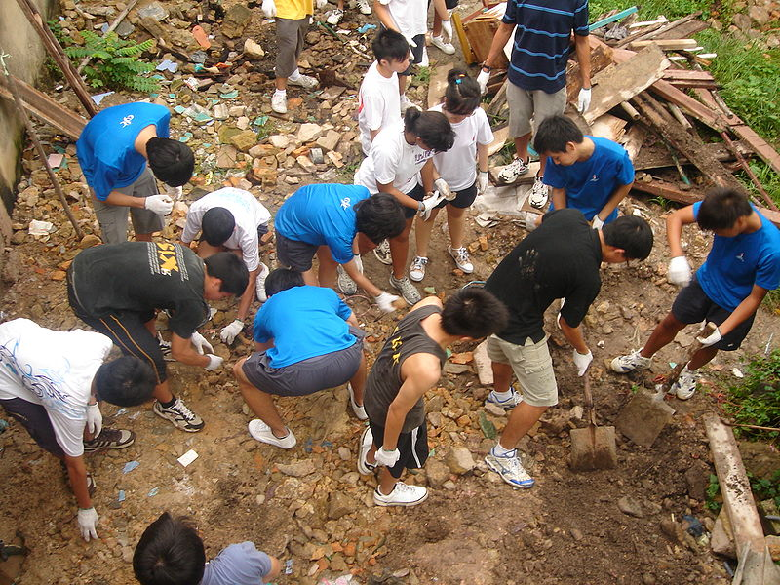
Wikipedia’s volunteers
20 million registered
80,000 active users
1,400 admins
Notes:
Who writes Wikipedia? 20 million registered users, 80,000 of whom are active each month, with 1400 administrators to do cleanup. These are dedicated, passionate volunteers who work for free, with no central control.

Slide 16
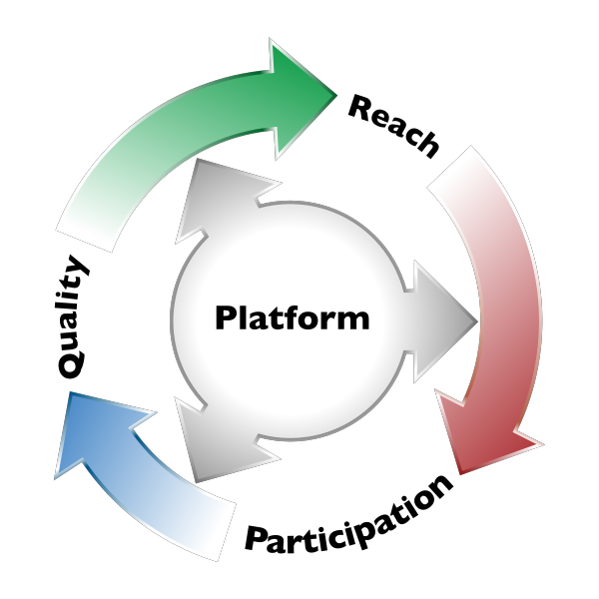
The Library Connection
WP only as good as our sources
Libraries have the best sources
Wikipedia has the most eyeballs
Connect a circle of research, dissemination
WP as starting point for deeper learning

Slide 17
The Wikipedia Library
Gain access to paywalled sources
Facilitate research for editors
Connect to libraries
Lead to free and local sources
Promote open access
Notes:
started in 2011 with a donation from Credo reference, 2013 grant from the Wikimedia Foundation

Slide 18
Access partnerships
Incorporate closed access sources
Donations for mutual benefit
Top editors
Volunteer distributed
High impact metrics
Notes:
4,000 accounts individually would cost several hundred thousand dollars (institutional buyer caveat)

Slide 19
Impact
2000 editors
3000 accounts
$1.2 million
14 partners
22% non-english

Slide 20
Thinking big
What if every publisher donated
free access to the 1000 most active
Wikipedians in that subject area?

Slide 21
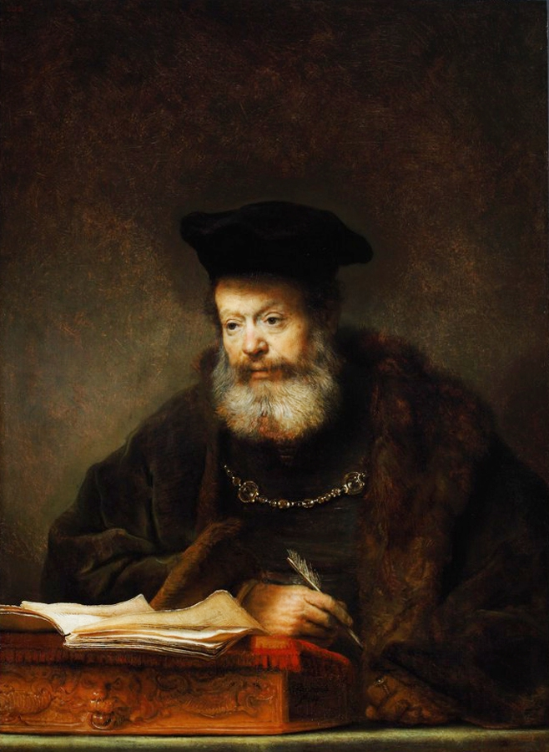
Wikipedia Visiting Scholars
Academic tradition
Research affiliates
Unpaid, remote
Full access to collections
Liason to Wikipedia’s community
Notes:
WVS, research affiliate + WIR (peter suber)

Slide 22
Impact
Successful pilot
25 articles each
4 schools
5 scholars
Exposing collections

Slide 23
Thinking big
What if every library or research institution had one Wikipedia on staff to access their
collections and build the encyclopedia?

Slide 24
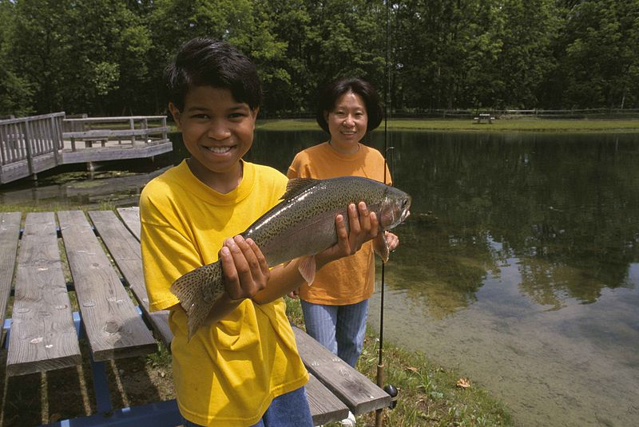
Full text reference tool
OCLC Pilot
IP affiliation
Proxy Resolver
Open URL
University initiative

Slide 25
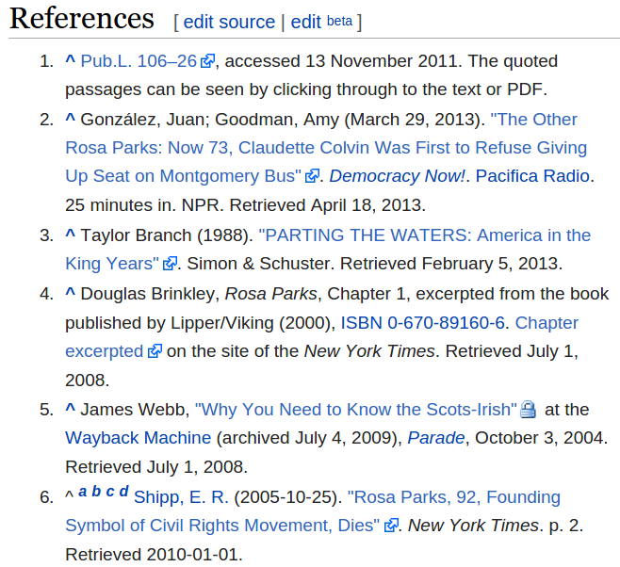
Impact
Alpha version
Tool labs
Wikimedia Labs
Local links

Slide 26
Thinking big
What if every reference in a Wikipedia article
had the link to the full text source next to it?
Notes:
get as close to full text as possible: gold standard, open url resolver, keyword search

Slide 27
Building tech
Expose collections
Connect to reference experts
Remix metadata
Demonstrate impact

Slide 28
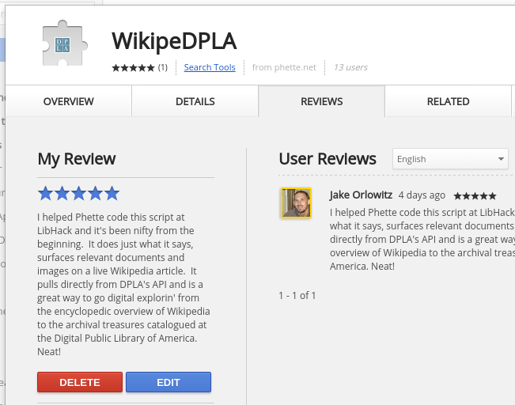

Slide 29
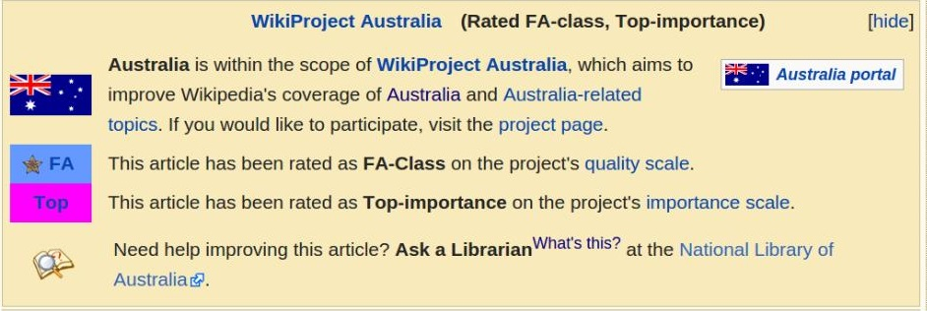

Slide 30
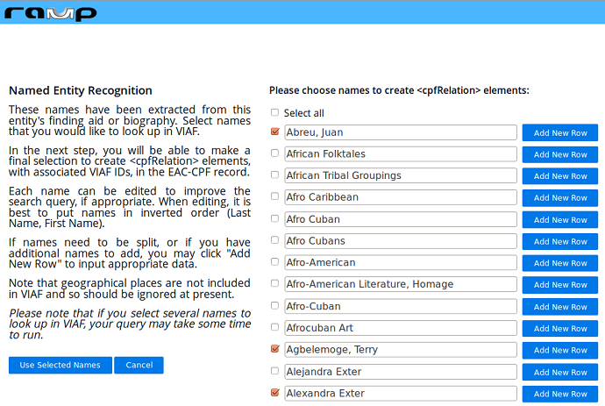

Slide 31
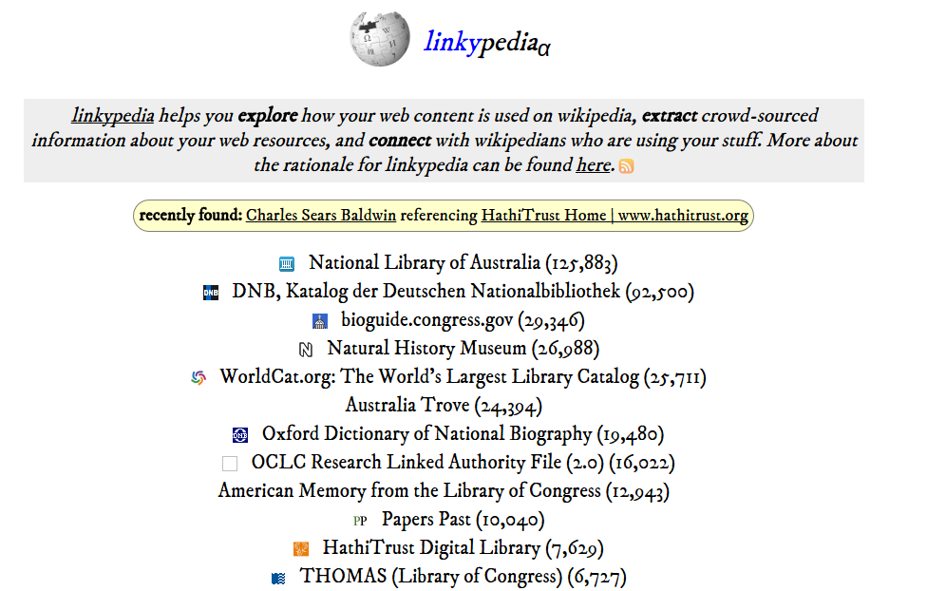

Slide 32
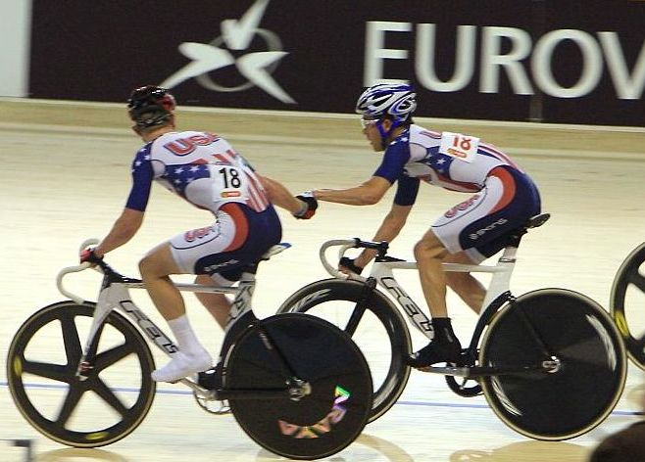
Resource exchange
WP:RX
Fair use
Academic sharing
Global
OA Button

Slide 33
Thinking big
What if any editor anywhere in the
world could be given a fair-use, full-text copy of the source they need?

Slide 34
Thinking big
What if every language version of Wikipedia had its own branch of The Wikipedia Library?
Notes:
get as close to full text as possible: gold standard, open url resolver, keyword search

Slide 35
OA signalling
Notes:
FUTON bias, WP:PAYWALL

Slide 36
Thinking big
What if every reference in a Wikipedia article
tagged whether it was free to read or reuse?

Slide 37
Thinking ARCHIVES
Why doesn’t every Wikipedia article have citations to relevant archival items, collections, or finding aids?
==Further reading==
==External Links==
Best practices for coi: Disclose, Link to others, too!
Citation circle: provide auto-cites from archive to WP

Slide 38
Case study
40 assets viewed 13,000 times--an increase of 600%
10,000 pageviews were referred via Wikipedia
5 times greater than the total pageviews via any source
Pageviews for the whole 149 asset collection tripled
raised awareness of the existence of these resources
an overwhelming success...remarkable in its efficiency.
Archivists can achieve greater success in generating collection use by using Wikipedia to connect users with digital archival materials at the item level.
“Using Wikipedia to Enhance the Visibility of Digitized Archival Assets”. Michael Szajewski, Ball State University. http://www.dlib.org/dlib/march13/szajewski/03szajewski.html (more at: http://outreach.wikimedia.org/wiki/GLAM/Case_studies)

Slide 39
Wikipedia, Libraries = natural allies
Wikipedia is the starting point for research
We lead readers back to sources at libraries
So they can think critically about subjects
Notes:
Make Wikipedia the Internet's Library
Make Libraries Wikipedia's fiercest ally

Slide 40
Questions?
Jake Orlowitz
@JakeOrlowitz
jorlowitz@gmail.com
http://enwp.org/WP:TWL
Funded by the Wikimedia Foundation
Notes:
Make Wikipedia the Internet's Library
Make Libraries Wikipedia's fiercest ally

Slide 41
Lily Todorinova

Slide 42
Lily Todorinova, Undergraduate Experience Librarian
Lily.todorinova@rutgers.edu
Yu-Hung Lin, Metadata Librarian for Continuing Resources, Scholarship and Data
Yuhung.lin@rutgers.edu
Rutgers University Libraries

Slide 43
Overview
•Undergraduate Research Study
•Wikipedia Editor-Librarian Workflow
•Faculty’s Use of Wikipedia

Slide 44
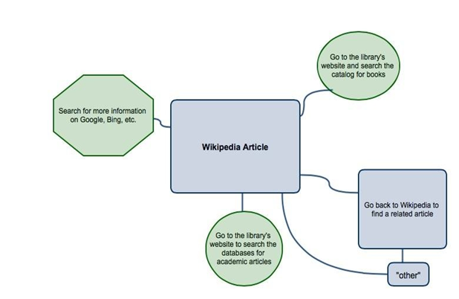
Undergraduate Research Study

Slide 45
Design
•30 participants, 20-30 min Qualtrics® survey
•Pre-test/Post-test
•Start with Wikipedia and tell us what you will do next
•Evaluate using modified SEER® Rubric

Slide 46
Findings
•Wikipedia and Google are difficult to separate in the research processes of undergraduates
•Students have been discouraged to use Wikipedia (but use it anyway)
•Students’ actions are informed by the conflicting combination of faculty influence, resource convenience, time, and efficiency of the task

Slide 47
Findings
In our sample, students tended to…
overlook bibliographies in Wikipedia, and in general…
find the bibliographies in Wikipedia confusing and overwhelming
assume that the 1st citation to appear in Wikipedia’s bibliography is the “best” one
like the idea of using a rubric/tool within Wikipedia to quickly assess if they should “follow” a given link to its holdings in the library databases

Slide 48
Rutgers Wikipedian in Residence Program
Recruit Wikipedia editors to enrich Wikipedia contents
Identify subjects which align with the institution’s strategic direction and digital content collection
Train liaison librarians to familiar with Wikipedia culture

Slide 49
Methodology
● Identify Wikipedia content gaps in the specific subject areas
● Write/Co-write new article(s) or edit existing content in above topics to enrich the depth and authoritative of Wikipedia content and provide reliable digital content to close the identified gaps
● Wikipedia editors engage with Rutgers librarians and provide training and guidance in the culture for Wikipedia editing to enable them to be effective Wikipedia editors

Slide 50
Findings
● Writing perception -- Neutral tone and no primary research source
● Wikipedia’s community and editing culture
● Wikipedia editors engage with Rutgers librarians and provide training and guidance in the culture for Wikipedia editing to enable them to be effective Wikipedia editors

Slide 51
Faculty’s Use of Wikipedia
● Do Rutgers faculty, in fact, discourage the use of Wikipedia? If so, what are the main reasons? Does this vary across departments/disciplines?
● Do they edit Wikipedia pages themselves? Does it matter if they are tenured, or tenure-track?
● Would they like the library to have an active role in training the academic community on how to contribute to Wikipedia?
● Would they consider Wikipedia is an open access and peer-review environment?

Slide 52
Thank you!
Project Website:
https://en.wikipedia.org/wiki/Wikipedia:GLAM/Rutgers

Slide 53
Kenning Arlitsch

Slide 54
Does Google Know Us?
Semantic Identity
on the Web
Kenning Arlitsch
Dean of the Library
Kenning Arlitsch, Dean of the Library

Slide 55
Google’s Perception of MSU Lib - 2012
Notes:
Google Knowledge Graph Card

Slide 56
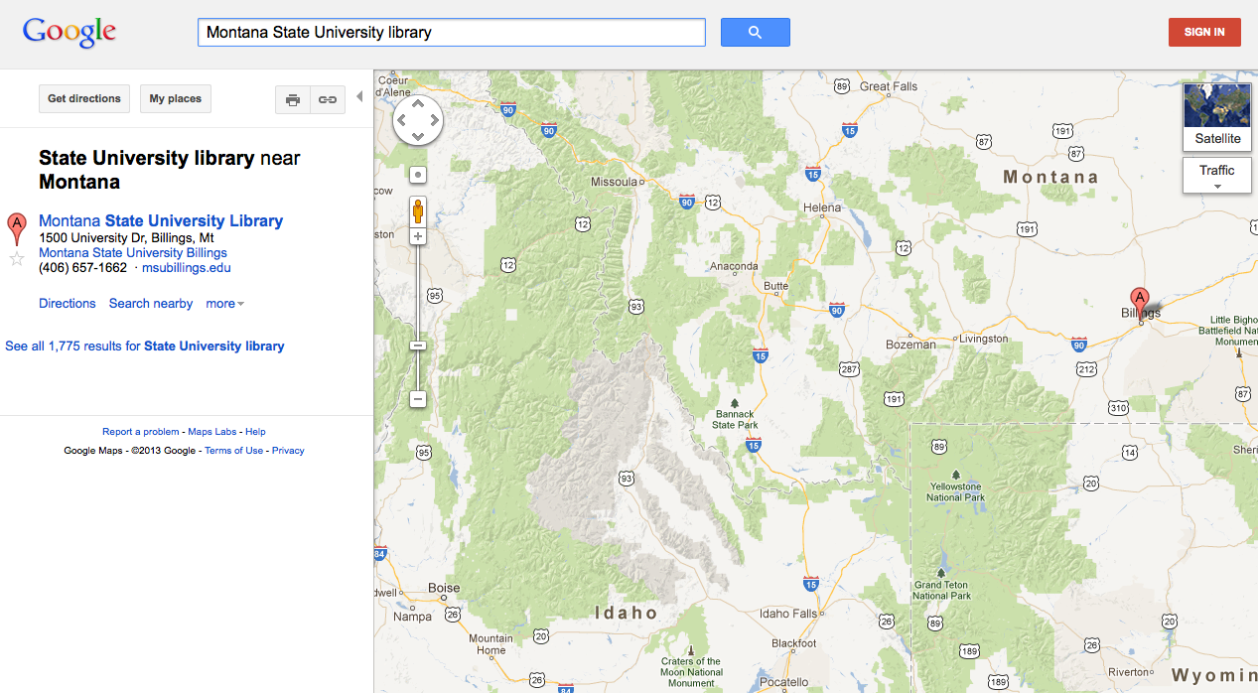
Google Maps

Slide 57
Where does Google get its information?

Slide 58
Trusted Sources for Search Engines
Wikipedia/DBpedia
No Wikipedia presence?
You don’t exist as a recognized “entity” or “thing”
You exist only as a string of text
Influences to Google’s Knowledge Graph
Google Places/Google My Business
Google+
FreeBase

Slide 59
Wikipedia - 2012

Slide 60
DBPedia entry - 2012

Slide 61
Google Places - 2012

Slide 62
Why?

Slide 63
Search: “Wikipedia authoritative source”
Notes:
Here’s one answer. Libraries have spent years telling

Slide 64
Extend the logic
What other concepts are poorly defined?
“Library?”
“Institutional Repository”
Search “NBA teams” vs. “institutional repositories”

Slide 65
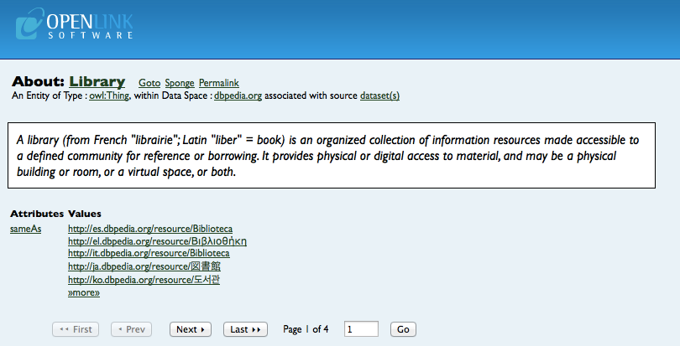
DBPedia Library “Entity” Definition

Slide 66
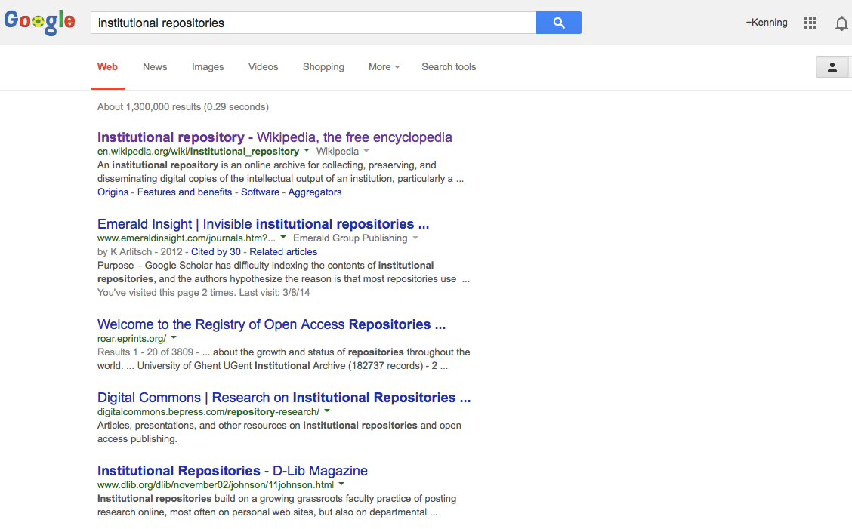

Slide 67
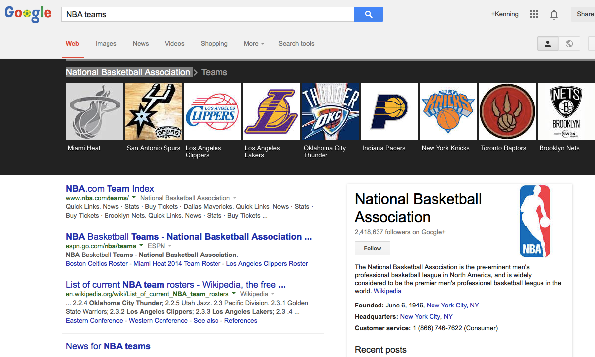

Slide 68
What’s a librarian to do?
Linked data as expression of network of concepts
things vs. strings
Establish a semantic identity
Notes:
Can OCLC provide service to guide Wikipedia article creation?

Slide 69
How?
Define libraries and library concepts in Wikipedia
Beware of *pedia culture and process
Engage with other trusted data sources
Google Places/Google My Business
Google+
FreeBase
Mark-up metadata with schema.org

Slide 70
Montana State University Library - 2014
Montana State University Library - 2014

Slide 71
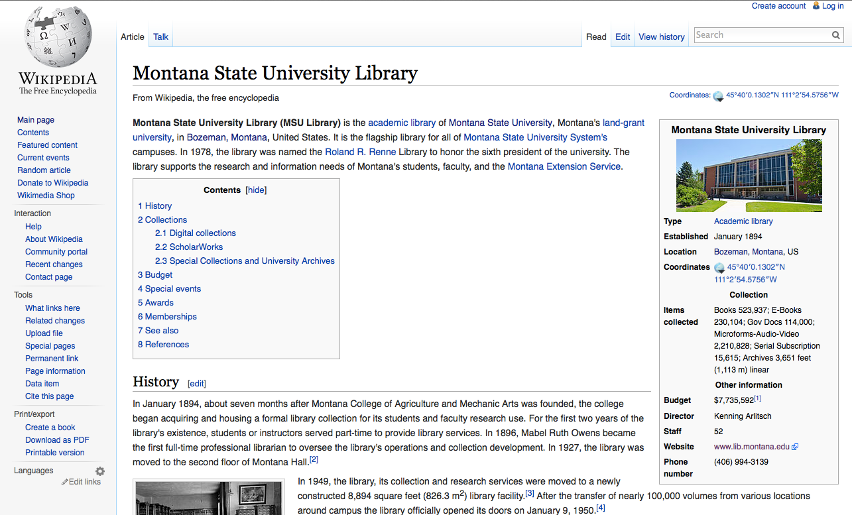

Slide 72
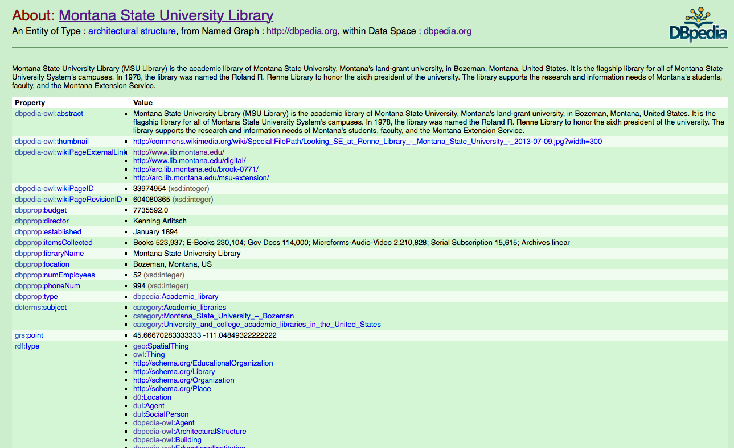
2014 DBpedia entry

Slide 73
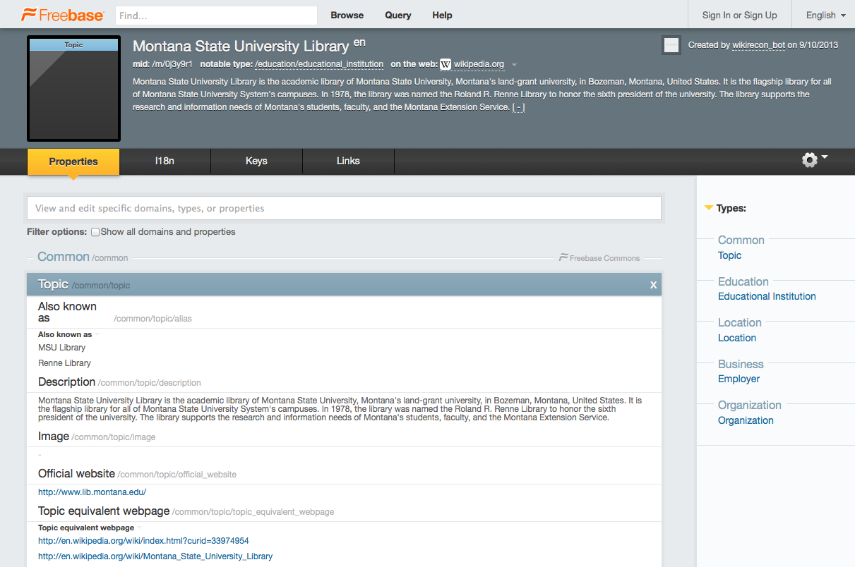
2014 Freebase entry

Slide 74
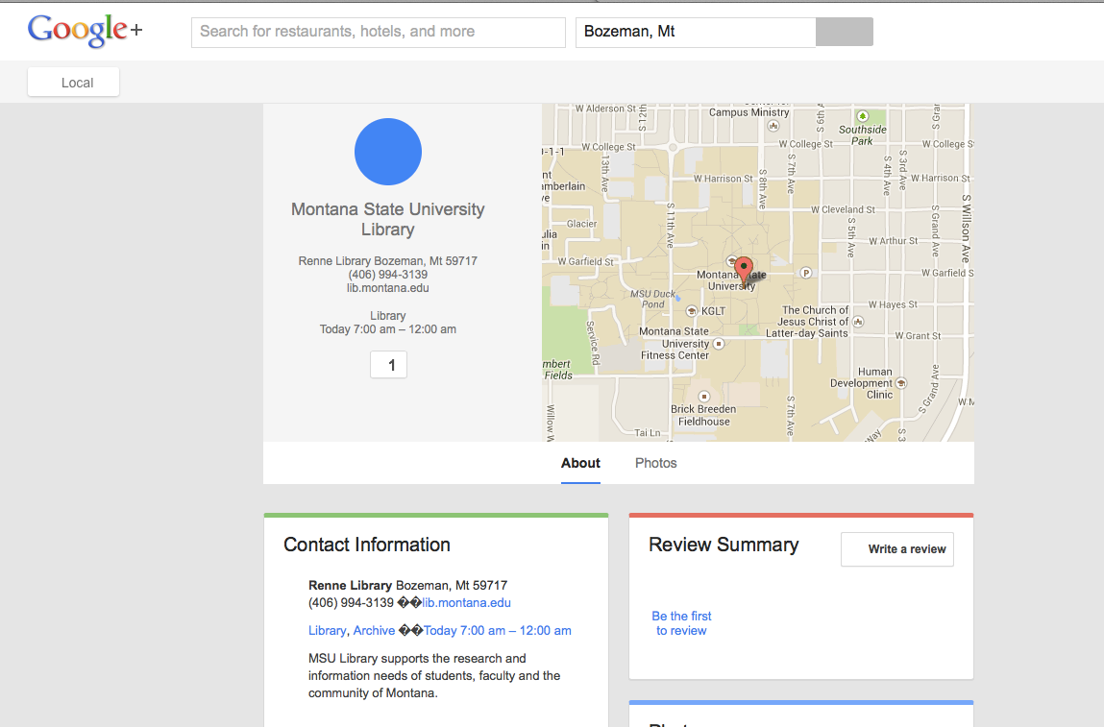
Google+ entry

Slide 75
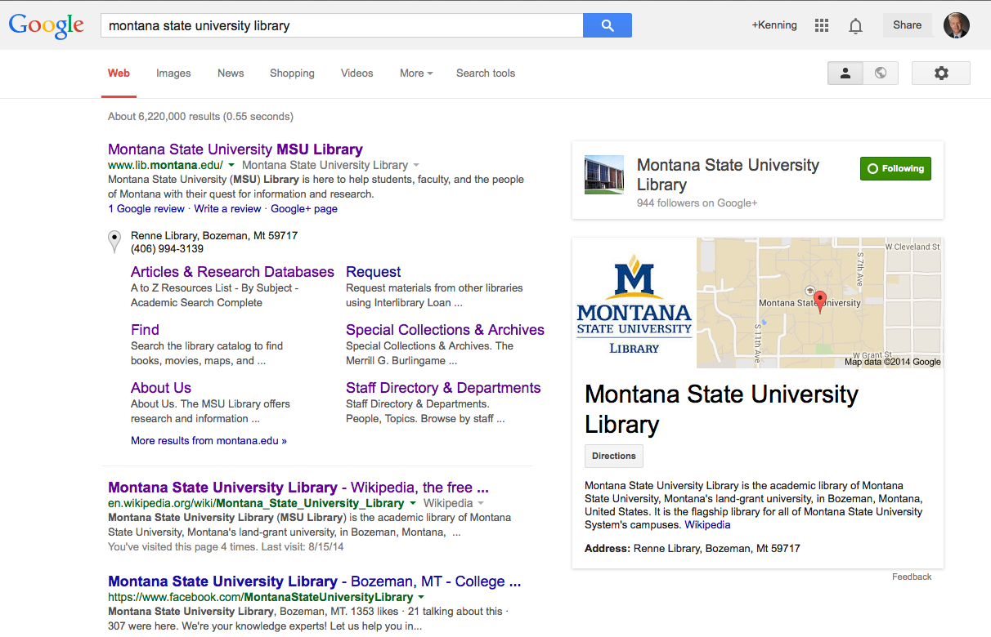
MSU Library - 2014

Slide 76
MSU Library Semantic Web Team
Kenning Arlitsch, Dean
Patrick OBrien, Semantic Web Director
Jason Clark, Head of Library Informatics and Computing
Scott Young, Digital Initiatives Librarian

Slide 77
Cindy Aden

Slide 78
The OCLC KB API
OCLC KB is designed as a cooperative KB, accepting input and edits from participants.
“Automating the content supply chain,” by getting publishers to contribute content collections and holdings information, making it easy for the library to see its full holdings.
API will put libraries in front of users at point of need on third-party sites, like EasyBib and Wikipedia.

Slide 79
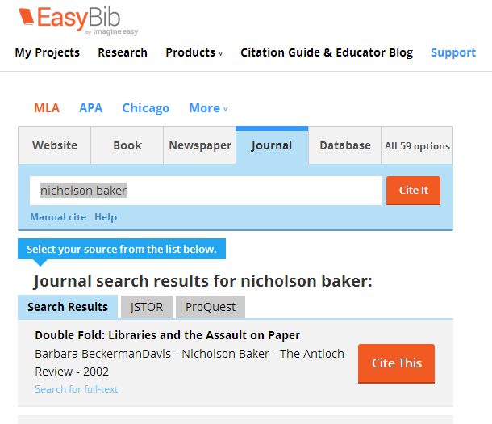
Notes:
Note the Search for full text prompt at the bottom of the article

Slide 80
Wikipedia Pilot
A user, logged into Wikipedia, can download a script enabled with the OCLC KB API.
User will be associated with an affiliated library, via IP address or Institution Code.
Articles, available full-text, can be viewed while the user is on Wikipedia.
If a library’s KB is not registered with OCLC, the API will attempt to locate the library’s URL resolver or open access full-text.

Slide 81
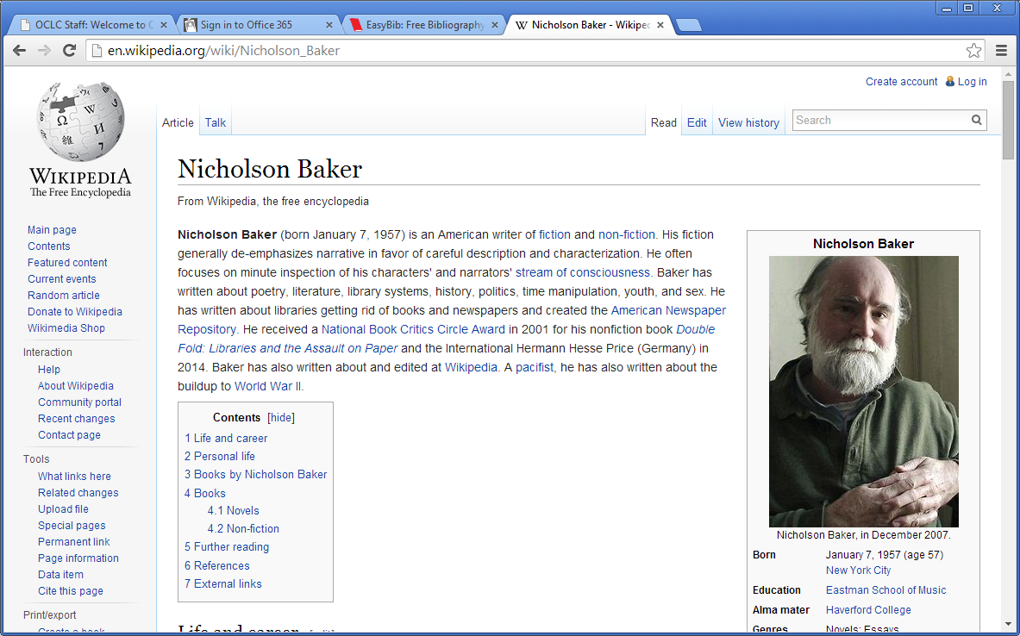
Notes:
Using Wikipedia, a user can scroll down to find the citations used to create the article

Slide 82
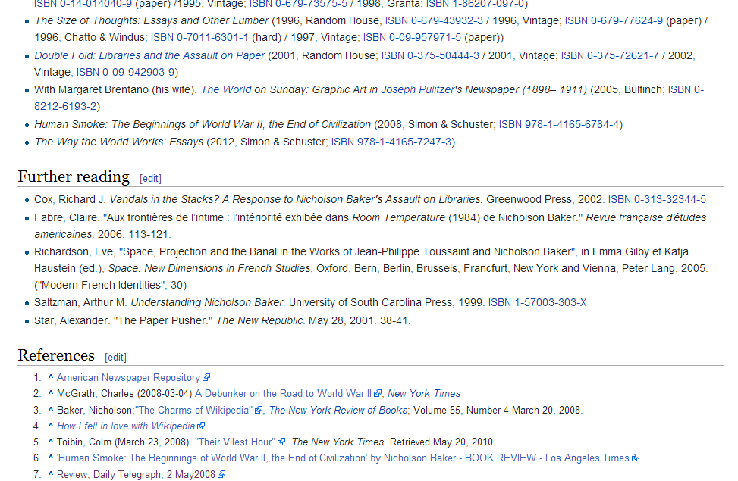
Notes:
At the end of Wikipedia articles there can be lengthy bibliographies. It is here that we expect the script will highlight those articles and ebooks available via the library collection affiliated with the user.

Slide 83
Register your library’s e-collection
Use OCLC’s WorldShare management interface to access your WorldCat knowledge base and register your collection manually by identifying all the collections to which your library subscribes.
Sign up for the PubGet service—your credentials are shared with OCLC which is authorized to harvest your holdings from content providers. Details of the PubGet service are here: http://www.oclc.org/knowledge-base/start.en.html
Notes:
In order to participate, a library must make sure to register its KB with OCLC, and while some publishers are helping to populate this information and automatically load subscribing library information, there may be some manual registration involved.

Slide 84
Transfer your KB to OCLC:
Working with OCLC’s implementation staff, output your library’s knowledge base file from your local resolver, and OCLC will ingest it into the WCKB. (SerialsSolutions, SFX, and EBSCO all allow sharing of their KBs.) Documentation for individual link resolvers is available on the WCKB documentation page:
http://www.oclc.org/support/services/knowledge-base/documentation.en.html
Notes:
If your library has a knowledge base, it can be exported to the OCLC KB.

Slide 85
Automatic updates to the KB:
OCLC has agreements with EBL and ebrary, where they will automatically send holdings information to OCLC as libraries buy their content, as authorized by the library. Libraries need to contact EBL and ebrary to indicate that they wish their holdings to be sent OCLC.
Libraries subscribing to ScienceDirect from Elsevier can request that their holdings information be shared with OCLC directly.

Slide 86
Most important of all:
To begin this process a library must first request activation of your KB, please click here to fill out a request form: http://www.oclc.org/content/forms/worldwide/en/wckb-request.html

Slide 87
Partners with KB API linking
Easybib.com
Bibme.org
CitationMachine.net
Sciencescape.com
Citavi.com
Wikipedia.org

Slide 88
Your questions?
Merrilee Proffitt, Senior Program Officer, OCLC Research
Kenning Arlitsch, Dean of the Library, Montana State University
Jake Orlowitz, Director of the Wikipedia Library
Lily Tordorinova, Undergraduate Librarian
Yu-Hung Lin, Technical Services, Rutgers University
Cindy Aden, OCLC Business Development

Slide 89
Cindy Aden
Director, Partner Program, OCLC
adenc@oclc.org
@cindycpaa
©2014 OCLC, Jake Orlowitz, Lily Todorinova, Yu-hung Lin, and Kenning Arlitsch. This work is licensed under a Creative Commons Attribution 3.0 Unported License. Suggested attribution: “This work uses content from “Wikipedia and Libraries: increasing your library’s visibility” © OCLC, Jake Orlowitz, Lily Todorinova, Yu-hung Lin, and Kenning Arlitsch, used under a Creative Commons Attribution license: http://creativecommons.org/licenses/by/3.0/”

