Slide 1
Update - OCLC Research Library Partnership or, “What have we done for you lately?”
April 2013
ARLIS in Pasadena
Dennis Massie
Program Officer OCLC
With contributions from the whole gang in Research San Mateo

Slide 2
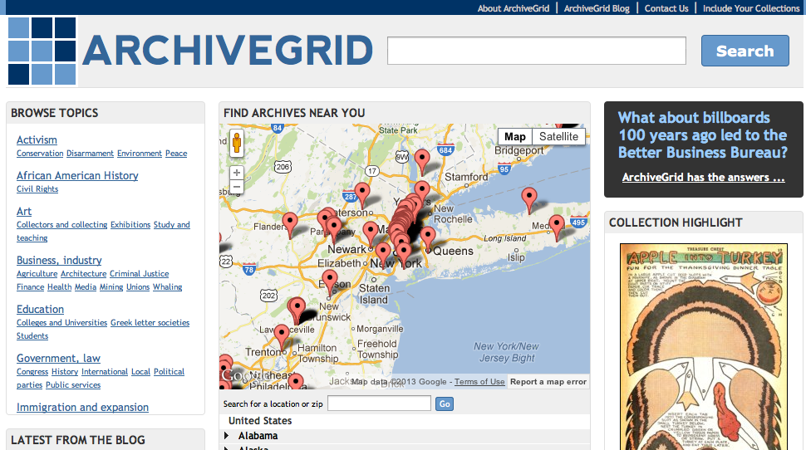

Slide 3
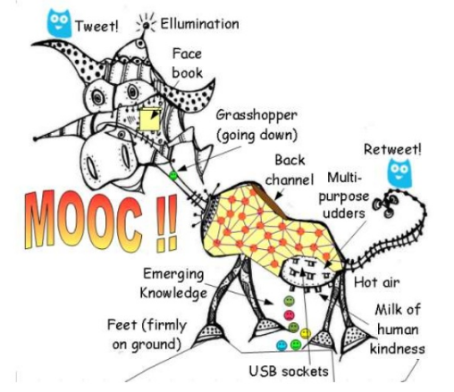
http://www.downes.ca/presentation/304

Slide 4
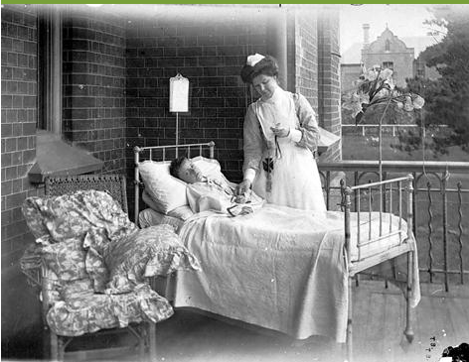
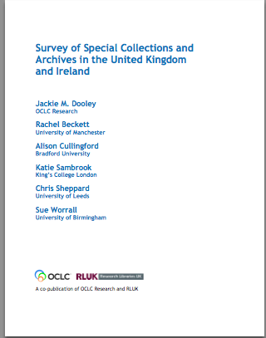
Taking Our Pulse(s)
Notes:
A 2009 survey of special collections and archives in the US and Canada shows that digitization of special collections and increasing user access to those collections are of critical importance to research libraries.
The survey was a follow up to the 1998 ARL survey led directly to many high-profile initiatives to "expose hidden collections.“
We updated ARL’s survey instrument and extended the subject population to encompass the 275 libraries in the following five overlapping membership organizations:
• Association of Research Libraries (124 universities and others)
• Canadian Academic and Research Libraries (30 universities and others)
• Independent Research Libraries Association (19 private research libraries)
• Oberlin Group (80 liberal arts colleges)
• RLG Partnership, U.S. and Canadian members (85 research institutions)
The rate of response was 61% (169 responses).
http://commons.wikimedia.org/wiki/File:Stethoscope_1.jpg
Stethoscope. Public domain.

Slide 5
Key Findings
“Most challenging issues”
Space
Born Digital
Digitization
Tough economy renders “business as usual” impossible
User demand for digitized collections is insatiable
Management of born-digital materials is in its infancy
Notes:
The OCLC report reveals, despite the efforts to uncover hidden collections, much rare and unique material remains undiscoverable, and monetary resources are shrinking at the same time that user demand is growing. The balance sheet is both encouraging and sobering:
• The size of ARL collections has grown dramatically, up to 300% for some formats
• Use of all types of material has increased across the board
• Half of archival collection descriptions have no online presence
• While many backlogs have decreased (compared to the 1998 survey), almost as many continue to grow
• User demand for digitized collections is insatiable
• Management of born-digital archival materials is still in its infancy
• 75% of general library budgets have been reduced
• Staffing is generally stable, but has grown for digital services
• The current tough economy renders “business as usual” impossible
The top three “most challenging issues” in managing special collections were space (105 respondents), born-digital materials, and digitization.

Slide 6
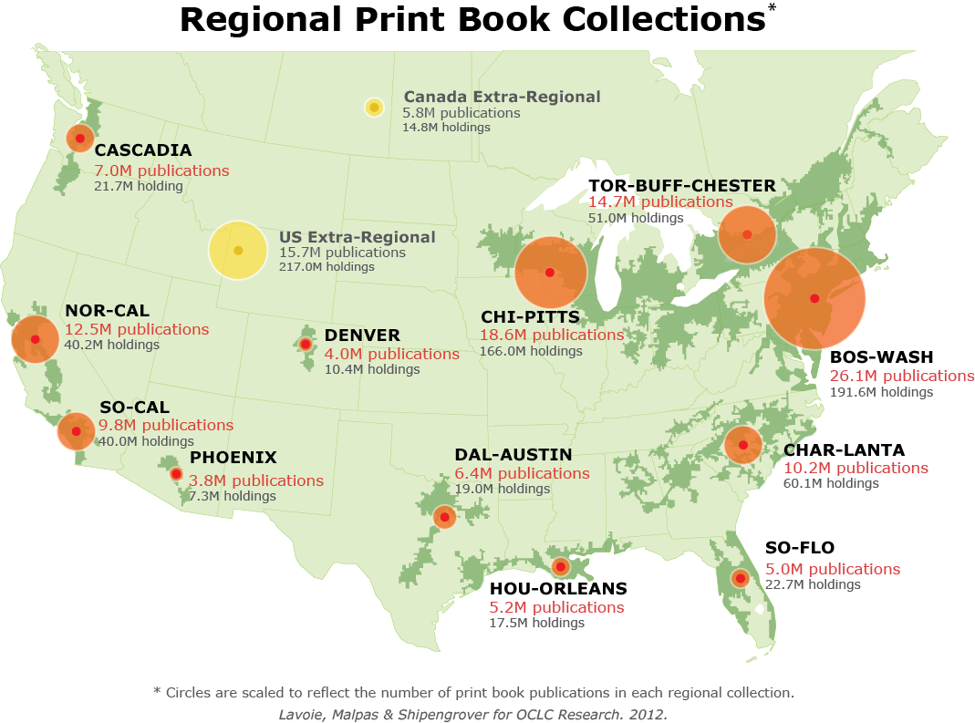
OCLC Research, 2012
Notes:
Here to talk about SoCal print book resource, but useful to put it in context of other NA mega regions.

Slide 7
Mega-regions and print management
An empirically derived framework (Richard Florida, et al.) based on regional economic activity; mega-regions are a ‘natural unit’ for analysis
Helps situate print management within broader networks of economic exchange; builds on existing organizational infrastructure and institutional interests
Shared print management efforts being undertaken at variable (and overlapping) scale; we have no objective benchmarks for establishing appropriate scale of action
For monographic literature especially, we believe a model based on economic ‘flows’ is an appropriate choice
Notes:
Mega-region framework not prescriptive – simply one model among others for how to organize a regional approach to print management.

Slide 8
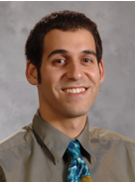
OCLC Wikipedian in Residence
Opportunities with library data
Education and outreach for librarians
Max Klein!

Slide 9
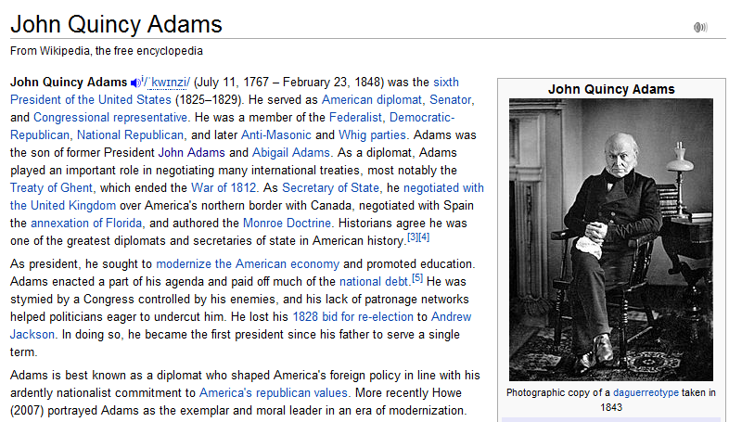

Slide 10
VIAFbot - Progress
250,000 + articles now have authority data, and links to VIAF
…out of roughly 1 million articles about “people” on WP:EN

Slide 11
Grant Proposal to NHPRC
3 NYC art museum librarians to share a Wikipedian in residence
Frick, Met, MoMA
OCLC Research to manage project
Project will explore ways to expose archival collections in Wikipedia
Proposal has been through a round of peer review
Will learn in May if it’s a “go”

Slide 12
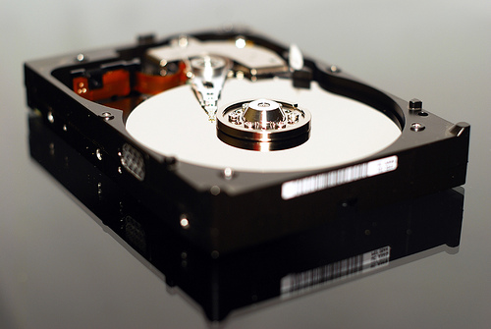
Demystifying Born Digital
Notes:
Program of work inspired by findings from our survey of special collections, which identified this not only as an area of concern, but an area where our partners and others have been paralyzed and have made very little progress. This program area focussed on enhancing effective management of born-digital materials as they intersect with special collections and archives in research libraries.
Working with a number of advisors (who are themselves largely learning as they go, rather than experts in digital preservation), break down what seems to be a giant problem into a number of smaller problems.
photo credit: <a href="http://www.flickr.com/photos/gatiuss/4053789290/">Gatis Gribusts</a> via <a href="http://photopin.com">photopin</a> <a href="http://creativecommons.org/licenses/by-nc/2.0/">cc</a>

Slide 13
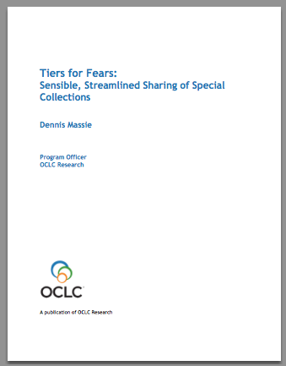
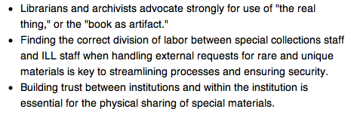
Sharing special collections
Coming spring 2013!

Slide 14
Ducks-in-a-Row Special Collections Facility checklist
Establishes baseline criteria for borrowing and hosting special collections materials from other libraries
Lenders can use to set expectations
Borrowers can use to demonstrate compliance
Borrowers can share with administration as evidence of need to upgrade
Borrowers can use as conversation starter with lender (if they meet a subset of criteria but not 100%)

Slide 15
Tiered approach to processing ILL requests for special collections
Lays out three levels of effort and complexity
Flexible framework can be adapted to fit each institution’s needs
Once upon a time all such requests received the deluxe treatment in the third column
Embraces the principle that not all special collections items are equally special
Requests for some classes of material can be handled by ILL staff without consultation
Affirms that lending physical item is still very much the exception

Slide 16
Art Museum Library Advisory Group
Louis Adrean, Cleveland Museum
Stephen Bury, Frick
Marianne Cavenaugh, SLAM
Anne Everhaugen, SI
Roger Lawson, NGA
Kathleen Salomon, Getty
Deborah Smedstad, MFAB
Arose out of HathtTrust/WorldCat collection comparison reports
OCLC Research convened a group of museum libraries to discuss reports in aggregate
Data suggested some areas of collaboration

Slide 17
HathiTrust/WorldCat Collection Comparison reports
Partner overlap
Holdings/dup growth
Jan’12 HT dup
6 Customized reports created in July 2012 for each member of the OCLC RLP.

Slide 18
HathiTrust/WorldCat Collection Comparison reports
Subjects & rights status
Material types
Holdings distribution
6 Customized reports created in July 2012 for each member of the OCLC RLP.

Slide 19
Group conversation: who was invited?
Amon Carter Museum of American Art
Art Institute of Chicago
Bard Graduate Center of the Decorative Arts
Clark Art Institute
Cleveland Museum of Art
Frick Research Collection
Getty Research Institute
Hagley Museum and Library
Huntington Library
Kimbell Art Museum
Metropolitan Museum of Art
Morgan Library and Museum
Museum of Fine Arts, Boston
Museum of Fine Arts, Houston
Museum of Modern Art
National Gallery of Art
Nelson Atkins Museum of Art
Philadelphia Museum of Art
Saint Louis Art Museum
Smithsonian Institution
Victoria and Albert Museum
Winterthur Museum, Garden and Library

Slide 20
Some fun facts on the overlap
The 22 symbols have 6,529,978 records in WC
While group’s WC records grew by 5.8% between 2011 and 2012, overlap with Hathi grew by 15%
An average of 58% of a library’s Hathi overlap is owned by >99 symbols
An average of 33% is held by 25-99 symbols
An average of 2% is held by <10 symbols
An average of 97% of overlap is books

Slide 21
The data suggests…what activities?
Gap filling?
Preserving the rare?
Deaccessioning the widely held?
Determining rights status of orphan works?
Advisory group to prioritize and shape activity?
What other customized reports might be useful?

Slide 22
Art Museum Library Advisory Group
Louis Adrean, Cleveland Museum
Stephen Bury, Frick
Marianne Cavenaugh, SLAM
Anne Everhaugen, SI
Roger Lawson, NGA
Kathleen Salomon, Getty
Deborah Smedstad, MFAB
What is uniquely held?
What has been digitized?
What classes of material offer collaborative management opportunities?
What can we learn from ILL data? What are we borrowing and lending?

Slide 23
The Big Question: list of unique titles?
Five ways to get a list of uniquely held titles
Be a subscriber to WorldCat Collection analysis
Use WorldCat collections dashboard (eventually)
Subscribe to WorldShare Collection Evaluation tool (soon)
Transition to any part of the WorldShare platform
The Hard Way

Slide 24
WorldCat collections dashboard http://www.stats.oclc.org/cusp/nav

Slide 25
WorldCat collections dashboard http://www.stats.oclc.org/cusp/nav

Slide 26
WorldCat collections dashboard http://www.stats.oclc.org/cusp/nav

Slide 27
WorldCat collections dashboard http://www.stats.oclc.org/cusp/nav

Slide 28
WorldCat collections dashboard http://www.stats.oclc.org/cusp/nav

Slide 29
Getting a list of uniquely-held titles http://firstsearch.oclc.org/

Slide 30
Getting a list of uniquely-held titles http://firstsearch.oclc.org/

Slide 31
Getting a list of uniquely-held titles http://firstsearch.oclc.org/

Slide 32
Getting a list of uniquely-held titles http://firstsearch.oclc.org/

Slide 33
Getting a list of uniquely-held titles http://firstsearch.oclc.org/

Slide 34
Getting a list of uniquely-held titles http://firstsearch.oclc.org/

Slide 35
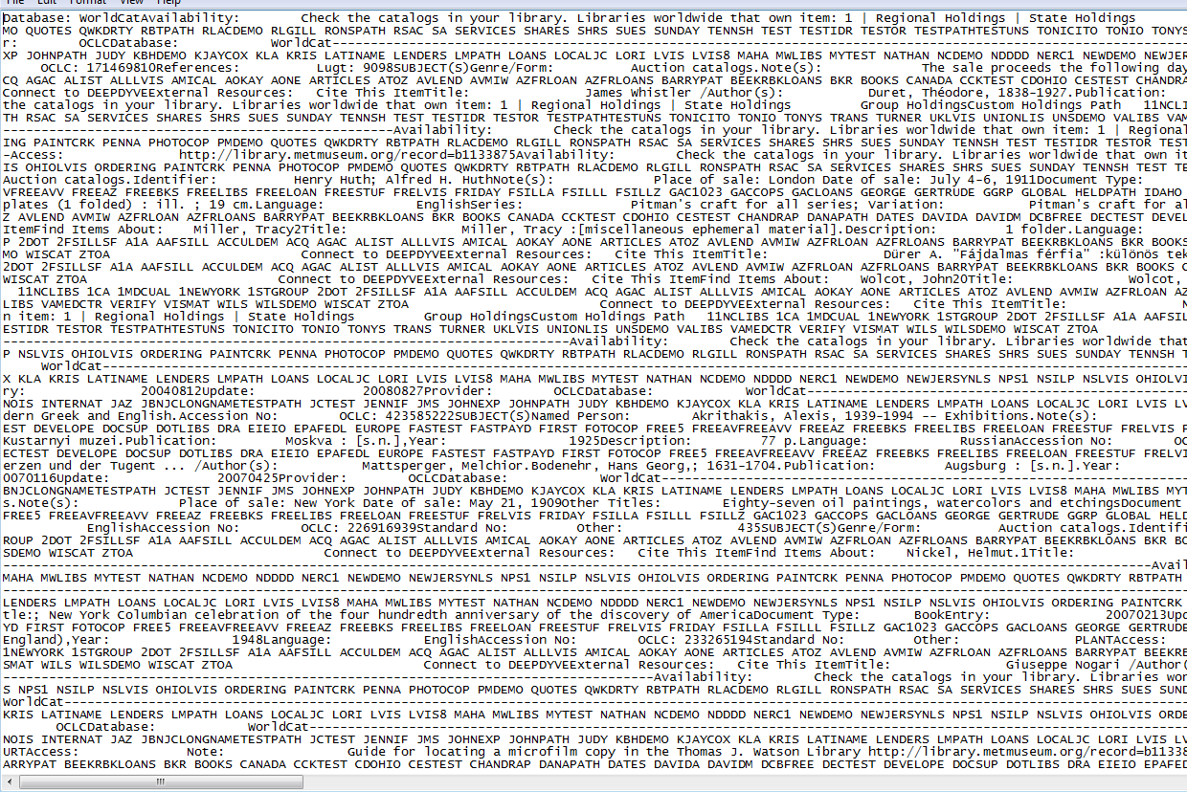

Slide 36
Getting a list of uniquely-held titles http://firstsearch.oclc.org/

Slide 37
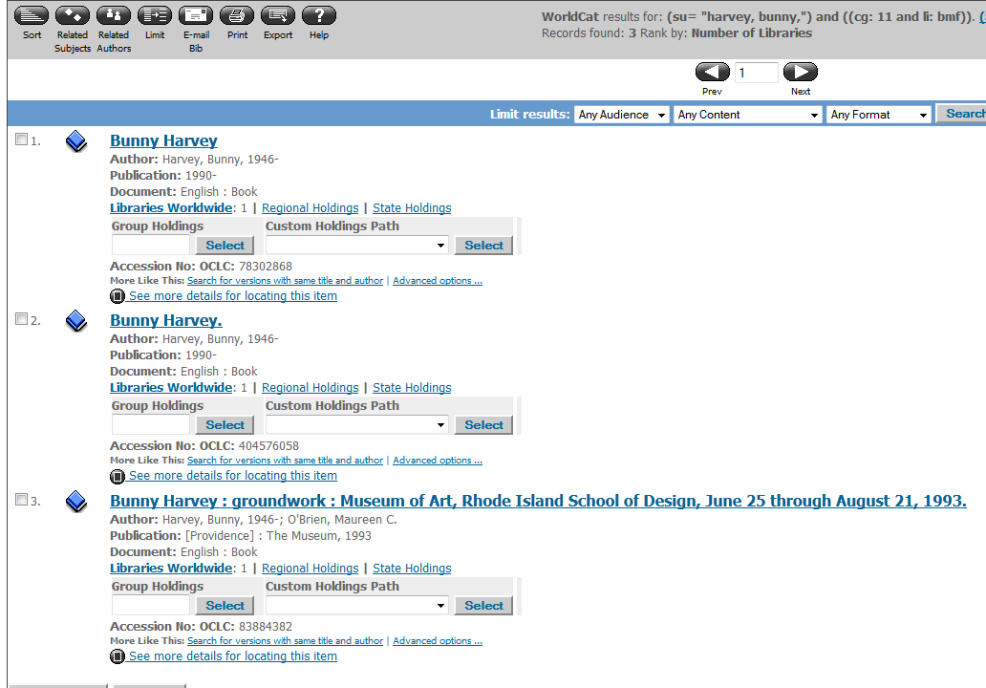
Getting a list of uniquely-held titles http://firstsearch.oclc.org/

Slide 38
The Big Question: list of unique titles?
Five ways to get a list of uniquely held titles
Be a subscriber to WorldCat Collection analysis
Use WorldCat collections dashboard (eventually)
Subscribe to WorldShare Collection Evaluation tool (soon)
Transition to any part of the WorldShare platform
The Hard Way

Slide 39
Art Museum Library Advisory Group
Louis Adrean, Cleveland Museum
Stephen Bury, Frick
Marianne Cavenaugh, SLAM
Anne Everhaugen, SI
Roger Lawson, NGA
Kathleen Salomon, Getty
Deborah Smedstad, MFAB
What is uniquely held?
What has been digitized?
What classes of material offer collaborative management opportunities?
What can we learn from ILL data? What are we borrowing and lending?

Slide 40
Questions?
Comments?

