Slide 1
Strategic Conversations at Harvard Library, Boston MA, June 9, 2016
Improving Support for Researchers: How Data Reuse Can Inform Data Curation
Ixchel M. Faniel, Ph.D.
Research Scientist, OCLC
fanieli@oclc.org
@imfaniel

Slide 2
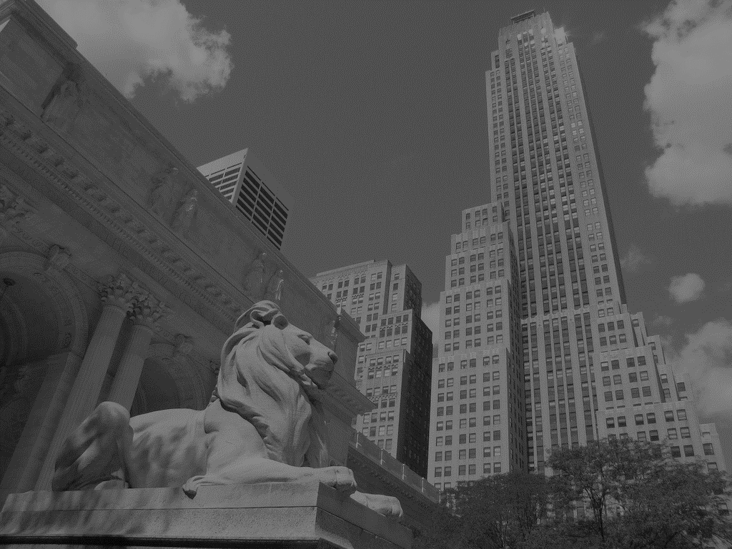
Data reuse lets researchers do
cool things.
“In 2005, a team of marine biologists…used inflation-adjusted pricing data from the New York Public Library’s (NYPL) collection of 45,000 restaurant menus, among other sources, to confirm the commercial overharvesting of abalone stocks along the California coast beginning in the 1920s…”.
(Enis, 2015)
Notes:
Image: http://www.flickr.com/photos/25869855@N04/6357282813
So here we have an example of marine biologists reusing price data from 45,000 restaurant menus at the NYPL to test whether a particular type of fish was overharvested in the 1920s. This is amazing. This is a great story of data reuse. This kind of story is what gets people excited about the possibility of data sharing mandates.

Slide 3
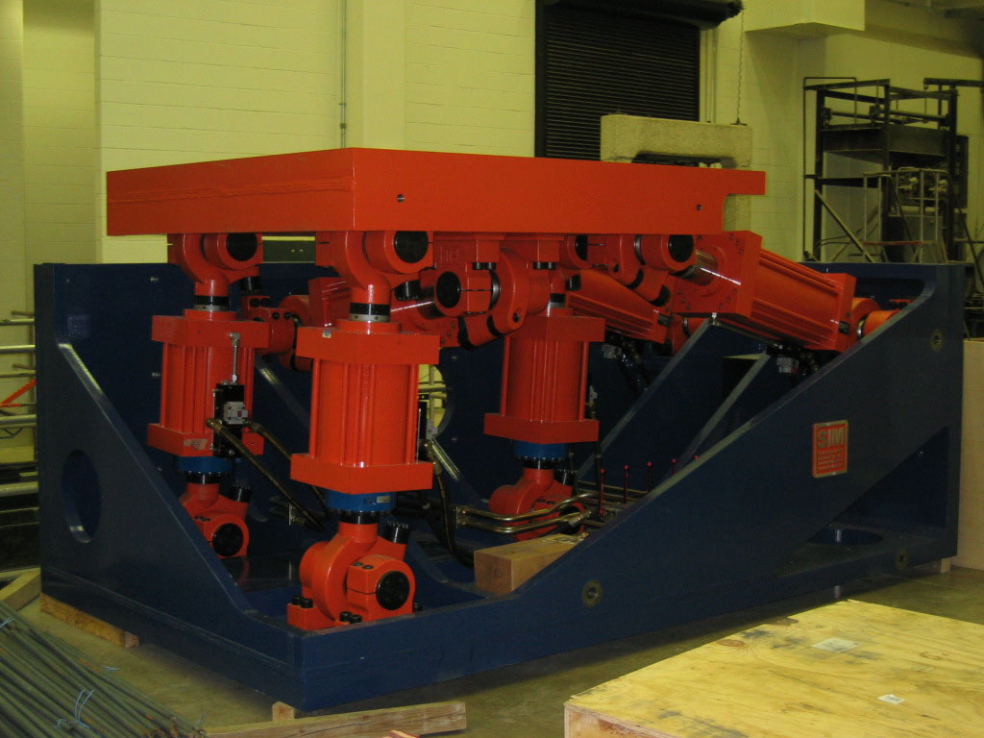
But data reuse is hard.
“[It] is a lot harder than a lot of people think because it’s not just about getting the data and getting some kind of file that tells you what it is, you really have to understand all the detail of an actual experiment that took place in order to make proper use of it usually. And so it’s usually pretty involved…”.
- Earthquake Engineering Researcher, 10
(Faniel & Jacobsen, 2010)
Notes:
Image: large-scale laboratory experimentation lab: http://nees.org/sites-mainpage/laboratories
But it’s hard, because there’s so much to be understood about the context of a research study “to make proper use of it” - the data. In this case the study was an experiment, but it could be any study. At the time I conducted this research, there wasn’t a lot of research in the area about what needed to be captured besides the data. What contextual information was important to capture so someone else can come along and reuse the data.
Data producers didn’t know and those curating the data weren’t asking reusers as far as I could tell. As a person who started her career designing and developing IS, I didn’t get it. Why wasn’t anyone asking the “end users”. That’s where my line of research started. With a study of earthquake engineering researchers. It lead to a proposal to IMLS.

Slide 4
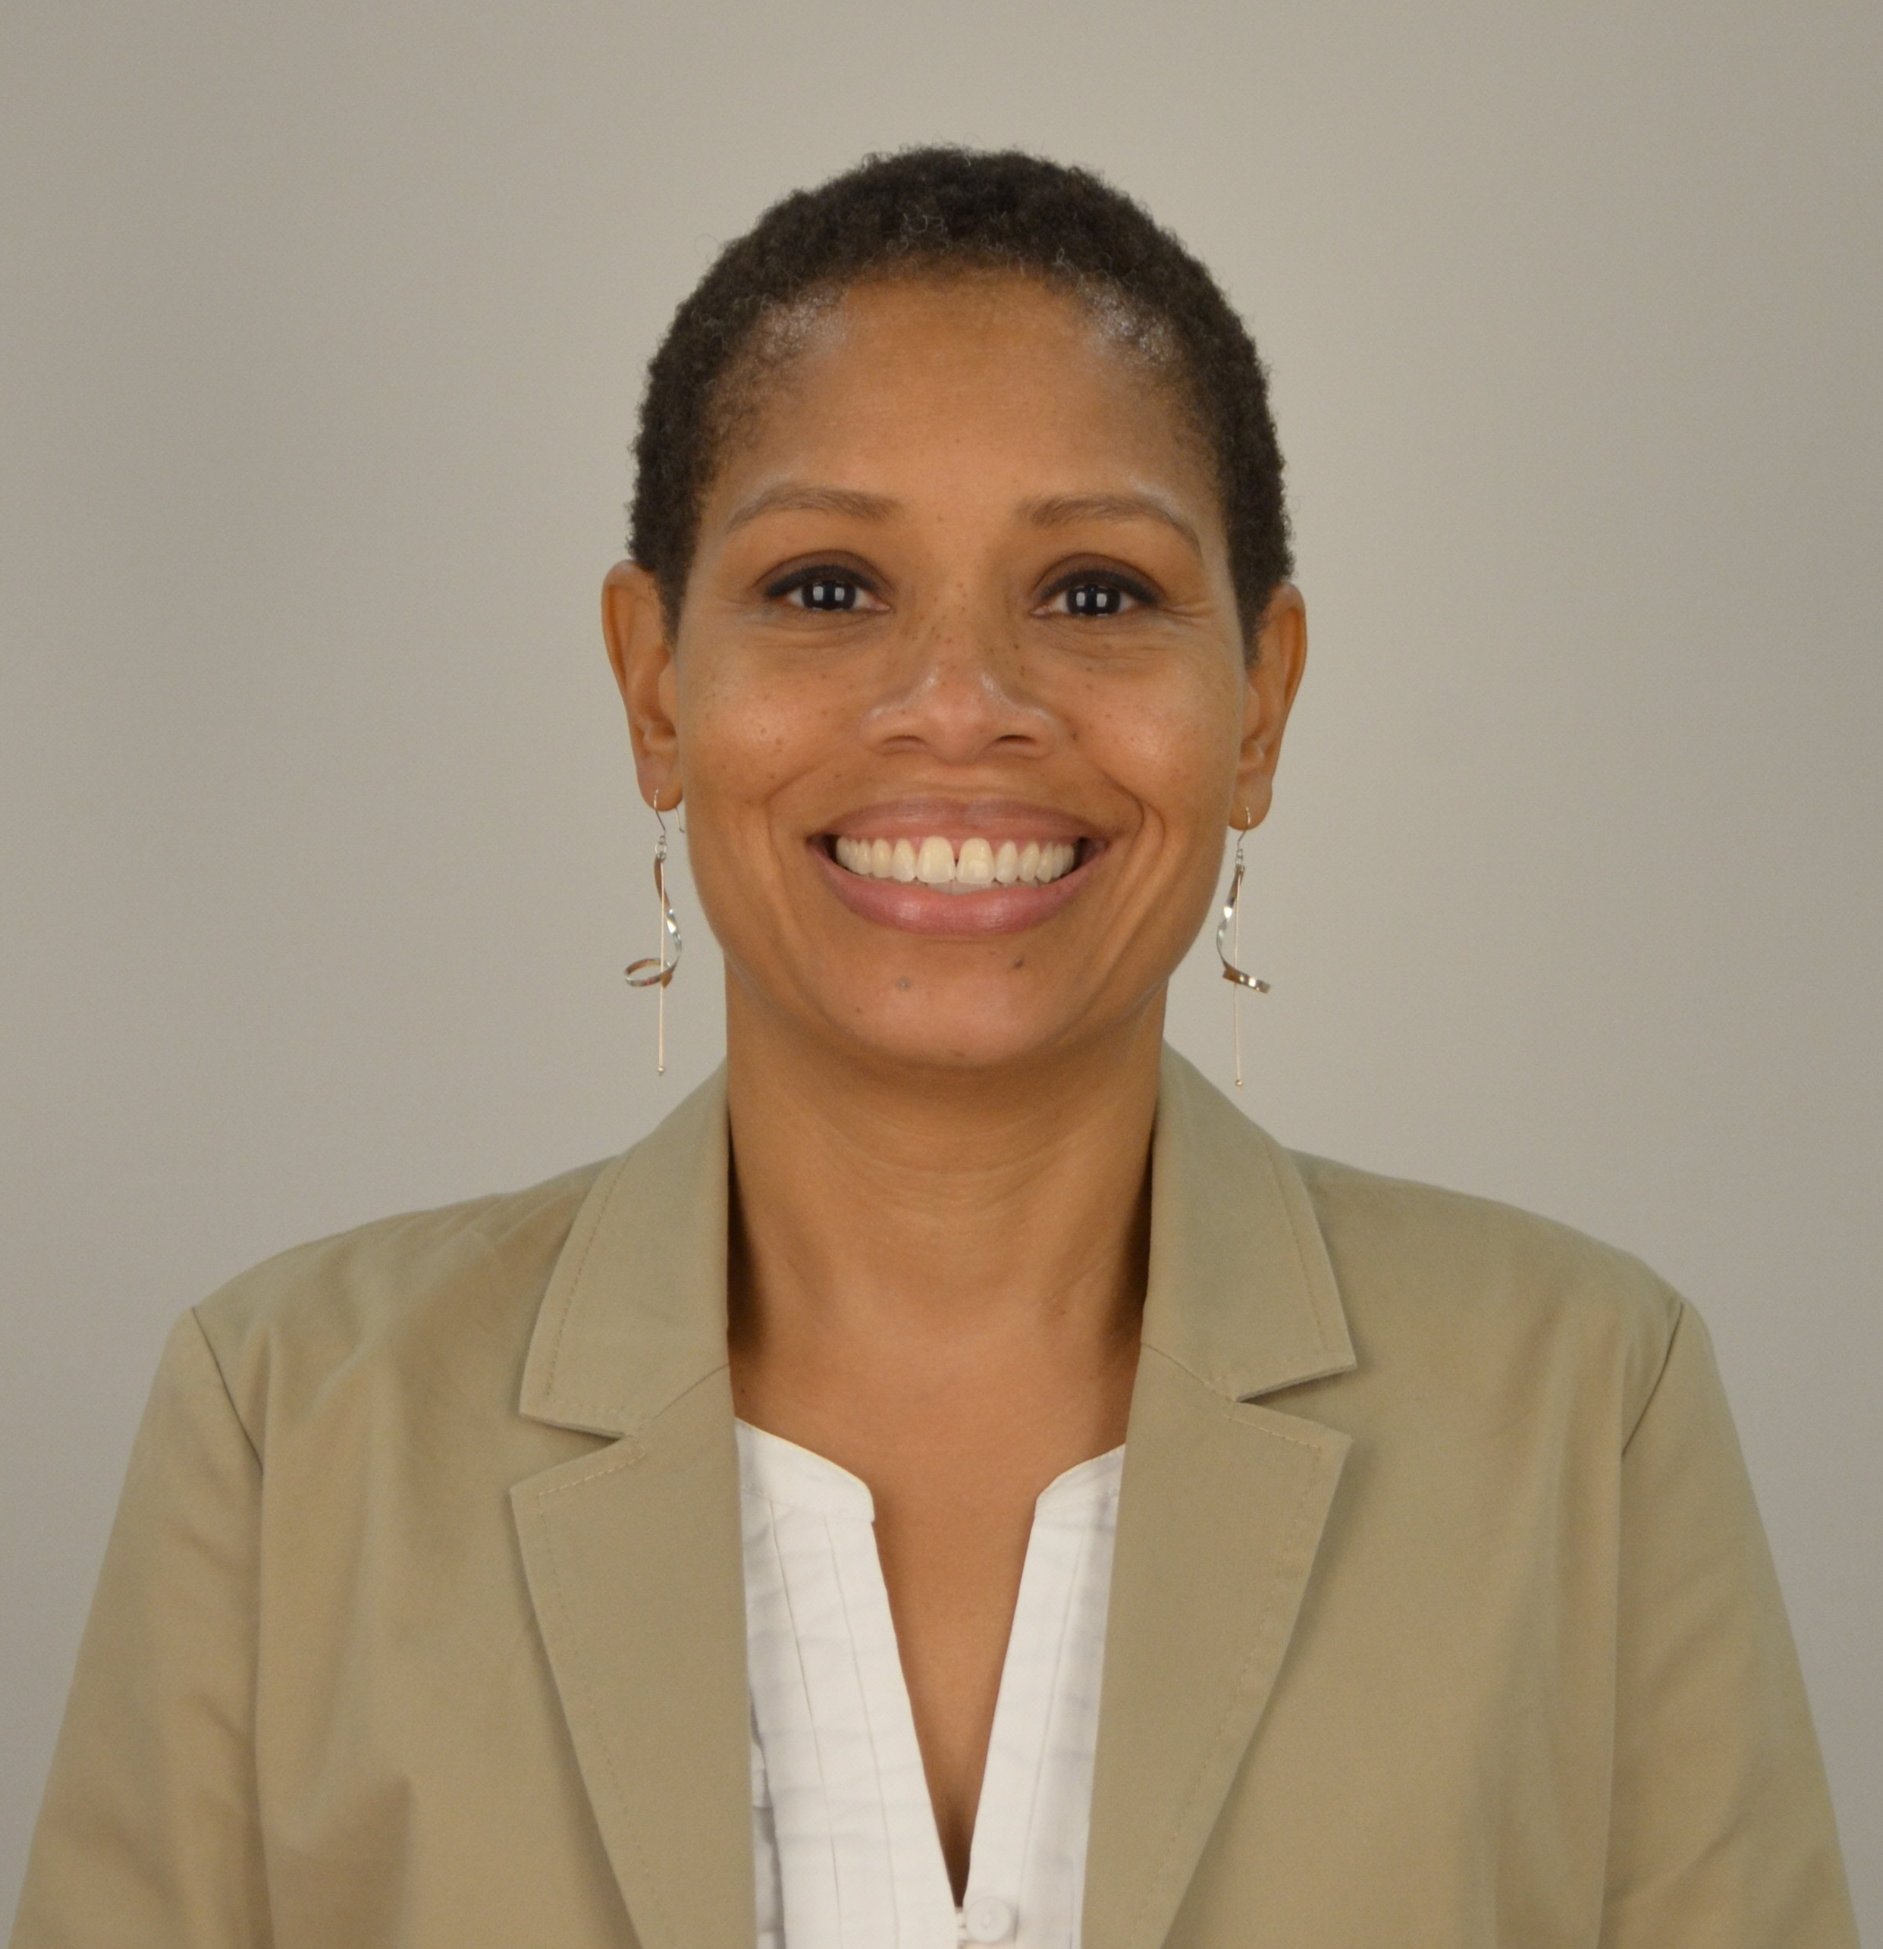
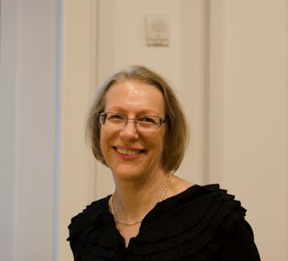
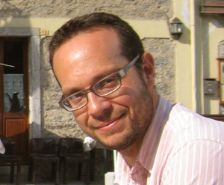
Dissemination Information Packages for Information Reuse (DIPIR)
The DIPIR Project was made possible by a National Leadership Grant from the Institute of Museum and Library Services, LG-06-10-0140-10, “Dissemination Information Packages for Information Reuse” and support from OCLC Online Computer Library Center, Inc., and the University of Michigan.
Notes:
Beth Yakel, University of Michigan, School of Information, and I collaborated on an IMLS proposal called DIPIR (Dissemination Information Packages for Information Reuse). DIPIR was a 3 year project funded by the Institute of Museum and Library Services. I was the principal investigator and Elizabeth Yakel the Co-PI. The funding has ended but our work on the project continues.
It focuses on data reuse, specifically the reuse of quantitative social science, archaeological, and zoological data, within the respective academic communities.
The DIPIR project is being done in partnership with scholars representing the Inter-university Consortium of Political and Social Research (ICPSR), the University of Michigan Museum of Zoology, and Open Context, an archaeological data repository and publishing service.
With Nancy McGovern, we are examining data reuse by quantitative social scientists, with Bill Fink/reuse by zoologists, and lastly with Eric Kansa/reuse by archaeologists.

Slide 5
Research Questions
What are the significant properties of social science, archaeological, and zoological data that facilitate reuse?
Can data reuse and curation practices be generalized across disciplines?
Our Interest
Data reuse research
Digital curation research
Disciplines curating & reusing data
(Faniel & Yakel, 2011)
Notes:
Researchers who are out to reuse other people’s data typically are interested in the conditions or circumstances under which the data were produced. I call that the context or significant properties of data. Researchers who end up reusing other’s data typically want to know a lot about the context of data production.
Motivated to bridge two literatures. Data reuse literature – typically focused on significant properties/context necessary to facilitate reuse, particularly understanding/interpreting data/judging data quality. Data curation literature – typically focused on significant properties/context necessary to access data over the long term.
So, one objective of DIPIR was to learn what data reusers needed besides the data, specifically what kinds of contextual information reusers needed to support their reuse and the implications for data curation. Since we were studying data reuse within several research communities, there also was interest in whether any generalizations could be made across disciplinary communities.

Slide 6
DIPIR Methodology
 | ICSPR | Open Context | UMMZ
Phase 1: Project Start up
Interview Staff | 10 | 4 | 10
Phase 2: Collecting and analyzing user data
Interview Reusers | 43 | 22 | 27
Survey Reusers | 1480
Web analytics |  | server logs
Observe Reusers |  |  | 13
Phase 3: Mapping data’s context to reusers’ needs
Notes:
Phase 1: Interviewed staff to understand the data submission, archival, and dissemination processes, how existing standards were applied, what data were available for reuse, and supportive tools & services provided.
Phase 2: Interviewed reusers within the three disciplines to learn about their reuse practices and information needs. For each site we used a multi-method approach to triangulate our findings.
w/Open Context examined online behavior to determine data discovery and access behaviors
w/UMMZ we conducted observations and think-aloud with data reusers in the museum to consider how they put digital and analog information together for reuse.
w/ICSPR we surveyed users of ICSPR data sets about their reuse practices and experiences.
Phase 3: We have looked across the 3 academic communities to look for generalizations and map data’s context to reusers’ needs and data curation activities and services.

Slide 7
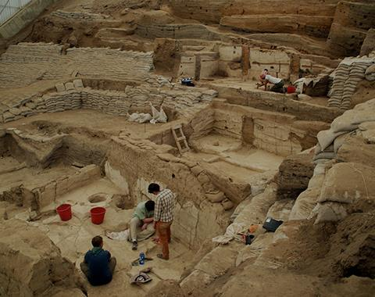
Today’s Focus: The Data Reuser
“I’m sort of transitioning from…hunting and herding …to look at how animals are incorporated into increasingly complex societies…so the role they play in the emergence of wealth and elites, particularly domestic animals, commodity production and the use of wool as a major foundation for urban economies in the Bronze Age…”.
- Archaeologist 13
Notes:
Photo credit: Jason Quinlan (2013). Çatalhöyük. https://www.flickr.com/photos/catalhoyuk/9184503529
Today my focus is solely on the data reusers’ perspective – their needs, their practices when it comes to reusing data from others within their disciplinary community.
This archaeologists is interested in reusing data that has been collected over time and maybe space/geography, given interests in transitions from hunting and herding of animals to how animals are incorporated into increasingly complex societies – domesticated animals, use of sheep’s wool, etc.
How do we support this archaeologist’s research? Or better yet, his data reuse needs, so the research can be conducted?

Slide 8
Today’s Focus: The Data Reuser
Context information needed
Its direct vs. indirect relationship with the data
Reasons context information needed
Role of data quality in the data reuse process
Sources of context information
Tracking, linking, and curating varied sources
Implications for academic libraries
Shaping data curation activities and services
Notes:
Photo credit: Jason Quinlan (2013). Çatalhöyük. https://www.flickr.com/photos/catalhoyuk/9184503529
Today I will focus on reusers needs in terms of
Context information needed – noticing that it has direct and indirect relationships to the data – it comes from places other than the context in which the data were produced
Reasons context information is needed – particularly the role of data quality in the data reuse process
Sources of context information – to determine how it is tracked and linked or curated
Throughout the presentation I will discuss implications for academic libraries emphasizing how data curation activities and services might be shaped to accommodate reuse needs.

Slide 9
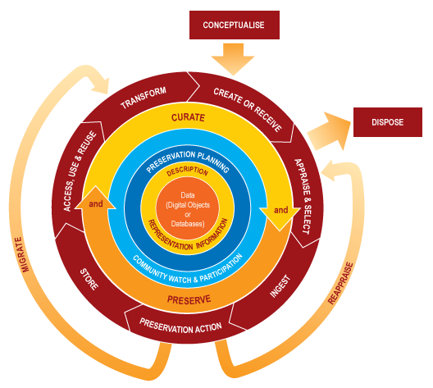
Digital Curation Centre (DCC)
Curation Lifecycle Model
Notes:
Photo credit: DCC Curation Lifecycle Model, http://www.dcc.ac.uk/resources/curation-lifecycle-model
I thought I would start kick things off with a definition of data curation from UIUC, which emphasizes the entire lifecycle.
“Data curation is the active and ongoing management of data through its lifecycle of interest and usefulness to scholarship, science, and education. Data curation enables data discovery and retrieval, maintains data quality, adds value, and provides for re-use over time through activities including authentication, archiving, management, preservation, and representation”. http://www.lis.illinois.edu/academics/degrees/specializations/data_curation.

Slide 10
Interviews and Observations
Data Collection
92 interviews
13 researchers observed at the University of Michigan Museum of Zoology
Data Analysis
1st cycle coding
based on interview protocol
more codes added as necessary
2nd cycle coding for context
Detailed context needed
Place get context
Reason need context
Notes:
Most of my talk will focus on findings from our qualitative research, so I wanted to spend some time talking about our data collection and analysis methods briefly.
In total, across the three disciplines we have conducted 92 interviews and observed 13 researchers at UMMZ. We asked them about: their experiences reusing data. Topics of inquiry included how respondents discovered and evaluated data for reuse and their experiences using data repositories
Our data analysis was done in two cycles. The first was based on the interview protocol primarily with more codes added as necessary. The second was based on three broad categories – the detailed context reusers needed, the places they went to get it and the reasons they needed it. The categories were broken down based on literature and the data itself as we read about mentions of particular types of context, places or reasons.
The findings I will present are based on the detailed codes created for each of these categories.

Slide 11
Context information needed
Its direct and indirect relationship with data.
Notes:
These are the types of context information that we found reusers needed across the 3 disciplines we studied. This photo of the cards is from a workshop we did at the International Digital Curation Conference in February 2016. The workshop drew in data librarians and curators primarily. We had them do two card sort exercises.
For the first exercise, we had them rank order the cards of context information from most to least important for their designated communities of users. In the second card sort exercise we had them re-sort the cards with their existing data deposit requirements in mind.

Slide 12
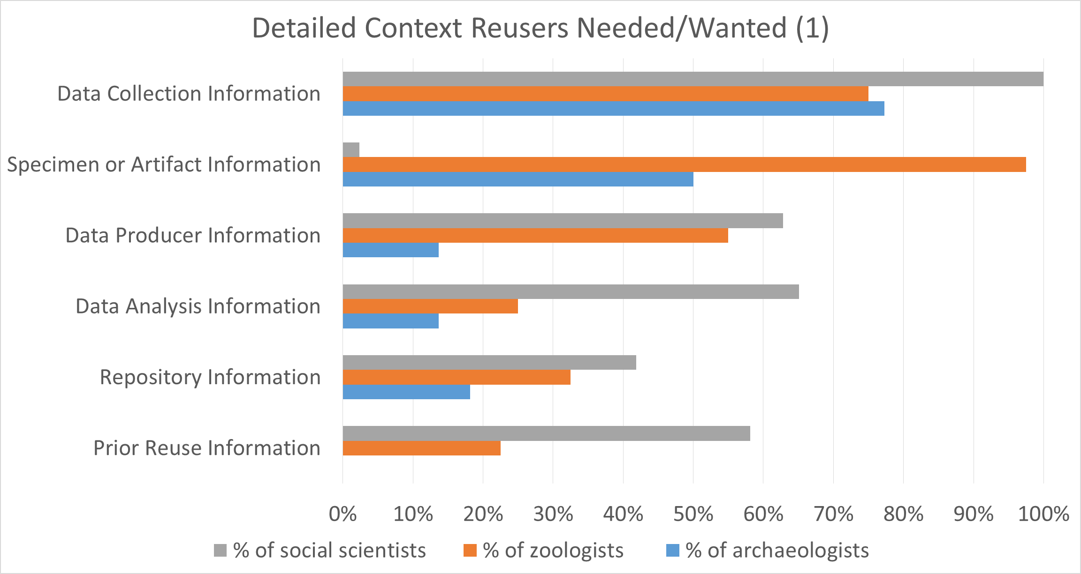
Notes:
Here we see the percentage of reusers within each discipline who mentioned different types of context information they needed and we get a sense of what’s important during decisions about reusing data.
So I will point out a couple of things and follow that with example quotes to illustrate what reusers in different disciplines described needing for different context types.
We see data collection information is important to all. Specimen information is important to practically all zoologists, but only 50% of the archaeologists mentioned artifact information. Data producer information was particularly important for social scientists and zoologists, less so for archaeologists. Data analysis information was important for about 2/3 of the social scientists, but fewer zoologists and archaeologists.
The other thing of interest was the types of context mentioned. Many had a direct relationship with the data and its context of production. Others were indirectly related, for instance repository and prior reuse information.

Slide 13
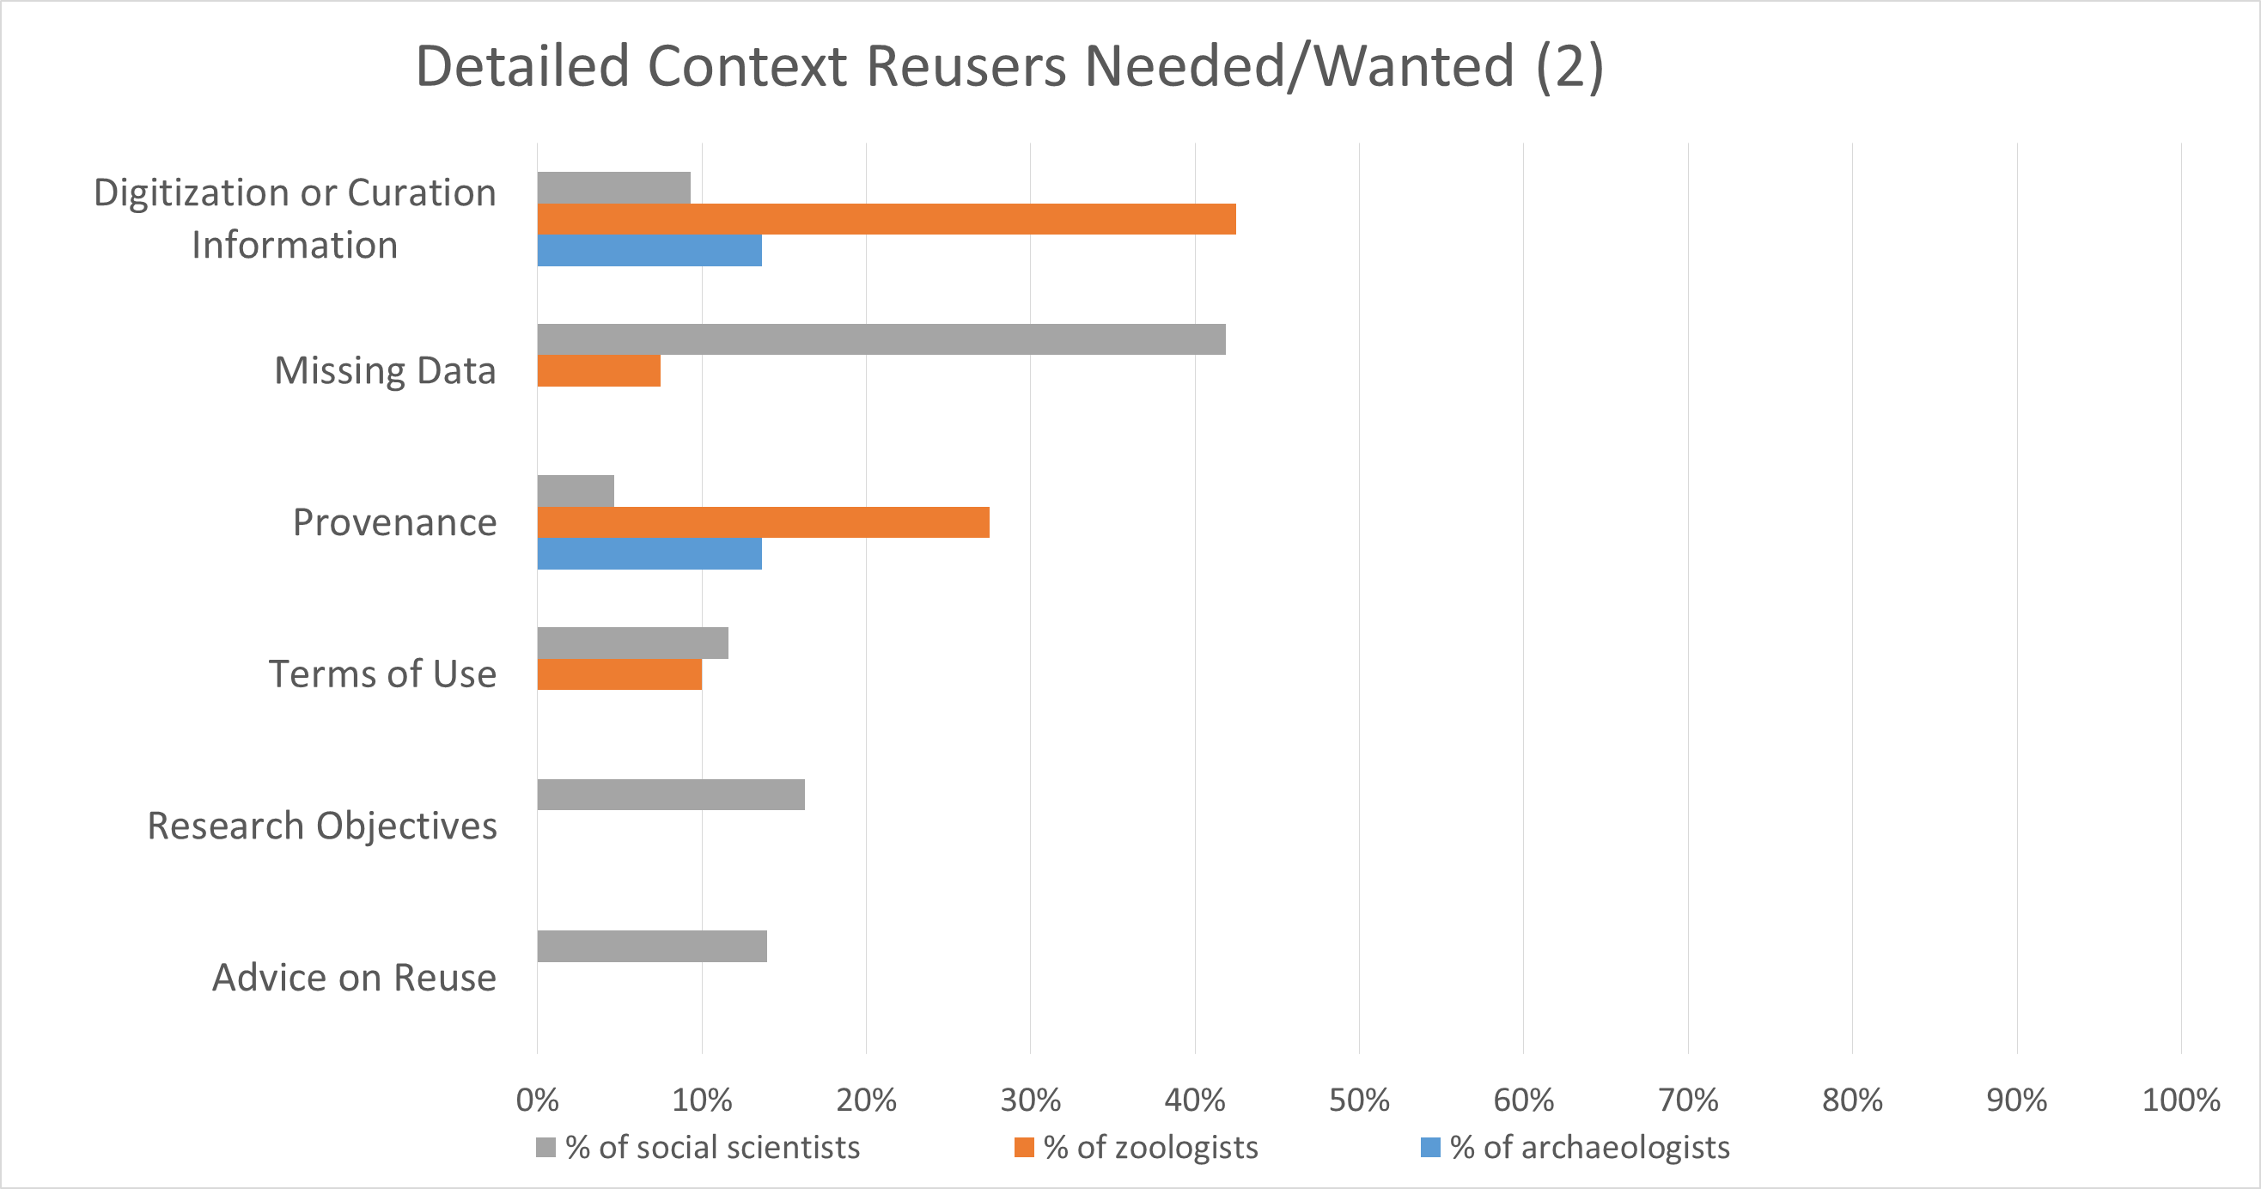
Notes:
Here we also see more types of context, some of which were related to the data and we would expect to get from the data producer such as missing data, terms of use, research objectives.
Then we have others that reusers mentioned needing/wanting that may not be something the data producer would provide, such as digitization/curation information and provenance information, and advice on reuse.
So, what are data reusers in each of the disciplines describing when the talk about these different types of context? I won’t talk about each one individually, but I did want to spend time on a few.

Slide 14
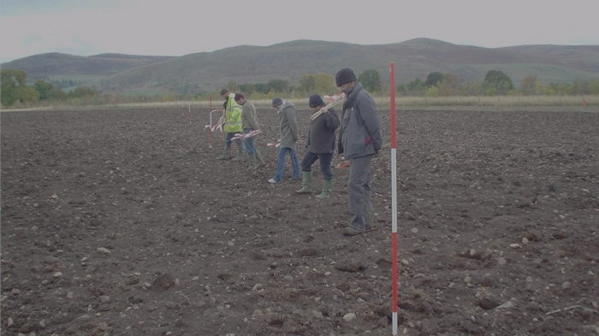
Data collection information
“Sometimes they'll simply declare we were only interested in broad-based information. We were only collecting broad-based artifacts...So, they're walking huge tracts of land, but they're only hitting big things…I've heard of things like shoulder surveys, where they literally walk side by side and pick those little things, but then, again, you've only, you're doing a very narrow tract. So there are procedures”.
- Archaeologist 01
Notes:
Photo credit: Archaeologists fieldwalking at Lanton Quarry http://www.archaeologicalresearchservices.com/lantonwebsite/how/fieldwalking.html
Data collection info: includes anything related to how a study was designed and the data were gathered. For instance, data collection procedures/strategies were important across disciplines. The photo shows a team walking the field site. One of our archaeologist’s explained that details about field walks that occur during data collection were important, because it impacted what they were interested in finding and whether that was of interest to him. For social scientists interested in using human subjects data collected via surveys/questionnaires, how the survey was designed and administered is important. The question wording provided insight into how variables were defined and measured and whether they were relevant to the reuser’s research.
See Faniel, Kansa, Witcher Kansa, Barrera-Gomez, Yakel (2013) and Faniel, Kriesberg, Yakel (2012).

Slide 15
Specimen Information
“People have looked at morphometrics of lizards before, but usually they're not at the skeletal level... And then…Nobody measures teeth…I'm very interested in teeth and dentition”.
- Zoologist 30
Notes:
Photo credit: Sonia Fernandez (2015) from Estrada, Andrea. “The Challenge of Measuring a Bird Brain.” Accessed May 27, 2016. http://phys.org/news/2015-06-bird-brain.html at http://phys.org/news/2015-06-bird-brain.html#jCp.
Specimen and artifact info: included specimen or artifact descriptors such as name, age, gender, accession number, when and where found. The most frequently mentioned specimen information was species identification and location where specimens occurred/were found. This information was typically the starting point for deciding whether the data were relevant and accurate.
Interestingly there were many instances when zoologists reused the physical specimen to collect their own data –e.g. image and quote above.
See Faniel & Yakel (forthcoming).

Slide 16
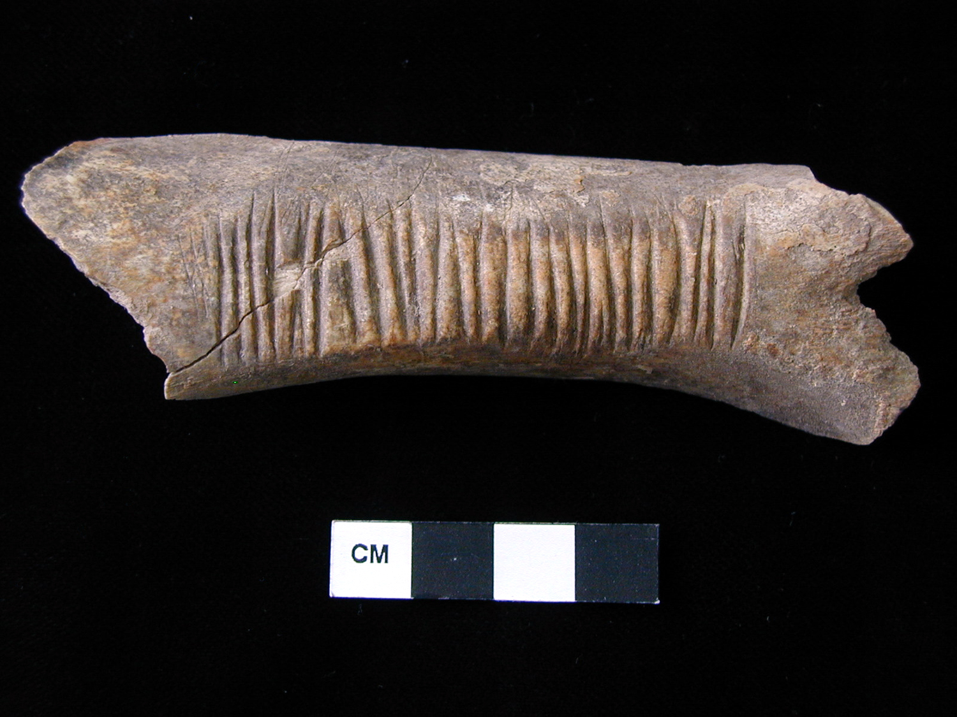
Artifact Information
“So I was contacting him for other specific information. Where was this found, what period did it date to, and what artifacts were found with it because that's often not cataloged along [with] this primary zooarchaeological data nor do you have access to field notes or anything like that.”.
- Archaeologist 02
Notes:
Photo credit: “Photo of worked bone” by Bradley Parker, Peter Cobb. "F_5_5003_5010_1.JPG from Turkey/Kenan Tepe/Area F/Trench 5/Locus 5003/Finds Bag 5010". (2012) In Kenan Tepe. Bradley Parker, Peter Cobb (Eds.) . Released: 2012-03-28. Open Context. <http://opencontext.org/media/F6BC22FE-AD79-4BB9-8AAA-E05AC705EF61> ARK (Archive): http://n2t.net/ark:/28722/k2862h17z, used under CC BY.
Contrast zoologists to archaeologists who needed artifact information. They were looking to understand and verify the data producers’ interpretations. They wanted to be able to draw their own conclusions.
See Faniel, Kansa, Witcher Kansa, Barrera-Gomez, Yakel (2013).

Slide 17
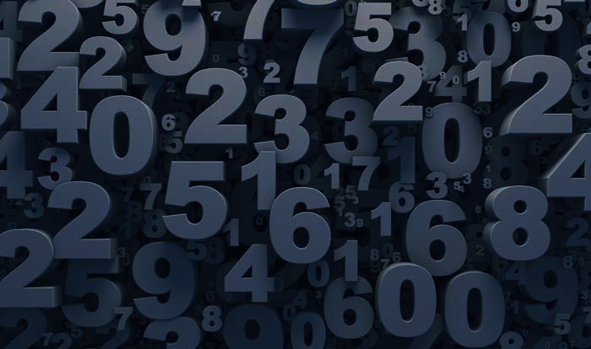
Data Analysis Information
“But even within the codebook they may tell you how it's coded. I had this a lot of times and I still don't know…they just say if this variable belongs to this category, we coded it as six. But it really doesn't tell, didn't tell me how they coded it…I wanted to make my own judgment whether this variable is exactly what I want. But that won't give me that indication”.
- Social Scientist 16
Notes:
Photo credit: http://www.pymnts.com/in-depth/2015/earnings-edition-pt-1-amazon-amex-and-ebay/
Data analysis info: any activities around interpretation, such as cleaning, transforming, calculating, or coding data that allows one to draw conclusions.
Social scientists often turned qualitative data into quantitative data. A common example is coding male and female as a 1 and a 0 in order to compare differences across the two groups. Others might be more elaborate, such as – reading and coding news paper articles based on a set of policy codes regarding House vs. Senate hearings. See Faniel, Kriesberg, Yakel (2012).
Coding is also something that occurred in archaeology during data recording – e.g. sheep can be recorded as “sheep” “sheep/goat”, “ovis”, “14”, “Caprinae”. Zoologists and archaeologists did radiocarbon dating, another kind of data analysis, which led to the need for different kinds of context information.

Slide 18
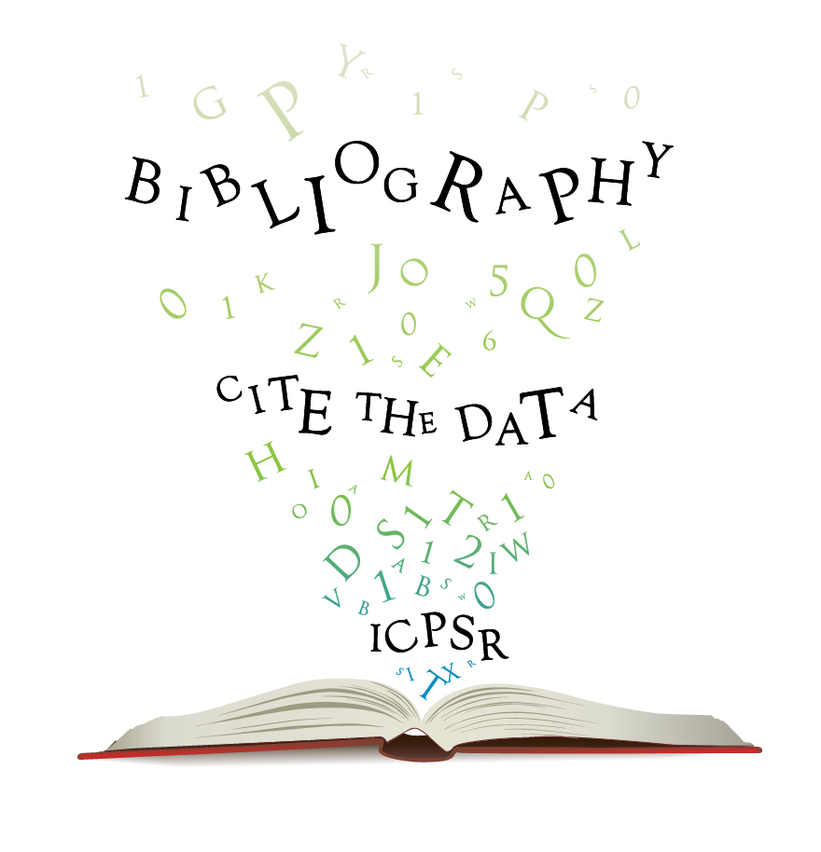
Prior Reuse Information
“At least, if I know other people are using it in criminology and publishing in it, and it seems to be a pretty reliable data source and something that's pretty useful for criminology, then I know, ‘Okay, let's see if it's got the information that we specifically want for our project’”.
- Social Scientist 33
Notes:
Prior reuse info: mentions of other researchers who have also reused the same data, primarily in the form of a published journal article incorporating some or all of the data in a study or critique.
Social scientists frequently mentioned prior reuse information. They used it, mainly through journal articles. Data that were well known and widely reused indicated a level of community acceptance that the data were credible. Fewer zoologists relied on prior reuse information even though data sharing and reuse have been happening. No archaeologists mentioned prior reuse, which is not surprising given it is a relatively new phenomenon.

Slide 19
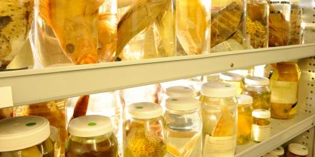
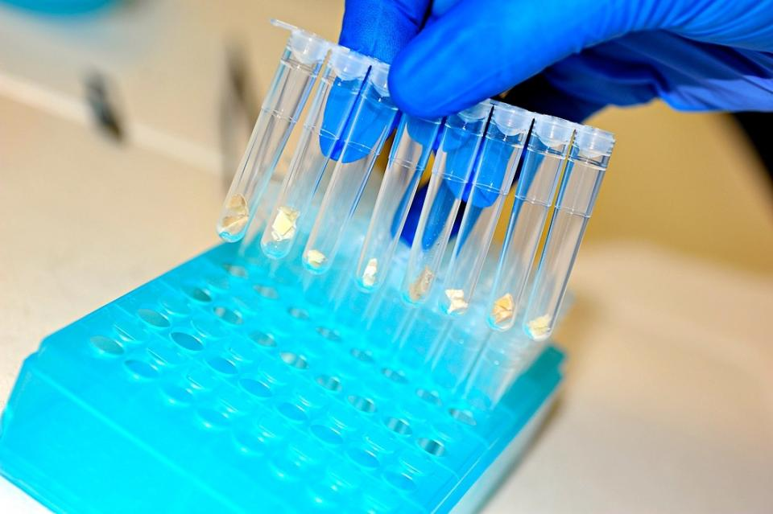
Digitization/Curation Information
“If it is a tissue sample that's associated with a voucher specimen, in other words, it's a tissue sample that was taken from an animal that wound up in a museum, I would like to know that. I think that there should be a field for that, or at least I should be able to extract that data easily enough, so that I know whether I can confirm the taxonomic status of the fish from whence this tissue came”.
- Zoologist 02
Notes:
Photo credit: Specimens in the Australian National Fish Collection. Image: CSIRO at http://cba.anu.edu.au/research/projects/genetic-characterisation-formalin-preserved-fish-tissue
Photo credit: Shark tissue for testing. Image: CSIRO at http://cba.anu.edu.au/research/projects/genetic-characterisation-formalin-preserved-fish-tissue
Digitization/curation info: describes how someone or some organization digitized or curated data, a specimen, or an artifact, including the functions or services associated with digitization/curation information and how provenance and preservation processes are handled.
Zoologists mentioned it the most frequently. Several wanted to know what specimens were preserved in before requesting physical samples for DNA analysis. Provenance was important when retrieving data from repositories that aggregated data from various sources – like GenBank (sequence data) or GBIF (Global Biodiversity Information Facility).

Slide 20
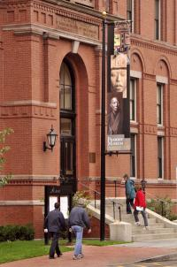
Repository Information
“There was a relationship already between the museum and the university. And having to be related to a famous museum that has a reputation, it does make the source more reliable…”.
- Archaeologist 04
Notes:
Photo credit: Daderot (2009). Peabody Museum of Archaeology and Ethnology, Harvard University, 11 Divinity Avenue, Cambridge, Massachusetts, USA. Exterior facade. https://en.wikipedia.org/wiki/Peabody_Museum_of_Archaeology_and_Ethnology.
Repository info: mentions about a repository or museum that provides access to the data
Similar to prior reuse and in some cases digitization/curation. Repository information was not something the data producer provided upon deposit. In fact the repository information reusers often spoke about was not captured anywhere. It was things that were known and passed around. The quote by Archaeologist 04, exemplifies things said across all the disciplines – the reputation of the repository/museum impacted perceptions about the credibility of the data.
See Faniel, Kansa, Witcher Kansa, Barrera-Gomez, Yakel (2013) and Yakel, Faniel, Kriesberg, Yoon (2013).

Slide 21
Establishing Trust in Repositories
Role of repository functions and classic trust factors
Notes:
I want to drill down into repository information a bit, specifically trustworthy digital repositories.
A study we published in the International Journal of Digital curation a few years back looked at the role of repositories in data reuse. We looked at 1) how reusers constructed/came to trust repositories and 2) whether and how they associated repository actions with trustworthiness. See Yakel, Faniel, Kriesberg, Yoon (2013).
We found reusers (in social science and archaeology) recognized a repository’s trustworthy actions (the functions they perform as outlined in the ISO audit and certification of trustworthy digital repositories document. We also found that reusers thought about trust in classic ways tied to management and management information systems literature on trust in organizations and information systems.

Slide 22
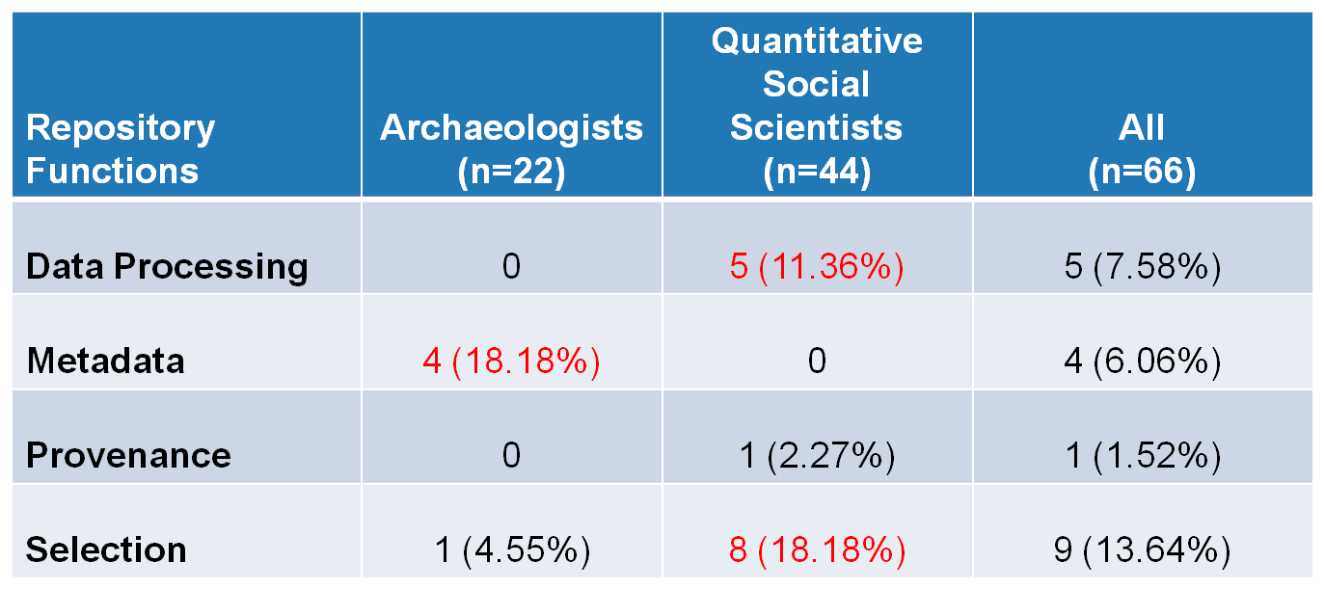
Frequency repository functions linked with repository trust
(Yakel, Faniel, Kriesberg, Yoon, 2013)
Notes:
When we looked at the role of repository functions in establishing trust in repositories for archaeologists and social scientists we found: Data processing and selection were mentioned more among social scientists, whereas archaeologists mentioned metadata creation.
Archaeologist 02 Metadata Creation: “They're very keen on producing the comprehensive metadata. And it's not that I trust each research … but I trust that the metadata is there for me to go back and check…on my own”.
Social scientist 14 Selection: “I wouldn't use a scale from a very overtly conservative or overtly liberal organization that was involved in other kinds of political activities outside of collecting data because that would make you question what the goal is in collecting that data. So that would I think affect sort of the trustworthiness of repositories at least in my field”. Social scientist 10 described a number of functions and policy information important for garnering her trust: “The staff, the operations, the existence, the process of how you make data available, what are the restrictions…Just detailed information about the repository”.

Slide 23
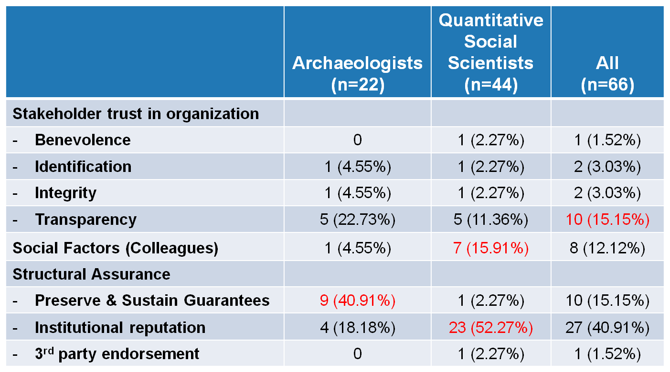
Frequency trust factors mentioned
(Yakel, Faniel, Kriesberg, Yoon, 2013)
Notes:
If we look at classic trust factors. From the management literature on organizational trust, transparency of the repository was the most important. Twice as many archaeologists mentioned it.
Archaeologist 04 who talked about reputation continued about Transparency: “So knowing that, they developed the work and that they were backing up the information. Also knowing that I have access to the collection itself if I wanted to and that they are explicit about everything that they did. They tell you all the methods that they use. They tell you every single person who wrote down anything. They tell you all the updates that they did with the material”.
Other trust factors found in the information systems literature that were mentioned frequently included social factors (e.g. colleagues saying something is good/can be trusted) for social scientists along with institutional reputation. More novice social scientists mentioned institutional reputation than experts.
Social scientist 32 Social factors: ‘I guess that's, well, trust …my own experience with using the data and then the organization’s long history, and then within the profession, it's very well spoken of. So, largely, informal mechanisms are why I trust [repository name]”.
Social scientist 28 Institutional reputation & preservation: “They've existed for a long time, they have incredible reputation for being able to maintain data, keep it well preserved, the issue of preservation is key, and that they go through extensive interrogation of the data to make sure that it is of high enough quality to be allowed to be part of their repository.
For archaeologists, guarantees of preservation and sustainability were the most frequently mentioned, which may not be surprising since they are in the early stages of data sharing and reuse. Archaeologist 21 talked about the importance of migrating data and understanding whether the migration was correct in terms of moving the bits and making sense for archaeological data.

Slide 24
Improving Support for Researchers
Evaluate data deposit requirements against reusers needs
Shape reusers’ perceptions when and where possible
Capture and share context information generated beyond data producers
Notes:
How closely do your data deposit requirements match reusers requirements in terms of type and content/level of detail? We are in the middle of doing this for representative repositories in the 3 disciplines we studied to see how closely they match (. If you don’t know the answer, assess what you are asking data producers to provide vs. what your reusers require. After all, you are doing all of this work so people can reuse data.
You can shape reusers perceptions about data indirectly (i.e. with information you provide). For instance, their perceptions about repositories’ trustworthiness provide a foundation of trust in the data. It’s not the only factor, but it is the starting point. Don’t make them guess. Tell them. Second, reusers talk to each other about you and your repositories (social factors are at play). Make sure they are getting the right information.. Third, reusers need to feel a sense of security when it comes to data repositories. For archaeologists it’s preservation/ sustainability. For social scientists its institutional reputation. Know what makes your reusers feel secure and figure out how to deliver on it.
Lastly, it’s not just repository information, capture and share the other types of context data producers cannot provide - information that is generated by the repository/repository staff upon data deposit or after data reuse. For instance, information about prior reuse (data reuse studies) and digitization/curation and provenance information.

Slide 25
Reasons context information needed
Role of data quality in the data reuse process
Notes:
Photo credit: http://www.emmsphere.com/blog/bid/234769/Garbage-In-Big-Data-Out
So I’ve talked lot about context information. But why do reusers need it?
A lot of it has to do with information reusers need to assess the quality of the data. Is it good enough for them to use – high enough quality.
In the management information systems literature the concept is presented as a multidimensional concept.

Slide 26
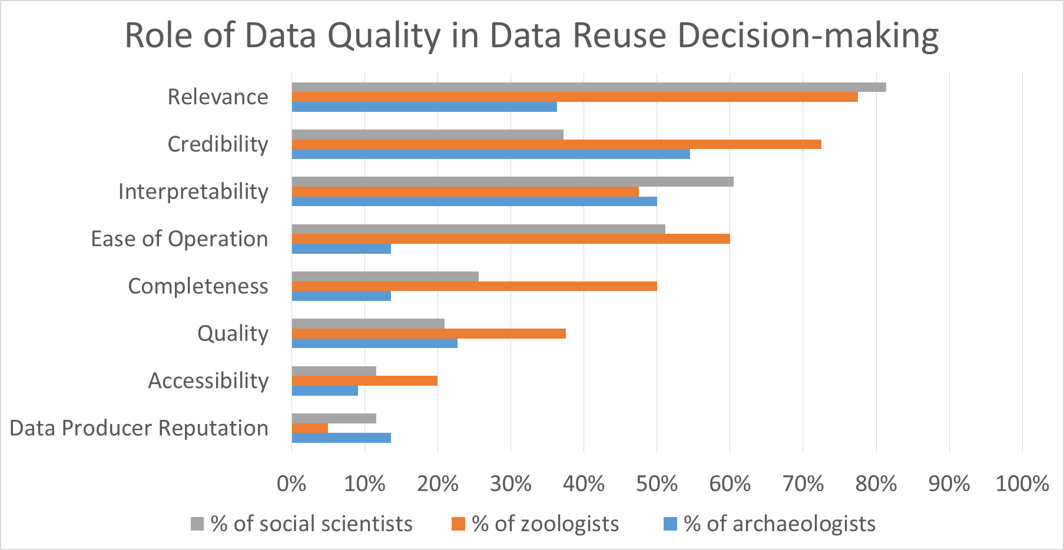
Notes:
Here you see several data quality indicators we used to code our interview data based on our interview protocols and prior literature.
The results show the percentage of reusers within each discipline who mentioned assessing/evaluating data based on these data quality attributes when asked about their decisions to reuse data.
These results may not seem surprising with relevance, credibility, interpretability topping the list. But I still wanted to talk through these a bit and compare against a survey we administered to social scientists who reused and published their studies to determine how data quality attributes related to data reuse satisfaction.
Relevance, interpretability, and ease of operation were mentioned most among social scientists.
Relevance, ease of operation, and credibility were mentioned the most among zoologists.
Credibility, interpretability, and relevance were mentioned the most among archaeologists.

Slide 27
Data Quality - Relevance
“And part of it is not even about trust. It's about how much that dataset fits your concept of what your theory is, it's your operationalization”.
– Social Scientist 03
Notes:
Data relevance - degree to which data apply to and help the task at hand
When reusers talked about relevance it was a lot about fit. For social scientist fit could be related to things like definition and measurement of variables, sampling procedures, research questions.
Similarly, for zoologists some were looking to match concepts like temperature and how it was measured.

Slide 28
Data Quality - Credibility
“If some fish is identified as X, and it's from Y, and X doesn't occur in Y, then I would say, ‘Okay, well that's wrong’. So he's got that... He or she's got that wrong”.
- Zoologist 08
Notes:
Data credibility refers to the “quality of being believed or accepted as true, real, honest” (Retrieved from http://www.merriam-webster.com/dictionary/credibility).
What reusers wanted to know essentially was whether the data were what they purported to be. For zoologists, a lot of credibility judgements were bound up in species identification and where they were found. Experts, systematists knew given those details alone whether the data were credible (first check).

Slide 29
Data Quality - Interpretability
“But understanding them in context and sort of defining them. I realized that there was a lot of potential for the data and for the site itself. And that's in large part, thanks go to the diligence of the original excavators, because without the accompanying documentation…”.
- Archaeologist 20
Notes:
Data interpretability - representational attribute of data which impacts understandability, for example are data in an appropriate language, unit of analysis, or clearly defined in order for reuse.
Archaeologists 20 discussed the role of context information in general to understanding the data so he could see the data’s potential for reuse.

Slide 30
Data Quality – Ease of operation
“What I really noticed was that almost every survey asked the questions slightly differently…some of the studies that were done in America actually copied the exact wording and the scaling of a particular question…some countries decided to do it just a little bit differently…so it was difficult to compile and harmonize the data”.
- Social Scientist 30
Notes:
Data ease of operation - extent to which data are easily managed and manipulated (i.e. updated, integrated, aggregated, reproduced).
Social scientists and zoologists examined data collection and specimen information to ensure consistency or compatibility of data or research design from multiple data collection instances in order to combine different datasets over time.
Here we have a social scientist discussing the difficulty combining data given small differences in how survey questions were written in America vs. other countries.

Slide 31
Data Quality – Completeness
“Tails are kind of tough to study…The last several tail vertebrae are very, very small, might get left behind when the specimen's prepared…So actually a lot of the skeletons in here would not work for us. And that's something you really don't know until you get the specimen”.
- Zoologist 36
Notes:
Data completeness - extent to which data have sufficient breadth, depth, and scope for the task at hand (comprehensiveness)
Zoologists (50.0%) were almost twice as likely to mention completeness as quantitative social scientists (25.6%) and almost four times as likely as archaeologists (13.6%). Here a zoologist is talking about the completeness of the physical specimen given preparation procedures of museum staff upon a zoologist’s return from the field, particularly what gets left behind in that process, whether it damaged or just not collected.
Several social scientists talked about completeness in terms of missing data points.

Slide 32
Data Quality – Accessibility
“…that [aggregator repository] targets so many different collections that once you have access you know pretty much…You can identify very quickly what you need”.
- Zoologist 13
Notes:
Data Accessibility - extent to which the data are available or easily and quickly retrievable
Accessibility was not a major reason for which context was sought in any of the disciplines, but disciplinary differences were apparent. Zoologists (20.0%) were almost twice as likely to mention accessibility as archaeologists (9.1%) or quantitative social scientists (11.6%).
These percentages were much lower than relevance, credibility, and interpretability when it came to their role in data reuse decision-making.
Here a zoologist talks about the advantage of using an aggregator repository to access specimen data from multiple collections at once.

Slide 33
Data quality – Data producer rep
“…that Germans in Munich tradition is one of the respected traditions for zooarchaeology in the Old World. So, those senior scholars and then their students are the ones that you trust”.
– Archaeologist 13
Notes:
Data producers reputation - extent to which the data producer’s research is highly regarded
The same holds true for data producer reputation. Few of our participants (archaeologists (13.6%), quantitative social scientists (11.6%), or zoologists (5.0%) needed context to assess data producer reputation.
A lot of this kind of information was known via word of mouth. It was passed down as part of becoming a researcher in a particular discipline.

Slide 34
Notes:
Now I want to compare these findings where we asked reusers how they evaluated data and decided whether to reuse data with quantitative research where we surveyed social scientists about their data reuse satisfaction after the data were reused and their findings were published in a journal (Faniel, Kriesberg, Yakel, 2016).
When it came to deciding whether to reuse social science data, relevance, credibility, interpretability, ease of operation were mentioned by larger percentages of social scientists than completeness, accessibility, data producer reputation.

Slide 35
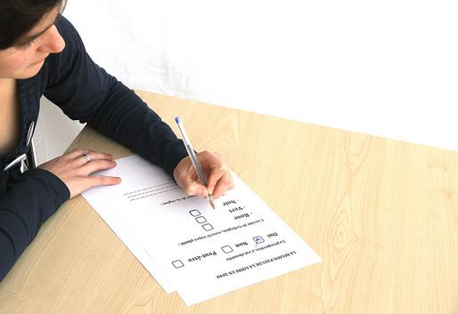
(Faniel, Kriesberg, & Yakel 2016)
Survey of Social Science Data Reusers
Used ICPSR’s bibliography of data related literature
Surveyed 1,480 data reusers
First authors on journal articles published 2009-2012
16.8% response rate
Notes:
For this study we used ICPSR’s bibliography of data related literature and sampled first authors of journal articles published between 2009-2012 that had reused data housed in ICSPR’s repository. We surveyed them about their perceptions of data quality, particularly relevancy, completeness, accessibility, ease of operation, credibility, data producer’s reputation. We also included documentation quality as a proxy of data quality.
We then gathered and included journal rank or reputation of the journal where the data reuse study appeared. We used Scopus SCImago Journal Rank (SJR), because it had the best coverage of the journals in our sample. We hypothesized that journal rank to be positively related to data reusers’ satisfaction. Publishing in higher ranking journals would translate to higher data reuse satisfaction.

Slide 36
(Faniel, Kriesberg, & Yakel 2016)
 | Β
Constant | -.030
Data relevancy | .066
Data completeness | .245***
Data accessibility | .320***
Data ease of operation | .134*
Data credibility | .148*
Documentation quality | .204**
Data producer reputation | .008
Journal rank | .030
Model Statistics
N | 237
R² | 55.5%
Adjusted R² | 54.0%
Model F | 35.59***
What data quality attributes influence data reusers’ satisfaction after controlling for journal rank?
*p < .05, **p < .01, ***p , .001
Notes:
Here’s what we found. 55% of the variance in data reusers’ satisfaction could be explained by this model. We see a flip of what was important during decision making vs. data reuse satisfaction post publication of a data reuse study.
Significant data quality attributes included accessibility, completeness, documentation quality, credibility, and ease of operation.
Relevance, journal ranking, and data producer reputation were not significantly related to data reuse satisfaction.
Why the change from decision making to data reuse study publication? Different data quality attributes important at different points in the data reuse process.

Slide 37
Improving Support for Researchers
Meeting changing needs throughout the data reuse process
Evaluate repository success in different ways
Shape documentation quality to meet reusers’ expectations
Notes:
Data reuse is a process, so you need to consider improving support for reusers throughout that process and keep in mind that different needs may come into play at different points in that process. Most data reuse studies focus on the evaluation and selection stages of reuse, there are a number of other stages, including discovery, access, preparation, and analysis. More work needs to be done, but until then you must keep in mind there are differences and be open to meeting them.
Repository success doesn’t end with discovery, views, or downloads. In fact there are several ways to measure repository “success”, such as TRAC (Trustworthy audit and certification criteria) and the ISO document, the data seal of approval. All of these provide an auditor’s perspective of success. We showed the reusers’ perspective, which included repository functions found in TRAC/ISO documents as well as other classic trust factors, and data reuse satisfaction.
Re-examining these data quality attributes with respect data reuse satisfaction paints a different picture of implications for curation. See Faniel, Kriesberg, Yakel (2016).

Slide 38
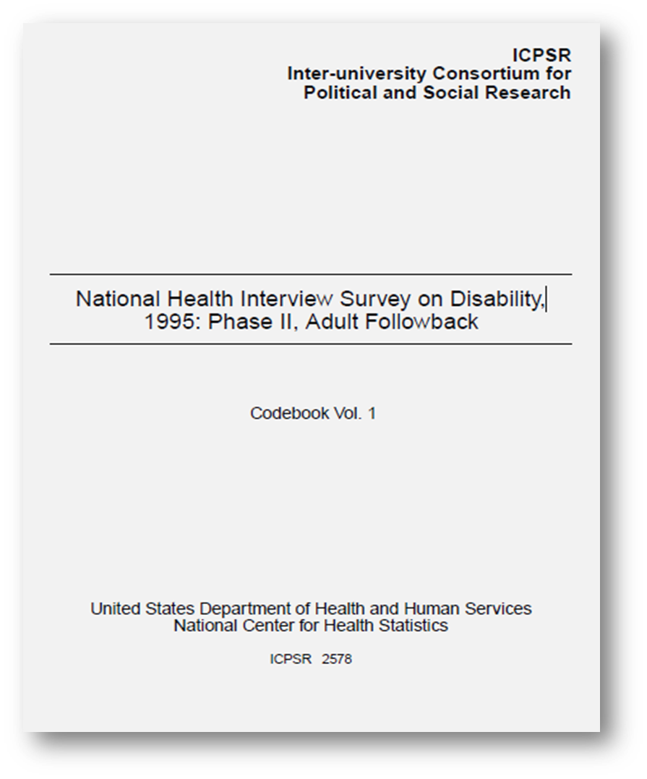
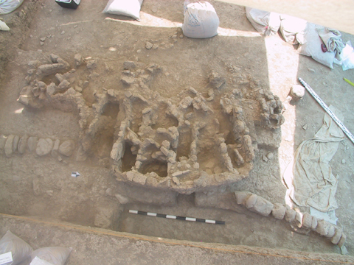
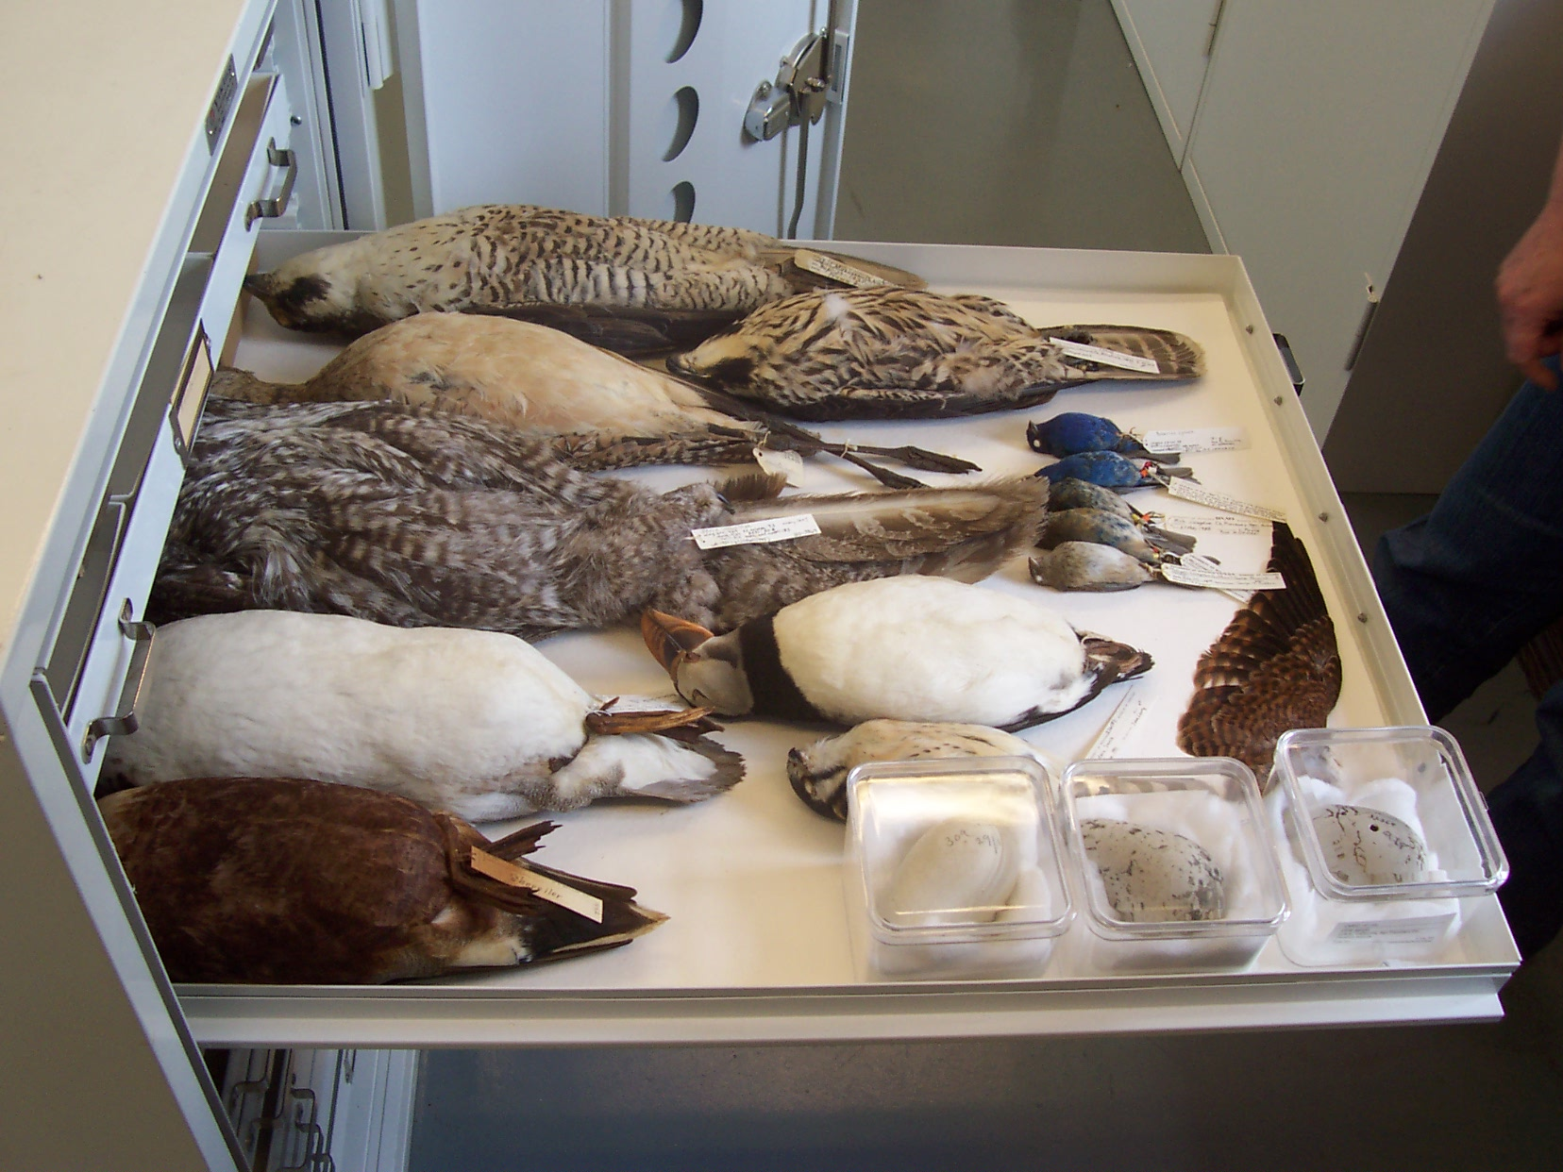
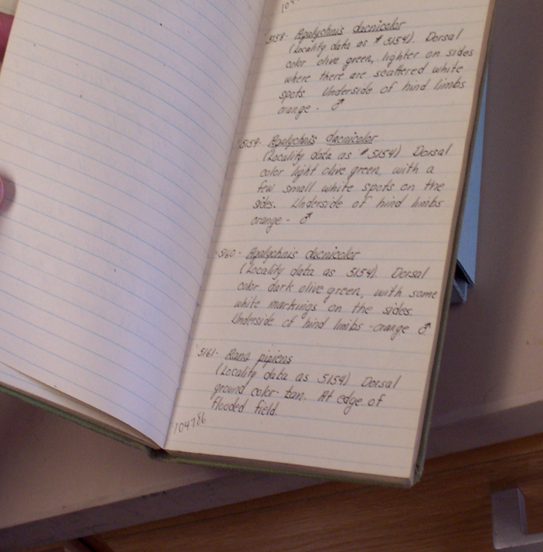
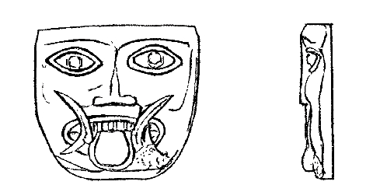
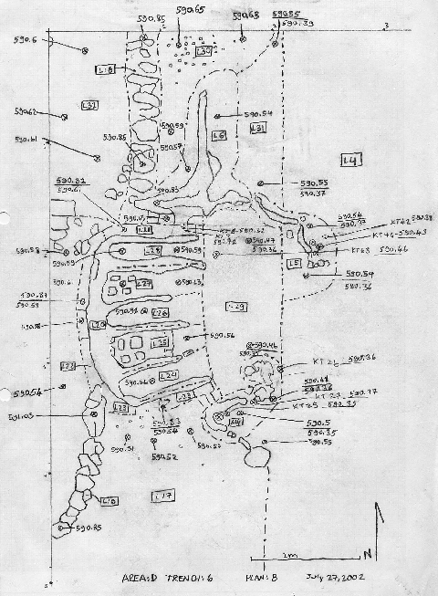
Sources of context information
Tracking, linking, and curating varied sources
Notes:
Photo credit passenger pigeon label at the University of Michigan Museum of Natural History http://www.birdzilla.com/blog/2015/02/17/two-countries-and-three-talks-michigan/
Photo credit of day plan: Drew McGaraghan, Catherine P. Foster. "Dayplan-D-6-2002-07-27-B from Turkey/Kenan Tepe/Area D/Trench 6/Locus 1". (2012) In Kenan Tepe. Bradley Parker, Peter Cobb (Eds.) . Released: 2012-03-28. Open Context. <http://opencontext.org/media/E9F08967-8098-4E0B-D4A5-34CAFAD80B6D> ARK (Archive): http://n2t.net/ark:/28722/k2v40r109
Photo credit for field photo of locus: Bradley Parker, Peter Cobb. "D-6-2002-07-17-Locus-W36 from Turkey/Kenan Tepe/Area D/Trench 6/Locus 5". (2012) In Kenan Tepe. Bradley Parker, Peter Cobb (Eds.) . Released: 2012-03-28. Open Context. <http://opencontext.org/media/BE74AF5E-1FC9-4B3D-87F2-D0E5B274B892> ARK (Archive): http://n2t.net/ark:/28722/k29s1rq64
Photo credit for Plaque-like fragment of ivory: Anthony Tuck. "19710102bmce1971fig12.gif from Italy/Poggio Civitate/Tesoro Rectangle/Tesoro Rectangle7/Tr-ID 283/PC 19710102". (2012) In Murlo. Anthony Tuck (Ed.) . Released: 2012-12-28. Open Context. <http://opencontext.org/media/A53B38E4-9A6C-4DD1-D88F-310C20A1AA88> ARK (Archive): http://n2t.net/ark:/28722/k2348m79w
Photo credit for field notebook: DIPIR team at the University of Michigan Museum of Zoology
Photo credit for museum specimens: DIPIR team at the University of Michigan Museum of Zoology
Photo credit for ICPSR National Health Interview Survey on Disability, 1995: Phase II. Adult Followback Codebook Vol. 1: https://www.icpsr.umich.edu/icpsrweb/ICPSR/studies/2578?searchSource=revise&q=national+health+interview+survey+on+disability+1995+Phase+II%2C+adult+followback
We have found that the sources/places reusers go to get context information were varied. They are not kept in one place. There is some wrangling of sources that occurs within each discipline and who does it varies as well.

Slide 39
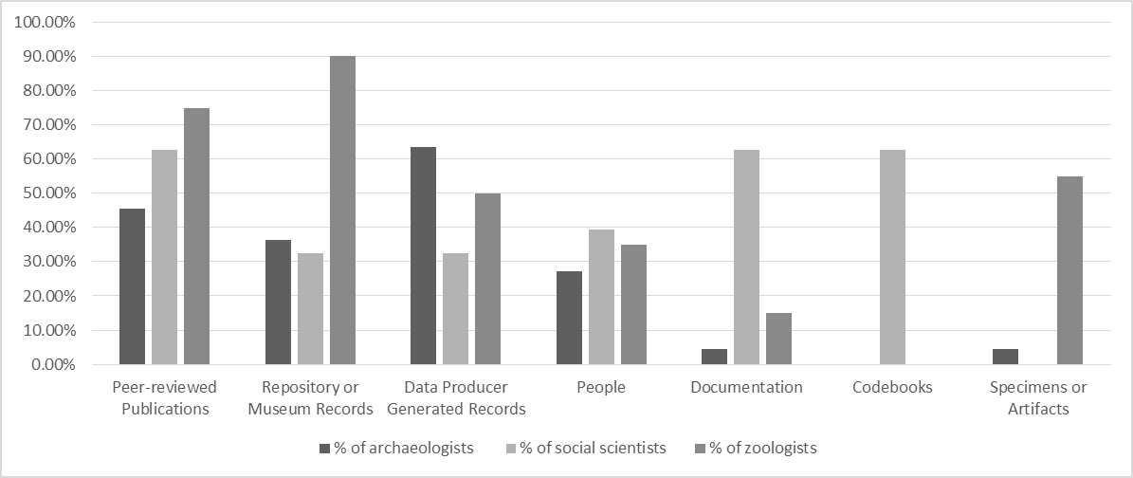
(Faniel & Yakel, forthcoming)
Seven Key Sources of Contextual Information
Notes:
So we know that these reusers needed different kinds of contextual information. These are the sources they relied on to get it. As you see some of the sources were employed across all three disciplines, but to different degrees. In other cases, the sources were discipline specific.
Social scientists used the terms codebooks & documentation interchangeably. ICPSR staff used data collection and analysis information captured in data producer generated records and added context. Peer reviewed pubs important as well as people. Archaeologists also relied on data producer records but the records were not assembled and repackaged into one information source like codebooks. Archaeologists had to search, review and assemble records on their own. Data producers’ publications used for data discovery and access to context info. People used in same way as pubs. Zoologists relied on repository/museum records, peer reviewed lit, specimens, and data producer records/field notebooks for data collection and specimen info. Physical specimen used to gather additional data. People used prior to visit to ensure visit would be worthwhile.

Slide 40
Improving Support for Researchers
Shape documentation during data creation
Recognize people as an important source of context information
Use reuse to inform potential reusers (e.g. reuse metrics, DOIs, data citations, bibliographies of data reuse)
Notes:
Shape documentation during data creation: Since context starts with data producer generated records, consider ways to center yourselves within your designated community of producers/reusers to understand upstream/downstream needs to align them with repository staff’s data deposit and curation activities, particularly documentation (Faniel & Yakel, forthcoming) .
Recognize people as an important source of context information: Given reliance on data producers, repository staff may want to consider reaching out to monitor producer-reuser exchanges to learn about the unmet needs of its designated community of users and adapt accordingly (Faniel & Yakel, forthcoming).
Use reuse to inform potential reusers: In all disciplines, reusers supplemented data reuse with peer-reviewed publications. Although data reuser pubs were more common with social scientists than with zoologist or archaeologists, consider gathering the information anyway, until reuse builds. In the meantime consider impact of using alternative evaluations, such as expert peer review of data (Faniel & Yakel, forthcoming).

Slide 41
Related Work
DIPIR
http://www.oclc.org/research/themes/user-studies/dipir.html
E-research and Data: Opportunities for Library Engagement
http://www.oclc.org/research/themes/user-studies/e-research.html
Beyond Management: Data Curation as Scholarship in Archaeology Project Description
http://alexandriaarchive.org/projects/bridging-creation-and-reuse/

Slide 42
Acknowledgements
Institute of Museum and Library Services
Co-PI: Elizabeth Yakel (University of Michigan)
Partners: Nancy McGovern, Ph.D. (MIT), Eric Kansa, Ph.D. (Open Context), William Fink, Ph.D. (University of Michigan Museum of Zoology)
OCLC Fellow: Julianna Barrera-Gomez
Doctoral Students: Rebecca Frank, Adam Kriesberg, Morgan Daniels, Ayoung Yoon
Master’s Students: Alexa Hagen, Jessica Schaengold, Gavin Strassel, Michele DeLia, Kathleen Fear, Mallory Hood, Annelise Doll, Monique Lowe
Undergraduates: Molly Haig

Slide 43
References
Enis, Matt. 2015. “Wisdom of the Crowd | Digital Collections.” Library Journal, July 13. http://lj.libraryjournal.com/2015/07/technology/wisdom-of-the-crowd-digital-collections/#_.
Faniel, Ixchel M., and T.E. Jacobsen. 2010. “Reusing Scientific Data: How Earthquake Engineering Researchers Assess the Reusability of Colleagues’ Data.” Computer Supported Cooperative Work 19 (3–4): 355–75.
doi:10.1007/s10606-010-9117-8.
Faniel, Ixchel M., and Elizabeth Yakel. 2011. “Significant Properties as Contextual Metadata.” Journal of Library Metadata 11 (3–4): 155–65.
Faniel, Ixchel M., Adam Kriesberg, and Elizabeth Yakel. “Data Reuse and Sensemaking among Novice Social Scientists.” Proceedings of the American Society for Information Science and Technology 49, no. 1 (2012): 1–10. doi:10.1002/meet.14504901068.
Faniel, Ixchel M., Eric Kansa, Sarah Whitcher Kansa, Julianna Barrera-Gomez, and Elizabeth Yakel. “The Challenges of Digging Data: A Study of Context in Archaeological Data Reuse.” In Proceedings of the 13th ACM/IEEE-CS Joint Conference on Digital Libraries, 295–304. JCDL ’13. New York, NY, USA: ACM, 2013. doi:10.1145/2467696.2467712.
Yakel, Elizabeth, Ixchel Faniel, Adam Kriesberg, and Ayoung Yoon. 2013. “Trust in Digital Repositories.” International Journal of Digital Curation 8 (1): 143–56. doi:10.2218/ijdc.v8i1.251.
Faniel, Ixchel M., Adam Kriesberg, and Elizabeth Yakel. 2016. “Social Scientists’ Satisfaction with Data Reuse.” Journal of the Association for Information Science and Technology 67 (6): 1404–16. doi:10.1002/asi.23480.
Faniel, Ixchel M., and Elizabeth Yakel. forthcoming. “Practices Do Not Make Perfect: Disciplinary Data Sharing and Reuse Practices and Their Implications for Repository Data Curation.” In Curating Research Data Volume 1: Practical Strategies for Your Digital Repository. Chicago, IL: Association of College and Research Libraries Press.
Additional references for the DIPIR project: http://www.oclc.org/research/themes/user-studies/dipir/publications.html

Slide 44
Strategic Conversations at Harvard Library
Thank you
Ixchel M. Faniel, Ph.D.
Research Scientist, OCLC
fanieli@oclc.org
@imfaniel
©2016 OCLC. This work is licensed under a Creative Commons Attribution 4.0 International License. Suggested attribution: This work uses content from Improving Support for Researchers: How Data Reuse Can Inform Data Curation © OCLC, used under a Creative Commons Attribution 4.0 International License: http://creativecommons.org/licenses/by/4.0/.

