Slide 1
Delivering Research Data Services: Early Experiences in Academic Libraries
21 October 2014
Ixchel M. Faniel, Ph.D.
Associate Research Scientist
OCLC Research
fanieli@oclc.org
Departamento de Biblioteconomía y Documentación Universidad Carlos III de Madrid

Slide 3
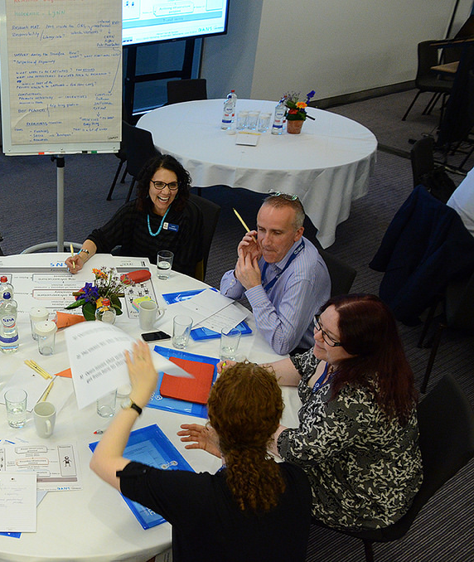
OCLC Research Roles
Community resource
Enhance engagement
Provide development, support & analysis
Notes:
Images: https://www.flickr.com/photos/oclcpar/14415067756/

Slide 4
Managing Data Needs of Scholars
Reusers
Producers
Data Needs
Supporters
Dissemination Information Packages for
Information Reuse (DIPIR) Project
E-research and Data:
Opportunities for Library Engagement (EDOLE) Project

Slide 5

Institute of Museum and Library Services (IMLS) funded project
Studying data reuse in three academic disciplines to identify how contextual information about the data that supports reuse can best be created and preserved.
Focuses on research data produced and used by quantitative social scientists, archaeologists, and zoologists.
The intended audiences of this project are researchers who use secondary data and the digital curators, digital repository managers, data center staff, and others who collect, manage, and store digital information.
For more information, please visit http://www.dipir.org

Slide 6
Delivering Research Data Services: Early Experiences in Academic Libraries
E-research and Data: Opportunities for Library Engagement (EDOLE) Project
http://www.oclc.org/research/activities/e-research.html

Slide 7

Motivation
In recent years libraries have seen an increase in research data services (Tenopir et al., 2013).
By helping research libraries adapt and make informed decisions, libraries will be able to strengthen partnerships with the research community (Feltes et al., 2012).
Notes:
Image: http://www.gulfnet.com.kw/images/slider/dataservices.jpg

Slide 8

Research Questions
What are librarians experiencing in the early stages of developing and delivering research data services (RDS)?
How can librarians’ experiences and research data services be improved?
Notes:
Image: http://medium7.com/wp-content/uploads/2012/05/questionmark1.jpg

Slide 9

Research Methods
Data Collection
One-on-one Interviews
  10 librarians
3 Focus Group Interviews
  26 librarians
Data Analysis
Initial codebook developed based on interview protocol and expanded
Notes:
Image: http://www.globeuniversity.edu/blogs/wp-content/uploads/2012/07/write.jpg

Slide 10

Librarian Profiles
Notes:
Image: http://socialgirlworld.com/wp-content/uploads/2013/07/pwn-webi.jpg

Slide 11
Full-time Equivalent Student Enrollment (N=36)
56%
25%
20%

Slide 12
Years of Library Experience (N=36)
47%

Slide 13
Data Management Experience (N=36)
3%
47%

Slide 14
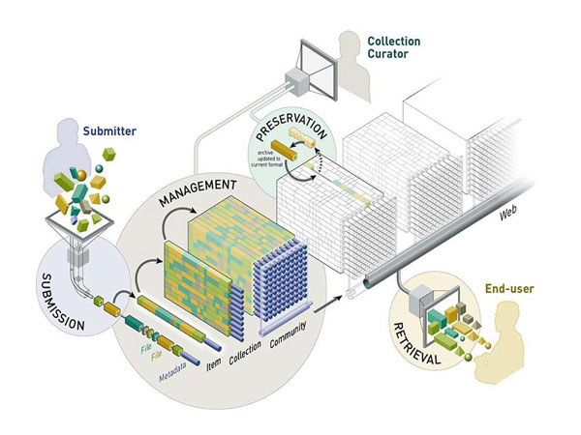
Top 3 Research Data Services
1. Data Deposit 67%
2. Data management planning 61%
3. Data management 42%
Notes:
Image: http://www.ariadne.ac.uk/issue55/vandeventer-pienaar

Slide 15

Top 3 Delivery Methods
Consultation 56%
Education 44%
Collaboration 28%
Notes:
Image: http://studymagazine.com/wp-content/uploads/2011/04/teacher-guidelines-for-social-media.jpg

Slide 16

Notes:
Image: http://blog.unum.co.uk/wp-content/uploads/2013/04/picture-word-benefits.jpg

Slide 17

Top Librarian Benefits
36% learning new things
33% library remaining relevant
31% work is interesting, enjoyable, rewarding
28% building relationships with researchers
Notes:
Image: http://www.ppcforhire.com/blog/wp-content/uploads/2012/11/seo-checklist.jpg

Slide 18

Challenges
Notes:
Image: http://exchanges.wiley.com/blog/wp-content/uploads/2014/06/OAfish.jpg

Slide 19

Top Librarian Challenges
33% lack of resources
28% lack of time
28% uncertain data storage plans
25% not seen as the go-to
22% unfamiliar/diverse inquires
Notes:
Image: https://encrypted-tbn2.gstatic.com/images?q=tbn:ANd9GcSJLteCyb4x9rL4TXHmnkhQrgSbJ2EIOLLg8Hovke2jzt34s7noQg

Slide 20

What Facilitates RDS Provision?
75% resources
64% training & experience
64% communication, coordination, collaboration
33% leadership support
Notes:
Image: http://www.nosweatpublicspeaking.com/wp-content/uploads/2011/11/Key-in-door.jpg

Slide 21

Resources (n=27)
59% Human resources
30% Institutional repositories, server space
"We're in the process of trying to advocate for funding for funding for 4 new positions that... We're building the Digital Commons, but we don't have anyone to run it." (3FG19)
Notes:
Image: http://www.utexas.edu/hr/eap/resources.html

Slide 22

Training (n=23)
39% had/are training
91% need/plan training
“When I’ve sought out webinars on data management, it’s often been, ‘Well this is mine, I’m starting at this new job and this is what I’m going to be doing at this job.’…that’s not really going to help me develop skills.” (2FG12)
Notes:
Image: http://www.cloudincredible.com/blog/tag/orangehrm-training/

Slide 23

Communication,
Coordination & Collaboration
(n=23)
52% with other campus units
22% with researchers
20% with colleagues in the library
We've met with Sponsored Research…we're…putting it on a document …Where the library states, ‘These are the potential services that we can provide to graduate students and faculty’, and then pass it over to Sponsored Research, they add their piece…” (1FG08)
Notes:
Image: http://m.c.lnkd.licdn.com/mpr/mpr/p/2/005/062/21a/0d46f10.jpg

Slide 24

Leadership Support (n=12)
67% inside the library
50% outside the library
“…one of the things that would make it easier is if the leadership we’re coming from up, higher—you know, if our Research and Sponsored Programs was saying, ‘Hey the library has put this in place, you will use it.’”
(3FG21)
Notes:
Image: http://bibblestudio.co.uk/3-skills-needed-every-small-business-leader/

Slide 25

Implications
RDS are energizing librarians, their work, their relationships, and the library
Libraries have to strike a balance between hiring new and developing existing human resources
Librarians need to build on campus relationships to pool expertise around the design, development and delivery
Notes:
Image: http://www.ashworthcreative.com/wp-content/uploads/2009/09/RelationshipBlogImage2.jpg

Slide 26
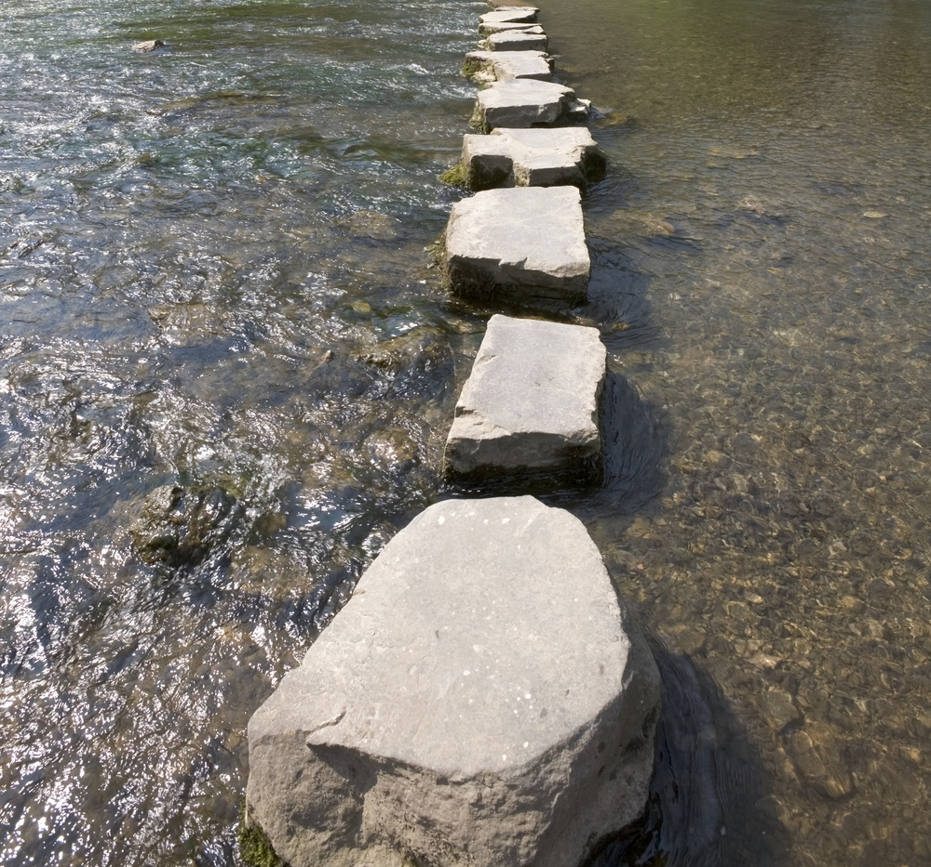
Next Steps…
Capitalize on the strategic thinking of research libraries by learning about strategic approaches research libraries have developed to support e-research and sharing findings with the library community
Notes:
Image: http://www.churchtimes.co.uk/media/3760349/next_steps_women.jpg

Slide 27
Ixchel M. Faniel, Ph.D.
Associate Research Scientist
OCLC Research
fanieli@oclc.org

