Slide 1
Demystifying Born Digital “ First Steps” reports from OCLC Research
Jackie Dooley
Program Officer
OCLC Research
Society of California Archivists
Berkeley, 13 April 2013

Slide 2
"Make things as simple as possible, but not simpler.”
--Albert Einstein

Slide 3
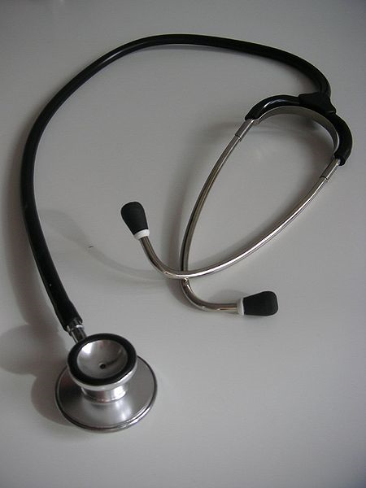
Taking Our Pulse: The OCLC Research Survey of Special Collections and Archives
<http://www.oclc.org/research/publications/library/2010/2010-11.pdf>
Notes:
A 2009 survey of special collections and archives in the US and Canada shows that digitization of special collections and increasing user access to those collections are of critical importance to research libraries.
The survey was a follow up to the 1998 ARL survey led directly to many high-profile initiatives to "expose hidden collections.“
We updated ARL’s survey instrument and extended the subject population to encompass the 275 libraries in the following five overlapping membership organizations:
• Association of Research Libraries (124 universities and others)
• Canadian Academic and Research Libraries (30 universities and others)
• Independent Research Libraries Association (19 private research libraries)
• Oberlin Group (80 liberal arts colleges)
• RLG Partnership, U.S. and Canadian members (85 research institutions)
The rate of response was 61% (169 responses).
http://commons.wikimedia.org/wiki/File:Stethoscope_1.jpg
Stethoscope. Public domain.

Slide 4
Top education and training needs
Born-digital materials: 83%
Information technology: 65%
Intellectual property: 56%
Cataloging and metadata: 51%

Slide 5
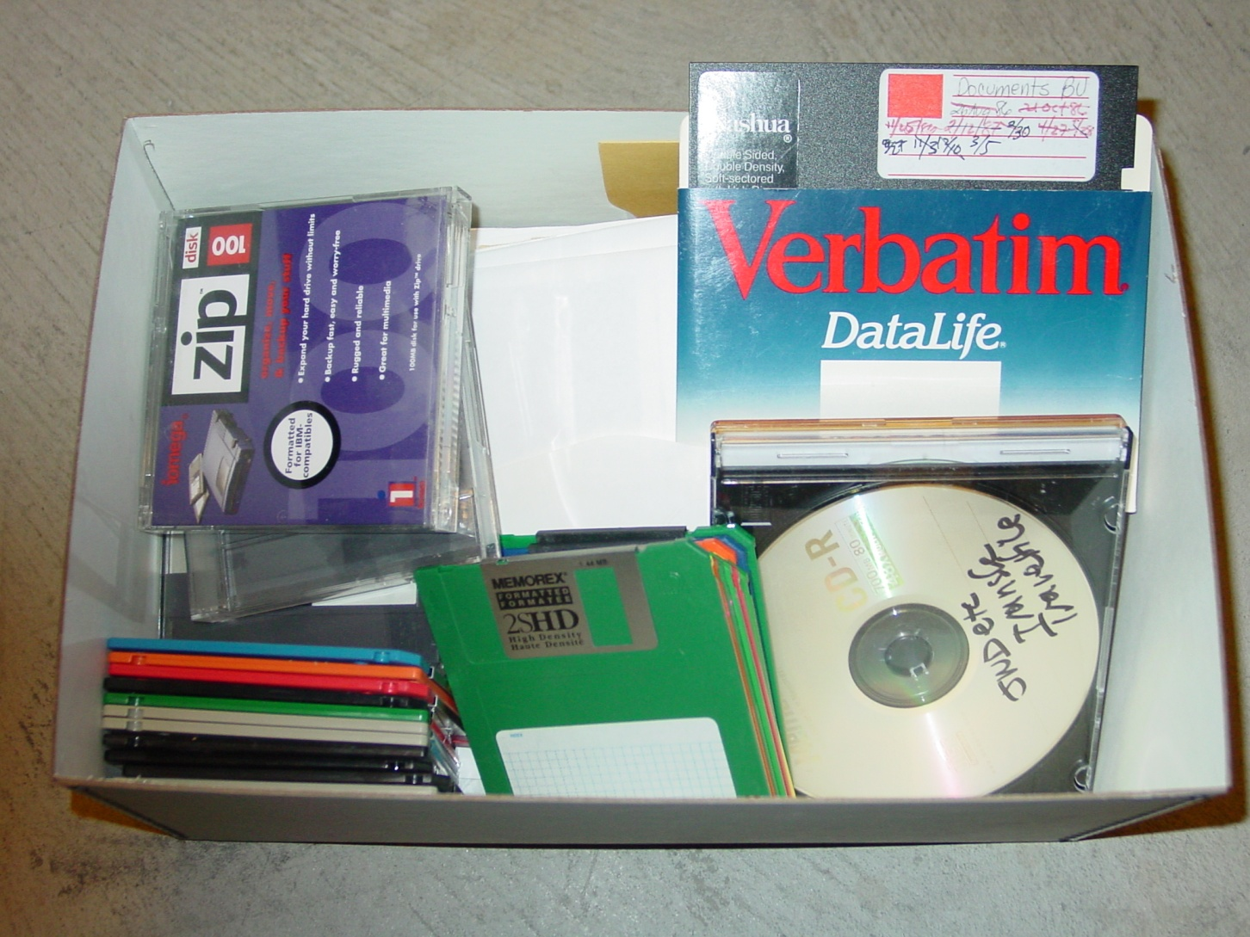
Born-digital materials are …
Undercollected
Undercounted
Undermanaged
Unpreserved
Inaccessible
American Heritage Center

Slide 6
In response, we launched an OCLC Research project …

Slide 7
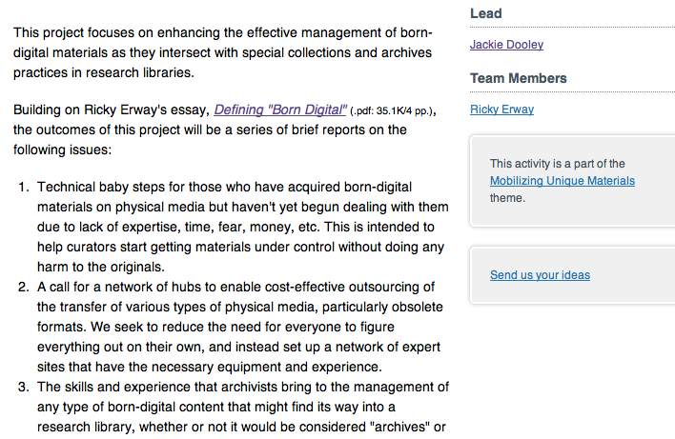
Demystifying Born Digital
etc.

Slide 8
Suite of “reportlets”
Outline first steps to begin managing removable physical media (1st & 3rd reports) ← ← ←
Advocate for collaboration in converting obsolete media (2nd)
Articulate the relevant skills and expertise of archivists (4th)
Describe how these pertain to various types of born-digital material and how special collections and archives intersect with “born digital” (5th)

Slide 9
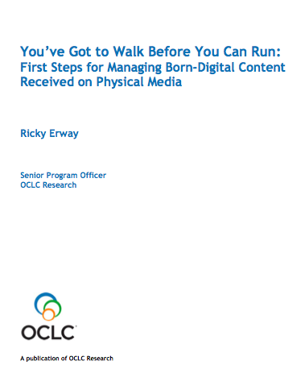
First Steps for Managing Born-Digital Physical Media (Published August 2012)

Slide 10
Intent of First Steps
Knowing what you have (i.e., do an inventory) and taking some simple technical steps can allay the fear factor.
Archivist may have to begin alone without help from IT staff.
Having taken first steps, it’s then easier to continue learning.
Seek confidence building rather than overwhelming novices with complex information and unattainable procedures.
Roughly the same steps can apply as new material is received.

Slide 11
Part 1: Collections management first steps
Inventory what you have
Types & quantities of physical media
File formats
Estimated number of gigabytes
Prioritize materials for processing
Anticipated level/nature of use
Level of significance/uniqueness
Potential loss due to age or type of media
Unique content not replicated elsewhere

Slide 12
Part 2: Technical Steps for Readable Media
1. Use a “clean” computer.
2. Use a write blocker.
3. Insert source media. Do not attempt to open any files.
4. Create a disk directory.
5. Copy files from media to the directory. Consider copying as a disk image.
6. Generate a copy of the directory.
7. Generate and record a checksum.
8. Create a readme file.
9. Copy the directory to trustworthy archival storage.
10. Return the original physical media to storage.
11. Create or update any associated descriptive tool(s).

Slide 13
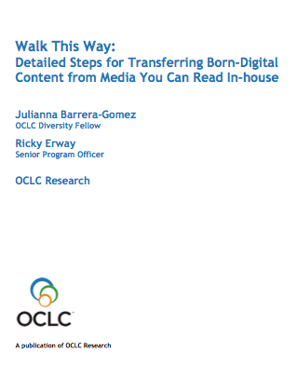
Detailed Steps for Transferring Born-Digital Content from Media You Can Read In-house
Coming in April!

Slide 14
Detailed Steps (Table of contents, pt. 1)
Introduction
Documenting the Project
Preparing the Workstation
* Set up a “Clean” Workstation
* Install Write Blockers
* Connect the Source Media
Transferring the Data
* Copy the Files or Create a Disk Image
* Check for Viruses
* Record the File Directory
* Run Checksums or Hashes
Generate an Accession Record
* Also included in First Steps.

Slide 15
Detailed Steps (Table of contents, pt. 2)
Securing Project Files
Prepare for Storage
* Transfer to a Secure Location
* Store or Deaccession the Source Media
Exploring the Content
Validate File Types
Assess Content
* Update Associated Collection Information
Next Steps
Sample Workflow
Additional Resources
* Also included in First Steps.

Slide 16
Comparison #1: A clean workstation
Introduction
Documenting the Project
Preparing the Workstation
* Set up a “Clean” Workstation ← ← ←
* Install Write Blockers
* Connect the Source Media
Transferring the Data
* Copy the Files or Create a Disk Image
* Check for Viruses
* Record the File Directory
* Run Checksums or Hashes
Generate an Accession Record
* Also included in First Steps.

Slide 17
First Steps: Clean workstation
1. Use a “clean” computer (a dedicated computer that is regularly scanned with up-to-date antivirus software and that is not used for online activities that may introduce viruses or used for other work that might be affected by viruses introduced when accessing media).

Slide 18
Detailed Steps: Preparing the Workstation
Prepare a dedicated workstation to connect to the source media and to use throughout the project. Start with a single type of media from a collection to aid in efficiency and in keeping track of your materials and metadata.
Set up a “Clean” Workstation
Level of Difficulty: Easy to Moderate
Desirability: Mandatory
Use a non-networked computer that is regularly scanned for viruses. This workstation serves the same purpose as the quarantine room many archives use for new acquisitions that have not yet been reviewed for mold, insects, etc. Keeping this computer virus-free is critical. Virus check your workstation using your institution's current virus protection system before beginning to copy materials, and plan to keep the software up to date and the workstation regularly scanned. See the Check for Viruses step for software options.
You will need the relevant peripherals such as cables, drives or ports for transferring digital files from the source media. You may need particular software or drivers to access the hardware—consult with your IT department or other qualified technicians to set this up appropriately.
Do not open files on your source media; it could change the files’ metadata (such as creator and date) or the content. We strongly recommend that you use a write-blocker (software or hardware) to prevent your actions on the workstation from altering the files on your source media.
Further Resources:
“Digital Curation Workstation,” Maryland Institute for the Digital Humanities http://mith.umd.edu/digital-curation-workstation An example of a workstation created by MITH.

Slide 19
Comparison #2: Checksums
Introduction
Documenting the Project
Preparing the Workstation
* Set up a “Clean” Workstation
* Install Write Blockers
* Connect the Source Media
Transferring the Data
* Copy the Files or Create a Disk Image
* Check for Viruses
* Record the File Directory
* Run Checksums or Hashes ← ← ←
Generate an Accession Record
* Also included in First Steps.

Slide 20
First Steps: Checksums
7. Generate and record a checksum (a unique value based on the contents of a file) on the disk image. Alternatively, if you copied the files instead of copying a disk image, generate and record a checksum on each file in the subdirectory.

Slide 21
Detailed Steps: Run Checksums or Hashes
Level of Difficulty: Easy to Complex
Desirability: Highly Recommended
A checksum, or hash, is a unique value based on the contents of a file and is generated by specific algorithms (e.g., MD5 or SHA-256). Comparison of checksums generated from the same file at different times identifies whether and when the file has changed. Creating checksums is not difficult and may be done during several processes described earlier (such as creating a disk image, generating a directory list, or using the Duke Data Accessioner). It is very easy to create a hash for a single file and then to compare that hash to one generated for another copy of the file. An automated technique is necessary, however, when processing a large number of files.
It is important to note that while a changed checksum can alert a repository to the fact that something in a file or folder has changed, it cannot indicate what exactly has changed, nor can it reverse the change. Regularly hashing the file or image you have copied and checking those new hashes against the hashes made at the time of the transfer should be part of your digital curation workflow. During the lifecycle of your digital collections you will need to periodically verify the checksums to ensure that files remain unchanged.

Slide 22
Detailed Steps: Checksums, cont.
Disk imaging or Disk copying tools that incorporate checksums (see the Copy the Files or Create a Disk Image section for more details on these tools):
BitCurator: http://www.bitcurator.net/
FTK Imager (Forensic ToolKit Imager): http://accessdata.com/support/adownloads
Duke Data Accessioner: http://library.duke.edu/uarchives/about/tools/data-accessioner.html
File directory printing tools that incorporate checksums (see the Record the File Directory section for more details on these tools):
Karen's Directory Printer: http://www.karenware.com/powertools/ptdirprn.asp
Beyond Compare: http://www.scootersoftware.com/
NARA File Analyzer and Metadata Harvester: https://github.com/usnationalarchives/File-Analyzer
Collection management tools that incorporate checksums:
Archivematica: https://www.archivematica.org/wiki/Main_Page
From the website: “A free and open-source digital preservation system that is designed to maintain standards-based, long-term access to collections of digital objects. Archivematica uses a micro-services design pattern to provide an integrated suite of software tools that allows users to process digital objects from ingest to access in compliance with the ISO-OAIS functional model.” Developed under a collaboration led by Artefactual Systems and the City of Vancouver Archives.

Slide 23
Detailed Steps: Checksums, cont.
Curator’s Workbench: http://www.lib.unc.edu/blogs/cdr/index.php/about-the-curators-workbench
From the website: “The Workbench helps archivists manage files before they are stored in an institutional repository or dark archive. As the files are selected, arranged, and described, a METS file is generated by the software that documents these processes. In addition, checksums and UUIDs are generated for each object and MODS descriptive metadata elements can be mapped to individual objects and folders.” Developed at the University of North Carolina, Chapel Hill.
Standalone checksum tools:
Jacksum: http://www.jonelo.de/java/jacksum/
Md5summer: http://ww.md5summer.org
Md5deep: http://md5deep.sourceforge.net, command line tool that can also be used as a directory printer
Further Resources:
“Checksum Verification Tools: Guest Post by Carol Kussmann” Practical E-Records http://e-records.chrisprom.com/checksum-verification-tools/ (accessed December 2012) This blog maintained by Christopher Prom reviewed five checksum generating and verification tools.

Slide 24
First Steps
http://www.oclc.org/research/publications/library/2012/2012-06r.html
Detailed Steps
Coming in April!
Demystifying Born Digital
http://www.oclc.org/research/activities/borndigital.html
OCLC Research
http://www.oclc.org/research.html

Slide 25
Thank you!
Jackie Dooley
dooleyj@oclc.org

