Slide 1
Library discovery:
past, present and some futures
@LorcanD
Lorcan Dempsey
20 November 2013
NISO Virtual Conference: Web-Scale Discovery Services: Transforming Access to Library Resources

Slide 2
Scope

Slide 3
Pretty general

Slide 4
Past: Some drivers Present: Some responses Future: Some directions

Slide 5
Drivers 1 The user environment The example of visitors and residents Lynn Silipigni Connaway, David White, Donna Lanclos, and Erin Hood. 2013. Meeting the Needs of Digital Visitors and Residents: Developing Engagement with Institutional Services Educause Annual Conference, 15-18 October 2013, Anaheim, California (USA).http://www.oclc.org/content/dam/research/activities/vandr/presentations/meeting-the-needs-of-digital-visitors-educause-2013.pptx Lynn Silipigni Connaway, Donna Lanclos, and Erin Hood. 2013. "I Find Google a Lot Easier Than Going To the Library Website." Imagine Ways to Innovate and Inspire Students to Use the Academic Library. ACRL 2013: Imagine, Innovate, Inspire, 10-13 April 2013, Indianapolis, Indiana (USA).http://www.oclc.org/content/dam/research/activities/vandr/presentations/acrl-vandr2013.pptx

Slide 6
“It’s convenience. It’s the immediacy of it.”
(UKF3, Experiencing, Male, Age 52, Artist & Technical Support)
Convenient Doesn’t Always Mean Simple
Image: http://www.flickr.com/photos/dubpics/8685963533/
Notes:
Image: http://www.flickr.com/photos/dubpics/8685963533/
Lynn
Visitors and Residents (V&R) data agree with other research projects that indicate that some individuals are frustrated with libraries and do not physically visit them because of limited hours, long travel distances, and the time needed to do their research in the library (Connaway 2013; Connaway, Lanclos, and Hood 2013a; Connaway, Lanclos, White, Le Cornu, and Hood 2013; Pullinger 1999; White and Connaway 2011-2012 ). Search engines (in particular, Google) are preferred because they are more convenient and faster—they are always available (De Rosa et al. 2005 ), and also because they are perceived to be reliable, as well as fast. (InfoKit, Convenient Doesn’t Always Mean Simple)
Speed and efficiency are relatively conventional ways of defining “convenience,” and they are certainly factors in the decisions people make about where to go and what to use, when seeking information. (InfoKit, Convenient Doesn’t Always Mean Simple)
Data from the V&R project reveal that individuals in all educational stages cite the relevance of convenience/ease of use to their decision-making, trumping all other reasons for selecting and using a source (White and Connaway 2011-2012 ; Connaway, White, and Lanclos 2011). (InfoKit, Convenient Doesn’t Always Mean Simple)
Familiarity appeared to also be a major component of individuals’ perceptions both of authority and convenience. If an individual had done something/used something before, they were more likely to perceive that thing as being “convenient,” even if it objectively took more steps and/or time than other solutions. While the methods some individuals used to seek and assess information were inelegant, they had been developed at an early age, and had become well worn and comfortable, if not terribly efficient or sophisticated. They continued using these methods in part because they tended to yield effective results. (InfoKit, Convenient Doesn’t Always Mean Simple)
Connaway, Lynn Silipigni. 2013. Why the internet is more attractive than the library. The Serials Librarian 64, no. 1-4: 41-56.

Slide 7
“...Google doesn’t judge you.”
(UKF3, Male, Age 52)
Image: http://www.flickr.com/photos/cubmundo/6184306158/
Notes:
“And also the fact that Google doesn’t judge you.” Digital Visitors and Residents (UKF3 0:16:35 Male Age 52)
“I don’t know, it’s habit. I know what it looks like and how to use it.” Digital Visitors and Residents (UKU9 0:19:06 Male Age 27) (speaking about Google)
“I find Google a lot easier than going to the library website because I don’t know, it’s just like sometimes so many journals come up and when you look at the first ten and they just don’t make any sense I, kind of, give up.” Digital Visitors and Residents (USU7 0:34:11 Female Age 19)

Slide 8
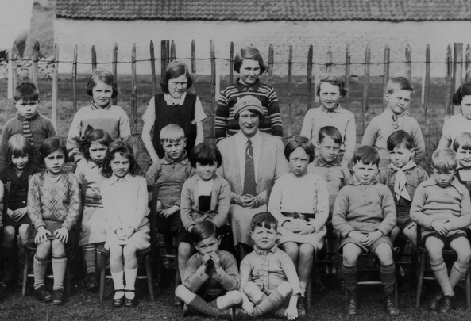
Academia Isn’t (Always) Learning
“And so like my parents will always go, ‘Well look it up in a book, go to the library.’ And I’ll go, ‘Well there’s the internet just there.’” (UKU5, Emerging, Female, Age 19, Chemistry)
Image: http://www.flickr.com/photos/22326055@N06/6732616879/
Notes:
Image: http://www.flickr.com/photos/22326055@N06/6732616879/
Donna
Those participants in the “Emerging” educational stage tended to consider physical books as the most academically credible source but often used what they considered less authoritative information from the web. This usually was because searching online was the most convenient method of discovering what they needed and usually provided more focused “answers” than alternatives. (InfoKit, Academia Isn’t (Always) Learning)
Participants in the later educational stages (Embedding and Experienced) had more sophisticated critical evaluation techniques and a deeper understanding of their chosen subject so were prepared to vouch for less traditional sources. However, they still were tentative about citing non-traditional resources in formal work even when they knew the information to be high quality. (InfoKit, Academia Isn’t (Always) Learning)
All of the students we interviewed had constructed a precise, if conservative, model of what they thought their institution would accept as legitimate practices in their academic work and were adept at only presenting these during class time and in formal assessments. For tutors, faculty, and other academic staff, the notion of what constitutes legitimate practice was far less clear and appeared to be negotiated on an individual basis. (InfoKit, Academia Isn’t (Always) Learning)

Slide 9
“It’s like a taboo I guess with all teachers, they just all say – you know, when they explain the paper they always say, “Don’t use Wikipedia.” (USU7, Female, Age 19)
“I just type it into Google and see what comes up.” (UKS2)
Learning Black Market
Image: http://wp.me/pLtlj-fH
Notes:
Image: http://wp.me/pLtlj-fH
Covert online study habits
Wikipedia
Don’t cite
Widely used
Guilt
Students & teachers disagree
Quality sources
There is a “Learning Black Market”: learners use non-traditional sources but feel they cannot talk about them in an institutional context. Wikipedia usage is an example of this. (White & Connaway, 2011)
White, D. S., & Le Cornu, A. (2011). Visitors and Residents: A new typology for online engagement. First Monday, 16(9). Retrieved from http://firstmonday.org/htbin/cgiwrap/bin/ojs/index.php/fm/article/viewArticle/3171/3049
“I mean if teachers don’t like using Wikipedia they don’t want you to use Wikipedia. A lot of students will still use Wikipedia and then cite another source. As long as it has the same information and it is not word for word or anything they’ll use Wikipedia because it is the easiest thing to go look up on Wikipedia. It will give you a full in-depth detailed thing about the information. Teachers don’t just like it because it’s not the most reliable source since anyone can post something on there even though the site is monitored, it’s because it’s too easy.” (USU3 0:30:59, Male Age 19)
Students’ Perceptions of Teachers’ opinions of Wikipedia:
“Avoid it.” (UKS8 0:28:28.3, Female Age 16)
“They say it’s because anyone can make up – I mean, anyone can add information on there but I mean when I’ve actually looked into information it seemed the same as any information I find anywhere else. I mean, it’s not like if you look up fourth of July, it’s not like it gives you like some weird explanation of aliens or something.” (USU7 0:33:14, Female Age 19)
Students’ on Wikipedia:
“I use it, kind of like, I won't cite it on my papers but I, kind of, use it as a like, as a start off line. I go there and look up the general information, kind of, read through it so I get a general idea what it is. Then I start going through my research.” (USU7 0:33:49, Female Age 19)
“Everyone knows that you try not to use Wikipedia as a source because it is a cardinal sin.” (UKU3 0:31:03, Female Age 19)

Slide 10
Then: Resources were scarce and time was abundant Now: Resources are abundant and time is scarce Convenience is an important value.

Slide 11
Drivers 2: The service environment “How can building a website be so difficult?”

Slide 12
Until recently …..
… library websites were providing a very thin layer of integration over two sets of heterogeneous resources, ….
…which map more to legacy technical and business issues than to user behaviours.

Slide 13
1. Systems
2. Databases
Catalog/ILS
Legacy database boundaries map more to historically evolved publisher configurations and business decisions than to user needs or behaviors.
A-Z lists
Metasearch
Resolver
Repository

Slide 15
Full text publishers
A&I publishers
Aggregators
Discovery layer providers

Slide 16
Driver 3: The network environment Stuck in the middle

Slide 17
Webscale: operating at the scale of the web. We have seen many service providers emerge in recent years which operate at webscale. Facebook, Amazon, Expedia, Etsy.
They concentrate capacity in platforms whose benefits can be broadly shared. The platform supports the aggregation of data and infrastructure at scale.
Additionally, many of these services build strong communities - networks of participants who communicate, share, or trade on the platform.

Slide 18
Webscale and personal go together.

Slide 20
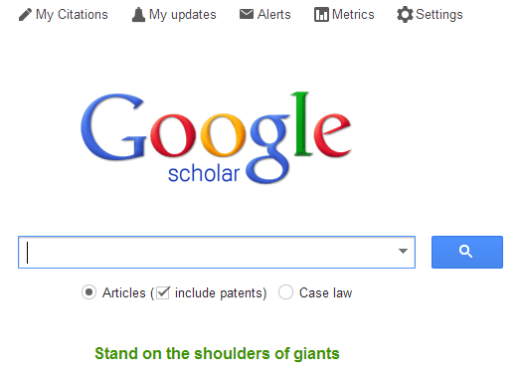

Slide 22
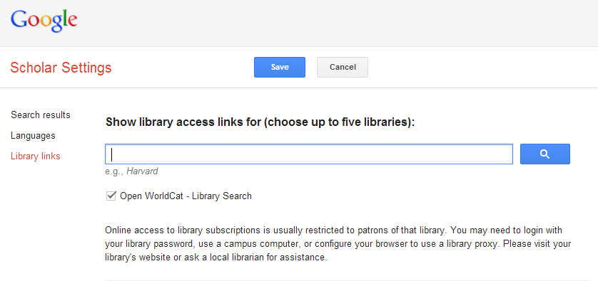
Webscale and personal go together. The institution is the squeezed middle?

Slide 23
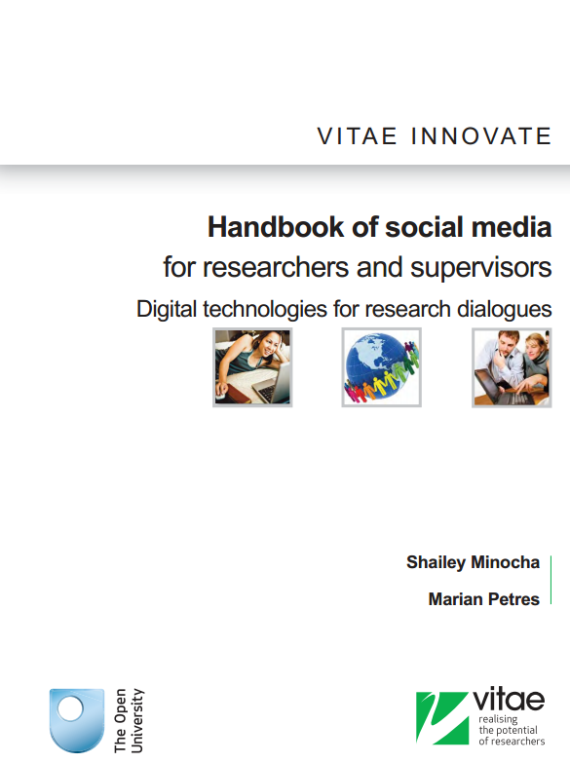
Researchers prefer to adopt open source and social media technologies that are available in the public domain rather than institutional license-based applications ….. First the social media technologies facilitate networking and community building. Second, researchers prefer to use technologies that will enable them access to resources and their own materials beyond their institution-based PhD research.
“
e.g. Mendeley, Zotero, Endnote

Slide 24
Then: users built their workflow around the library. Now: the library must build its services around its users workflow.

Slide 25
Users value convenience. Library destinations fragmented and demand too much work (cognitive and mechanical). The institution is being squeezed between the webscale and the personal. Have to get into workflows.

Slide 26
Users value convenience. Library destinations fragmented and demand too much work (cognitive and mechanical). The institution is being squeezed between the webscale and the personal. Have to get into workflows.
Discovery layer
The challenge of discoverability

Slide 27
Some responses

Slide 28
Some responses
Systems integration – unified discovery and unified backoffice workflows
Website integration – an integrated experience
Make discovery more like web search
Discoverability – a decentered network presence

Slide 29
Systems integration – unified discovery and unified backoffice workflows
Website integration – an integrated experience
Make discovery more like web search
Discoverability – a decentered network presence

Slide 30
Worldshare MS
ALMA
Sierra
Intota
Kuali Ole

Slide 31
Worldcat Local
Primo
EDS
Summon
Worldshare MS
ALMA
Sierra
Intota
Kuali Ole

Slide 32
(Partial) systems integration Cloud-based. Workflow integration across purchased, licensed, digital? Central index. Best-of-breed vs Trend to single supplier ecosystems?

Slide 33
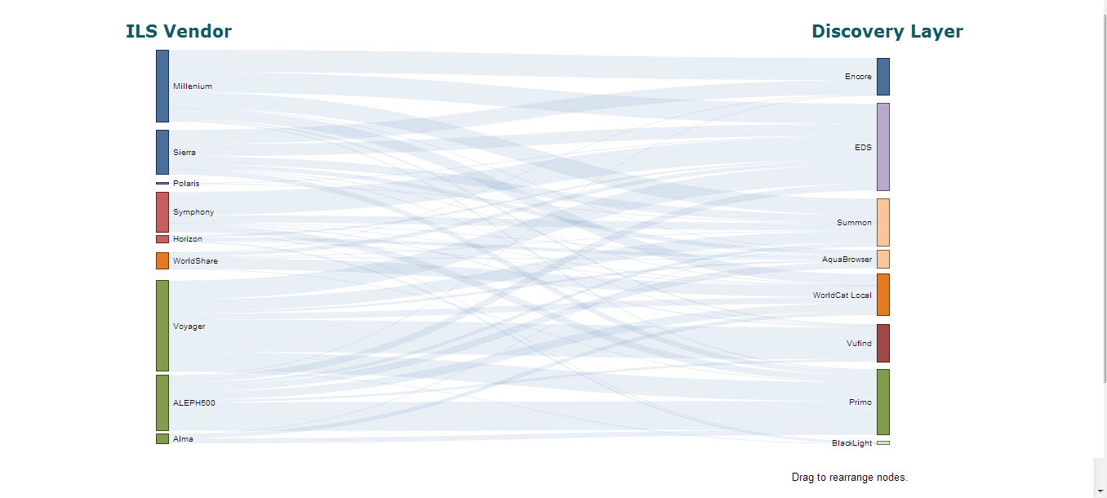
US Academic Libraries
Based on data from Marshall Breeding’s Lib-Web-Cats technology profiles, August 2013.
N = 881
Created by Constance Malpas, OCLC Research, using the Sankey template from Bruce McPherson.

Slide 34
Systems integration – unified discovery and unified backoffice workflows
Website integration – an integrated experience
Make discovery more like web search
Discoverability – a decentered network presence

Slide 35
Some examples ..
Content management systems
Resource guides
Locally controlled search container
VuFind
Blacklight
Discovery systems
A unified view
Move work from user to system

Slide 36
Systems integration – unified discovery and unified backoffice workflows
Website integration – an integrated experience
Make discovery more like web search
Discoverability – a decentered network presence

Slide 37
“Simple” search box to find everything

Slide 38
“Simple” search box
Refine results

Slide 39
“Simple” search box
Refine results
A focus on fulfilment …

Slide 40
Systems integration – unified discovery and unified backoffice workflows
Website integration – an integrated experience
Make discovery more like web search
Discoverability – a decentered network presence

Slide 41
Network Presence
John Doe University Library
Website
John Doe University Library
Decoupled Communication
External Syndication
Cloud Sourced

Slide 42
Decoupled Communication
Flickr
Blogs
Facebook
Twitter
Google
Youtube
Discovery
Knowledgebase
Libguides
Cloud Sourced
Resolver

Slide 43
WorldCat
ArchivesGrid
Metadata
Summon
Scirus
Blogs
Suncat
Europeana
RSS
Catalogue
Ethos
Mobilepp
Proxy Toolbar
Dspace
Linked Data (Catalog)
OAI-PMH (Dspace)
Discovery
Services
Proxy Widgets
External Syndication
Library APIs
Z39.50
Data
Jorum
Digital Archive

Slide 44
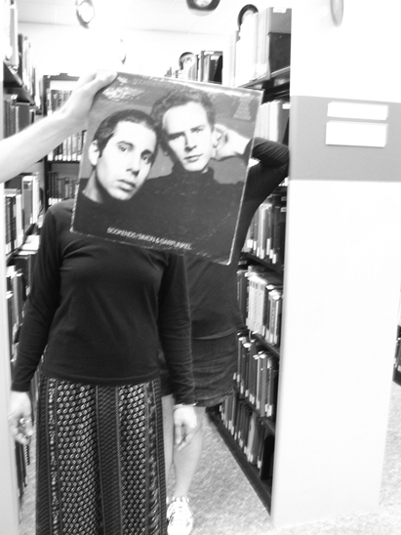
Creating conversations around collections:
Sleevefacing at Bowling Green State Univ
http://blogs.bgsu.edu/librarysleevefacing/2012/08/15/bookends/

Slide 45
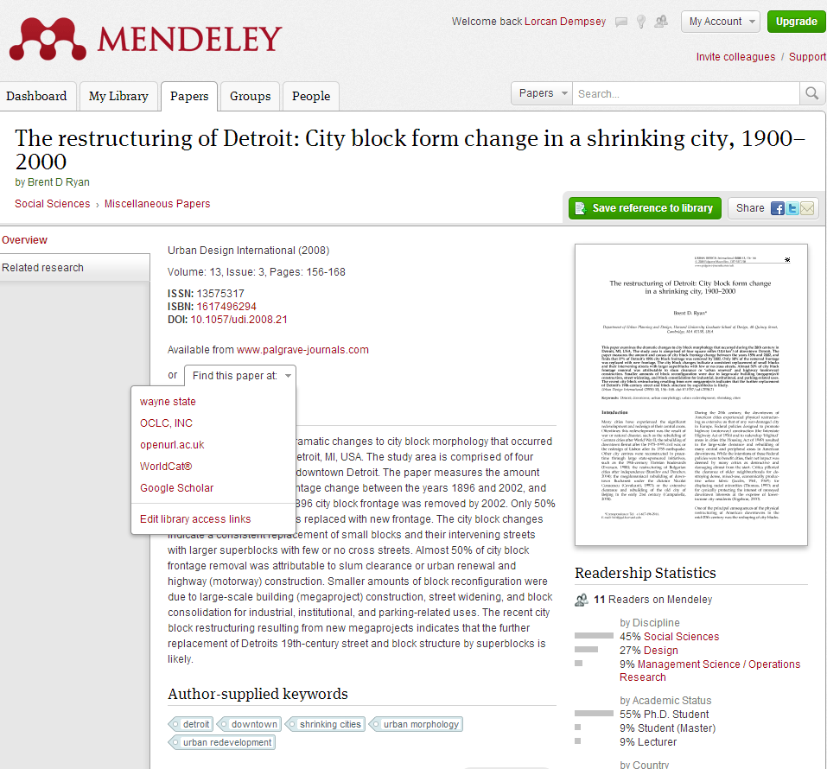

Slide 46
‘Discoverability’ needs to be managed in parallel with ‘discovery’ … Get into research and learning workflows …

Slide 47
Results?

Slide 48
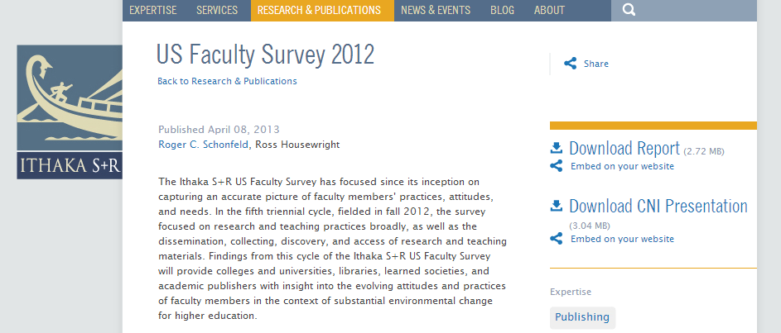

Slide 49
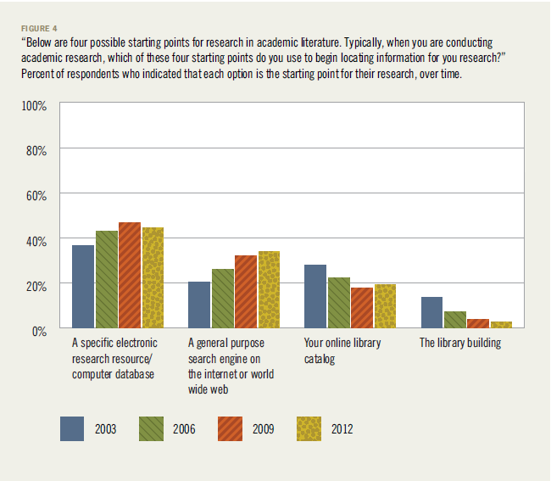

Slide 50
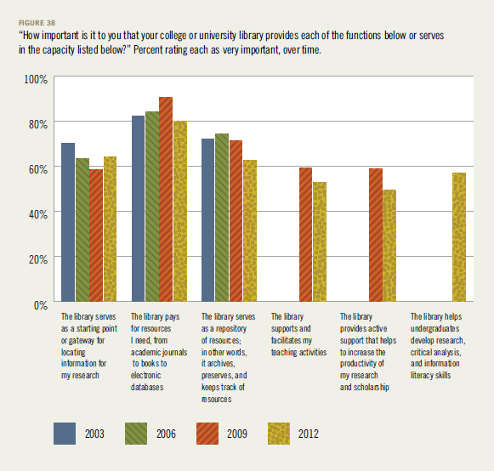

Slide 51
Directions: some futures

Slide 52
Full library discovery Fulfillment at the point of need Ranking, relating, recommending Outside-in and inside-out From strings to things

Slide 53
Full library discovery

Slide 54
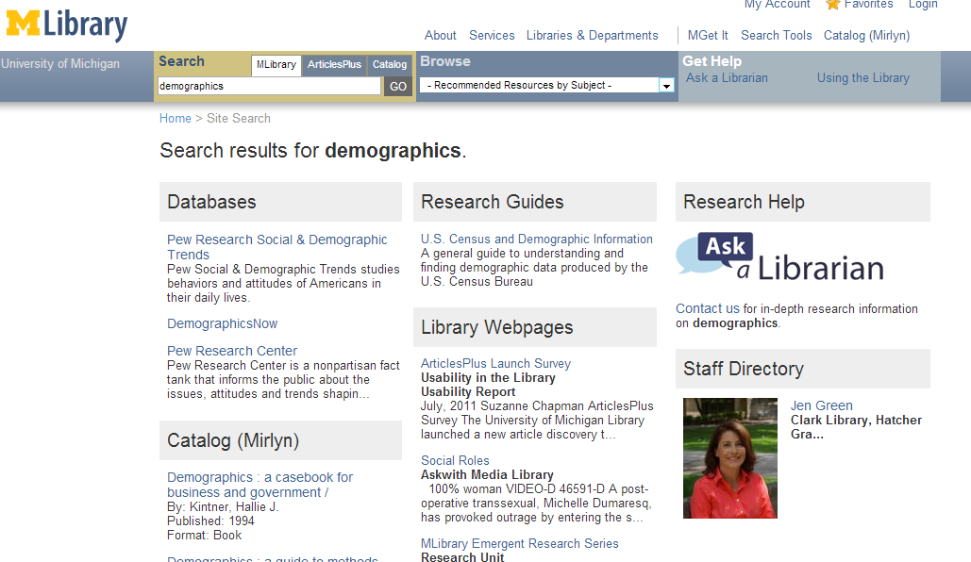

Slide 55
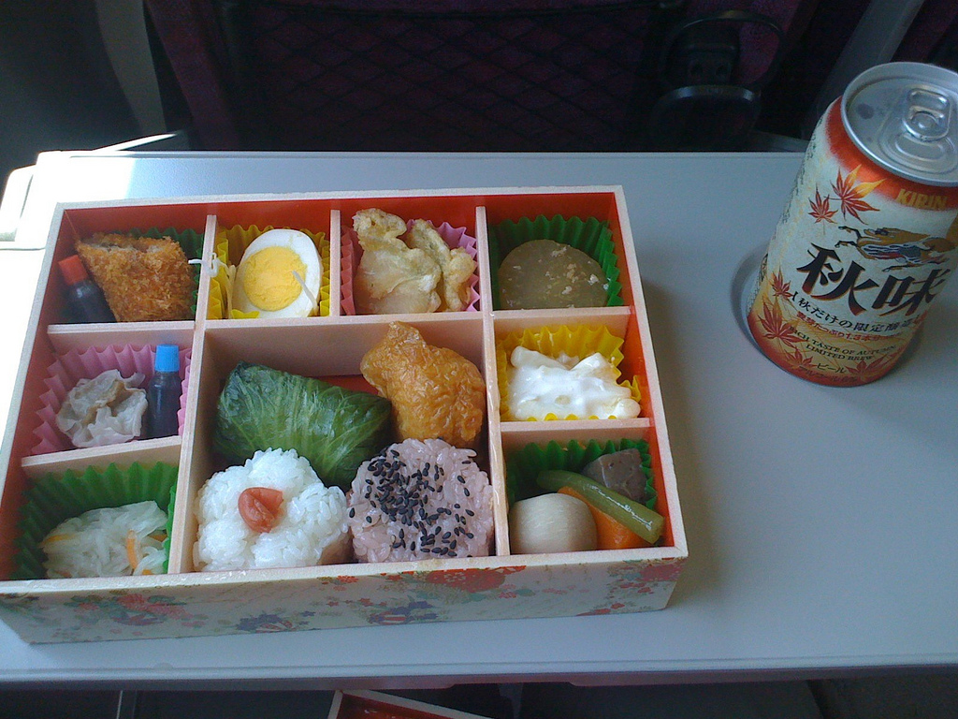
Bento Box?
Ranking?
Collections
Resource Guides
Website
People
Events
…
Image: http://www.flickr.com/photos/4563photo/3889124590/sizes/l/in/photostream/

Slide 56
Ranking, relating, recommending Specialising to institution/person

Slide 57
Examples
Analytics
Improve user experience
Improve management decisions
Recommendations
Reading lists/course reserves
Specialise to courses

Slide 58
Fulfillment at the point of need … Buy, borrow, connect, … Demand driven acquisition …

Slide 59
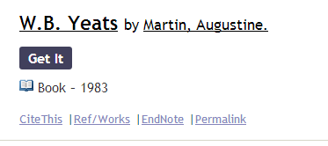
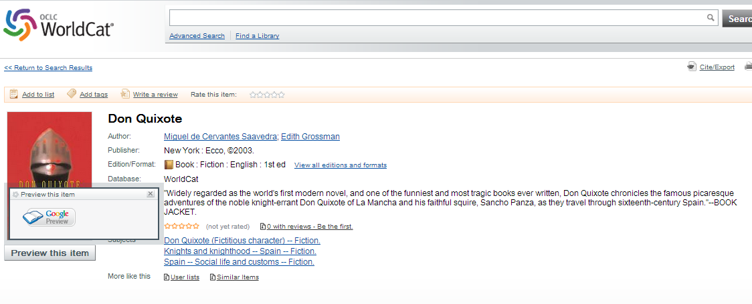

Slide 60
Outside-in vs inside-out

Slide 61
Outside in Bought, licensed
Discovery layer
Aim: to discover, to fulfill
Inside out
Institutional assets: special collections, research and learning materials (IR), institutional records, … Aim: to *have* discovered … discoverability
Notes:
Licensed content will dominate in years to come.
Special collections will grow but only modestly (and only at some institutions); mostly growth in managing archival resources including institutional.
Much greater investment in managing research outputs.
No change in web archiving.

Slide 62
From strings to things

Slide 63
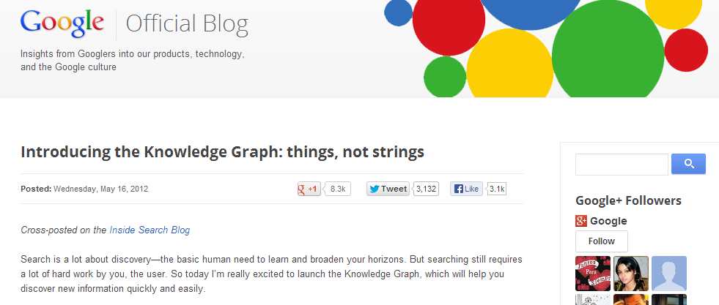
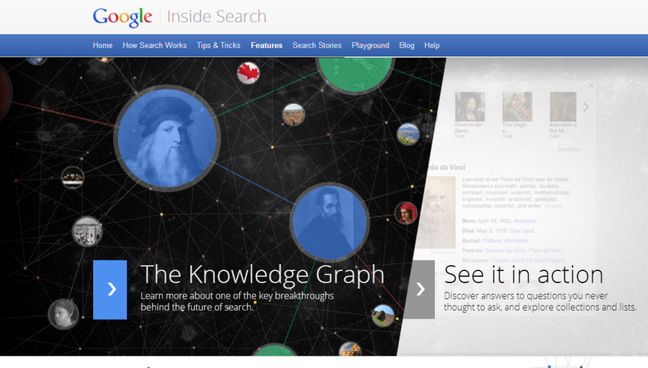
The social graph

Slide 64
Three benefits acc to Google:
Find the right thing
Get the best summary
Go deeper and broader

Slide 65
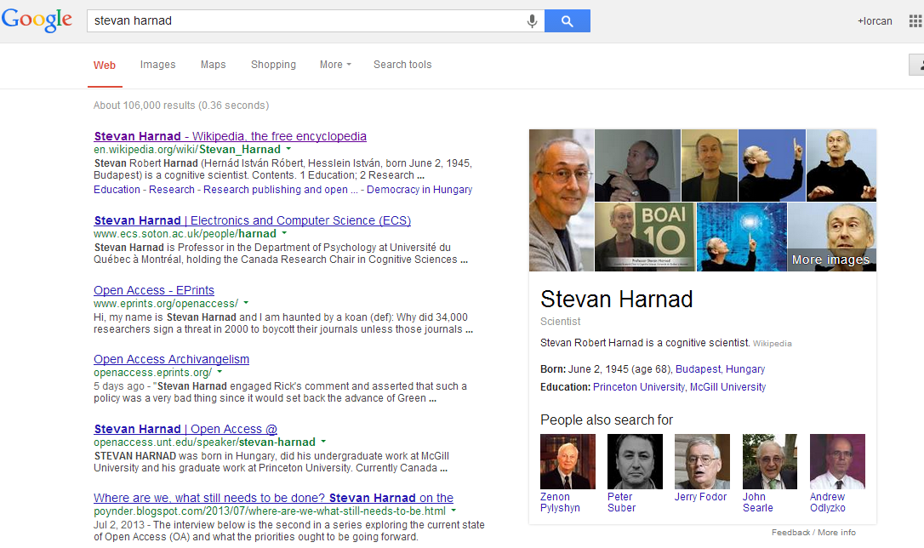

Slide 66
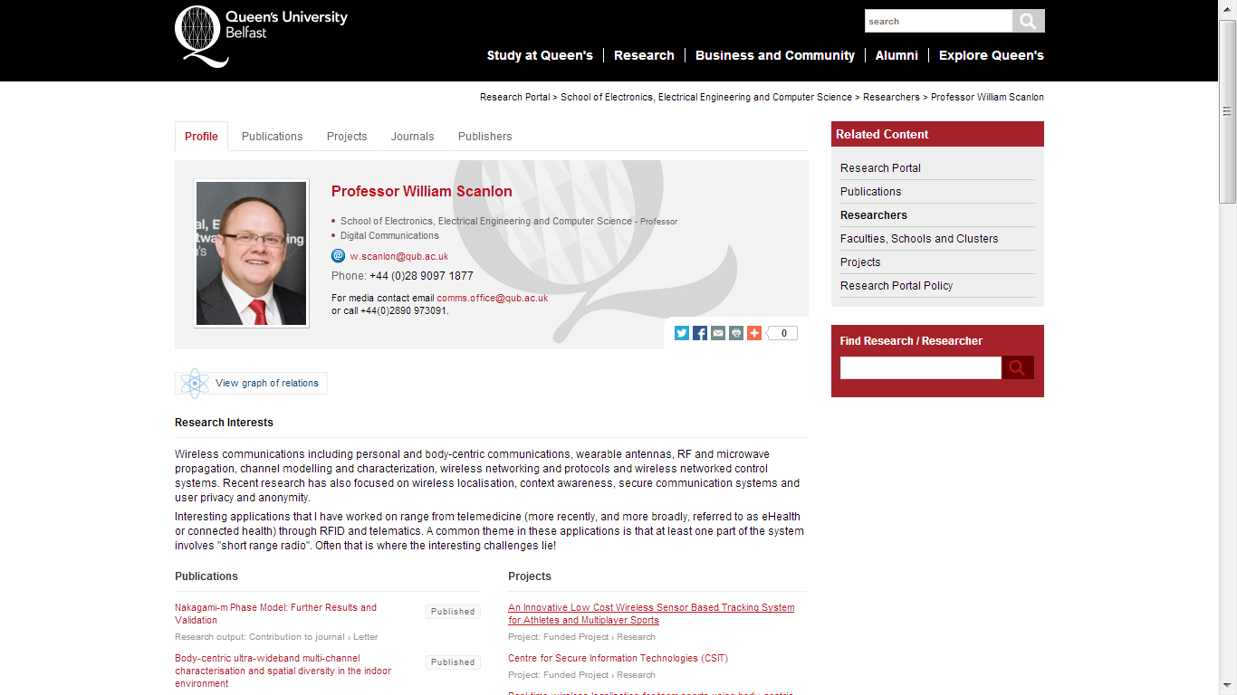

Slide 67
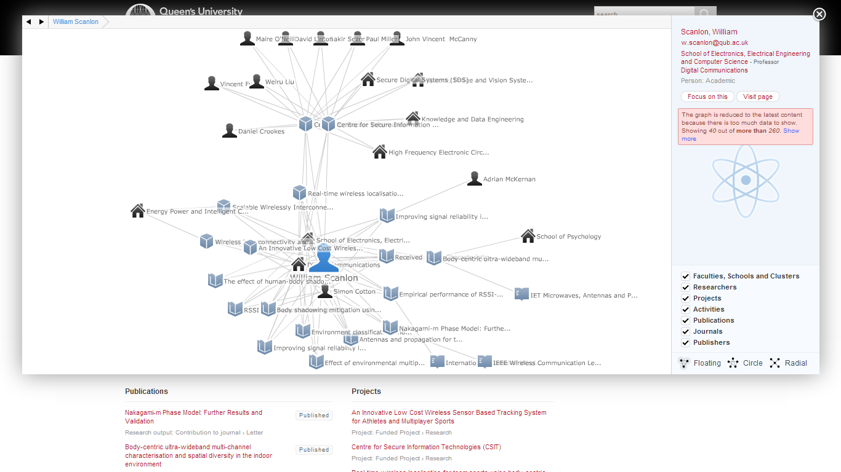

Slide 68
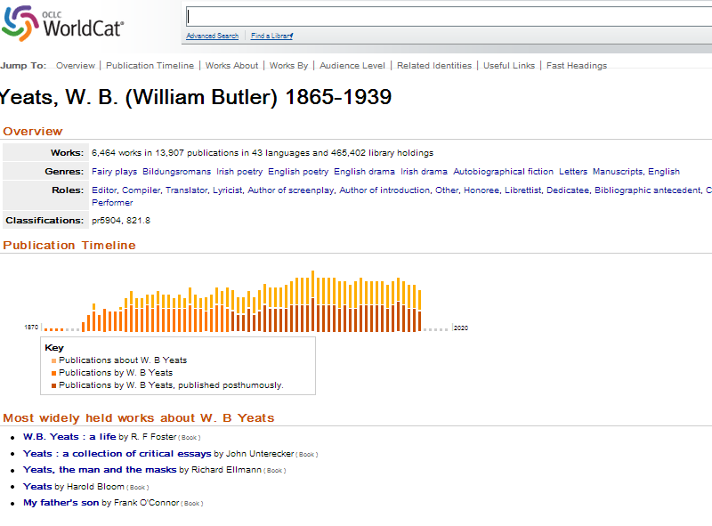
Examples
Include ‘cards’ about:
People
Works
Institutions
Linked data backbones?
VIAF

Slide 69
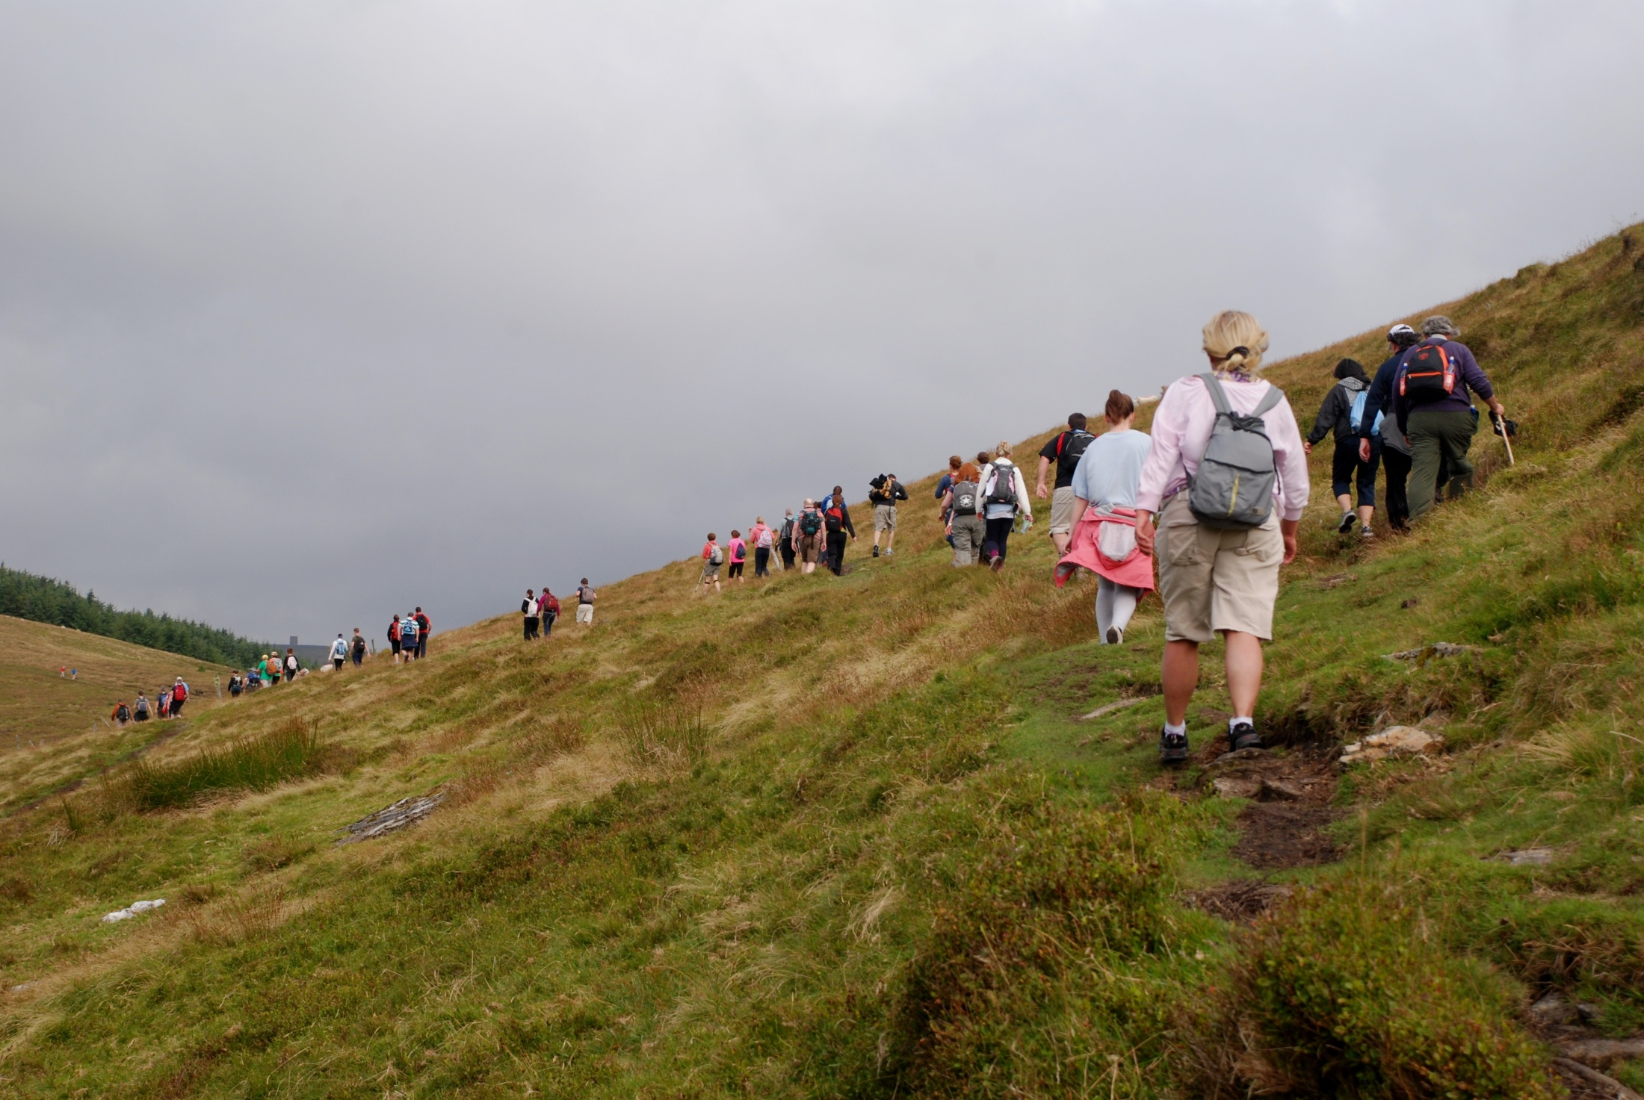
Discoverability
Discovery
Image: http://www.flickr.com/photos/martindo/5975419889/

Slide 70
@LorcanD

