Slide 1
Libraries, collections, technology
https://collection1.libraries.psu.edu/cdm/compoundobject/collection/rabin/id/2363/
Lorcan Dempsey & Constance Malpas, OCLC Research
@LorcanD
Penn State University Library, State College, PA March 3 2016

Slide 2
Complementary!

Slide 3
PSU Collections
4
1
Collection environment
Technology reshapes practice; practice reshapes technology
The facilitated collection
2
5
Web sightings
Collections and service reconfiguration
Some notes about assessment
3
6

Slide 4
PSU collections
1
Libraries, collections, technology

Slide 5
Penn State in WorldCat
XO4 – Penn State, Berks
MHY – Penn State, Hershey
UPM – Penn State, University Park
TODAY’S FOCUS
GH4 – Penn State, Erie
UVC – Penn State, Harrisburg
PU9 – Penn State, Harrisburg - Marshall Collection
UPC – Penn State, Commonwealth
Notes:
Penn State is represented by 7 (or more…) symbols in WorldCat. Some of these have only a handful of holdings or represent a subset of special collections. For the purposes of discussion today, we will focus on collection under the ‘UPM’ symbol, which represents (by far) the largest share of the university library holdings.

Slide 6
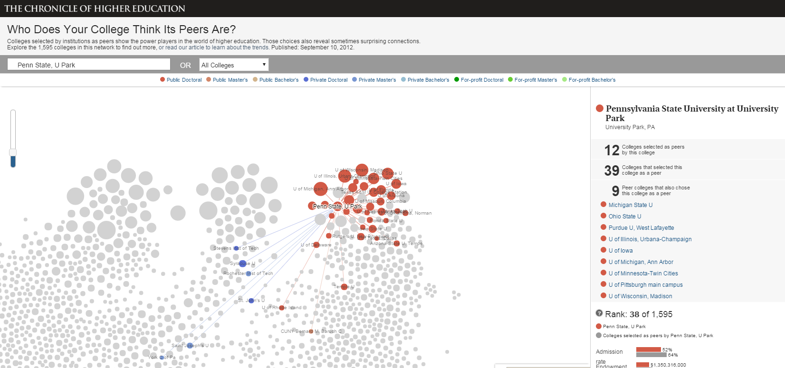
Penn State mostly compares itself to other public doctoral universities (in the mid-west)
http://chronicle.com/interactives/peers-network
Notes:
NB: based on 2012 IPEDS data

Slide 7
OCLC Research, data current as of February 2016
Notes:
Traditional view of library value: collection size
For analysis, we selected the libraries of institutions of PSU’s ‘mutual peers’ – i.e., institutions that PSU identified as a comparator and that PSU had also identified as a comparator.
NB: holdings for PSU based on symbol UPM. The Penn State system is represented by multiple symbols in WorldCat. If all PSU symbols were included in this analysis, the figures would look different – but would also be less representative of collection strengths at University Park.

Slide 8
More distinctive
More common or ‘core’
OCLC Research, data current as of February 2016
Notes:
But character of collection also matters.
In general, larger libraries will tend to have a greater proportion of rare/distinctive materials – Purdue’s collection is “more common” than Michigan’s.
Penn State’s collection is in the middle range of its peers with respect to duplication in WorldCat. It looks most similar to Michigan State on this single (and very broad) parameter.
We don’t think that size or ‘distinctiveness’ of a collection are good metrics for judging value or fit with institutional mission, but it is a useful starting point for identifying institutions that face similar kinds of management challenges.

Slide 9
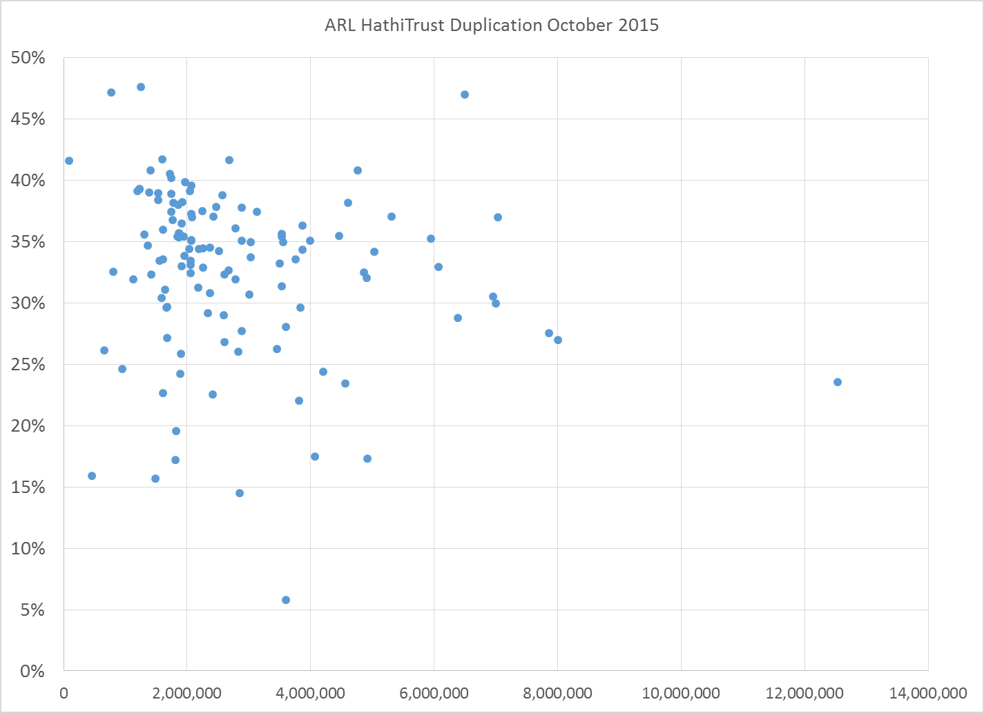
ARL HathiTrust Duplication October 2015
Penn State overlap = 35%
Median overlap = 34%
OCLC Research, data current as of October 2015
Titles
Notes:
HathiTrust is a good example of a partnership formed around a common need: shared stewardship of digitized collections.
Penn State is a member and contributor to HathiTrust. As HT shared print efforts ramp up, understanding the level of duplication between member libraries and the collective HT collection will become more important.

Slide 10
1,244,988
Penn State saw the greatest increase
Avg. increase of 5% YOY in number of titles duplicated in HathiTrust
OCLC Research, data current as of October 2015
Notes:
We typically look at the rate of increase in HathiTrust duplication as it relates to the institutional collection – so as the local collection grows or shrinks, the rate of duplication with HathiTrust will change.
If we instead look at the absolute number of titles duplicated for each ARL library, we see that there is a healthy growth rate of about 5% year over year. For Penn State, the increase was much greater – almost 19% over the prior year. This is presumably a result of HathiTrust ingesting a large number of titles contributed by PSU.

Slide 11
“Centers”
Penn State holds more titles related to these topics than
any other library in WorldCat
PSU holds more than 4,500 titles related to civil rights of African Americans
… but holding ‘many titles’ does not necessarily equate to complete coverage of a topic
OCLC Research, based on analysis of FAST headings and WorldCat holdings as of March 2013
Notes:
For the past several years, we have been experimenting with the use of FAST and VIAF identifiers as a tool for clustering institutional holdings.
Using FAST (a faceted version of LCSH), we can compare the subject strengths of institutional holdings based on both the total number of titles held and in terms of relative coverage of published literature.
Based on a data snapshot from 2013, Penn State ranks first in total number of titles in a wide range of subjects. This word cloud shows a sampling of some of those topics.
It is important to recognize that this kind of analysis is based on cataloging data – in some cases the ‘center’ of excellence reflects less about intentional acquisitions than intensive cataloging activity on a small part of the collection.
As an example of this, we typically find that flagship campuses of state universities are the ‘center’ of library holdings for publications produced by the university. This is partly because local cataloging practices will tend to include a reference to the corporate identity (corporate name) of the university to improve discoverability in the local system.

Slide 12
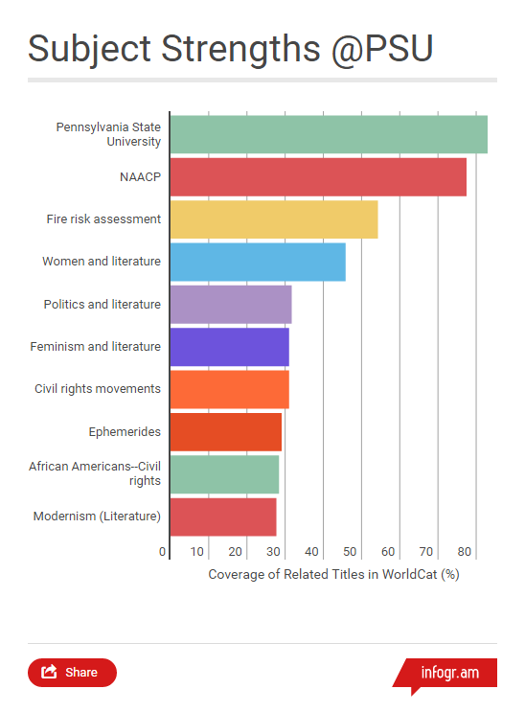
“Coverage”
Subject areas for which Penn State’s collection is most comprehensive relative to other topics in the collection
Despite holding more titles about the civil rights of African Americans, PSU is more comprehensive with respect to Civil rights movements in general
Coverage is generally inversely proportional to the size of the global corpus
OCLC Research, based on analysis of FAST headings and WorldCat holdings as of March 2013
Notes:
We can use our FAST and VIAF data to compare the coverage of institutional holdings in different subject areas. Here, we are looking at a range of subject areas in which PSU’s holdings are relatively comprehensive, compared to other parts of the library collection.
This kind of analysis will tend to reveal relatively small pockets of highly-specialized topic areas. For broad topical subjects (American History, English Literature, Political Science), where the global literature is vast, it is quite difficult to achieve substantial coverage.
Thus we see that PSU’s coverage of publications by and about PSU is very high. On a title basis, the library will have much larger collections related to other topics in the core curriculum, but its relative coverage of those topics will be quite small. This kind of analysis is most useful as a window into areas where the local collection is ‘coherent’ -- even if the topical areas do not necessarily align with major institutional priorities.

Slide 13
Top 15 most comprehensive collections related to:
“Coverage requires collaboration” – local excellence can be enhanced through partnerships
OCLC Research, based on analysis of FAST headings and WorldCat holdings as of March 2013
Notes:
To compute coverage, we first cluster all of the related titles with a given FAST or VIAF heading into FRBR-like worksets. Thus, for the subject area “Civil Rights Movements” we identified more than 7000 related works in WorldCat. The total number of related titles will be somewhat higher than that, since some works are represented by multiple editions.
Institutional holdings are then compared to the total related works in WorldCat and ranked against other institutional collections.
[More details on how centers and coverage are computed are provided in this blog post by Thom Hickey: http://outgoing.typepad.com/outgoing/2013/05/centers-and-coverage.html]
As shown here, based on data from our 2013 snapshot, PSU’s holdings ‘cover’ about 30% of the published works related to Civil Rights Movements. This means that PSU holdings at least one edition (and possibly more) of 30% of the works in this topical area.
An institution that has collected every edition of a given work in a topical area, rather than collecting one example of multiple works in that same subject, will be disadvantaged in this kind of analysis because we are measuring coverage of works rather than editions.
This kind of analysis can be helpful in identifying institutions with shared collection strengths that might benefit from coordinated curation.

Slide 14
Technology reshapes practice; practice reshapes technology Citation management Institutional repository
2
Libraries, collections, technology

Slide 15
Citation management

Slide 16
So in a relatively short time, a solitary and manual function has evolved into a workflow enacted in a social and digital environment. In addition to functional value, this change has added network value, as individual users benefit from the community of use. People can make connections and find new work, and the network generates analytics which may be used for recommendations or scholarly metrics. In this way, for some people, citation management has evolved from being a single function in a broader workflow into a workflow manager, discovery engine, and social network.
Dempsey & Walter, 2014
http://crl.acrl.org/content/75/6/760.full.pdf+html

Slide 17
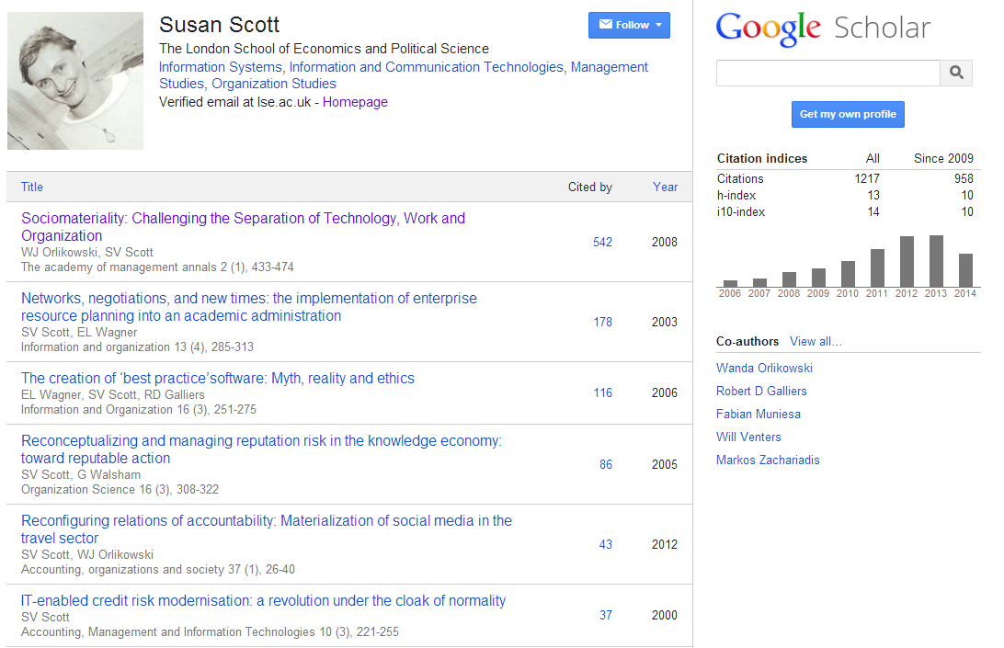
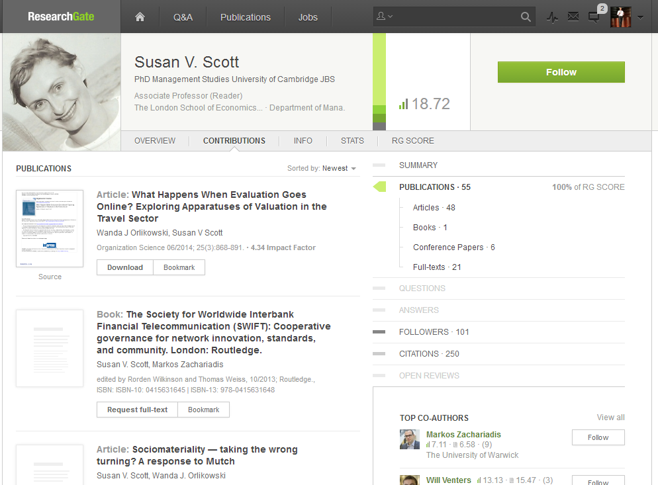
Identity > workflow > content

Slide 18
This:
Provide and promote reference manager products.
And this:
Support – and help shape - emerging practices around citation management, research networking and profiles.

Slide 19
Institutional repository > workflow is the new content

Slide 20
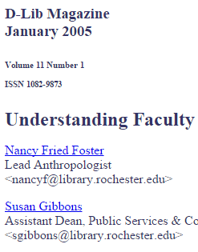
In a well-known article, Salo (2008) offers a variety of reasons as to why they have not been as heavily used as anticipated. These include a lack of attention to faculty incentives (‘prestige’) and to campus workflows. She concludes that IRs will not be successful unless developed as a part of “systematic, broad-based, well-supported data-stewardship, scholarly-communication, or digital-preservation program”.
http://minds.wisconsin.edu/handle/1793/22088
Providing technology as artifact >
Supporting emerging practices

Slide 21
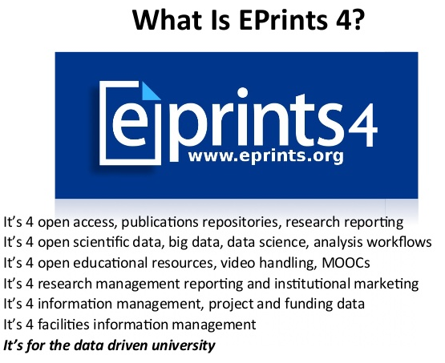
2
1
2
3
1
3
EPrints Update, Les Carr, University
of Southampton, Repository Fringe, 2014
http://www.slideshare.net/repofringe/e-prints42y

Slide 22
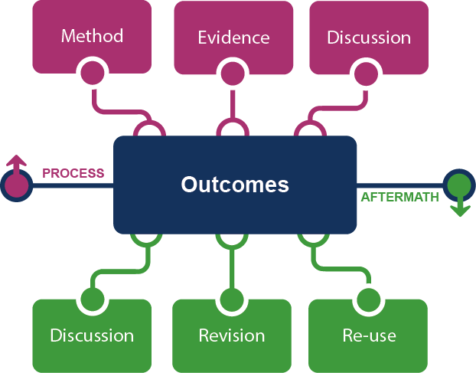
Framing the Scholarly Record …

Slide 23
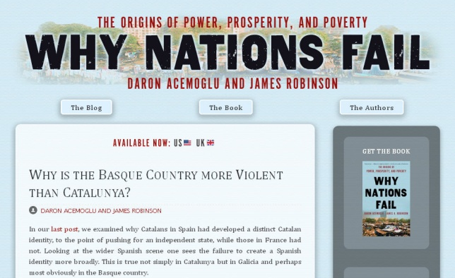
In practice …
Notes:
http://global.oup.com/uk/orc/busecon/economics/carlin/

Slide 24
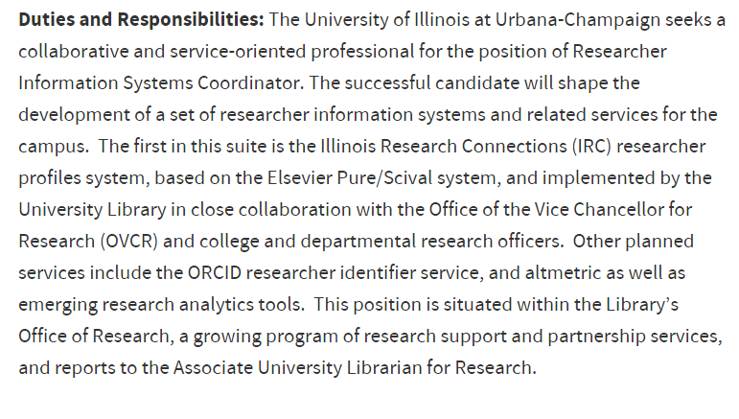

Slide 25
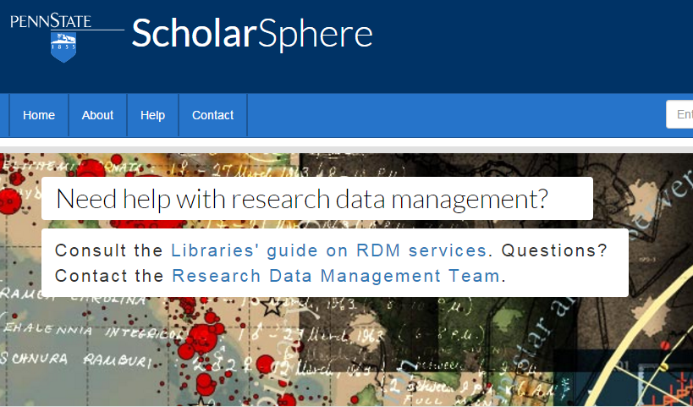
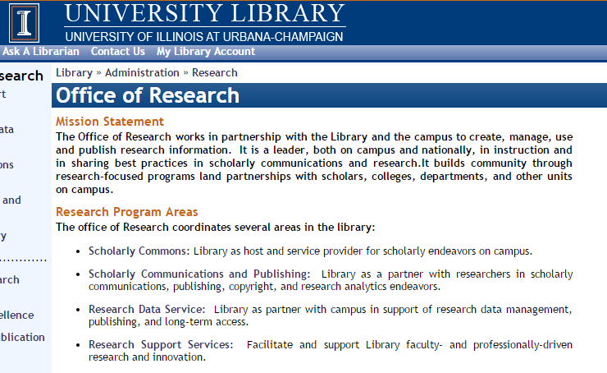
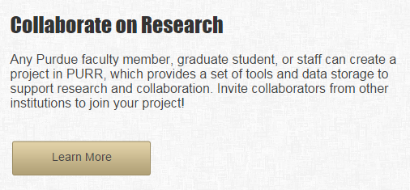
Institutional repository
Expertise profiling
Scholarly publishing
CRIS/Research information management
Research data management

Slide 26
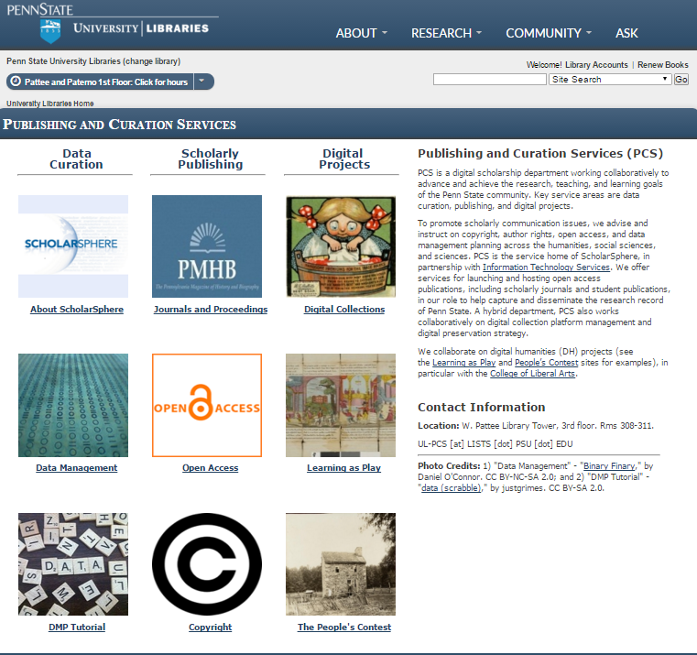

Slide 27
This:
Provide system to manage documentary research outputs.
And this:
Support - and help shape - emerging practices around the complete research life cycle.

Slide 28
Her view is that publishers are here to make the scientific research process more effective by helping them keep up to date, find colleagues, plan experiments, and then share their results. After they have published, the processes continues with gaining a reputation, obtaining funds, finding collaborators, and even finding a new job. What can we as publishers do to address some of scientists’ pain points?
A publisher’s new job description
Annette Thomas,
CEO of Macmillan
Publishers (now Chief Scientific Officer Springer Nature)
http://www.against-the-grain.com/2012/11/a-publishers-new-job-description/

Slide 29
Web sightings: Collections in a new service configuration
3
Library, collections, technology

Slide 30
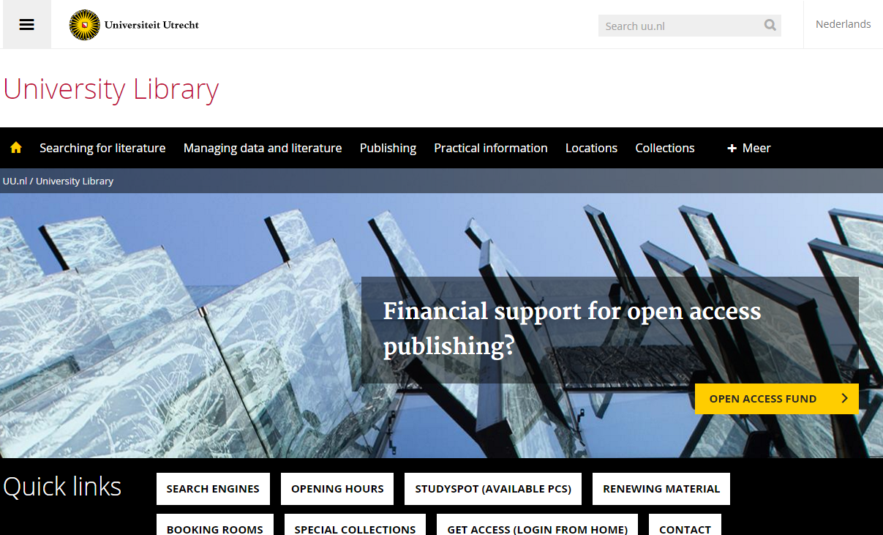
Discovery at network
level
Support for research/creation
Place
Local collections

Slide 31
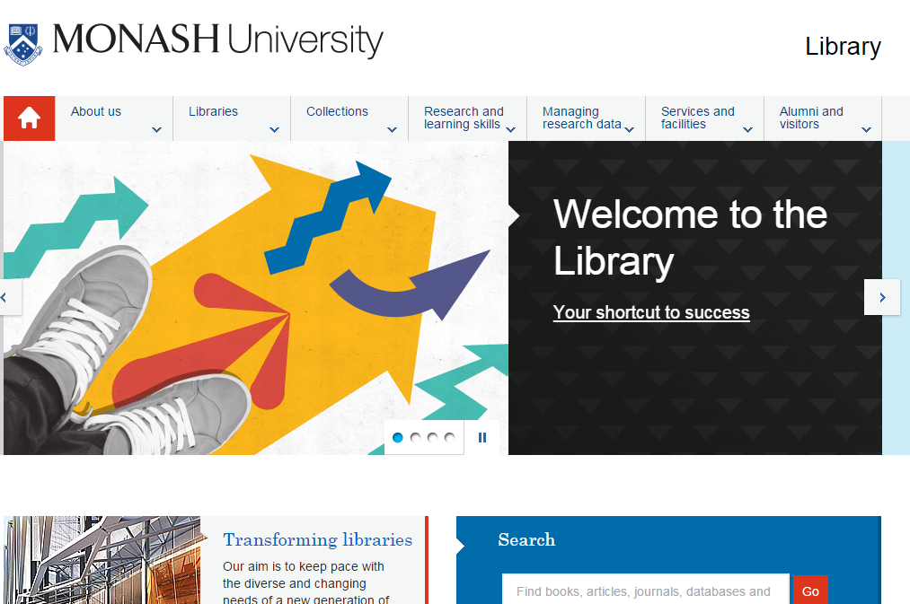
Place
Local collections
Student success
Support for research/creation

Slide 32
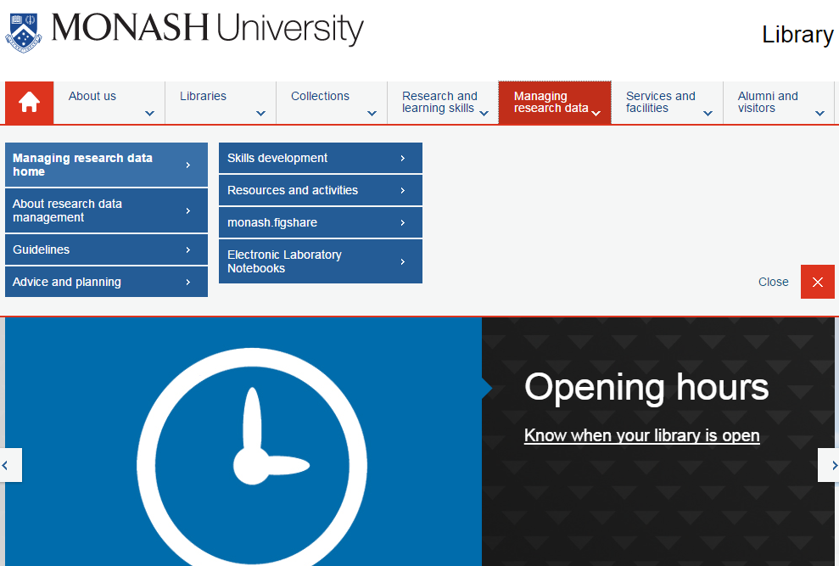

Slide 33
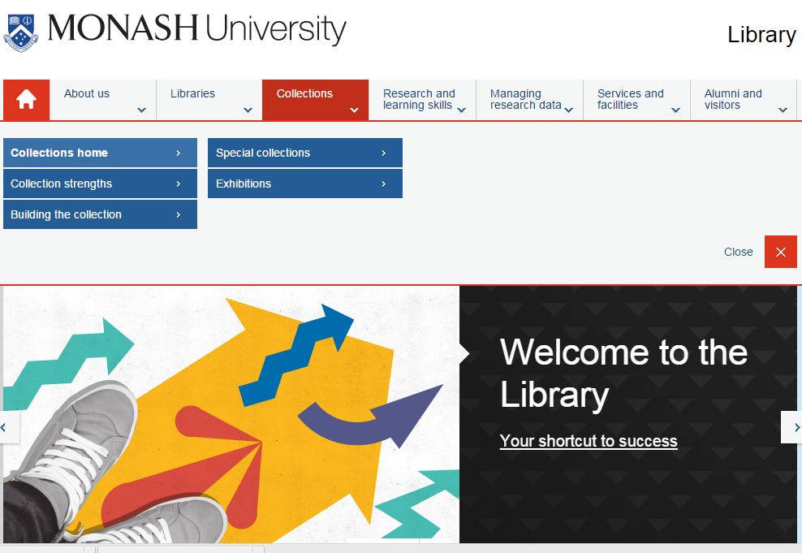

Slide 35
Collection environment
4
Libraries, collections, technology

Slide 36
1
The logic of print distribution influenced library development:
Close to user – multiple library collections.
Big = good.
Just in case.

Slide 37
The bubble of growth in twentieth-century
printed collections has left … librarians
with a tricky problem.
Barbara Fister New Roles for the Road Ahead:
Essays commissioned for ACRL’s 75th Birthday

Slide 38
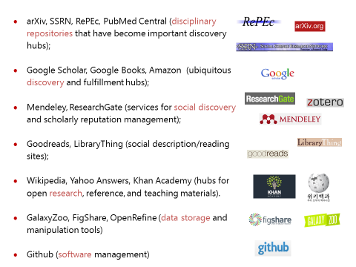
2
An abundance of resources in the network world

Slide 39
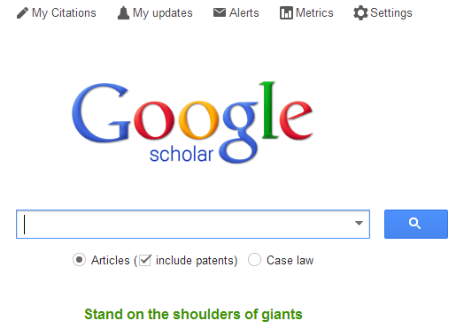
Discovery moved to the network level
Peeled away from local collection
“Discovery happens elsewhere”
Discoverability very important (WorldCat syndication)
3

Slide 40
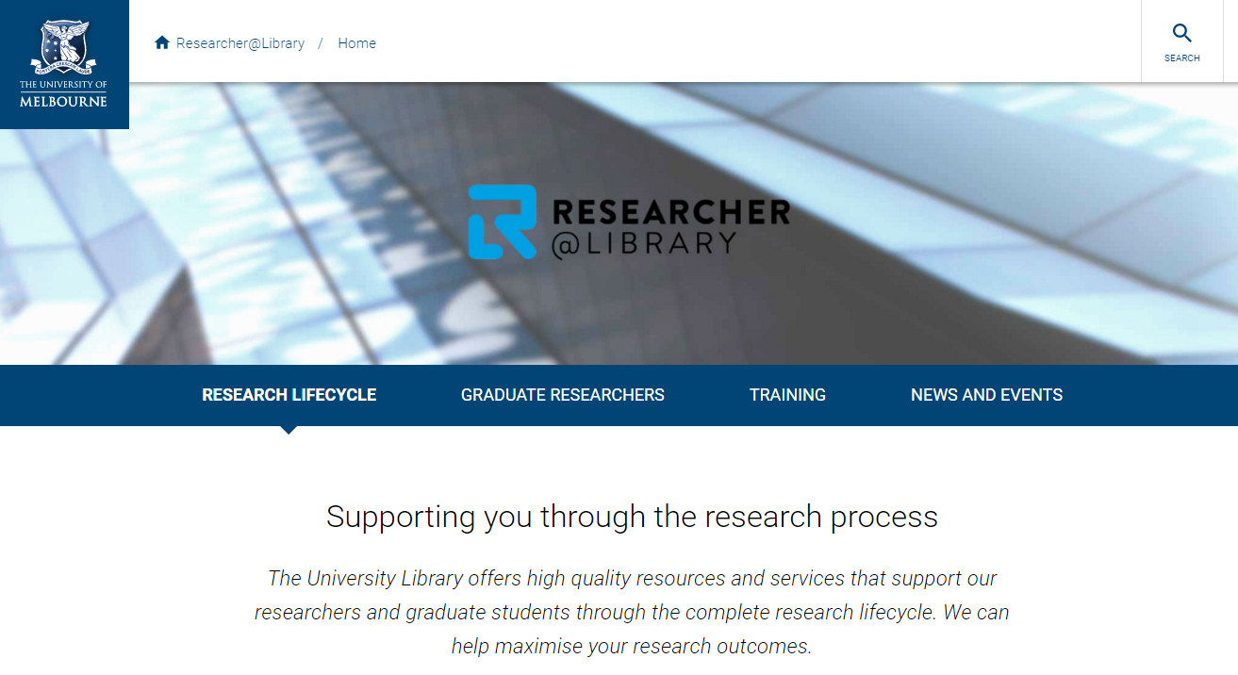
4
From consumption to creation:
Support process as well as product, making as well as taking
Workflow is the new content..
Support for publishing and digital scholarship.
An inside out perspective increasingly important.

Slide 41
A print logic
A network logic
http://www.xkcd.com/917/
The user in the life of the library
The library in the life of the user
Owned
Facilitated
Value relates to locally assembled collection.
Value relates to ability to efficiently meet a variety of research and learning needs.
Product
Process
Manage the products of research (books, articles, …)
Make the whole life cycle of process of research and learning more productive.
Outside in
Inside out

Slide 42
Towards the facilitated collection
5
Libraries, collections, technology

Slide 43
A print logic: the distribution of print copies to multiple local destinations
A network logic: a coordinated mix of local, external and collaborative services are assembled around user needs
A collections spectrum
The ‘owned’ collection
The ‘facilitated’ collection
Purchased and physically stored
Meet research and
learning needs in best way

Slide 44
The ‘external’ collection:
Pointing researchers at Google Scholar;
Including freely available ebooks in the catalog;
Creating resource guides for web resources.
The ‘borrowed’ collection
The ‘shared print’ collection
The ‘shared digital’ collection
The evolving scholarly record
A collections spectrum
The ‘owned’ collection
The ‘licensed’ collection
The ‘demand-driven’ collection
The ‘facilitated’ collection
Purchased and physically stored
Meet research and
learning needs in best way

Slide 45
Collaboration requires ‘conscious coordination’
Rightscaling – optimum scale?
The ‘borrowed’ collection
The ‘shared print’ collection
The ‘shared digital’ collection
The evolving scholarly record

Slide 46
Assessment questions
6
Libraries, collections, technology

Slide 47
“Rather than constructing archipelagoes of isolated collections, increasingly libraries are seeking to create ecosystems of shared collections.”
Karla Strieb “Collaboration: The Master Key to Unlocking Twenty-First-Century Library Collections” in Shared Collections: Collaborative Stewardship (ALCTS, 2016)
Notes:
Network logic demands a new kind of collections assessment. Evaluating ecosystems becomes at least as important as analyzing local holdings.

Slide 48
Collections Assessment -- Issues
THEN:
PRINT LOGIC
Value closely associated with size, scope of local inventory
Just-in-case acquisitions model favors volume counts over use or utility metrics
Purchased/owned = institutional assets
NOW:
NETWORK LOGIC
Collection excellence relies on partnerships (licensed, DDA, shared print, shared digital)
Continuous de-selection and “re-selection” maintains collection value
Curation of locally created content is growing in importance
Notes:
Systemwide perspective for collections assessment – not just about identifying sources of duplication or benchmark collections, but identifying potential partners for collaborative sourcing.

Slide 49
Collections Assessment -- Scale
LOCAL:
Do we have the right balance of ‘outside-in’ and ‘inside-out’ attention and investment?
GROUP:
Are we maximizing the value of existing partnerships? EZ-Borrow, CIC, HathiTrust etc.
GLOBAL:
How can patterns in the system-wide collection inform local decision-making?
Notes:
Assessment is increasingly about understanding institutional/group/global context for local collection?

Slide 50
Conclusion
Libraries, collections, technology

Slide 51
The practices of research and learning are changing.
Research and learning outputs are diversifying.
Some emerging themes:
Creation and Curation
Libraries are supporting the process as well as the products of research.
Inside out
Management and disclosure of institutional materials.
Facilitated collection
Coordinated mix of local, external and collaborative services are assembled around user needs
Conscious coordination
The print and digital scholarly record needs conscious coordination at the network level.

Slide 52
@LorcanD
@ConstanceM
http://www.oclc.org/research

Slide 53
Credits
This presentation reflects ongoing shared work with our colleague Brian Lavoie. Thanks to our colleague JD Shipengrover for graphics.
The Evolving Scholarly Record http://oclc.org/content/dam/research/publications/library/2014/oclcresearch-evolving-scholarly-record-2014.pdf
Understanding the Collective Collection http://oclc.org/research/publications/library/2013/2013-09r.html
Collection Directions http://www.oclc.org/content/dam/research/publications/library/2014/oclcresearch-collection-directions-preprint-2014.pdf
Stewardship of the Evolving Scholarly Record http://www.oclc.org/research/publications/2015/oclcresearch-esr-stewardship-2015.html

