Slide 1
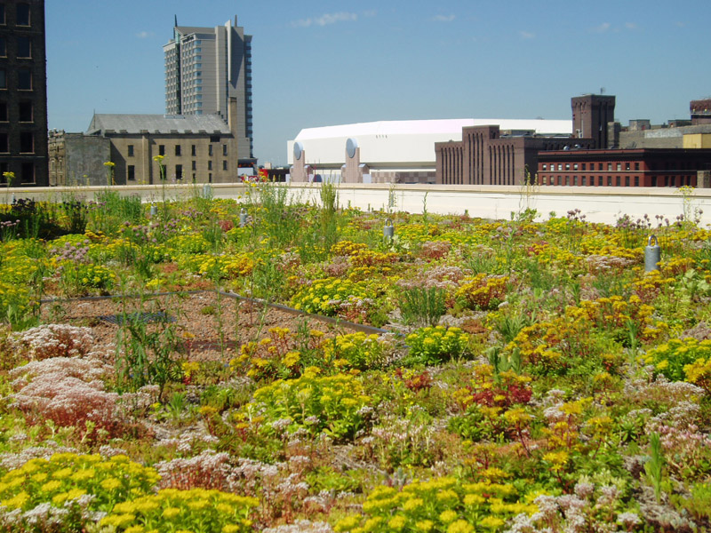
From infrastructure to engagement: thinking about the library in the life of the user
@LorcanD
Lorcan Dempsey (& Chrystie Hill)
OCLC Research
Keynote at Minitex ILL Conference, St Paul, 12 May 2015
http://www.greenacressprinkler.com/gallery/library-gallery

Slide 2
2
1
Preamble(s)
Major rebalancing
Research
Examples – OCLC Research
Changing users: Visitors and residents.
Changing collections: Shared print.
Changing spaces: Rooms that rock.
Notes:
Introduction – that’s the part we are in now

Slide 3
Preamble

Slide 4
Major rebalancing
The user in the The library in life of the library the life of the user
Bureaucracy Enterprise
Reproduction of means is main goal
Changing goals reshape means.
Collection, Space, Services, Expertise
Local infrastructure Engagement
Collections, systems. Sourcing?
People
Place making
Collection Curation Creation

Slide 5
Knowledge
Plan with confidence
Evidence
Position with effect
Models
Make an impact

Slide 6
Visitors and residents
one

Slide 7
Our traditional model was
one in which we thought of
the user in the life of the library
… but we are now increasingly
thinking about the library
in the life of the user
Lorcan Dempsey

Slide 8
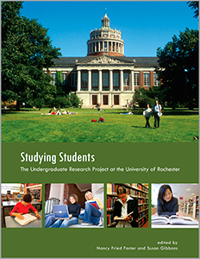
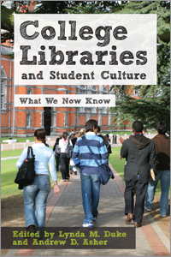

Slide 9
What people actually do, not what they say they do
The cost of context switching
Convenience
Workflow
Fragmentation is a deterrent
People like people
Relationship – sharing – engagement
Spaces and places
Different strokes

Slide 10
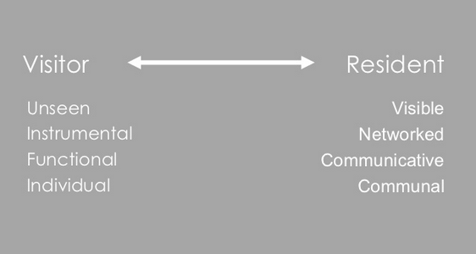
“Google doesn’t judge me” (UKF3)
#vandr

Slide 11
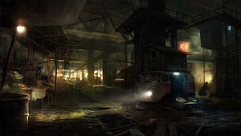
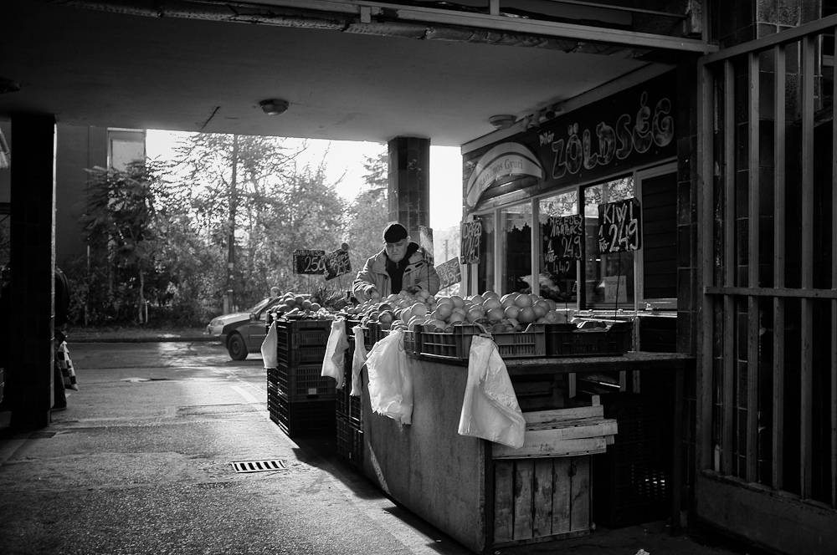
The Learning Black Market
“It’s like a taboo I guess with all teachers, they just all say – you know, when they explain the paper they always say, ‘Don’t use Wikipedia.’”
(USU7, Female, Age 19, Political Science)
Notes:
Image: http://www.deviantart.com/morelikethis/211376699
Covert online study habits
Wikipedia
Don’t cite
Widely used
Guilt
Students & teachers disagree
Quality sources
There is a “Learning Black Market”: learners use non-traditional sources but feel they cannot talk about them in an institutional context. Wikipedia usage is an example of this. (White & Connaway, 2011)
Connaway, Lynn Silipigni, Donna Lanclos, and Erin M. Hood. 2013. “I find Google a lot easier than going to the library website.” Imagine ways to innovate and inspire students to use the academic library. Proceedings of the Association of College & Research Libraries (ACRL) 2013 conference, April 10-13, 2013, Indianapolis, IN. http://www.ala.org/acrl/sites/ala.org.acrl/files/content/conferences/confsandpreconfs/2013/papers/Connaway_Google.pdf.
White, David. 2008. Not “natives’”& “immigrants” but “visitors’ & “residents.” TALL Blog: Online Education with the University of Oxford, April 23, http://tallblog.conted.ox.ac.uk/index.php/2008/07/23/not-natives-immigrants-but-visitors-residents/.
Saunders also found that faculty are “concerned with students’ reliance on Google and Wikipedia for information.” This may help to explain why many of the Emerging stage participants expressed a reluctance to acknowledge or cite Wikipedia in their work for fear of being ridiculed by faculty, or be given a lower grade. This is referred to as the Learning Black Market, which is discussed in more detail in Connaway, Lanclos, and Hood and White’s 2011 blog entry.
Saunders, Laura. 2012. Faculty perspectives on information literacy as a student learning outcome. The Journal of Academic Librarianship 38, no. 4 (2012): 231.

Slide 12
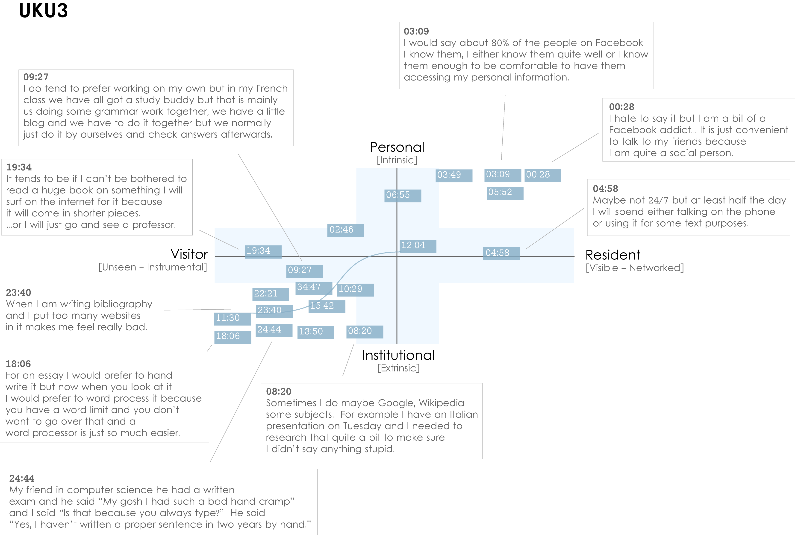
Notes:
Images created by David White, Co-manager, Technology Assisted Lifelong Learning, University of Oxford
Institutional Resident Gap
UKU3 (UK 1st year undergraduate)
This participant has a clear demarcation between Resident modes of engagement in her personal life and Visitor modes of engagement for study.
The map is a mode of engagement landscape onto which individuals can be plotted. The limits of the map have been defined by the four major framing concepts of the project: V&R – Personal and Institutional. The Personal end of the axis encompasses an individual’s private life, and the Institutional is their professional and/or academic life.
The data from the Emerging educational stage seem to suggest that individuals were engaging with systems and materials not provided by their institutions to do institutional work (e.g., consulting Wikipedia to write an essay). Such user-owned literacies, when mapped like this, take a prominent role in the academic work of many of our research subjects. Given the effect that the internet is having on collapsing the relationship between certain modes of activity and specific physical spaces, it is important not to tie notions of the intuitional and the personal to ideas of “school/university/library” and “home” as buildings.
White, D., & Connaway, L.S. Visitors & Residents: What Motivates Engagement with the Digital Information Environment. 2011-2012. Funded by JISC, OCLC, and Oxford University. http://www.oclc.org/research/activities/vandr/.

Slide 13
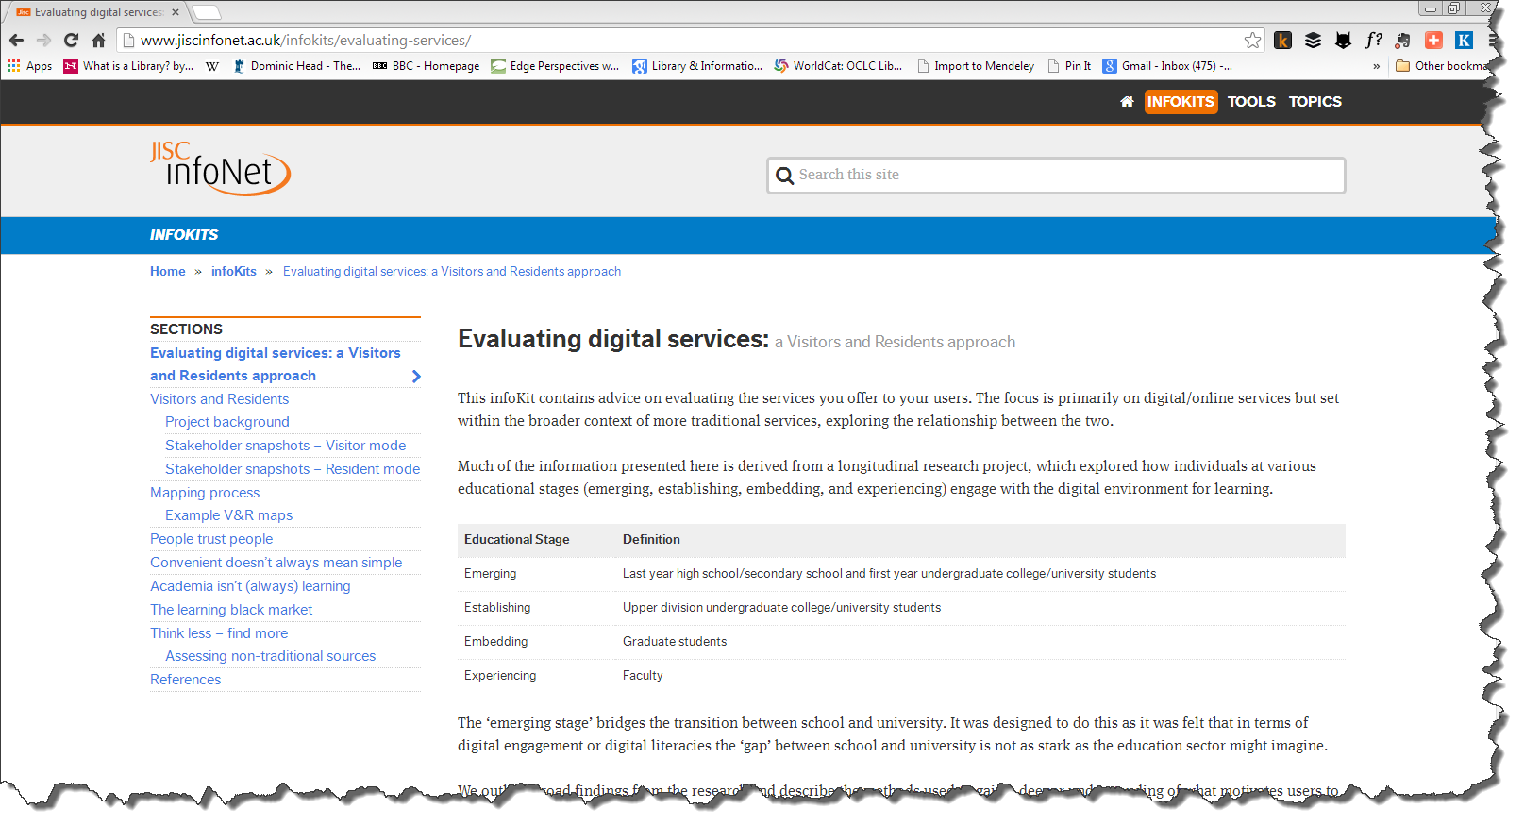

Slide 14
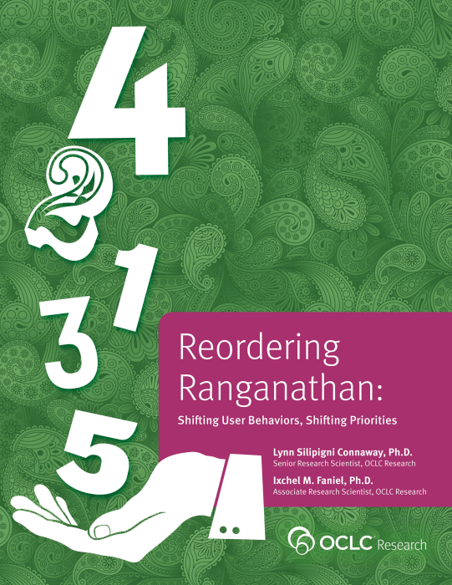
Investigate & describe user-owned digital literacies
Position the role of the library within the workflows & information-seeking patterns of students & faculty
Influence library’s design & delivery of physical spaces & digital platforms & services
The library in the life of the user …

Slide 15
Shared print
Two

Slide 16
The bubble of growth in twentieth-century printed collections has left … librarians with a tricky problem.
Barbara Fister New Roles for the Road Ahead:
Essays commissioned for ACRL’s 75th Birthday

Slide 17
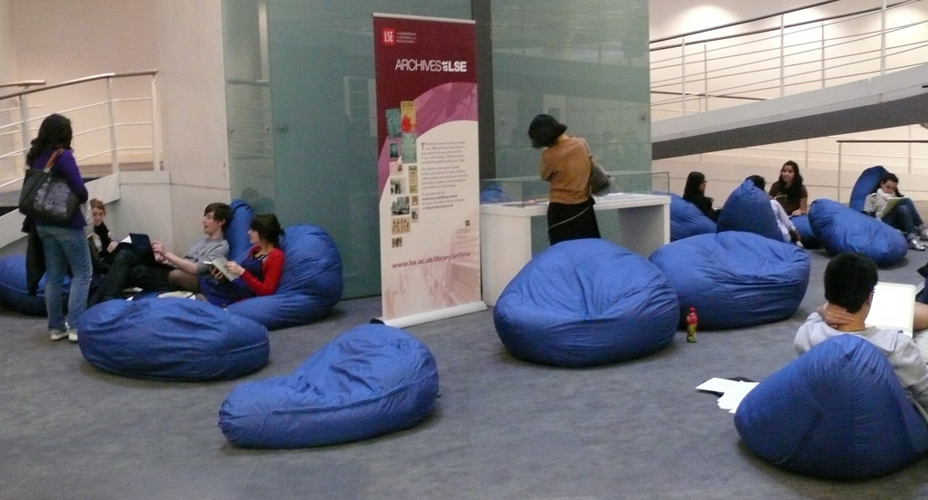
https://www.flickr.com/photos/lselearningspaces/4623536095/
Space is being reconfigured around learning and research
experiences rather than around collections.

Slide 18
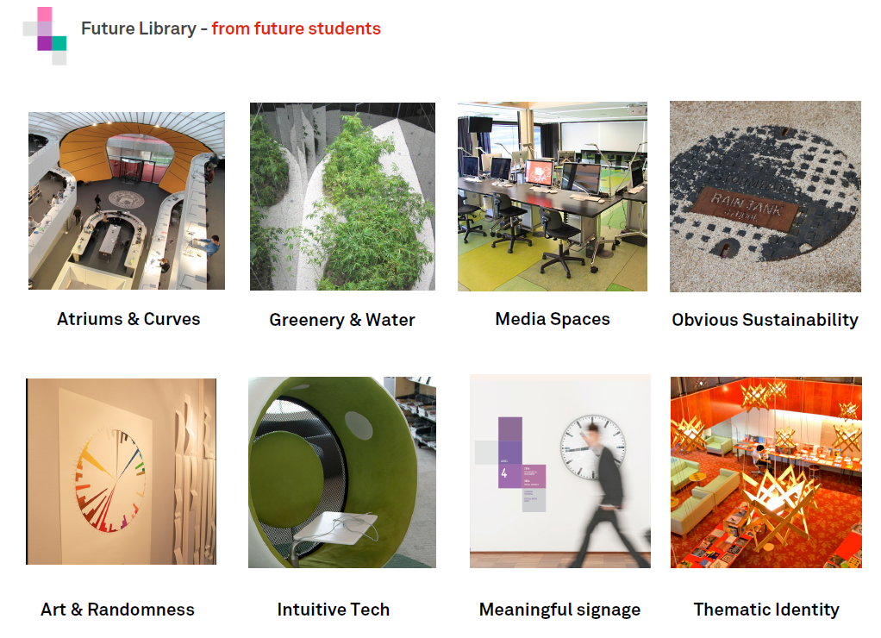
http://www.slideshare.net/malbooth/uts-future-library-more-than-spaces-technology
Mal Booth, UTS Library

Slide 19
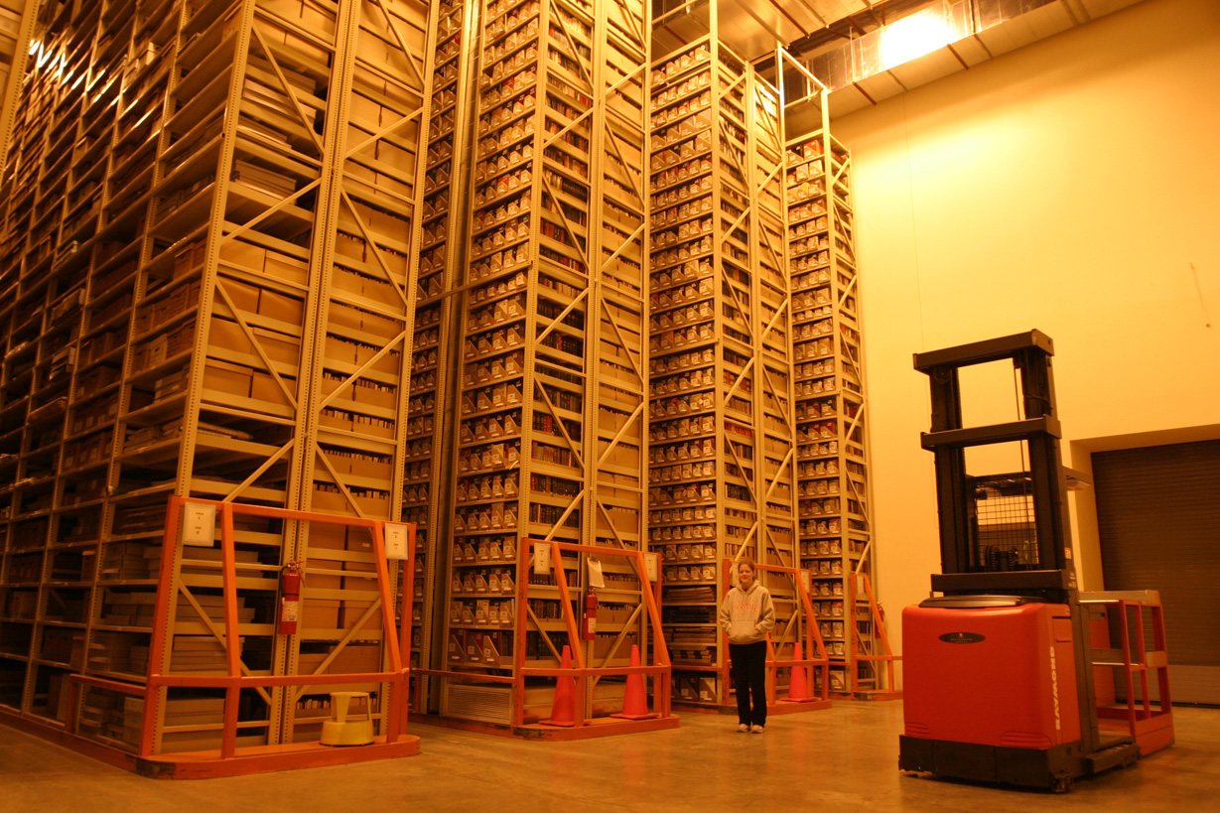
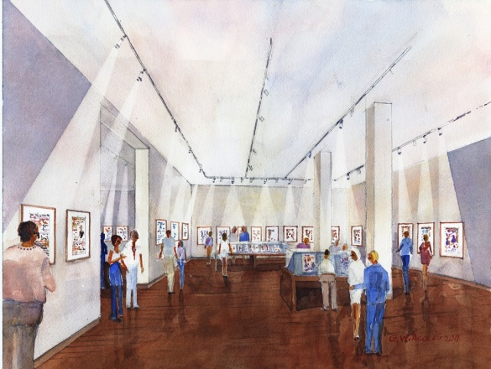
http://library.osu.edu/blogs/cartoons/2012/02/28/blog-launch-and-the-construction-of-our-new-home-in-sullivant-hall/

Slide 20
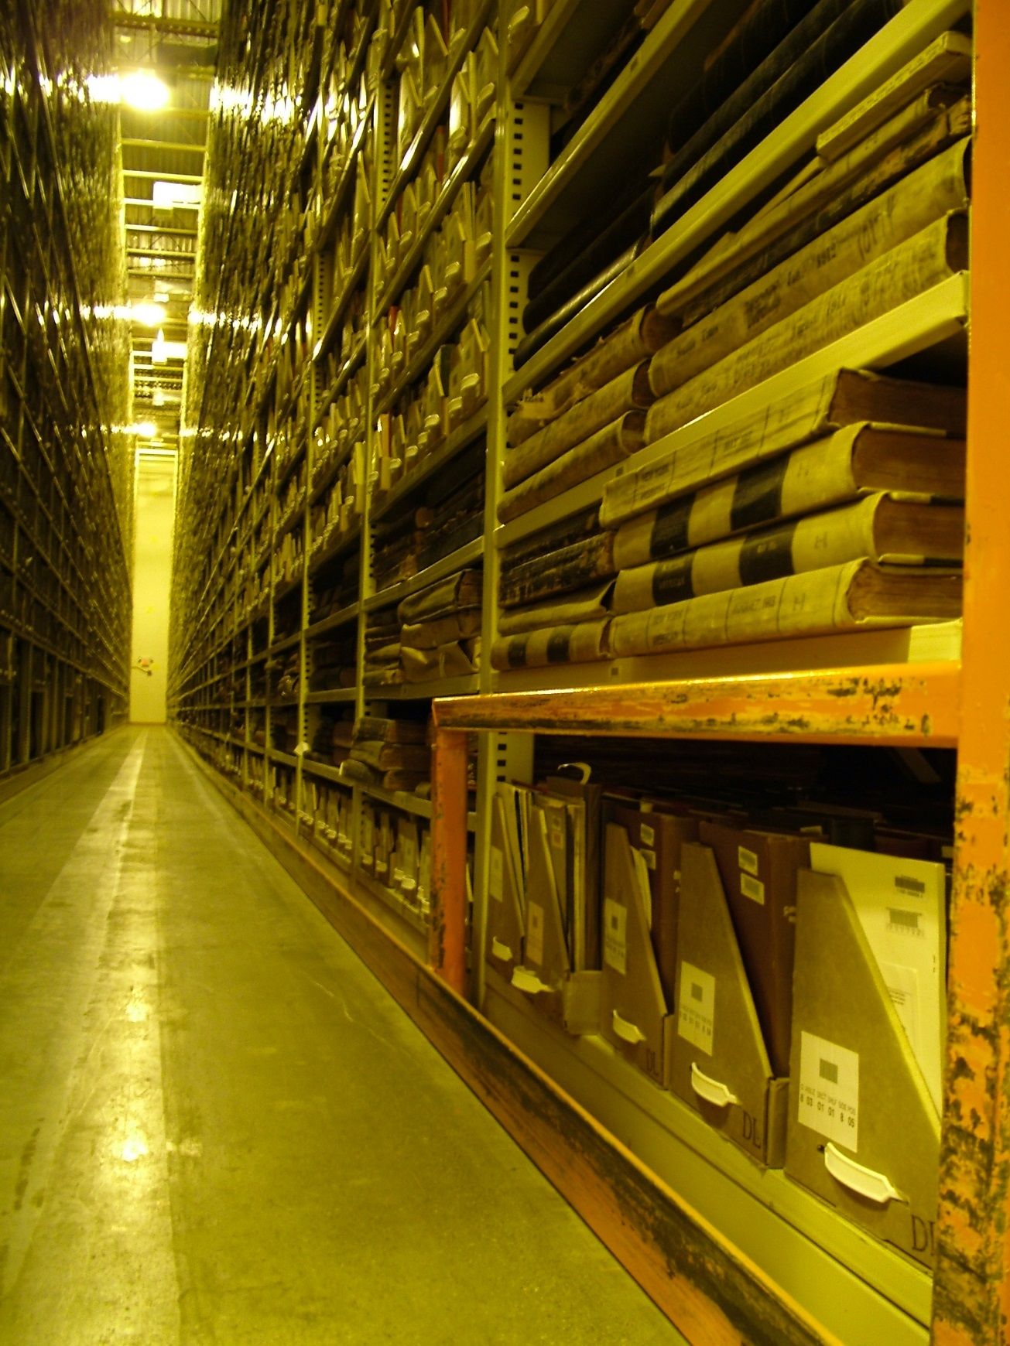
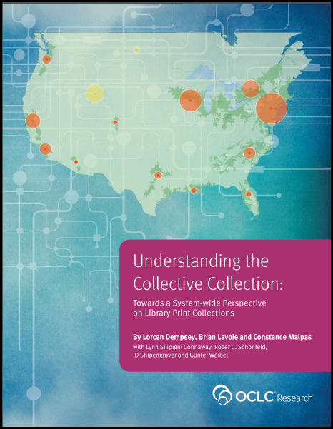
Perhaps the most influential descriptive studies have come from OCLC Research, which has now shared reports outlining both levels of uniqueness as well as duplication among various aggregations of library collections. This growing body of computationally intensive analysis of the collective collection has also begun to clarify geographic distribution and other key characteristics of library collections relevant for decision making around coordinating activities. There is new understanding of collections at scale. Libraries can better assess past successes in coordination and cooperation and surface the outlines of new frontiers for collaborative activities as well as clarify potential efficiencies and opportunities.
Karla Strieb Ohio State University

Slide 21
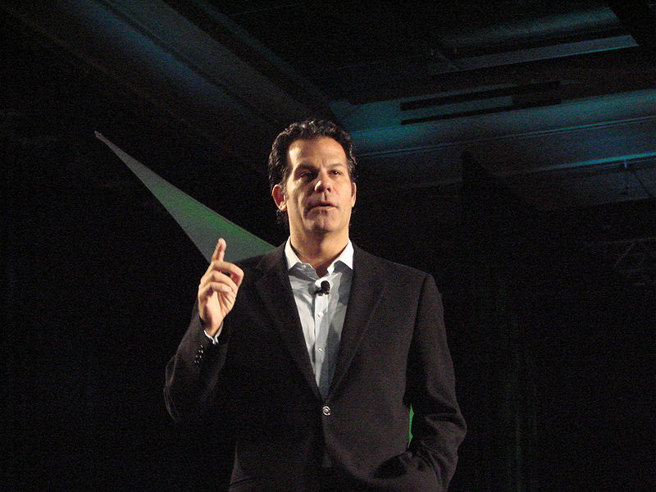
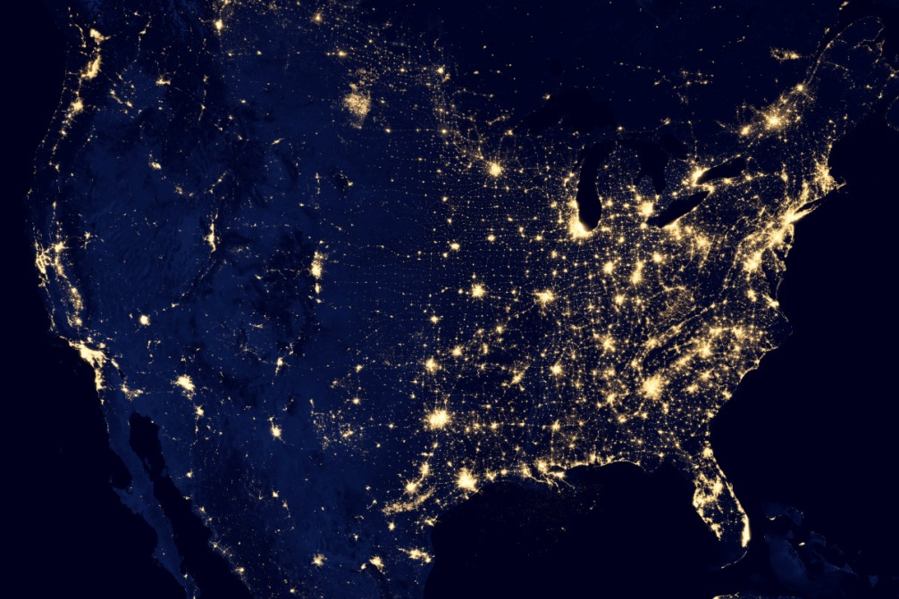
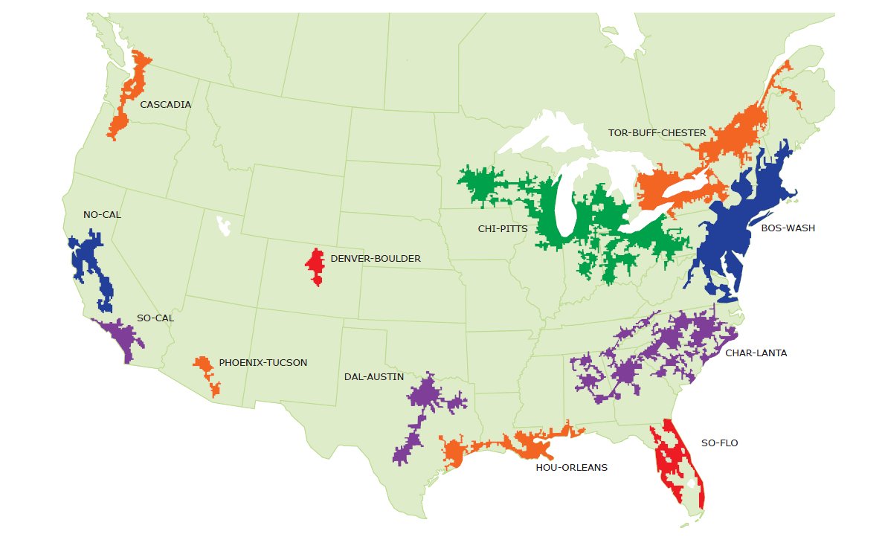
Geographic area defined by high level of economic integration, underpinned by robust supporting infrastructure (transportation, logistics, etc.)

Slide 22
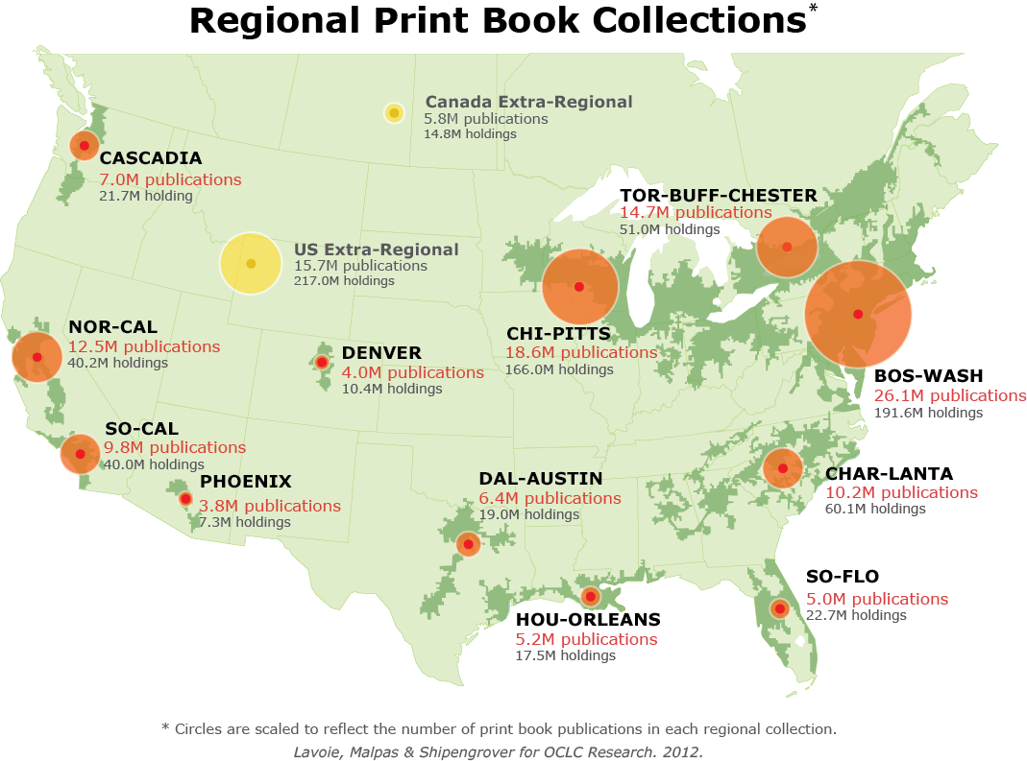
North American print book resource:
45.7 million distinct publications
889.5 million total library holdings
OCLC Research, 2013

Slide 23
Mega-regions & Shared Print Initiatives
Orbis-Cascade
OCUL
MSCS
WEST
CIC
SCELC
WRLC
GWLA
ASERL
FLARE
OCLC Research, 2013

Slide 24
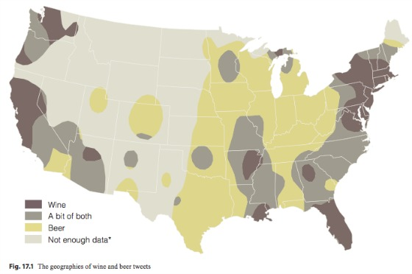
http://www.psmag.com/navigation/nature-and-technology/geography-beer-78105

Slide 25
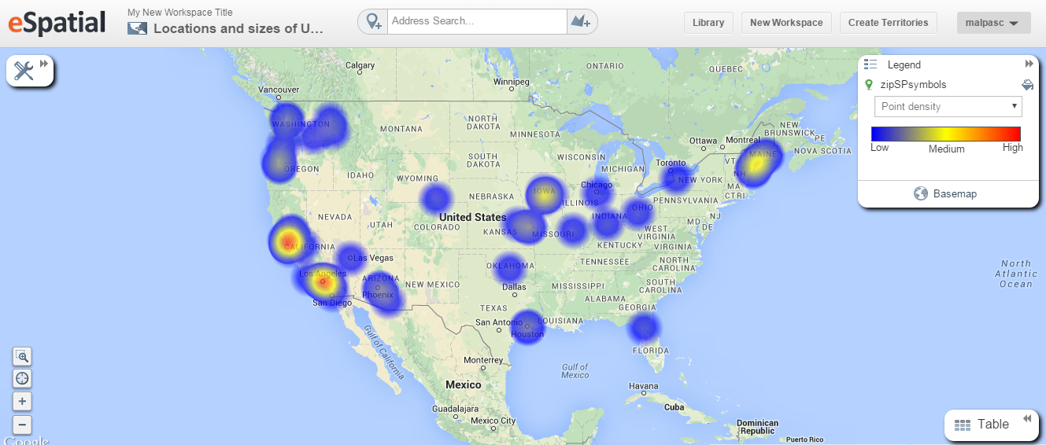
As of December 2014:
63 registered shared print repositories in WorldCat
High concentrations in NorCal, SoCal; other notable concentrations in Cascadia and ChiPitts megaregions

Slide 26
N = 1.92M shared print holdings
Based on WorldCat data as of December 2014.

Slide 27
Challenging assumptions…
with evidence
Shared print is altering the library landscape
It affects the full spectrum of library materials – formats, languages, audiences
It concerns all segments of the library community
It is increasingly embedded in our shared bibliographic infrastructure
It will reshape the gamut of library operations – cataloging, collection management, resource sharing, public service and outreach

Slide 28
Rooms that rock
three

Slide 29
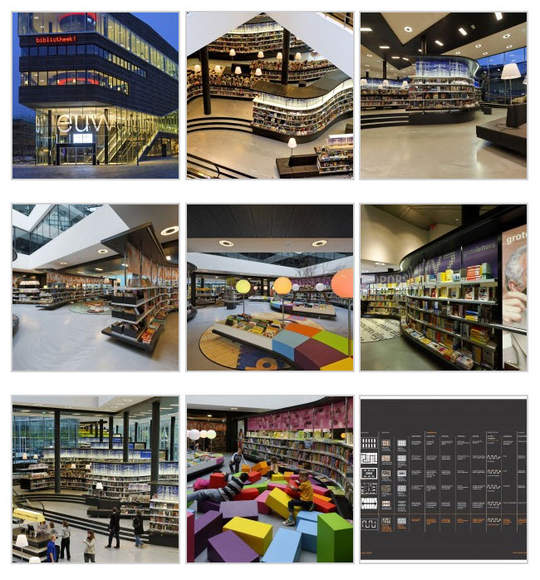
http://flooringtheconsumer.blogspot.com/2010/12/bibliotheek-almere-for-unforgettable.html

Slide 30
WebJunction webinar on Transforming Library Space
Notes:
This image is from a WebJunction webinar on Transforming Library Space. Participants were asked to locate themselves on this continuum. Check mark responses indicate a distinct shift away from the book repository end, but still many solidly in the middle of the spectrum.
Not everyone is asking themselves: What are we going to do with all this space? Not yet.

Slide 31
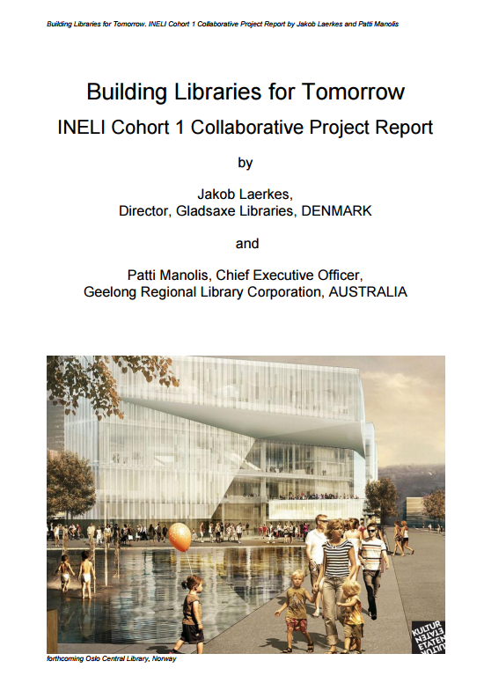
It documents a massive shift internationally from space planning for collections, equipment and associated physical infrastructure to a strong focus on design for people, community outcomes, experience and innovation.

Slide 32
WebJunction webinar on Transforming Library Space

Slide 33
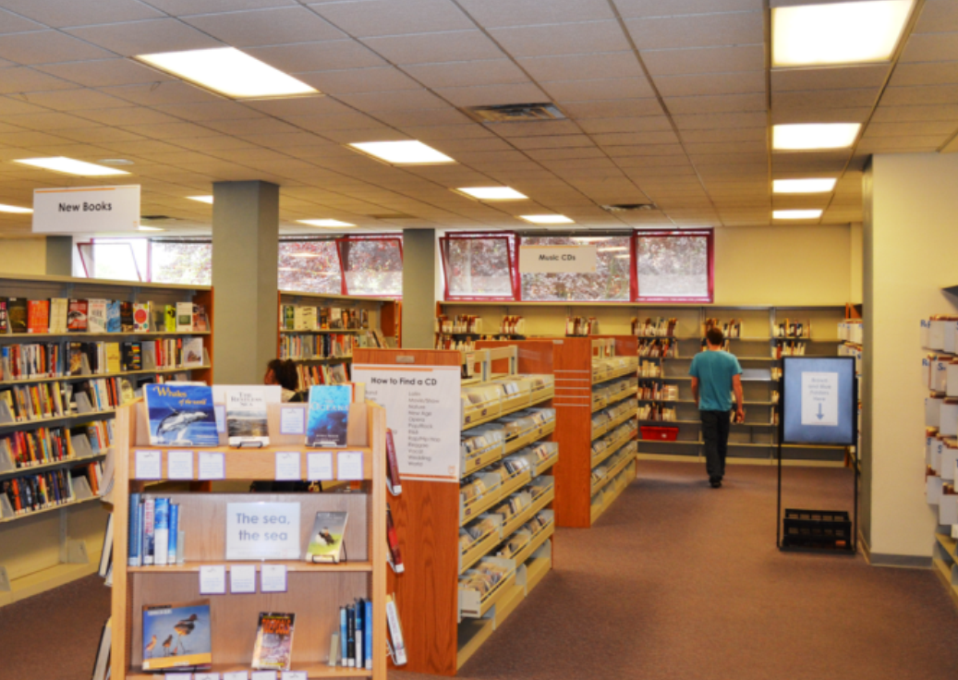
before…
Notes:
In 2013, the team secured support from the Paul G. Allen Family Foundation to further investigate the opportunities and challenges related to transforming physical spaces in small to mid-size public libraries.
Two library communities in Washington state (one small urban library, one small rural library) engaged their communities through focus groups, surveys, and consultation with library facilities designers.
We found that smaller libraries are aware of trends in space transformation and community engagement but are challenged to make effective use of their spaces with limited resources.
This support from the Allen Family gave us the opportunity to practically apply the concepts we uncovered in our initial investigation.
This example is of a small city public library with a service population of around 80,000, that decided to take this space (CDs, holds) in a very central location of their main library and turn it into a space that could accommodate

Slide 34
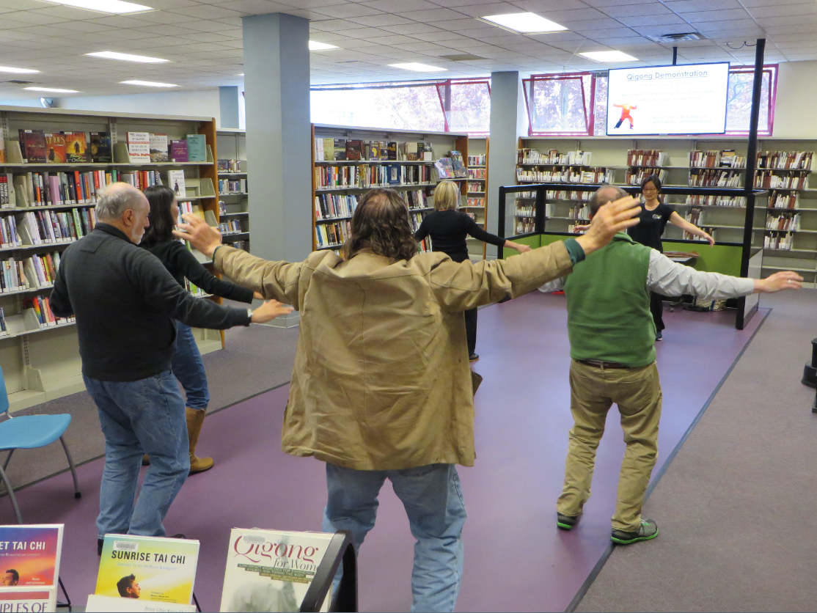
After!
Notes:
This: A space in the library that previously housed stacks of books and CDs was transformed, both physically and energetically. Where patrons would before just grab an item or two, checkout and leave, now the layout, furnishings and targeted resources of these spaces invite people to investigate, participate, and create content to enrich knowledge and networks w/in the community.
This is Bellingham Public Library’s Skillshare space, where patrons now enjoy tech classes, craft creation, Qigong lessons, and baby sign language classes; with its position near the entrance, others stop to watch or join in spontaneously.

Slide 35
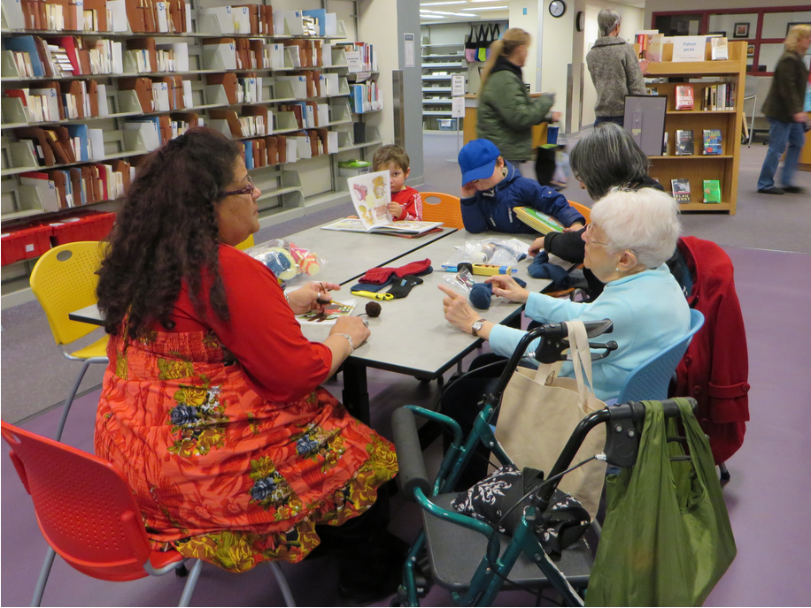
After!
Notes:
Here’s another example from that library. It’s gratifying to go to this library’s website and see the daily impact they are having in the community with new programs in their unexpected space. And perhaps squashing one of the biggest stereotypes in libraries, the librarians encouraged use and engagement of the space – so not one “Shhhhh” was heard! There were also no complaints or concerns from other patrons about the space being noisy.
Now we’re looking to apply the strategies and practices that surfaced in this pilot to a range of libraries, regardless of size or location. We want to take it national.

Slide 36
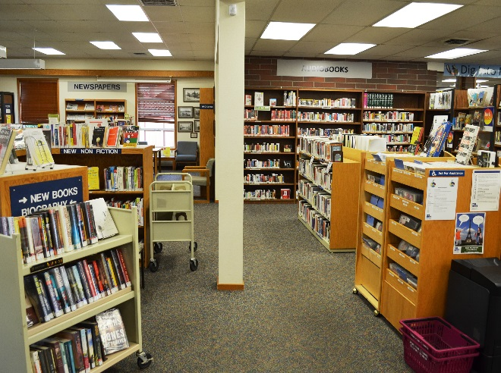
before…
Notes:
The Everson branch of the Whatcom County Library System serves a small town population of 3,000. The area to the right of the white post contains mostly CDs and old VHS tapes. They chose to re-envision the use of this space.

Slide 37
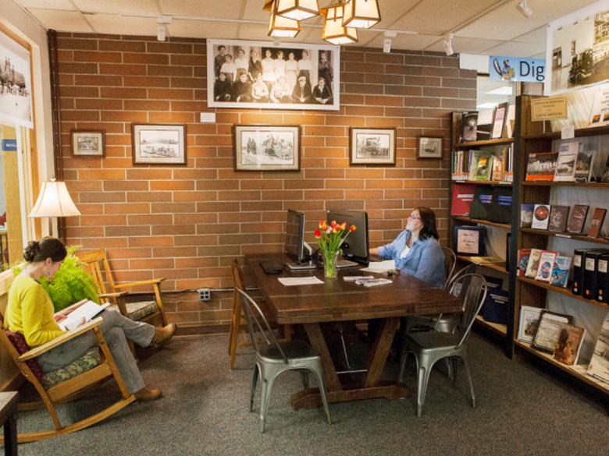
After!
Focus is now on what is gained in community engagement rather than what is lost in numbers of the collection items.
Notes:
The area became the Nooksack Valley Heritage Center, where both digital and analog resources highlight Everson’s rich history of which the residents are so proud. Prior to the remodel, visitors darted in, grabbed a CD, checked out and left. Now, they sit, explore and share in that same floor space. Focus is now on what is gained in community engagement rather than what is lost in numbers of the collection items.

Slide 38
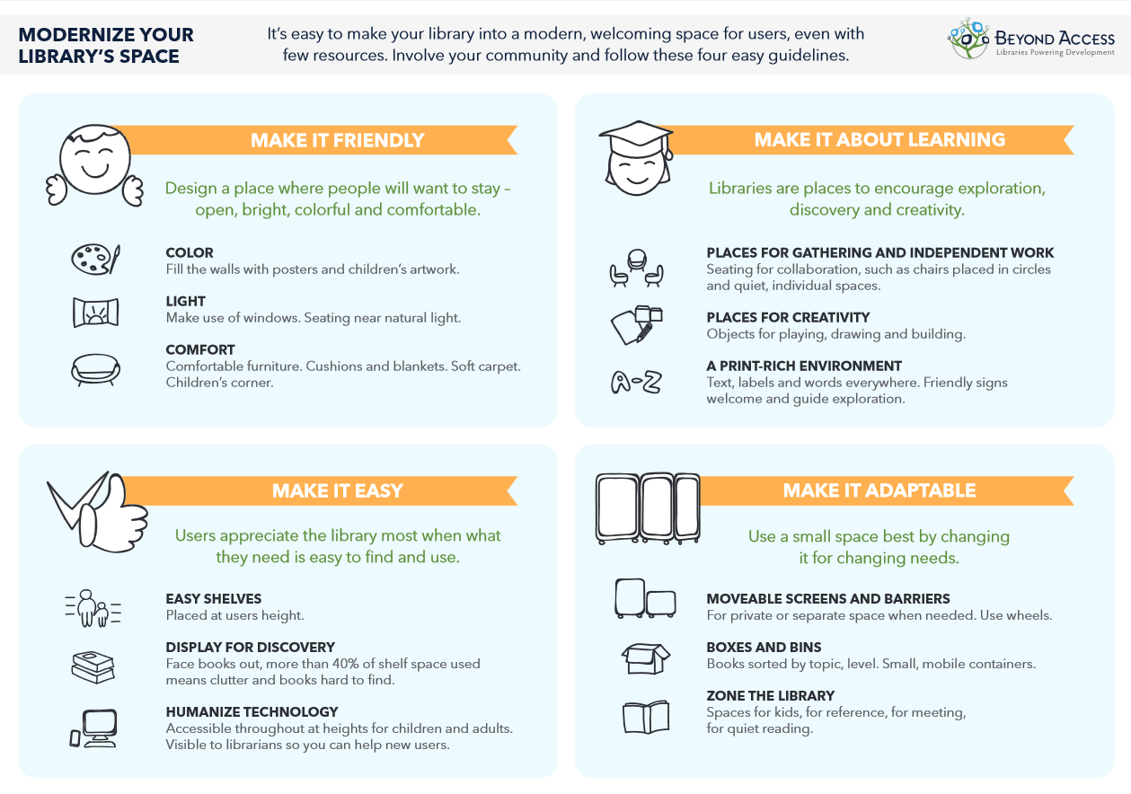
Notes:
The “Rooms that Rock” resource guide (and later infographic) created based on these pilots highlight space innovation opportunities and resources that are accessible and affordable to libraries of all sizes.

Slide 39
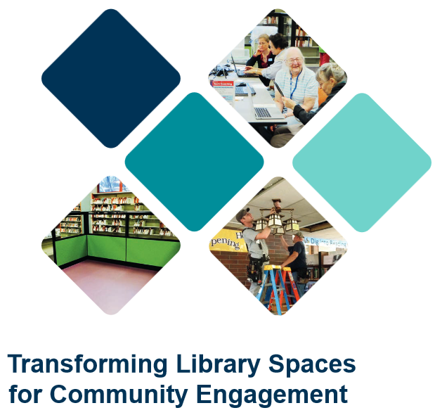
Resource Guide for Libraries
Notes:
The “Transforming Library Spaces for Community Engagement” resource guide from WebJunction is freely available and explores space innovation opportunities and resources that are accessible and affordable to libraries of all sizes
When implications from OCLC research, derived from the collective intelligence of the cooperative can point to a very practical and specific model that we can put into practice; we can test via pilot, and then scale.
But we’re also constantly looking at others’ research for intelligence and implications for service model adjustments or even innovations.

Slide 40
Conclusion

Slide 41
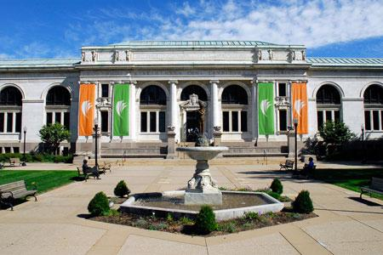
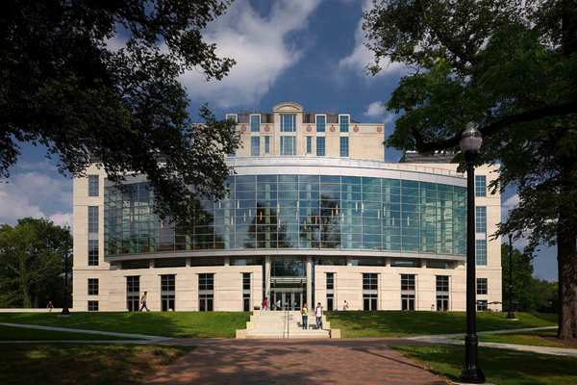
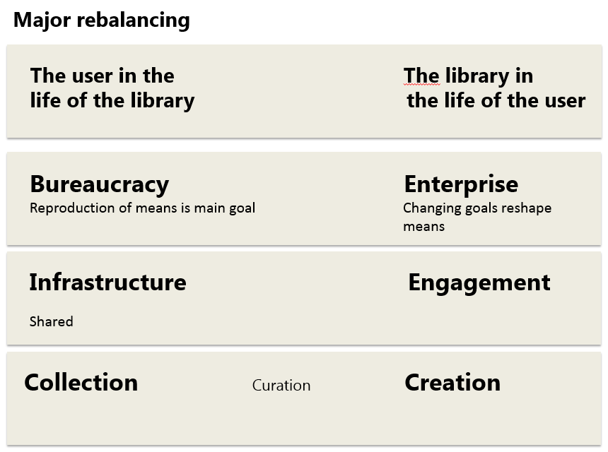
Consider similarities …
Columbus Metropolitan Library
The Ohio State University
Thompson Library
Focus Areas
Notes:
have the names called out

Slide 42
A reset moment
The library should not provide an argument for a particular case, but demonstrate that there is always another case to be made. The notion that the library is a place that has no agenda other than allowing people to invent their own agendas is what makes it an indispensable resource for a democracy. It is where we can learn not just to be readers, but to be the authors of our own destiny. Fintan O’Toole
Dublin City Public Libraries, Flickr: http://www.flickr.com/photos/dublincitypubliclibraries/6029467474/in/set-72157594513778442

