Slide 1
IFLA 2014 - Lyon, France
19 August 2014
Same Principles,
New Context:
An Emerging Profession in the Digital Environment
#rrreport
Lynn Silipigni Connaway, Ph.D.
Senior Research Scientist
OCLC Research
connawal@oclc.org
@LynnConnaway
Notes:
Abstract:
This session will provide an overview of the OCLC Research report, Reordering Rangathan‎, by Lynn Silipigni Connaway and Ixchel M. Faniel, and will identify how the Five Laws‎ of Library Science still are relevant in today's information environment.‎ It will include a discussion of how these laws can be reordered and reinterpreted to reflect an emerging information profession and the resources and services offered, as well as behaviors that people demonstrate when engaging with these.

Slide 2
Explore the trends that shape our future
Share data, work & resources
Magnify the impact of libraries
Notes:
Image: https://www.flickr.com/photos/24354425@N03/14337938973/
OCLC
Research:
Devoted to exploration, innovation & community building on behalf of libraries, archives, and museums
Dedicated to helping cultural heritage institutions
Explore:
Explore trends and new technologies for research
Conduct research, build studies and execute programs, explore new technologies
Share:
Large-scale, high performance services, allow members to share data, work and resources
Magnify:
Program leadership and services.
Advocacy, community building
Amplify library resources in a digital world.
Strategic Directions:
Intelligent workflows→Connected to a global data network→Powered by library cooperation.

Slide 3
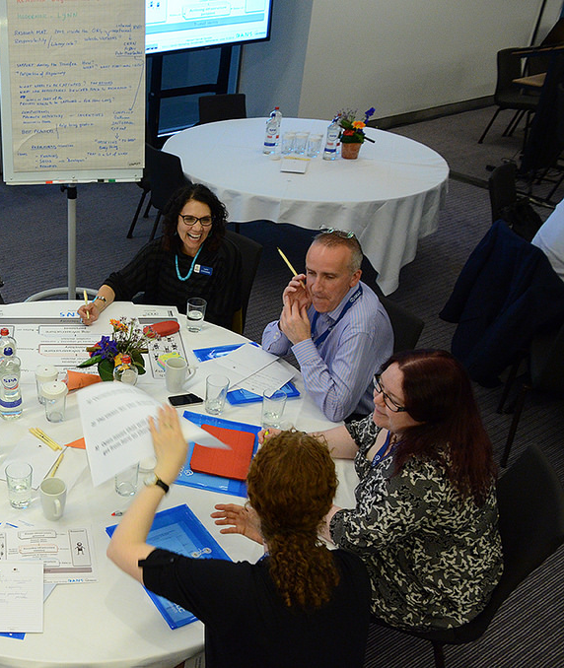
OCLC Research Role
Community resource
Enhance engagement
Provide development, support and analysis
Notes:
Image: https://www.flickr.com/photos/oclcpar/14415067756/
OCLC has three roles:
To act as a community resource for shared research and development (R&D)
To enhance OCLC’s engagement with members and to mobilize the community around shared concerns through Research Library Partnership.
To provide advanced development, technical support and custom analysis to other OCLC divisions

Slide 4
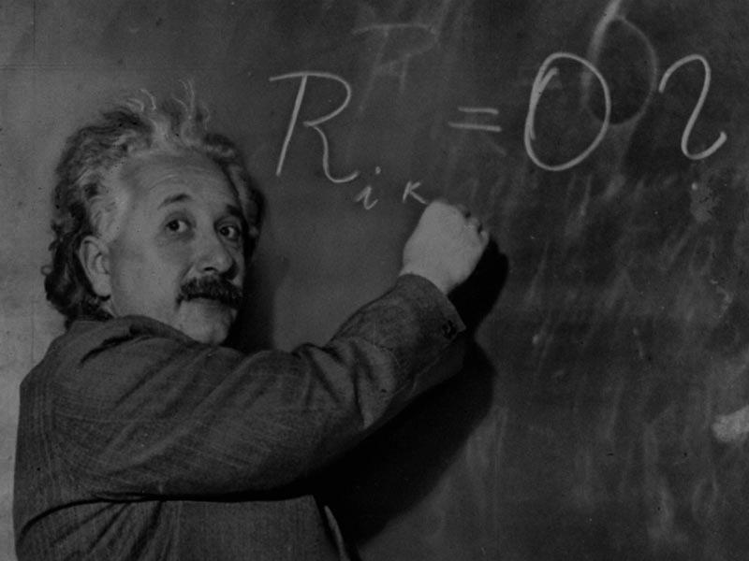
Time is of the Essence
“A new type of thinking is essential if mankind is to survive and move toward higher levels.”
(Einstein 1946)
Notes:
Image: http://calnewport.com/blog/wp-content/uploads/2007/10/einstein.jpg
Rationale for Report
We want to consider today’s information environment, how libraries & Librarians are contributing to it & what can be done to enlarge their footprints (107).
We greatly esteem Ranganathan’s work & laws (108).
In all probability, others will continue to use his laws in this way for another hundred years & our particular thoughts at this point in time will become helpful (hopefully) footnotes.
For us, these laws will continue to serve as a sign post (108).
Reflect the laws, not supplant them
Laws as a framework for our user-behavior & synthesis activity
Connaway, Lynn Silipigni, and Ixchel M. Faniel. 2014. Reordering Ranganathan: Shifting user behaviors, shifting priorities. Dublin, OH: OCLC Research. http://www.oclc.org/content/dam/research/publications/library/2014/oclcresearch-reordering-ranganathan-2014.pdf.

Slide 5
Our Interpretation and Reordering
Notes:
Image: Connaway and Faniel 2014, 105
Laws of nature have not changed, even though the nature itself has.
New media
“Books” stand-in for any and all media used and circulated in a library
“Books are for use” is too powerful a statement to warrant much improvement
Connaway, Lynn Silipigni, and Ixchel M. Faniel. 2014. Reordering Ranganathan: Shifting user behaviors, shifting priorities. Dublin, OH: OCLC Research. http://www.oclc.org/content/dam/research/publications/library/2014/oclcresearch-reordering-ranganathan-2014.pdf.
Ranganathan, Shiyali Ramamrita. 1931. The five laws of library science. London: Edward Goldston, Ltd.

Slide 6
 | Ranganathan’s Original Conception | New Conception in the Current Environment
First Law | Books are for use. | E-books are for reading. | Netflix is for watching. | Blackboard is for studying.
Second Law | Every person his or her book. | Every listener her iTunes. | Every artist his Photoshop. | Every student her EasyBib.
Third Law | Every book its reader. | Every blog its reader. | Every Google Map its traveler. | Every digital repository its researcher.
Fourth Law | Save the time of the reader. | Save the time of the listener. | Save the time of the traveler. | Save the time of the researcher.
Fifth Law | A library is a growing organism.

Slide 7
Embed library systems and services into users’ existing workflows
Save the Time of the Reader
Notes:
Image: http://www.ivillage.ca/sites/default/files/imagecache/node_photo_gallery_single_view/iStock_000017998458Small.jpg
Save time of the reader, previously #4, is now more important (#1) (8, 107)
Scarcity of time and attention (lack of time not content) (8)
Multitude of information service providers (8)
A lens through which we interpret other laws (8)
Convenience as a primary factor in getting & choosing information (107)
Librarians need to consider how to save users more time, in more places & in ways that are convenient and familiar to them (105).
Convenience is a moving target (105).
Convenience is dependent on the situation individuals find themselves in when they need information & on the context of the specific situation (105).
No value in saving the time of the reader if the content needed cannot be found & accessed (106).
One size fits none (106).
Connaway, Lynn Silipigni, Timothy J. Dickey, and Marie L. Radford. 2011. “If it is too inconvenient I’m not going after it:” Convenience as a critical factor in information-seeking behaviors. Library & Information Science Research 33, no. 3: 179-90.
Connaway, Lynn Silipigni, and Ixchel M. Faniel. 2014. Reordering Ranganathan: Shifting user behaviors, shifting priorities. Dublin, OH: OCLC Research. http://www.oclc.org/content/dam/research/publications/library/2014/oclcresearch-reordering-ranganathan-2014.pdf.

Slide 8
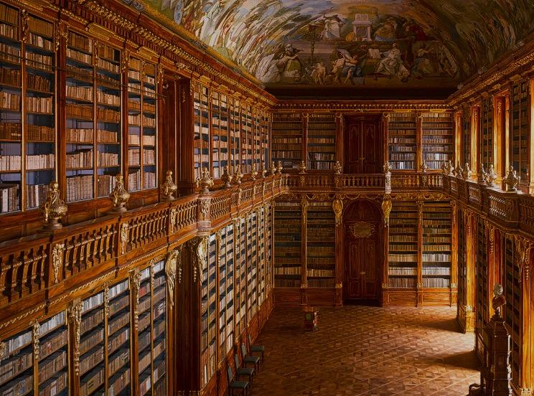
“Perhaps the most convenient method of studying the consequences of this law will be to follow the reader from the moment he enters the library to the moment he leaves it…”
(Ranganathan 1931, 337)
Notes:
Image: http://i2.cdn.turner.com/cnn/dam/assets/131126191411-strahov-abbey-library-horizontal-large-gallery.jpg
Ranganathan, Shiyali Ramamrita. 1931. The five laws of library science. London: Edward Goldston, Ltd.

Slide 9
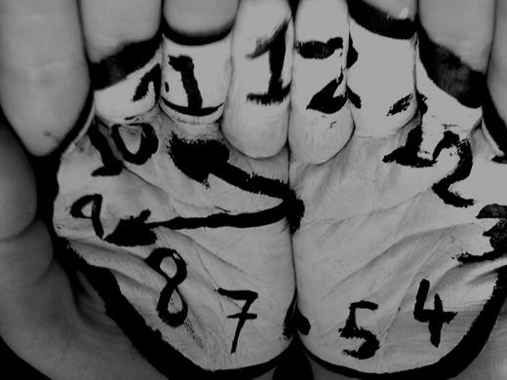
Time as Time
Convenience
Time
Familiarity
(Connaway and Faniel 2014)
Notes:
Image: http://www.heinzmarketing.com/assets/80-20-rule-time-management-stop-wasting-time.jpg
Today, people are inundated with information that they have to review and evaluate to make choices (Connaway, Dickey, and Radford 2011) (9)
Librarians adjusting their systems and services for scholars now required to provide better management/accurate metadata (Connaway and Dickey 2010b) (10)
Operating within time constraints is an issue under these circumstances—no tolerance for delays (Connaway and Dickey 2010b) (10)
Earthquake engineering researchers delay contributing data to a central repository because uploading and documenting the data were time- and labor-intensive processes
(Faniel 2009) (10)
“Millennials, by their own admission, have no tolerance for delays” (Sweeney 2006, 3) (9)
They respond quickly to communications from others and expect the same in return (Oblinger and Oblinger 2005), especially from their information sources (Connaway 2008; Connaway and Radford 2007; Connaway and Radford 2011; Connaway, Radford, Dickey, Williams, and Confer 2008; Van Scoyoc and Cason 2006) (9)
Libraries
Limited hours
Long travel distances
Time intensive
Search Engines
Fast & easy
Cost-effective
Available
Discovery
Quick & convenient
Familiar
Rated, reviewed, & ranked by relevancy
.

Slide 10
Notes:
Calhoun, Karen, Joanne Cantrell, Peggy Gallagher, and Janet Hawk. 2009. Online catalogs: What users and librarians want: An OCLC report. Dublin, OH: OCLC.
Connaway, Lynn Silipigni. 2008. Make room for the Millennials. NextSpace 10: 18-19. http://www.oclc.org/nextspace/010/research.htm.
Connaway, Lynn Silipigni. 2013b. Why the internet is more attractive than the library. The Serials Librarian 64, no. 1-4: 41-56.
Connaway, Lynn Silipigni, and Ixchel M. Faniel. 2014. Reordering Ranganathan: Shifting user behaviors, shifting priorities. Dublin, OH: OCLC Research. http://www.oclc.org/content/dam/research/publications/library/2014/oclcresearch-reordering-ranganathan-2014.pdf.
Connaway, Lynn Silipigni, Donna Lanclos, and Erin M. Hood. 2013b. “I find Google a lot easier than going to the library website.” Imagine ways to innovate and inspire students to use the academic library. Proceedings of the Association of College & Research Libraries (ACRL) 2013 conference, April 10-13, 2013, Indianapolis, IN. Chicago: Association of College & Research Libraries. http://www.ala.org/acrl/sites/ala.org.acrl/files/content/conferences/confsandpreconfs/2013/papers/Connaway_Google.pdf.
Connaway, Lynn Silipigni, Donna Lanclos, David White, Alison Le Cornu, and Erin M. Hood. 2013. User-centered decision making: A new model for developing academic library services and systems. IFLA Journal 39, no. 1: 30-36.
Connaway, Lynn Silipigni, David White, Donna Lanclos, and Alison Le Cornu. 2013. Visitors and Residents: What motivates engagement with the digital information environment? Information
Research 18, no. 1, http://informationr.net/ir/18-1/infres181.html.
Connaway, Lynn Silipigni, Timothy J. Dickey, and Marie L. Radford. 2011. “If it is too inconvenient I’m not going after it:” Convenience as a critical factor in information-seeking behaviors. Library & Information Science Research 33, no. 3: 179-90. http://www.oclc.org/content/dam/research/publications/library/2011/connaway-lisr.pdf.

Slide 11
Notes:
Connaway, Lynn Silipigni, Marie L. Radford, Timothy J. Dickey, Jocelyn De Angelis Williams, and Patrick Confer. 2008. Sense-making and synchronicity: Information-seeking behaviors of Millennials and Baby Boomers. Libri 58, no. 2: 123-35. http://www.oclc.org/resources/research/publications/library/2008/connaway-libri.pdf.
Connaway, Lynn Silipigni, and Marie L. Radford. 2007. Service sea change: Clicking with screenagers through virtual reference. In Sailing into the future: Charting our destiny: Proceedingsof the Thirteenth National Conference of the Association of College and Research Libraries, March 29-April 1, 2007, Baltimore, Maryland, edited by Hugh A. Thompson. Chicago: Association of College and Research Libraries. http://www.oclc.org/research/publications/archive/2007/connaway-acrl.pdf
Connaway, Lynn Silipigni, and Marie L. Radford. 2011. Seeking synchronicity: Revelations and recommendations for virtual reference. Dublin, OH: OCLC Research. http://www.oclc.org/reports/synchronicity/full.pdf.
Dempsey, Lorcan. 2012. Thirteen ways of looking at libraries, discovery, and the catalog: Scale, workflow, attention. EDUCAUSE Review Online (December 10), http://www.educause.edu/ero/
article/thirteen-ways-looking-libraries-discovery-and-catalog-scale-workflow-attention.
De Rosa, Cathy, Joanne Cantrell, Diane Cellentani, Janet Hawk, Lillie Jenkins, and Alane Wilson. 2005. Perceptions of libraries and information resources: A report to the OCLC Membership. Dublin, OH: OCLC Online Computer Library Center.
Oblinger, Diana G., and James L. Oblinger, eds. 2005. Educating the net generation. Boulder: EDUCAUSE. http://www.educause.edu/content.asp?PAGE_ID=5989&bhcp=1.
Pullinger, David. 1999. Academics and the new information environment: The impact of local factors on use of electronic journals. Journal of Information Science 25, no. 2: 164-72.
Sweeney, Richard. 2006. Millennial behaviors & demographics. http://certi.mst.edu/media/administrative/certi/documents/Article-Millennial-Behaviors.pdf.
Van Scoyoc, Anna M., and Caroline Cason. 2006. The electronic academic library: Undergraduate research behavior in a library without books. portal: Libraries and the Academy 6, no. 1: 47-58.

Slide 12
“A webmaster should think about users and how to attract them, develop for them, cater to them, if s/he wants to satisfy the Web community.”
(Noruzi 2004)
Notes:
Image: http://asisnj.com/wp-content/uploads/2012/08/HiRes.jpg
Inform users: Specifically, we recommend that librarians reexamine their systems and services in the context of how they do the following:
• Market and promote library services;
Provide a broad range of tools;
• Remove the barriers between discovering and accessing information (16-17)
Be seamless: Consider walking through the library’s workflow from the perspective of a user trying to accomplish a particular task. How often do you leave one interface and go to another? Every time that happens, individuals have to reevaluate their surroundings, which often equates to a direct loss of time or, at least, a poorly perceived experience. Seamlessness is not just about doing something efficiently (17)
Be proactive: Librarians must sense and respond to challenges across user communities (18)
Be bold, be inventive and take risks (18)
Look upstream: Looking upstream is about more than proactively considering user communities’ current needs. It’s seeing those needs in a much larger context and thinking broadly within the information profession and other professions related to it (18)
If users are early adopters of a service, librarians should think about how to meet them there with library resources sooner rather than later (18)
Connaway, Lynn Silipigni, and Ixchel M. Faniel. 2014. Reordering Ranganathan: Shifting user behaviors, shifting priorities. Dublin, OH: OCLC Research. http://www.oclc.org/content/dam/research/publications/library/2014/oclcresearch-reordering-ranganathan-2014.pdf.
Noruzi, Alireza. 2004. Application of Ranganathan’s Laws to the web. Webology 1, no. 2, http://www.webology.org/2004/v1n2/a8.html.

Slide 13
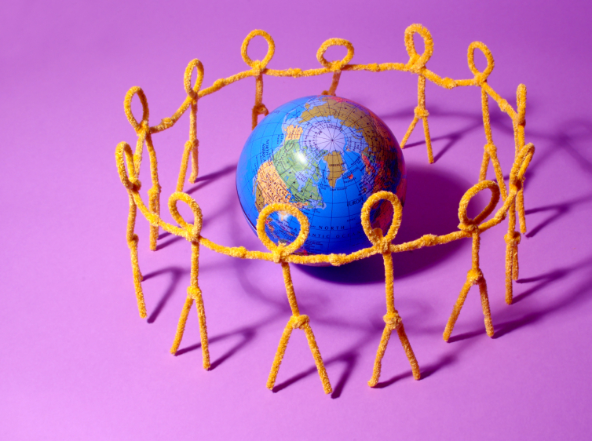
Know your community and its needs
Every person his or her book
(Connaway and Faniel 2014, 32)
Notes:
Image: http://www.loxahatcheegroves.org/images/image/world-connect-people-community-international.jpg
#2 Know your community and its needs, previously #2 Every person his or her book (86)
Connecting every user with the precise content they need is of paramount importance in distinguishing libraries from other information service providers in the digital environment (86)
There is no value in saving the time of the reader if we cannot pinpoint the information they need & information cannot be found or accessed (86)
World has been transformed by Web → necessary for librarians to change the way materials and programs are developed and delivered (107)
Librarians are redefining the communities they serve around e-content and a wide range of needs and demographics (107)
Difficult balance between personalized and generalized service, which is why it is imperative to constantly collect, analyze and discuss data to help librarians know their communities and their needs (108)
Connaway, Lynn Silipigni, and Ixchel M. Faniel. 2014. Reordering Ranganathan: Shifting user behaviors, shifting priorities. Dublin, OH: OCLC Research. http://www.oclc.org/content/dam/research/publications/library/2014/oclcresearch-reordering-ranganathan-2014.pdf.
Ranganathan, Shiyali Ramamrita. 1931. The five laws of library science. London: Edward Goldston, Ltd.

Slide 14
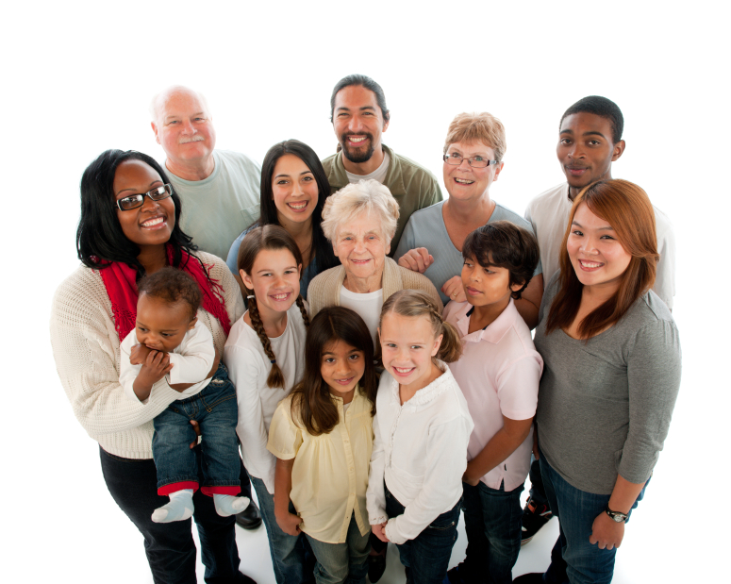
The Changing Landscape of Information-Seeking
(Connaway and Faniel 2014)
Notes:
Image:http://www.actionforageing.com/wp-content/uploads/2011/11/Family-multi-gen-ethnic.jpg
Research indicates that people are more familiar with search engines than with libraries (Connaway Lanclos, and Hood 2013a, 2013b; De Rosa et al. 2005) (30)
36% of the survey respondents reported being “extremely familiar” with search engines
26% reported being “very familiar” with libraries
20% percent reported they “have never heard of” online libraries (De Rosa et al. 2005, 1-8) (30)
Search engines (Google, Bing and Yahoo) are major discovery tools for all online audiences (Jisc quickguide 2014) (30-31)
Google as the main starting point for a wide range of users (Jisc quickguide 2014) (30-31)
Graduate students willing to wait for good content, but not necessarily willing to spend the time learning to fish for themselves (Calhoun et al. 2009; Connaway and Radford 2011; Connaway and Wakeling 2012) (32).
Calhoun, Karen, Joanne Cantrell, Peggy Gallagher, and Janet Hawk. 2009. Online catalogs: What users and librarians want: An OCLC report. Dublin, OH: OCLC.
Connaway, Lynn Silipigni, Donna Lanclos, and Erin M. Hood. 2013a. “I always stick with the first thing that comes up on Google…” Where people go for information, what they use, and why. EDUCAUSE Review Online (December 6), http://www.educause.edu/ero/article/i-always-stick-first-thing-comes-google-where-people-go-information-what-they-use-and-why.
Connaway, Lynn Silipigni, Donna Lanclos, and Erin M. Hood. 2013b. “I find Google a lot easier than going to the library website.” Imagine ways to innovate and inspire students to use the academic library. Proceedings of the Association of College & Research Libraries (ACRL) 2013 conference, April 10-13, 2013, Indianapolis, IN. Chicago: Association of College & Research Libraries. http://www.ala.org/acrl/sites/ala.org.acrl/files/content/conferences/confsandpreconfs/2013/papers/Connaway_Google.pdf.
Connaway, Lynn Silipigni, and Marie L. Radford. 2011. Seeking synchronicity: Revelations and recommendations for virtual reference. Dublin, OH: OCLC Research. http://www.oclc.org/reports/synchronicity/full.pdf.
Connaway, Lynn Silipigni, Marie L. Radford, Timothy J. Dickey, Jocelyn De Angelis Williams, and Patrick Confer. 2008. Sense-making and synchronicity: Information-seeking behaviors of
Millennials and Baby Boomers. Libri 58, no. 2: 123-35. http://www.oclc.org/resources/research/publications/library/2008/connaway-libri.pdf.
Connaway, Lynn Silipigni, and Simon Wakeling. 2012. To use or not to use WorldCat.org: An international perspective from different user groups. Unpublished report, April 26.
De Rosa, Cathy, Joanne Cantrell, Diane Cellentani, Janet Hawk, Lillie Jenkins, and Alane Wilson. 2005. Perceptions of libraries and information resources: A report to the OCLC Membership. Dublin, OH: OCLC Online Computer Library Center.
Jisc. 2014. Make your digital resources easier to discover. Quickguide. http://www.jisc.ac.uk/guides/make-your-digital-resources-easier-to-discover.
Connaway, Lynn Silipigni, and Ixchel M. Faniel. 2014. Reordering Ranganathan: Shifting user behaviors, shifting priorities. Dublin, OH: OCLC Research. http://www.oclc.org/content/dam/research/publications/library/2014/oclcresearch-reordering-ranganathan-2014.pdf.

Slide 15
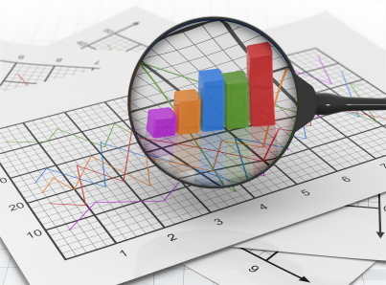
Emerging need and opportunity for research data services
(Connaway and Faniel 2014)
Notes:
Image: http://www.greenbookblog.org/wp-content/uploads/2013/08/Martin-Dec-2010.jpg
Research Data Services
Librarians have been championing the effort, more than other units on campus (Faniel, Connaway, and Parson 2014) (29)
Librarian-led efforts may be partly attributed to the benefits librarians anticipate gaining for themselves as well as the library (Faniel, Connaway, and Parson 2014) (29)
Big opportunities:
developing more personal relationships with the researchers
learning more about current research in their subject areas
providing research data services to faculty & students will help improve service in other aspects of their jobs (instruction & collection development)
Fun, interesting & rewarding
Increase revenue (Connaway and Faniel 2014) (29)
Faniel, Ixchel, Lynn Silipigni Connaway, and Kendra Parson. 2014. 20th Annual Reference Research Forum. Presented at ALA Annual Conference & Exhibition, June 26-July 1, in Las Vegas, NV.
Connaway, Lynn Silipigni, and Ixchel M. Faniel. 2014. Reordering Ranganathan: Shifting user behaviors, shifting priorities. Dublin, OH: OCLC Research. http://www.oclc.org/content/dam/research/publications/library/2014/oclcresearch-reordering-ranganathan-2014.pdf.

Slide 16
Develop the physical and technical infrastructure to deliver materials
Books are for use
(Connaway and Faniel 2014, 51)
Notes:
Image: https://flic.kr/p/k976Ka
#3 Develop the physical and technical infrastructure needed to deliver physical and digital materials, Previously #1 Books are for use
Libraries are customer focused (44)
Offer a wider range of content, systems and services (44)
Ranganathan’s day = books & book lending (44)
“Books are for use” & “every book its reader” are interconnected & build on each other (108)
“Books are for use” pertains to ongoing evaluation & assessment of library’s physical and technical infrastructure in relation to users behaviors & needs (108)
Looking beyond content to infrastructure (access point to content) (108)
Providing content people want depends upon the reliability and integrity of the library’s systems that make it discoverable and accessible (Connaway and Faniel 2014, 108)
Connaway, Lynn Silipigni, and Ixchel M. Faniel. 2014. Reordering Ranganathan: Shifting user behaviors, shifting priorities. Dublin, OH: OCLC Research. http://www.oclc.org/content/dam/research/publications/library/2014/oclcresearch-reordering-ranganathan-2014.pdf.
Ranganathan, Shiyali Ramamrita. 1931. The five laws of library science. London: Edward Goldston, Ltd.

Slide 17
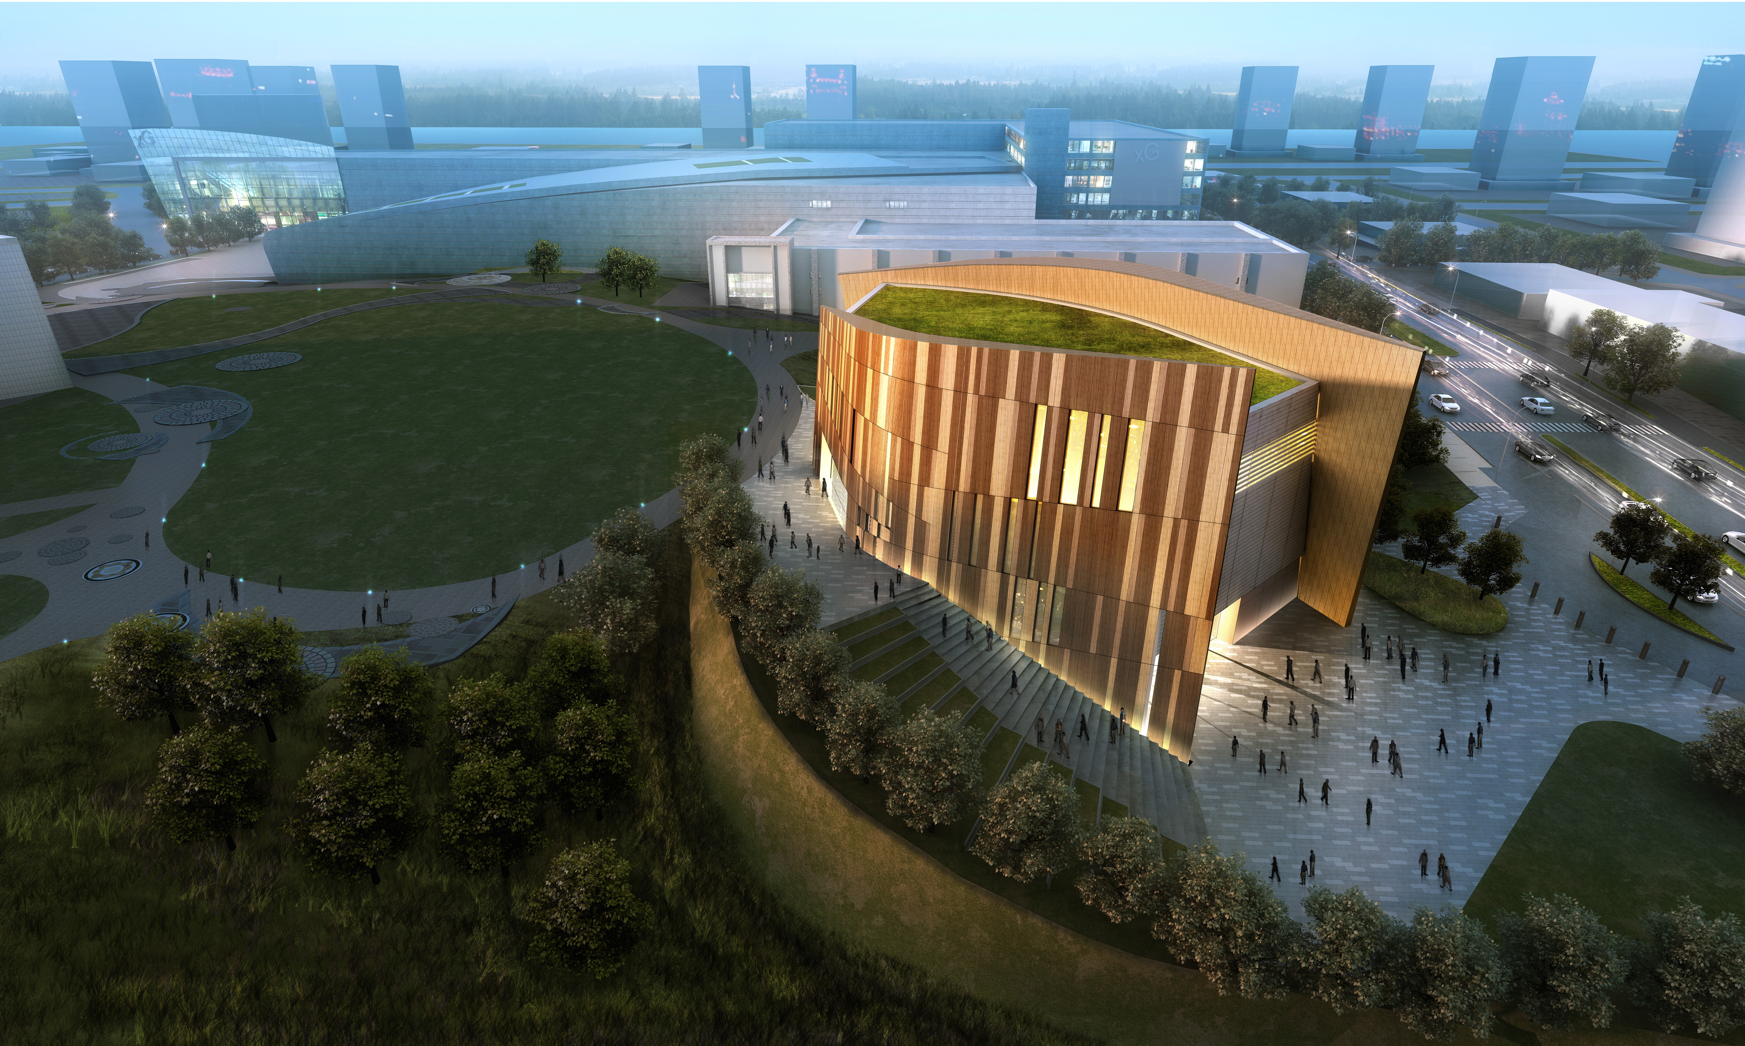
Access & Engagement
Design space for change
Stacks are out, people are in
Break the mold
Change user perceptions
(Connaway and Faniel 2014)
Notes:
Image: http://i1.wp.com/blog.freelon.com/wp-content/uploads/C03-0.jpg
Ranganathan stressed improvements such as library location, hours of operation, space, furniture & staff education & training as he believed they would improve access (48)
Librarians also must actively manage users’ social engagement with experts & peers in virtual environments as well as FtF (48)
Information commons at the University of Southern California & the University of Iowa in the 1990s were early attempts to provide technology-enabled spaces where students could collaborate and seek help from library and computer services staff (Lippincott 2010) (48)
No one size fits all approach (48)
Recent reconfigurations of space have emphasized flexibility in the face of changing and, at times, competing user needs (Pierard and Lee 2011; Sadler 2012) (48)
11-day final exam period at University of North Carolina at Charlotte (Hiebert and Theriault 2012, 540). BLAST:
Bouncing ball activities, such as ping-pong and indoor sponge basketball;
Lounging opportunities in comfortable seating and low tables;
Art activities with coloring books, Play-Doh® and puzzles
Sleep time, including disposable pillows; and
Touch with therapy dogs to cuddle and pet (48-49)
Makerspaces are places where students can access specialist equipment to build, create and craft (49)
By providing physical space and tools, people can share resources and knowledge while engaging in hands-on experimentation (Fisher 2012) (49)
Trust plays a role in the extent to which data are shared and resued (Van House 2002; Yakel et al., “Trust in Digital Repositories,” 2013; Yoon 2013) (50)
Connaway, Lynn Silipigni, and Ixchel M. Faniel. 2014. Reordering Ranganathan: Shifting user behaviors, shifting priorities. Dublin, OH: OCLC Research. http://www.oclc.org/content/dam/research/publications/library/2014/oclcresearch-reordering-ranganathan-2014.pdf. Fisher, Erin. 2012. Makerspaces move into academic libraries. ACRL TechConnect (November 28), http://acrl.ala.org/techconnect/?p=2340.
Hiebert, Jean, and Shelly Theriault. 2012. BLASTing the zombies! Creative ideas to fight finals fatigue. College & Research Libraries News 73, no. 9: 540-69.
Lippincott, Joan K. 2010. A mobile future for academic libraries. Reference Services Review 38, no. 2: 205-213.
Pierard, Cindy, and Norice Lee. 2011. Studying space: Improving space planning with user studies. Journal of Access Services 8: 190-207. Doi: 10.1080/15367967.2011.602258.
Sadler, Shawna. 2012. Session 3: Exploiting space as a distinctive asset. Presented at Libraries rebound: Embracing mission, maximizing impact, June 5-6, in Philadelphia, PA. https://www.
youtube.com/watch?v=AmEtdVPro54&feature=youtu.be.
Van House, Nancy. 2002. Digital libraries and practices of trust: Networked biodiversity information. Social Epistemology: A Journal of Knowledge, Culture and Policy 16, no. 1: 99. Doi:
10.1080/02691720210132833.
Yakel, Elizabeth, Ixchel Faniel, Adam Kriesberg, and Ayoung Yoon. 2013. Trust in digital repositories. The International Journal of Digital Curation 8, no. 1, http://www.ijdc.net/index.php/
ijdc/article/view/8.1.143/303.
Yoon, Ayoung. 2013. End users’ trust in data repositories: Definition and influences on trust development. Archival Science 14, no. 1: 17-34. Doi: 10.1007/s10502-013-9207-8.
Connaway, Lynn Silipigni, and Ixchel M. Faniel. 2014. Reordering Ranganathan: Shifting user behaviors, shifting priorities. Dublin, OH: OCLC Research. http://www.oclc.org/content/dam/research/publications/library/2014/oclcresearch-reordering-ranganathan-2014.pdf

Slide 18
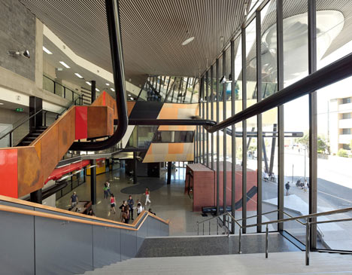
“The message must be clear: the library is genuinely invested in student success and offers the personnel, spaces, technology, and services to achieve it.”
(Hiebert and Theriault 2012, 546)
Notes:
Image:http://static.dezeen.com/uploads/2011/04/dezeen_Central-Institute-of-Technology-by-Lyons-02.jpg
Provide a Warm Transfer
Working FtF with individuals, library staff can increase trust on a personal level & ensure positive future visits (Connaway and Radford 2011).
Demonstrate online systems and services during in-person encounters (Connaway and Radford 2011) (51).
Understand and Internalize User’s Interests
Changes to the technical infrastructure should be negotiated on an ongoing basis (Faniel 2009).
Challenges should be recognized & reconciled during a process that is more inclusive of the users who the changes affect (Faniel 2009).
Installing pop-up chat services on library websites & in online catalogs when users are idle or their search retrieves no sources (Connaway and Radford 2011) (51).
Demonstrate Library Value
Video introductions on the library website or YouTube, linked to the library website, which provides faces and names to connect FtF or virtually (Lippincott and Duckett 2013).
Provide video instruction on how to improve discovery & access through the open Web and how to review search results and determine relevant and authoritative sources (54).
Toot Your Own Horn
Value librarians create made more visible so that librarians’ expertise is identified & internalized (Dempsey 2012).
As librarians engage with the academic community, they can articulate their expertise & new library services.
Study of faculty behavior provided a tremendous opportunity for library outreach by meeting people where they work & socializing while delivering & promoting existing library services (Peters and Dryden 2011) (54).
Leverage the Power of Social Influence
Influence of peers & mentors.
Students interact with friends, fellow students, lecturers, tutors and library staff, in addition to experts and professionals when seeking information (Connaway, Lanclos, and Hood 2013; Connaway and Radford 2011; Diehm and Lupton 2012).
Depends on context & needs.
Offer content, interaction and services in multiple environments and formats.
Physical, on campus presence & virtual, social media & web presence.
People who didn’t use VRS indicated that they would try it if it were recommended by a trusted librarian, colleague or friend (Connaway and Radford 2011).
A similar phenomenon is at work for those seeking data to reuse. More experienced social scientists were found to point novices to data repositories and to influence their future data sharing and reuse behavior (Faniel, Kriesberg, and Yakel 2012; Kriesberg et al. 2013) (54).
Connaway, Lynn Silipigni, and Ixchel M. Faniel. 2014. Reordering Ranganathan: Shifting user behaviors, shifting priorities. Dublin, OH: OCLC Research. http://www.oclc.org/content/dam/research/publications/library/2014/oclcresearch-reordering-ranganathan-2014.pdf.
Hiebert, Jean, and Shelly Theriault. 2012. BLASTing the zombies! Creative ideas to fight finals fatique. College & Research Libraries News 73, no. 9: 540-69.

Slide 19
Increase the discoverability, access and use of resources within users’ existing workflows
Every book its reader
(Connaway and Faniel 2014, 74)
Notes:
Image: https://flic.kr/p/4xQYjH
#4 Increase the discoverability, access and use of resources within users’ existing workflows, Previously #3 Every book its reader
Sometimes “every book” doesn’t mean the book itself (80)
Book can mean pieces and parts of many books, or a blog, comments, videos, presentations and metadata (80)
The right piece of content is always dependent on context, more so now than ever (new powerful discovery and access tools) (80)
New reordering of this law is dependent on the provision of resources and systems (108)
Human sources still play a huge role in users’ information activities (108)
Opportunities to become part of users’ social networks & put resources in context of users’ information needs (108)
Connaway, Lynn Silipigni, and Ixchel M. Faniel. 2014. Reordering Ranganathan: Shifting user behaviors, shifting priorities. Dublin, OH: OCLC Research. http://www.oclc.org/content/dam/research/publications/library/2014/oclcresearch-reordering-ranganathan-2014.pdf
Ranganathan, Shiyali Ramamrita. 1931. The five laws of library science. London: Edward Goldston, Ltd.

Slide 20
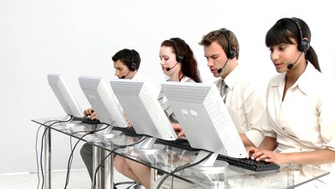
Connecting “Every Book”
Understanding the flow and workflow
Acknowledging the role of online social interaction
Paying more attention to context
(Connaway and Faniel 2014)
Notes:
Image: http://ak8.picdn.net/shutterstock/videos/657118/preview/stock-footage-business-people-working-in-a-call-center-against-a-white-background.jpg
User-Workflows
Tools that communities use to address their own needs have changed in recent decades (69)
Some tools are more universal—information seekers in general tend to show heavy use of Web information sources, such as Wikipedia and Google (Connaway and Dickey 2010; Connaway, Prabha, and Dickey 2006; Head and Eisenberg 2010; Prabha, Connaway, and Dickey 2006) (69)
College students rate libraries significantly higher than all respondents in terms of lifestyle fit, for both online and for physical libraries (De Rosa et al. 2006) (69)
The issue is that the library’s Facebook pages, Twitter streams and blog posts are not part of the users’ workflow in the same way as Google or Wikipedia (Connaway, Lanclos, and Hood 2013a, 2013b) (71)
Several academic libraries have increased discovery of their collections by adding links to Wikipedia (Elder, Westrbook, and Reilly 2012; Lally and Dunford 2007; Szajewski 2013) (71)
Social Connections
Learning has always been social (72)
Dervin, Reinhard, Kerr, Song, and Shen (2006) make the case that both faculty and students tend to turn toward peers in terms of information-seeking behavior (72)
We have found the same trend in our studies of user behavior: faculty turns to co-workers and colleagues; graduate students turn to peers, instructors, and advisors; undergraduates to their friends and peers (Connaway and Dickey 2010; Connaway, Lanclos, and Hood 2013a, 2013b; Dervin et al. 2006; Faniel, Kriesberg, and Yakel 2012; Kriesberg et al. 2013; Yakel et al., “Trust in Digital Repositories,” 2013) (72)
Seeing as convenience is known as the most significant factor in choosing among information sources, the most natural first step for information seeking is to ask the people with whom you’re already in contact (Radford and Connaway 2008) (72)
Connaway, Lynn Silipigni, and Ixchel M. Faniel. 2014. Reordering Ranganathan: Shifting user behaviors, shifting priorities. Dublin, OH: OCLC Research. http://www.oclc.org/content/dam/research/publications/library/2014/oclcresearch-reordering-ranganathan-2014.pdf.

Slide 21
Notes:
Complex Content
Important to provide the context in order for users to make decisions given a rich and complicated information environment (73)
Evidence of this in the academic community in which researchers are increasingly reusing each other’s data (Carlson and Anderson 2007; Faniel and Jacobsen 2010; Faniel et al. 2013; Faniel, Kriesberg, and Yakel 2012; Rolland and Lee 2013; Zimmerman 2008) (73)
Librarians, as info. professionals need to provide services that not only connect more dots but also make access to deeper, more authoritative sources of context available in ways that users can adopt into their workflows (74)
Users can’t discern whether the content that rises to the top of a search engine result is relevant and trustworthy enough to meet the needs of their circumstances (74)
Their ability to select credible materials and to help discern which content is best given a particular user’s needs is missing from the search engine equation (74)
Connaway, Lynn Silipigni, and Ixchel M. Faniel. 2014. Reordering Ranganathan: Shifting user behaviors, shifting priorities. Dublin, OH: OCLC Research. http://www.oclc.org/content/dam/research/publications/library/2014/oclcresearch-reordering-ranganathan-2014.pdf.

Slide 22
Notes:
Carlson, Samuelle, and Ben Anderson. 2007. What are data? The many kinds of data and their implications for data re-use. Journal of Computer-Mediated Communication 12, no. 2: 635–61. Doi: 10.1111/j.1083-6101.2007.00342.
Connaway, Lynn Silipigni, and Timothy J. Dickey. 2010. The digital information seeker: Report of findings from selected OCLC, RIN, and JISC user behavior projects. n.p.: Higher Education Funding Council for England (HEFCE). http://www.jisc.ac.uk/media/documents/publications/reports/2010/digitalinformationseekerreport.pdf.
Connaway, Lynn Silipigni, Donna Lanclos, and Erin M. Hood. 2013a. “I always stick with the first thing that comes up on Google…” Where people go for information, what they use, and why.
EDUCAUSE Review Online (December 6), http://www.educause.edu/ero/article/i-always-stick-first-thing-comes-google-where-people-go-information-what-they-use-and-why.
Connaway, Lynn Silipigni, Donna Lanclos, and Erin M. Hood. 2013b. “I find Google a lot easier than going to the library website.” Imagine ways to innovate and inspire students to use the academic library. Proceedings of the Association of College & Research Libraries (ACRL) 2013 conference, April 10-13, 2013, Indianapolis, IN. Chicago: Association of College & Research Libraries. http://www.ala.org/acrl/sites/ala.org.acrl/files/content/conferences/confsandpreconfs/2013/papers/Connaway_Google.pdf.
Connaway, Lynn Silipigni, Chandra Prabha, and Timothy J. Dickey. 2006. Sense-making the information confluence: The whys and hows of college and university user satisficing of information needs. Phase III: Focus group interview study. Report on National Leadership Grant LG-02-03-0062-03, to Institute of Museum and Library Services, Washington, DC. Columbus, OH: School of Communication, The Ohio State University.
De Rosa, Cathy, Joanne Cantrell, Janet Hawk, and Alane Wilson. 2006. College students’ perceptions of libraries and information resources: A report to the OCLC Membership. Dublin, OH: OCLC Online Computer Library Center.
Dervin, Brenda, CarrieLynn D. Reinhard, Zack Y. Kerr, Mei Song, and Fei C. Shen. 2006. Sensemaking the information confluence: The whys and hows of college and university User satisficing
of information needs. Phase II: Sense-making online survey and phone interview study. Report on National Leadership Grant LG-02-03-0062-03 to Institute of Museum and Library Services,
Washington, DC. Columbus, OH: School of Communication, Ohio State University.
Elder, Danielle, R. Niccole Westbrook, and Michele Reilly. 2012. Wikipedia lover, not a hater: Harnessing Wikipedia to increase the discoverability of library resources. Journal of Web
Librarianship 6, no. 1: 32-44. DOI:10.1080/19322909.2012.641808.
Faniel, Ixchel M., and Trond E. Jacobsen. 2010. Reusing scientific data: How earthquake engineering researchers assess the reusability of colleagues’ data. Computer Supported
Cooperative Work 19, no. 3-4: 355-75.
Faniel, Ixchel, Eric Kansa, Sarah Whitcher Kansa, Julianna Barrera-Gomez, and Elizabeth Yakel. 2013. The challenges of digging data: A study of context in archaeological data reuse. In JCDL 2013 Proceedings of the 13th ACM/IEEE-CS Joint Conference on Digital Libraries, 295-304. New York: ACM. http://dx.doi.org/10.1145/2467696.2467712.
Faniel, Ixchel M., Adam Kriesberg, and Elizabeth Yakel. 2012. Data reuse and sensemaking among novice social scientists. Paper presented at the annual meeting of the American Society for
Information Science and Technology, October 26-31, in Baltimore, MD.
Head, Alison J., and Michael B. Eisenberg. 2010. How college students evaluate and use information in the digital age. Project Information Literacy progress report. Seattle: The Information
School, University of Washington.
Kriesberg, Adam, Rebecca D. Frank, Ixchel M. Faniel, and Elizabeth Yakel. 2013. The role of data reuse in the apprenticeship process. ASIST 2013, November 1-6, 2013, Montreal, Quebec, Canada.
Lally, Ann M., and Carolyn E. Dunford. 2007. Using Wikipedia to extend digital collections. D-Lib Magazine 13, no. 5/6, http://www.dlib.org/dlib/may07/lally/05lally.html.
Prabha, Chandra, Lynn Silipigni Connaway, and Timothy J. Dickey. 2006. Sense-making the information confluence: The whys and hows of college and university user satisficing of information needs. Phase IV: Semi-structured interview study. Report on National Leadership Grant LG-02-03-0062-03, to Institute of Museum and Library Services, Washington, DC. Columbus, OH: School of Communication, The Ohio State University.
Radford, Marie L., and Lynn Silipigni Connaway. 2008. Seeking synchronicity: Evaluating virtual reference services from user, non-user, and librarian perspectives: IMLS final performance report. Report on Grant LG-06-05-0109-05, to Institute of Museum and Library Services, Washington, DC. Dublin, OH: OCLC Online Computer Library Center.
Rolland, Betsy, and Charlotte P. Lee. 2013. Beyond trust and reliability: Reusing data in collaborative cancer epidemiology research. In Collaboration and sharing in scientific work, 435–
44. New York: ACM.
Szajewski, Michael. 2013. Using Wikipedia to enhance the visibility of digitized archival assets. D-Lib Magazine 19, no. 3/4, http://www.dlib.org/dlib/march13/szajewski/03szajewski.html.
Yakel, Elizabeth, Ixchel Faniel, Adam Kriesberg, and Ayoung Yoon. 2013. Trust in digital repositories. The International Journal of Digital Curation 8, no. 1, http://www.ijdc.net/index.php/ ijdc/article/view/8.1.143/303.
Zimmerman, Ann S. 2008. New knowledge from old data: The role of standards in the sharing and reuse of ecological data. Science, Technology & Human Values 33, no. 5: 631–52. Doi:10.1177/0162243907306704.
Connaway, Lynn Silipigni, and Ixchel M. Faniel. 2014. Reordering Ranganathan: Shifting user behaviors, shifting priorities. Dublin, OH: OCLC
Research. http://www.oclc.org/content/dam/research/publications/library/2014/oclcresearch-reordering-ranganathan-2014.pdf.

Slide 23
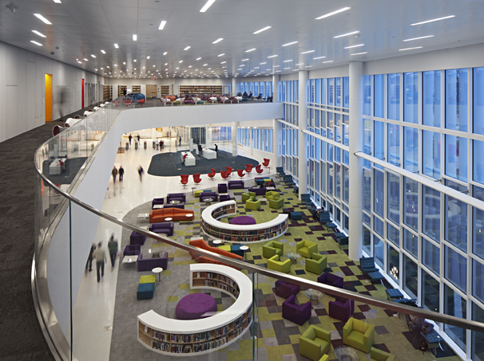
“Surprise is continually expressed when the public discover the width of [the library’s] service and the catholicity of its interests. ‘I didn’t know that you had…’”
(Ranganathan 1931, 315-16)
Notes:
Image:http://assets.inhabitat.com/wp-content/blogs.dir/1/files/2013/04/Snohetta-Hunt-Library-Mark-Herboth4.jpg
Increase Discoverability through Partnerships
Becoming discoverable in workflows:
• Working with technology companies to expose library metadata into more & vastly different user workflows (77)
• Teaming with logistics companies to solve issues of shared print collections, such as transportation and delivery of physical materials (77)
• Reaching out through academic communities to the professional organizations and industries that serve and are served by them in order to understand their challenges (77)
• Making library data compatible with other formats, such as linked data (77)
• Offering library resources—whether expertise, bandwidth, physical space or networking opportunities—to business leaders (77)
Increase Access through Redundancy
Approaching materials or services: “How can this be leveraged such that we can deliver it in multiple ways”? (78)
Librarians should link to more than pages in the online library catalog when giving reading lists, open source (78)
Audio access of books, Link to reviews written on Amazon, Facebook pages, Twitter accounts (78)
Provide physical space in online environments, too (78)
Online library catalog and website available on multiple platforms and tablet-and mobile-friendly (78)
Librarians should let users know about alternatives to the library’s offerings; such as local book stores, subject-matter experts, listservs, Facebook groups, etc. (78)
Increase Marketing through Social Networking
When advertising is well done, it works (79)
Make services as socially shareable as possible (79)
Libraries must compete with many other sources for attention (80)
Connaway, Lynn Silipigni, and Ixchel M. Faniel. 2014. Reordering Ranganathan: Shifting user behaviors, shifting priorities. Dublin, OH: OCLC Research. http://www.oclc.org/content/dam/research/publications/library/2014/oclcresearch-reordering-ranganathan-2014.pdf.
Ranganathan, Shiyali Ramamrita. 1931. The five laws of library science. London: Edward Goldston, Ltd.

Slide 24
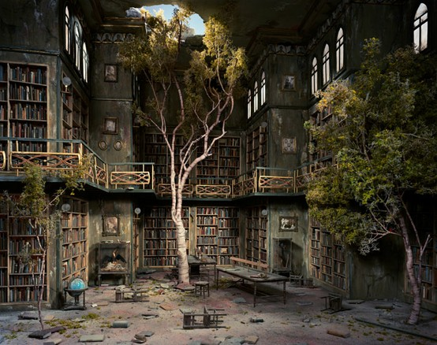
A library is a growing organism
(Connaway and Faniel 2014, 92)
Notes:
Image: http://img.4plebs.org/boards/tg/image/1376/94/1376945868144.jpg
#5 A library is a growing organism, Previously # 5 A library is a growing organism (88)
Three factors Ranganathan considered books, staff, and readers as major parts of library, capable of growth (88)
Ranganathan: Growth or change in one factor meant growth or change in the others (88)
Our interpretation of 5th law does not include a rephrasing or reinterpretation, but we propose additional factor for libraries to consider: share of attention (88)
Evaluate relevance, visibility & unique capabilities (108)
Essential to growth & change of traditional factors—collection, staff, infrastructure and patron use (108)
Not only are collections growing in size and type, but library staff is experiencing growth by retooling existing skills, hiring new people with new areas of expertise and changing users’ perceptions of librarians’ capabilities (108)
The question is whether supply is meeting demand (90)
In a survey of library directors, 52% reassigned or were planning to reassign staff to support research data services compared to 28% who hired or were planning to hire new staff (Tenopir, Birch, and Allard 2012) (90)
The latter are likely relying on new library and information science graduates of data curation programs at major universities (Harris-Pierce and Liu 2012; Palmer et al. 2013) and the two year post-doctoral fellowship program being offered by the Council on Library and Information Resources” (CLIR) (Keralis 2012) (90)
Changing infrastructure & patron use (108)
Growth within shifting contexts means growing whatever elements of collection, staff, infrastructure and patron use that are currently part of our users’ expectations (91)
Definitions of library services will change. We need to grow the ways users can engage with whatever they value from libraries, whether papyrus rolls, makerspaces or data management instruction (91)

Slide 25
Notes:
Council on Library and Information Resources. 1998. CLIR issues. Washington, DC: Council on Library and Information Resources.
Huler, Scott. 2014. Raleigh’s 50 foot librarian: Hunt Library. Our State (March), http://www.ourstate.com/hunt/.
Keralis, Spencer D. C. 2012. Data curation education: A snapshot. In The problem of data, by Lori Jahnke, Andrew Asher, and Spencer D. C. Keralis, 32-39. Washington, DC: Council on Library and Information Resources.
Millar, Erin. 2013. The university library of the future. The Globe and Mail (October 22), http://www.theglobeandmail.com/news/national/education/canadian-university-report/the-university-libraryof-the-future/article14980161/
Palmer, Carole L., Andrea K. Thomer, Karen S. Baker, Karen M. Wickett, Virgil Varvel, Sayeed Choudhury, Timothy DiLauro, Bruce Fouke, Abigail E. Asangba, and Ann Rodman. 2013. "Building a framework for site-based data curation". Proceedings of the American Society for Information Science and Technology. 50 (1): 1-4.
Ranganathan, Shiyali Ramamrita. 1931. The five laws of library science. London: Edward Goldston, Ltd.
Rock, Margaret. 2013. The future of libraries: Short on books, long on tech. Time (June 25), http://techland.time.com/2013/06/25/the-future-of-libraries-short-on-books-long-on-tech/.
Sadler, Shawna. 2012. Session 3: Exploiting space as a distinctive asset. Presented at Libraries rebound: Embracing mission, maximizing impact, June 5-6, in Philadelphia, PA. https://www.
youtube.com/watch?v=AmEtdVPro54&feature=youtu.be.
Tenopir, Carol, Ben Birch, and Suzie Allard. 2012. Academic libraries and research data services: Current practices and plans for the future. An ACRL white paper. Chicago: Association of College and Research Libraries.
Connaway, Lynn Silipigni, and Ixchel M. Faniel. 2014. Reordering Ranganathan: Shifting user behaviors, shifting priorities. Dublin, OH: OCLC Research. http://www.oclc.org/content/dam/research/publications/library/2014/oclcresearch-reordering-ranganathan-2014.pdf.

Slide 26
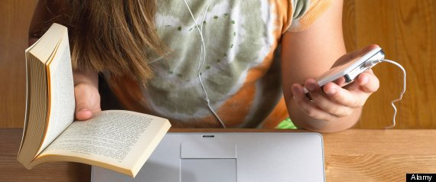
“We propose another major area of a library that is capable of growth: share of attention.”
(Connaway and Faniel 2014, 92)
Notes:
Image: http://31.media.tumblr.com/115230e4c3d9e371c8b7b4f16107e219/tumblr_mhelksZv9W1qaqu9io1_1280.jpg
Share of attention essential to promoting growth & change across all dimensions—collection, staff, infrastructure, patron use.
Nurture growth through:
Relevance
Visibility
Unique Capabilities
Ranganathan, Shiyali Ramamrita. 1931. The five laws of library science. London: Edward Goldston, Ltd.

Slide 27
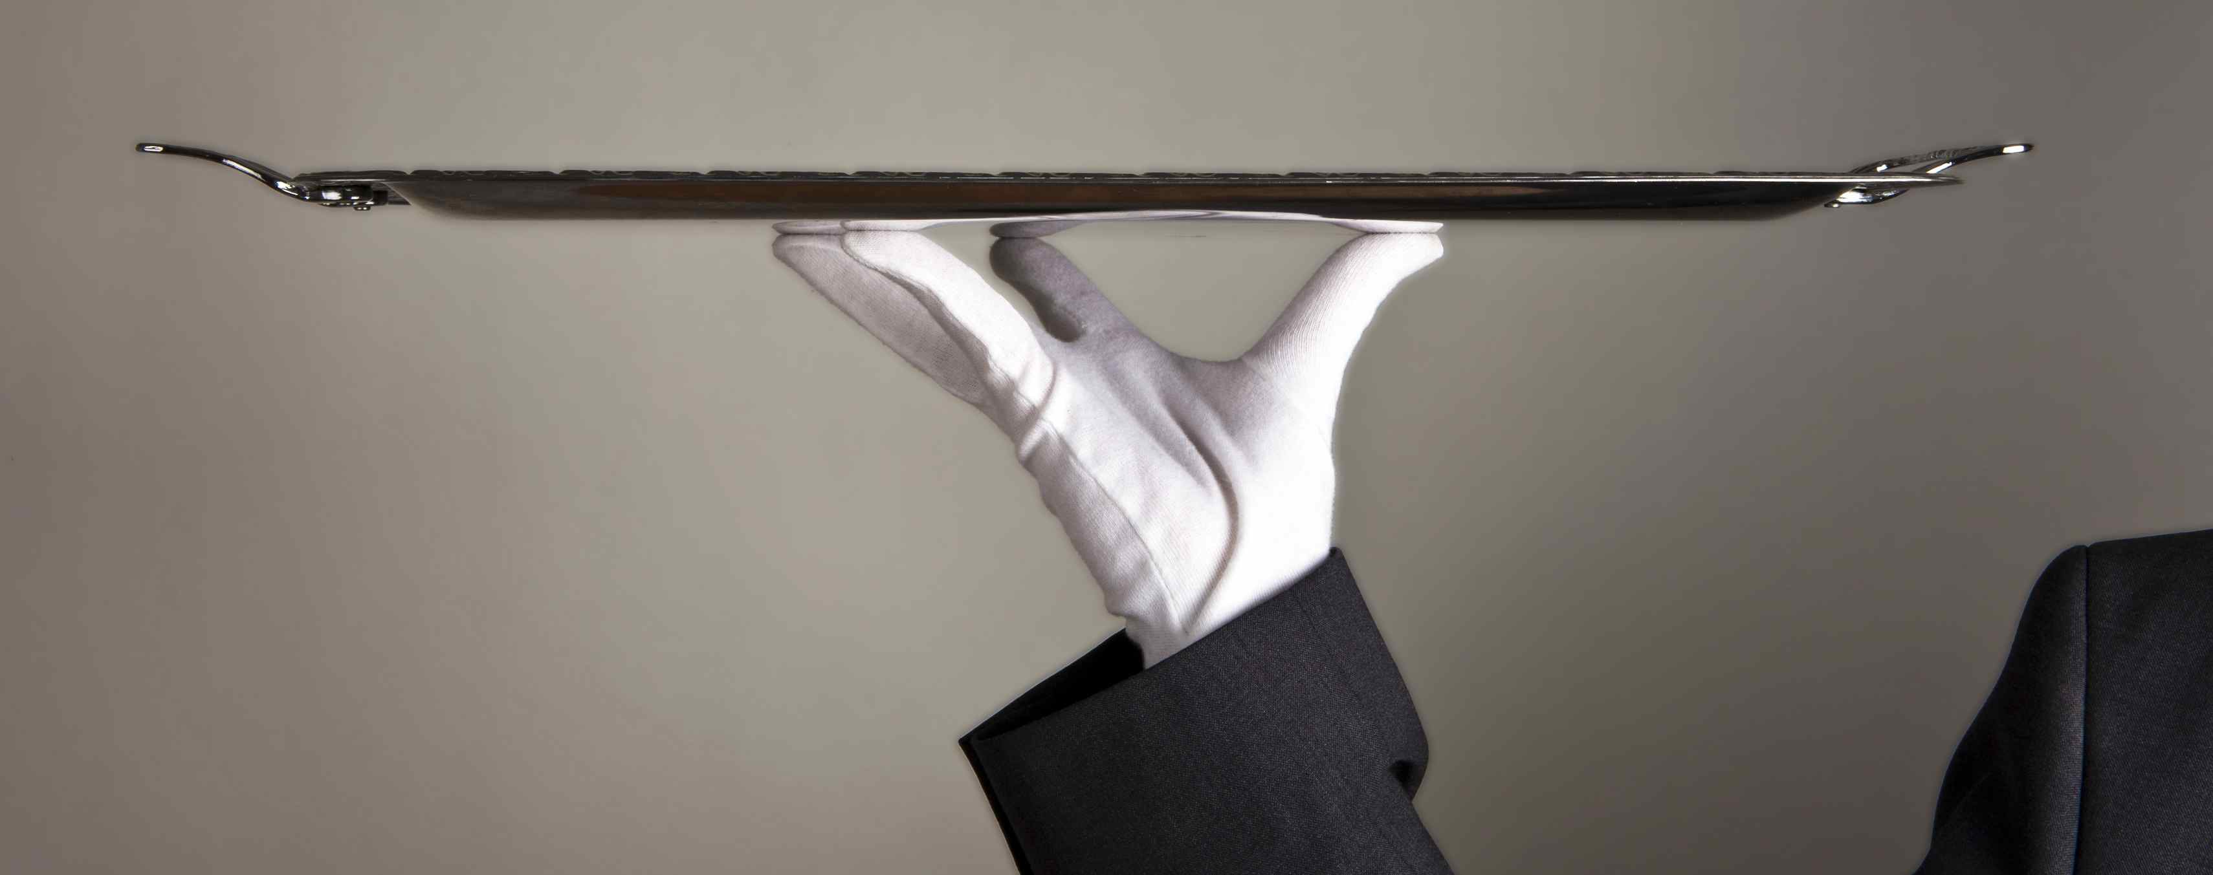
“…change is a constant, and we need to learn to deal with it. No matter what type of library you’re in or what you do in it, it’s important to remember that you are in a service industry.”
(Glassmeyer 2010, 24)
Notes:
Image: http://www.ellington-nice.com/wp-content/uploads/2012/03/SERVICE-EXCEPTION-HOTEL-ELLINGTON-NICE-%C2%A9-ThorstenSchmitt.jpg
Relevance
Current tool use (95)
Real world use (96)
Visibility
Connections from their most used services (96)
Connections to their most used services (96)
Connections with other librarians (96)
Unique Capabilities
Cross-selling activities (97)
Relationships & outcomes (97)
Physical & virtual space (97)
Librarian expertise (97)
Being nice (97)
Connaway, Lynn Silipigni, and Ixchel M. Faniel. 2014. Reordering Ranganathan: Shifting user behaviors, shifting priorities. Dublin, OH: OCLC Research. http://www.oclc.org/content/dam/research/publications/library/2014/oclcresearch-reordering-ranganathan-2014.pdf.
Glassmeyer, Sarah. 2010. Ranganathan 2.0. ALL Spectrum 14, no. 3:22-24.

Slide 28
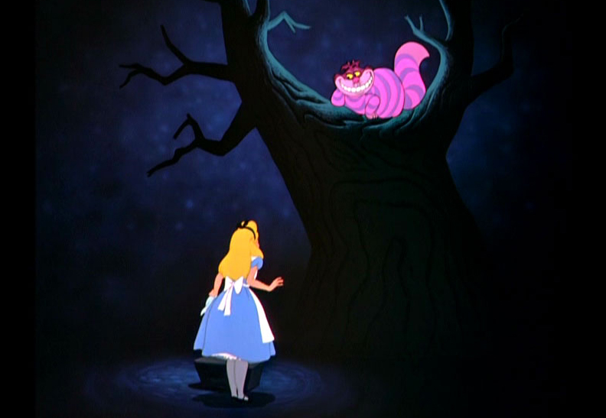
“‘…would you tell me, please, which way I ought to walk from here?’
‘That depends a good deal on where you want to get to,’ said the Cat.
‘I don’t much care where—’ said Alice.”
(Carroll [19--?], 66)
Notes:
Image: http://www.valuesbasedleader.com/wp-content/uploads/2013/04/Alice-and-Cheshire-cat.jpg
“Because, in the words of the Cheshire Cat, it helps to know “where you want to get to” as you proceed through unfamiliar or changing terrain. For us, these laws will continue to serve as a sign post” (Connaway and Faniel 2014, 108).
Carroll, Lewis. [19--?]. Alice’s adventures in Wonderland; and, Through the looking-glass and what Alice found there. Illustrated by John Tenniel. New York: Hurst. http://hdl.handle.net/2027/nc01. ark:/13960/t6446qh74.
Connaway, Lynn Silipigni, and Ixchel M. Faniel. 2014. Reordering Ranganathan: Shifting user behaviors, shifting priorities. Dublin, OH: OCLC Research. http://www.oclc.org/content/dam/research/publications/library/2014/oclcresearch-reordering-ranganathan-2014.pdf.

Slide 29
Acknowledgements
Without the help of Andy Havens, Brad Gauder and Tom Storey for their insightful contributions and valuable feedback; Julianna Barrera-Gomez, Alyssa Darden, Erin M. Hood and Carrie Vass for their dedicated research support; Tam Dalrymple, Larry Olszewski and Jennifer Smither for their thoughtful comments; and Renee Page for her talented design and layout expertise, it would have been difficult to make this report a reality.

Slide 30
Funding
A Cyberinfrastructure Evaluation of the George E. Brown, Jr. Network for Earthquake Engineering Simulation (NEES), funded by the National Science Foundation (CMMI-0714116)
The Cyber Synergy: Seeking Sustainability through Collaboration between Virtual Reference and Social Q&A Sites, funded by the Institution of Museum and Library Services (LG-06-11-0342-11) in collaboration with OCLC Research, and Rutgers, The State University of New Jersey
The Digital Information Seeker Report, jointly sponsored by Jisc and OCLC Research
The Digital Visitors and Residents: What Motivates Engagement with the Digital Information Environment? project, funded by Jisc in collaboration with the University of Oxford, OCLC Research, and the University of North Carolina
The Dissemination Information Packages for Information Reuse (DIPIR) project, funded by the Institute for Museum and Library Services (LG-06-10-0140-10) in collaboration with the University of Michigan
The Seeking Synchronicity: Evaluating Virtual Reference Services from User, Non-user and Librarian Perspectives, funded by the Institution of Museum and Library Services (LG-06-05-0109-05) in collaboration with OCLC Research, and Rutgers, The State University of New Jersey
The Virtual Research Environment (VRE) Study, which was a collaborative project between Jisc and OCLC Research

Slide 31
References
Calhoun, Karen, Joanne Cantrell, Peggy Gallagher, and Janet Hawk. 2009. Online catalogs: What users and librarians want: An OCLC report. Dublin, OH: OCLC.
Carlson, Samuelle, and Ben Anderson. 2007. What are data? The many kinds of data and their implications for data re-use. Journal of Computer-Mediated Communication 12, no. 2: 635–61. Doi: 10.1111/j.1083-6101.2007.00342.
Carroll, Lewis. [19--?]. Alice’s adventures in Wonderland; and, Through the looking-glass and what Alice found there. Illustrated by John Tenniel. New York: Hurst. http://hdl.handle.net/2027/nc01. ark:/13960/t6446qh74.
Council on Library and Information Resources. 1998. CLIR issues. Washington, DC: Council on Library and Information Resources.
Connaway, Lynn Silipigni. 2008. Make room for the Millennials. NextSpace 10: 18-19. http://www.oclc.org/nextspace/010/research.htm.
Connaway, Lynn Silipigni. 2013b. Why the internet is more attractive than the library. The Serials Librarian 64, no. 1-4: 41-56.
Connaway, Lynn Silipigni, and Timothy J. Dickey. 2010. The digital information seeker: Report of findings from selected OCLC, RIN, and JISC user behavior projects. n.p.: Higher Education Funding Council for England (HEFCE). http://www.jisc.ac.uk/media/documents/publications/reports/2010/digitalinformationseekerreport.pdf.
Connaway, Lynn Silipigni, Timothy J. Dickey, and Marie L. Radford. 2011. “If it is too inconvenient I’m not going after it:” Convenience as a critical factor in information-seeking behaviors. Library & Information Science Research 33, no. 3: 179-90. http://www.oclc.org/content/dam/research/publications/library/2011/connaway-lisr.pdf.
Connaway, Lynn Silipigni, and Ixchel M. Faniel. 2014. Reordering Ranganathan: Shifting user behaviors, shifting priorities. Dublin, OH: OCLC Research. http://www.oclc.org/content/dam/research/publications/library/2014/oclcresearch-reordering-ranganathan-2014.pdf

Slide 32
References
Connaway, Lynn Silipigni, Donna Lanclos, and Erin M. Hood. 2013a. “I always stick with the first thing that comes up on Google…” Where people go for information, what they use, and why. EDUCAUSE Review Online (December 6), http://www.educause.edu/ero/article/i-always-stick-first-thing-comes-google-where-people-go-information-what-they-use-and-why.
Connaway, Lynn Silipigni, Donna Lanclos, and Erin M. Hood. 2013b. “I find Google a lot easier than going to the library website.” Imagine ways to innovate and inspire students to use the academic library. Proceedings of the Association of College & Research Libraries (ACRL) 2013 conference, April 10-13, 2013, Indianapolis, IN. Chicago: Association of College & Research Libraries. http://www.ala.org/acrl/sites/ala.org.acrl/files/content/conferences/confsandpreconfs/2013/papers/Connaway_Google.pdf.
Connaway, Lynn Silipigni, Donna Lanclos, David White, Alison Le Cornu, and Erin M. Hood. 2013. User-centered decision making: A new model for developing academic library services and systems. IFLA Journal 39, no. 1: 30-36.
Connaway, Lynn Silipigni, Chandra Prabha, and Timothy J. Dickey. 2006. Sense-making the information confluence: The whys and hows of college and university user satisficing of information needs. Phase III: Focus group interview study. Report on National Leadership Grant LG-02-03-0062-03, to Institute of Museum and Library Services, Washington, DC. Columbus, OH: School of Communication, The Ohio State University.
Connaway, Lynn Silipigni, and Marie L. Radford. 2007. Service sea change: Clicking with screenagers through virtual reference. In Sailing into the future: Charting our destiny: Proceedings of the Thirteenth National Conference of the Association of College and Research Libraries, March 29-April 1, 2007, Baltimore, Maryland, edited by Hugh A. Thompson. Chicago: Association of College and Research Libraries. http://www.oclc.org/research/publications/archive/2007/connaway-acrl.pdf

Slide 33
References
Connaway, Lynn Silipigni, and Marie L. Radford. 2011. Seeking synchronicity: Revelations and recommendations for virtual reference. Dublin, OH: OCLC Research. http://www.oclc.org/reports/synchronicity/full.pdf.
Connaway, Lynn Silipigni, Marie L. Radford, Timothy J. Dickey, Jocelyn De Angelis Williams, and Patrick Confer. 2008. Sense-making and synchronicity: Information-seeking behaviors of Millennials and Baby Boomers. Libri 58, no. 2: 123-35. http://www.oclc.org/resources/research/publications/library/2008/connaway-libri.pdf.
Connaway, Lynn Silipigni, and Simon Wakeling. 2012. To use or not to use WorldCat.org: An international perspective from different user groups. Unpublished report, April 26.
Connaway, Lynn Silipigni, David White, Donna Lanclos, and Alison Le Cornu. 2013. Visitors and Residents: What motivates engagement with the digital information environment? Information Research 18, no. 1, http://informationr.net/ir/18-1/infres181.html.
Dempsey, Lorcan. 2012. Thirteen ways of looking at libraries, discovery, and the catalog: Scale, workflow, attention. EDUCAUSE Review Online (December 10, 2012), http://www.educause.edu/ero/article/thirteen-ways-looking-libraries-discovery-and-catalog-scale-workflow-attention.
De Rosa, Cathy, Joanne Cantrell, Diane Cellentani, Janet Hawk, Lillie Jenkins, and Alane Wilson. 2005. Perceptions of libraries and information resources: A report to the OCLC Membership. Dublin, OH: OCLC Online Computer Library Center.
De Rosa, Cathy, Joanne Cantrell, Janet Hawk, and Alane Wilson. 2006. College students’ perceptions of libraries and information resources: A report to the OCLC Membership. Dublin, OH: OCLC Online Computer Library Center.
Dervin, Brenda, CarrieLynn D. Reinhard, Zack Y. Kerr, Mei Song, and Fei C. Shen. 2006. Sensemaking the information confluence: The whys and hows of college and university User satisficing of information needs. Phase II: Sense-making online survey and phone interview study. Report on National Leadership Grant LG-02-03-0062-03 to Institute of Museum and Library Services, Washington, DC. Columbus, OH: School of Communication, Ohio State University.

Slide 34
References
Elder, Danielle, R. Niccole Westbrook, and Michele Reilly. 2012. Wikipedia lover, not a hater: Harnessing Wikipedia to increase the discoverability of library resources. Journal of Web Librarianship 6, no. 1: 32-44. DOI:10.1080/19322909.2012.641808.
Faniel, Ixchel, Lynn Silipigni Connaway, and Kendra Parson. 2014. 20th Annual Reference Research Forum. Presented at ALA Annual Conference & Exhibition, June 26-July 1, in Las Vegas, NV.
Faniel, Ixchel M., and Trond E. Jacobsen. 2010. Reusing scientific data: How earthquake engineering researchers assess the reusability of colleagues’ data. Computer Supported Cooperative Work 19, no. 3-4: 355-75.
Faniel, Ixchel, Eric Kansa, Sarah Whitcher Kansa, Julianna Barrera-Gomez, and Elizabeth Yakel. 2013. The challenges of digging data: A study of context in archaeological data reuse. In JCDL 2013 Proceedings of the 13th ACM/IEEE-CS Joint Conference on Digital Libraries, 295-304. New York: ACM. http://dx.doi.org/10.1145/2467696.2467712.
Faniel, Ixchel M., Adam Kriesberg, and Elizabeth Yakel. 2012. Data reuse and sensemaking among novice social scientists. Paper presented at the annual meeting of the American Society for Information Science and Technology, October 26-31, in Baltimore, MD.
Fisher, Erin. 2012. Makerspaces move into academic libraries. ACRL TechConnect (November 28), http://acrl.ala.org/techconnect/?p=2340.
Glassmeyer, Sarah. 2010. Ranganathan 2.0. ALL Spectrum 14, no. 3:22-24.
Head, Alison J., and Michael B. Eisenberg. 2010. How college students evaluate and use information in the digital age. Project Information Literacy progress report. Seattle: The Information School, University of Washington
Hiebert, Jean, and Shelly Theriault. 2012. BLASTing the zombies! Creative ideas to fight finals fatigue. College & Research Libraries News 73, no. 9: 540-69.

Slide 35
References
Huler, Scott. 2014. Raleigh’s 50 foot librarian: Hunt Library. Our State (March), http://www.ourstate.com/hunt/.
Jisc. 2014. Make your digital resources easier to discover. Quickguide. http://www.jisc.ac.uk/guides/make-your-digital-resources-easier-to-discover.
Keralis, Spencer D. C. 2012. Data curation education: A snapshot. In The problem of data, by Lori Jahnke, Andrew Asher, and Spencer D. C. Keralis, 32-39. Washington, DC: Council on Library and Information Resources.
Kriesberg, Adam, Rebecca D. Frank, Ixchel M. Faniel, and Elizabeth Yakel. 2013. The role of data reuse in the apprenticeship process. ASIST 2013, November 1-6, 2013, Montreal, Quebec, Canada.
Lally, Ann M., and Carolyn E. Dunford. 2007. Using Wikipedia to extend digital collections. D-Lib Magazine 13, no. 5/6, http://www.dlib.org/dlib/may07/lally/05lally.html.
Lippincott, Joan K. 2010. A mobile future for academic libraries. Reference Services Review 38, no. 2: 205-213.
Millar, Erin. 2013. The university library of the future. The Globe and Mail (October 22), http://www.theglobeandmail.com/news/national/education/canadian-university-report/the-university-libraryof-the-future/article14980161/.
Noruzi, Alireza. 2004. Application of Ranganathan’s Laws to the web. Webology 1, no. 2, http://www.webology.org/2004/v1n2/a8.html.
Oblinger, Diana G., and James L. Oblinger, eds. 2005. Educating the net generation. Boulder: EDUCAUSE. http://www.educause.edu/content.asp?PAGE_ID=5989&bhcp=1.
Palmer, Carole L., Andrea K. Thomer, Karen S. Baker, Karen M. Wickett, Virgil Varvel, Sayeed Choudhury, Timothy DiLauro, Bruce Fouke, Abigail E. Asangba, and Ann Rodman. 2013. "Building a framework for site-based data curation". Proceedings of the American Society for Information Science and Technology. 50 (1): 1-4.
Pierard, Cindy, and Norice Lee. 2011. Studying space: Improving space planning with user studies. Journal of Access Services 8: 190-207. Doi: 10.1080/15367967.2011.602258.

Slide 36
References
Prabha, Chandra, Lynn Silipigni Connaway, and Timothy J. Dickey. 2006. Sense-making the information confluence: The whys and hows of college and university user satisficing of information needs. Phase IV: Semi-structured interview study. Report on National Leadership Grant LG-02-03-0062-03, to Institute of Museum and Library Services, Washington, DC. Columbus, OH: School of Communication, The Ohio State University.
Pullinger, David. 1999. Academics and the new information environment: The impact of local factors on use of electronic journals. Journal of Information Science 25, no. 2: 164-72.
Radford, Marie L., and Lynn Silipigni Connaway. 2008. Seeking synchronicity: Evaluating virtual reference services from user, non-user, and librarian perspectives: IMLS final performance report. Report on Grant LG-06-05-0109-05, to Institute of Museum and Library Services, Washington, DC. Dublin, OH: OCLC Online Computer Library Center.
Ranganathan, Shiyali Ramamrita. 1931. The five laws of library science. London: Edward Goldston, Ltd.
Rock, Margaret. 2013. The future of libraries: Short on books, long on tech. Time (June 25), http://techland.time.com/2013/06/25/the-future-of-libraries-short-on-books-long-on-tech/.
Rolland, Betsy, and Charlotte P. Lee. 2013. Beyond trust and reliability: Reusing data in collaborative cancer epidemiology research. In Collaboration and sharing in scientific work, 435–44. New York: ACM.
Sadler, Shawna. 2012. Session 3: Exploiting space as a distinctive asset. Presented at Libraries rebound: Embracing mission, maximizing impact, June 5-6, in Philadelphia, PA. https://www.youtube.com/watch?v=AmEtdVPro54&feature=youtu.be.
Sweeney, Richard. 2006. Millennial behaviors & demographics. http://certi.mst.edu/media/administrative/certi/documents/Article-Millennial-Behaviors.pdf.
Szajewski, Michael. 2013. Using Wikipedia to enhance the visibility of digitized archival assets. D-Lib Magazine 19, no. 3/4, http://www.dlib.org/dlib/march13/szajewski/03szajewski.html.

Slide 37
References
Tenopir, Carol, Ben Birch, and Suzie Allard. 2012. Academic libraries and research data services: Current practices and plans for the future. An ACRL white paper. Chicago: Association of College and Research Libraries.
Van House, Nancy. 2002. Digital libraries and practices of trust: Networked biodiversity information. Social Epistemology: A Journal of Knowledge, Culture and Policy 16, no. 1: 99. Doi: 10.1080/02691720210132833.
Van Scoyoc, Anna M., and Caroline Cason. 2006. The electronic academic library: Undergraduate research behavior in a library without books. portal: Libraries and the Academy 6, no. 1: 47-58.
Yakel, Elizabeth, Ixchel Faniel, Adam Kriesberg, and Ayoung Yoon. 2013. Trust in digital repositories. The International Journal of Digital Curation 8, no. 1, http://www.ijdc.net/index.php/ijdc/article/view/8.1.143/303.
Yoon, Ayoung. 2013. End users’ trust in data repositories: Definition and influences on trust development. Archival Science 14, no. 1: 17-34. Doi: 10.1007/s10502-013-9207-8.
Zimmerman, Ann S. 2008. New knowledge from old data: The role of standards in the sharing and reuse of ecological data. Science, Technology & Human Values 33, no. 5: 631–52. Doi: 10.1177/0162243907306704.

Slide 38
Lynn Silipigni Connaway, Ph.D.
Senior Research Scientist
connawal@oclc.org
@LynnConnaway

