Slide 1
Inspiring Initiatives in Qualitative Inquiry
Indianapolis, 12 April 2013
ACRL 2013: Imagine, Innovate, Inspire
Focus Group Interviews:
Lynn Silipigni Connaway, Ph. D
Senior Research Scientist
OCLC
@LynnConnaway

Slide 2
Qualitative Research:
“Methods focus on observing events from the perspective of those involved and attempt to understand why individuals behave as they do.”
(Connaway & Powell, 2010, p. 2)
Notes:
Connaway, L. S. & Powell, R. R. (2010). Basic research methods for librarians (5th ed.). Westport, Conn: Libraries Unlimited.

Slide 3
Focus group interviews:
A face-to-face group interview of a target population designed “to explore in depth the feelings and beliefs people hold and to learn how these feelings shape overt behavior”
(Connaway & Powell, 2010, p. 173)
Notes:
Connaway, L. S. & Powell, R. R., (2010). Basic research methods for librarians (5th ed.). Westport, Conn: Libraries Unlimited.

Slide 4
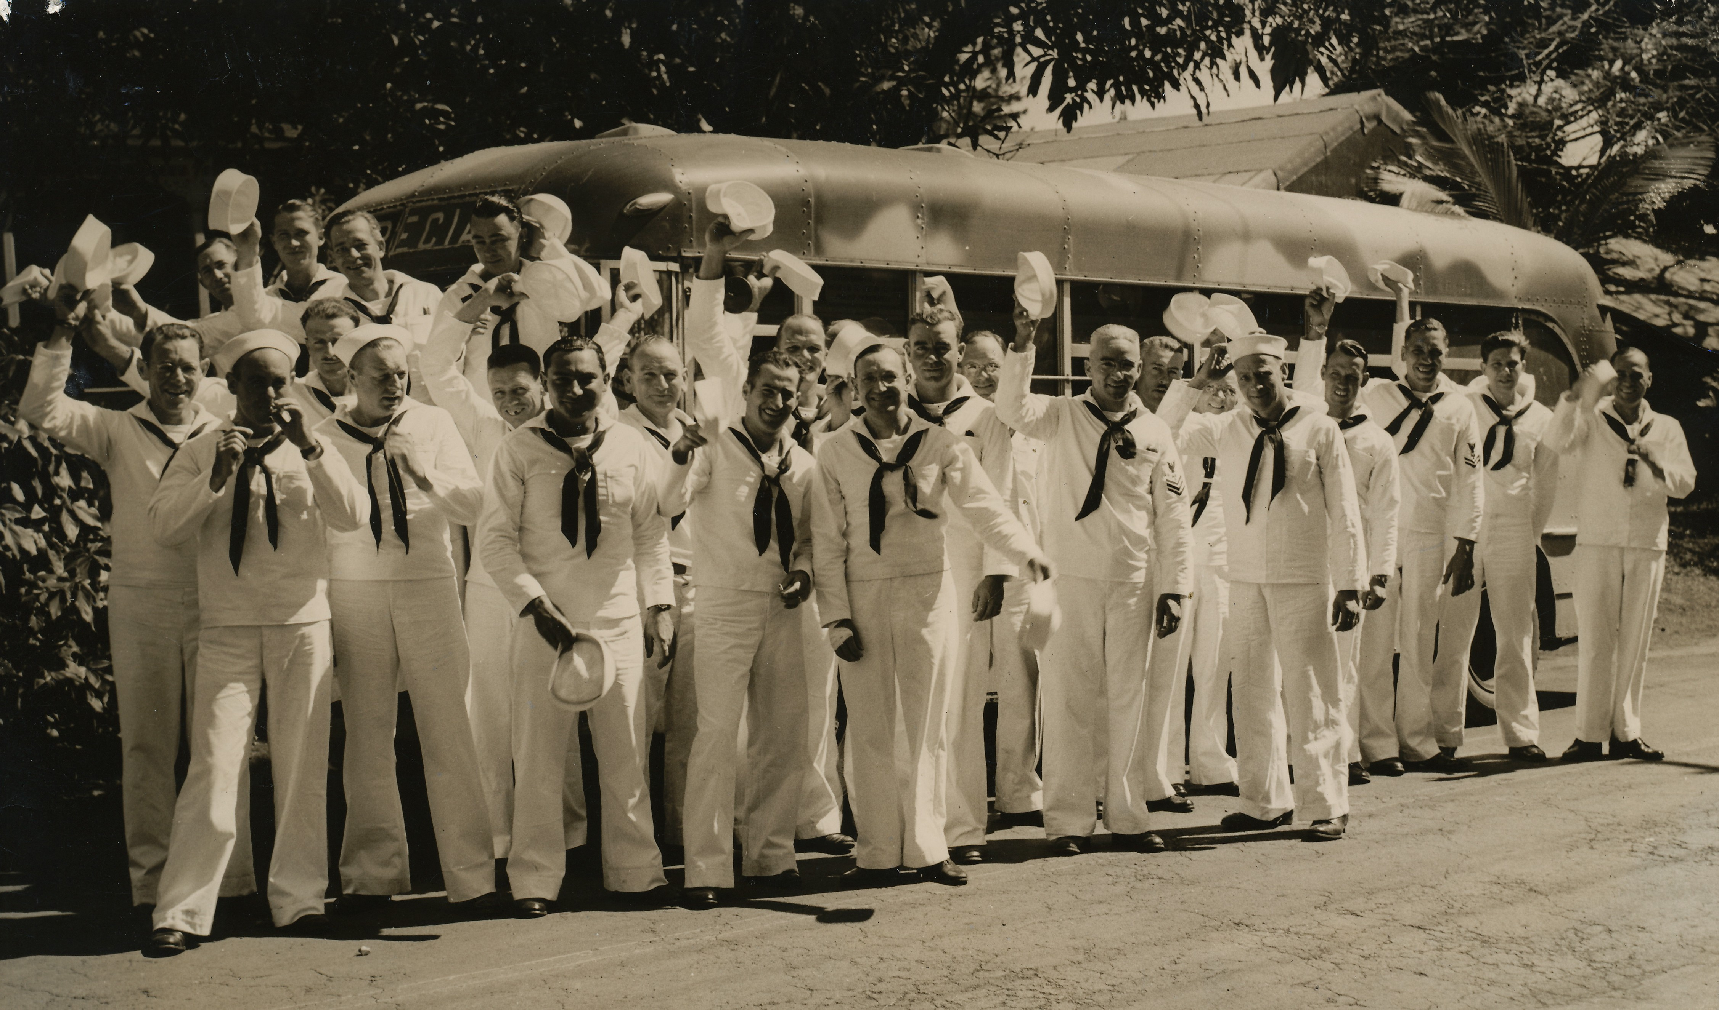
History of Focus Group Interviews
Communications research & propaganda analysis
Used in WWII to increase military morale
Underutilized in social sciences
(Connaway, Johnson, & Searing, 1997)
(Krueger & Casey, 2009)
Notes:
Connaway, L. S., Johnson, D. W., & Searing, S. (1997). Online catalogs from the users’ perspective: The use of focus group interviews. College and Research Libraries, 58(5), 403-420.
Krueger, R. A., & Casey, M. A. (2009). Focus groups: A practical guide for applied research. Thousand Oaks, Calif: SAGE Publications.

Slide 5

Why Focus Group Interviews?
Understand perceptions & attitudes
Orient to new field
Develop ideas
Evaluating different research populations
Develop & refine research instruments
(Connaway & Powell, 2010)
Notes:
Connaway, L. S. & Powell, R. R. (2010). Basic research methods for librarians (5th ed.). Westport, Conn: Libraries Unlimited.

Slide 6

Focus Group Interviews in LIS Research
  Needs assessment
  Community analysis
  Promotional strategies for new services
  Evaluation of library resources & services
  Information-gathering patterns
  Development of resources & services
(Connaway, 1996)
Notes:
Connaway, L. S. (1996). Focus group interviews: A data collection methodology. Library Administration & Management, 10(4), 231-39.

Slide 7
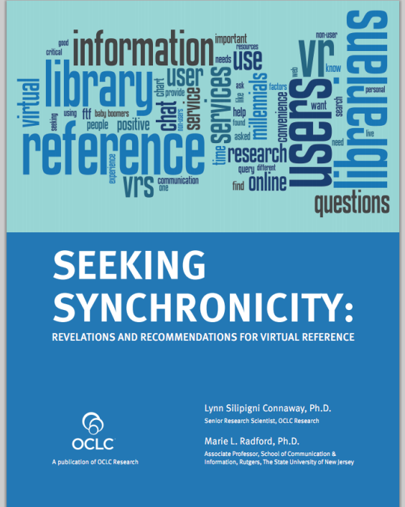

Focus Group Interviews in Our Research
Sense-making the Information Confluence
Seeking Synchronicity
User-Centered Design of a Recommender
System for a "Universal" Library Catalogue
Notes:
Sense-making the Information Confluence
Explored
Commonalities & diversities in why & how people use electronic information
How system design features affect how well systems meet the needs of users & the actual use
Boundary-bridging concepts enabling more effective application & collaboration in system design & user research
Blended differences between researchers & practitioners in multiple fields - approaches for identifying unities &for making sense of differences
Four phases: members of college and university communities
Phase I: Literature review & dialogue
Phase II: ~950 in-depth interviews: ~475 each - online surveys & telephone
Phase III: 78 participants in focus group interviews
Phase IV: 15 participants in semi-structured interviews
Dervin, B., Connaway, L.S., & Prabha, C. 2003-2006 Sense-making the information confluence: The whys and hows of college and university user satisficing of information needs. Funded by the Institute of Museum and Library Services (IMLS). http://www.oclc.org/research/activities/past/orprojects/imls/default.htm.
Seeking Synchronicity
Studied habits & needs of virtual reference services (VRS) users and non-users to identify characteristics for informing library system and service development.
Four phases:
Focus group interviews
Analysis of 850 QuestionPoint live chat transcripts
Online surveys of VRS
137 VRS Users
173 VRS Librarians
134 VRS Non-users
Telephone interviews
76 VRS Users
100 VRS Librarians
107 VRS Non-users
Generalizable through large sample sizes, multiple methods of data collection, and triangulation of results.
http://www.oclc.org/research/activities/synchronicity/default.htm
User-Centered Design of a Recommender System for a “Universal” Library Catalogue
Joint research project of OCLC Research & the Information School, University of Sheffield
Investigate development of recommender systems for retrieval in WorldCat.org
OCLC has recommender system for WorldCat.org
Functionality basic
Often does not provide logical recommendations to end users
User-centered design & empirical evaluation of a prototype system will provide data for OCLC in assessing the value of recommender services for WorldCat.org

Slide 8




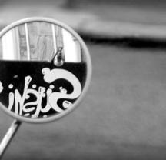

PLANNING
RECRUITING
PARTICIPANTS
DEVELOPING QUESTIONS
MODERATING
COLLECTING& ANALYZING DATA
REPORTING FINDINGS

Slide 9

Planning
Plan processes
Identify project goals
Evaluate all options
Identify personnel & budgeting
Develop timelines
(Morgan, 1998)
Notes:
Plan through entire project
Work done before & after focus group interview
Plan to meet your purposes
What are project goals?
Evaluate all options
Identify personnel & budgeting
Develop timelines
Set location, date
Morgan, D. L. (1998). Planning focus groups. Thousand Oaks, Calif: SAGE Publications.

Slide 10

Recruiting Participants
Decide who will be interviewed
  Typically 5-12 people
  As representative as possible of population
Develop recruitment screening & invitation scripts
Determine follow-up procedures
(Connaway & Powell, 2010)
(Morgan, 1998)
Notes:
Image from http://www.flickr.com/photos/stillframe/2367457529/
Morgan, D. L. (1998). Planning focus groups. Thousand Oaks, Calif: SAGE Publications.
Connaway, L. S. & Powell, R. R. (2010). Basic research methods for librarians (5th ed.). Westport, Conn: Libraries Unlimited.
In Sense-Making the Information Confluence, we also identified segments within the target population, giving us three groups to interview.
Four groups
Undergraduate students (n=28)
Graduate students (n=19)
Faculty (n=31)
Decide who will be interviewed
The more homogeneous, the more freely the discussion will flow
Leave room for no-shows & last-minute dropouts
Define target population
Define segments within target population
Develop recruitment screening & invitation scripts
Make initial contact
Encourage to recommend to others
Determine follow-up procedures

Slide 11

Attracting Participants
Offer incentives
  Payment
  Food & beverages
Hold in a comfortable, convenient, informal location
Follow up & send reminders
(Connaway & Powell, 2010)
(Morgan, 1998)
Notes:
In the Worldcat.org study, students were offered refreshments as well as a cash incentive for attending, amounting to to £15 in the UK and $25 in the US, which aided recruitment (Connaway & Wakeling, 2012).
Connaway, L. S., & Wakeling, S. (2012). To use or not to use Worldcat.org: An international perspective from different user groups. OCLC Internal Report.
Connaway, L. S. & Powell, R. R. (2010). Basic research methods for librarians (5th ed.). Westport, Conn: Libraries Unlimited.

Slide 12
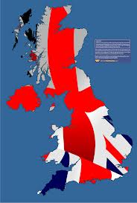


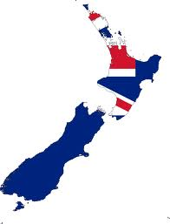
WorldCat.org Study Recruitment
Difficult
  Little data of user-base
  Participants across 3 continents
  Hard-to-reach populations
    Historians
    Antiquarian booksellers
Non-probabilistic methods
  Convenience sampling
  Snowball sampling
(Connaway & Wakeling, 2012)
Notes:
Connaway, L. S., & Wakeling, S. (2012). To use or not to use Worldcat.org: An international perspective from different user groups. OCLC Internal Report.
To recruit the librarians, key contacts at participating institutions provided email addresses for suitable staff members, or distributed the invitations themselves. In both cases a standard email was used that informed potential participants of the focus group interview details, explained the aims of the research, and specified what would be required of participants.
Library contacts were used to identify the subject liaison librarian for History departments, which resulted in a limited number of introductions to historians. Invitation emails were sent to interested parties, but overall recruitment numbers were low. Antiquarian Booksellers required a different approach, since in most cases our library contacts were unable to help with this group. Booksellers were identified through their membership of professional bodies (the Australian & New Zealand Association of Antiquarian Booksellers, the Antiquarian Booksellers Association (UK), and the Antiquarian Booksellers' Association of America), whose websites include contact details for members. Emails were sent to all booksellers included in the online membership directories, explaining the research and inviting them to attend a session. While this approach was unsuccessful in Australia and the US, we were able to recruit enough UK-based booksellers to conduct a focus group interview session.
Students were recruited with fliers distributed around libraries, academic departments, and student library assistants.

Slide 13
Developing Questions
Identify purpose of interview & research question
Should have:
  Range
  Specificity
  Depth
  Personal context
(Merton, Fiske, & Kendall, 1990)
Notes:
Merton, R. K., Lowenthal, M. F., & Kendall, P. L. (1990). The focused interview: A manual of problems and procedures. New York: Free Pree.

Slide 14
Categories of Questions
Opening
Participants get acquainted, “warm up”
Introductory
Begins discussion of topic
Transition
Moves smoothly into key questions
Key
Ending
Areas of central concern in study
Determine where to place emphasis
Brings closure
(Krueger, 1998, p.22)
Notes:
Krueger, R. A. (1998a). Developing questions for focus groups. Thousand Oaks, Ca: SAGE.

Slide 15

Characteristics of Good Questions
Open-ended
Conversational
Direct, easy wording
Meaning clearly conveyed
Consistent between groups
Test and revise your questions!
(Krueger, 1998, p.22)
Notes:
Krueger, R. A. (1998). Developing questions for focus groups. Thousand Oaks, Ca: SAGE.
You may need to probe after some vague comments with some of these phrases:
“Would you explain further?”
“Can you give me an example?”
“Would you say more?”
“Is there anything else?”
“Please describe what you mean.”
“I don’t understand.”
(Krueger, 1998, p. 46).
You might send a copy of questions to participants beforehand (Connaway & Wakeling, 2012)
Connaway, L. S., & Wakeling, S. (2012). To use or not to use Worldcat.org: An international perspective from different user groups. OCLC Internal Report.

Slide 16
Example: WorldCat.org
Focus Group Interview Questions
Question | Purpose
1. Tell us about your experiences with WorldCat.org | A broad introductory question intended to reveal the extent to which users have engaged with WorldCat.org, and the information-seeking contexts within which they use the system.
2. Describe a time when you used WorldCat.org that you considered a success. | Explores the features and functions of WorldCat.org that participants view positively. Requiring participants to discuss a particular instance provides richer data about the range of uses of the system.
3. Describe a time when using WorldCat.org was unsuccessful – i.e., you did not get what you wanted. | Explores the features and functions (or lack thereof) of WorldCat.org that participants view negatively.
4. Think of a time when you did not find what you were looking for, but did find something else of interest or useful to your work? | Intended to encourage discussion about the role of serendipity in information seeking, and the extent to which WorldCat.org facilitates resource discovery .
5. If you had a magic wand, what would your ideal WorldCat.org provide? | Encourages participants to discuss potential improvements to WorldCat.org. The use of the phrase “magic wand” ensures that participants are not restricted by what they believe to be practical or realistic.
Notes:
Connaway, L. S., & Wakeling, S. (2012). To use or not to use Worldcat.org: An international perspective from different user groups. OCLC Internal Report.
Flanagan, J. C. (1954). The critical incident technique. Washington: American Psychological Association.
Questions 2-4 employ the Critical Incident Technique

Slide 17

Moderating
Define role of the moderator
  Multiple moderators
  Train moderators
Develop questions for discussion guide
Identify external props or materials
Determine what kind of field notes moderator will take
(Krueger, 1998, p.22)
Notes:
Krueger, R. A. (1998b). Moderating focus groups. Thousand Oaks: Sage.

Slide 18
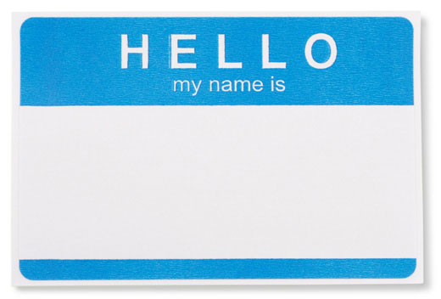
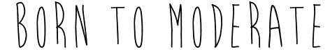
The Ideal Moderator
Not affiliated with institution or organization conducting the research
No vested interest in results
Trained in focus group techniques
Good communication skills
(Connaway & Powell, 2010)
Notes:
Connaway, L. S. & Powell, R. R. (2010). Basic research methods for librarians (5th ed.). Westport, Conn: Libraries Unlimited.

Slide 19

The Moderator’s Job
Guide discussion, remain neutral
Ask open-ended questions
Natural conversational approach
  Remain flexible to accommodate natural flow of discussion
Ensure everyone responds in each question area
Evaluate individual natures
(Krueger, 1998, p.22)

Slide 20
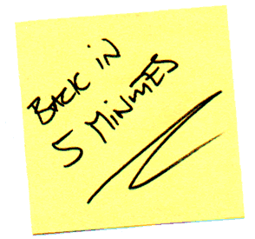
Dealing with Problem Participants
Interrupt diplomatically
Take a break
Discontinue eye contact
Call on participant by name
Write questions for all to see
(Krueger, 1998, p.59-63)
Notes:
Image from: http://www.jackeeholder.com/wp-content/uploads/2011/12/JH-Blog-Writers-Back-in-5-minutes.gif
Krueger, R. A. (1998b). Moderating focus groups. Thousand Oaks: Sage.
Problem Participants:
Experts & influentials
Dominant talkers
Disruptive participants
Ramblers & wanderers
Quiet & shy participants
Inattentive participants

Slide 21

Collecting Data
Note-taking
Audio recording
After focus group
  Organize data & review for completeness
Transcripts
Code-book
(Connaway & Powell, 2010)
Notes:
Connaway, L. S. & Powell, R. R. (2010). Basic research methods for librarians (5th ed.). Westport, Conn: Libraries Unlimited.
Tips on note-taking
Trace threads of an idea throughout the discussion
Identify the subgroup or individual to whom an idea is important
Distinguish between ideas held in common from those held by individuals
Capture the vocabulary and style of group
Distinguish, if possible, among perceptions, feelings, & insights
(Powell & Connaway, 2010, pp.152-153)
May help to write attendees’ names as they are seated
Record non-verbal communication as well

Slide 22
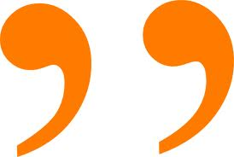
Analyzing Data
Two approaches
  Ethnographic summary
    Qualitative
    Direct quotations
    “Thick description” (Geertz, 1973, p.6)
  Content analysis approach
    Numerical descriptions of data
    Tallying of mentions of specific factors
Can be combined
n
%
(Connaway & Powell, 2010. p.175)
(Connaway, Johnson, & Searing, 1997, p. 409)
(Geertz,1973. p.6)
Notes:
Connaway, L. S., Johnson, D. W., & Searing, S. (1997). Online catalogs from the users’ perspective: The use of focus group interviews. College and Research Libraries, 58(5), 403-420.
Services (IMLS). http://www.oclc.org/research/activities/past/orprojects/imls/default.htm
Geertz, C. (1973). The interpretation of cultures: Selected essays. New York: Basic Books.
Powell, R. R., & Connaway, L. S. (2010). Basic research methods for librarians (5th ed.). Westport, Conn: Libraries Unlimited.
Stability
Same data coded more than once by same coder with same results
Accuracy
Extent to which the classification of text corresponds to a standard
Reproducibility
Intercoder reliability
Same data coded with same results by more than one coder
Powell, R. R., & Connaway, L. S. (2010). Basic research methods for librarians (5th ed.). Westport, Conn: Libraries Unlimited.
Sense-Making the Information Confluence, Dervin, B., Connaway, L.S., & Prabha, C. 2003-2006 Sense-making the information confluence: The whys and hows of college and university user satisficing of information needs. Funded by the Institute of Museum and Library
Ethnographic & content analysis approach
Collated & ranked by frequency of response
Themes within each situation & type of user group
Quotations used
WorldCat.org, Connaway, L. S., & Wakeling, S. (2012). To use or not to use Worldcat.org: An international perspective from different user groups. OCLC Internal Report.
Code-book
Findings divided by
Use
Strengths
Challenges & weaknesses
Suggestions for improvement

Slide 23

Reporting Findings
Multiple reporting strategies
Remember intended audience
Themes are better
  Narrative style
(Krueger, 1998)
Notes:
Krueger, R. A. (1998c). Analyzing & reporting focus group results. Thousand Oaks, Calif: SAGE Publications.

Slide 24
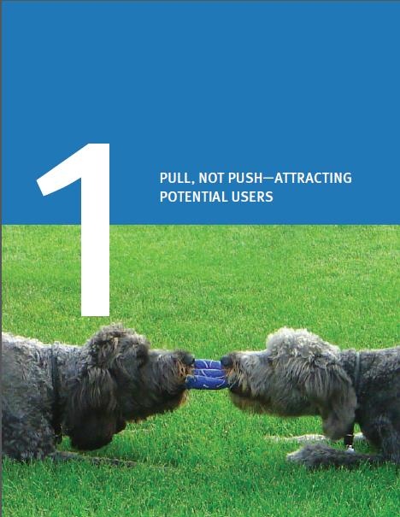
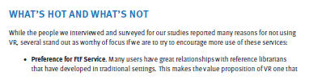
Reporting Findings: Seeking Synchronicity
Seeking Synchronicity: Revelations & Recommendations for Virtual Reference
  Friendly & brief
  Intended for library reference staff
  6 chapters
  Recommendations
Webinars
Presentations
Panels
Journal articles
Notes:
Connaway, L. S. & Radford, M. L. (2011). Seeking Synchronicity: Revelations and recommendations for virtual reference. Dublin, OH: OCLC Research. Retrieved on February 26, 2012 from http://www.oclc.org/reports/synchronicity/full.pdf
Radford, M. L., & L.S. Connaway. 2005–2008a. Seeking synchronicity: Evaluating virtual reference services from user, non-user, and librarian perspectives. Funded by the Institute of Museum and Library Services (IMLS). http://www.oclc.org/research/activities/synchronicity/default.htm
Multiple reporting strategies
Remember intended audience
Themes are better
Narrative style

Slide 25

Strengths of Focus Group Interviews
  Observe large amount of interactions in limited time
  Efficient & economical
  Assess nonverbal responses
  Can be used with hard-to-reach groups
  Moderator has a chance to probe & develop questions
  Positive impact on PR
(Young, 1993)
(Connaway, 1996)
(Connaway & Powell, 2010. p.176)
(Mellinger & Chau, 2010)
Notes:
Image from Microsoft Clip Art
People tend to be less inhibited due to the group interaction (Young, “Focus on Focus Groups”, p. 393)
Find out why groups think what they do (Connaway & Powell, 2010).
Focus groups are efficient and economical compared to one-on-one interviews, they can be quite expensive in and of themselves.
Young, V. L. (1993). Focus on focus groups. College and Research Libraries New (7), pp. 391-94.
Connaway, L. S. (1996). Focus group interviews: A data collection methodology. Library Administration & Management, 10(4), 231-39.
Connaway, L. S. & Powell, R. R. (2010). Basic research methods for librarians (5th ed.). Westport, Conn: Libraries Unlimited.
Mellinger, M., & Chau, M. (2010). Conducting focus groups with library staff: Best practices and participant perceptions. Library Management, 31 (4/5), 267-278.

Slide 26

Weaknesses of Focus Group Interviews
Cost
Must have skilled moderator
Group interview can suppress individual differences
Can foster conformity
(Morgan, 1988)
(Connaway, 1996)
(Connaway & Powell, 2010, p.177)
Notes:
Cost
Each session can cost as much as $2,500 (Morgan, Focus Groups as Qualitative Research, 64)
Gifts & gratuities
Moderator fees
Refreshments
Travel expenses
(Connaway & Powell, 2010, p.177)
Ways to cut costs:
Train staff to be moderators
Pay mileage only for participants
Use library facilities for the sessions
Offer refreshments to the participants instead of gifts & gratuities
(Connaway & Powell, 2010, p. 177)
Morgan, D. L. (1988). Focus groups as qualitative research. Newbury Park, Calif: Sage Publications.
Connaway, L. S. (1996). Focus group interviews: A data collection methodology. Library Administration & Management, 10(4), 231-39.
Connaway, L. S. & Powell, R. R. (2010). Basic research methods for librarians (5th ed.). Westport, Conn: Libraries Unlimited.

Slide 27
Selected Bibliography
Connaway, L. S. (1996). Focus group interviews: A data collection methodology. Library Administration & Management, 10(4), 231-39.
Connaway, L. S., Johnson, D. W., & Searing, S. (1997). Online catalogs from the users’ perspective: The use of focus group interviews. College and Research Libraries, 58(5), 403-420.
Connaway, L. S. & Powell, R. R. (2010). Basic research methods for librarians (5th ed.). Westport, Conn: Libraries Unlimited.
Connaway, L. S. & Radford, M. L. (2011). Seeking Synchronicity: Revelations and recommendations for virtual reference. Dublin, OH: OCLC Research. Retrieved from http://www.oclc.org/reports/synchronicity/full.pdf
Connaway, L. S., & Wakeling, S. (2012). To use or not to use Worldcat.org: An international perspective from different user groups. OCLC Internal Report.
Dervin, B., Connaway, L.S., & Prabha, C. 2003-2006 Sense-making the information confluence: The whys and hows of college and university user satisficing of information needs. Funded by the Institute of Museum and Library Services (IMLS). http://www.oclc.org/research/activities/past/orprojects/imls/default.htm.
Flanagan, J. C. (1954). The critical incident technique. Washington: American Psychological Association.
Geertz, C. (1973). The interpretation of cultures: Selected essays. New York: Basic Books.

Slide 28
Selected Bibliography
Krueger, R. A. (1998a). Developing questions for focus groups. Thousand Oaks, CA: SAGE.
Krueger, R. A. (1998b). Moderating focus groups. Thousand Oaks: Sage.
Krueger, R. A. (1998c). Analyzing & reporting focus group results. Thousand Oaks, CA: SAGE Publications.
Krueger, R. A., & Casey, M. A. (2009). Focus groups: A practical guide for applied research. Thousand Oaks, CA: SAGE Publications.
Mellinger, M., & Chau, M. (2010). Conducting focus groups with library staff: Best practices and participant perceptions. Library Management, 31 (4/5), 267-278.
Merton, R. K., Lowenthal, M. F., & Kendall, P. L. (1990). The focused interview: A manual of problems and procedures. New York: Free Pree.
Morgan, D. L. (1988). Focus groups as qualitative research. Newbury Park, CA: Sage Publications.
Morgan, D. L. (1998). Planning focus groups. Thousand Oaks, CA: SAGE Publications.
Radford, M. L., & L.S. Connaway. 2005–2008a. Seeking synchronicity: Evaluating virtual reference services from user, non-user, and librarian perspectives. Funded by the Institute of Museum and Library Services (IMLS). http://www.oclc.org/research/activities/synchronicity/default.htm
Wilson, V. (2012). Research methods: Focus groups. Evidence Based Library & Information Practice, 7(1), 129-131.
Young, V. L. (1993). Focus on focus groups. College and Research Libraries New (7), pp. 391-94.

Slide 29
Special thanks to Alyssa Darden, OCLC Research, for assistance in preparation of this presentation

Slide 30
Questions & Discussion
Lynn Silipigni Connaway, Ph.D.
connawal@oclc.org
@LynnConnaway
Notes:
30
30
30

