Slide 1
OCLC Research Roundup
Webinar
Eric Childress
Consulting Project Manager
OCLC Research
@echildress
Notes:
Presented 2013-02-21
Unless otherwise noted, all material ©2013 OCLC Online Computer Library Center, Inc.

Slide 2
Outline of Today’s Session
Purpose
People
Projects (Selected)
OCLC Research

Slide 3
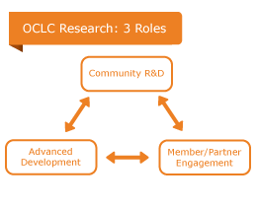
About OCLC Research
Mission: expand knowledge that advances OCLC's public purposes:
Furthering access to the world's information
Reducing library costs
One of the world's leading centers devoted exclusively to exploring the challenges facing libraries & archives

Slide 4
Advanced Development
OCLC’s “Proving Grounds”
Develop/trial innovative processes & frameworks
First adopter of new standards & tools
Technology diffusion
OCLC Innovation Lab
Rapid development of new services
Example: Article Exchange
WorldCat Resource Sharing, ILLiad
Lender
Borrower
tinyURL & password
for each document
Patron
Notes:
[The Hadoop logo and name are property of Apache Software Foundation]
“The Apache Hadoop software library is a framework that allows for the distributed processing of large data sets across clusters of computers using simple programming models. It is designed to scale up from single servers to thousands of machines, each offering local computation and storage. Rather than rely on hardware to deliver high-availability, the library itself is designed to detect and handle failures at the application layer, so delivering a highly-available service on top of a cluster of computers, each of which may be prone to failures.“ -- http://hadoop.apache.org/

Slide 5
Shared Community R&D
Current emphases (Themes):
Original research
Collaborative work with OCLC members & other stakeholders
Outputs:
Surveys
Studies & reports
Scholarly articles/papers
Data mining / Visualization
Data enrichment
Prototypes
Experimental machine services
Advancing the Research Mission
Mobilizing Unique Materials
Metadata Management
Infrastructure & Standards Support
System-wide Organization
User Behavior Studies & Synthesis

Slide 6
Member/Partner Engagement
Mobilize the community around shared concerns
Collaboration/case studies
Surveys and other info. gathering
Engagement with OCLC members, partners, others
Conferences, visits, conversations
Feedback on OCLC Research prototypes/software/web services
Communication – sharing our findings/work
Web site
Presentations
Publications
Newsletters
Social media
OCLC Research Library Partnership
Issues important to research institutions
Annual dues & active role
Working Groups
Partnership events
~160 institutions
24 of the top 30 universities in The Times Higher Education World Ranking

Slide 7
Other Activities
Work with professional and standards bodies including:
The Frederick G. Kilgour Award
OCLC and LITA
Award of $2000 + travel to ALA
Recognizes research relevant to the development of information technologies
OCLC/ALISE Library & Information Science Research Grants
OCLC and ALISE
Grant awards range up to $15,000 to support one-year research projects by LIS faculty
OCLC data for research
Provision of OCLC data to facilitate academic work by university faculty & other researchers
Rolling application/approval process
Letter of confirmation for grant proposals, if needed
Notes:
[Logos and names of the listed organizations are property of the respective organizations]
Of particular note with regard to OCLC Research’s participation in professional bodies: We’re honored to have one of our staff, Jackie Dooley, serving as the president of SAA.

Slide 8
OCLC Research staff
Staff includes:
Program Officers
Research Scientists
Software Architects & Programmers
Communication specialists
Expertise includes:
Libraries & Archives
Metadata & Knowledge Organization
Information Retrieval
User studies
Computational Linguistics
Economics
Operations Research
Office locations:
Dublin, OH, USA
Leiden, Netherlands
San Mateo, CA, USA
Special positions:
Diversity Fellow (early career)
Postdoctoral Scholar
Research Assistants (graduate students)
Wikipedian-in-Residence

Slide 9
System-wide Organization
Cloud-sourcing Research Collections
Print Management at “Mega-scale”
Mobilizing Unique Materials
Special collections/archives surveys
Other MUM reports
Metadata Management
mapFAST
Classify

Slide 10
System-wide Organization

Slide 11
Cloud-sourcing Research Collections
Shifting emphases for research libraries and print resources:
Dropping demand for print
Carrying costs of print are significant
Digital versions of most/all older print materials are realized or likely over time
What might a new environment look like?
Managing print down for individual libraries
Treating print resources as part of a collective collection, not just local assets
Rise of shared print service providers
Substitution of digital version for print copy
Report examines mass-digitized library environment and uses a case study (NYU) to illustrate possible responses
Notes:
https://www.oclc.org/resources/research/publications/library/2011/2011-01.pdf
[The HathiTrust logo and name are property of the HathiTrust]

Slide 12
Digitized corpus and shared print repositories
OCLC Research, 2013
Notes:
From: http://www.oclc.org/content/dam/research/presentations/malpas/umtc2011.pdf

Slide 13
Potential gained space/inventory reduction for NYU
OCLC Research, 2013
Notes:
“In addition to space recovery, the potential cost avoidance that might be achieved if redundant inventory were permanently removed from the library is considerable. Using a recently published cost model produced by economist Paul Courant, one could calculate the total annual cost savings that might be achieved by replacing 700,000 locally-managed print volumes with a surrogate service provision to be as much as $3 million per year—assuming (somewhat improbably) that all staffing, operational and facilities expenditures were adjusted to reflect the change in collection size (Courant and Nielson, 2010). Yet if even a small fraction of this cost avoidance could be achieved, it is obvious that the library might substantially reduce or, more strategically, redirect its draw on the financial resources of the university. “ – p. 46

Slide 14
Print Management at “Mega-Scale”
Exploration of characteristics and implications of a North American network of regional shared print book collections
Cast in a regional framework grounded in mega-region concept
Based in work by urban theorist, Richard Florida (U Toronto & NYU)
An exercise grounded in fact, but not prescriptive: one possible model among many
Intended to inform discussions around cooperative shared print organized at regional scale

Slide 15
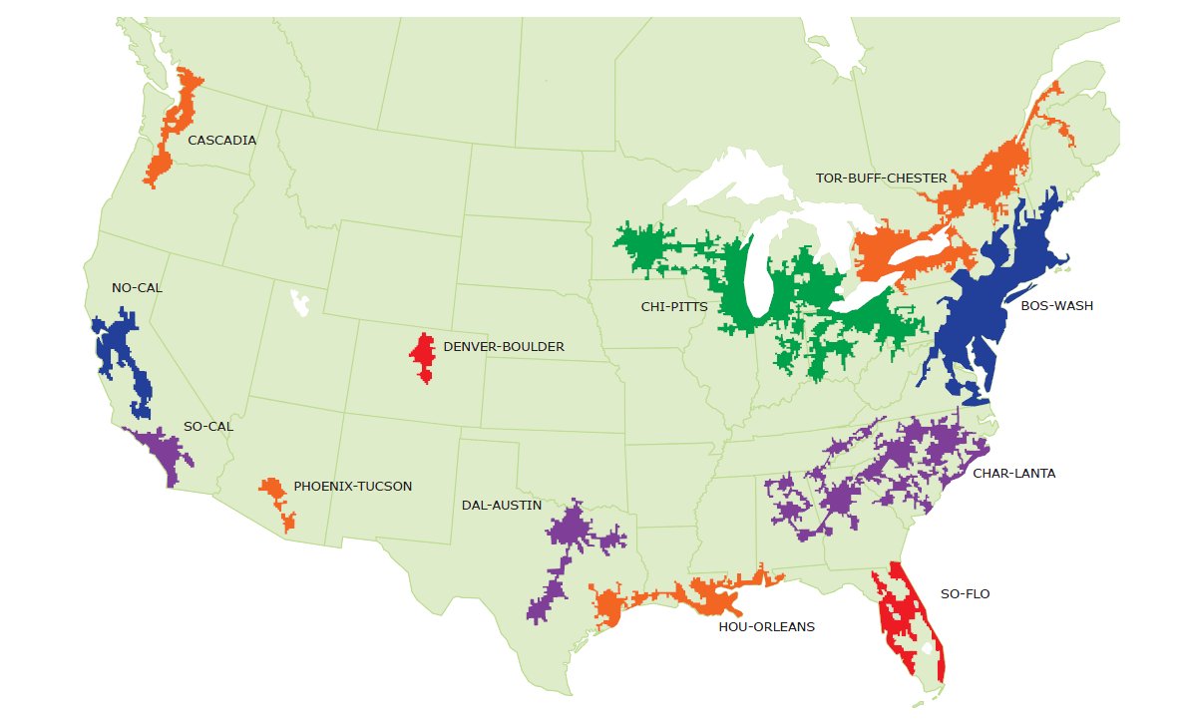
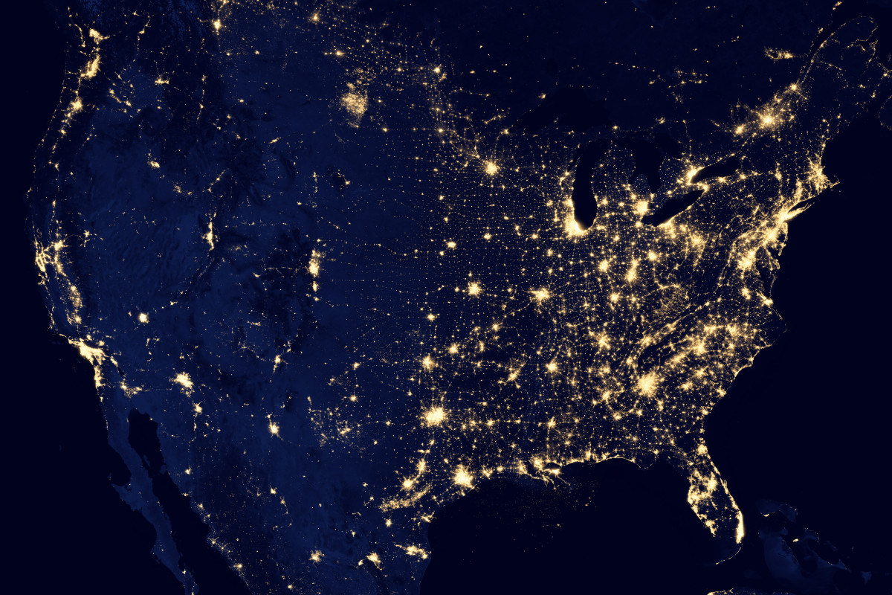
North American Mega-regions
OCLC Research, 2013
Notes:
Source of inset map is unknown

Slide 16
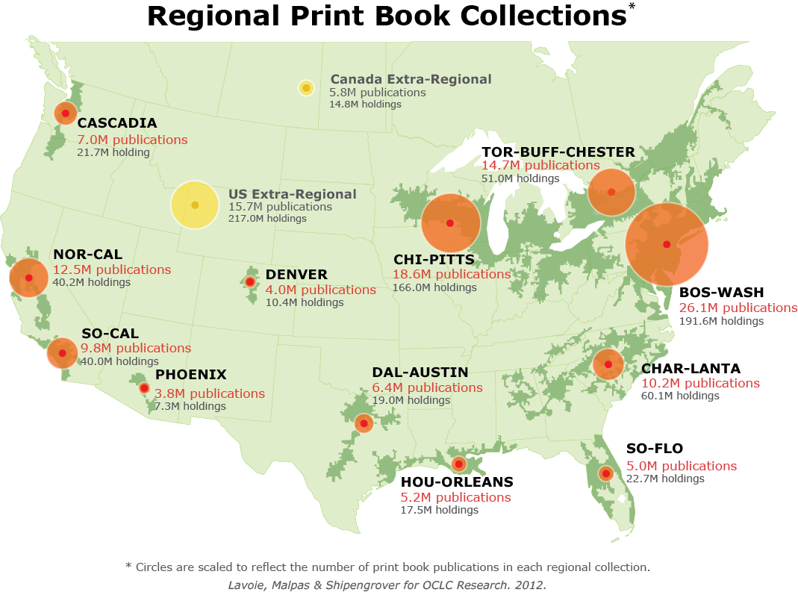
North American print book resource:
45.7 million distinct publications
889.5 million total library holdings
OCLC Research, 2013

Slide 17
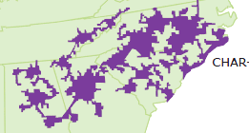
Print Books in Char-lanta Libraries
Char-lanta
Regional print book collection
10,156,810 discrete titles (manifestations)
8,098,748 discrete works
1.25 manifestations per work on average
60,102,186 holdings in Char-lanta libraries
5.92 holdings per title on average
Median age: 25 (i.e. published 1986)
= 22% of titles (7% of holdings) in North American print book collection
including more than 700K titles unique to Char-lanta
OCLC Research, 2013
Notes:
Work done by Lavoie for a presentation to ASERL

Slide 18
Distribution of Char-lanta Print Books by Holding Library Type
Char-lanta
1,811 libraries (i.e. OCLC inst. codes)
Majority of holdings are in academic libraries
N = 60M holdings
OCLC Research, 2013

Slide 19
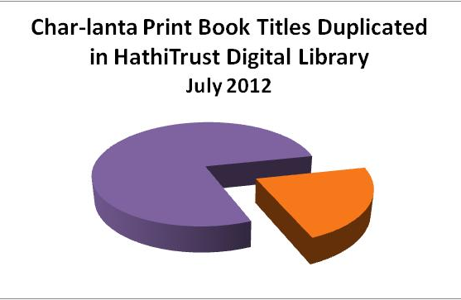
Digital preservation status of Char-lanta print books
Char-lanta
Range for other regions:
19% ←→ 33%
22%
2.24M titles
N = 10M titles (manifestations)
OCLC Research, 2013
Notes:
[The HathiTrust logo and name are property of the HathiTrust]

Slide 20
New work: Ohio State U & the Committee on Institutional Cooperation (CIC)
“…an analysis of print books held by a representative CIC member library with a view to understanding their value to the parent institution, the CIC consortium, and the surrounding Chi-Pitts mega-region.
WorldCat bibliographic and holdings data and aggregated inter-lending statistics will be used to characterize local print book collection in context of CIC collective print book resource and Chi-Pitts regional resource.”
http://library.osu.edu/blogs/director/2013/01/14/from-the-director-january-14-2013-research-study-with-oclc

Slide 21
Mobilizing Unique Materials

Slide 22
Special Collections & Archives
2010
U.S. &
Canada
2013
U.K. &
Ireland
Notes:
2010: a detailed survey to study special collections and archives in 275 academic and research libraries throughout the United States and Canada [conducted in 2009]
The OCLC Research survey updated and expanded a similar survey administered by the Association of Research Libraries in 1998
http://www.oclc.org/research/activities/hiddencollections.html
2013: a detailed survey to study special collections and archives in 82 academic and research libraries in the United Kingdom, Ireland, Northern Ireland, Scotland and Wales.
The survey was done in collaboration with Research Libraries UK (RLUK)
http://www.oclc.org/research/publications/library/2013/2013-01r.html

Slide 23
Finding aids on the Web
U.K./Ireland
U.S./Canada

Slide 24
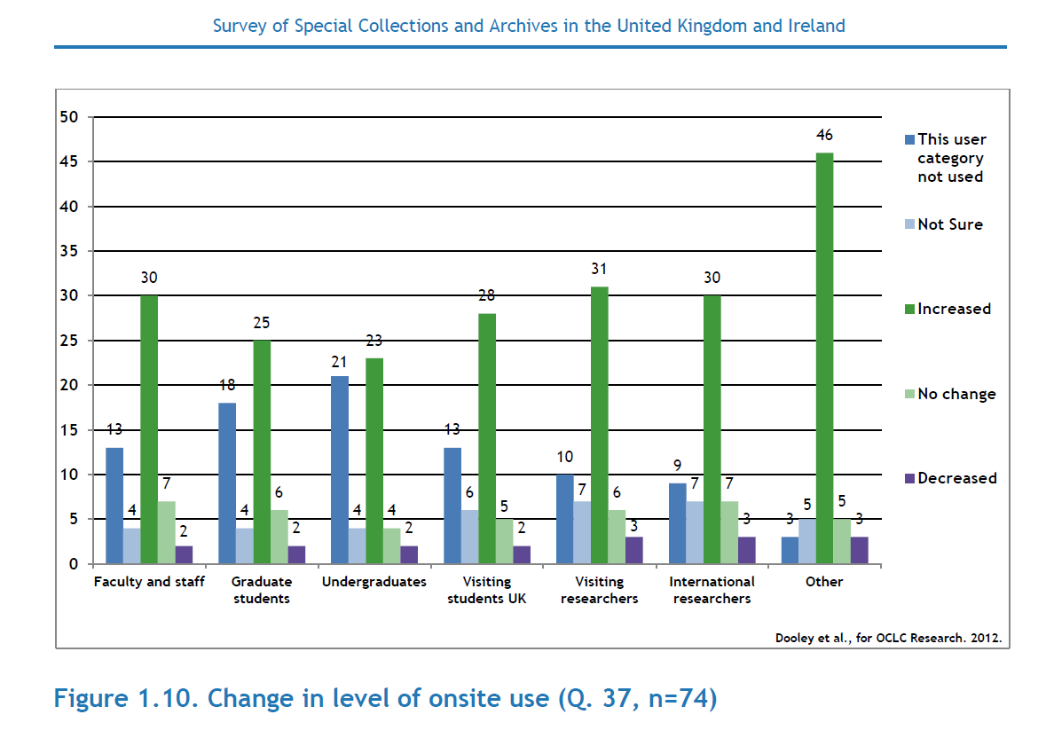
If they discover it, they will visit
Compared to 1999
U.K./Ireland
U.S./Canada
Notes:
The green lines show increased usage (the numbers = the quantity of agencies reporting). This seems to be driven in large part by improved discoverability of collections and various virtual outreach efforts including publishing finding aids and content on the Web (either on the agency’s site on in a hub or both) and from efforts to surface collections/services in social media.

Slide 25
Challenges (survey says…)
What are the most challenging issues currently facing your special collections?
Challenge | U.S. /Canada (rank) | U.K./Ireland (rank)
Space/facilities | 1 | 2
Born-digital management | 2 | 3
Digitization | 3 | 6
User needs (Outreach) | 4 | 1
Cataloguing/archival processing | 5 | 5
Preservation (Collection care) | 6 | 4
Notes:
The surveys asked respondents for their top 3 challenges. These sort out into roughly 6 key areas. (Note that there are some slight differences in terminology – the labels in parentheses are the U.K. phrases that map approximately to the corresponding U.S./Canada terms.)
Note that born-digital management is by far the most-cited area of need for education and training in both sectors.
Sources:
Dooley, Jackie M., and Katherine Luce. 2010. Taking our pulse the OCLC Research survey of special collections and archives. Dublin, Ohio: OCLC Research.
Dooley, Jackie M., Rachel Beckett, Alison Cullingford, Katie Sambrook, Chris Sheppard, and Sue Worrall. 2013. Survey of special collections and archives in the United Kingdom and Ireland. Dublin, Ohio: OCLC Research.

Slide 26
Top challenges
U.K./Ireland
U.S./Canada

Slide 27
Reports: Building better processes & policies
Notes:
Rapid capture (2011): This report provides examples of how to simplify and streamline digital capture of non-book collections.
Nine case studies illustrate processes and procedures institutions have adopted to speed up digitization of special collections. The intent in sharing these vignettes is to enable others to consider whether or not any of the approaches could be applied to their own initiatives to increase the scale of their digitization efforts.
http://www.oclc.org/content/dam/research/publications/library/2011/2011-04.pdf
Scan and deliver (2011): This report details the work of the RLG Partnership Working Group on Streamlining Photography and Scanning and its result—a flexible, tiered approach to delivering digitized materials that acknowledges differences in user needs, collections, institutions, and resources. This tiered workflow for user-initiated digitization consists of four main steps: review, decide, scan, and deliver.
http://www.oclc.org/content/dam/research/publications/library/2011/2011-05.pdf
Capture and release (2010): Digital cameras can be a gentle and patron-friendly option for special collections. This report provides information designed to guide the creation/updating of local policies on permitted uses of digital cameras. Based on recent surveys by OCLC research, the majority of special collections and archives permit at least some use of digital cameras (87% U.S./Canada; 71% U.K./Ireland).
http://www.oclc.org/content/dam/research/publications/library/2010/2010-05.pdf

Slide 28
Metadata Management

Slide 29
mapFAST
Experimental service
mapFAST on the Web
mapFAST API
Mashup of FAST & Google Maps
Uses FAST headings to which OCLC has assigned latitude and longitude
Provides a map search interface for a subset of WorldCat
Geographic locations and features
Historical events
About FAST:
FAST (Faceted Application of Subject Terminology)
Joint effort of OCLC Research & Library of Congress
Provides a faceted version of LCSH (Library of Congress Subject Headings)
Available as linked data
http://experimental.worldcat.org/mapfast/

Slide 30
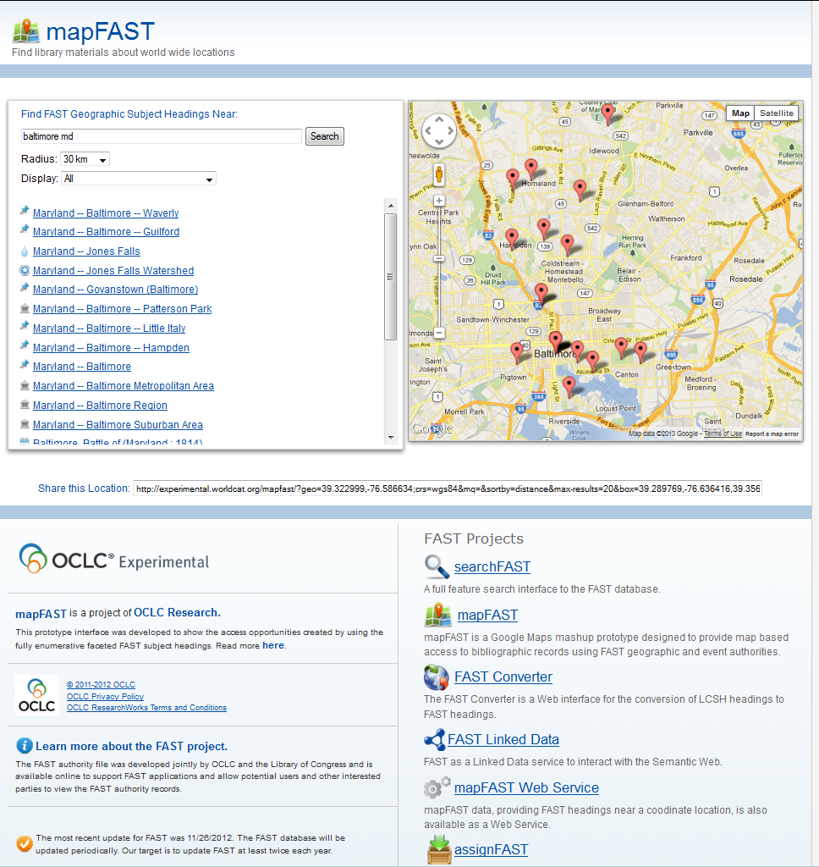
mapFAST exampled: Baltimore
http://experimental.worldcat.org/mapfast/

Slide 31
Classify
Experimental service
Classify on the Web
OCLC Connexion Client
Classify API
Designed to assist users with the assignment of classification numbers
DDC (Dewey Decimal Classification)
LCC (Library of Congress Classification
Known title? Search by
ISBN (International Standard Book Number)
ISSN (International Standard Serial Number)
UPC (Universal Product Code)
Author + Title
OCLC control number
Just know the topic?
Search by FAST heading
Find works with the heading and see what DDC/LCC has been assigned
http://classify.oclc.org

Slide 32
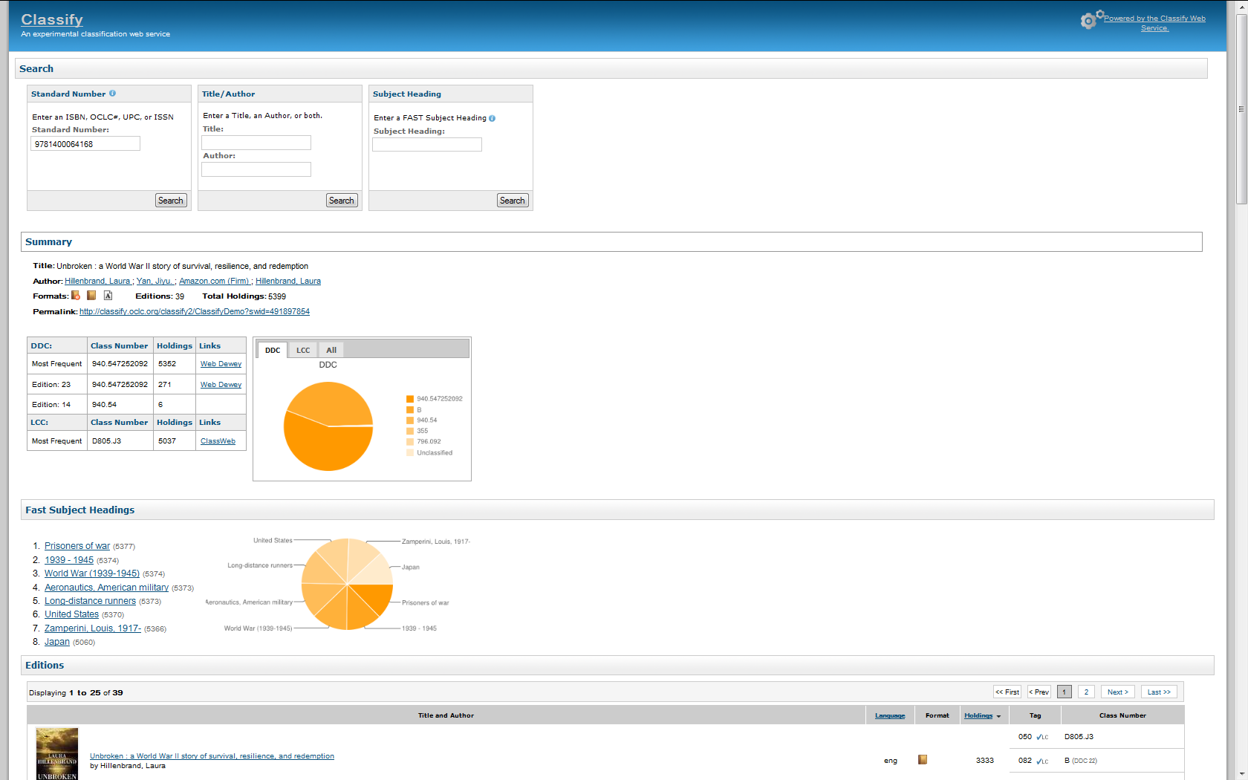
Classify example: Unbroken
http://classify.oclc.org

Slide 33
Questions?

Slide 34
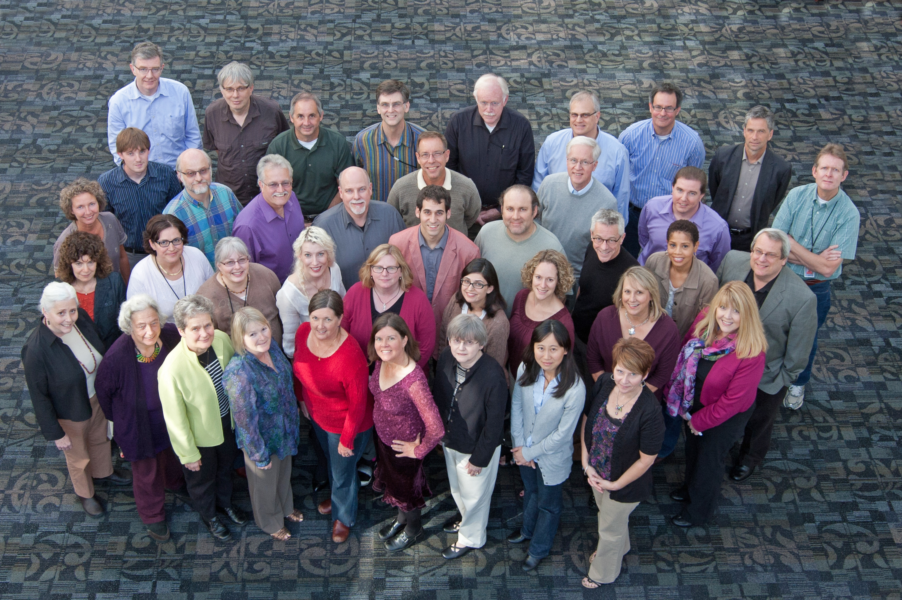
Thank you
http://www.oclc.org/research
Notes:
OCLC Research staff are based in offices in San Mateo, California ; Dublin, Ohio, and Leiden, The Netherlands.

