Slide 1
San Juan, Puerto Rico (21 October 2015)
RDA, Linked Data, BIBFRAME
Eric Childress
Consulting Project Manager
OCLC Membership & Research
Notes:
It is a pleasure to address you today. I am Eric Childress of OCLC Research. My background is as a cataloger, and I’ve been involved with metadata, controlled vocabularies and classification for my entire career.
Presentation to
Escuela Graduada de Ciencias y Tecnologías de la Información, Universidad de Puerto Rico (Graduate School of Information Sciences and Technologies , University of Puerto Rico)

Slide 2
Outline
Resource Description & Access (RDA)
Linked Data
BIBFRAME
schema.org

Slide 3
RDA

Slide 4
RDA Basics
Resource Description & Access
A content standard for libraries
Successor to AACR2
Designed to cover all digital and analog resources
Stewarded by JSC (Joint Steering Committee)
Available online & in print
Model- and other standards-cognizant
FRBR (Functional Requirements of Bibliographic Records)
Functional Requirements for Authority Data, (FRAD)

Slide 5
Benefits
A structure based on the conceptual models of FRBR and FRAD to help catalog users find the information they need more easily
A flexible framework for content description of digital resources that also serves the needs of libraries organizing traditional resources
A better fit with emerging database technologies, enabling institutions to introduce efficiencies in data capture and storage retrievals
Notes:
Quoted from: http://www.rdatoolkit.org/background

Slide 6
RDA vs AACR2
Transcribe as found
Abbreviations much less used than in AACR2
Record all/most parties (no “rule of three”)
Changes in terminology
Abandons card-catalog legacy practices

Slide 7
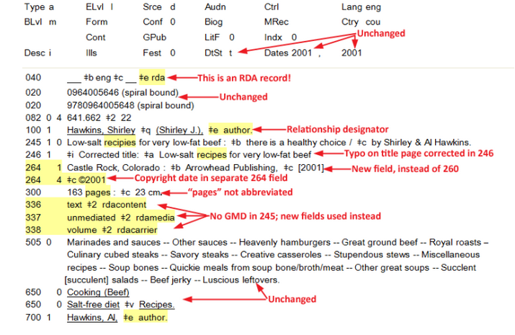
RDA example
Notes:
Source of image: https://www.libraries.psu.edu/psul/cataloging/catref/rda/rdaintro.html

Slide 8
OCLC & RDA
OCLC staff reviewed and commented on drafts
FRBR work by OCLC was informative
Implementation support
Installation of MARC changes (bib, auth, holdings)
Systematic RDA enhancements to WorldCat records
Work with communities as needed
Changes to OCLC documentation

Slide 9
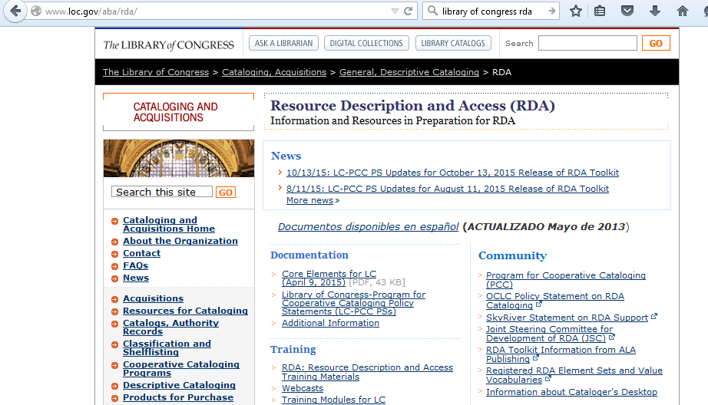
LC RDA Support Web site

Slide 10
Linked Data

Slide 11
Linked Data basics
First elaborated in a 2006 design document by Tim Berners-Lee
A set of common practices for exposing data on the Web in way that:
Allows many parties to participate in a Web of data
Fosters creating connections in a Web of data
Produces new knowledge and added value

Slide 12
Linked Data design principles
Use URIs to name (identify) things.
Use HTTP URIs so that these things can be looked up (interpreted, "dereferenced").
Provide useful information about what a name identifies when it's looked up, using open standards such as RDF, SPARQL, etc.
Refer to other things using their HTTP URI-based names when publishing data on the Web.
Notes:
From: https://en.wikipedia.org/wiki/Linked_data
Principles are by Tim Berners-Lee (see source above for full citation)

Slide 13
Linked Data triples
Subject (URI or blank node)
Predicate (URI)
Object (URI, literal or blank node)
Subject
Predicate
Object

Slide 14
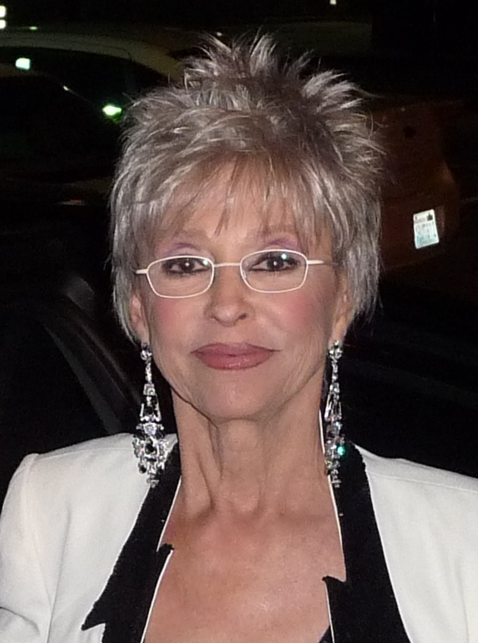
Illustrative diagram for Rita Moreno
Rita
VIAF
given
name
https://viaf.org/viaf/76500985/
family
name
Moreno
CC BY-SA 3.0
date
of birth
place
of birth
https://www.wikidata.org/wiki/Q2307535
1936-12-11
Humacao, Puerto Rico
Notes:
Wikidata page: https://www.wikidata.org/wiki/Q230151
Image: https://upload.wikimedia.org/wikipedia/commons/e/e2/Rita_Moreno_face.jpg

Slide 15
BIBFRAME

Slide 16
BIBRAME basics
Schema maintained by the Library of Congress
General model for expressing and connecting bibliographic data
Foundation for the future of bibliographic description, both on the web, and in the broader networked world
Successor to MARC 21

Slide 17
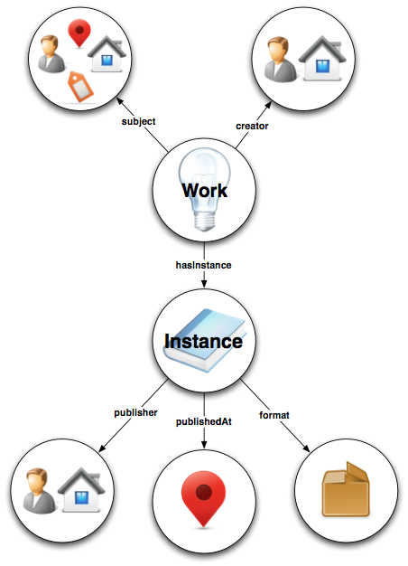
BIBFRAME
Initial design, pilot testing, refinements completed
Bespoke MARC to BF conversion software developed by OCLC, others
Tools released by LoC, others
LoC working through further improvements
Several agencies are experimenting with using BF

Slide 18
BIBFRAME sample
Notes:
From: http://kcoyle.net/bibframe/book.rdf.xml

Slide 19
Publications released
2012
2013
2015

Slide 20
Schema.org

Slide 21
schema.org basics
Joint effort of major search engines
Provides a common schema for general use
Extensions for some types of resources
Communities can propose community-specific extensions
Enjoying rapid adoption

Slide 22
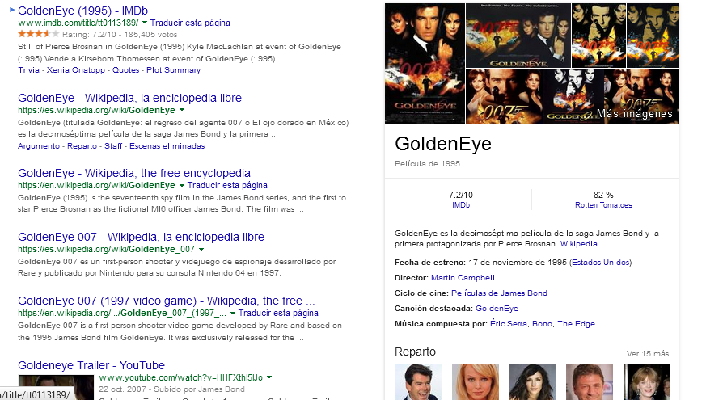
Enhanced listings - GoldenEye
enhanced
listing

Slide 23
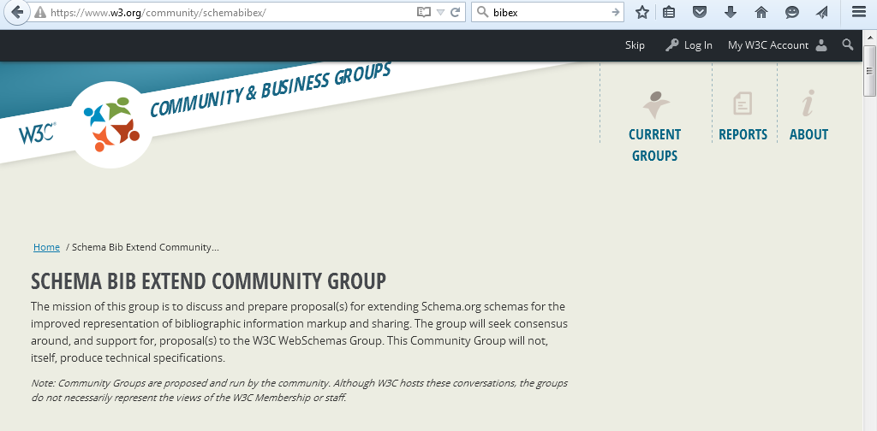
Schema BibEx

Slide 24
Why Should Libraries Care?

Slide 26
Improving Web Discovery of Library Materials
WorldCat Works Linked Data Released
Unique Visitors to WorldCat
Notes:
As we will describe more in depth later, we have been sharing information on a large number of creative works for a while now.
We believe that exposing linked data to search engines has already improved WorldCat visits, which then leads users to local library collections.

Slide 29
OCLC & Linked Data

Slide 30
OCLC and Linked Data
Involved in standards development and testing
Member of W3C, NISO, ISNI, others…
Connections with other orgs (DCMI, ORCiD…)
First adopter & innovator
Publisher of linked data
WorldCat, VIAF, FAST…

Slide 31
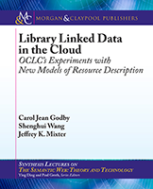
Library Linked Data in the Cloud
Describes OCLC's efforts to help increase the visibility of library collections on the Web through the creation of library linked data
2015
Notes:
data—moving from a web of documents to a web of data. It focuses on the conceptual and technical challenges involved in publishing linked data derived from traditional library metadata and aims to achieve a balanced treatment of theory, technical detail, and practical application.

Slide 32
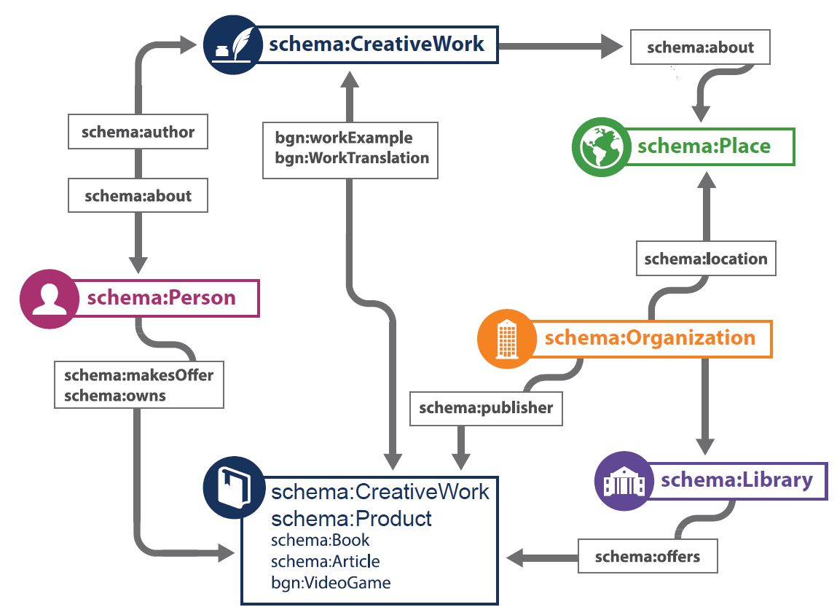
Notes:
This is the model that we currently use for CreativeWorks. As you can see, the model recognizes a few key entities, such as CreativeWork, Person, Organization, Place etc., and some of their most important relationships. RDF triples, or other machine processable statements conforming to the model can say that:
‘Malcom Gladwell is the author of ‘The Tipping Point,’
‘The Tipping Point was published by Little, Brown in 2000,’
‘Gandhi: an Autobiography is an English translation of the Gujarati original’
‘The Ohio State University lends or offers the edition published in 2000,’ and so on.

Slide 33
OCLC Production Services
LCSH
Linked Data
Entities
VIAF
Internal OCLC Research Resources
FAST
enhanced
WorldCat
GMGPC
External OCLC Research Systems
WORKS
GSAFD
GTT
Kindred Works
FictionFinder
Identities
MeSH
LCTGM
Cookbook Finder
DDC
Classify
Notes:
The point o this chart is not to explain all of the boxes and their relationships, but merely to demonstrate that we are doing massive data processing to enrich our data resources in various ways before we create entities and linkages to other entities. This makes the entire aggregation richer and more useful. This data then is used in various public interfaces to create compelling examples of how our data can be made to work harder in the service of our users.

Slide 34
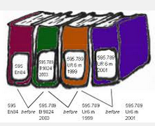
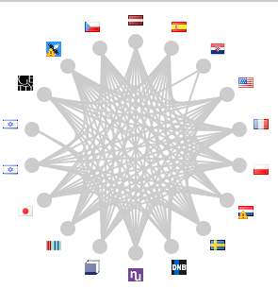
OCLC’s linked data resources
works
10-50 million triples
DDC
300
million triples
5 billion
RDF triples
Works
2
billion triples
15 billion triples
FAST
23 million
triples
VIAF
Notes:
As of August 2014, we can say that OCLC has published over 20 billion RDF triples extracted from MARC records and library authority files. This is without a doubt the largest library aggregation of linked data resources in the world.

Slide 35
Virtual International Authority File
Aggregates data from ~36 sources
Includes personal and organizational names, works and their translations
Links in Wikidata (and thus Wikipedia)
One of most frequently accessed sources consumed by linked data services

Slide 36
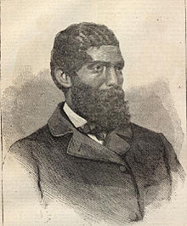
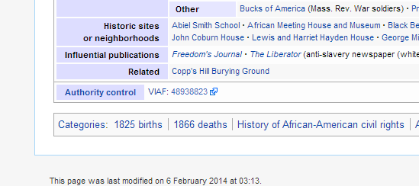
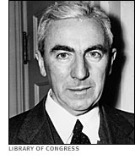
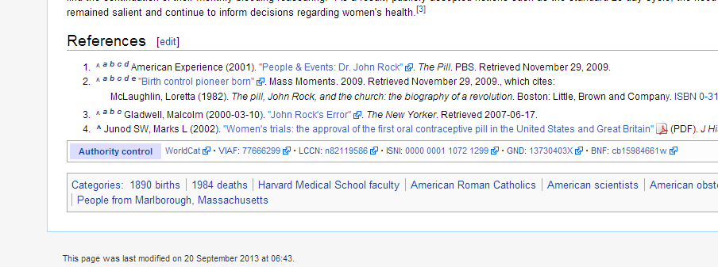
Aiding Authority Control on the Web
Notes:
Who is John Rock?
As a hub of library data, OCLC can use best practices for aggregation, disambiguation and reconciliation.
We can then draw lessons about the future of authority work, cataloging, and the best way to leverage the expertise of the library profession.

Slide 37
OCLC’s Explorations…

Slide 38
WorldCat Linked Data Explorer

Slide 39
Library knowledge graph

Slide 40
Entities of Initial Focus
person
person
place
object
concept
organization
work
work
Notes:
We are initially focusing on these entities, with Works already created and Persons being worked on now. We plan to get to these other entity types in turn.

Slide 41
Linking Translations Appropriately
Title: 西遊記
Language: Chinese
Author: 吳承恩
Created: 1592
HasTranslation:
Title: Journey to the West
Language: English
Translator: Anthony C. Yu
Date: 1977
IsTranslationOf:
Title: Pilgerfahrt
Language: German
Translator: Georgette Boner Date: 1983
IsTranslationOf:
Title: Journey to the West
Language: English
Translator: W. J. F. Jenner
Date: 1982-1984
IsTranslationOf:
Title: 西遊記
Language: Japanese
Translator: 中野美代子
Date: 1986
IsTranslationOf:
Title: Tây du ký bình khảo
Language: Vietnamese
Translator: Phan Quân
Date: 1980
IsTranslationOf:
Notes:
Another purpose for Linked data is to move beyond simple text matching and keyword searches.
We can use the richness of existing WorldCat data – generated by thousands of libraries over many decades – to find and surface connections in a machine-readable way.
Not every connection between works and copies is a simple title match, but the richness of our bibliographic data, as it includes uniform titles, alternate script forms, and authority control, can be transitioned into linked data connecting translations.

Slide 42
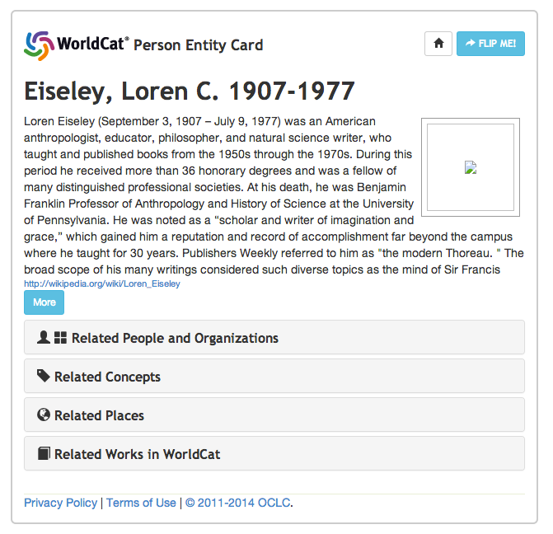
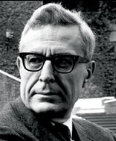
Producing Entities at Scale
Works: released 197 million work IDs for items in WorldCat
People: 18 million entities now in progress
Notes:
One very important thing we are doing is producing linked data entities at scale. We’ve already released nearly 200 million IDs for works in WorldCat. These identifiers relate all of the various manifestations of a work so that libraries can produce new kinds of search and display features for their users. We are now working on producing canonical identifiers for people. But let’s take a deeper look at what we mean by “creating entities”.

Slide 43
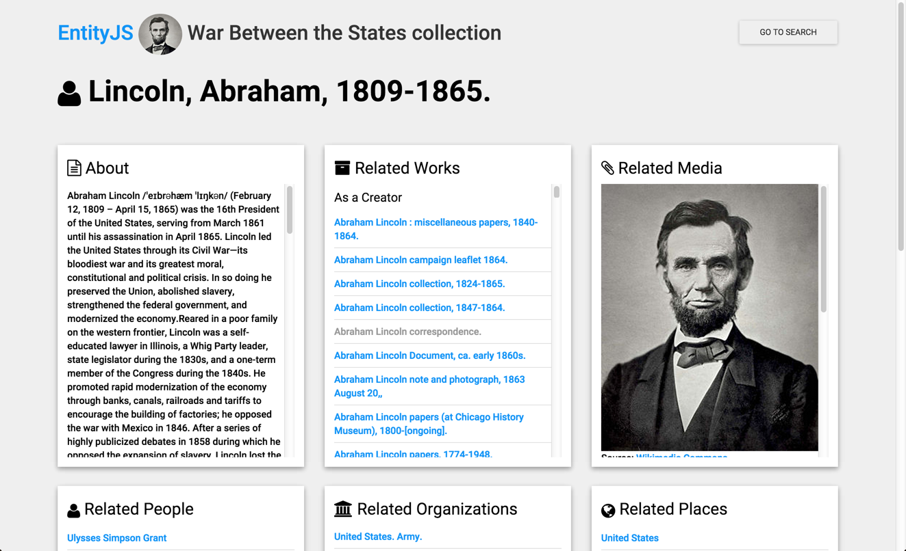
Exploring Ways to Use Linked Data
Notes:
We are also experimenting with ways to consume linked data in user interfaces. In this experiment, searching for “Abraham Lincoln” in a collection of library linked data about the Civil War will find not only works related to this person but will also go out and fetch a brief bio and picture from Wikipedia. These experiments are still in early days, but we have found that by viewing our linked data assertions in this way we can discover how well or poorly we are doing at producing entities. We are also experimenting with mechanisms of engaging library staff in fixing incorrect assertions or adding additional data in a way that can then make the linked data aggregation richer and more accurate.

Slide 44
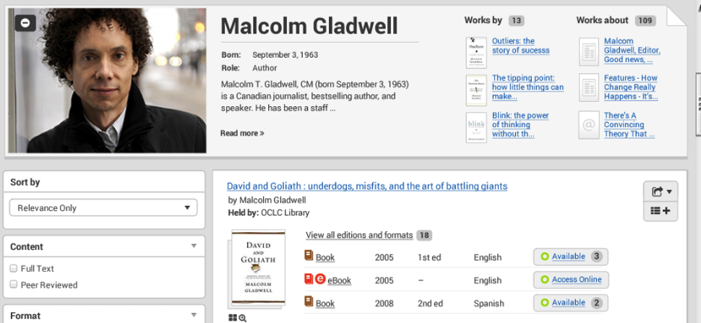
Improving the Discovery Experience
Mockup
Notes:
By modeling data differently, we can do a better job of showing not just works by, but works about, and can pull in information from other sources such as Wikipedia.
Showing links between creative works and the people responsible for them is an intuitive connection that really resonates.

Slide 45
Knowledge Vault data flow
EnhancedWorldCat
Extractor
Knowledge Triples
Scored Triples
VIAF
Extractor
Fusers
FAST
Extractor
Data Sources
Extraction
Collective
Fusion
Knowledge
Vault
Notes:
This diagram depicts some cutting-edge work we have embarked upon based on some papers from Google researchers on their “Knowledge Vault”. We believe that these same principles and techniques can be used to make our linked data better.
The first step in the process is extract “triples” from record-oriented data.
Triples are simple statements that describe a relationship between a subject and an object. For example, the creative work Persuasion was created by Jane Austen.
Expressing those simple statements in RDF, the standard model for information interchange on the web, provides a way to aggregate and process triples provided by a wide range of sources.
The “Extractors” produce “Knowledge Triples” which can associate the statement with who produced the statement, when it was produced, and other properties that can be used later on to compare related claims.
The “Fusion” processes apply mathematics to the collective of Knowledge Triples, to produce Scored Triples in the Knowledge Vault.

Slide 46
Thank you
Eric Childress
Consulting Project Manager
childree@oclc.org
@echildress
©2015 OCLC. This work is licensed under a Creative Commons Attribution 4.0 International License. Suggested attribution: This work uses content from Linked Data, RDA, BIBFRAME © OCLC, used under a Creative Commons Attribution 4.0 International License: http://creativecommons.org/licenses/by/4.0/.

