Slide 1
Semantic Web in Libraries (SWIB19), Hamburg, Germany
27 November 2019
Lessons from representing library metadata in OCLC Research’s Linked Data Wikibase prototype
Karen Smith-Yoshimura
OCLC Research

Slide 2
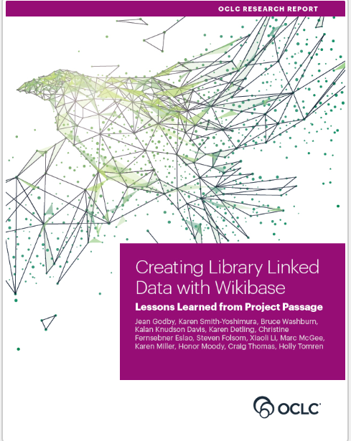
About Project Passage
Ran from December 2017 through September 2018
16 OCLC Member libraries participated
Objective: Evaluate a framework for reconciling, creating, and managing bibliographic and authority data as linked data entities and relationships
Pilot Wikibase instance included 1.2M entities from matches among Wikidata, VIAF, and WorldCat
Godby, Jean, Karen Smith-Yoshimura, Bruce Washburn, Kalan Davis, Karen Detling, Christine Fernsebner Eslao, Steven Folsom, Xiaoli Li, Marc McGee, Karen Miller, Honor Moody, Holly Tomren, and Craig Thomas. 2019. Creating Library Linked Data with Wikibase: Lessons Learned from Project Passage. Dublin, OH: OCLC Research. https://doi.org/10.25333/faq3-ax08.
Notes:
This project provided a sandbox for hands-on experimentation. How do I create a linked data representation for the resource I am looking at right now? How does this process compare with the method I may have already used to describe the resource? Pilot tests of original description with linked data have been conducted by the Library of Congress and other libraries, but this one had a different focus. The was an open-ended exploration that met catalogers where they are – with resources on their to-do lists, which can be described either in the existing paradigm or a new one.
Our report on the project was published last August (2019).

Slide 3
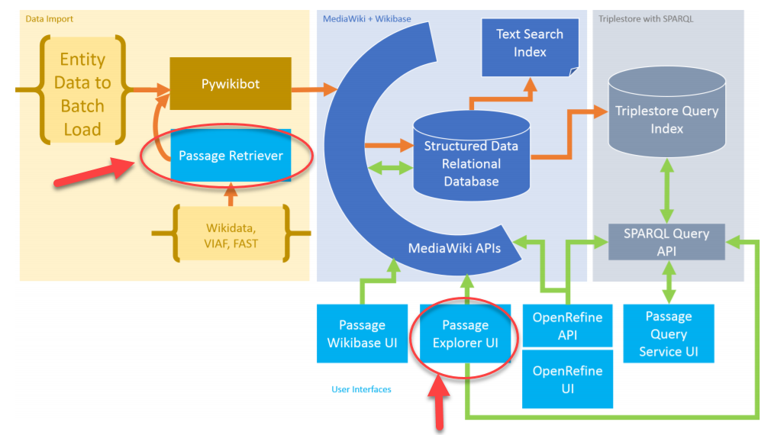
Project Passage Ecosystem
Notes:
Project Passage took advantage of all the functionality in the Wikibase system, shown here, from left to right: data import, Mediawiki functions including the user interfaces, and the triplestore. It enabled us to create a fully configurable environment for experimentation, with many features for editing, crowdsourcing, native multilingual support, and full support for linked data creation. These features are mostly hidden from human users so that metadata librarians were free to concentrate on the work they wanted to do, not the technical details of a linked data implementation.
What I’ve highlighted here with the red arrows are two functions we added in response to feedback from our Project Passage partners: a “Retriever” to import data from other sources and an “Explorer” interface so pilot participants could see the impact of the relationships they added as part of their workflow.

Slide 4
Notes:
Project Passage participants needed a way to bring in entities already defined elsewhere rather than create them from scratch. Here’s a view of the Project Passage Retriever, with search results for the keyword search Elizabeth Gould, an American neuroscientist. The Retriever used the three different APIs that are available for Wikidata, VIAF, and FAST to look for matches. It also used the identifiers associated with the matching results to check in Project Passage, to make sure the entity wasn’t already available there. The Project Passage Retriever used the Wikidata API to retrieve data for the entity description, and using a built-in “crosswalk” it looked for Wikidata properties that had an equivalent property in Project Passage. It displayed a selected entry in a web form where a human could review it and make modifications if needed before adding the entity to the Project Passage Wikibase instance.
In some ways, the biggest takeaway was that the various projects trying to model bibliographic data all tend to identify the same problems and areas of difficulty, but collectively we haven’t found a way to synthesize or share out the modeling problems more broadly, and while some communities have been better about making visible their decision making than others, in general we need to focus more effort on mapping our modeling decisions and being explicit about when and why we diverge from existing models in machine readable ways.
Where partner communities fundamentally disagree on modeling decisions, federated wikibases combined with vocabulary and ontology mappings has a lot of appeal to librarians and other communities that are unwilling to cede control over their data model, but are willing and eager to share their data itself. For many library communities, a federated model is currently the only one that could even be considered, though that may change in time, as we all become more comfortable working with multiple vocabularies and data models.

Slide 5
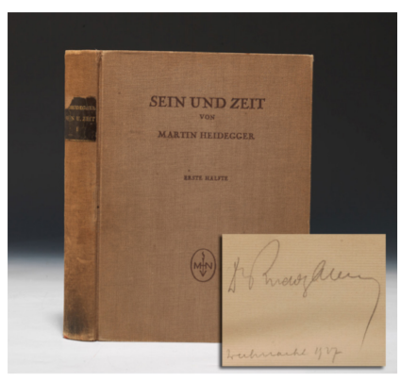
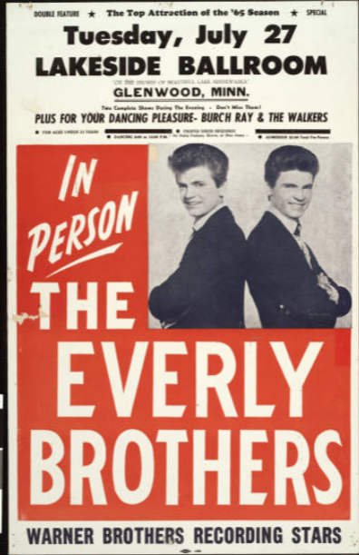
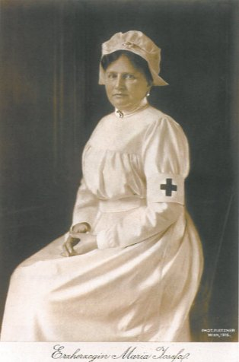
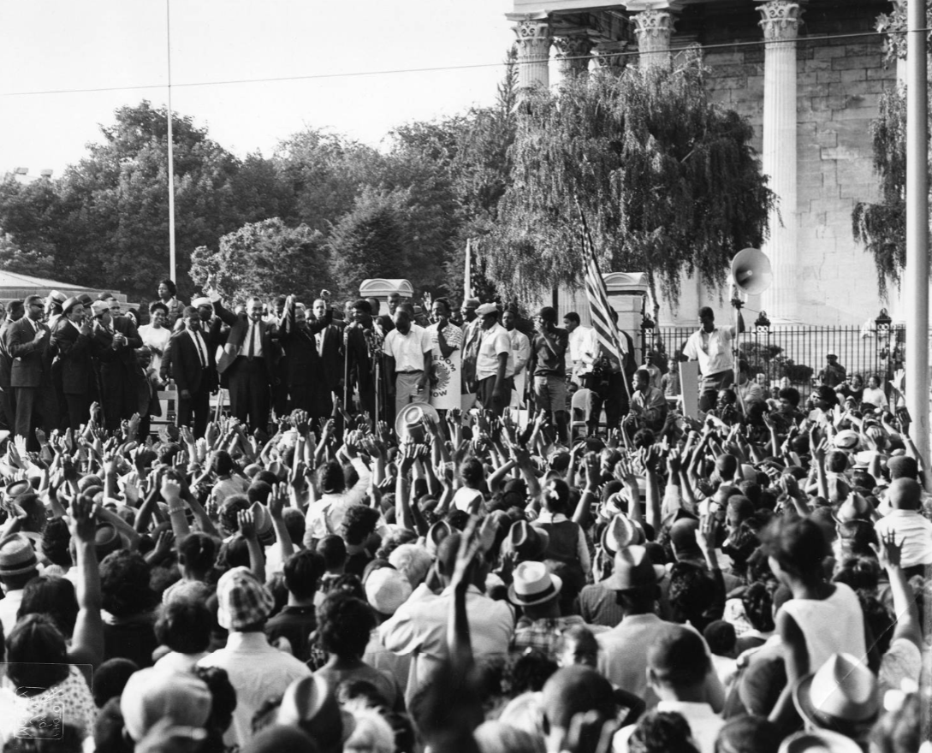
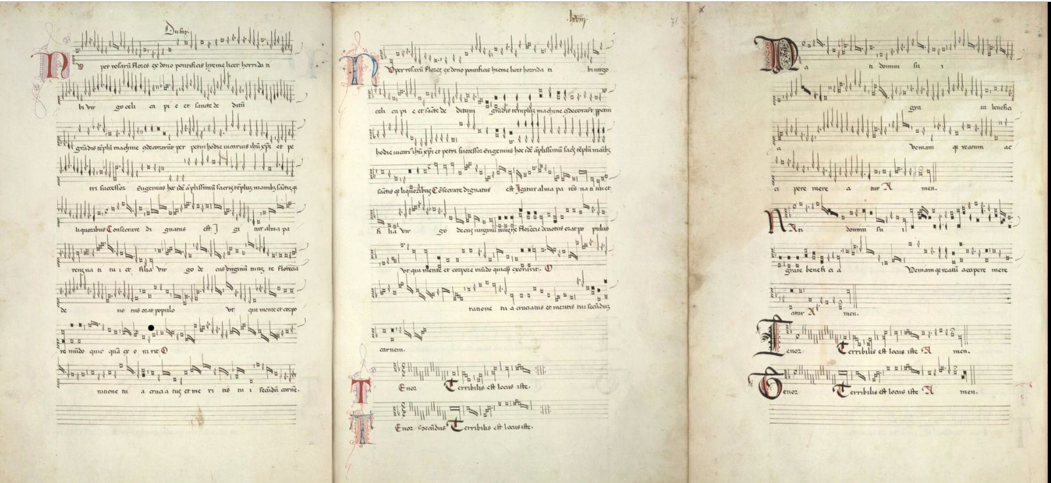
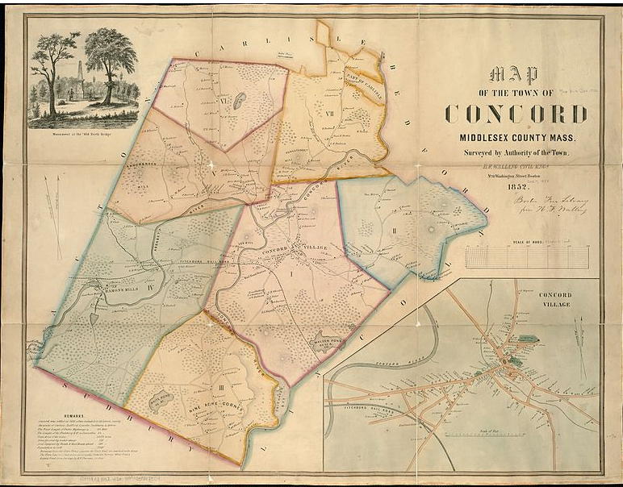
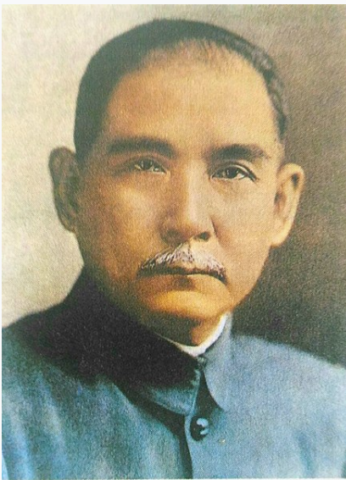
Passage Pilot Partners Use Cases
Notes:
During weekly “office hours”, Passage Pilot Partners showcased some of the use cases they were working on in describing resources and their related entities in the Wikibase structure, highlighting the issues they encountered which often led to additional features or properties. These are some of them: translations, digitized map, a poster for an event, a musical work associated with an event, a digitized postcard, a photo within an archival collection, and exercising Wikibase’s embedded multiscript capabilities with a person entity. We all learned a lot! These use cases revealed patterns or archetypes in a pool of common knowledge. And it was so much fun!
In the following slides I’ll be covering some details about these use cases from our Project Passage report.

Slide 6
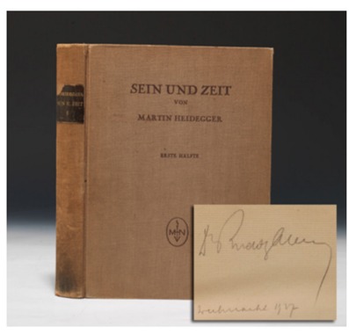
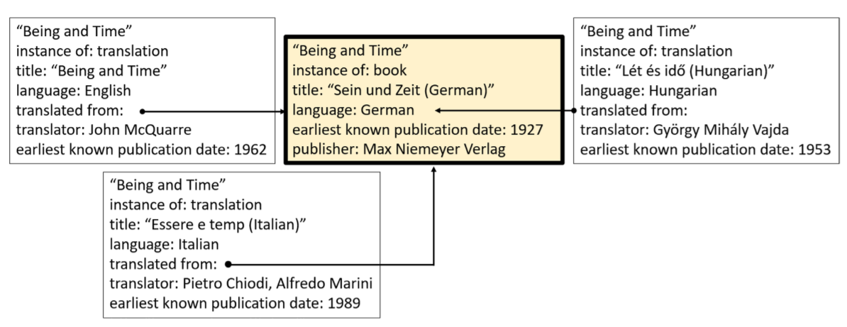
Project Passage Use Case: Translations
From: Godby, Jean, Karen Smith-Yoshimura, Bruce Washburn, Kalan Knudson Davis, Karen Detling, Christine Fernsebner Eslao,
Steven Folsom, Xiaoli Li, Marc McGee, Karen Miller, Honor Moody, Craig Thomas, and Holly Tomren. 2019. Creating Library
Linked Data with Wikibase: Lessons Learned from Project Passage. Dublin, OH: OCLC Research. https://doi.org/10.25333/faq3-ax08.
Notes:
Translations were one of the first Project Passage use cases and homework assignments. We imported from WorldCat 37 different translations of Heidegger’s Sein und Zeit. Each translation is its own entity with the property “translated from” linked to the original German work. There was a temptation to also add “translated to” to the entity for the original work, but that would mean it would have to be edited each time a new translation was added. Instead, the Explorer interface showed that adding the inverse relationship was not needed, and people could see the results of their entries without leaving the metadata-creation workflow.

Slide 7
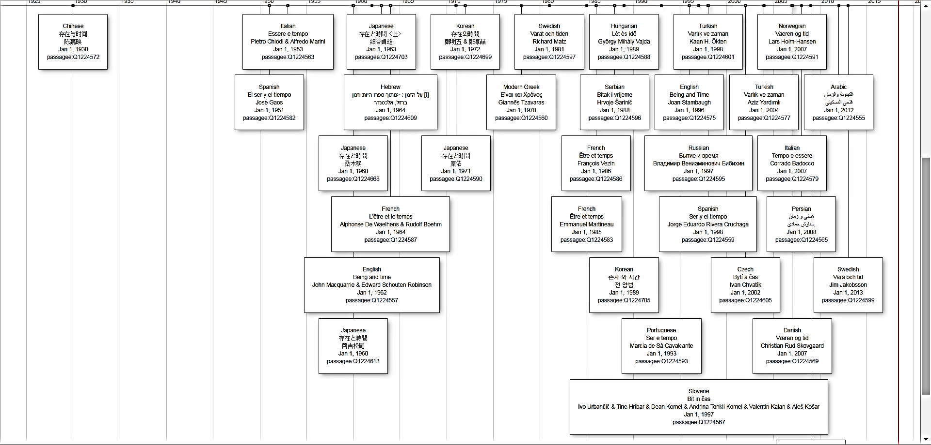
Translations of Sein und Zeit
Notes:
These are all the Passage entities retrieved by a SPARQL query that had a “ “Translated from:” statement for Sein und Zeit displayed in a timeline. I chose to display in a timeline the statements for Language of the translation, the translated title, the translators, and the date. <click> The four circled here are for Japanese translations, each by a different translator. Some translations are better than others, especially for languages as different as German and Japanese, which is why it’s so crucial to identify the respective translators. This visualization far exceeds what we can accomplish with raw MARC records.

Slide 8
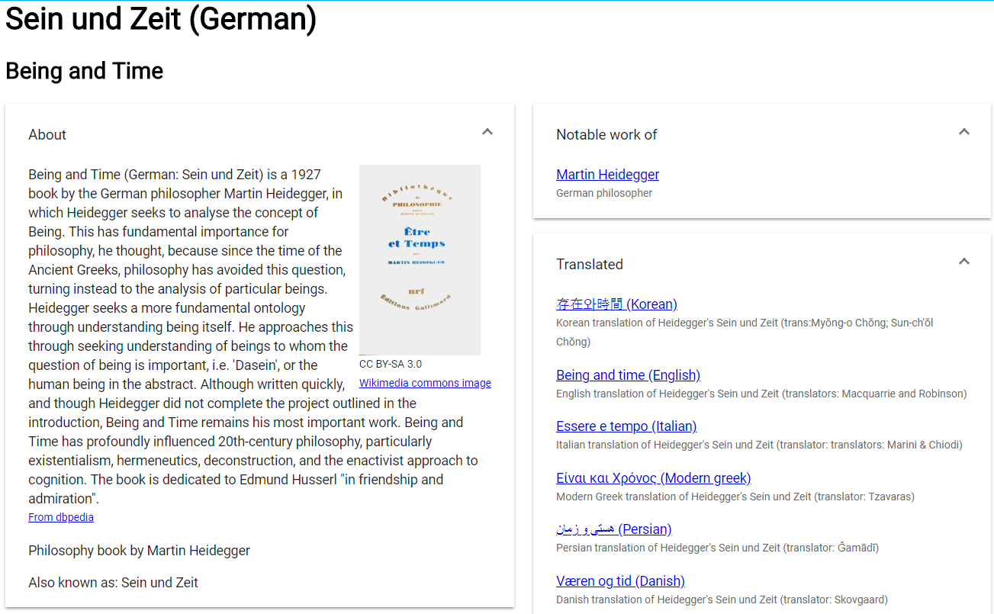
Explorer Interface
Explorer Interface
Notes:
The Explorer interface allowed metadata creators to verify that all the inverse relationships were indeed represented. In this case, we show that the original work, Sein und Zeit was translated into other languages. The Explorer discovery layer also pulled in images from Wikimedia commons and descriptions from DBpedia. And it served to remind us that the free text descriptions we’ve put into our MARC records could be pulled in from other sources instead in a linked data environment.

Slide 9
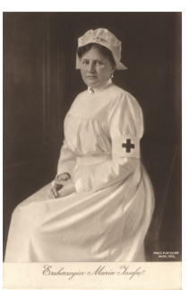
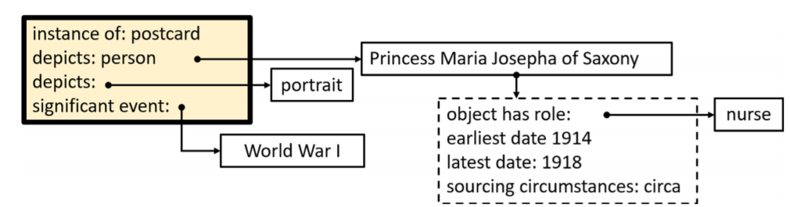
Use Case: Postcard Depicting a Person
From: Godby, Jean, Karen Smith-Yoshimura, Bruce Washburn, Kalan Knudson Davis, Karen Detling, Christine Fernsebner Eslao,
Steven Folsom, Xiaoli Li, Marc McGee, Karen Miller, Honor Moody, Craig Thomas, and Holly Tomren. 2019. Creating Library
Linked Data with Wikibase: Lessons Learned from Project Passage. Dublin, OH: OCLC Research. https://doi.org/10.25333/faq3-ax08.
Notes:
The schematic here shows the Wikibase entities for content relationships in this postcard depicting Princess Maria Josepha of Saxony , the sister-in-law of Franz Ferdinand, the Archduke of Austria whose assassination in Sarajevo, Serbia in 1914 sparked the events starting World War I. It illustrates how we can specify a temporary role during a specific time period, as she served as a nurse only during World War I. The object described in Wikibase is actually the postcard, depicting a person.

Slide 10

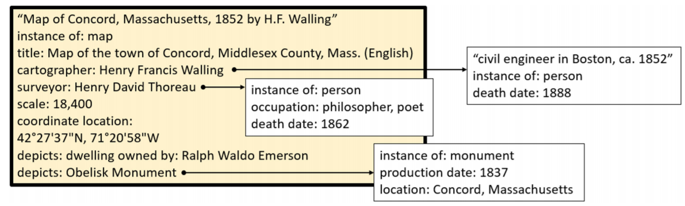
Project Passage Use Case: Map
From: Godby, Jean, Karen Smith-Yoshimura, Bruce Washburn, Kalan Knudson Davis, Karen Detling, Christine Fernsebner Eslao,
Steven Folsom, Xiaoli Li, Marc McGee, Karen Miller, Honor Moody, Craig Thomas, and Holly Tomren. 2019. Creating Library
Linked Data with Wikibase: Lessons Learned from Project Passage. Dublin, OH: OCLC Research. https://doi.org/10.25333/faq3-ax08.
Notes:
This use case illustrate the use of “depicts” for both the main image of a map of Concord, Massachusetts and a section of Middlesex County, as well as the inset message of Ralph Waldo Emerson’s dwelling and an Obelisk monument. This supports searching for each image within an image – a level of granularity that cannot be expressed in our legacy MARC systems. We also found we needed to modify the ontology we had imported from Wikidata. <click> Thoreau, the surveyor of the two ponds on the map, was initially connected to the description by the “contributor” property, as “surveyor” was not defined as a property. We added “surveyor” as a property to the Project Passage ontology, allowing a more precise description of Thoreau’s contribution to the map.

Slide 11
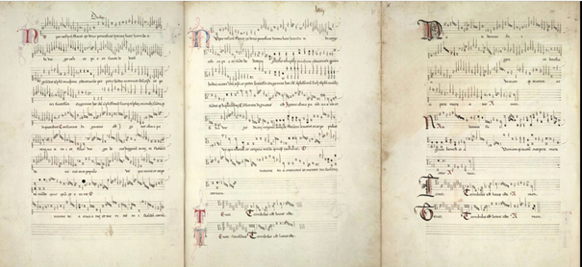
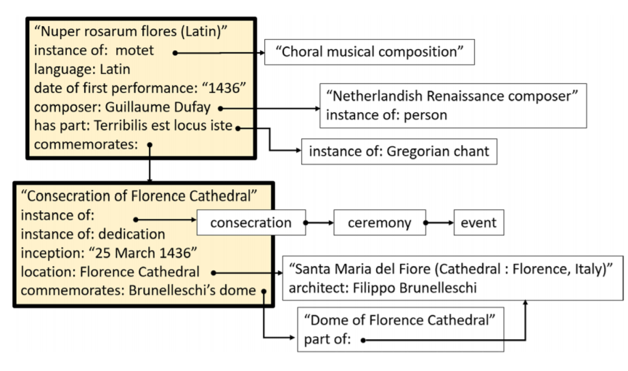
Use Case: Musical Work for an Event
From: Godby, Jean, Karen Smith-Yoshimura, Bruce Washburn, Kalan Knudson Davis, Karen Detling, Christine Fernsebner Eslao,
Steven Folsom, Xiaoli Li, Marc McGee, Karen Miller, Honor Moody, Craig Thomas, and Holly Tomren. 2019. Creating Library
Linked Data with Wikibase: Lessons Learned from Project Passage. Dublin, OH: OCLC Research. https://doi.org/10.25333/faq3-ax08.
Notes:
This case represented a sacred musical composition commissioned for and performed at the consecration of Florence Cathedral in 1436. The items and properties describing the musical score, the consecration event, and the interconnections between the two were all added to the brief entity for the musical work that was imported into Passage from Wikidata from the Retriever-- producing a network of relationships that exceeds the detail currently represented in corresponding MARC-based library authority files.
It also highlighted a common question from all our use cases – how to share all these enrichments back to Wikidata or other relevant Wikibase instances?
This figure shows that the Nuper rosarum flores commemorates the consecration of the Florence Cathedral, but the inverse is also true: the consecration was commemorated by the motet. This inverse relationship could be automatically generated and revealed in the Project Passage Explorer discovery layer.

Slide 12
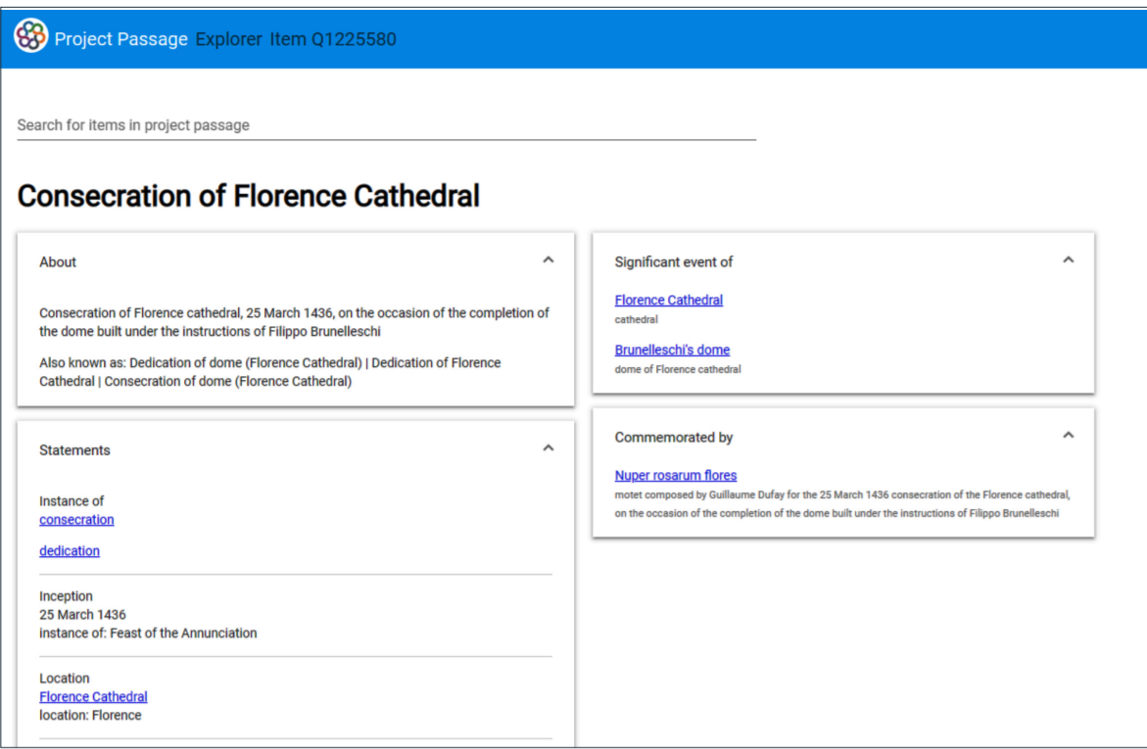
Notes:
Here we see the inverse relationship displayed in the Explorer interface, that the Consecration of Florence Cathedral was commemorated by the motet.

Slide 13

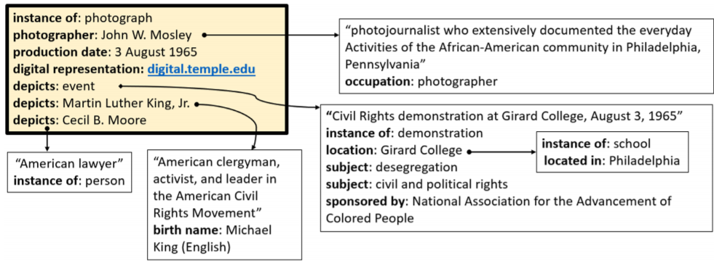
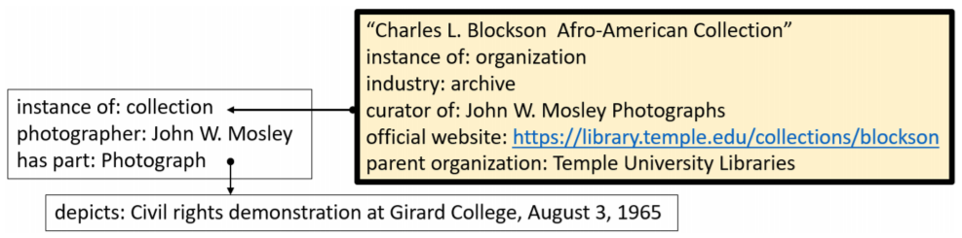
Use Case: Photograph in an Archive
Content
Institutional context
Notes:
The photograph illustrates that in contrast to the map example, the “depicts” statements complements the “subject” statements inherited from the existing metadata for the image.” “Depicts” was good for picking out who or what is *in* the photograph but “Subject” was needed to state *what* this scene is about. It reveals issues about context-building for items in a collection and how to represent narrative or expository text about the resource that establishes context, identifies content, and engages in commentary.
This photograph also provided a starting place for describing archives in the Passage editing workflow, as an item in a collection within a research institution shown in the second graph. The Passage descriptions for the archive were a by-product of the need to describe the photograph. Given the tradition of narrative and other text-based description, archives would seem to benefit most from workflows that facilitate creating structured data because so little is otherwise available. But the Passage experience revealed we need much more community discussion to produce models redrawing the line between structured and textual data and best practices for both.

Slide 14
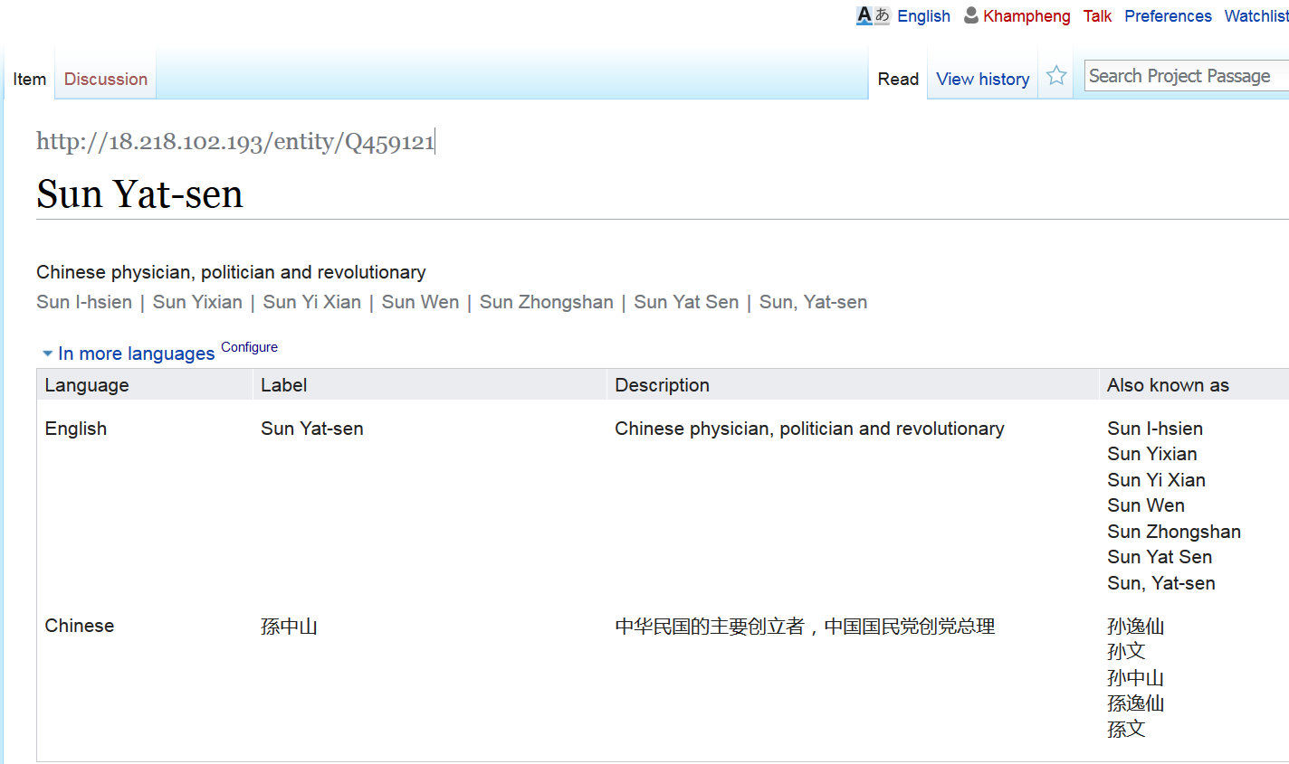
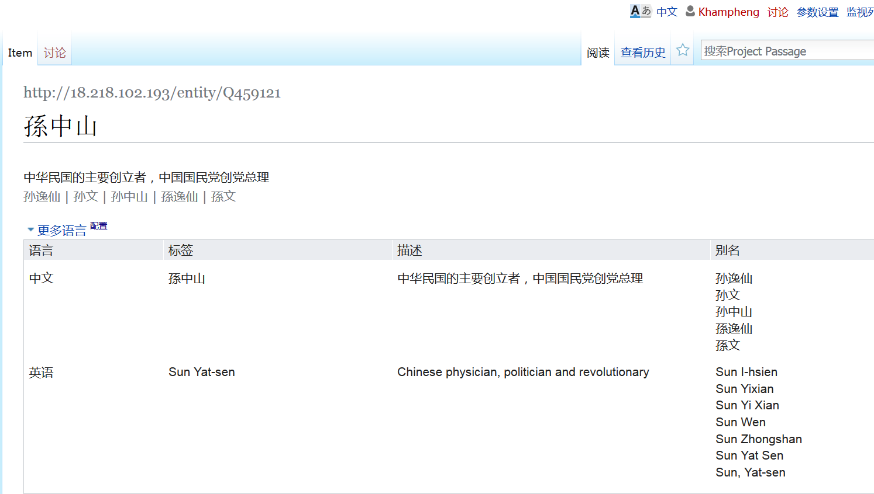
Notes:
The same entity, Sun Yat-sen—with the same identifier—can be edited and displayed in different languages and writing systems. No need to decide which form of the name is considered the authorized string (like current practice).

Slide 15

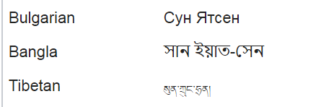


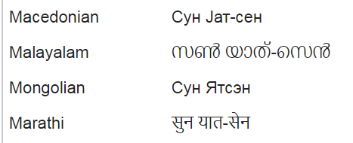
Some other Wikidata labels
Notes:
These are some of the Wikidata labels for Sun Yatsen now in different scripts. There can be any number of variant forms in these different scripts – there are no constraints on the “preferred form” as in our current authority files and the concept of “language of cataloging” disappears.

Slide 16
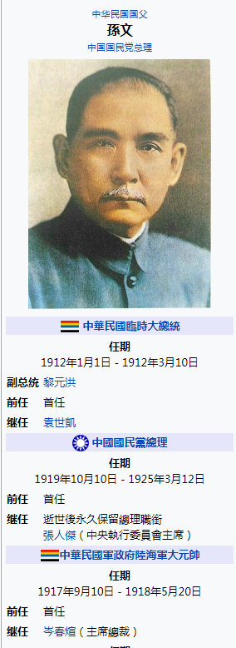
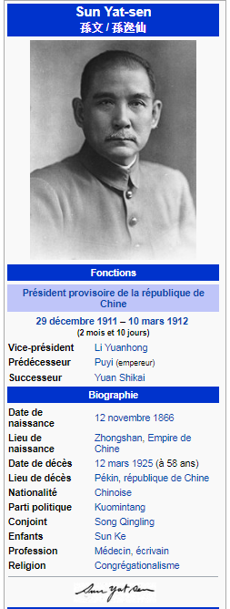
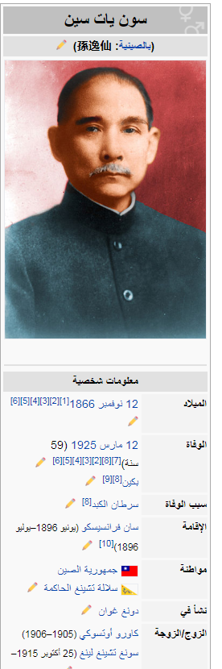
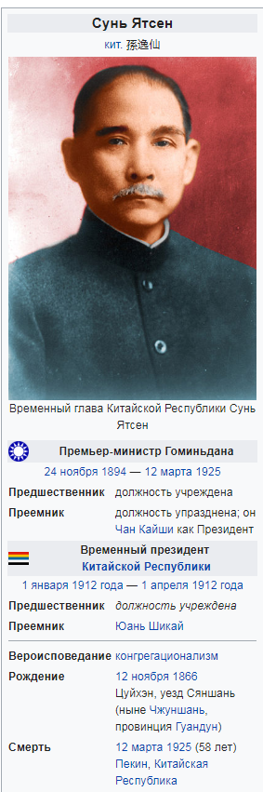
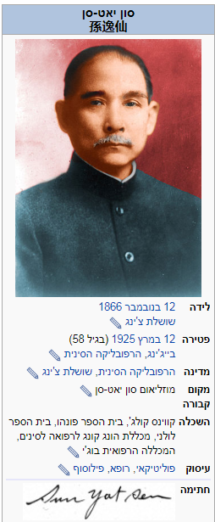
Notes:
Here we can see the effects of structured metadata associated with the same entity. These are Wikipedia information boxes with the data represented in Wikidata – Chinese, French, Russia, Arabic, and Hebrew. All are tied to the same Wikidata identifier--representing the same entity—but the information is presented in the preferred language and script of the user.

Slide 17
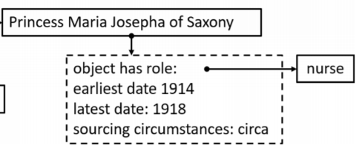
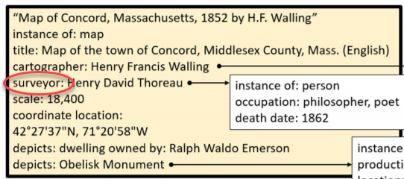
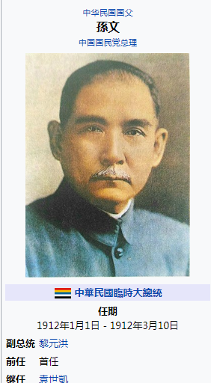
Lessons Recap
Need for Retriever (import)
and Explorer (discovery)
Structured data created with more
precision than current library standards
Need to enhance the imported
ontology – but how do we share the enhancements? Need interoperability
Multiscript support replaces “language of
cataloging” and obviates the need for
transliterations
Notes:
To populate knowledge graphs with library metadata we need tools like the Retriever to facilitate the import of data created elsewhere and the Explorer to allow librarians to see the results of their effort without leaving the metadata-creation workflow. This was especially important to quench the temptation to include inverse relationships which could be shown through a discovery application instead of the data itself.
Most use cases demonstrated that we could enrich the descriptions in structured data with a precision that exceeded current library practices.
Some use cases required that we had to add properties and terms not represented in the Wikidata ontology. Some of the use cases demonstrated many areas where the entity description could be greatly enriched – but that raised the question of how to share back those enhancements with the Wikidata source or the growing number of relevant Wikibase instances now being installed by a variety of libraries?
With the embedded multiscript support, people could add structured data in their own writing systems and thus the minimizes the need to also include transliterations as in current library practices. The ability to change one’s language interface replaces the “language of cataloging” we use now.

Slide 18

Reflections
What entities matter to this object? Traditional
distinction between authority and bibliographic data disappears
Need “best practices”: What statements, what properties?
Still need interpretative context: interplay of “structured” and “narrative” data
Would crowd-sourcing undermine librarians’ authoritative, quality data?
Local Wikibase instances expedient, but how to interoperate with Wikidata, other instances?
Notes:
Identifying the “entities that matter” shifts the focus from the “item in hand” that underlies current cataloging practices to establishing the relationships among the entities relevant to the object being described. But deciding where to start and stop can be difficult when the deliverable is no longer a discrete record but a “piece of the knowledge graph.”
Throughout the pilot, participants needed some guidance about what statements and properties were needed and the more diverse the community, the more best practices will be needed.
We also found that narrative data is crucial for digital and archival collections. So much so that after the pilot OCLC launched a new “Archives and Special Collections Linked Data Review Group” to define the requirements for data that need to be reflected in a linked data environment.
Although members of the “crowd” would have expertise to contribute to library metadata, pilot participants raised concerns about whether encouraging “unvetted” information from unknown sources would dilute the integrity of curated library data.
The key issue raised by the pilot was the long-term sustainability of a local Wikibase instance. For a short-lived pilot like Project Passage, a local Wikibase instance was expedient as it provided a fully featured but private and configurable space to try out a wide range of use cases and minimized the consequence of failure. The proliferation of other Wikibase instances raises the specter of library resource descriptions continuing to be represented in separate datasets. How to share the enrichments done in Project Passage with Wikidata or other Wikibase instances? Or ingest enriched data created by other Wikibase instances? Technically, all Wikibase instances will likely have an architecture compatible with linked data principles, offering the promise of interoperability with data published both inside and outside the library community.
Image from Unsplash

Slide 19

Semantic Web in Libraries (SWIB19), Hamburg, Germany
27 November 2019
Thank you!
Contact: Karen Smith-Yoshimura
smithyok@oclc.org
@KarenS_Y
oc.lc/linkeddataresearch
©2018 OCLC. This work is licensed under a Creative Commons Attribution 4.0 International License. Suggested attribution: “This work uses content from Lessons from representing library metadata in OCLC Research’s Linked Data Wikibase prototype © OCLC, used under a Creative Commons Attribution 4.0 International License: http://creativecommons.org/licenses/by/4.0/.”
Notes:
All OCLC Research’s work on linked data, including the Project Passage report, is accessible at the URL given here.

