Slide 1

OCLC Research library partnership update

Slide 2
OCLC Membership and Research Division
Engage members as advocates who participate effectively in the cooperative
Activate communities of practice that help libraries plan with confidence, position with effect and make an impact
Generate knowledge, evidence and models that will improve libraries

Slide 3
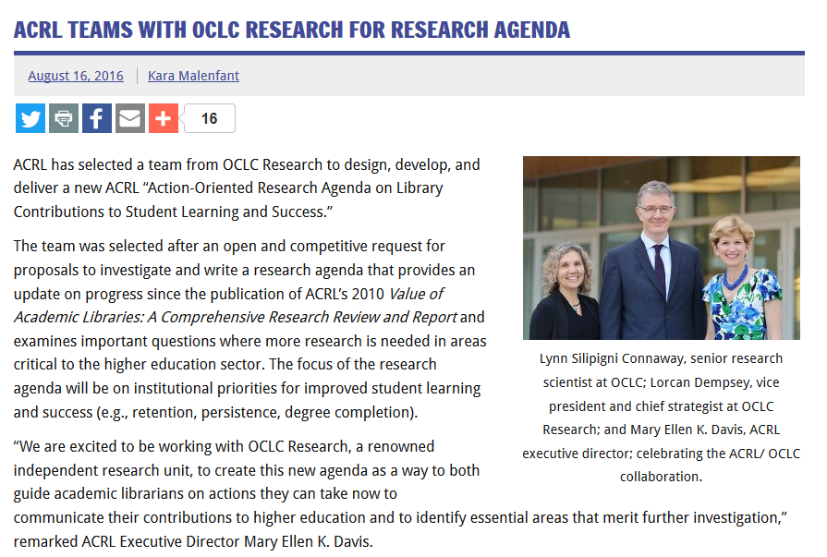
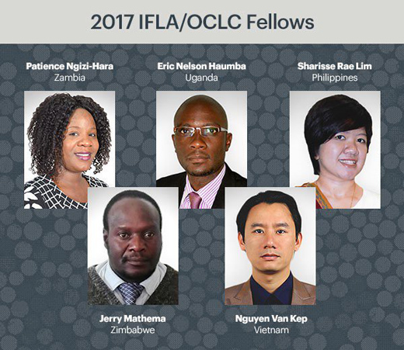
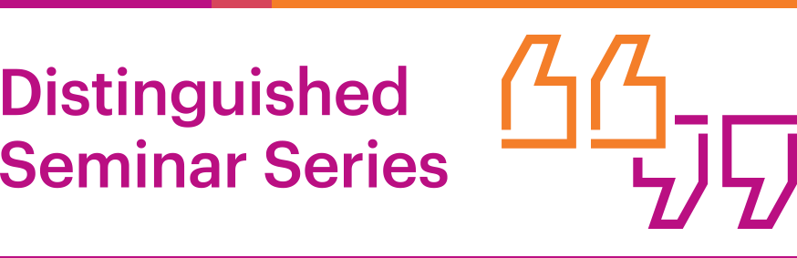


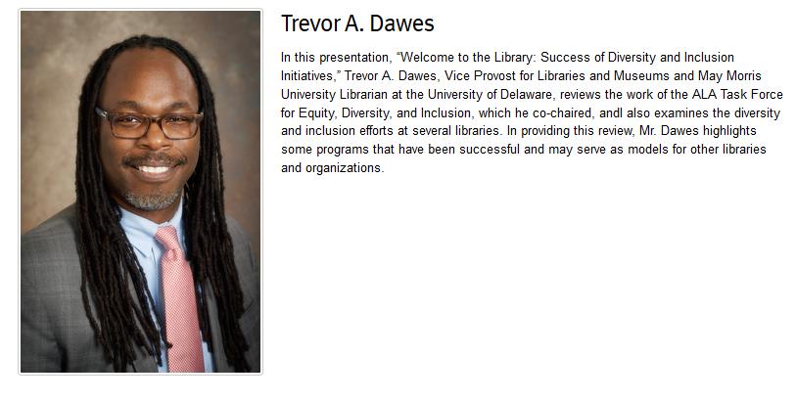
News
2016
  1,100 attendees
  13 events
  US, Canada, Puerto Rico and the UK
Launched 2015
9,000+ members
Notes:
ACRL “Action-Oriented Research Agenda on Library Contributions to Student Learning and Success.” http://www.acrl.ala.org/acrlinsider/archives/12324
IFLA Fellows 2017 http://www.ifla.org/node/10753
DSS: http://www.oclc.org/research/events/dss.html
Member Forums: https://www.oclc.org/en/events/member-forums.html
Community Center https://www.oclc.org/community

Slide 4
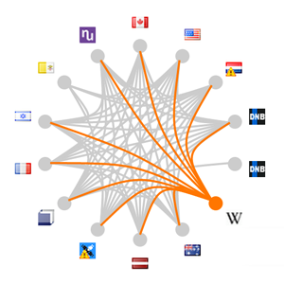
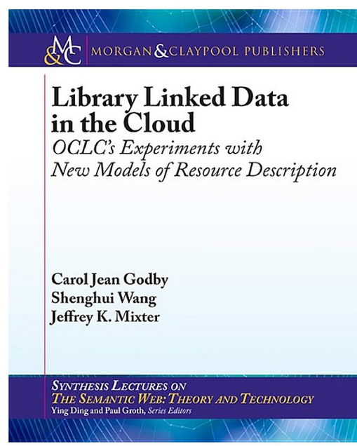

Data Science
The Web is the native environment of information seekers. OCLC Research recognizes that to be integrated into the Web, traditional library data must be transformed in various ways. We are analyzing the data in WorldCat and other sources to derive new meaning, insights, and services for use by libraries and others on the Web.
VIAF
Virtual International Authority File

Slide 5

Notes:
WebJunction provides free content, programs and resources to build the knowledge, skills and confidence library staff need to power vibrant, relevant libraries.
WebJunction’s course catalog now includes 43 self-paced courses on library topics and over 200 webinar recordings, all available for free and ready when you are.

Slide 6
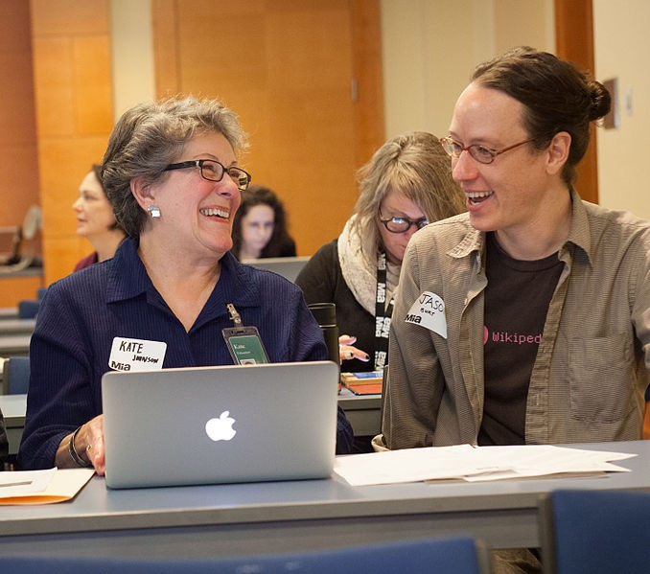
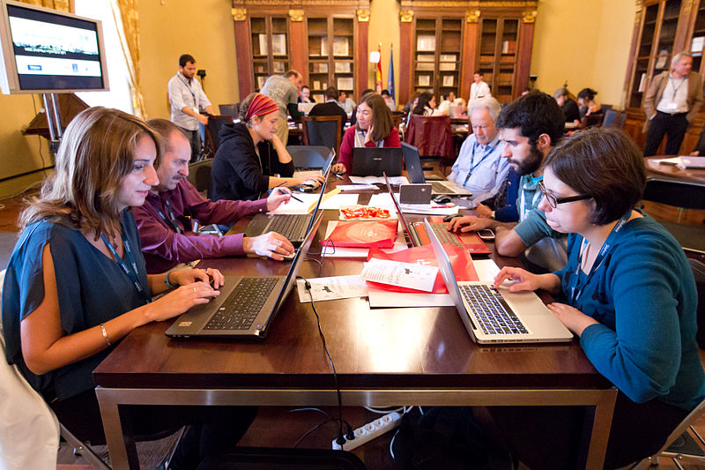
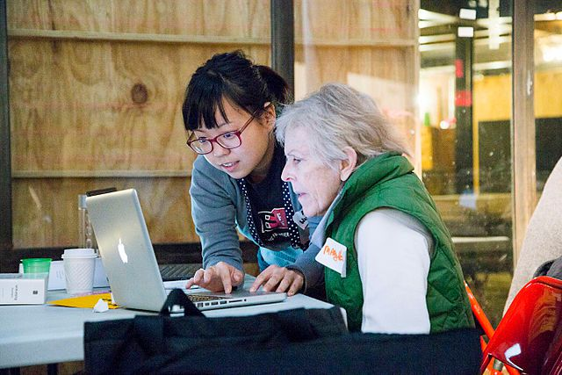
Public libraries + Wikipedia
(Photo: CC BY-SA 4.0/Michael Mandiberg)
Notes:
What are the results we expect from this match between Wikipedians and Librarians?
Wikipedians will better understand how their local public library can enrich their work.
Libraries and their resources will be more visible on Wikipedia.
And librarians will be better equipped to help information seekers make the best use of Wikipedia.
New human-to-human connections and understanding between the Wikipedia and library communities will be forged, so that they can be advocates for how the two entities protect free and open access to knowledge.
We also hope to see libraries offer new programs that guide community members to become Wikipedia editors in their own right and thus inject new and more diverse perspectives into Wikipedia.
Under the guidance of librarians who understand how to create high-quality articles and new connections to the Wikipedian community to reinforce this shared goal, Wikipedia will be improved as an information resource.

Slide 7
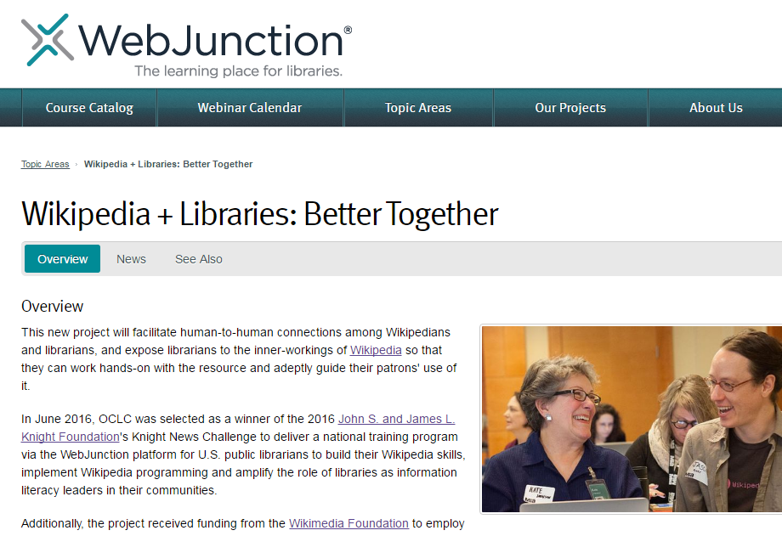
oc.lc/oclc-wikilib

Slide 8
Wikipedia project
Build awareness – wherefore Wikipedia?
Online training program for 500 US public library staff
Guidance from a Wikipedian-in-Residence
Learning applied in libraries and community programs
Case studies and resources published
December 2016 – May 2018
Notes:
We are currently in the first phase of the project, which kicked off last month.
We are building general awareness of the topic of Wikipedia, why it is worth libraries’ time and attention, and how libraries can get involved.
We’re in the process of selecting a Wikipedian in Residence to work with us for the duration of the project.
We’ll offer an online training program to 500 public library staff. This training will be created by WebJunction staff, in collaboration with our Wikipedian in Residence, our subject matter expert Merrilee Proffitt, and our project advisors.
Then, the Wikipedian in Residence will continue to guide libraries who chose to try out new programming in their library around Wikipedia. There are examples of libraries who have done these types of programs, such as editathons on locally relevant topics, that we can draw from.
We’ll pull together case studies from what we learn from the training program and the library activities, and all will be shared broadly to the community.

Slide 9
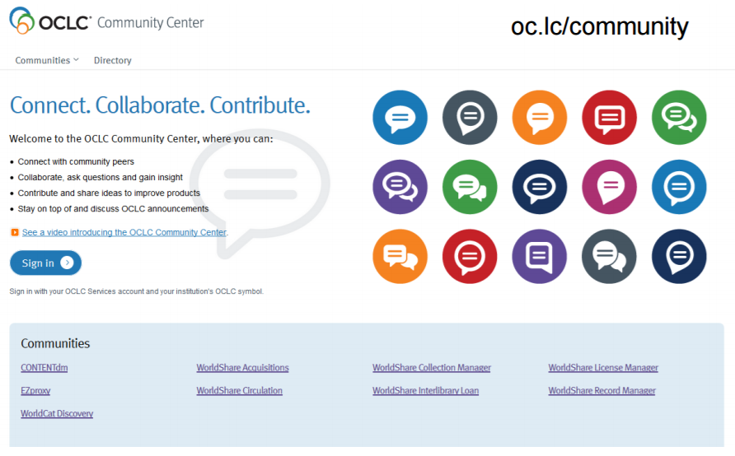
Notes:
In one place…documentation and training, participate in online discussions with other users, learn about OCLC updates, be alerted to upcoming events, and suggest track and comment on product enhancements.

Slide 10
The OCLC Research Library Partnership
A Platform to actively engage with OCLC Research and its Partners
Trusted Resource helping libraries understand research in context with confidence, position with effect and make an impact
Access to Expertise providing advice and guidance
Metadata and Knowledge Work
Distinctive (Special) Collections
Research Data Management / Researcher Information Management
Collective Collections
Notes:
The OCLC Research Library Partnership brings together an international cohort of leading research libraries to work closely with OCLC and each other to identify and explore issues of import to this community.
The functional deliverables for the Partnership are as follows…

Slide 11
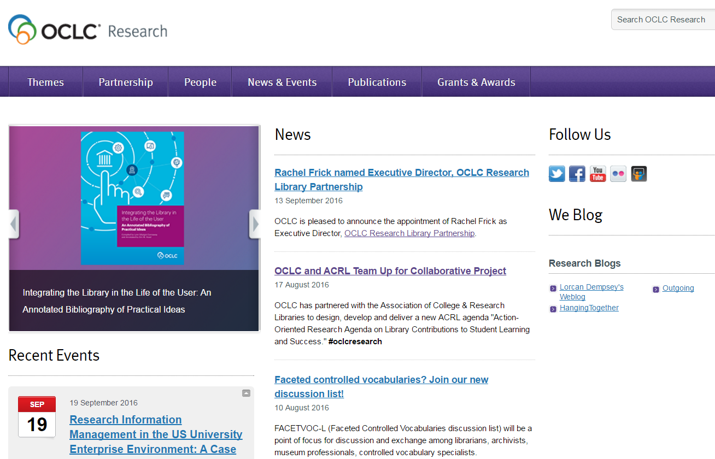
www.oclc.org/research

Slide 12
Two takeaways – Partner staff
Are you subscribed to OCLCRLP-ANNOUNCE-L?
Have you picked an OCLC Research brain lately?
  Email massied@oclc.org

