Slide 1
6 December 2017
Research Information Management and the Role of the Library
OCLC Research Library Partnership
Works in Progress Webinar

Slide 2
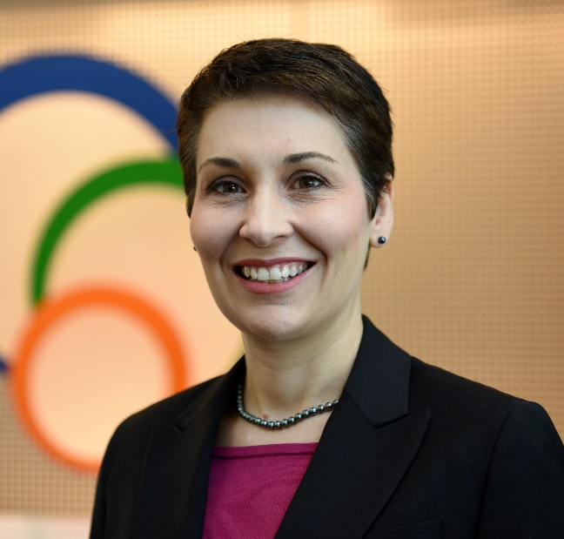
Rebecca Bryant, PhD
Senior Program Officer, OCLC Research, USA
orcid.org/0000-0002-2753-3881 @rebeccabryant18 bryantr@oclc.org
Simon Huggard
Deputy Director, Research & Collections, La Trobe University Library, Australia
orcid.org/0000-0002-0365-112X @simonhuggard s.huggard@latrobe.edu.au

Slide 3

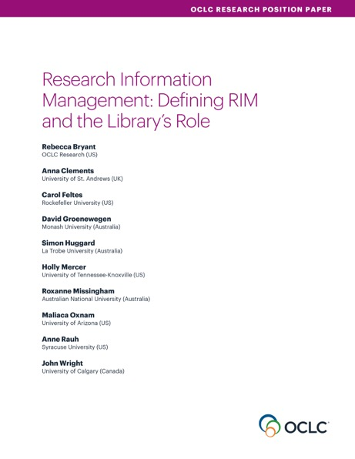
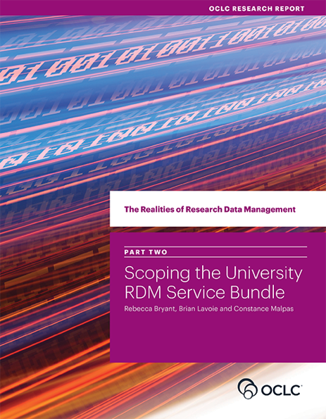
oc.lc/RIMpaper
oc.lc/rdm
Division of OCLC
Since 1978
Community resource for shared Research and Development (R&D)
Engagement with OCLC members
oc.lc/research
http://www.oclc.org/research/publications/reports.html
Notes:
OCLC Research continues to provide insight for the field in many areas including research data management, user-centered library services, and digitization efforts. These are three of our recent reports and all are available as free downloads on our website.

Slide 4

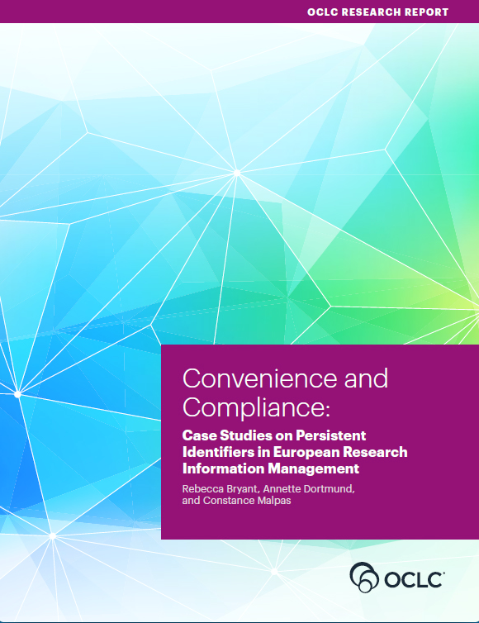
oc.lc/rimpaper
oc.lc/rim
oc.lc/rim
Research Report
Survey on Research Information Management Practices
Forthcoming 2018
Forthcoming December 2017

Slide 5
OCLC Research Library Partnership (RLP)
~150 research libraries worldwide
Facilitates collaboration, research, & sharing across member institutions & with OCLC Research
  Working groups
  Research reports
  Webinars
  Consultations & events
www.oclc.org/research/partnership.html

Slide 6
Provides an international framework for understanding RIM practices
Synthesizes the value proposition of libraries in RIM service provision
oc.lc/rimpaper

Slide 7
Position paper description
The goal of this report is to help libraries and other institutional stakeholders understand developing research information management practices—and particularly the value add that libraries can offer in this complex ecosystem.
  It offers a definition of RIM practices and nomenclature, offering models to explain the metadata sources, uses, and institutional stakeholders.
  It also provides examples and models of library engagement in RIM.

Slide 8


What is Research Information Management (RIM)?
The aggregation, curation, & utilization of metadata about research activities
    Overlapping terms:
    CRIS (Current Research Information System)
    RIS (Research Information System)
    RNS (Research Networking System)
    RPS (Research Profiling System)
    FAR (Faculty Activity Reporting)
    RIMs ≠ social networking platforms like ResearchGate or Academia.edu
    RIM ≠ Research Data Management (RDM)
Notes:
I joined OCLC Research in 2016, after spending most of my time as an administrator working in academic and student affairs at the University of Illinois, establishing institutional-wide RIM services at UIUC, and also some time as community director at ORCID.
At OCLC I lead research efforts related to research information management, as we recognize this is an emerging area for libraries—in North America and worldwide.
To that end, I’ve worked with our global community of research library partners, including Anna Clements, to try to develop a framework for understanding a multitude of practices—and names—that can fall under a more broad ”research information management” umbrella.

Slide 9
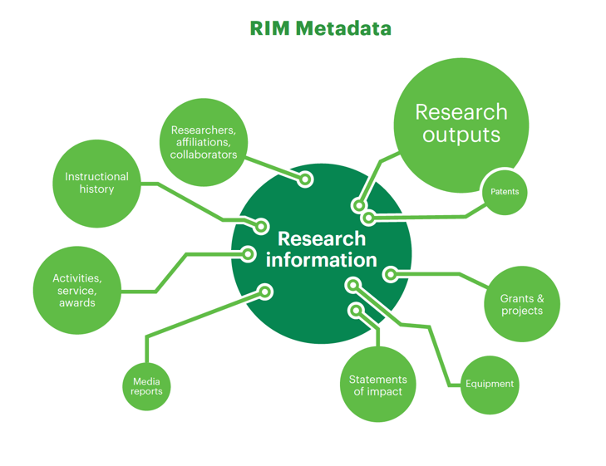
RIM Metadata

Slide 10
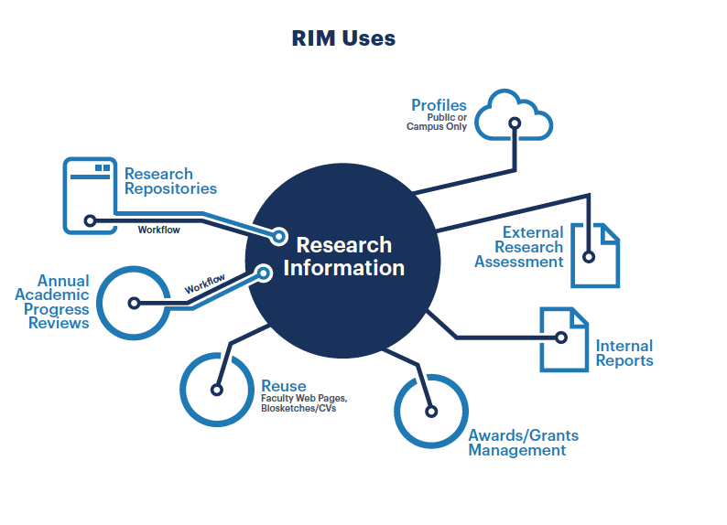
RIM Uses

Slide 11
CASE STUDY:
Research Information Management at La Trobe University

Slide 12
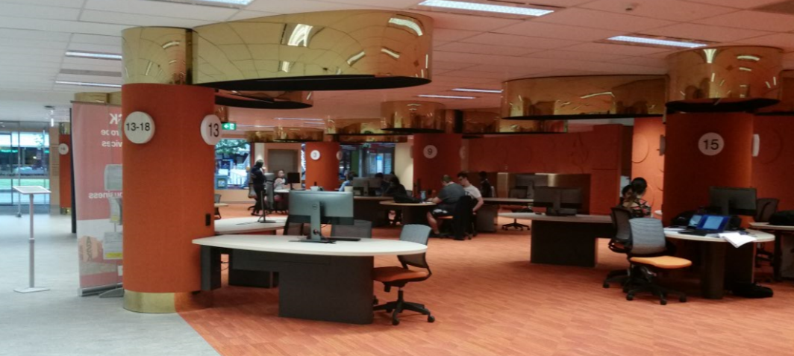
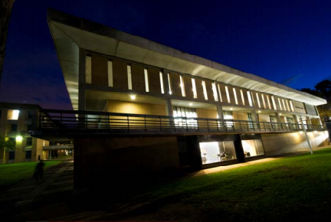
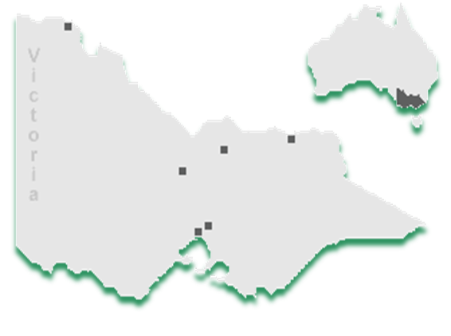

La Trobe University (Victoria, Australia)
Established in 1964
More than 36,000 students (27, 971 full-time equivalent)
20% are graduate students (6,847) ; 1,636 Research students
23% are international (8451) ; 1,488 Faculty academic staff
Main campus in Melbourne; 4 regional campuses in the state of Victoria
$26m Library budget (AUD); $14m Information Resources budget

Slide 13
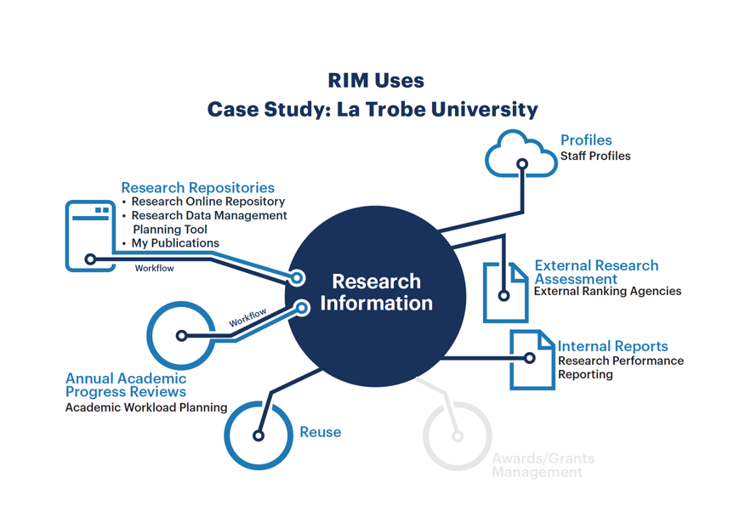
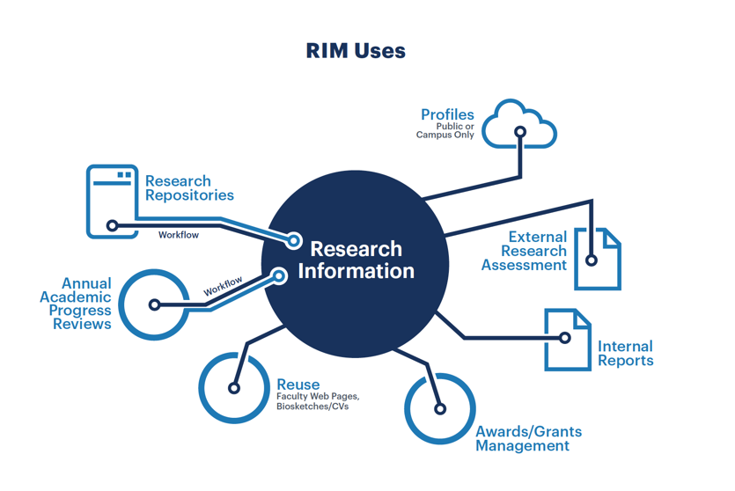

Slide 14
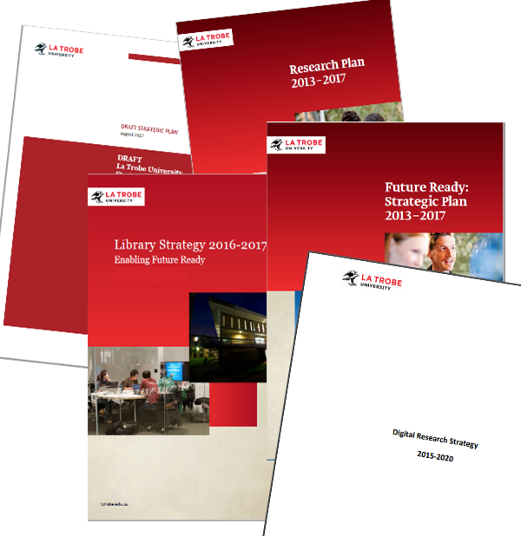
La Trobe University Strategic Goals and Plans
Improve research quality and impact
Support excellent research
Investment in state of the art IT and
e-Research infrastructure
Improve La Trobe’s international
ranking by promoting research
Increase research quantity and quality
Notes:
University Future Ready Strategic Plan 2013-2017; Research Plan 2013-2017 ; Library Strategy 2016-2017; Digital Research Strategy 2015-2020.

Slide 15
Initiatives and projects
Library-led research data management initiative 2015-
Digital Research Strategy 2015-2018
Enterprise Research Data Management Systems (ERDMS) Project 2016-2018
Project for Research Information Management Enablement (PRIME) 2017-2019
Projects will unify researchers’ digital presence and simplify their research workflows

Slide 16



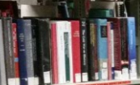

Australian Research Information
Management Landscape
Government reporting
Funder mandates
Changing policies
Australian Code for the Responsible Conduct of Research

Slide 18
Who?
Enterprise-wide collaboration and the role of the library

Slide 19
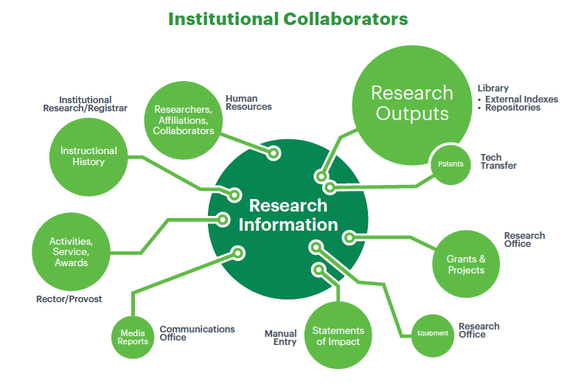
Institutional Collaborators
Notes:
Opportunities to leverage through collaborations to address other institutional challenges
Opportunities to better address local goals by understanding the problems others at the institution are trying to solve.
Provost & institutional research
Research Office
Campus communications
Library
Researchers!

Slide 20
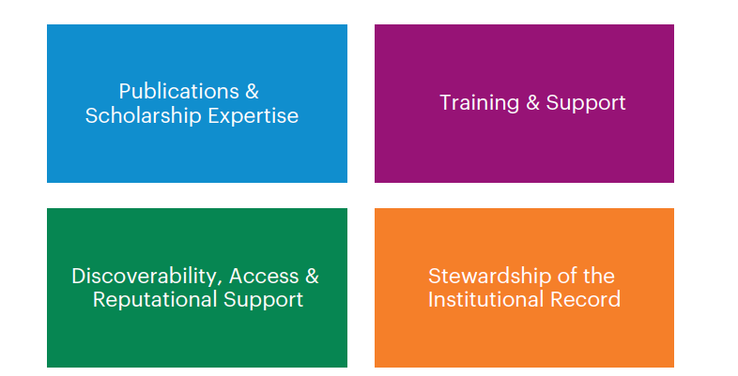
Libraries in Research Information Management

Slide 21
Why Libraries?

Slide 22
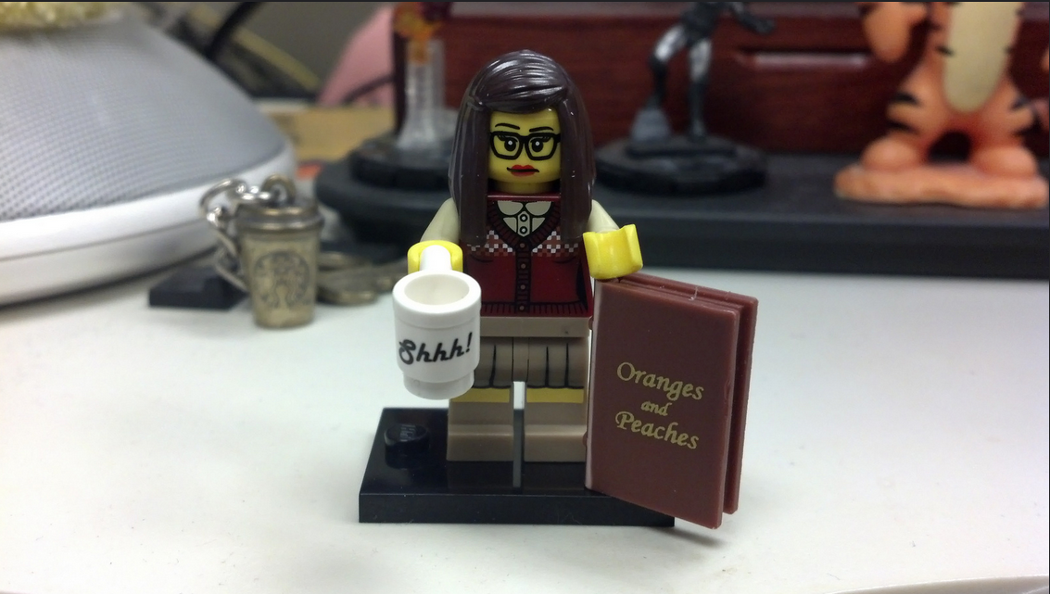
Librarian Skills
Notes:
Skills that librarians bring are essential to making these tools work
Libraries understand subtle challenges of using aggregated data, distinctions amongst disciplines, challenges with interpreting journal or book based metrics, etc.
Xml story at SU

Slide 23



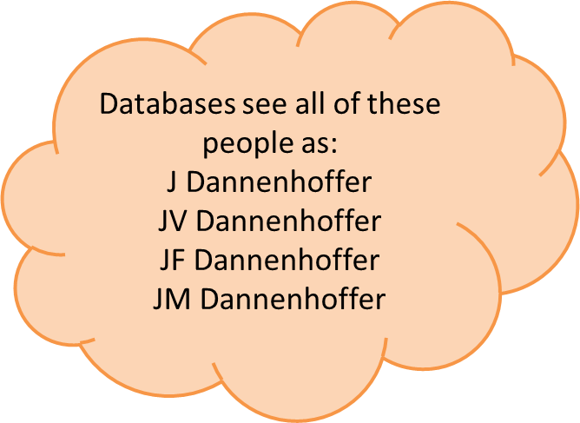


Author Disambiguation in Publications
(spouses)
(siblings)
Joan V. Dannenhoffer
Syracuse University
John F. Dannenhoffer III
Syracuse University
Joanne M. Dannenhoffer
Central Michigan University
(siblings)
Joanne V. Dannenhoffer
M.D. May 2013
John F. Dannenhoffer IV
Engineer, Pratt & Miller
Notes:
Annie
Nephew – Thomas Dannenhoffer-Lafage is a chemistry PhD candidate at University of Chicago
John’s brother – Dr. Robert Dannenhoffer, Roseburg Oregon MD
John’s cousin – Ray Dannenhoffer is professor at University of Buffalo Med school
You may be able to distinguish your own publications, others cannot
The data is good, it isn’t always perfect. Librarians can help untangle issues in Pure and Scopus data about your faculty and their work.

Slide 24


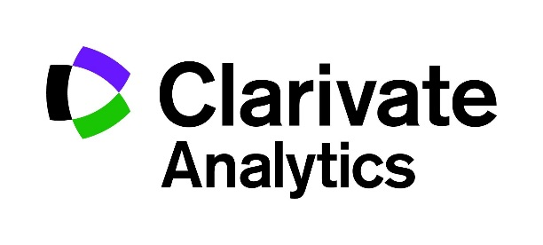











Information Market
Notes:
Annie
Many of these tools come from companies libraries already work we have an understanding of their relationships
Every time we’ve shown this tool to a group, we get asked, why isn’t Web of Science data included instead of Scopus

Slide 25
Case studies of adoption of person & organizational identifiers in 3 national settings:
                Finland
                Germany
                Netherlands
Collaborative research with LIBER
Coming in December
oc.lc/rim

Slide 26


Survey of Research Information Management Practices
  Rebecca Bryant, OCLC Research
  Pablo de Castro, University of Strathclyde & euroCRIS
  Anna Clements, University of St. Andrews & euroCRIS
  Jan Fransen, University of Minnesota, Twin Cities
  Julie Griffin, Virginia Tech
  Constance Malpas, OCLC Research
  Michele Mennielli, DuraSpace & euroCRIS
  Rachael Samberg, University of California, Berkeley
Collaborative research project by OCLC RLP & euroCRIS
Survey is currently LIVE
Results published in 2018
Jointly implemented by OCLC Research & euroCRIS
Learn more at oc.lc/rim

Slide 27
Survey goals
This survey will help us understand and report on RIM activities worldwide, and it seeks answers to the following questions:
Why have institutions adopted--or are considering adopting--RIM infrastructures? What are the principal drivers?
How are institutions using RIM functionality? What are the principal uses?
Who are institutional stakeholders, and what, in particular, is the role of libraries?
What processes and systems are in use? How do they interoperate with internal and external systems? What is the scope?
What are regional and international differences in drivers, uses, and processes?

Slide 28
Survey seeks input from institutions at all stages of RIM adoption
Please choose the status that best describes your institution’s research information management (RIM) implementation stage
Live Implementation: Currently live with RIM system and service made publicly visible to campus stakeholders
In the process of implementing: A decision has been made on which RIM system(s) to use; contracts are signed but not yet operational.
Procurement Process: In the procurement process - in the process of evaluating specific systems under consideration
Exploring: Defining system requirements and comparing available options
Not considering: Not considering a RIM system at this time

Slide 29
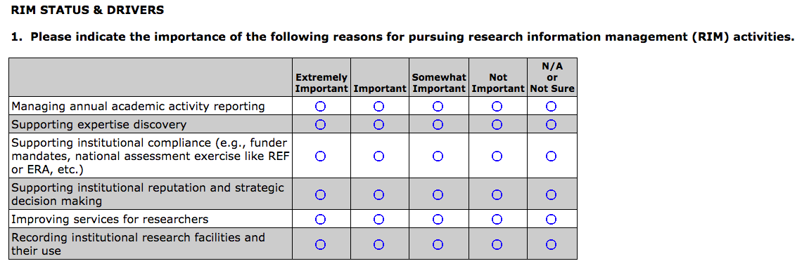
WHY?
identify different drivers for RIM adoption worldwide

Slide 30
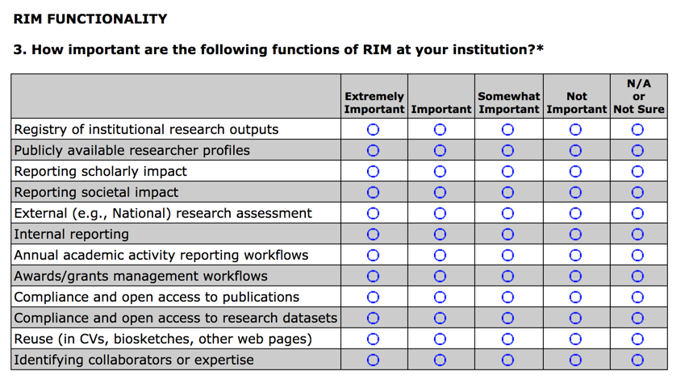
HOW?
We want to understand how institutions are USING RIM functionality

Slide 31
WHAT?
Processes, systems, interoperability & scope
System(s) in use & when implemented
Interoperability with internal & external systems
Sources of publications metadata
Use of standards, persistent identifiers, & vocabularies
Which campus populations are included in the RIM?
All disciplines?
How many researchers are included?

Slide 32
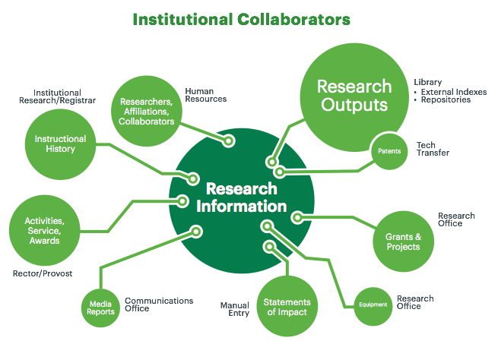
WHO?
Stakeholders & collaborators
Who are the institutional stakeholders involved in RIM adoption?
What’s the specific role of the library?
Staff resources?
Outreach & education activities?
Measures of success?

Slide 33
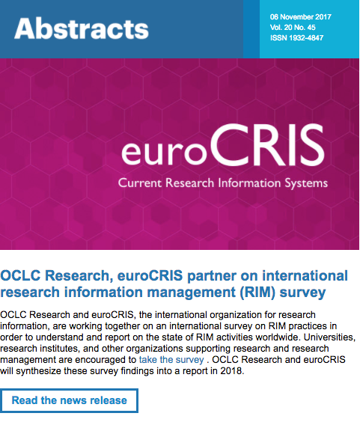
Promotion
OCLC blogs, lists
EuroCRIS outlets
RIM vendors through their user group communities
Library & research organization lists
RLP partners & their networks
Promotion at meetings like
    Pure International Conference
    North American Pure User Group
    Charleston Library Conference
    Force11
    euroCRIS membership meeting

Slide 34
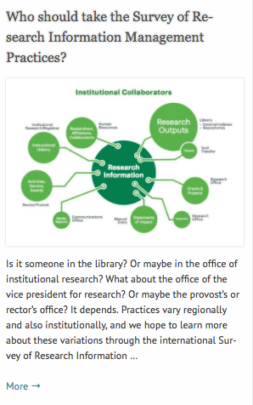
Who should participate?
Universities, research institutes, and other organizations supporting research and research management. One survey per institution.
Institutions should participate regardless of the status of RIM implementation
  In production
  In process of implementation
  Exploring RIM options
Closes January 15, 2018
Survey findings & data will be published CC-BY in 2018

Slide 35
In other words. . .
Your institution should participate!
Please share about your local practices.
oc.lc/rim

Slide 36
Questions?
Rebecca Bryant, PhD
Simon Huggard
OCLC Research, USA
La Trobe University Library, Australia
orcid.org/0000-0002-2753-3881
bryantr@oclc.org
@rebeccabryant18
orcid.org/0000-0002-0365-112X
s.huggard@latrobe.edu.au
@simonhuggard
Survey on Research Information Management Practices available at oc.lc/rim

