Slide 1
19 September 2016
Research Information Management in the US University Enterprise Environment:
A Case Study from the University of Minnesota-Twin Cities
OCLC Research Library Partnership
Works in Progress Webinar

Slide 2
Jan Fransen
Service Lead for Research and Discovery Systems, University Libraries, University of Minnesota-Twin Cities
Caitlin Bakker
Biomedical/Research Services Liaison, University Libraries, University of Minnesota-Twin Cities

Slide 3
Research Information Management in the U.S. University Enterprise Environment
A Case Study from the University of Minnesota-Twin Cities

Slide 4
Jan Fransen
Service Lead for Researcher and Discovery Systems
University of Minnesota Libraries
University of Minnesota – Twin Cities
https://experts.umn.edu/en/persons/jan-fransen

Slide 5
70,963 Twin Cities Students, Faculty, and Staff
Professional
3,761
Faculty
3,709
Non-Degree
3,365
Undergraduate
28,638
Graduate
12,046
Staff (all types)
19,444
Notes:
The University of Minnesota is a Carnegie Research One institution, with large numbers of undergraduates, graduate students, and faculty members, in addition to professional and non-degree-seeking students and University staff.
We’re also a land grant institution, here to serve the citizens of the state as well as our direct affiliates.
In an institution that big, we’re always looking for ways to both keep track of what the many entities and individuals that make up the University are doing, and to tell the stories of that work to the whole community.

Slide 6
UMTC Colleges
Biological Sciences
Continuing Education
Dentistry
Design
Education and Human Development
Extension
Food, Agricultural and Natural Resource Sciences
Graduate
Law
Liberal Arts
Management
Medicine
Nursing
Pharmacy
Public Affairs
Public Health
Science and Engineering
Veterinary Medicine
Notes:
The University isn’t just one set of disciplines: Our academic programs and research span the range from basic sciences, medicine, and engineering through liberal arts and public policy, and everything in between.

Slide 7
Vendor: Elsevier
Sponsor: Libraries/Vice President for Research
Research outputs for faculty and staff members
Public display for individuals and organizations
Continuous updates
Data can be exported at the publication level for further analysis
Vendor: Digital Measures
Sponsor: Provost (Faculty & Academic Affairs)
Faculty activity (published, research in progress, teaching, etc.)
Internal reporting for individuals subject to P&T
Updated annually
Includes research in progress
Vendor: Academic Analytics
Sponsor: Institutional Research
Aggregate level, not details
Internal audience
Compare U of M programs to those of peer institutions
Updated annually to provide “snapshots”
Experts@Minnesota
Academic Analytics
Works
Notes:
To keep track of all that work in all those disciplines, several different systems have emerged. There are numerous grassroots systems at the departmental and college levels, but for University-wide tools these three have emerged. Each is our implementation of a licensed product. Although all three are, in part, collections of the articles and other research outputs by faculty at the University, they each have a distinct set of goals.
Experts@Minnesota is our implementation of Elsevier’s Pure. I’ll be focusing on that today.
Works is our implementation of Digital Measures, managed by the Provost’s Office. Works is used for Faculty Activity Reporting, an internal activity with a promotion and tenure focus. It’s used by several departments and colleges, but not all.
Academic Analytics is licensed through and maintained by our Office of Institutional Research. It’s an aggregated snapshot of our work that provides a way of comparing specific departments to peer programs at other institutions.

Slide 8
Vendor: Elsevier
Sponsor: Libraries/Vice President for Research
Research outputs for faculty and staff members
Public display for individuals and organizations
Continuous updates
Data can be exported at the publication level for further analysis
Vendor: Digital Measures
Sponsor: Provost (Faculty & Academic Affairs)
Faculty activity (published, research in progress, teaching, etc.)
Internal reporting for individuals subject to P&T
Updated annually
Includes research in progress
Vendor: Academic Analytics
Sponsor: Institutional Research
Aggregate level, not details
Internal audience
Compare U of M programs to those of peer institutions
Updated annually to provide “snapshots”
Experts@Minnesota
Academic Analytics
Works
Notes:
Experts@Minnesota was first conceived as a public-facing portal that anyone can use to find out about the work of our researchers. It covers the Twin Cities campus only, but covers all disciplines. Research output lists are updated continuously from Scopus, and individual “Experts” or their delegates can add research outputs that aren’t in Scopus and enhance their profile in other ways.
It is internal in one important way: We can pull the data out to feed other systems (like Works), create our own aggregations, or do our own analyses that drill down to the individual research output level.

Slide 9
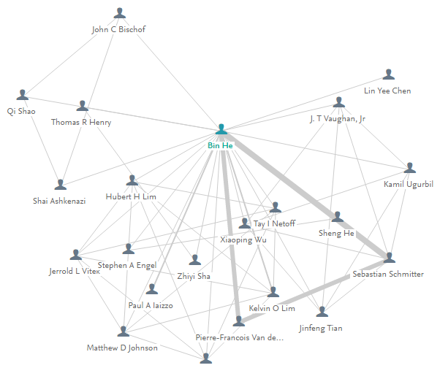
Original Goal: The University would like its researchers to find each other and work together
Notes:
When we first launched Experts@Minnesota, we had one goal in mind: We wanted to help researchers at the University of Minnesota put together teams made up of other U of M researchers, ideally across the disciplines.

Slide 10
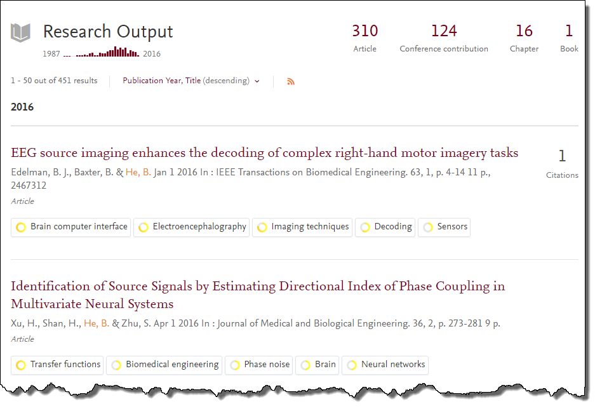
You need more than names to build a team
Notes:
To build a team, you can’t just look at a list of names. You need to know about the work they’ve done. The easiest way to learn about their work is to see what they’ve published.

Slide 11
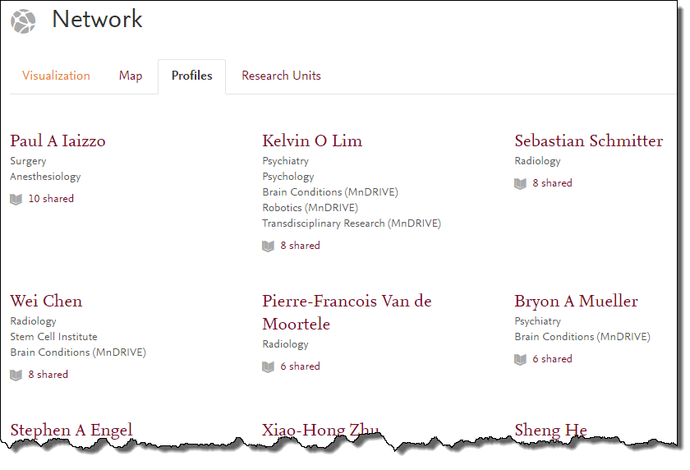
You need more than names to build a team
Notes:
It’s also helpful to know who they’ve worked with before. For example, who are their coauthors and what disciplines are they in?

Slide 12
What is Experts@Minnesota?
Research Outputs: Scopus+
People: UMTC HR Data
Platform: Elsevier Pure
Notes:
Now let’s dive a little deeper into the three things that make up Experts@Minnesota:
The platform itself, Pure
The people featured on the profile pages, which we draw from our Human Resources data
And the research outputs, which I’ve indicated here as “Scopus+.” I’ll describe what I mean about that in a minute.
Rubik Cube taken from Rubik Cube PowerPoint Template on www.SlideHunter.com (Creative Commons license)

Slide 13
Putting Together the Pieces
Notes:
So how do we put those pieces together?

Slide 14
Pure provides...
Well-structured database
Profile pages (individual and aggregate)
Search
Some visualizations
Automatic Scopus imports for most people
Import tool for other publications sources
Reporting tool
Notes:
The platform we use is Elsevier’s Pure. Out of the box, it provides a well-structured database, public web pages for each researcher and for their colleges and departments, a search feature, a few visualizations like that collaborator web I had on a previous slide, ways of getting research outputs into the database, and a reporting tool.

Slide 15
Organizations and People are up to us
System of Record = Human Resources data
PeopleSoft
Accessible to us through the University’s Data Warehouse
We also incorporate grant data
System of Record = Sponsored Projects Administration database
Notes:
Filling that database with people and organizations is up to us.
At Minnesota, our System of Record for employees and organizations is our Human Resources data. We use PeopleSoft, and the data are available to us as a consumer through the University’s data warehouse.
I should mention that we also pull in Grant data. That system of record is the database owned by our Sponsored Projects Administration, and those records are also available through the Data Warehouse.

Slide 16
Organizations and People are up to us
Specific job codes/departments
Mostly faculty
Increasing number of other researchers, including librarians and staff who publish in their areas of expertise
College-Department relationships
Updated about three times a year
Notes:
For people, we only pull people with specific job codes in specific departments. Most of the people in Experts@Minnesota are faculty, but we have a large number of other researchers.
We update about three times a year but are heading toward a more frequent schedule as we refine our methods for pulling and uploading data from one system to the other.

Slide 17
Research Output Metadata: A joint effort
Automatic Scopus imports for 5400 of the 6000 people visible in Experts@Minnesota
People can log in and add their own research outputs by importing or data entry
Notes:
The research outputs. This layer is truly a joint effort: One part of Pure that is very important to us is its integration with Scopus. Our Pure instance automatically receives new research outputs from Scopus on a weekly basis, for the people we specify.
As you can see, we don’t request that automatic Scopus feed for everyone. Here’s why.

Slide 18
How complete is Scopus for our researchers?
Great!
...if you’re in physical science, engineering, life science, or medicine
Pretty good
...if you’re in social science disciplines
Not so great
...if you’re in humanities disciplines
Notes:
Scopus is a fantastic source for research output if you’re in the right discipline. Most of our researchers in medicine and health sciences, biological sciences, physical sciences, and engineering have close to complete sets of research outputs in Scopus.
Scopus is pretty good if you’re in the social sciences. It depends a lot on your exact field of research.
It’s not so great for people in humanities disciplines. It’s primarily an article database, and people in humanities disciplines tend to produce a lot more books and other forms of scholarship.

Slide 19
Articles, books, etc.
Notes:
That isn’t going to be news to any librarian in the audience. We all know that you have to carefully consider which database or databases to use if you’re trying to do a comprehensive search for an author’s work. And that’s fine for work in specific discipline: You’re essentially narrowing your search before you even start typing in terms. That’s a good thing when you’re aiming for precision.

Slide 20
Negotiations and Contracts
Articles, books, etc.
Notes:
But if you want both breadth and depth across disciplines, you need to consider how database content comes to be what it is. Out of the universe of articles, books, and other types of scholarship, a database publisher makes decisions about coverage that are partially constrained by what agreements they can reach with the publishers of those research outputs.

Slide 21
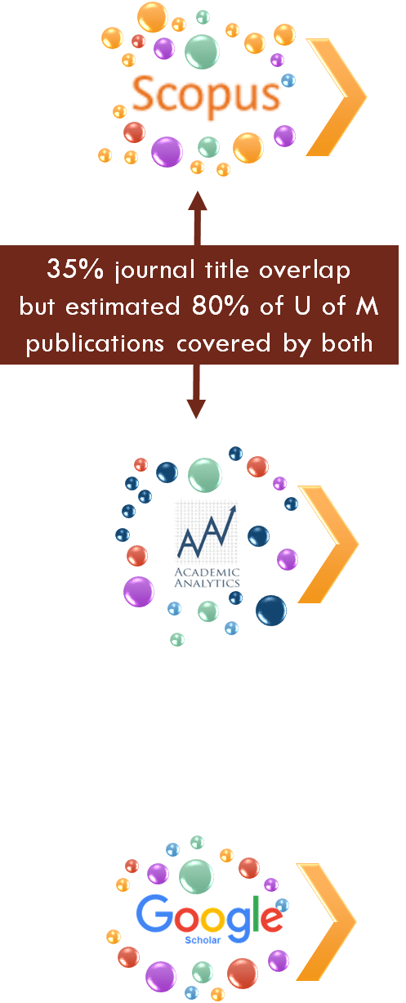
Negotiations and Contracts
Articles, books, etc.
Notes:
Those agreements are not going to be the same from Scopus to Academic Analytics to Google Scholar, so the list of articles you find in any of those will differ as well.

Slide 22
Tale of Two Disciplines
 | Sociology
 | Source A | Source B
Journal Articles (2011-2014) | 120 | 105
Books (2005-2014) | 56 | 15
Book Chapters (2005-2014) | 0 | 101
Conference Papers (2011-2014) | 4 | 1
Total | 180 | 221
Sociology: Source B has more items, but there are big gaps…
Source A indexes far more books
Source A does not index individual chapters
 | Horticultural Science
 | Source A | Source B
Journal Articles (2011-2014) | 137 | 191
Books (2005-2014) | 5 | 1
Book Chapters (2005-2014) | 0 | 36
Conference Papers (2011-2014) | 1 | 13
Total | 142 | 241
Horticultural Science: Source B has more items because…
Few books (Source A’s strength) published
Articles dominate, but book chapters and conference papers do exist
Notes:
Here’s an example comparing two different sources in two different disciplines.
For the top example, a Sociology department, Source B has more items but not necessarily better coverage. Source A has far more books, which appear to be important in this discipline. But on the other hand it’s missing a large number of book chapters and those are also important.
In the Horticultural Science department, Source B clearly performs better. Some of the difference is likely due to better journal coverage for the discipline by Source B, and for this department there are few books to be found in either source, so Source A’s strength there doesn’t balance out their weakness with articles and book chapters.
In either case, neither source provides a perfect picture of research outputs for either discipline.

Slide 23
Takeaways
No data source is perfect
Relationships between publishers and aggregators are constantly evolving, so data source content will change
Scholarly communication practices differ from discipline to discipline
We can’t rely completely on Scopus (or any other single source)
Experts@Minnesota benefits from manual curation
Notes:
With all those points in mind, if our goal is a comprehensive database of the University of Minnesota’s research outputs, we can’t rely on any one source. There needs to be some kind of manual curation.

Slide 24
Is manual curation worth it?
Original goal: The University would like its researchers to find each other and work together
To build a team you need to know
What research have they done (and published)?
With whom have they previously collaborated?
So...maybe pretty good is good enough?
Notes:
Manual = work someone will have to do and the University will have to pay for, so we need to step back and consider whether such a database is needed. Considering our original goal of helping researchers find each other, maybe all they need is a sense of what others have published and not a comprehensive list.
Maybe pretty good is good enough.

Slide 25
Who has questions that a robust research outputs database could answer?
Notes:
Except.
As Experts@Minnesota evolved, it became apparent that we were sitting on an imperfect dataset that was nevertheless the closest the University has ever gotten to a single database of the institution’s work. As people figured that out, they started asking us questions.

Slide 26
OVPR
Board of Regents
Provost
Academic Programs, Centers, Institutes…
Where in the world are we collaborating?
Are we publishing/getting cited more than last year?
Are our faculty productive on an individual level? (Annual Activity Reporting)
How can we use our collective research output to tell a story about our organization?
With what industries?
Are our initiatives making a difference?
Are we publishing more than our peers?
What are the strengths of our academic programs?
Did someone just publish something we should promote?
Where should we focus next?
Who has questions that a robust research outputs database could answer?
Notes:
Here are a few examples of questions we’ve been asked over the last four years. From left to right, the questions are coming from our Office of the Vice President for Research, the Board of Regents, the Provost, and numerous academic programs, colleges, centers, and institutes.

Slide 27
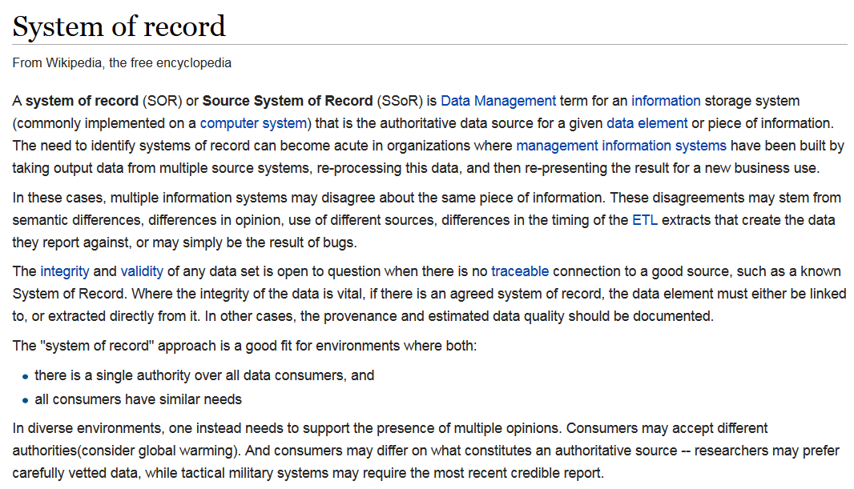
Notes:
As the questions mounted and we were able to answer them by extracting data from Experts@Minnesota, we realized that what we really had was another System of Record. You’ll remember that I mentioned the Human Resources and Sponsored Programs Administration databases as the systems of record for employee and job information and for grant information.

Slide 28
Notes:
The statement I’ve highlighted in this Wikipedia article the problem we’re starting to see here: There are lots of different systems with research outputs, and they’re not going to agree with each other for good reasons. One of them needs to be the authoritative record and the others should leverage that authoritative record.

Slide 29
U of M needs a database that is...
As accurate and comprehensive as possible
Available to analysts on campus in the same ways as our employee and student databases
Notes:
That System of Record needs to be accurate, comprehensive, and available to the people on campus who need to use it.

Slide 30
How do we improve quality?
Author is best source for verifying publication list
In the US, there is no requirement that researchers provide accurate publication lists to a central authority
But if authors know people are seeing and using their list, they will be motivated to improve their list
Notes:
Data quality is something we can always improve. Although the ideal for researchers is an automatically populated database, the data source we have doesn’t work equally well for all of our researchers. We need for each researcher to look at their pre-populated record and add items that don’t appear or notify us to remove items that aren’t actually theirs.
But we have no way to make them do that.
We do have ways to encourage them, though: If people and organizations are seeing and using their publication lists, authors will be motivated to make sure their list is accurate. That requires a lot of communication and education.

Slide 31
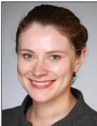
Luckily we have a secret weapon
Notes:
Luckily we have a secret weapon. These are our liaison librarians. They each support several academic departments or programs on campus. They understand the scholarly communication practices of the disciplines they support, and they have good personal relationships with both faculty and support staff throughout their departments.
Now I’m going to turn over the podium to one of those people, Caitlin Bakker, to tell you more about how our librarians are using Experts@Minnesota in their work.

Slide 32
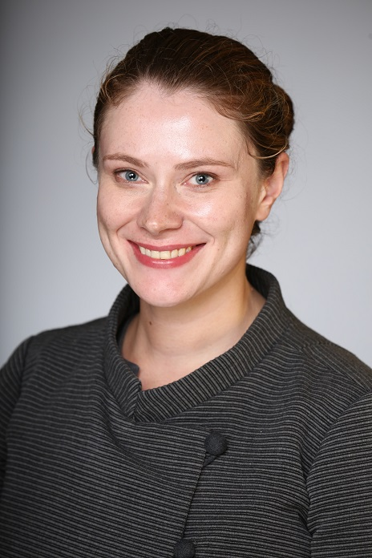
Caitlin Bakker
Biomedical/Research Services Liaison
University of Minnesota Health Sciences Libraries
University of Minnesota – Twin Cities
https://experts.umn.edu/en/persons/caitlin-j-bakker

Slide 33
Functional Specialists
“Superliaisons” who serve all disciplines
In-depth understanding of unique areas of expertise, such as copyright or digital humanities
Liaison Librarians
Baseline knowledge across a wide range of issues and areas
In-depth understanding of disciplinary needs, norms and practices

Slide 34
Functional Specialists
“Superliaisons” who serve all disciplines
In-depth understanding of unique areas of expertise, such as copyright or digital humanities
Experts@Minnesota
(c. 2012)
1 project lead
1 technical specialist
Liaison Librarians
Baseline knowledge across a wide range of issues and areas
In-depth understanding of disciplinary needs, norms and practices

Slide 35
Functional Specialists
“Superliaisons” who serve all disciplines
In-depth understanding of unique areas of expertise, such as copyright or digital humanities
Experts@Minnesota
(c. 2016)
1 project lead
2 communication leads
1 technical specialist
1 developer
Liaison Librarians
Baseline knowledge across a wide range of issues and areas
In-depth understanding of disciplinary needs, norms and practices

Slide 36
Where does RIM fit in?
RIM is an extension of existing areas of Libraries’ expertise
We understand the data and the sources
We know how this publication data can be leveraged for other purposes
We have existing relationships and can tailor services to meet disciplinary needs

Slide 37
RIM for Liaisons
Where are my faculty publishing?
Do we collect those journals?
What does administration need to know about publication rates and venues?
How many faculty are publishing open access?
What interdisciplinary research is occurring on campus?
Images: Thinking by Alberto Guerra Quintanilla available from the Noun Project

Slide 38
Public profiles create new ways to showcase engagement

Slide 39
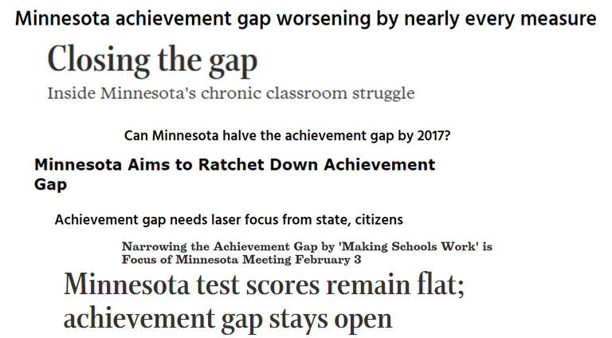

Slide 40
118 researchers
26 departments
9 colleges or schools
1 website (gap.umn.edu)

Slide 41
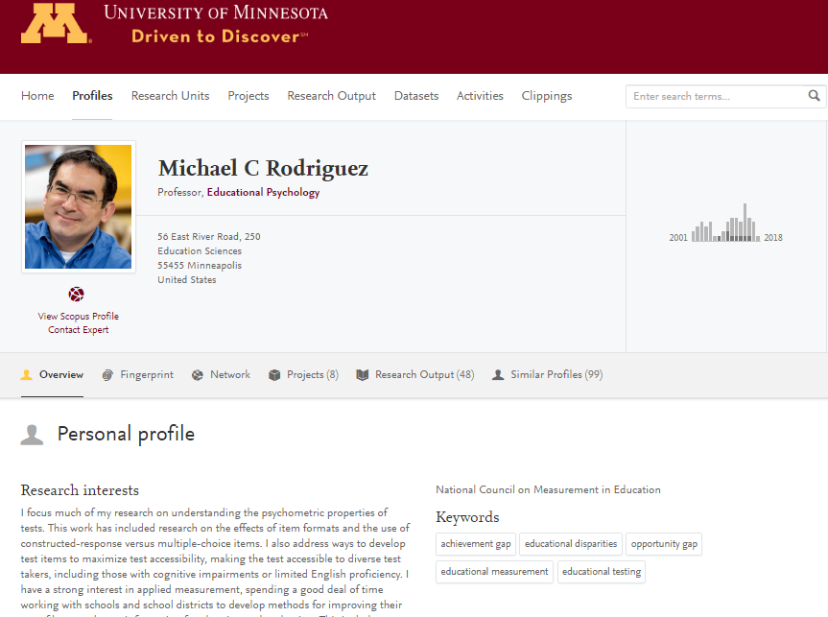

Slide 42
Clean data creates new opportunities

Slide 43
A system for the Medical School which combines human resources data and publication data from Scopus
Produces customized metrics for reporting and assessment purposes
A restricted-access interface which includes measures of scholarly work such as citation counts, h-index, and relative distribution of metrics

Slide 44
Getting Liaisons Engaged
Internal training opportunities on the system and related concepts
Getting liaisons active in maintaining their own profiles
Promoting a model of partnership and support

Slide 45
Next Steps
Growing integration into the suite of services offered by liaison librarians
Outreach strategy to educate faculty about the utility of the system, its benefits and its limitations

Slide 46
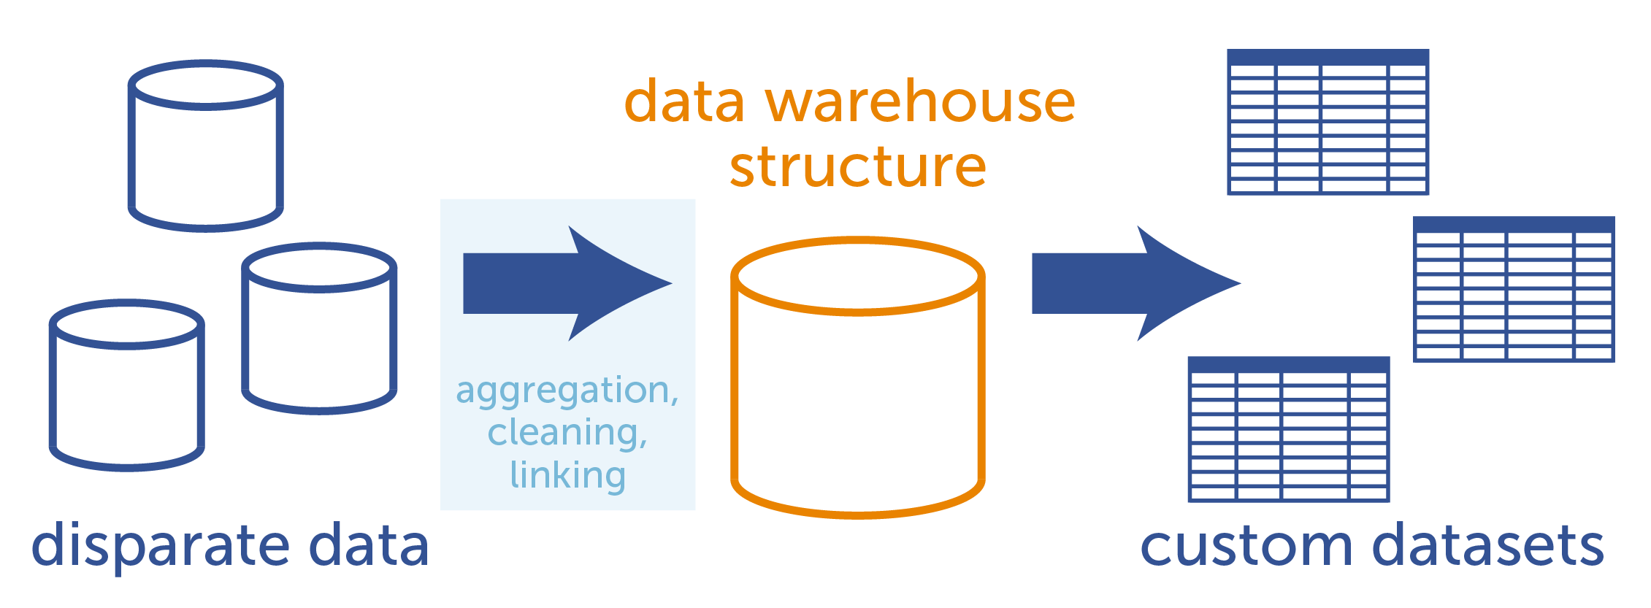
What about making the data available?
Image from http://www.aunalytics.com/why-data-warehouse/
Notes:
Everything Caitlin’s talked about has a dual purpose: Each project fills an important need on campus, and each project encourages people to use Experts@Minnesota as the System of Record for research outputs. Now I want to talk about how we are making that research output data available to the systems and people who want to make use of it.

Slide 47
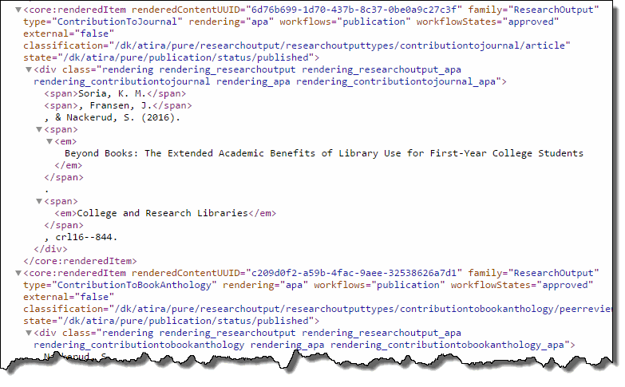
Today: Pure API
Notes:
Right now, people can ask me for credentials to access the Pure API. There are about a dozen of them, and they are primarily programmers who know how to write code that requests specific information from the API and then does something useful with the XML document that’s returned. What you’re looking at here is the Pure API’s representation of one of my publications.

Slide 48
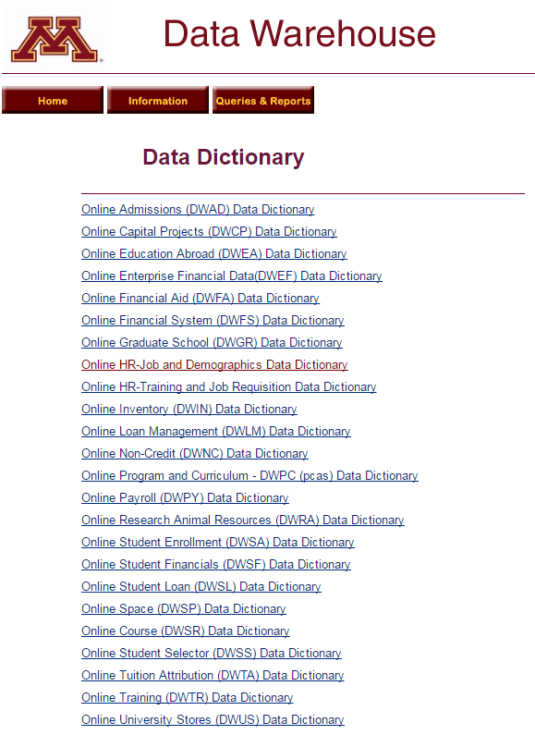
Notes:
But there are hundreds of programmers and analysts and even people like me on campus who work with different aspects of our University Data Warehouse every day. If we can make the research output data in Pure available as another data source on this list, we can greatly expand the number of people who are able to use research output data from the system of record in their analyses and applications.

Slide 49
Wierschem, D., McMillen, J., & McBroom, R. (2003). What Academia Can Gain from Building a Data Warehouse. Educause Quarterly, 26(1), 41-46.
Notes:
Data warehouses are nothing new. This article from Educause way back in 2003 extolls the virtues of a data warehouse in an academic environment. Your campus probably has one, too.

Slide 50
HR Tables
(source is PeopleSoft)
Financials Tables
(source is PeopleSoft)
DW-Experts Logic
Goal: Minimize manual entry
“Experts Data Warehouse”
DW-Experts Tables
(source is PeopleSoft + Experts Logic + Pure API)
Pure Import process
Pure API to import research outputs and user-entered information to Experts tables
Pure
(source is Experts Tables + user entry + Profile Refinement Service)
Notes:
What is new, at least for us, is adding data about the research outputs of University of Minnesota researchers to the data warehouse. This is my little schematic of what that might look like. I”ve been referring to the project as the “Experts Data Warehouse,” though of course the research output data is intended to be just one small part of the University’s data warehouse.
Essentially, what we aim to do is bring HR and Grant data from the Data Warehouse to Pure for display, and send back the research outputs added to Pure to the Data Warehouse for consumption by others as well as regular archiving.

Slide 51
Timeline
Phase 1: Oracle Database built and maintained by University Libraries
Phase 2: Documentation and training for interested consumers
Phase 3: Integration with Office of Information Technology next-generation data warehouse
Notes:
Right now we’re just starting Phase 1: Building an Oracle database that will be maintained by the Libraries.
Phase 2 will involve documenting the tables and fields available in that database and training people on how and when to use research output information properly. We see this as a place where the Libraries really have primacy, and we’ll be counting on the expertise of our liaison librarians to provide the needed outreach and education.
Phase 3 will happen when our Office of Information Technology is ready to bring our data into the next-generation data warehouse they’re currently planning.

Slide 52
Near-term Consumers
Notes:
We know a few of the needs that will be immediately served by the Experts Data Warehouse.

Slide 53
Vendor: Elsevier
Sponsor: Libraries/Vice President for Research
Research outputs for faculty and staff members
Public display for individuals and organizations
Continuous updates
Data can be exported at the publication level for further analysis
Research outputs
Vendor: Digital Measures
Sponsor: Provost (Faculty & Academic Affairs)
Faculty activity (published, research in progress, teaching, etc.)
Internal reporting for individuals subject to P&T
Updated annually
Includes research in progress
Experts@Minnesota
Works
???
Notes:
I mentioned Works earlier, the system used by a number of departments and colleges to track faculty activity. We have sent research output data to Works in batch before, but now we plan to provide ongoing access to up-to-date data so our Academic Affairs colleagues can pull data as needed. In return, we’re investigating whether they are capturing unique data that we could use to enhance Experts@Minnesota.

Slide 54
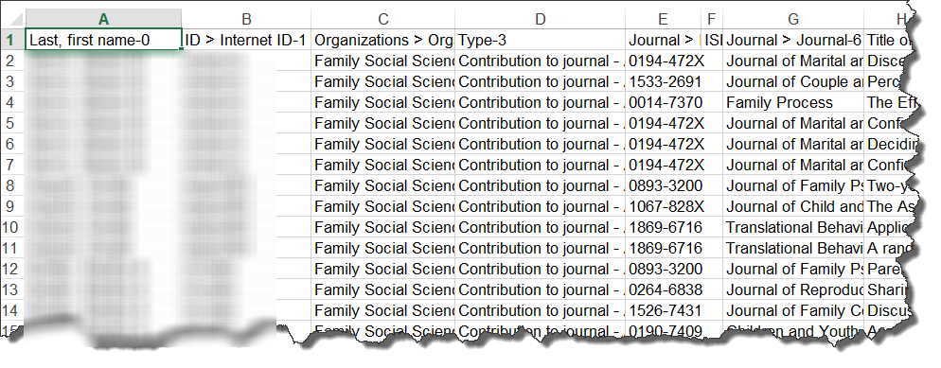
Activity Reporting
Accurate research output lists for departments and colleges not yet using Works
Notes:
Not everyone uses Works, but all departments and colleges do regular activity reporting. We have trained some departmental staff on how to pull research output data through the Pure reporting module, and that use could expand with a readily available data dictionary.

Slide 55
Medical School’s custom analytics application
2.0
Notes:
Caitlin mentioned the Manifold project in the Medical School. There are plans for a Manifold upgrade that would draw on the Experts Data Warehouse as its data source.

Slide 56
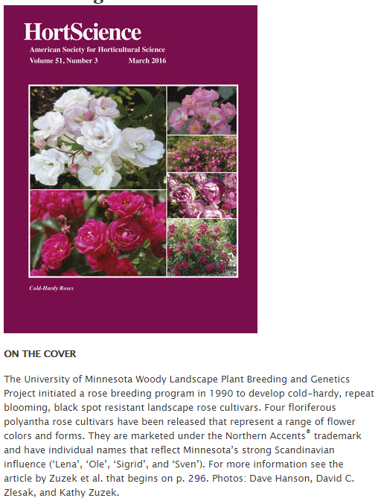
Academic Program Reviews
Data to prompt discussions and plan for program’s future direction
Top Journals for Horticultural Science (2011-16)
Journal Title | Number of Publications (2014-15 Faculty)
HortScience | 34
HortTechnology | 16
Canadian Journal of Plant Science | 8
Journal of Chromatography A | 8
Crop Science | 7
Invasive Plant Science and Management | 6
Plant Physiology | 5
PLoS ONE | 4
Plant Journal | 4
Notes:
Academic Program Reviews are another common need on campus. The Experts Data Warehouse can provide data on publications over time to feed discussions on the program’s future directions.

Slide 57
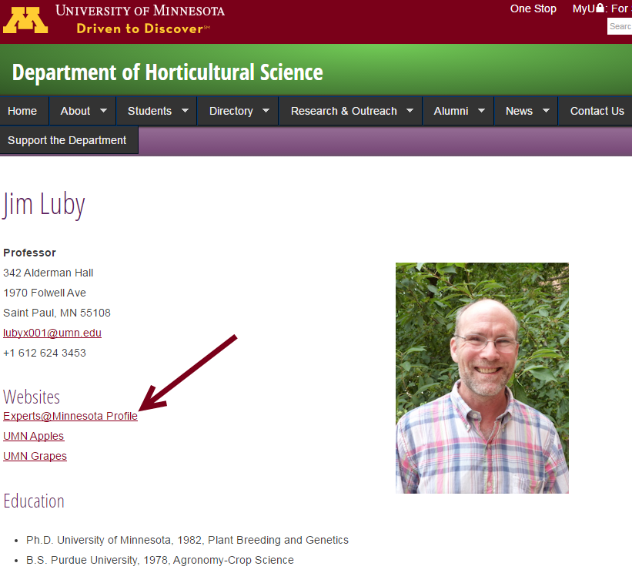
UMN Websites
Notes:
Several departments on campus are linking to Experts@Minnesota from individual faculty profiles. With data in the Data Warehouse, we could build a Drupal widget that would allow those websites to display recent or prominent publications directly on the department-level pages.

Slide 58
Questions?
Notes:
Those are just a few of the things we’re thinking about. Now we invite any questions or comments you might have.

