Slide 1
What League Are You In?: Rankings, Ratings, and the Quest to Be Best
Ginny Steel
University Librarian
UCLA
June 3, 2015

Slide 2
Notes:
As I prepared for this presentation and thought about what I wanted to discuss with you, I realized that I had never really looked closely to see what my home institutution—UCLA—says about itself in terms of rankings and reputation. So I took a look at the UCLA website and lo and behold, it only took a second to find a whole series of webpages offering a variety of rankings. The first is the ever-popular and frequently mentioned U.S. News and World Report, and this page focused on how UCLA stacks up in terms of competition in this country.

Slide 3
Notes:
The second one, also U.S. News & World Report, focuses on global rankings, this time showing how UCLA compares with institutions around the world.

Slide 4
Notes:
A few pages later, I found another example of rankings, this time from the Center for Measuring University Performance. They’re the ones who have commented that “nothing stirs the public imagination about higher education more than rankings, unless it’s football. Rankings are a major national sport themselves, feeding an insatiable market searching for the best universities and colleges in America, and even should they be so interested, abroad.”

Slide 5
Notes:
And here’s an example of more rankings of UCLA, again in the global context. As competition for foreign students intensifies and more and more faculty work with colleagues around the world, having a global presence is essential.

Slide 6
Notes:
All of this material helped bring home the point that even though there haven’t been many discussions of rankings and ratings in meetings of the deans and other senior campus administrators, the importance of being able to provide some measures of excellence and demonstrations of value are increasingly important. Interestingly enough, according to one rankings website, “the world’s first system for ranking universities is still not 30 years old.” The U.S. News and World Report best colleges listing started in 1983.
With this as some general context, I want to spend the rest of my time talking about two initiatives and one offer of partnership at UCLA. All three of these relate to the desire to achieve the highest possible reputation, but they also illustrate some of the pitfalls and challenges inherent in this “ratings race.”

Slide 7
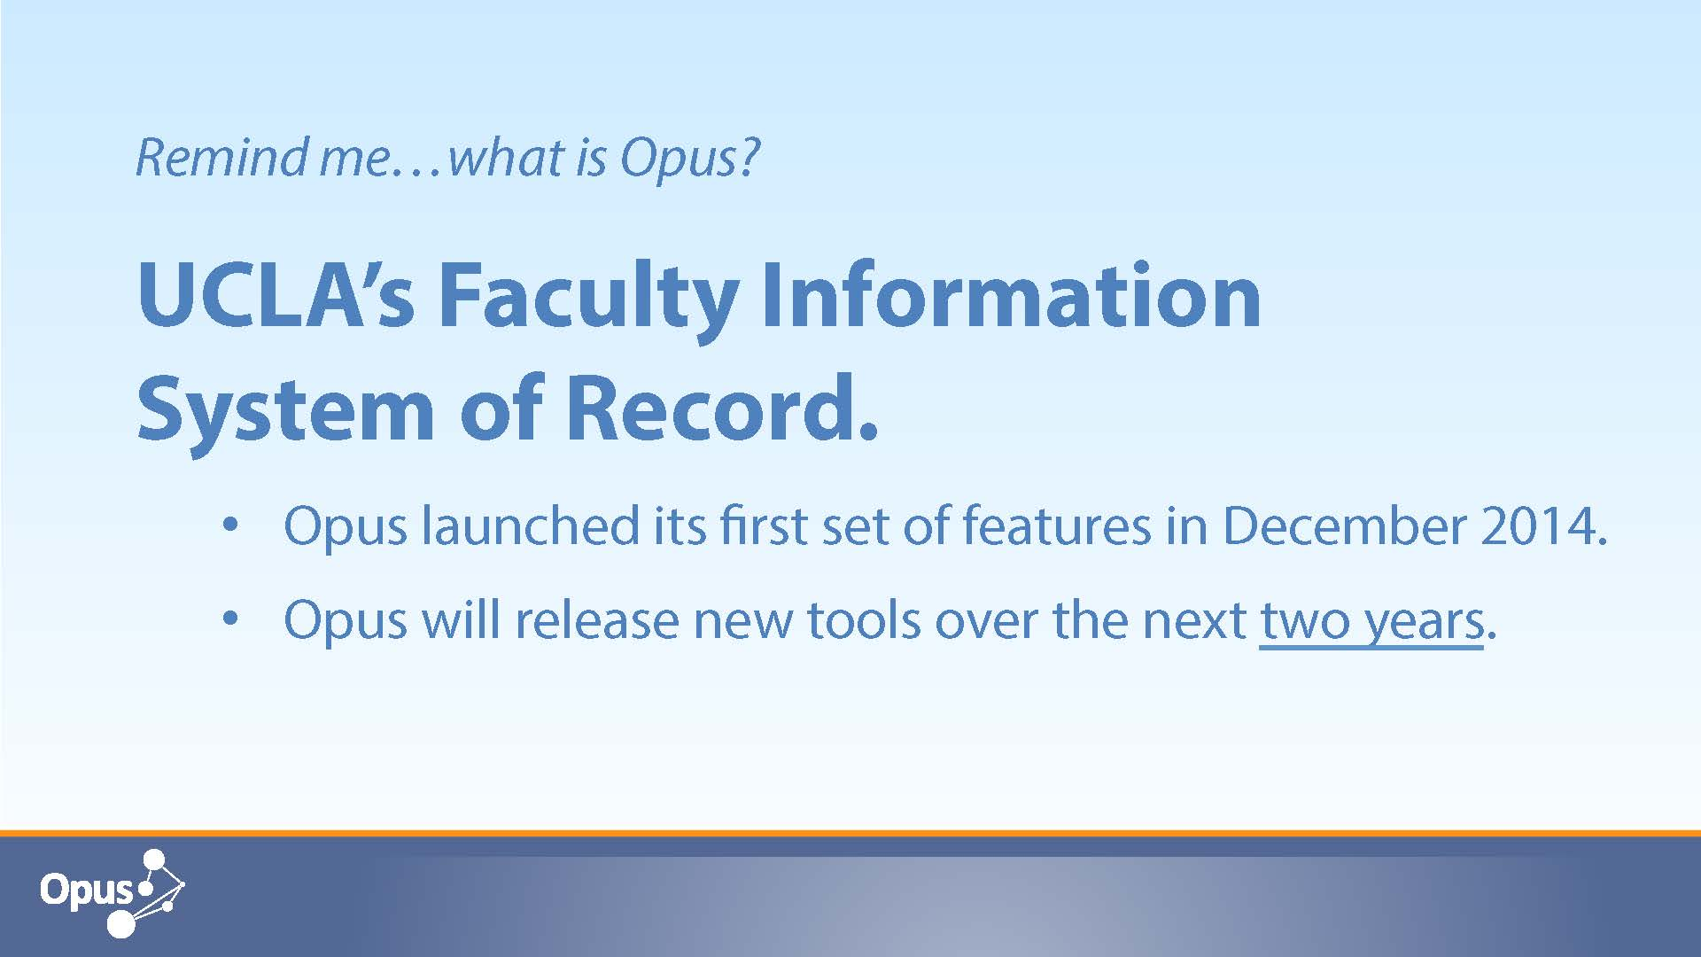
Opus: UCLA’s campus faculty profile system
Notes:
The first initiative I’ll discuss is “Opus”—the newly launched “information system of record for academic appointees at UCLA. Opus will improve efficiency, transparency, and accuracy of the academic review process by replacing current paper files with a secure electronic profile, providing a paperless review process, and offering robust reporting features. It will allow UCLA to satisfy current and growing needs and holds the promise of future uses and benefits currently unimagined.”

Slide 8
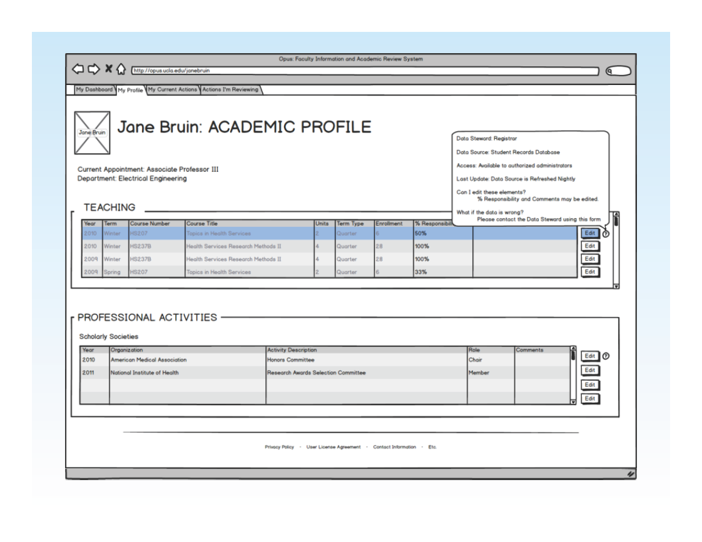
Notes:
This is an example of a profile for a faculty member. Like other commercially-available or campus-developed systems, OPUS has different fields in which various types of information about faculty members is gathered and displayed.

Slide 9
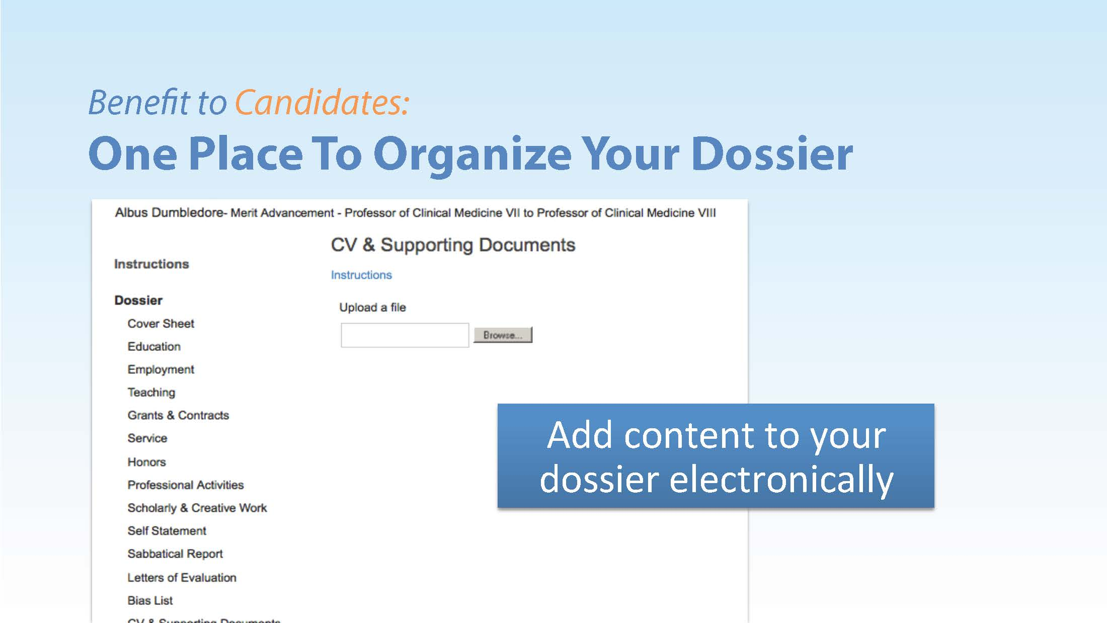
Notes:
Touted as “one place to organize your dossier,” OPUS will list courses taught; professional activities; publications, presentations, and other forms of scholarly and creative work, among its many fields.

Slide 10
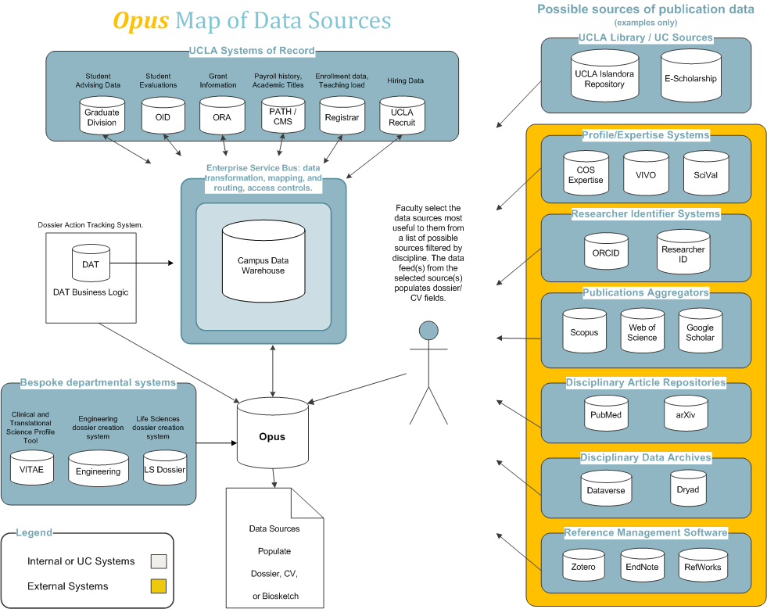
Notes:
OPUS was development to be “a true database of faculty information, which could pull data from other campus IT systems” and indeed from external sources as well. In this image (apologies for the fine print), the lefthand two-thirds of the image show the variety of data sources that could come from the campus. These range from departmental or divisional systems to campus-wide or even systemwide systems such as information from the Office of Research Administration or the Registrar.
On the righthand side, the top two buckets show the “UCLA Islandora Repository” and “E-Scholarship”, the UC system open access repository. Further down, in the gold-shaded section (the gold indicates data sources external to UCLA), data is shown as coming from various sources libraries license and/or access regularly such as Web of Science, Scopus, and Google Scholar. Although this map of data sources is a bit out of date, having been created as Opus was being planned a few years ago, the UCLA Library is a major player as a data provider. Not only do we provide metadata about publications and other scholarly works, but we have also been instrumental in helping the campus disambiguate names by assigning ORCID id’s to faculty that then get associated with them in Opus.

Slide 11
Issues already identified:
Incomplete, inaccurate, or inappropriately used data
Conflict between the need for transparency in a public institution and the privacy of information about individuals and research
Uncertainty about how the data will be used and combined
System security
“The very nature of systematizing and recording information creates categories and names that can unintentionally influence perception or privilege certain ways of looking over others”
Notes:
As you might expect, faculty reaction to Opus has been mixed. While those in department chair or dean positions look forward enthusiastically to a much more streamlined review process, other faculty have been either doubtful about Opus or even openly hostile to it. Their concerns include worry that this so-called “record” of their professional lives will present only a partial picture of their accomplishments, and they worry about the risk of losing control of their data and having it be used in ways that could be detrimental to their reputations. Jean-Francois Blanchette, a faculty member in the Information Studies program, prepared a “trade-offs analysis” that not only describes how Opus will function but also articulates “the various challenges Opus poses with respect to data entry, disciplinary cultures, performance review, and privacy.” As he notes, “looming large in the background is the British evaluation system of measuring academic performance. The narrative of administrative rationality that typically frames academic analytics will do little to dispel the perception that systems like Opus will effect a major step in the direction of UK-style review of faculty and higher education institutions.”
Another major concern that has surfaced is around the tension between privacy and transparency. California Public Records law requires that “information relating to the conduct of the public’s business” be made available on demand. As Jean-Francois comments, “by standardizing this data and bringing it into a single system, Opus will effectively eliminate any burden of collecting the data. But more importantly, it will eliminate the burden of aggregating and correlating the data. Any such correlation might become fair game for a PRR, e.g., highest paid UC faculty with smallest number of students taught and worst students evaluations…”

Slide 12
UCLA’s Research Informatics Strategic Planning Initiative (RISP)
Goals include the following:
To allow UCLA to stay in the forefront of “big data” analytics;
To foster collaboration and significantly broaden faculty participation in data-drive research; and
To bring visibility to UCLA in “big data”
Notes:
Turning to a second initiative, the Research Informatics Strategic Plan process began 3 years ago. The plan was ditributed in draft form two years ago, and for the past year a newly-formed RISP Board has been meeting to develop a set of pilot projects. These range from the development of mobile platforms that can be used for medical applications without violating HIPPA to the establishment of a strategy for data storage, management, and curation as well as the creation of a set of tools for data manipulation and visualization.

Slide 13
The UCLA Library’s contributions to OPUS and RISP
Governance and participation in policy development
System design
Source of some types of data
Identity management
Data visualization pilots including publication of the visualizations
Accessibility of data to others

Slide 14
Debate about a vendor research analytics product
Concerns:
Privacy
Completeness of data
Value of data

Slide 15
Final thoughts and recommendations
Importance of campus partnerships
Need to bring library expertise to bear
  Name disambiguation
  Help in providing more complete record of scholarship
  Links to repositories of new publications and publication types
  Evaluation and licensing of commercial research analytics services
  Resource on literature of rankings and reputation
  Policy development (privacy, security, etc.)
How can the library impact institutional rankings directly?

Slide 16
One final comment:
Remember the sometimes untapped power librarians have: the power to convene

