Slide 1
Technical Advances for Innovation in Cultural Heritage
Institutions (TAI CHI) Webinar Series
5 November 2015
How You Can Make the Transition from MARC to Linked Data Easier
Jean Godby and Karen Smith-Yoshimura
OCLC Research
#oclcresearch
#linkeddata
Notes:
Happy Thursday and thanks for tuning in! Today Karen and I will share some lessons we have learned from two linked data projects being conducted in OCLC Research that show us some useful ways to make the transition easier. Karen gave a version of this presentation at the ALCTS preconference preceding ALA Annual last June.
Introduction: J (Dublin)
K (San Mateo) – multilingual bibs
J (Dublin) – av and summary
“Beyond the looking glass: Beyond the Looking Glass: Real World Data. What does it take to make it work?” San Francisco, CA 26 June 2015.

Slide 2
To make linked data work, we need…
Good data!
Structured, accurate, unambiguous,
actionable and can be linked to
other data.
Notes:
Briefly, to make linked data work we need <click>
Of course, you can achieve these goals with MARC, but they aren’t an automatic consequence of current cataloging standards. But MARC records can be converted more easily into linked data by following a few conventions that are already defined.

Slide 3
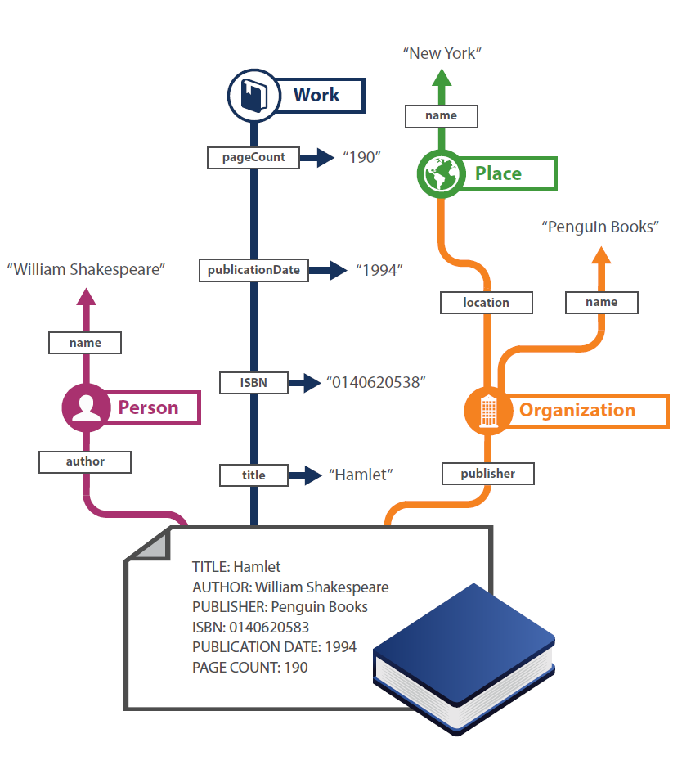
From records to entities
Notes:
So where do we start? Make our data more machine-readable. But isn’t MARC “Machine-readable” Cataloging? Yes and no. A MARC record is certainly more readable than a physical library catalog card. But it is only readable in library systems. And the record is fully understandable only to human readers. So we need to take the next step shown in this slide: transform the flat record shown at the bottom to the network shown at the top. We’re doing two things.
--We’re pulling out entities—or the real-world things that the record describes. A person named William Shakespeare, a Work named Hamlet, a place named New York, and so on.
--We’re also pulling out the relationships among the entities. William Shakespeare is the author of Hamlet. It was published by an organization named Penguin Books, and so on.
So why are entities and relationships more powerful than the flat record?
--They exist outside the world of library metadata. If they’re described in common standards such as schema.org, other systems besides library systems can understand them.
--They can also contribute their own knowledge about them. Librarians care about certain attributes, but we can learn more about William Shakespeare and Hamlet by consulting authoritative information managed by scholarly communities, news organizations, encyclopedias, and standard web resources such as Wikipedia.

Slide 4
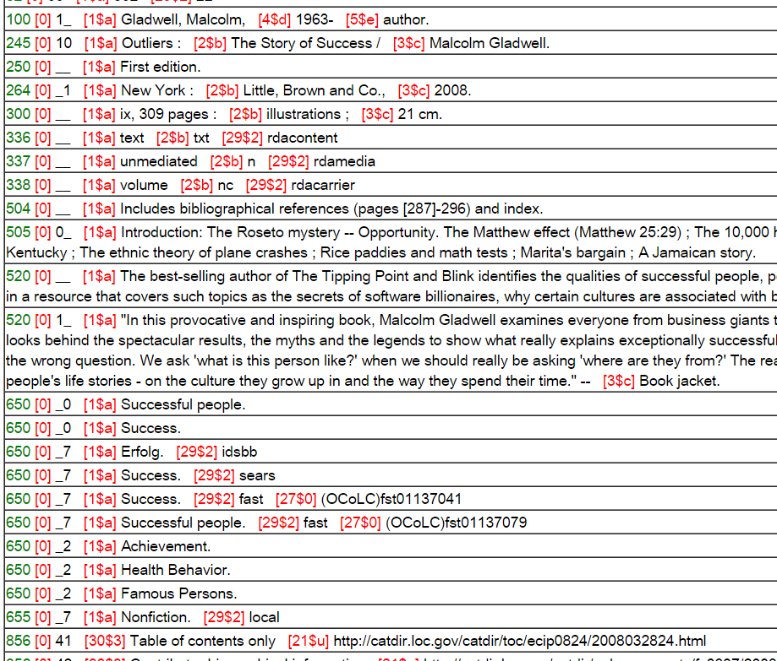
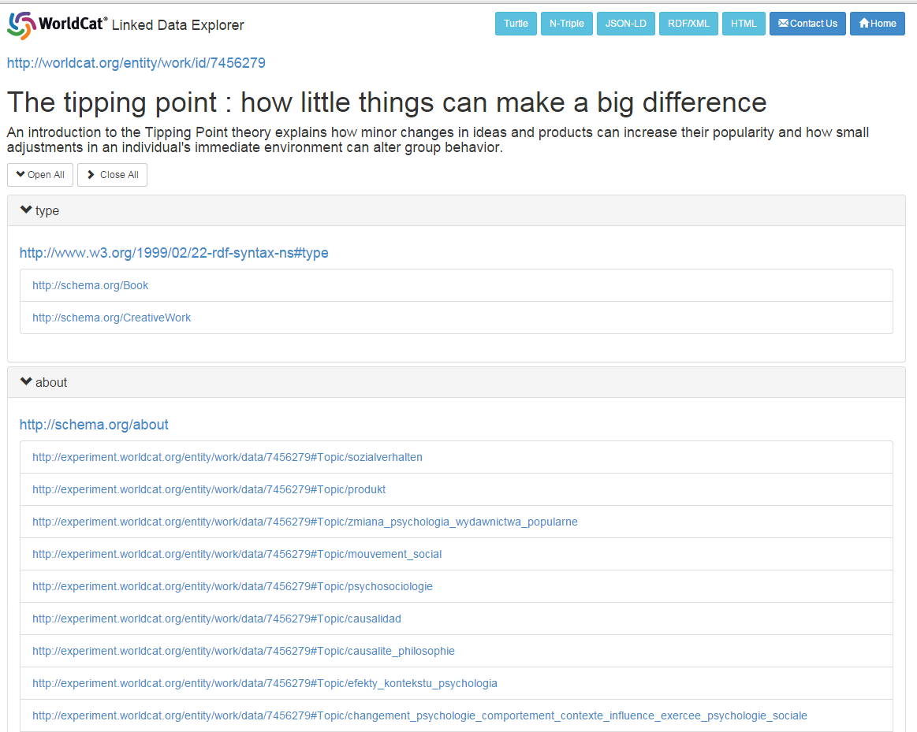
From records to things: ‘Work’
Notes:
Dig deeper with a real example. (click) Start with a MARC record about the Tipping Point by Malcolm Gladwell. $100 Personal Name, a $245 Title, a $520 summary and $650 subjects are extracted and expressed as machine-readable statements, or ‘triples’ in RDF.
But this is not just a simple conversion process from MARC to RDF. It is a process of learning or accumulating information about Malcolm Gladwell, the Tipping Point, and other entities that are described in WorldCat or other datasets about resources managed by libraries. So the same information is extracted from every MARC record about the Tipping Point in WorldCat to form a Work Cluster.
(click) The result is a description of a WorldCat Work entity for ‘The Tipping Point.’ It is a Knowledge Graph about everything we can learn about The Tipping Point from WorldCat’s hundreds of millions of MARC records. It represents content common to many manifestations or formats.
The Work description is no longer human-readable, but is a rich collection of pointers, or URIs, to other machine-understandable resources.

Slide 5
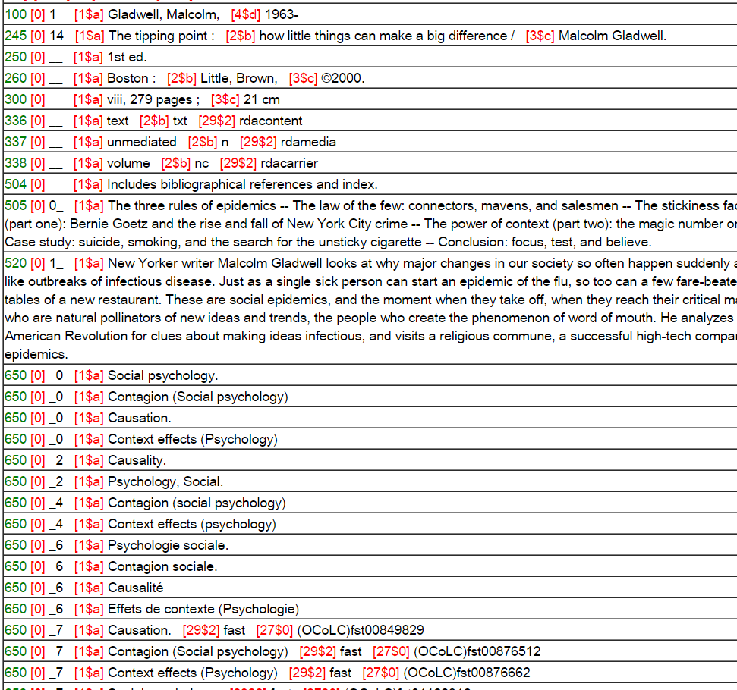
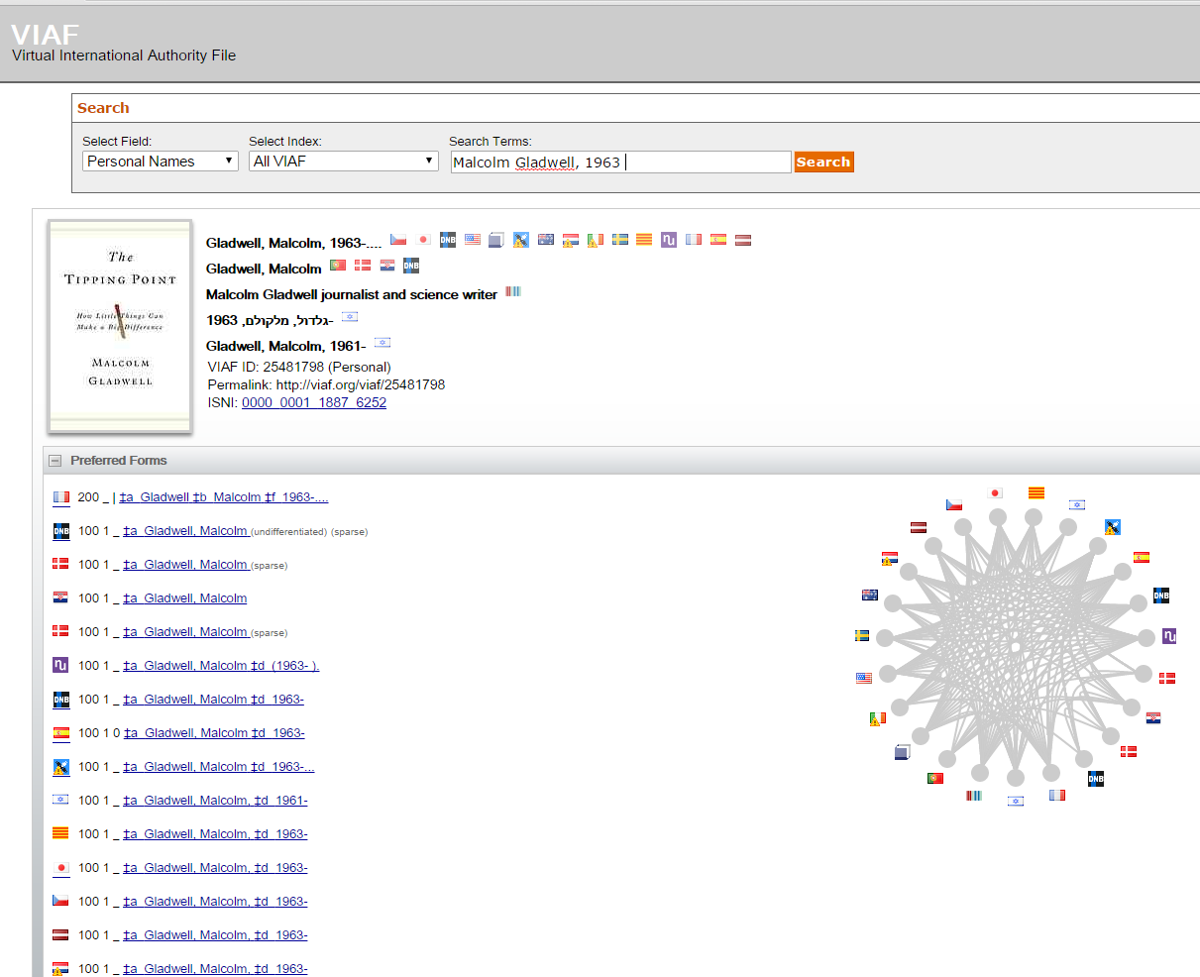
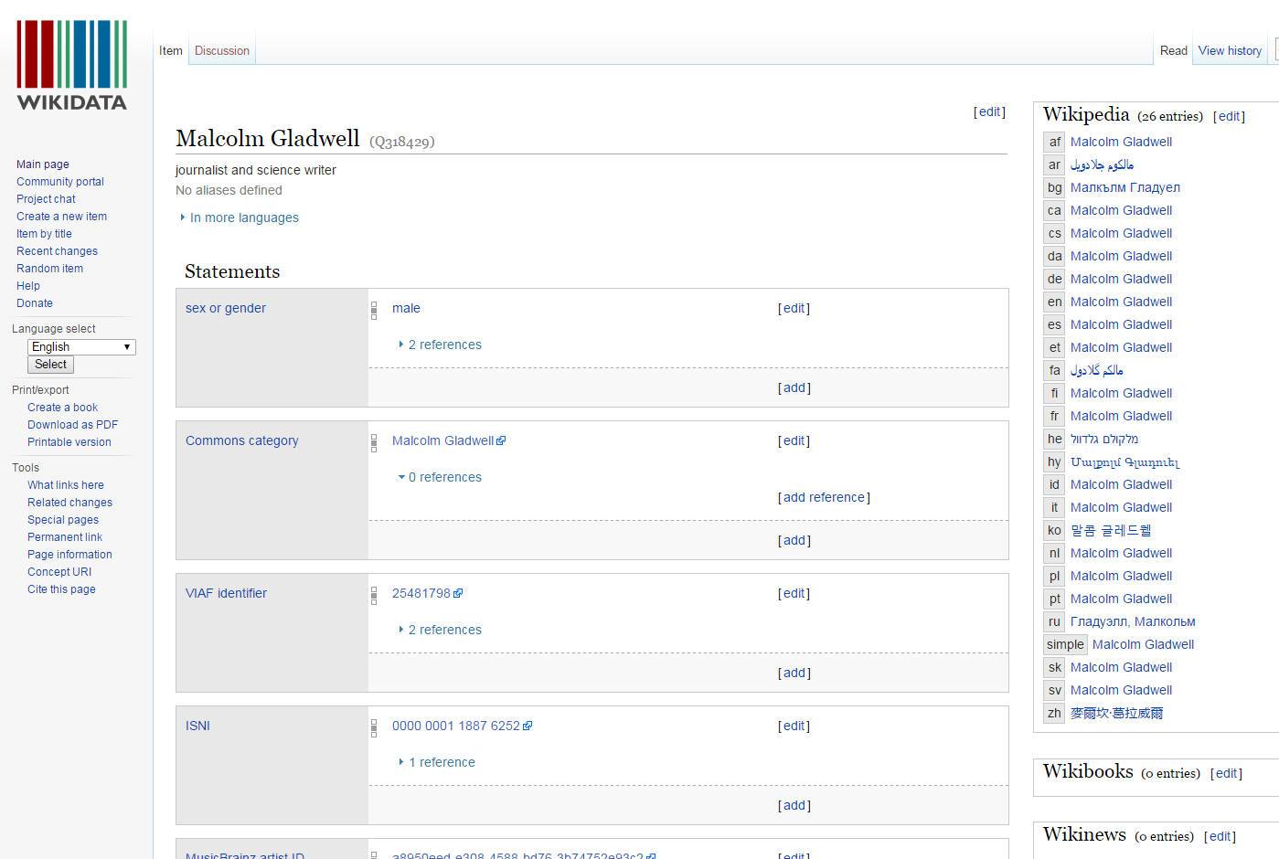
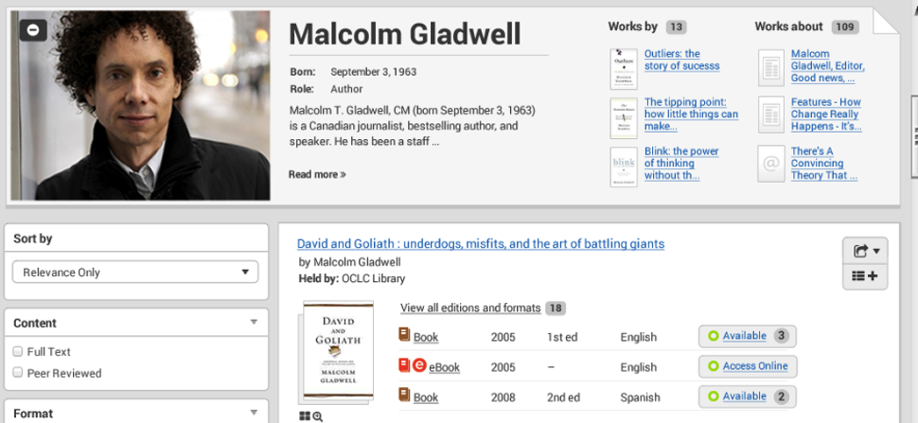
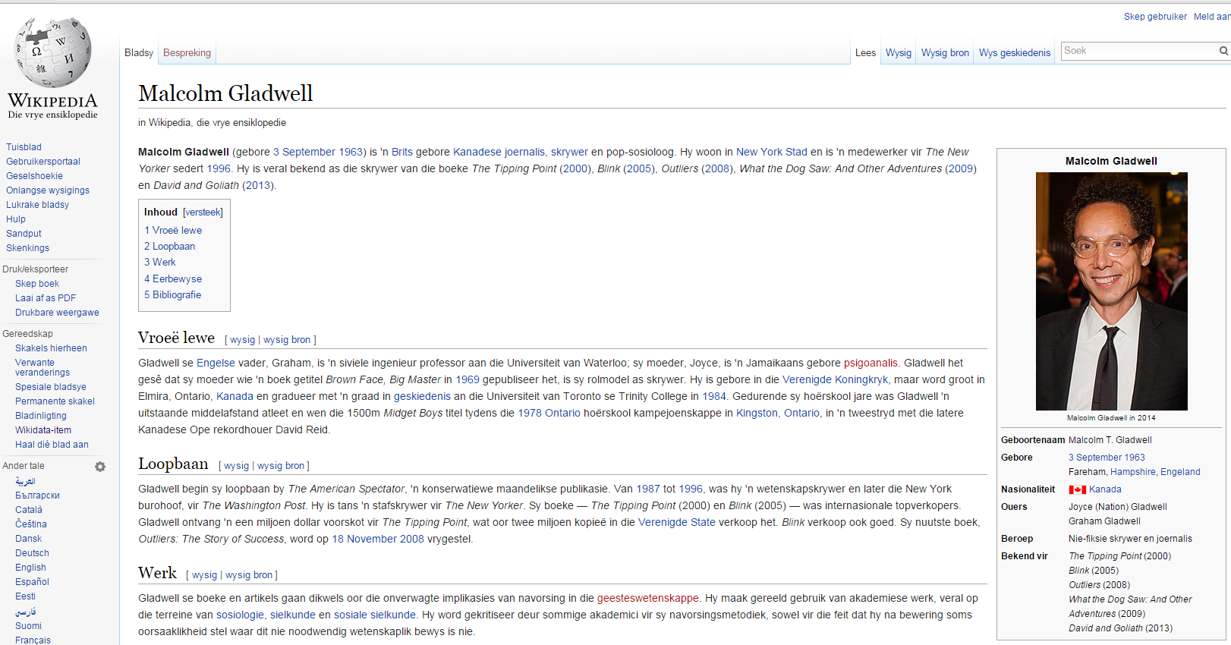
From records to things: ‘Person’
Mockup
Notes:
A similar process can collect information about the author Malcolm Gladwell. Start from the MARC record.
(click) in multiple library authority files aggregated by VIAF
(click) in Wikidata and (click) Wikipedia
(click ) We are also experimenting with the generation of ‘person’ entities for the people who show up in the library record. Here is a mockup for Malcolm Gladwell. It integrates information from the library community and the broader Web in a single place. Malcolm Gladwell is already described in library authority files, but many authors or creators are not – scholars who have published only journal articles, people who have assembled archives, and the many contributors to multimedia resources who are not authors but are contributors in other ways (musicians, composers, playwrights, etc).
So what we’re really doing is building hubs for Works, Persons, and other entities that are important to librarianship. The descriptions that result are much richer than an individual human-readable record. This data can be used in lots of ways to create customized user experiences. But to get there, we have to have good data. Karen will walk us through some examples involving translations.

Slide 6
Title: 西遊記
Language: Chinese
Author: 吳承恩
Created: 1592
HasTranslation:
Title: Journey to the West
Language: English
Translator: Anthony C. Yu
Date: 1977
IsTranslationOf:
Title: Monkeys Pilgerfahrt
Language: German
Translator: Georgette Boner Date: 1983
IsTranslationOf:
Title: Journey to the West
Language: English
Translator: W. J. F. Jenner
Date: 1982-1984
IsTranslationOf:
Title: 西遊記
Language: Japanese
Translator: 中野美代子
Date: 1986
IsTranslationOf:
Title: Tây du ký bình khảo
Language: Vietnamese
Translator: Phan Quân
Date: 1980
IsTranslationOf:
Notes:
The relationship of a work (with an author) and its associated translations (with their respective translators) is relatively straight-forward. This diagram captures the relationship in two reciprocal links, one from the original Chinese book (blue box) through its property HasTranslation pointing (with blue arrows) to each translation (red boxes), and one from each translation back to the original Chinese work (red arrows) through the property IsTranslationOf . A work can have any number of translations, and there can be multiple translations into the same language which is why identifying the translator is so important.

Slide 7
Markup for the Semantic Web
# Original Work (in Chinese)
<http://worldcat.org/entity/work/id/1215997>
a schema:CreativeWork;
schema:creator <http://viaf.org/viaf/102266649> ; # "Gao, Xingjian”
schema:inLanguage "zh";
schema:name "靈山"@zh-hant
.
# Translated Work (in English)
<http://worldcat.org/entity/work/id/145209748>
a schema:CreativeWork;
schema:creator <http://viaf.org/viaf/102266649> ; # "Gao, Xingjian“
schema: translator <http://viaf.org/viaf/81663420> ; # "Lee, Mabel"
schema:inLanguage "en";
schema:name "Soul Mountain"@en ;
schema:translationOfWork <http://worldcat.org/entity/work/id/1215997>
Notes:
Machines access VIAF far more than humans. To leverage all the work done by the OCLC cooperative we want to share the relationships we’ve established between original works and their associated translations with the semantic Web. Here is a sample markup of an original Chinese work written by Gao Xingjian, a Chinese Nobel Prize laureate for literature, and one of the translations of his work into English. We marked this up with schema.org; there were two new terms we proposed, since accepted as a bib extension, shown here: translator and translationOfWork. We are also exploring using ISO-defined script differentiators for simplified and traditional Chinese characters, “hant” here for traditional and “hans” for simplified.
The same process contributes to WorldCat Work descriptions. The relationships we’re establishing in VIAF also flow into WorldCat Works over time.

Slide 8
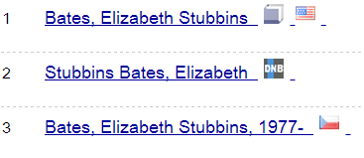
Originally 3 clusters each for
a different title but by the same author
Split off the “Murakami Haruki” with same romanization; different romanizations of same title also resulted in non-match.
These still need to be merged.
Even the best algorithms still
need manual intervention
Notes:
VIAF includes XA records that act as “Police records”, records we create to force records out of clusters that don’t belong and merge clusters that didn’t have enough matching points. An xA record indicates manual intervention, where we manually split clusters that represent more than one person or merged clusters that really represent the same person.
In the first case, two different Japanese names have the same romanization. Most sources do not include the kanji of either the author or the works, and the romanizations for the same title differed so some entries were associated with the incorrect “Murakami Haruki”. The xA records we created split the two Murakami’s apart and made sure they were associated with the correct titles.
In the second case, my college room-mate had written several different works both in the US and France. Each source listed a different title – we didn’t have anything to match except her name so we ended up with three different clusters. She confirmed that she wrote all three so the xA record merged them into one cluster.
A triplicate for another name, this time due to the differences in how the same name is represented by different sources, has been reported. Humans are still better at detecting these kinds of errors than algorithms so we will continue to need a manual over-ride.

Slide 9
Examples

Slide 10
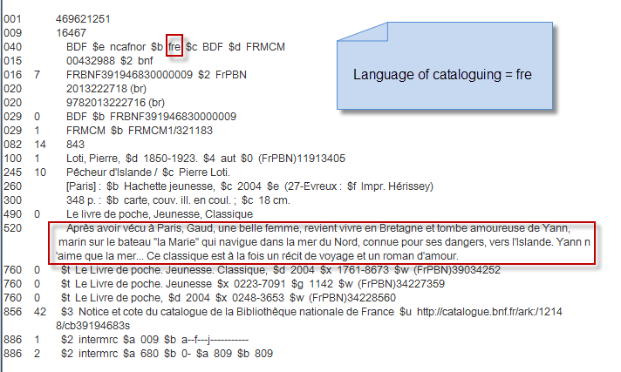
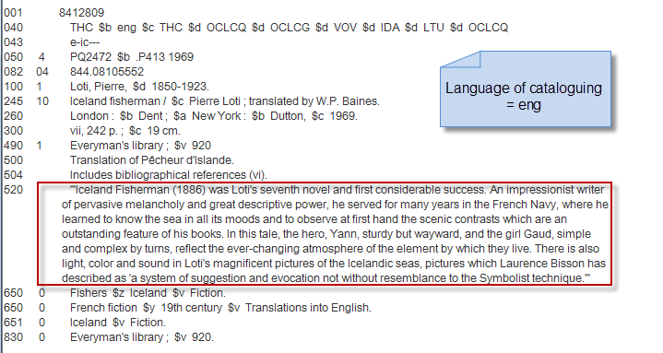
Notes:
It’s lovely to see records that include a summary! To present information in the preferred language of the user, we need to know the language of the individual data elements, not just the language of the resource being described. The language of cataloging in a record can indicate the language of the free-text fields such as summaries.
Slide from Janifer Gatenby, OCLC

Slide 11
Notes:
So when we transform these summary text strings into RDF we can provide language tags, allowing us to present information in the preferred language and script of the user.

Slide 12
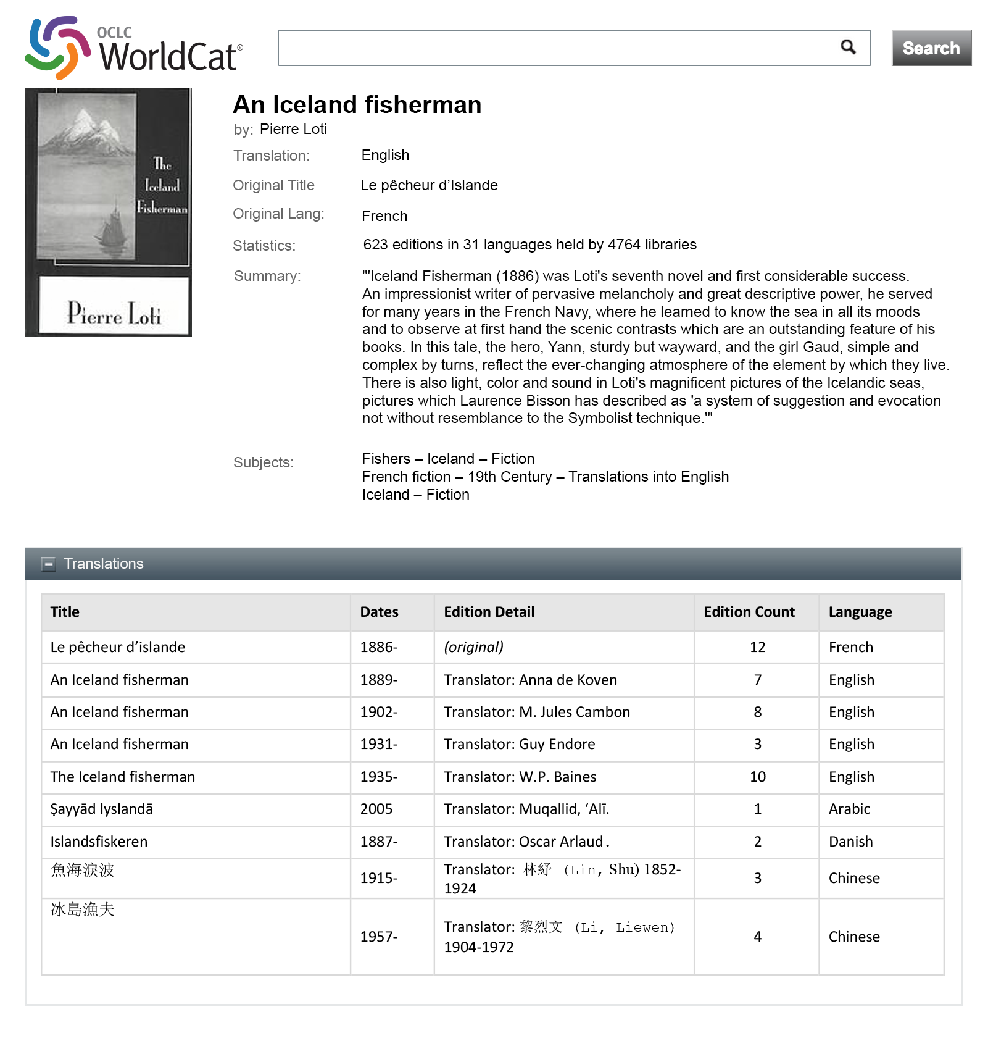
Mockup
Notes:
We have mocked up what a display could look like from the content of WorldCat records. Here, we take advantage that we have an English-tagged summary of An Iceland Fisherman, original in French, displayed in an English interface and with a table of translations and translators of the work.
Mockup designed by JD Shipengrover, OCLC Research

Slide 13
Mockup
Notes:
This is the same record with a Chinese interface. Since we don’t have a Chinese-language summary, none would be shown.
Mockup designed by JD Shipengrover, OCLC Research

Slide 14
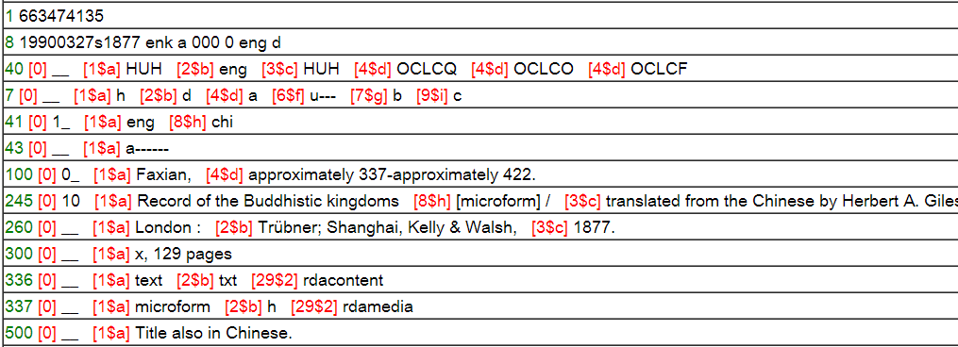
Notes:
This is a record for the English translation of a Chinese classical work, a travelogue of a Chinese explorer ca 400 AD – but it doesn’t say what the original title was, only “title also in Chinese.” <click> This one is better, as it gives the romanization of the Chinese title, but it’s in a free text notes field. <click> And this one gives the romanized Chinese title in the uniform title field. Yay. Of course I’d prefer to see the Chinese characters, especially since this isn’t the Pinyin romanization we use now. But since we group these records into “content clusters” it’s OK that the other records don’t have a uniform title, since this one does.

Slide 15
Notes:
Now when we convert the information into RDF, we can state not only the English translation but also state the work it is a translation of with the appropriate language tags.

Slide 16
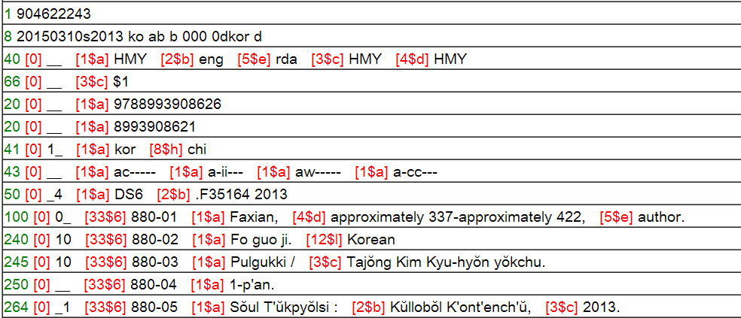
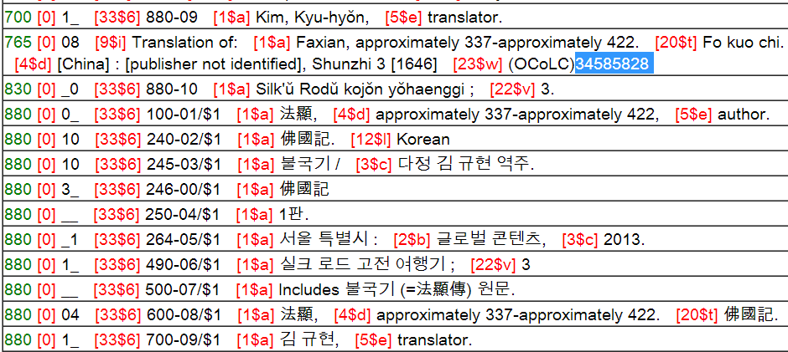
A good example
Language code of original
Original title entry
Uniform title
Added entry for translator, with role term
Notes:
This represents a “gold standard” that makes it easy for us to parse. It has an 041 indicating the language of the original <click> it has a uniform title of the Chinese original, with Chinese characters <click> it has an added entry for the translator, with the role term <click> AND, be still my heart, it even has an original title entry with a link to the WorldCat record for the Chinese original.
It’s pretty rare to find an original title entry for translations.
In April 2015, only 684,000 WorldCat book records had a 765 field, and only 12,000 of them had a $w link to the original.

Slide 17
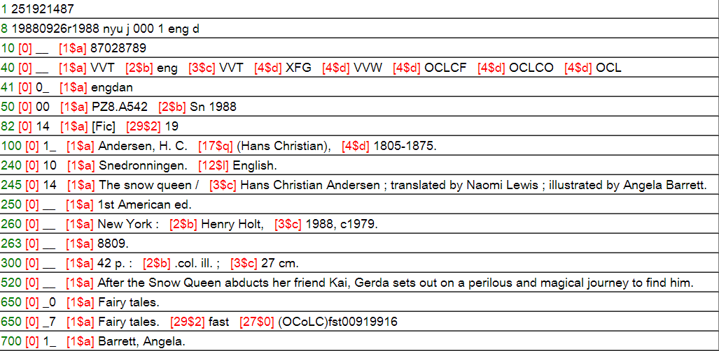
Without added entries, we must parse the 245 $c for translator in different languages
Notes:
Hans Christian Andersen’s “Snow Queen” (originally written in Danish) has been translated into many languages. When records for translations do not include an added entry for the translator, we resort to parsing the 245 $c, using a very long table representing all the ways “translator” or “translated by” can be written in different languages. So the English “translator” is easy for us to spot, but we have to also need to identify, for example, translator in Russian and in Turkish.

Slide 18
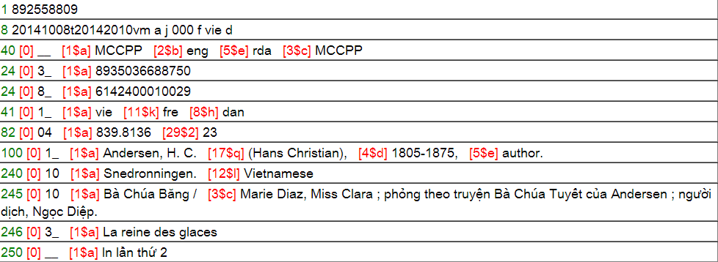
Also nice! Intermediate translation coded (Vietnamese translation from the French translation of the Danish)
Nice! Added entries for translators – with role term

Slide 19
Distinguish translations into the same language by translator
Notes:
In VIAF displays, we’re displaying the translators where we can identify them. Here it’s really useful to distinguish Snow Queen translations into English and into Swedish by different translators.

Slide 20
Free text is unreliable
Jan 2015: 20,108,253 WorldCat records with a 700 $e included for translators:
305,143 Tł
238,839 translator.
217,074 tr
179,368 Ü̈bers.
162,510 Traduction.
138,471 trad.
136,569 yi.
22,947 Trad.
68% of 700 fields have no $e or $4
30,574,365 records with 700 $4: 1,148,813 had code trl
Notes:
The $e terms are language-dependent. This is the list of the most frequently used terms for “translator” in different languages, with some variations (“Traduction” in French also abbreviated as “trad.”) This doesn’t even list all the typos we find farther down the frequency list. Using the $4 code is language-independent, and we can generate the appropriate label
Stats from http://experimental.worldcat.org/marcusage/700.html

Slide 21
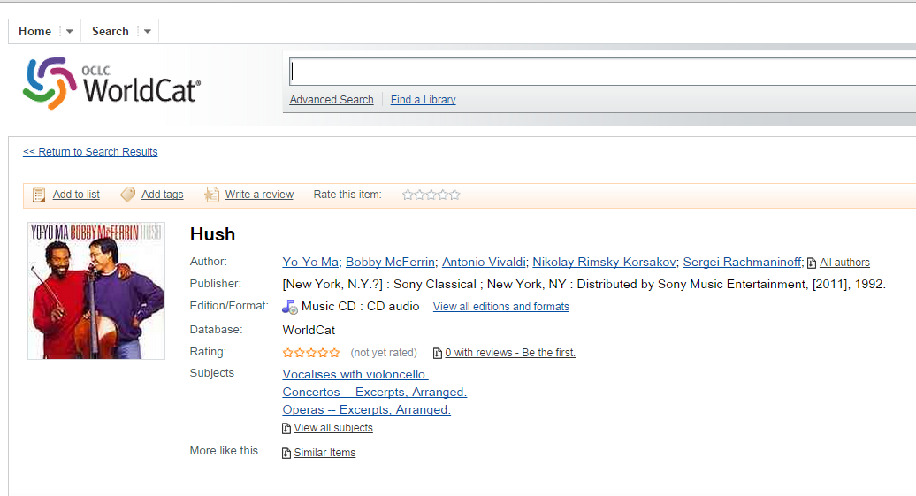
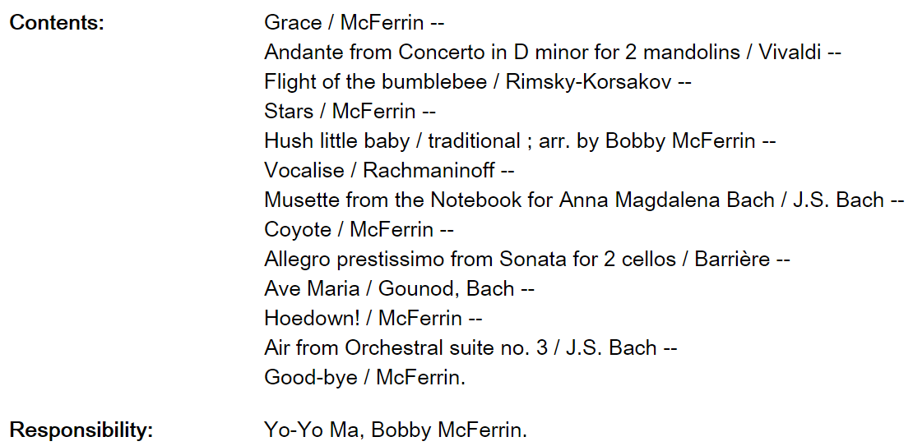
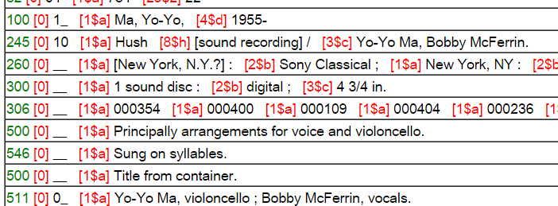
A sound recording
Notes:
--AV materials are rich in entities and relationships;
--subject of an important LC study;
--other communities besides librarians have authoritative info about music and movies
This WC record describes a work by Bobby McFerrin and Yo-Yo Ma, a popular musician paired with a classical musician.
(click) In the underlying MARC record. Describe 100, 700, 511
(click) It is a complex work. Each track is a work with different composers and roles for the two performers. Shown in the MARC 505 field. Note that Yo-Yo Ma, the primary creator for the recording, is not mentioned at all. In addition, the composer role can only be inferred by the human reader. It is not explicitly marked.

Slide 22
The first-draft linked data model
‘Manifestation’
schema:exampleOfWork
CreativeWork
CreativeWork
‘Work’
Person
Yo-Yo Ma
schema:contributor
Person
Bobby McFerrin
schema:performer
Organization
Notes:
But the linked data model that can be inferred from the RDF statements published on the MARC record available from WorldCat shows none of this richness.
It is derived only from the machine-understandable (structured) data. The MARC record represents a Work Example (for a CD). The corresponding Work represents a cluster of descriptions of the same recording – as a CD or audiocassette released multiple times since 1992. The 700 and 710 fields are converted to a set of contributors – or something more specific if there is a role code.
As a result, the published linked data says very little about who did what to each creative work. It is not very actionable.

Slide 23
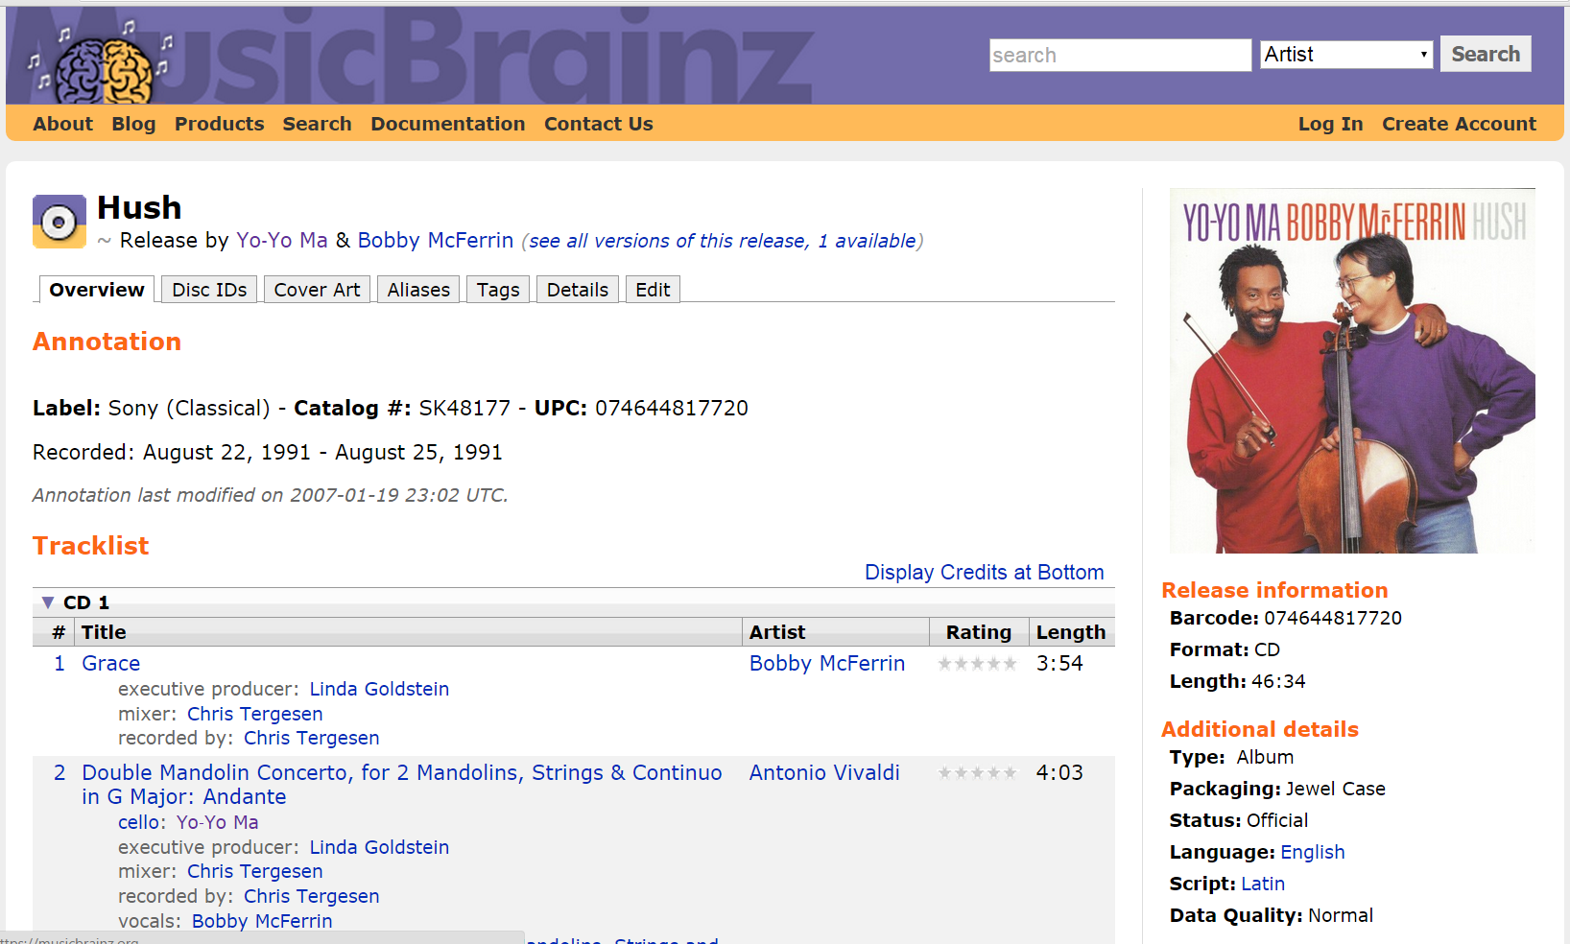
More evidence for the model
Notes:
In the 505 field in the MARC record, it is not possible for a machine to determine who did what to each track. The semantics have to be inferred. But structured, parseable data does exist in MusicBrainz.
If we can link the MARC record to the corresponding description in MusicBrainz, three good things happen:
We link to the broader community of music producers and consumers, who almost certainly have important facts to add to the Person and Work entities being described
We can algorithmically discover more of the model for sound recordings,
The task of retrospective conversion of MARC records for linked data is simplified.
If descriptive task is shared among librarians and stakeholder communities (which the linked data paradigm encourages), we would only be required to parse the record for search terms that connect it to a more machine-understandable description created elsewhere.

Slide 24
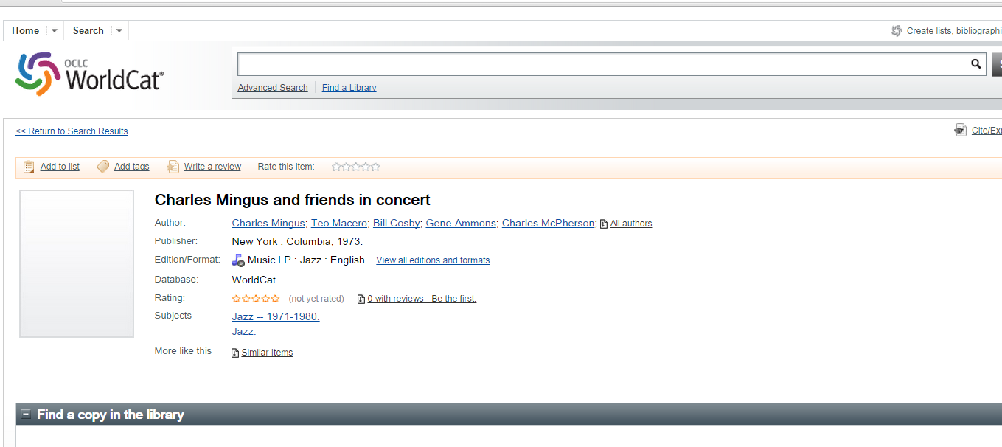
A good example
Notes:
The next few slides walk through a description of a sound recording that can be converted more easily to linked data. Simpler because it does not describe a collection.

Slide 25
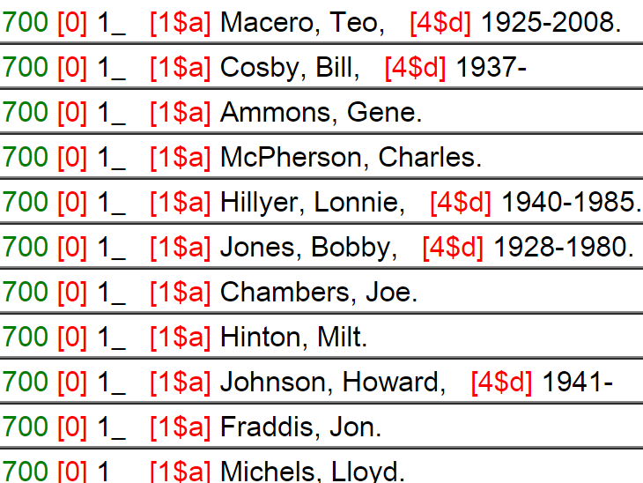
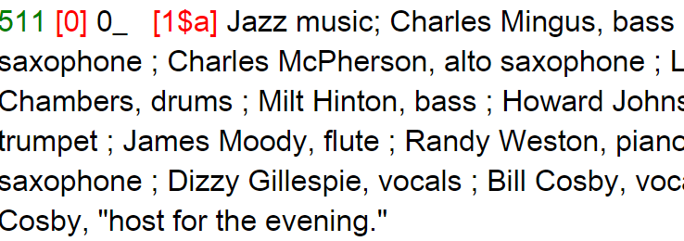
A good example
An obvious primary creator
No redundant role data
Plenty of 700 fields
Specific field semantics and easily parsed text
Notes:
Here is what makes this record relatively easy to parse and interpret.
It strikes the right balance between the limited expressiveness of the MARC relator codes and the rich role detail that is available for this resource.
<click>The 511 field identifies the performers and the roles they play in the performance.
The semantics of the 511 field identifies them as ‘participants or performers’ and the 0 in #1 that they are not cast members, but some other kind of performer.
<click>Most of the names are repeated in the 700 field. The role code is omitted, but the only relevant value would be ‘prf,’ which is redundant with the semantics of the 511 field.
A relatively straightforward algorithm can match the free-text form of the name in the 511 with the controlled form in 700. Then it can be established that this is Charles McPherson the alto saxophone player, not the veterinary scientist (who wrote ‘Techniques with guinea pigs’ http://www.worldcat.org/title/techniques-with-guinea-pigs/oclc/18360705&referer=brief_results)
<click>The 100 field does not have to appear in a MARC record about audiovisual materials. But here it makes sense because there is a primary creator. In the previous example, Yo-Yo Ma and Bobby McFerrin were co-stars, but only Yo-Yo Ma appeared in the 100 field.
<click>Role information does not appear elsewhere in the record, which is good, because it would be redundant, and possibly inconsistent.

Slide 26
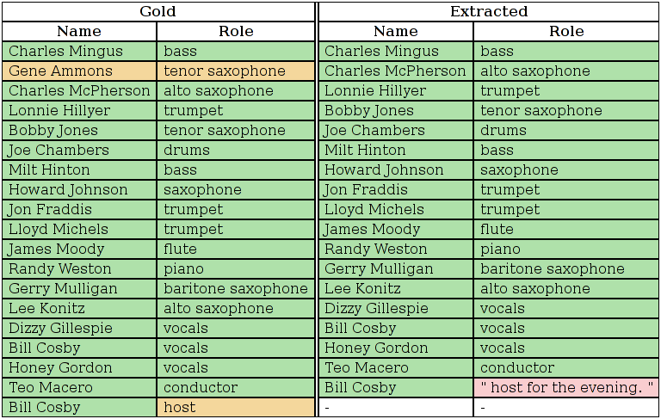
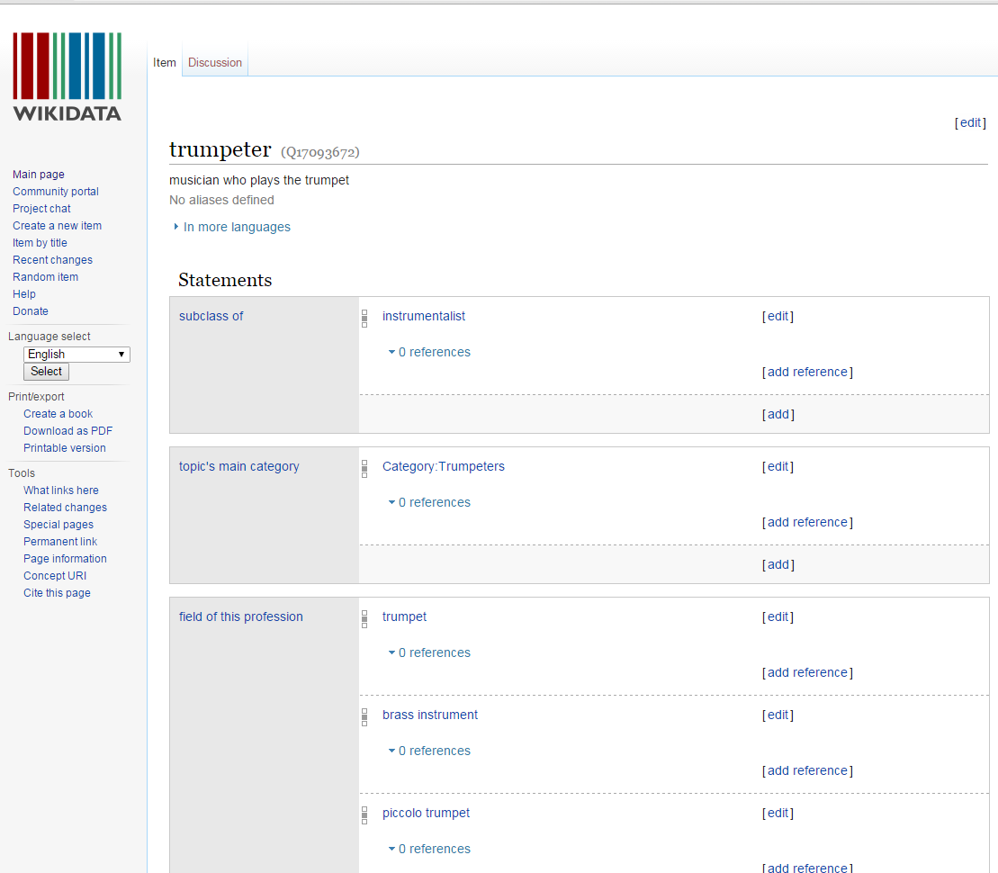
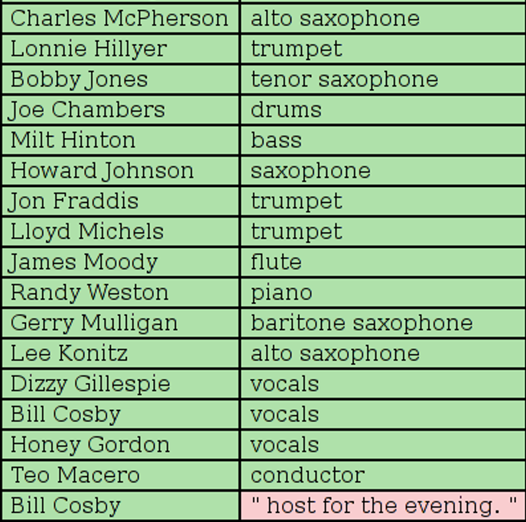
Some parsing results
Notes:
In one of our research projects, we are trying to extract the rest of the rich relationships from this record. A simple parsing algorithm was applied to the 511 field. This image shows the results. On the left (marked ‘gold’) are the substrings judged as correct by a human reader. On the right (marked ‘extracted’) are the strings extracted by the algorithm. A yellow background (in the gold data) identifies correct answers that were not identified (or false negatives). A pink background in the extracted data marks strings that were extracted, but are not in the gold data (or false positives).
This record yields data about roles that is not expressible using MARC relator codes. Though we have to infer that Lonnie Hillyer ‘played’ rather than ‘built’ or ‘painted’ a trumpet, normalization to a more obvious ‘role’ noun can be done by linking to the corresponding Wikidata page that has an ontology connecting the instrument to the player of it (with identifiers) (click)

Slide 27
A more expressive model
host
MusicEvent, CreativeWork
“Charles Mingus and friends”
schema:creator
drums
Person
“Charles Mingus”
bass
Person
“Charles Mingus”
bass
schema:workPerfomed
Person
“Milt Hinton”
CreativeWork,
Music Album
vocals
Person
“Dizzie Gillespie”
schema:encodesCreativeWork
CreativeWork,
sound recording
Person
“Joe Chambers”
schema:publisher
Person
“Bill Cosby”
Organization
“Columbia Records”
schema:performer
Notes:
Here is the model that now be derived from the data. It can be expressed in Schema.org.
There are 3 creative works—a performance event, an album, and a physical realization of the album.
The sound recording ‘encodes’ the album (published by Columbia Records), and the event is a performance of the work.
The performers are now identified by their specific contributions.

Slide 28
Our recommendations
Least machine-processable
If you must use free text:
Use established conventions
Use standardized terms
Algorithmically recoverable
Use the most specific fields appropriate for a descriptive task
Minimize the use of 500 fields
Obey field semantics
Avoid redundancy
Most machine-processable
Use uniform titles
Use added entries with role codes (7xx and $4)
Use 041 for translations, including intermediate translations
Use indicators to refine the meaning
Notes:
The list of recommendations can be organized into a sort of metadata “food pyramid.” Those at the top may be necessary, but should be used sparingly. Those further down should form the foundation of practice, if the goal is improved machine understanding of MARC metadata. This kind of analysis is only one thread of work in the general program for making entities and relationships more visible in MARC records. Another—the PCC URI committee, which is tasked with making it easier to add URIs to MARC records.

Slide 29
To make linked data work, we need…
Good data!
Structured, accurate, unambiguous,
actionable and can be linked to
other data.

Slide 30
Resources

Slide 31
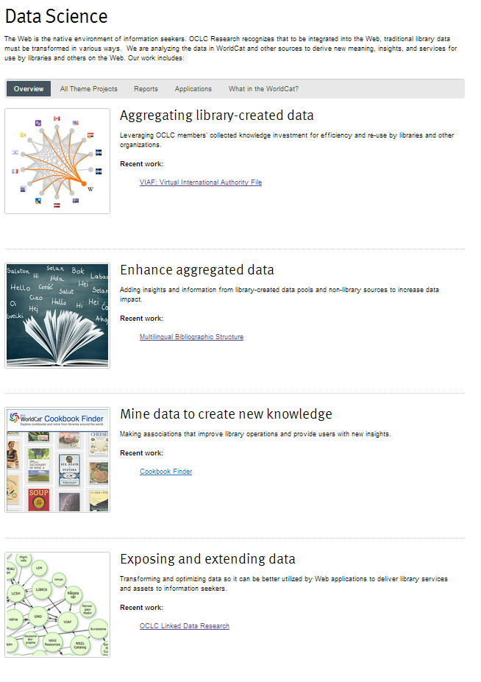
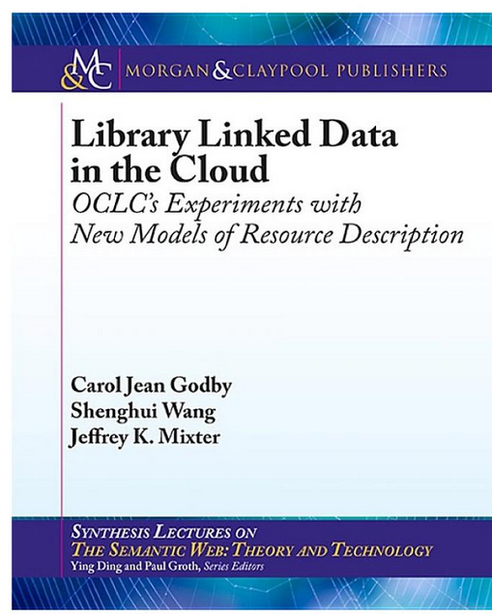
http://www.oclc.org/research/themes/data-science.html

Slide 32
For more information
Godby, Carol Jean, and Ray Denenberg. 2015. Common Ground: Exploring Compatibilities Between the Linked Data Models of the Library of Congress and OCLC. Dublin, Ohio: Library of Congress and OCLC Research. http://www.oclc.org/content/dam/research/publications/ 2015/oclcresearch-loc-linked-data-2015.pdf
Godby, Carol Jean, Shenghui Wang and Jeffrey K. Mixter. 2015. Library Linked Data in the Cloud: OCLC’s Experiments with New Models of Resource Description. Morgan & Claypool. http://www.morganclaypool.com/toc/wbe.1/1/1
Godby, Carol Jean. “A Division of Labor: The Role of Schema.org in in a Semantic Web Model of Library Resources.” In Missing Links (Ed Jones, editor). ALA Publications. In press.
RDA. 2015. “RDA Element Sets: Expression Properties.” http://www.rdaregistry.info/Elements/e/
Van Malssen, Kara. 2014. BIBFRAME AV Modeling Study: Defining a Flexible Model for Description of Audiovisual Resources. http://www.loc.gov/bibframe/pdf/bibframe-avmodelingstudy-may15-2014.pdf.

Slide 33
Technical Advances for Innovation in Cultural HeritageI nstitutions (TAI CHI) Webinar Series
5 November 2015
Thank you!
Contact: Karen Smith-Yoshimura
Jean Godby
smithyok@oclc.org
godby@oclc.org
@KarenS-Y
©2015 OCLC. This work is licensed under a Creative Commons Attribution 4.0 International License. Suggested attribution: “This work uses content from How You Can Make the Transition from MARC to Linked Data Easier © OCLC, used under a Creative Commons Attribution 4.0 International License: http://creativecommons.org/licenses/by/4.0/.”

