Slide 1
OCLC Research Library Partnership
Work-In-Progress webinar
3 December 2015
A Close Look at the Four Million Archival MARC Records in WorldCat
Jackie Dooley
Program Officer
OCLC Research

Slide 2
overview
Research Objective
Some Initial Questions
Scope of the Dataset
Key Findings
Data Analysis
Tentative Recommendations
What’s Next?

Slide 3
Research objective

Slide 4
Research Objective
Establish a detailed profile of MARC data element occurrences in archival catalog records, providing a view of 30+ years of practice.
Reveal variations in descriptive practice across formats
Characterize practice before MARC usage diminishes
Debunk any inaccurate assumptions
Suggest changes to descriptive practice
Enable analysis of implications for discovery
Take note! I studied field occurrences, not content.

Slide 5
Some initial questions

Slide 6
Some Initial Questions
What is “archival material”?
Is archival use of MARC accurate and fulfilling its potential?
How does archival description differ across types of material?
Are archival materials usually described as collections?
Does the archival control byte capture all archival descriptions?
How often is DACS specified as the content standard?
To what extent have DACS minimum requirements been met?
Bonus question: What implications for next-gen cataloging do the data suggest?

Slide 7
Scope of The Dataset

Slide 8
Archival records filtered from WorldCat
OCLC’s WorldCat database of 340+ million records filtered to extract “archival” records
Currently 4 million, about 1% of WorldCat
Scope expanded two years ago to add more types of material
Brief version of the filter specs
“Unpublished” materials in any format
Under “archival control”
Held by a single institution
Excludes published materials
Spoiler alert: It’s not perfect.

Slide 9
Same dataset as ArchiveGrid
The full filter specs:
Only one library holding symbol is attached (to eliminate non-unique items or collections)
The MARC Leader has one or more of the following:
Leader byte 06 (recordtype) has the value d (manuscript music), f (manuscript cartographic), g (projected graphics), i (nonmusic recording), j (music recording), k (visual), p (mixed), r (realia), or t (textual manuscript). [does this include all the new ones?]
Leader byte 06 has the value "a" (language material) and Leader byte 07 (bibliographic level) has the value "c" (collection).
Leader byte 08 has the value "a" (archival control).
Field 260 subfields "a" and "b" are not present (to filter out published works)
"Bibliography" does not occur at the beginning string of any MARC subject heading subfield "a" or "v" (to filter out published works).
Field 502 is not present (to filter out theses and dissertations).
Records with material type "book" or "serial" that have no value in fields 008 or 006 “Nature of Contents” bytes (to eliminate theses, reference works, and other non-archival materials).
http://beta.worldcat.org/archivegrid/about/

Slide 10
Key findings

Slide 11
Key Findings
Record type (Leader 06) sometimes used incorrectly
Mixed materials, computer files, web sites (aka Integrating Resources)
Cataloging practices reveal format-specific silos
Record type, archival control, descriptive rules, note fields, use of topical subject field (650) for genre/form terms (655)
Records describing single items greatly predominate for all record types except Mixed Materials
… and 25% of Mixed Materials records describe a single item
Format-specific notes (5xx) underutilized
506, 511, 520, 524, 545, 546, 555, 561 …
500 is most-used note for maps, recordings, scores, text, visual

Slide 12
Key Findings, cont.
Archival control (Leader 08) specified in 28% of records
40% of Mixed Materials records
Archival descriptive standards (040 $e) specified in 20% of records
appm, dacs, gihc
61% of records specify AACR2, 1.5% RDA
One-third of records link (856) to digital content
Digital objects or finding aids

Slide 13
Data analysis
1. Full data
2. Visual materials
3. Mixed materials
4. Textual materials
5. Recordings
6. Scores
7. Maps
8. Other formats

Slide 14
1. Full data (4 million records)
88% are visual, mixed, or textual materials
39% describe collections, 51% single items
“Component” levels are little used
Records for collections are mostly Mixed Materials
28% of records specify archival control (Leader 08)
20% specify use of archival cataloging rules (040 $e)
Creator names (1xx and 7xx) indexed in 86%
Subject terms (6xx) indexed in 84%
Link (856) to digital content in 33%
Digital objects or finding aids

Slide 15
Percent of records by type of material (Leader 06)

Slide 16
Number of records by bibliographic level (Leader 07)

Slide 17
Subject and genre/form index terms

Slide 18
2. Visual Materials
1.5 million records (36% of total)
2-D graphics (30% of all records)
Projected graphics (film, video, slides: 6% of of all records)
Small number of kits and 3-D artifacts
Coded data
76% describe items, 15% collections
Less than 10% specify archival control (Leader 08)
1% specify use of gihc
Coded physical characteristics (007) in 57%
Most-used notes
General note (500) in 77% of records
Summary (520) in 68%
Conditions governing use/reproduction (540) in 57%

Slide 19
2. Visual Materials, cont.
Primary creator (1xx) in 51% of all records
Secondary creator (7xx) in about 31%
Personal name subject (600) in 32%; mean of 1.1 per record
Topical subject (650) in 68%; mean of 4.2
Geographic subject (651) in 38%; mean of 1.5
Genre/form (655) in 81%; mean of 1.5
Link to digital content (856) in 48%

Slide 20
3. Mixed Materials
1.3 million records (31% of all records)
Coded data
75% describe collections, 25% items
40% specify archival control (Leader 08)
40% specify use of appm or dacs
10% have no title in 245 $a ($k usually included)
Organization/arrangement (351) in 12%
Most-used notes
Summary (520) in 75% of records
General note (500) in 44%
Restrictions on access (506) in 37%
Biographical/historical (545) in 27%
No other 5xx used in more than 30%

Slide 21
3. Mixed Materials, cont.
Personal author (100) is primary creator in 40%
Corporate author (110) is primary creator in 21%
Secondary creators (7xx) in about 20%
Personal name subject (600) in 34%; mean of 1.5 per record
Topical subject (650) in 45%; mean of 3.0
Geographic subject (651) in 40%; mean of 1.3
Genre/form (655) in 65%; mean of 1.3
Link to digital content (856) in 34%

Slide 22
3. Mixed Materials, cont.
Presence of DACS (2004- ) single-level required minimum elements (Mixed Materials records only)
Reference code: stored in local database
Name/location of repository: stored in MARC holdings record
Title: 100% of records
Date(s): 52% in 245 $f, 21% in 260 $c
Extent (300): 78%
Creator(s), if known (1xx): 61%
Scope/content (520): 75%
Conditions governing access (506): 37%
Languages/scripts of the material (546): 13%

Slide 23
3. Mixed Materials, cont.
Note fields used in >10% of records
Field |  |  |  |  | Key
500 | 44% | General note |  |  | 5-25%
506 | 37% | Restrictions on access |  |  | 26-50%
520 | 75% | Summary |  |  | 51-90%
524 | 15% | Preferred citation |  |  | 91-100%
540 | 31% | Terms governing use/reproduction
541 | 18% | Source of acquisition
545 | 27% | Biographical/Historical note
546 | 13% | Language
555 | 21% | Finding aid

Slide 24
4. Textual materials
809,000 records (20% of all records)
Collections of printed materials (4% of all records)
Textual manuscripts (21% of all records)
Coded data
66% describe collections, 29% items
16% specify archival control (Leader 08)
17% specify use of appm or dacs
Most-used notes
Summary (520) in 75%
General note (500) in 54%
Restrictions on access (506) in 37%

Slide 25
4. Textual materials, cont.
Primary author (mostly 100) in 77% of records
Secondary author (7xx) in about 50%
Personal name subject (600) in 30%; mean of 0.9 per record
Topical subject (650) in 47%; mean of 1.7
Geographic subject (651) in 29%; mean of 0.8
Genre/form (655) in 35%; mean of 0.7
Link to digital content (856) in 5%

Slide 26
5. Recordings
322,000 records (8% of all records)
Music (5% of all records), nonmusic (3%)
Coded data
95% describe items
3% specify archival control (Leader 08)
Coded physical characteristics (007) in 78%
Most-used notes
General note (500) in 68% of records
Date/time/place of event (518) in 49%
Participant/performer (511) in 33%

Slide 27
5. Recordings, cont.
Primary creator (1xx) in 75% of records
Secondary creator (7xx) in 100%
Topical subject (650) in 66%; mean of 5.2 per record
Geographic subject (651) in 22%; mean of 0.9
Genre/form term (655) in 25%; mean of 1.2
Link to digital content (856) in 3%

Slide 28
6. Scores
117,000 records (3% of all records)
Mostly manuscript scores (3% of all records), a few printed scores
Coded data
77% describe items, 14% components
3% specify archival control (Leader 08)
Uniform title (240) in 41%
Most-used notes
General note (500) in 96% of records
Little use of any other 5xx’s

Slide 29
6. Scores, cont.
Primary creator (1xx) in 90% of records
Secondary creator (7xx) in ca. 50%
Topical subject (650) in 96% of records; mean of 2.4
Genre/form (655) in 34%; often in 650 instead
650s will gradually move to 655
Link to digital content (856) in 25%

Slide 30
7. Maps
22,000 records (0.6% of all records)
Mostly manuscript maps, a few printed maps
Coded data
95% describe items
Coded physical characteristics (007) in 65% of records
4% specify archival control (Leader 08)
Hierarchical geographic area code (043) in 80%
Geographic classification code (052) in 66%
Cartographic mathematical data (255) in 92%
Most-used notes
General note (500) in 96%
Little use of any other 5xx’s

Slide 31
7. Maps, cont.
Primary creator (1xx) in 53% of records
Secondary creator (7xx) in 50%
Topical subject (650) in 68%; mean of 2.8 per record
Geographic subject (651) in 83%; mean of 2.7
Genre/form (655) in 84%; mean of 1.8
Link to digital content (856) in 14%

Slide 32
Other formats
Dataset also includes a few records for:
Computer files (1,275)
Most should instead use record type for nature of content
Web sites (146)
Record type used for these is Integrated Resources
Thousands of others use another record type, e.g. Mixed Materials
Serials (109)
Included only because archival control (Leader 08) is specified

Slide 33
What’s next?

Slide 34
My Questions for You
Which of the findings are significant enough to warrant changes in practice?
Do the data debunk any assumptions?
Would you tweak the specs of our filter?
What other questions should I be asking?
… And what are the implications for next-generation cataloging?

Slide 35
Tentative Recommendations
Consider eliminating some little-used note fields from MARC
Educate archival community about accurate use of record types and why consistency matters
Promote DACS single-level minimum required elements
Promote value of collection-level records to special materials communities
Consider doing some automated data remediation
Sample possibilities: add missing language notes, “no restrictions” notes, country codes, titles in 245 $a
What else? What would help you in your work?

Slide 36
Next Steps
Publish OCLC Research report early in 2016
Prepare a second paper on implications for discovery, comparing MARC and EAD data (Bron et al. in Code{4}Lib, 2013)
Possible future projects
Study data content
Selective data remediation
Enhance generic titles (e.g., Papers, Records)
Add missing language notes (field 546)
Descriptive practice for web archiving
What research might you take on?

Slide 37
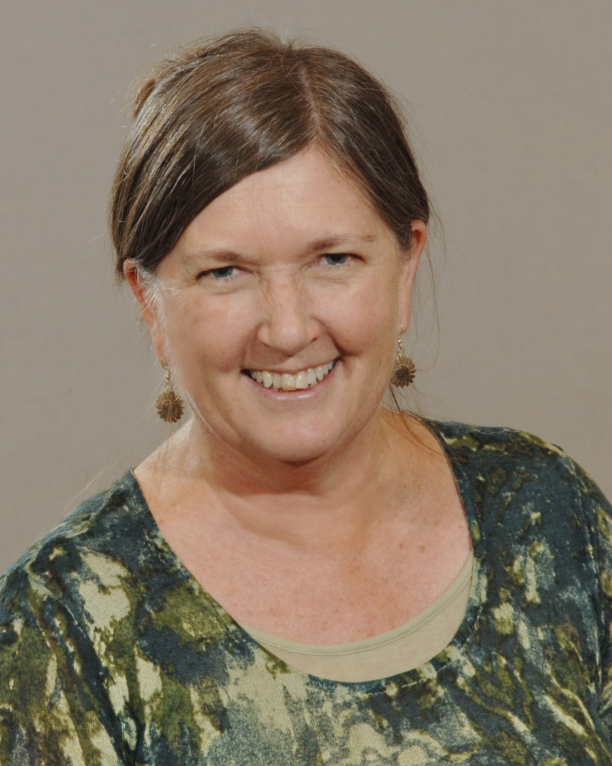
OCLC Research Library Partnership
Work-in-progress webinar
3 December 2015
Please send feedback!
Jackie Dooley
Program Officer, OCLC Research
dooleyj@oclc.org
@minniedw

