Slide 1
Long-tailed e-Humanities and the Big Bad Data: A fairytale
Antal van den Bosch
Centre for Language Studies
Radboud University Nijmegen
OCLC / Libraries and Research: Supporting Change/Changing Support, June 11, 2014
With: Martha van Hoven, Matje van de Camp, Kalliopi Zervanou,
Nicoline van der Sijs, René van Stipriaan

Slide 2
Topics
Big data vs the long tail in e-Humanities
Example 1: linking social history research to a big data text archive
Example 2: Nederlab
Example 3: Twiqs.nl
Developments
Research data management
E-Infrastructures
Libraries: supporting change

Slide 3
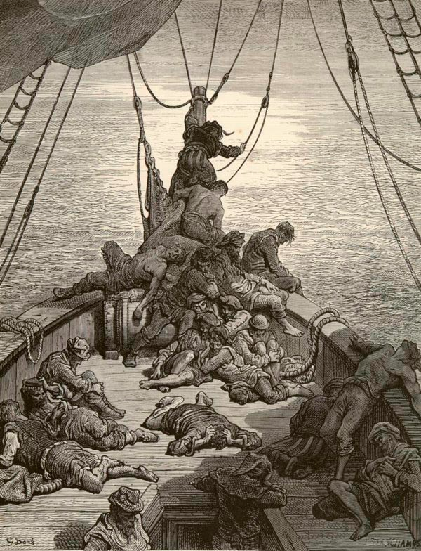
The Rime of the Ancyent Marinere
Day after day, day after day,
We stuck, nor breath nor motion;
As idle as a painted ship
Upon a painted ocean.
Water, water, every where,
And all the boards did shrink;
Water, water, every where,
Nor any drop to drink.
Samuel Taylor Coleridge, 1798

Slide 4
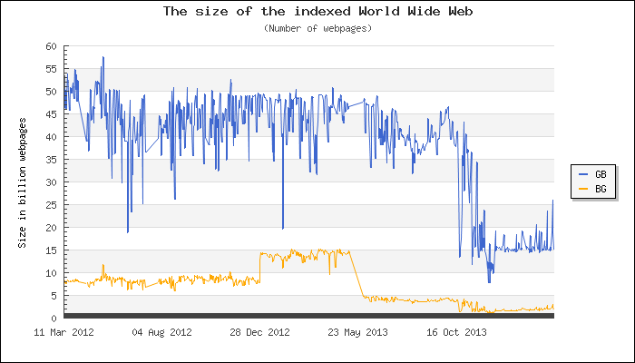
www.worldwidewebsize.com

Slide 5
“There is no data like more data”
Example corpora number of words
Alice In Wonderland 33,361
Bibel 783,137
Spoken Dutch Corpus 10,089,346
Reuters RCV1 130,396,703
Twente News Corpus 566,350,874
LDC Gigaword 2,080,268,230
ValkuilCorpus 3,491,856,359
Google 1Tb 5-grams 5,882,353,315
Twiqs.nl Dutch tweets 42,???,???,???

Slide 6
Classic perception of Humanities
“A new history of humanities” (Bod, 2014)
Humanities researchers as lone wolves
Underdeveloped notions of formal systems and data
Association with stereotypical researchs methods
Sharp divide with exact and behavioral sciences

Slide 7
Humanities
Long tail topics
products of the human mind
Not a closed set of laws or building blocks
But an endless sea of abstractions
Complex spaces in time
Folklore, culture, art
Language, communication, media
Ideology, religion, philosophy, science

Slide 8
HiTiME Historical Timeline Mining and Extraction
Tilburg centre for Cognition and Communication, Tilburg University
International Institute for Social History, Amsterdam
Centre for Language Studies, Radboud University Nijmegen
CATCH event, 6 June 2014

Slide 9
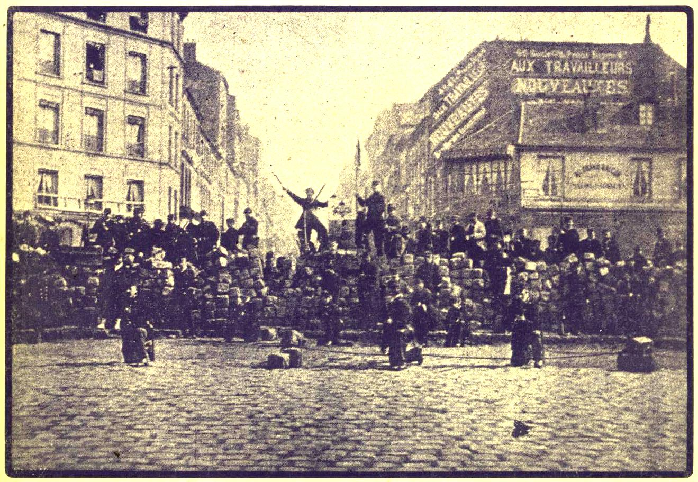
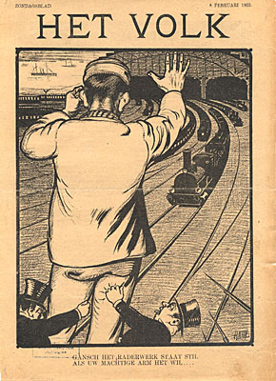
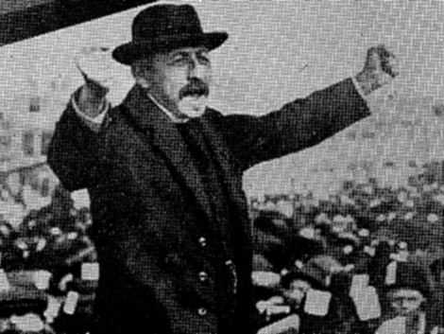
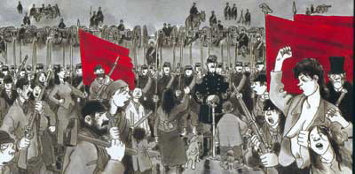
HiTiME aims
History of the social movement in Europe, 1850-1940
Automatic analysis of primary and secondary text sources
Detecting persons, occupations, organisations, locations, time expressions, events
Linking all of this information
Visualising the links through timelines

Slide 10
Events in time
conflict strike occupation
negotiation threat
Event
resolution agreement
Daily narrative
Time

Slide 11
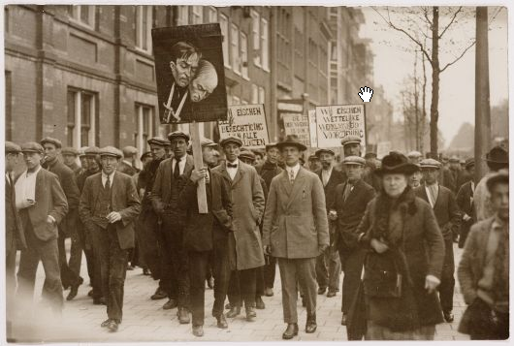
Strike database
Designed and created by Sjaak van der Velden
Contains over 16,000 strikes in the Netherlands

Slide 13
Newspaper archives
Koninklijke Bibliotheek in The Hague
Newspapers from 1618 to 1995
Over 8 million pages online
Searchable on title, date, words
Cf. Forces of labor, Silver (2003)

Slide 14
Example query
SELECT all articles
CONTAINING THE WORDS
stak?n* AND
(blokband OR Amsterdam OR taxichauffeur)
AND artikeldatum BETWEEN 6 apr 1937 – 7 AND 9 apr 1937 + 3

Slide 15
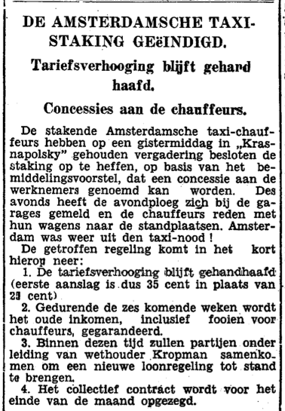
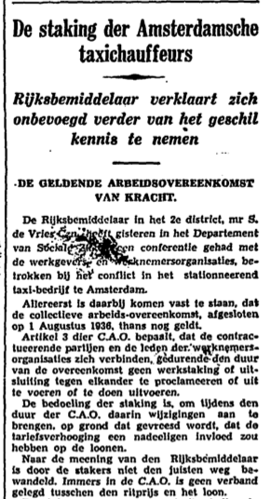
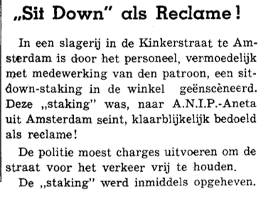
Notes:
Relevante en niet relevante resultaten
Andere artikelen uit dezelfde periode, met het woord staking en een van de andere trefwoorden
Meer niet-relevant bij vaker voorkomende trefwoorden zoals Amsterdam, minder bij Appelscha.
OCR-problemen, dwz problemen met het inlezen van de tekst maken zoeken ook moeilijk.

Slide 16
Strikes that never happened
Many strikes have a lead-in “prelude” period (often associated with social unrest)
Prelude does not necessarily lead to strike
By finding prelude periods typical for strikes, can we find strikes that never happened?
Notes:
In die aanloop is er sprake van overleg, dreiging, ultimatums van de kant van werknemers en werkgevers
Terug te vinden in artikelen die dateren in de week voor een staking
Niet elke stakingsdreiging hoeft natuurlijk in een staking geeindigd te zijn.
Het zou voor historici interessant kunnen zijn om die dreigingen te vinden en te kunnen vergelijken met wel gebeurde stakingen
Kunnen we uit de aanloop naar stakingen een patroon, kenmerken halen waarmee de aanloop naar niet-gebeurde stakingen kunnen vinden?

Slide 17
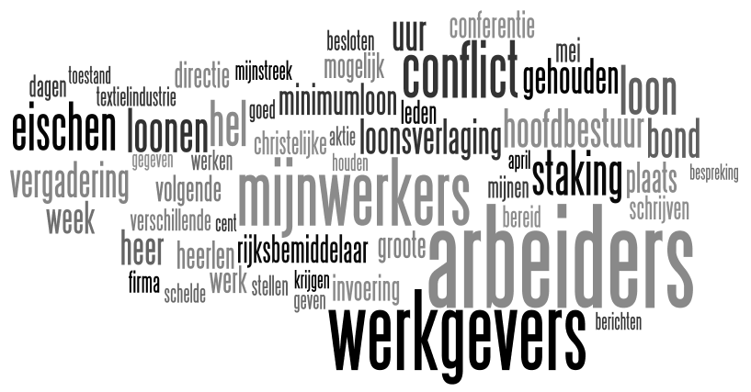
Word frequency
Notes:
Hier de inhoudswoorden met de hoogste frequenties. Hoe vaker een woord voorkomt, hoe groter.
TiMBL, de lerende machine, wordt gevoerd met de voorbeelden van aanloop- en niet aanloop artikelen.
Niet de hele teksten, maar een rij van 208 indicatoren 0 of 1, die aangeeft of dat woord wel of niet voorkomt in dat artikel.
TiMBL krijgt ruim 200 voorbeelden met bijbehorende klasse: wel of niet aanloop
TiMBL bepaalt welke woorden het beste onderscheid maken
Dat kan dus heel anders zijn dan de meestvoorkomende woorden.

Slide 18
Discriminatory power
Notes:
Geen echte uitschieters, maar bv rijksbemiddelaar is hier veel belangrijker dan op de vorige slide.
Kennelijk komt dat woord niet vaak voor, maar is het wel een goede indicator.
Rijksbemiddelaar was een functie die in die jaren was aangesteld om in arbeidsconflicten te bemiddelen.

Slide 19
Did we find strikes that did not happen?
Check against database:
1912: policemen in Amsterdam, tram conductors The Hague (2 articles), and teachers (3 articles)
1926: butchery in Boxmeer; transport workers of Steenkolen Handelsvereeniging
1938: metal factory in Delft
Mean average precision: 0.43
Notes:
Als er namelijk een echte staking bij het betreffende bedrijf of beroepsgroep is gevonden, telt het niet als niet-gebeurde staking
Hierdoor vallen een aantal dreigingen af.
Maar er blijven in elke onderzochte week ongebeurde stakingen over

Slide 20
Now what?
First experiments were on a HDD sent to us
Second used SRU (search by URL)
Data had changed and may change in the future
Reproducing our idea
Done! In a Digging Into Data project
With NaCTeM, University of Manchester, and University of Illinois at Urbana-Champaign, with New York Times Data
Replicating our experiments, bitwise
Only possible when exact same data remains accessible
Version control

Slide 21
A nano-lesson in versioning
Software versioning
Major number (2 in 2.0)functionality has changed in a major way compared to the previous major number
Minor number (0 in 2.0): a bit of functionality has changed, or a major bug has been fixed
Revision number (third): small problems and bugs have been fixed
Plus:
Under 1: beta (before that: alpha, unreleased)
Release candidates: 1.0rc2 is second candidate version to become 1.0 te worden
Cf. http://en.wikipedia.org/wiki/Software_versioning (source figure: Wikimedia)
Sometimes a build number is added (changes per day, hour, build moment)
‘1.0’, ‘2.0’, ‘3.0’ etc are used metaphorically (‘hijackally’)
Usually without knowledge of the above
Usually only with ‘0’ as the minor number

Slide 22
Nederlab
Started January 2013
Granted by the Dutch Organization Of Scientific Research (NWO)
Total investment 2013-2017: > 4 M EUR

Slide 23
The printed heritage
in the Dutch language, 1000-2000
(rough estimates)
From Middle Ages to 1800: 200 000 000 pages
19th Century 100 000 000 pages
20th century 200 000 000 pages
------------------- +
500 000 000 pages

Slide 24
What has been digitized?
(rough estimates)
From Middle Ages to 1800: 200 000 000 pages 10%
19th Century 100 000 000 pages 25%
20th century 200 000 000 pages 15%
-------------------------------------- +
500 000 000 pages 15%

Slide 25
Nederlab goals
To offer access to all digitized text, metadata and full-text
To offer automatic analysis tools
In a user-friendly interface
Using apt standards
OCR post-corrected
To allow research into patterns of change in Dutch language and culture
Proposed by a large conglomerate of researchers in literary studies, historical research, and linguistics

Slide 26
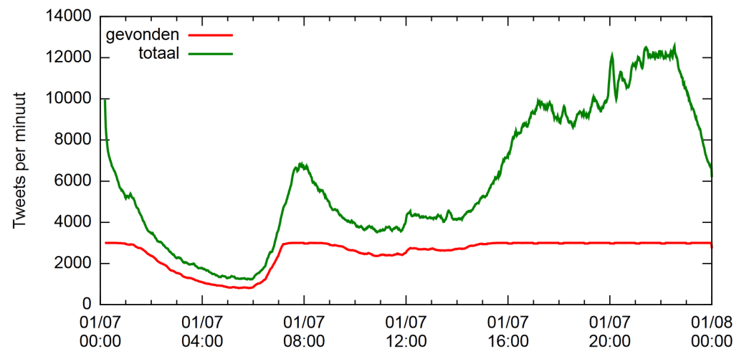
http://TWIQs.nl
An archive of Dutch tweets since December 2010.
We continuously search for common Dutch words on Twitter (keyword tracking)
Additionally we collect all the tweets of most frequent 5000 users in Dutch of the previous month (user tracking)
This generates close to 4 million tweets per day

Slide 27
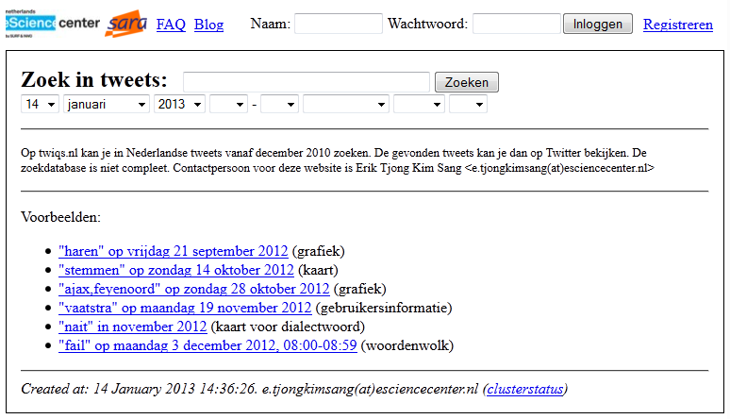
Twiqs.nl
Twiqs.nl web interface
A web interface has been built for searching the data: http://twiqs.nl

Slide 28
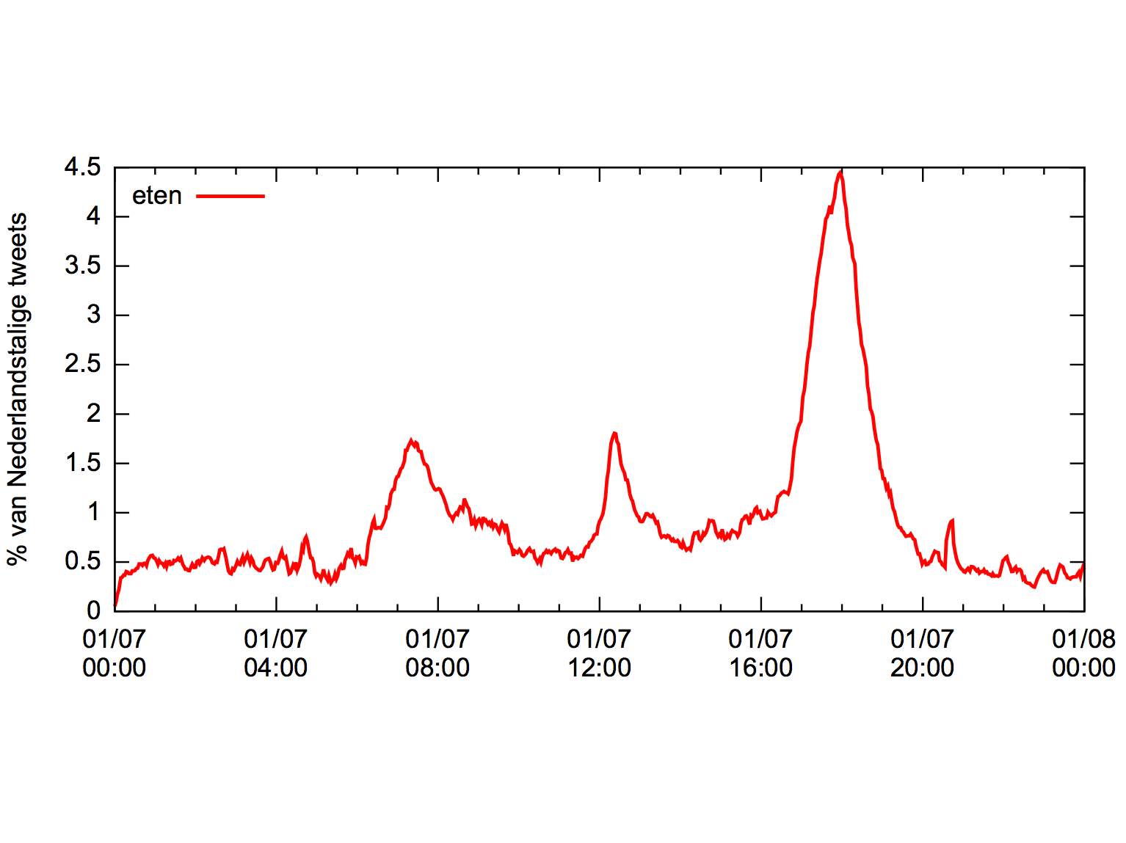
Twiqs.nl
“eten”

Slide 29
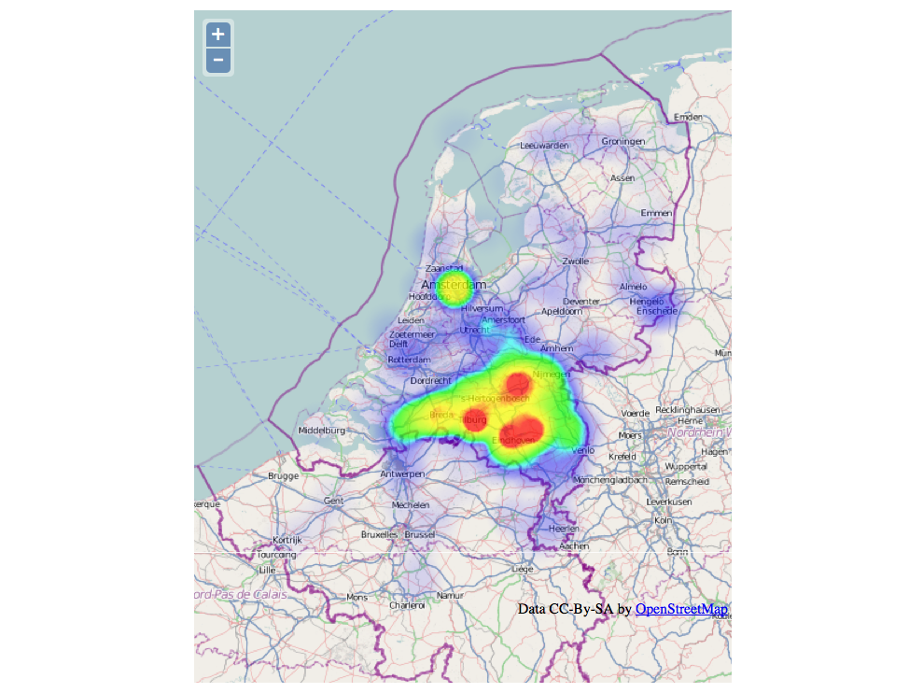
Twiqs.nl
“hedde”

Slide 30
Research Data Management
Research Metadata
Research Data
Research Software

Slide 31
Research Data Management
EUDAT
DANS
Research Metadata
3TU
SurfSARA
Research Data
DSpace
RU
Research Information
Research Software
METIS
?
Github
me

Slide 32
Radboud University
Radboud U. exec board, November 2013:
Data are stored at time of publication of the research at the latest, with metadata. Data management plan drafted before data collection.
Data of approved Bachelor’s and Master’s theses are stored.
Retention period for research data is a minimum of ten years.
The primary responsibility for data storage and proper data management lies with the supervisor/ researcher / project leader. The director of the research institute is ultimately responsible.
The university
provides knowledge, advice, and guidance for the purpose of data management and provide a data management plan.
provides an adequate infrastructure for data storage and management, during and after research, insofar as the researchers have not organised it themselves.
A list of stored data sets will be included in the self-evaluation of the Standard Evaluation Protocol.
The university policy regarding the storage and management of research data will be supplemented by each research institute;

Slide 33
The research institute specifies:
Responsibilities for data management and storage;
what data are included;
how metadata are established;
where data are stored for the short and long term;
how the data are protected in the event of technical problems;
a possible longer minimum retention period (longer than ten years);
which maximum retention periods will apply (a minimum of ten years);
accessibility and reuse of data sets (defining for each data set or research project how, under which conditions, when, and by whom the data can be reused);
privacy of sensitive data (processing, storage, access, security);
support and training for researchers.

Slide 34
Radboud University
Research Data Management
Steering Group:
library, information systems, university board, researchers
Pilot: Large institute (Donders)
Co-pilot: ‘The Long Tail’
< 2 GB datasets
Scientific integrity

Slide 35
Research Data Management
EUDAT
DANS
Research Metadata
3TU
SurfSARA
Research Data
DSpace
RU
Research Information
Research Software
METIS
?
Github
me

Slide 36
The Netherlands
Research data storage
3TU.Datacentrum
DANS
Data seal of approval; EuroCRIS
SurfSARA
The Language Archive (MPI)
Software
Alliance for Software Sustainability

Slide 37
Europe
EUDAT
The joint ‘SurfSARA’s’ of Europe
CLARIN ERIC
European Research Infrastructure Consortium
Horizon2020
Participate in Research Data Pilot
Data Management Plan within 6 months of grant confirmation

Slide 38
World
Dspace (used @RU)
DuraSpace
Also: Fedora (digital objects), DuraCloud, Vivo (semantic web)
Zenodo
CERN
FigShare
Nature
Research Data Alliance
standards
DataConservancy
software
Re3data.org
overview

Slide 39
The role of the library
“Let us take care of that for you”
RDM: the national academic (super)computing facilities
Software: distributed, cloud-based solutions
Metadata: traditionally a library task, and CRIS
Will soon include research data and software
What does the (humanities) user want?
Full-text search
Wide access to big data
(humanities data can be big too)
Deposit own long tail data
(humanities data can be small too)

Slide 40
a.vandenbosch@let.ru.nl
©2014 Antal van den Bosch. This work is licensed under a Creative Commons Attribution 3.0 Unported License. Suggested attribution: “This work uses content from "Long-tailed e-Humanities and the Big Bad Data: A fairytale" © Antal van den Bosch, used under a Creative Commons Attribution license: http://creativecommons.org/licenses/by/3.0/”

