Slide 1
ArchiveGrid and Related Work
OCLC Research TAI CHI Webinar Series, 23 May 2013
#archivegrid
Bruce Washburn Software Engineer
Ellen Eckert Research Assistant
Merrilee Proffitt Program Officer

Slide 2
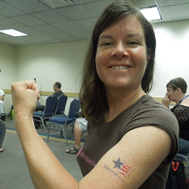
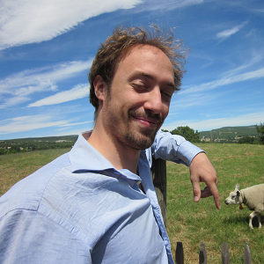
Meet the ArchiveGrid team
Bruce Washburn
Software Engineer
San Mateo, CA
Ellen Eckert
Research Assistant
Portland, OR
Merrilee Proffitt
Program Officer
San Mateo, CA
Marc Bron
Research Intern
University of Amsterdam
Notes:
Bruce, Ellen and Merrilee are the core of the small but mighty ArchiveGrid team.
For the months of February through April 2013 we were very fortunate to have Marc Bron from the University of Amsterdam working with us in the San Mateo CA OCLC Research office. His contributions to ArchiveGrid were considerable, in several areas of investigation we’ve been pursuing, and will be discussed in more detail later in this presentation.
[click]
We confer and consult regularly with other members of OCLC Research to guide our work, in particular Jen Schaffner and Jackie Dooley

Slide 3
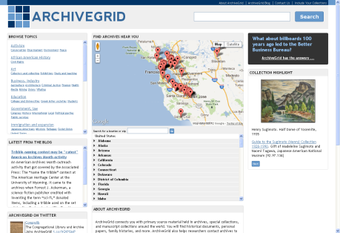
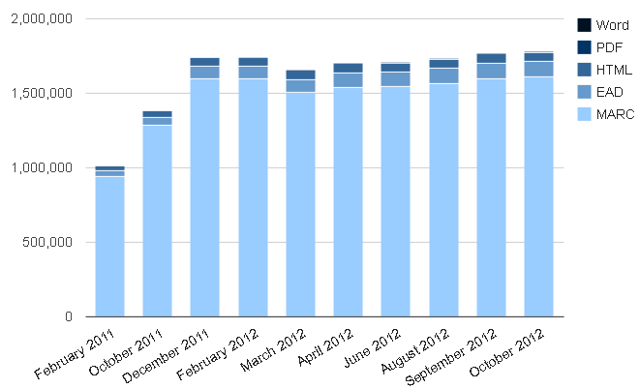
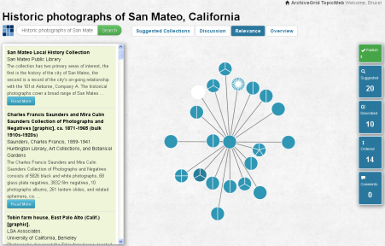
About ArchiveGrid
The Mission
Users and Uses
A Brief Tour
How we promote it
How your collections can be included
Recent Research
Notes:
An overview of the topics we’ll be covering in this presentation:
General background on ArchiveGrid: what it is, and its mission
A discussion of who’s using ArchiveGrid and how they use it
A brief tour of ArchiveGrid in action
Some details on how we promote it and how your collections can be included
And a more in depth discussion of recent OCLC Research work to better understand the ArchiveGrid aggregation, how information about special collections is used, and an exploration of new methods for making connections between related archival collections.

Slide 4
What is ArchiveGrid?
A discovery system used by researchers and scholars to locate primary source materials in archives
ArchiveGrid is working well when it identifies a collection you did not know existed, perhaps in an archival institution you would not have expected, and provides a contact point for more information.

Slide 5
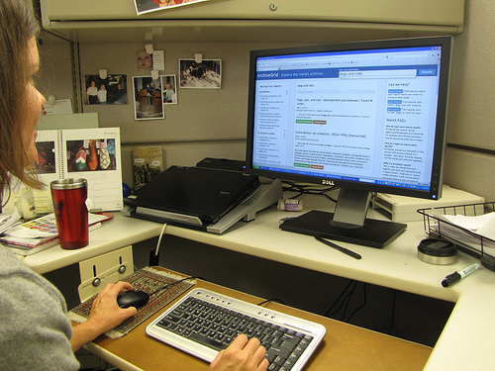
ArchiveGrid’s mission: Connect researchers …

Slide 6
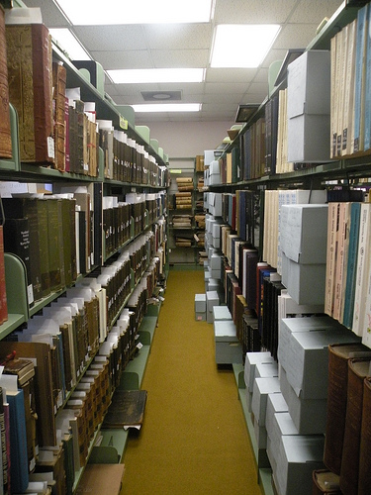
to primary source materials …
“Current Archives” is copyright (c) 2011 Carmichael Library and made available under a Attribution 2.0 license: http://creativecommons.org/licenses/by/2.0/deed.en
Notes:
“Current Archives” is copyright (c) 2011 Carmichael Library and made available under a Attribution 2.0 license: http://creativecommons.org/licenses/by/2.0/deed.en

Slide 7
Who uses ArchiveGrid?
Researchers
Independent Scholars
Genealogists
Faculty
Dr. Matthew Simon
Age: 49
University History Dept.
Writing a book on the California Gold Rush
Amy Powell
Age: 27
Post-graduate study in Political Science
Writing her thesis on rural to urban labor migration
John Stevenson
Age: 35
Mechanical Engineer
Studying the history of pipe organs
Catherine Andrews
Age: 61
Former K-12 Teacher, Retired
Researching her family history
Notes:
In past user studies we’ve established that the primary audiences for ArchiveGrid are faculty, post-graduate researchers, independent scholars and both amateur and professional genealogists.
We’ve used Personas to help guide the design process for ArchiveGrid. A sketch of a few of them are shown here.

Slide 8
What does ArchiveGrid include?
ArchiveGrid includes descriptions of nearly 2 million archival collections housed in thousands of archives and libraries.
Descriptions can be provided as MARC records (through OCLC’s WorldCat) or harvested from contributor websites as EAD XML, HTML, PDF, or Word document finding aids.

Slide 9
Aggregating archival collection descriptions in a single resource
ArchiveGrid
WorldCat MARC Records
EAD XML Finding Aids
HTML Finding Aids
PDF and other Finding Aids
Notes:
Because not all the archival collection descriptions available to us are in a single resource already, we draw them in from multiple sources and in multiple formats to build our own separate aggregated ArchiveGrid index.

Slide 10
WorldCat MARC records are the source of 90% of ArchiveGrid descriptions
6%
4%
ArchiveGrid
WorldCat MARC Records
EAD XML Finding Aids
HTML Finding Aids
PDF and other Finding Aids
90%
< 1%
Notes:
It should be pointed out that most of the archival descriptions are indexed in a single aggregation already … that’s WorldCat. The separate ArchiveGrid index helps in two ways: it allows the aggregation to extend to include finding aids that are not yet contributed to WorldCat, and it also filters WorldCat to include just the descriptions that fit our requirements.

Slide 11
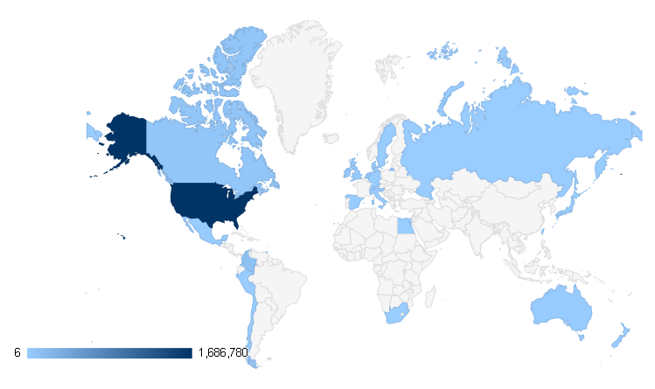
ArchiveGrid collections by archive location country
Notes:
Most ArchiveGrid contributing institutions are in the US.
We aren’t limiting the aggregation to the US, but other regions have well-established regional or national aggregations that may not benefit from replication in ArchiveGrid.

Slide 12
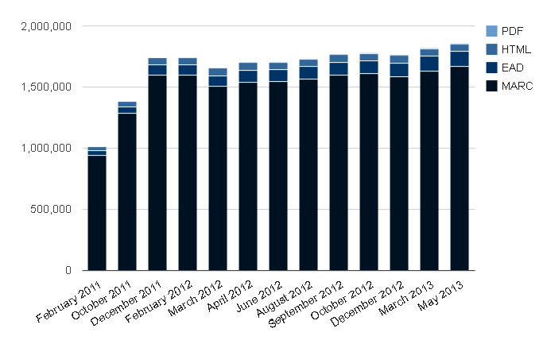
ArchiveGrid growth
Notes:
The growth of ArchiveGrid has been significant over the past year. We see a dip in March 2012, as we tuned our selection algorithm for WorldCat MARC records to exclude some descriptions that were not for archival materials. Word documents represented a minor component, for a few months in 2012 (we currently do not have active contributors of Word documents, though we accept that format).
You can see the dominance of MARC records from WorldCat in ArchiveGrid. Finding aids in EAD, HTML, and (to a much smaller extent) PDF make up about 10% of the entire aggregation.

Slide 13
A Tour of ArchiveGrid
Try it out at
http://beta.worldcat.org/archivegrid
Notes:
We’ll start a quick tour of the ArchiveGrid system so that you can see it in action. You can also try it yourself at this URL.
Don’t worry too much about the “beta” in the hostname. ArchiveGrid is using this hostname for now, in part because we want to differentiate this OCLC Research system from other OCLC production services. Perhaps over time the hostname will change to avoid the “beta test” implication.

Slide 14
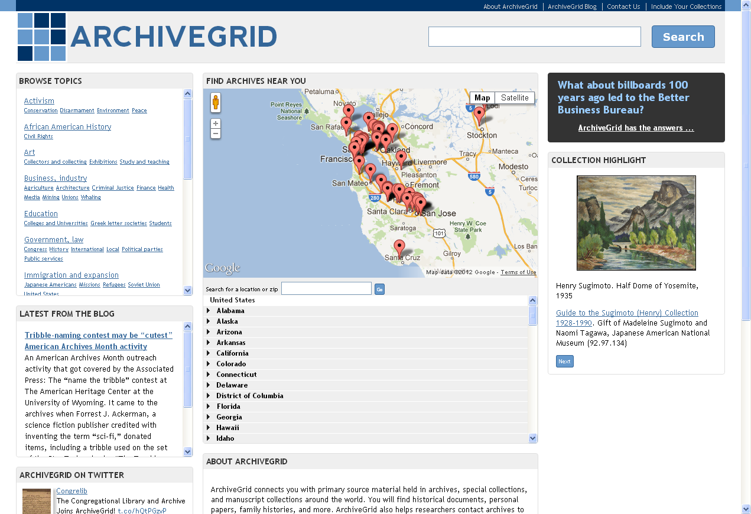
Notes:
The home page
We expect this page to be found by users who are referred to the site by a link on a partner or contributor site
So we want to provide a variety of ways for these users to get a sense of what’s inside, find nearby archives, browse topics, or start a search

Slide 15
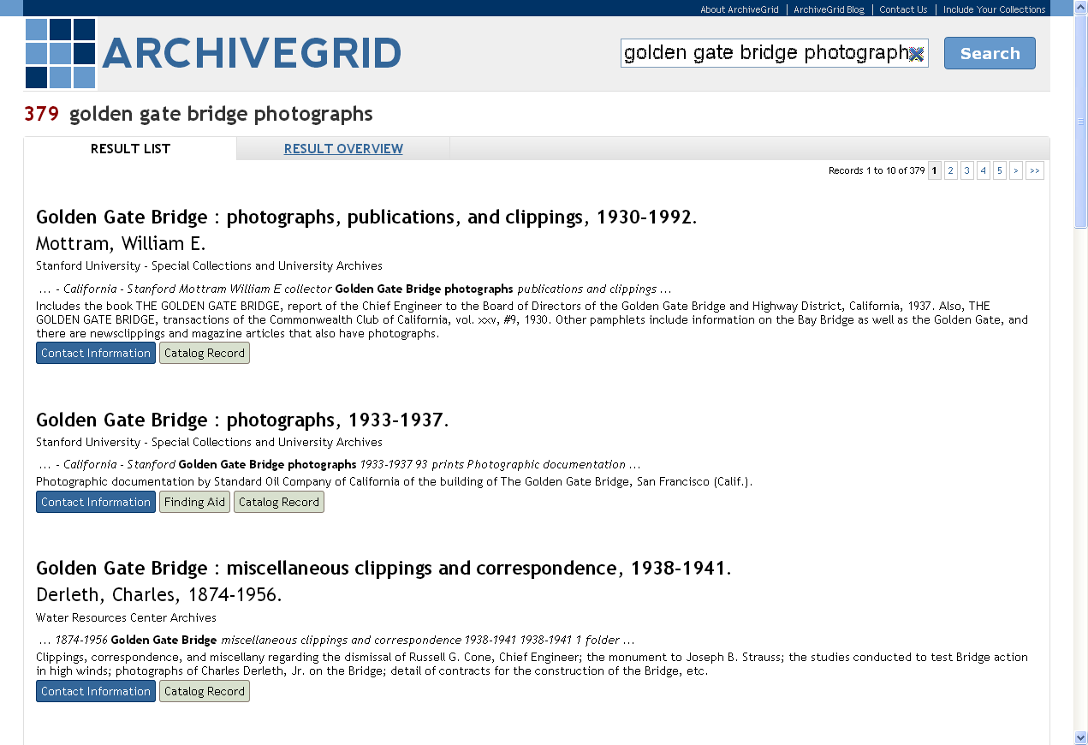
Notes:
A brief search result includes the title and creator name for a collection, the name of the contributing institution, a snippet of keywords in context, a scope and content note (if provided in the description) and links to contact information or either a catalog record (for MARC sources) or the finding aid on the contributor’s website.

Slide 16
Notes:
For catalog records (based on MARC records from WorldCat) we can show more information about the collection within ArchiveGrid, along with a prominent link to contact an archivist (leadings to a page on the contributor’s website)

Slide 17
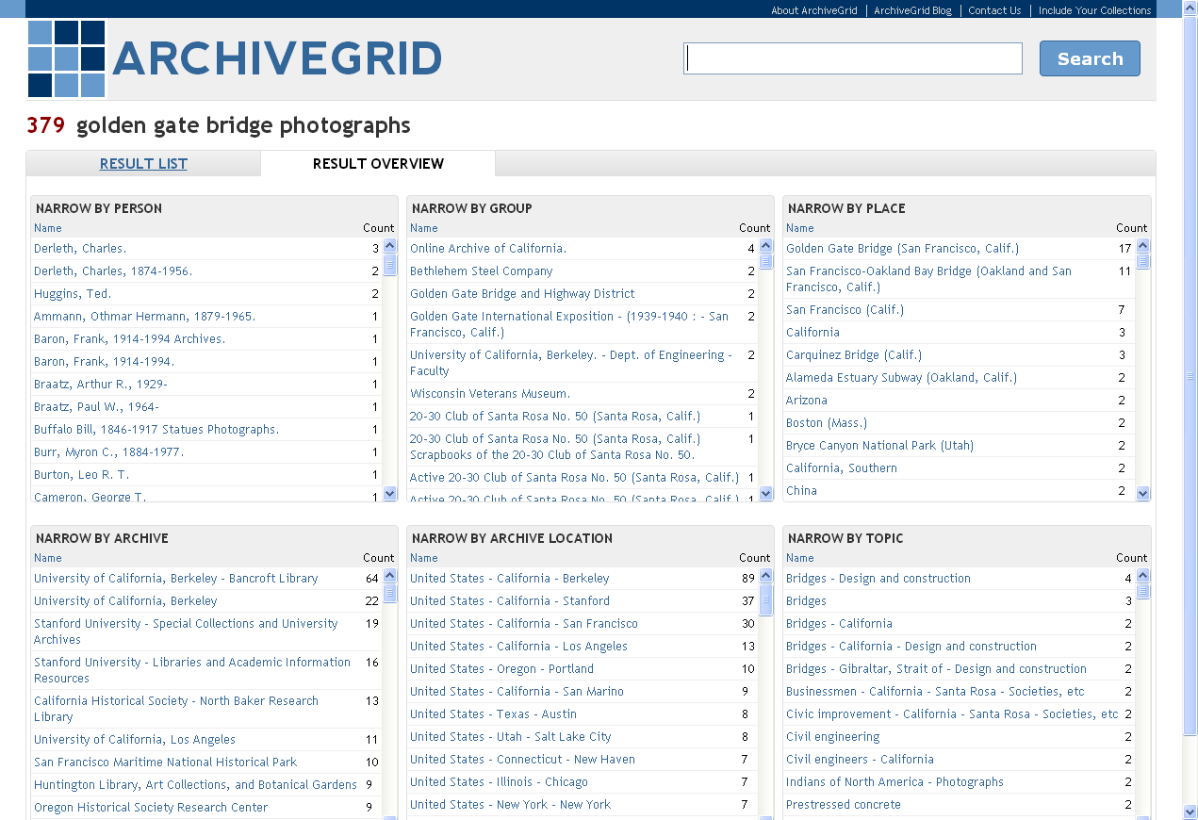
Notes:
We’re also providing an overview of the search result, showing names of people, groups, and places found in the result set, subject headings, and the names and locations of the institutions where the collections are held.
This can be a useful way to quickly narrow a large result.
This is also something of a work in progress, as we cannot yet reliably and consistently extract names and subjects from HTML and PDF finding aids, and for EAD the tagging isn’t consistent across all documents. So, those description formats may be under-represented, until we improve our named entity recognition and extraction processes.

Slide 18
Notes:
From a search result or a catalog record there is always a prominent link to Contact Information. Very little of the content described in ArchiveGrid has been digitized, and access to the physical materials is often required to complete the research process.
And we learned in earlier user studies that at the very least a working link to the contributor’s website for more information on access to the collection would be expected and necessary.
We maintain links in ArchiveGrid for each of the contributors, to facilitate this next step.

Slide 19
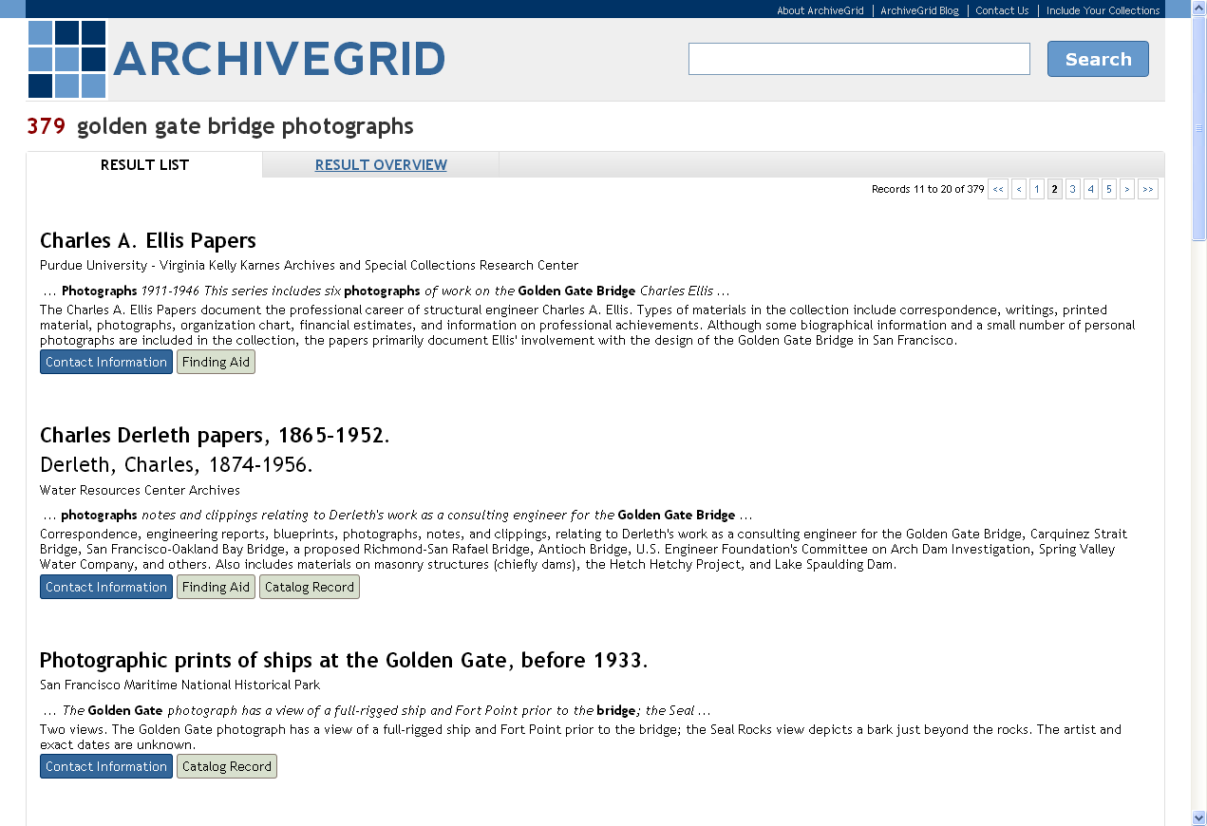
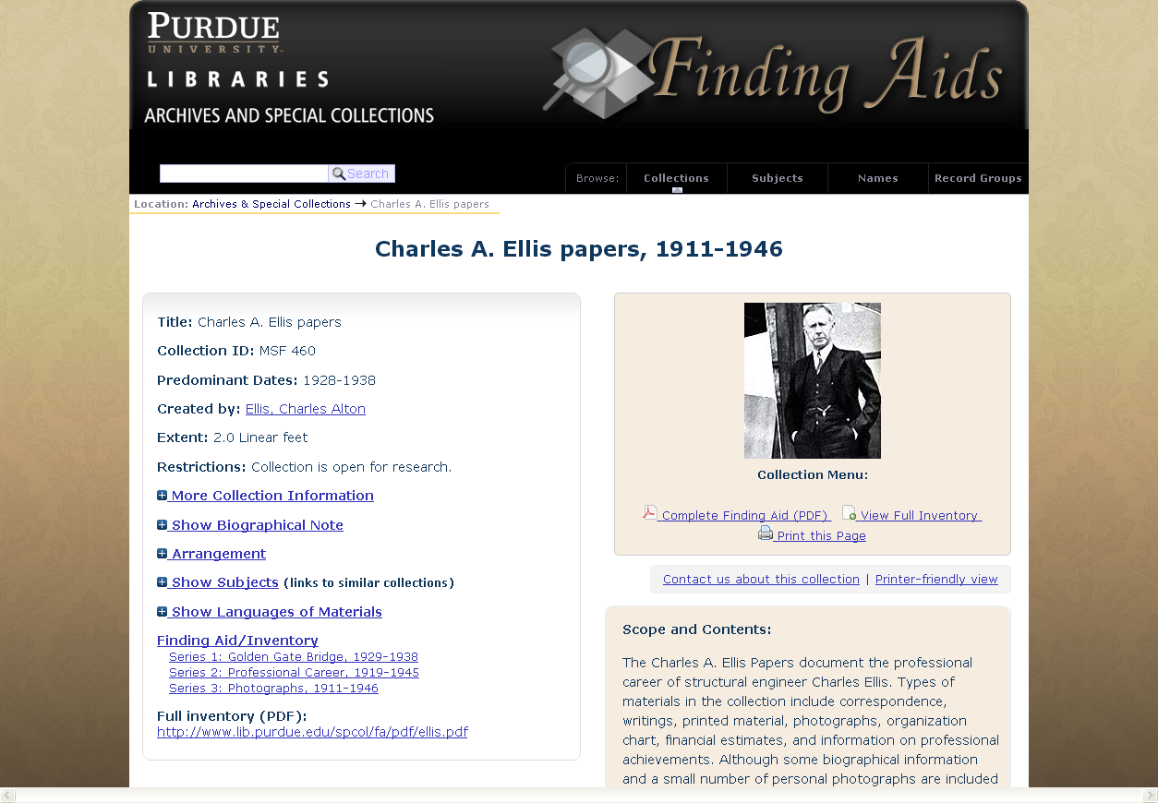
Notes:
Similarly, when a collection description in ArchiveGrid is based on a finding aid from a contributor’s website, we provide a link back to that finding aid, rather than attempting to show the finding aid within ArchiveGrid.

Slide 20
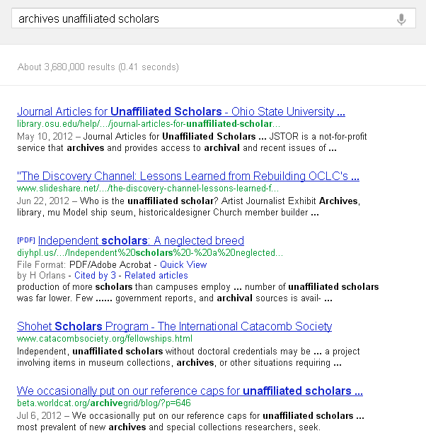
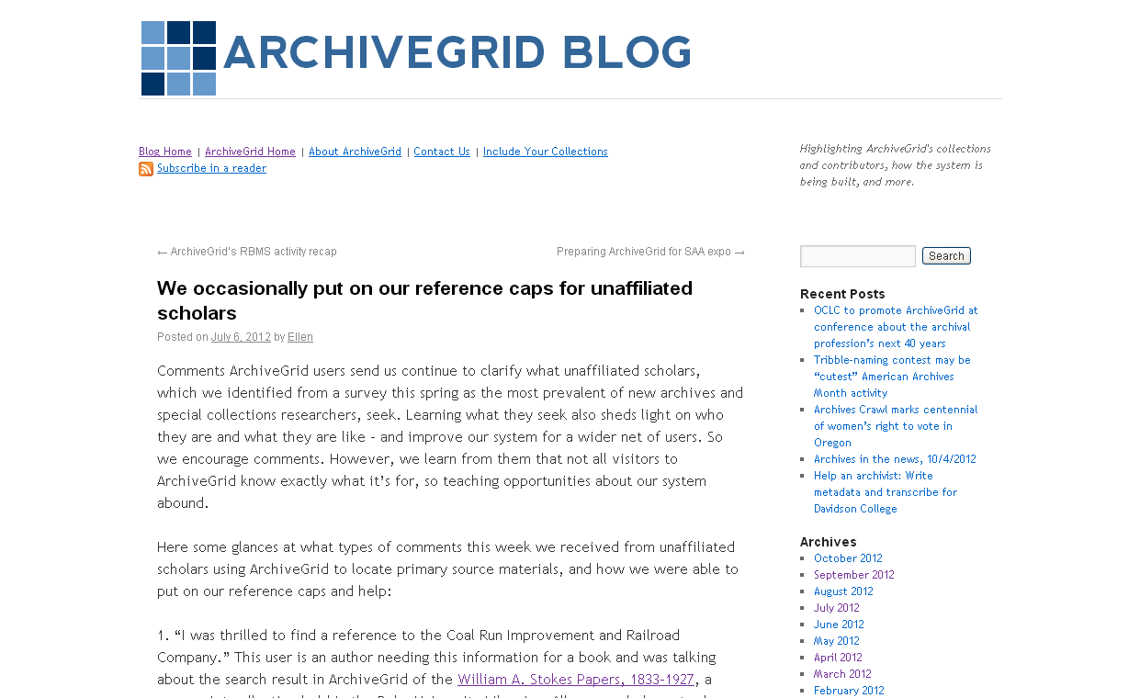
The ArchiveGrid Blog … another way to talk about archival collections
Notes:
In early 2012 we launched the ArchiveGrid Blog. Ellen Eckert, a Research Assistant in OCLC Research, edits the blog to help promote news and events related to Archives and to make connections between the news and ArchiveGrid’s collections. She also describes the work we’re doing behind the scenes to build and support ArchiveGrid.
This is another way we can help promote archival collections, using words not found in the collection descriptions but that may match search terms used on the web. For example, this google search
[click]
Leads to an ArchiveGrid blog post Ellen wrote about some of the questions we receive through ArchiveGrid’s comments page from independent, unaffiliated scholars.

Slide 21
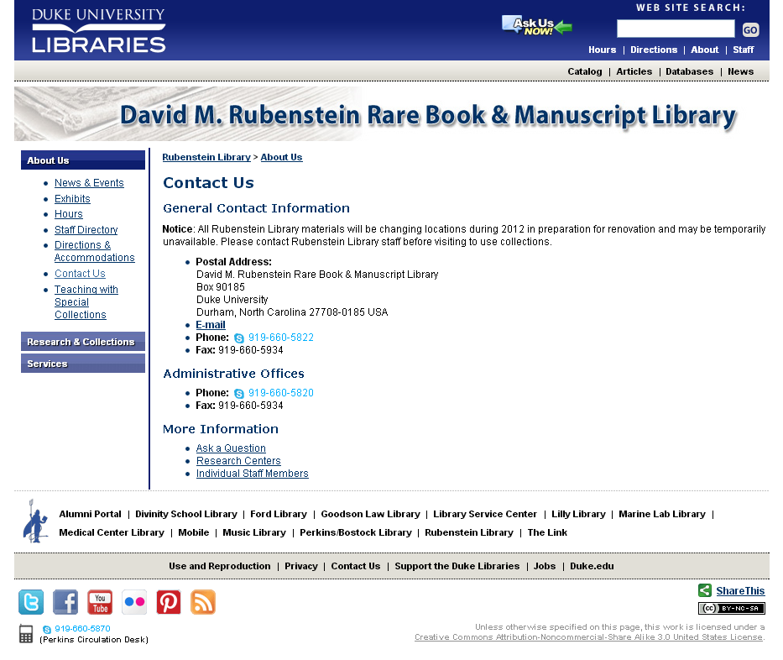
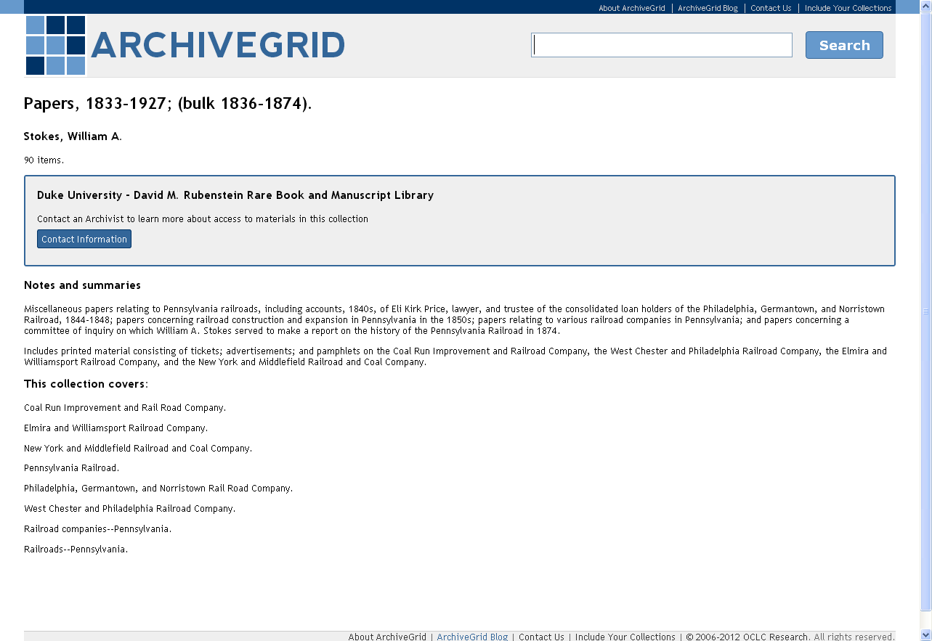
… and lead searchers to archives
Notes:
That blog post includes a link to a collection description in ArchiveGrid that is related to one of the questions we received, and
[click]
That collection description leads to contact information for the contributing archive

Slide 22
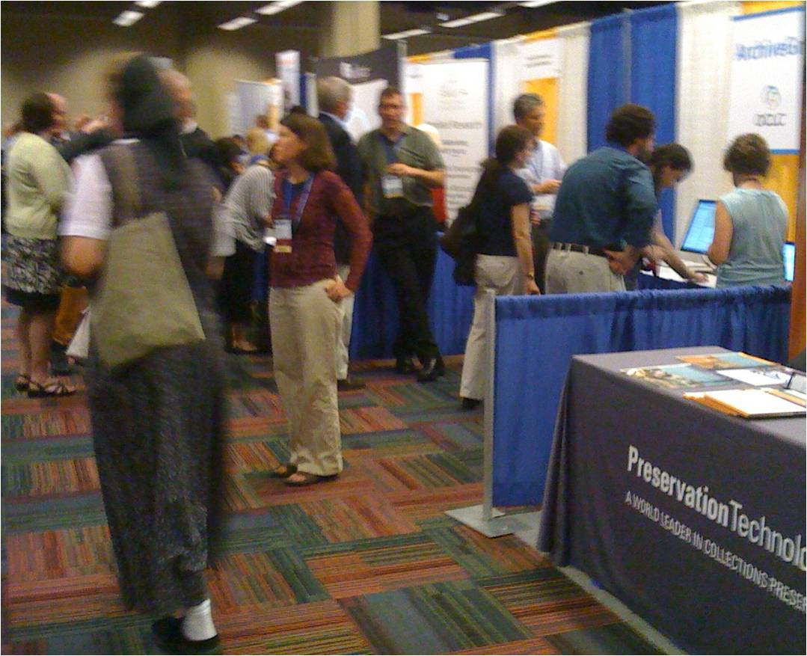
Getting feedback, consulting with the community, and improving ArchiveGrid
Demonstrating ArchiveGrid at SAA
Notes:
We’re actively seeking opportunities to promote ArchiveGrid at conferences and other events. For example, we’ve demonstrated the system at an SAA Annual Meeting exhibit in 2011 and 2012, and will again in 2013. We’ve also presented at the RBM, MARAC, and SCA conference in the past year.

Slide 23
How do users reach ArchiveGrid?
79% of traffic comes from search engines
10% of traffic comes from referrals from other websites
11% of traffic comes “direct” … a bookmark, typing the URL in the browser, etc.
Notes:
We’ve tried to make ArchiveGrid content easy to find on the web, as that’s where so much research activity takes place.
And we’re having some success with that, as the site analytics should that close to 80% of visits are from users who have found us via a search engine like Google.

Slide 24
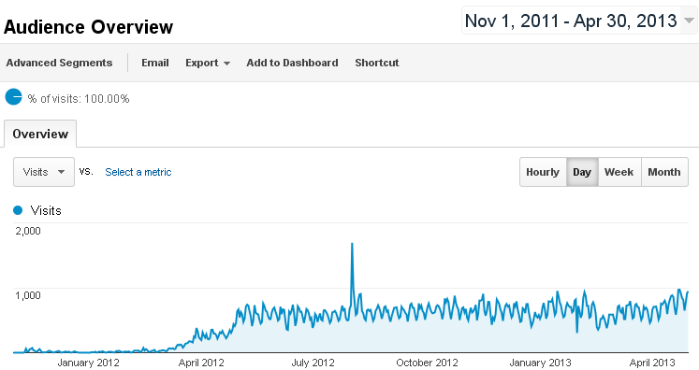
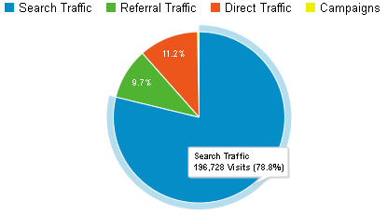
ArchiveGrid Visitors
Notes:
Visits increased in March 2012 as we began promoting the site to search engines. There have been occasional spikes in use due to activity in social networks and on listservs and related to promotional events such as the August 2012 SAA exhibits.

Slide 25
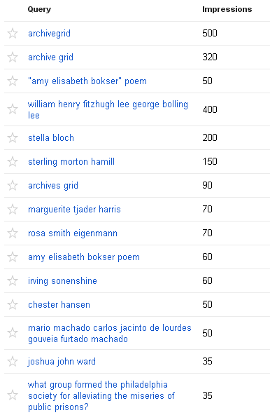
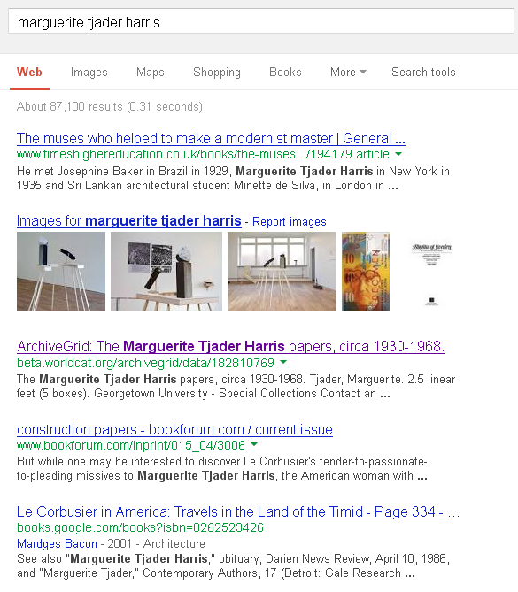
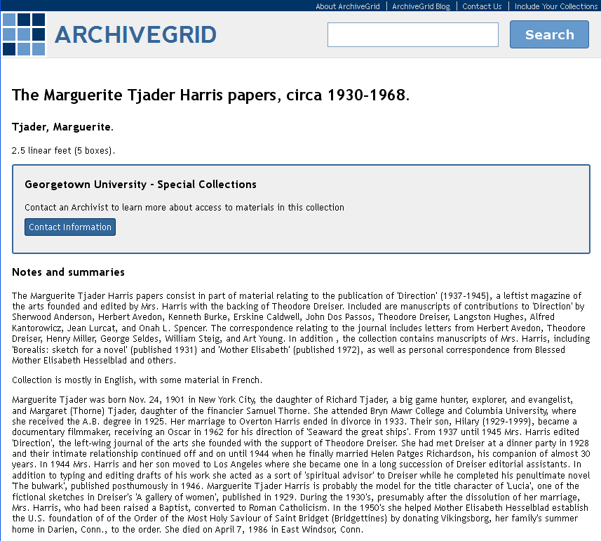
How do users find ArchiveGrid? Usually through search engines.
Notes:
Here’s a list of recent searches entered in search engines that led to users finding a link to archivegrid. If the entire long list was shown, you’d note that the long tail includes lots of names … of people, groups and places.
[click]
Here’s a google search where an ArchiveGrid match appears on the first page. Following the link takes the searcher to a Catalog Record view. Since most of ArchiveGrid’s traffic comes from search engines, this is in effect the “home page” for those visitors. We’re continuing to work on ways to improve the user experience when the user’s first experience of ArchiveGrid is a catalog record page like this one.

Slide 26
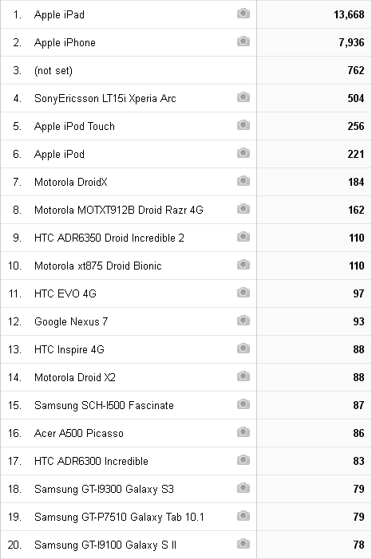
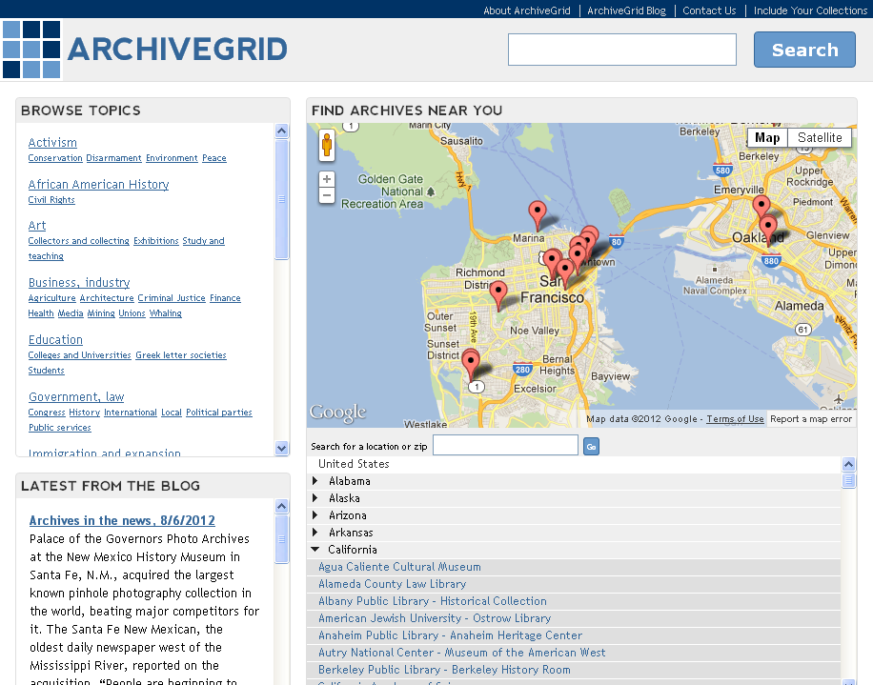
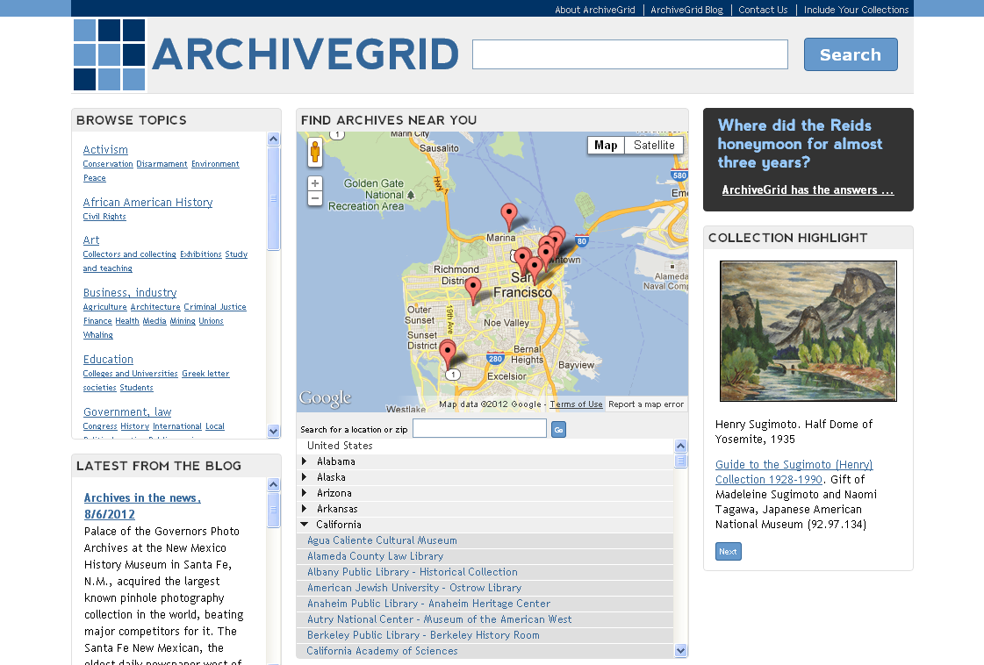
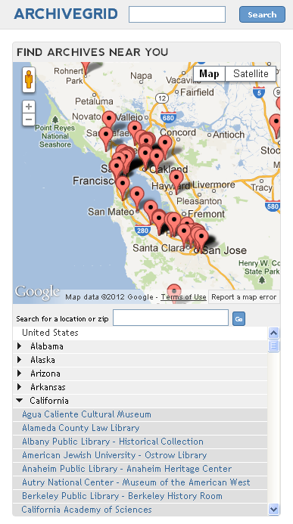
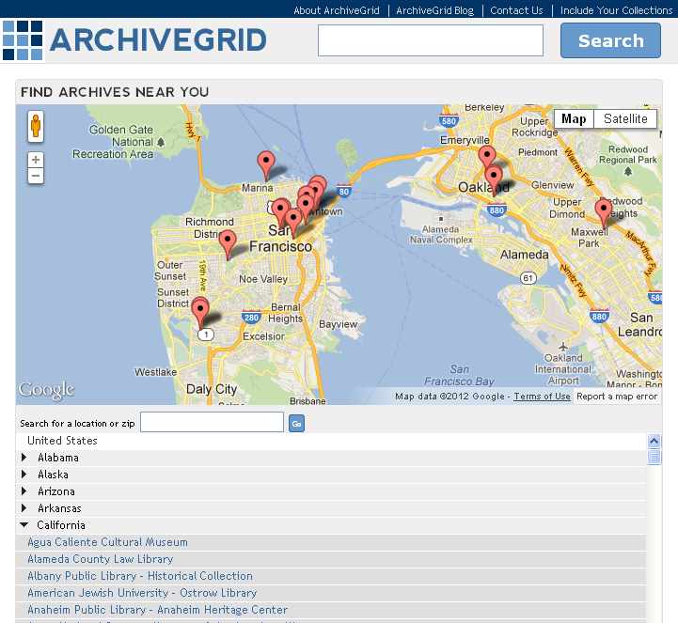
A responsive and open website maximizes access and accessibility
Notes:
When we recently redesigned ArchiveGrid, we were taking into account user feedback and site analytics that show a small but increasing number of users attempting to use the site on mobile devices: smartphones and tablets of various kinds.
The new system follows a “Responsive Design” approach, offering different displays and options for the same underlying data and index depending on the type of device.
[click]
Here are just some of the mobile devices that have been used to reach ArchiveGrid recently, based on our site analytics.
In the past year, we’ve seen an increase in mobile and tablet use from 8% to 13%, which helps justify the importance of designing the system to operate effectively on this growing community of use.

Slide 27
How can I include my collections?
If your MARC cataloging records for your collections are contributed to WorldCat, they may already be in ArchiveGrid
(Let us know if they aren’t!)
If you have finding aids on your website in EAD, HTML, PDF or Word, we can collect them with our web harvester

Slide 28
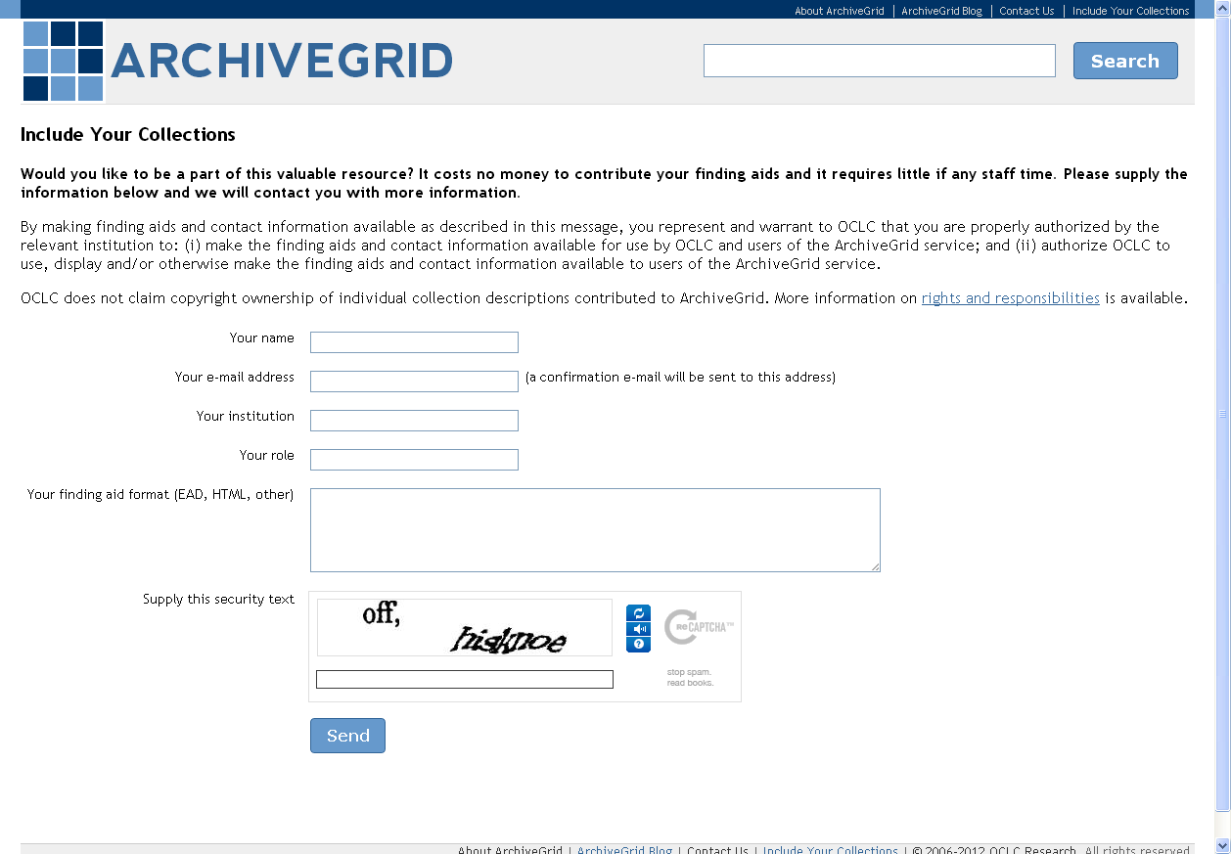
A simple form to tell us to include your finding aids
http://beta.worldcat.org/archivegrid/collections/

Slide 29
How often is ArchiveGrid updated?
About every 6 weeks
We get a fresh extract of MARC collection records from WorldCat
And we completely reharvest all the finding aids from contributor websites
The only way to ensure that we account for adds, updates and deletes

Slide 30
Recent Research
Special Collections Survey
EAD Tag Analysis
Notes:
Part of what we do in OCLC Research is evaluate how people think about and use information, and how data structures are utilized by those who create and distribute metadata.
We’ll talk briefly about two recent examples of that work, a survey of special collections use, and a tag analysis study for EAD documents

Slide 31
Understanding Special Collections
A survey conducted in April and May 2012
To refresh our knowledge about our target audience; to find out how they find out about and share information about services like ArchiveGrid; and to determine how useful they find various social media tools (user comments, reviews, recommendations, connecting with others, and making lists)
695 survey responses
More details on the blog: http://beta.worldcat.org/archivegrid/blog/?p=631
Paper with findings coming soon!
Notes:
Our work is guided by what we understand about the collections we’re aggregating and how they are used
Though we conducted our own in-depth user and usability studies in 2005 and 2006, and others have carried out related user studies in the interim, we wanted to refresh our perspective on how is using special collections, how they find research resources, how they share them, and what they value.
We carried out an online survey in April and May 2012, the results of which were noted on the ArchiveGrid Blog and summarized in a paper delivered at the RBM conference in July 2012 by Ellen Eckert.
The survey results confirmed some earlier findings about the audiences ArchiveGrid can serve and how they conduct research, and helped inform our perspective on the role social media can play within ArchiveGrid itself and as part of the context of research (something that had not been on the radar when we studies users in 2005).
You can learn more about the study on the ArchiveGrid blog, and Ellen and Merrilee are working on a paper summarizing the findings, which should be available soon.

Slide 32
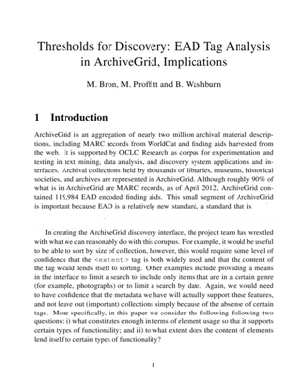
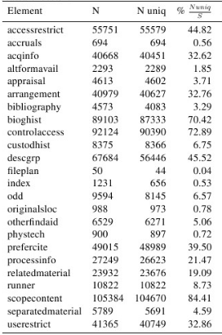
EAD Tag Analysis Report
In process now
Expected to be submitted for publication in Code4Lib Journal
Notes:
We carried out an analysis of tag usage in the roughly 130,000 EAD finding aids that are included in ArchiveGrid.
As expected, tag usage varies widely, not only across the heterogeneous mix of content providers, but sometimes across finding aids from the same provider.
Given that variation, when thinking about a discovery system or when considering how to relate and compare multiple documents, what thresholds should be used to determine whether the data support indexing, sorting, browsing, and other types of functionality?
A paper now being completed by the ArchiveGrid team considers the following two questions:
i) what constitutes “enough” in terms of element usage so that it supports certain types of functionality;
and ii) to what extent does the content of elements lend itself to certain types of functionality?

Slide 33
Addressing Challenges in Archival Discovery
We started with Named Entity Recognition
That led us to explore collaborative search and gamification
We’re testing and appraising that approach
Notes:
ArchiveGrid also plays a “research sandbox” role in OCLC Research. We’ll explore on example of that in some detail, discussing an on-going investigation into collaborative search and gamification.

Slide 34
Making ArchiveGrid browsable
Wikipedia style links: from entities to documents
Links between documents: categories/clusters
Links between entities: determine relations, e.g., correspondence, family, enemies, …
Recommender system style links: “if you are interested in A, also look at …”
Notes:
Named Entity Recognization has been an interest in part because we have a larger goal. We want to make ArchiveGrid browsable.
How does browsing work on the web? A variety of ways.
We’re accustomed to wikipedia-style links. If I see a name of a person I expect to link to documents related to that person.
Subject headings can provide a nice way of clustering similar documents, but broader/narrower categories may not be supported.
Links between entities are an effective browsing method. Co-occurrence becomes meaningful in finding relationships.
And recommender systems are also common, but for these to work you need lots of data (about the materials, from use of the system, etc., and ArchiveGrid data is relatively sparse)
We decided to concentrate on the 3rd … links between entities

Slide 35
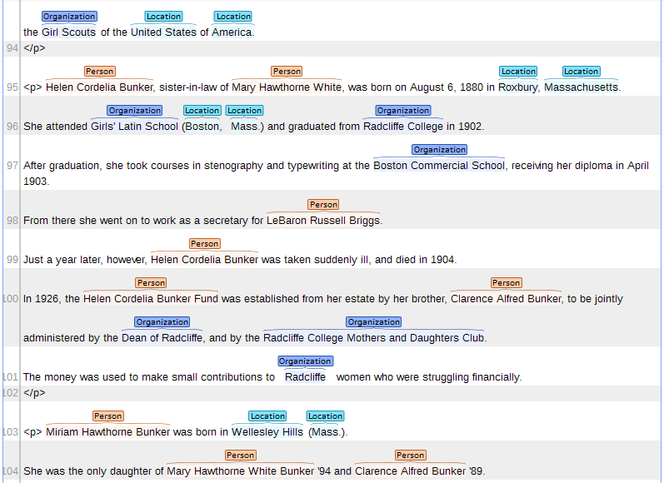
We decided to focus on entities
Annotating relations is difficult, even for humans.
Notes:
We used a Named Entity Recognition tool developed by Dan Roth at the University of Illinois at Urbana-Champaign, and extended by Jean Godby and Devon Smith in OCLC Research.
It ran nicely out of the box, in particular for names of people, groups and places, when we applied it to our aggregation of 130,000 EAD finding aids.
But our task was to annotate relations: the correspondence between entities.
Generating gold training data is critical, and really difficult (at least for us). We expected to need about 1,000 annotated documents in order to help train the model for finding relations in EAD documents. Between a few of us, it was taking a tremendous amount of time and effort to assemble that set. We lacked the time and resources, and the subject expertise, to build a sufficient store of reliable training data.

Slide 36
OK, what if we try clustering?
Sample of 130,000 finding aids
The use of elements varies a lot
Some finding aids are rich, others sparse in description
Some content is template driven or “not processed yet”
Notes:
We went back to thinking about the 2nd option, clustering around related categories and classifications.
It’s very problematic to tell if documents are about the same thing, and that’s especially true when the description in highly variable.
We need ground truth data in order to train a model that is able to effectively cluster this type of data

Slide 37
Ground Truth for Clustering
Find descriptions of exhibitions and the archival collections involved in the exhibitions
Use a range of retrieval / clustering models, pool the top X results, judge them for relevance and refine the models
Develop a tool to crowd-source identifying “key collections” about a topic
Notes:
We considered some ways to assemble ground truth data for clustering.
Attempting to derive connections and ground truth from the prior work of others building exhibit sites based on archival collections was a cute idea but not very reliable.
The second approach may be very biased to the annotators, model, and sample.
The third approach intrigued us and led to another kind of investigation.

Slide 38
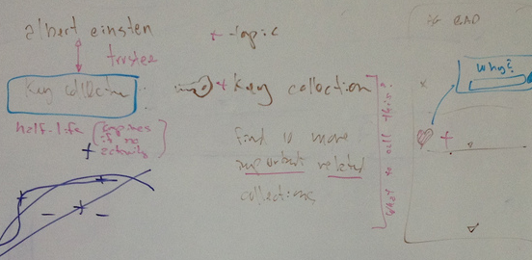
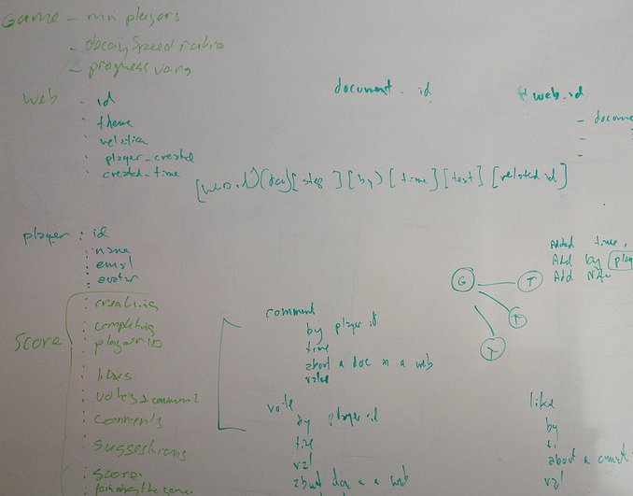
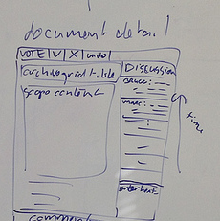
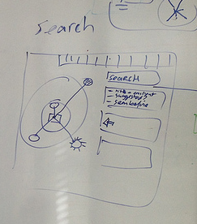
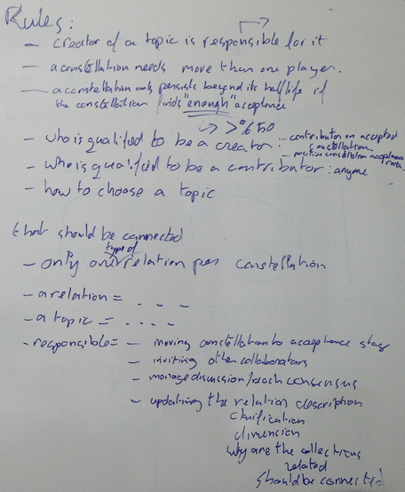
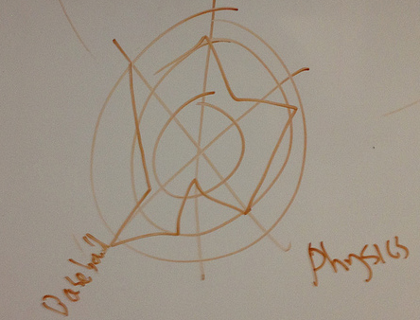
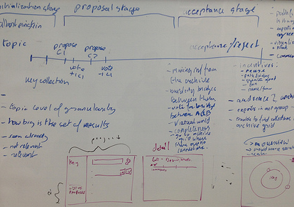
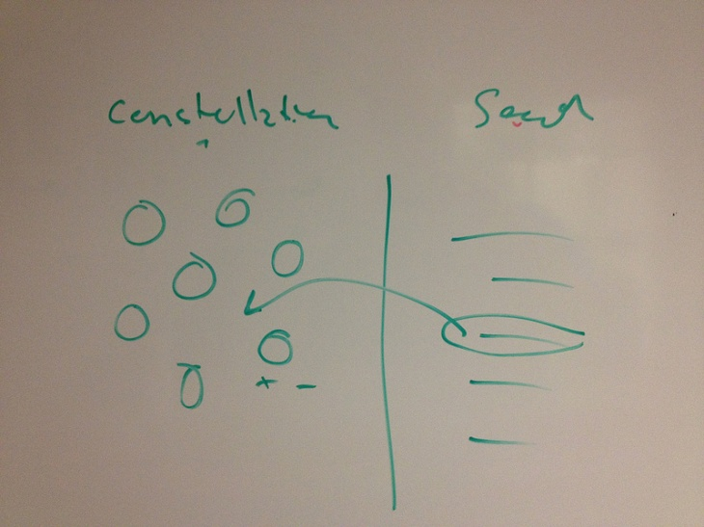
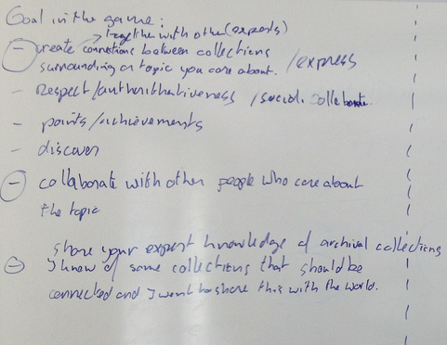
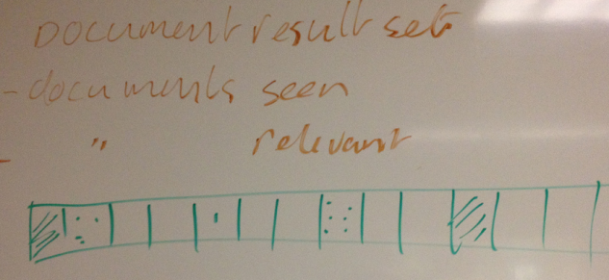
Notes:
We began developing an idea for how a crowd-sourced application might work, to gather expert views on how archival collection descriptions relate to a topic.

Slide 39
But there was something missing
Who would be our “workers”?
Are they qualified for the task?
What is their motivation?
Notes:
While we were getting some intriguing ideas about how we might build an environment where ground truth data could be assembled, we had questions about who would use it.
Will it be researchers who have dug around archives?
Archivists who are knowledgeable about their own collections but not necessarily others?
What kinds of mechanisms could be used to get people to collaborate?

Slide 40
Collaborative Search
Notes:
The website SearchTeam.com offers a working example of Collaborative Search.
Imagine that you were thinking of buying a new camera. You could search on your own and find recommendations from various sources. Or you could search with a team of people you know, or other invited experts, combine your search results in folders, compare, rank and discard results, and produce an organized or persisting result for your team and others to use.
From http://searchteam.com/faq.php#FAQGS1
What is SearchTeam.com?
SearchTeam is a collaborative search engine.
To start with, you can use SearchTeam to efficiently research the Web for information. You start your research by creating a SearchSpace on a topic of interest. From within a SearchSpace, you can search the Web, videos, images, books and more. You can find and save only what you want while you are searching and throw away what you don't want or find irrelevant. You can automatically organize what you save, into folders of your choosing. Everything is automatically saved into your personal account, and you can return to your searches any time and continue from where you left before.
What makes SearchTeam unique and valuable is that you can do your searches collaboratively with others you trust, such as friends, colleagues and family members. You can invite any set of people you trust to search with you from within a SearchSpace. An invitation is sent via email to those people you invite to join your search. When they enter your SearchSpace, they see exactly what you've found and saved so far. They can comment on or like your findings. They can chat with you from within the SearchSpace, and do further searches relevant to that topic and save more results into the SearchSpace. All changes made by any collaborator are relayed to all other collaborators in real-time, so everyone is instantly in synch with what others are doing.

Slide 41
Why collaborative search works
Users are experts on some things but novice on others
Users may not know (who are) the experts
So …
How can we create an environment in which experts can be found and can lend their expertise?
Notes:
This nicely translates to our scenario. You may not know who or where the experts are on a topic.
But motivation is a challenge. Why would someone be attracted to our environment to carry out this work?

Slide 42
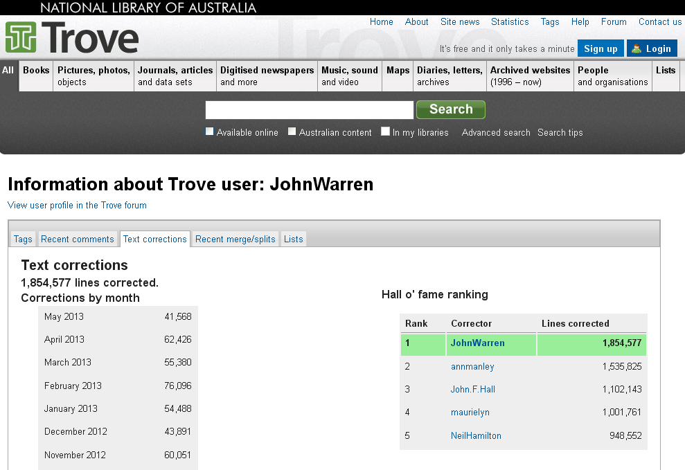
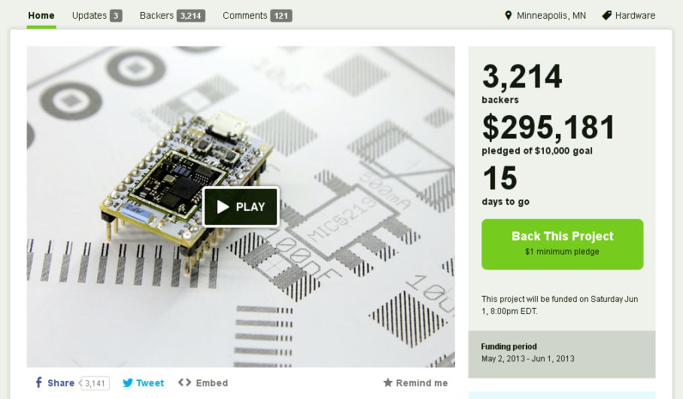
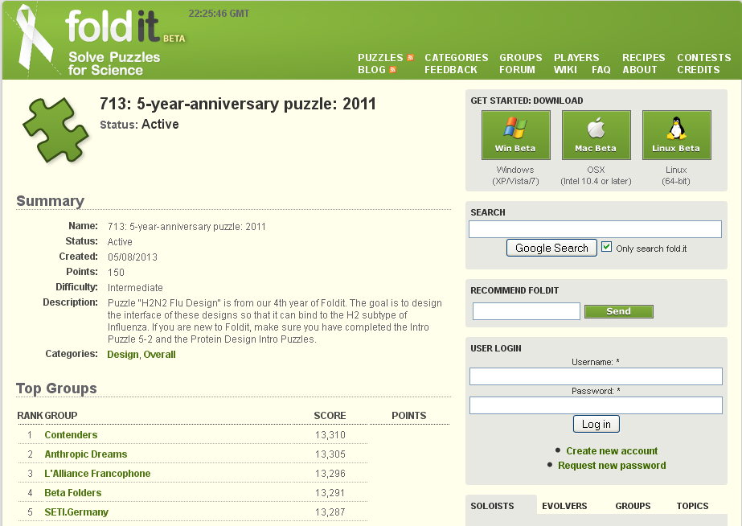
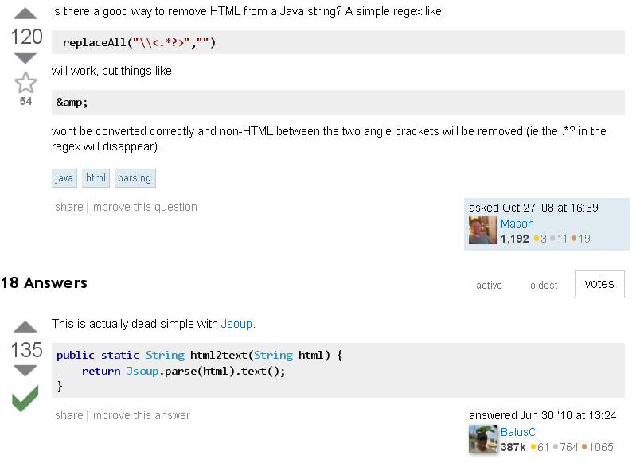
Other sources of inspiration
Notes:
Other collaborative, non-zero-sum applications have proven to be quite successful and inspire our thinking.
Just a few examples include:
Kickstarter – crowd-sourced project funding
Foldit – teams solving protein-folding puzzles
StackOverflow – technical questions answered by community experts
National Library of Australia’s Trove Newspaper OCR text corrections
Old Weather – transcribing ship’s logs to help recover mid-19th center weather observations and improve climate model projections

Slide 43
What do these have in common?
They are fun, engaging and fulfilling … games
They build something useful
They build something that can’t be built by just one person
And they inspired us to imagine a collaborative solution to our problem
Notes:
In all of these examples lots of people come together in a non-zero-sum game to solve a problem that one person can’t solve on their own.

Slide 44
Designing the player journey
What are we building? A collaborative search game for archival collections
Why? To get recommendations for collections
For whom? Archivists, researchers, students, teachers, hobbyists
What is the key benefit? Making collections discoverable
Where is the fun? Helping others, reputation, accomplishment
Amy Jo Kim, “Designing the Player Journey” (2011)
http://www.slideshare.net/amyjokim/gamification-101-design-the-player-journey
Notes:
We did research on the theory of game design, influenced by recent work of Amy Jo Kim on non-zero-sum games.
We applied her outline for designing the player journey to help clarify our thinking.

Slide 45
Our players
The people who actually are working with these collections; who are writing the finding aids and managing the materials
They know (or could find out) what is in a collection, even if the information is not in the finding aid
Assisting people to find relevant collections is an on-going practice
Notes:
We figured that players of our collaborative search game would need to work in archives or special collections.
They know their collections best, and have an on-going practice of helping people find relevant collections.

Slide 46
TopicWeb Basic Actions
Choose a topic that you care about
Suggest collections for the topic
Order collections based on how central they are to the topic
Add notes about collections
Invite colleagues to help
Notes:
We settled on the name “TopicWeb” for our collaborative search game.
It’s basic actions are to choose a topic that you care about, suggest collections that are related to that topic, order the collections based on how central they are to the topic, add notes to expand upon the available collection descriptions, and invite colleagues to help.

Slide 47
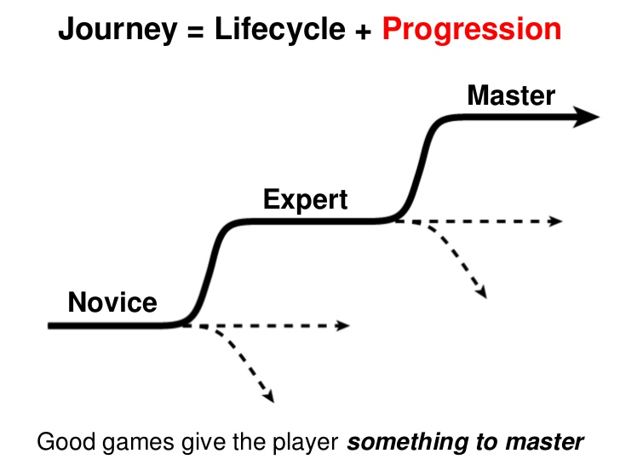
Amy Jo Kim, “Designing the Player Journey” (2011)
http://www.slideshare.net/amyjokim/gamification-101-design-the-player-journey
Notes:
So far this sounds like a bunch of atomic actions, that do not sound like much fun.
What is a game? It’s a journey. Again, referencing work by Amy Jo Kim, we asked:
What is the TopicWeb journey?
Build a TopicWeb about something you care about
Get points and badges for actions involved in creating the TopicWeb
Get a sense of accomplishment as the TopicWeb is finished and published; a sense of pride as other people view and “like” it; curiosity of what other collections or topics are out there; friendly competition with others’ TopicWebs
What are people saying about “my” collections? Suggest TopicWebs to players that use your collections; like/comment on other players’ TopicWebs; nominate TopicWebs for publication

Slide 48
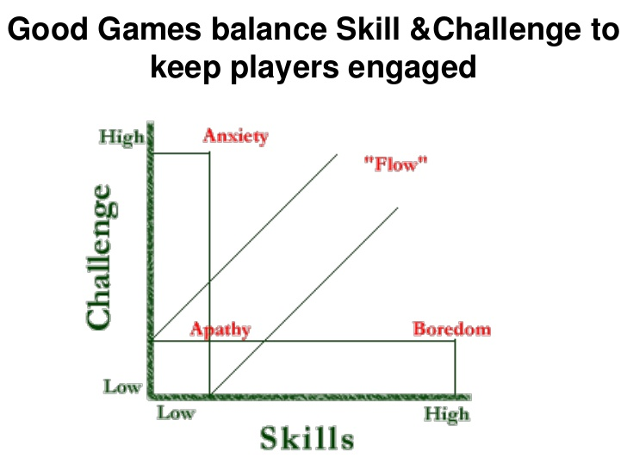
Amy Jo Kim, “Designing the Player Journey” (2011)
http://www.slideshare.net/amyjokim/gamification-101-design-the-player-journey
Notes:
How would we keep TopicWeb interesting?
Novice: build a TopicWeb from collections in your own institution; look at other people’s TopicWebs and “like” them; invite colleagues;
Expert: collaborate with others to build cross archival TopicWebs; suggest collections from your archive that someone missed
Master: Discover and create unexplored/rare topics; influence what gets published; customize the look and feel of your publications; manage the construction of big cross-archival TopicWebs

Slide 49
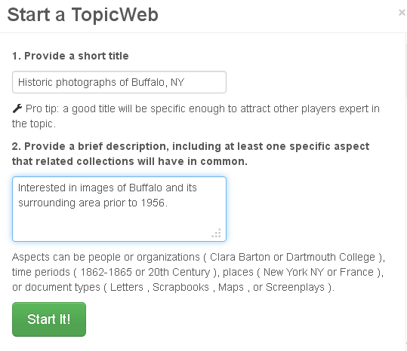
Notes:
Let’s look at some screen shots of the TopicWeb game we’re developing.
It’s easy to get a TopicWeb started. Just think of a topic you care about, give it a title and a brief description, and hit the Start It button.

Slide 50
Notes:
Just doing that much gets you in the game.
Now you’re on a Novice “getting started” mission, and you’ve already succeeded in its first step, and you can see what other goals to meet in order to complete the mission.

Slide 51
Notes:
Viewing the TopicWeb game page for the first time, a search result from ArchiveGrid automatically appears, based on the title of my TopicWeb
I can search for other things, but sometimes just the words in my TopicWeb title will be get me started.
I’m being prompted to suggest some collections for the TopicWeb …

Slide 52
Notes:
This collection in the ArchiveGrid search result looks to be right on topic, with the description noting historic photographs of Buffalo in a scrapbook, so I suggest it.
Once suggested the collection, appears as a card in my Suggested Collections deck, and my Suggested count is incremented.

Slide 53
Notes:
After some more searching and suggestion, I’ve added 5 collections to my TopicWeb, and I get an update on my mission.
I can move on to other tasks at any time, including ordering collections based on relevance and adding descriptions.

Slide 54
Notes:
I can view the collection description in detail and select from a few easy choices to say ho it is to the topic.

Slide 55
Notes:
And add descriptive commentary to expand on how the collection relates to the topic

Slide 56
Notes:
Now my TopicWeb is starting to look useful, even with just one person playing.
From here I could invite others to play, or get something back from the game to use elsewhere (like this list of related collections). And I’ve contributed knowledge to ArchiveGrid, for recommending related collections, and to assemble ground truth data to train and test a clustering model. Those things are all useful, quickly built with TopicWeb, but that have eluded us otherwise for years.

Slide 57
Notes:
In TopicWebs that have had more players and more attention, the visualization of the TopicWeb provides a quick way to see which collections are considered to be more relevant (closer to the center)
And to see the Leaderboard for the game and other statistics.

Slide 58
Possible TopicWeb results
Get a list of the collections in the TopicWeb for use elsewhere
Publish the TopicWeb as a document in ArchiveGrid
See recommended collections in ArchiveGrid, when they are connected as part of a TopicWeb
Related collections: San Mateo Local History Collection, Residence of William Chapman Ralston, California Counties Photograph Collection, and 18 more.
Notes:
We’re still working through the answers to fundamental questions about the TopicWeb game.
How do players know when they’re done? What can they do with the results when finished. How do they and others benefit?
Some ideas we’re considering include:
Getting a list of the suggested collections in the TopicWeb for use elsewhere (the game creator may have a special interest in this).
Publishing the TopicWeb as a document for others to search for and find in ArchiveGrid (the game players get recognition and reputation for that, and the document may prove to be highly useful for others interested in the same topic)
Using the list of suggested collections as a way to recommend related documents when anyone sees one of the collections in an ArchiveGrid search result

Slide 59
Next steps for TopicWeb
Focus Group in early June to evaluate the idea with archival community experts
Focus Group study will test our assumptions of how TopicWeb fits in a work and social context
Based on results of that study determine how best to proceed
Notes:
We need help in answering those and other fundamental questions about TopicWeb, as it’s still in a very formative stage.
We’re inviting archivists who have seen an earlier version or have been helping us in identifying key collections in ArchiveGrid to a focus group, to consider those questions.
Questions we’d like experts in the archival community to help us answer include:
1) does TopicWeb support any existing practice or work process in the archival community?
2) does TopicWeb support any new practice or work process in the archival community currently difficult or impossible to carry out?
3) does collaboration with other archivists in TopicWeb facilitate any new or existing practice or work process in the archival community?
4) does the gamification element of TopicWeb add or detract from its interest to the archival community?
5) what elements of our presentation of TopicWeb make sense, and what elements are confusing?
6) are the basic functions of TopicWeb -- creating, suggesting, describing, ordering, publishing -- obvious and understandable?
7) are archivists likely to 1) try, 2) use, and/or 3) recommend TopicWeb in its present form, and what changes would make that more likely?
Based on what we hear, we’ll consider how best to move forward.

Slide 60
ARCHIVEGRID
1999: EAD proving ground
2006: Aggregated discovery system for subscribers
2011: Freely available discovery system from OCLC Research
2012: Basis for more research into improving archival description and access
2013: EAD Tag Analysis, Collaborative Search experiments
Notes:
This in depth exploration of recent OCLC Research work on collaborative search and gamification helps illustrate our on-going and expanding interest in ArchiveGrid as an aggregation.
It began years ago as a proving ground for aggregated EAD documents, developed into a more inclusive discovery system, was taken on by OCLC Research to ensure it would be freely accessible, continued to develop its discovery features, and now helps us research its content, opportunities for automatically generating connections between collections, and a challenge to explore emerging methods of getting communities to work and share together.

Slide 61
ARCHIVEGRID
http://beta.worldcat.org/archivegrid
The ArchiveGrid Team
OCLC Research, San Mateo CA
bruce_washburn@oclc.org

