Slide 1
Positioning Special Collections at Penn State University
Mike Furlough
June 4 2013 New Haven CT
Past Forward! Meeting Stakeholder Needs in 21st Century Special Collections
This work is licensed under a Creative Commons Attribution 3.0 Unported License. http://creativecommons.org/licenses/by/3.0/

Slide 2
“….libraries and their institutions will increasingly be distinguished by the special collections of rare and unique materials that they hold…”
Don Waters, 2005

Slide 3
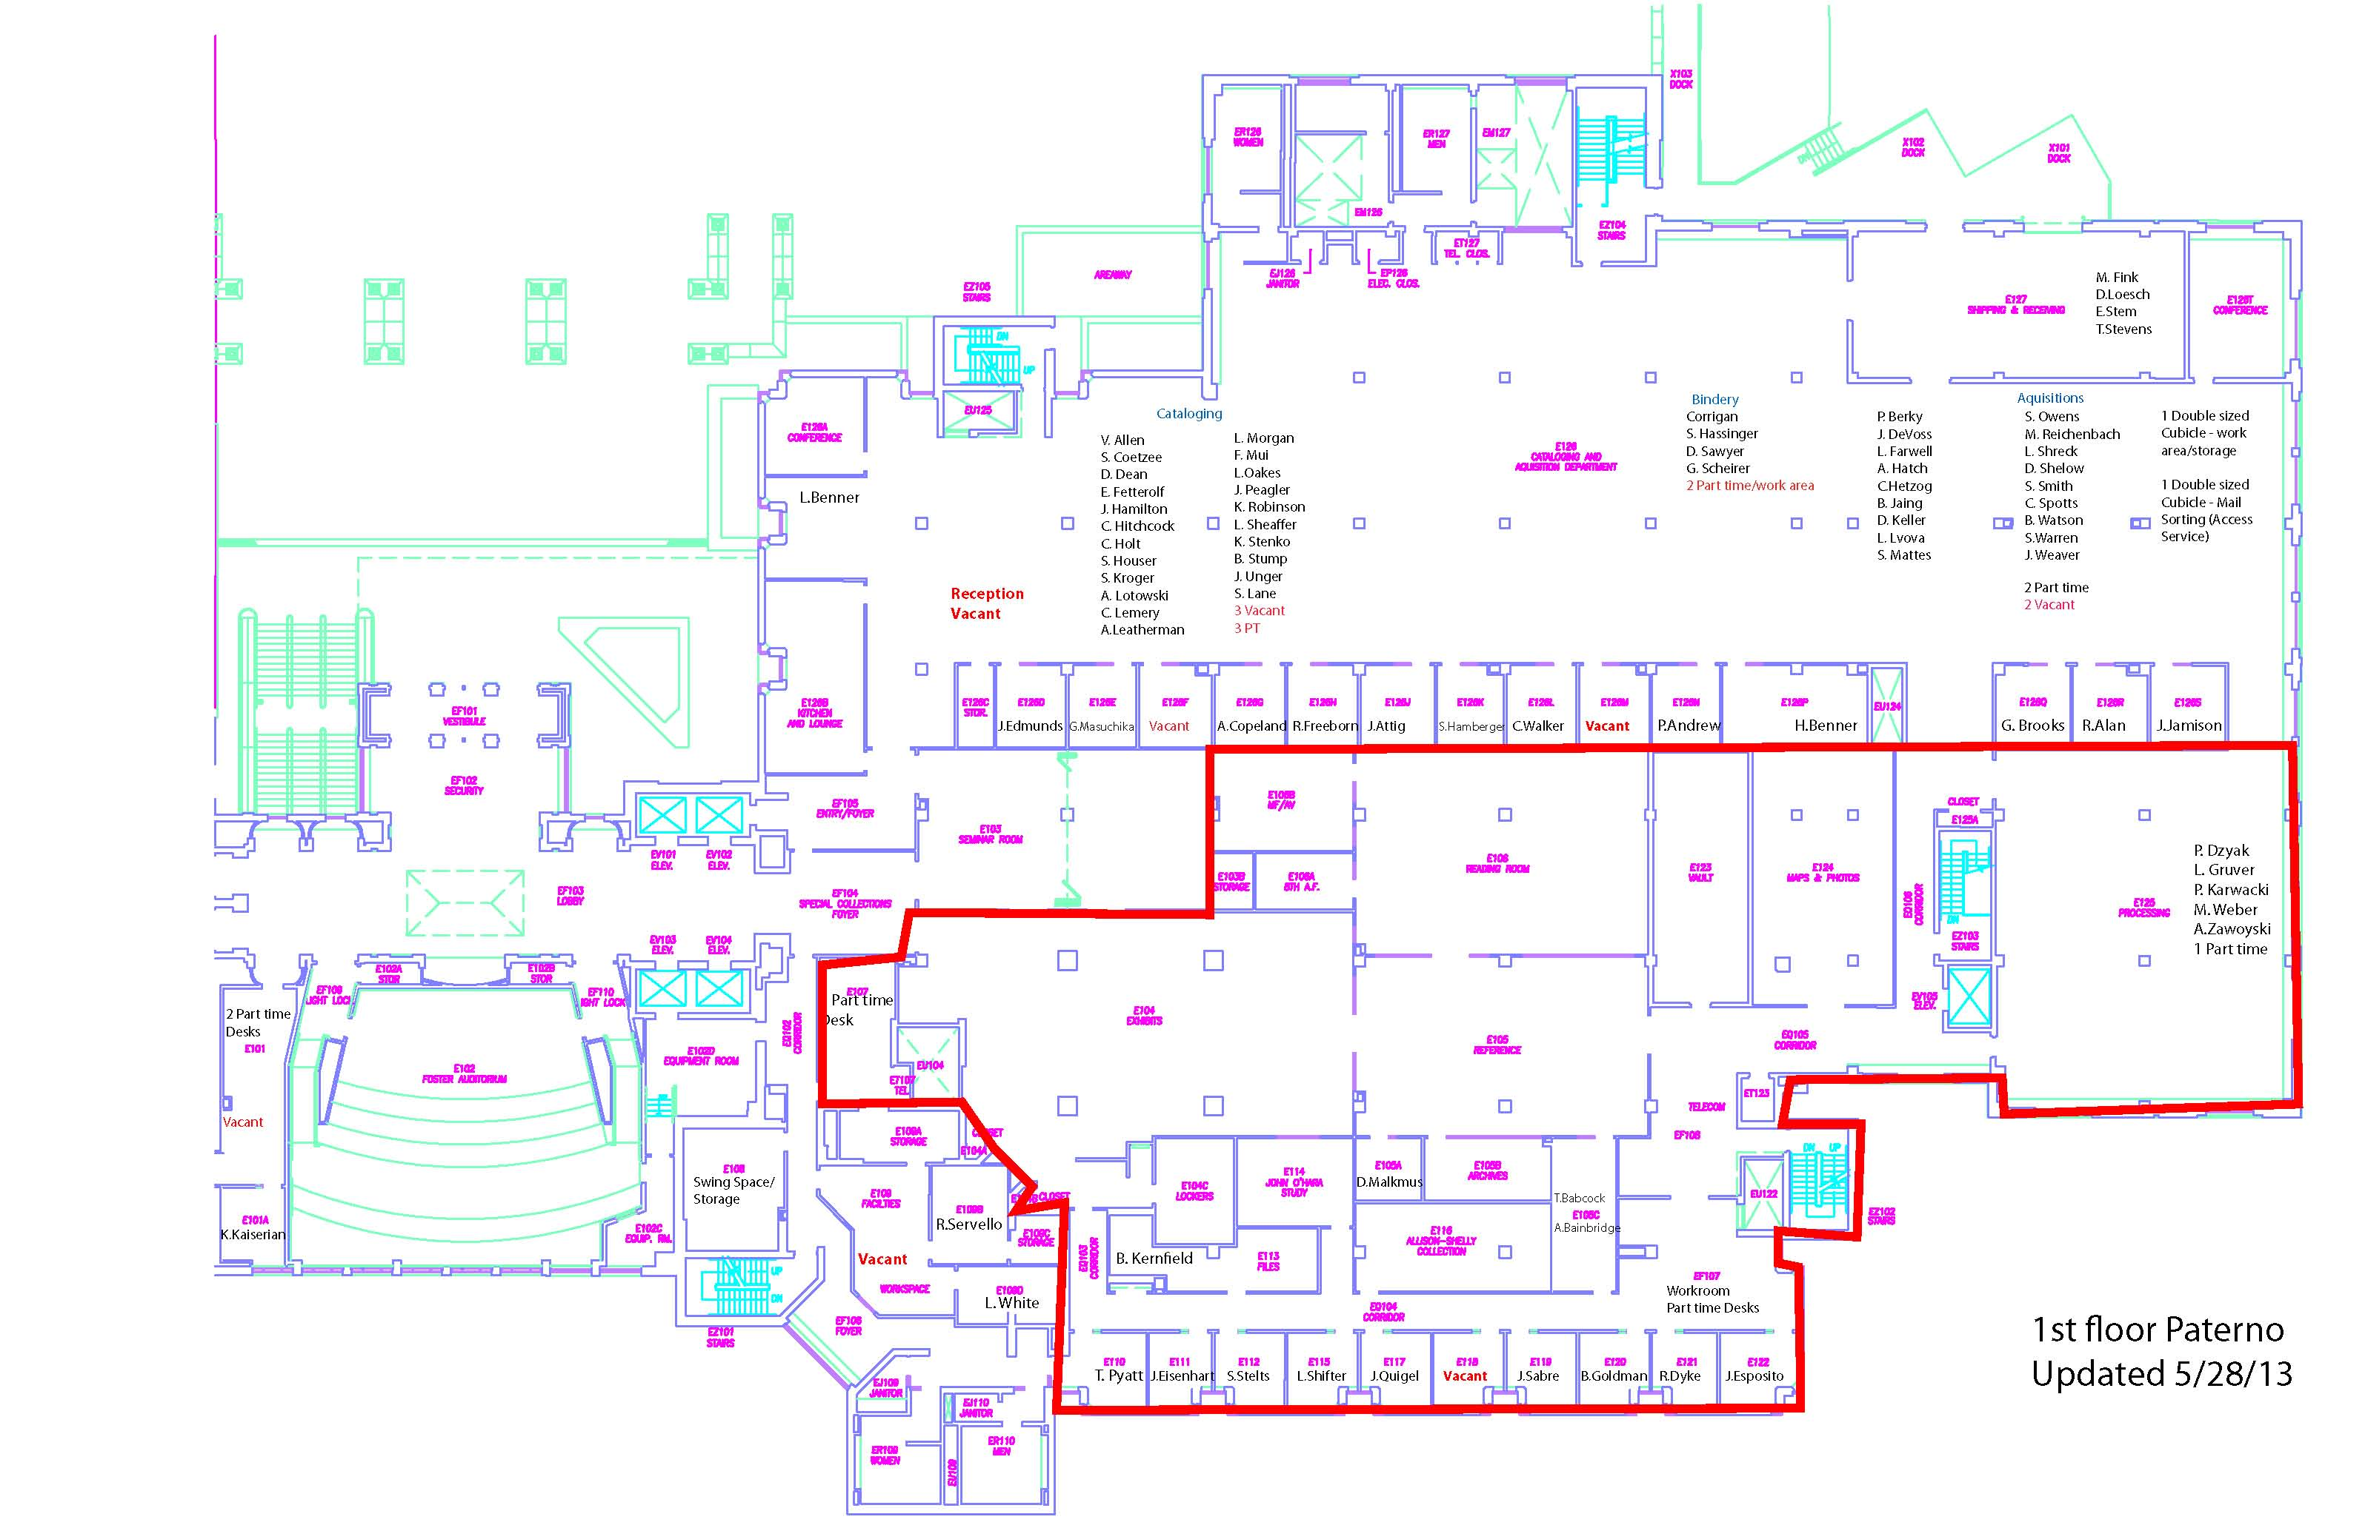

Slide 4
“….taken to an extreme, the argument about institutional distinctiveness can also limit scholarly productivity by provoking the impulse to protect silo-like boundaries around collections...”
Don Waters, 2009

Slide 5
Assessing Collections

Slide 6
Collection Development Policy
Deaccessioning
Process Improvement
Improving Discovery

Slide 7
University
Region
Special Topics
(for teaching and research)
Collections of Distinction

Slide 8
Scholarly Communication

Slide 9
Research & Scholarly Communications
Special Collections
Digitization & Preservation
Publishing and Curation Services

Slide 10
“Data are the new special collections.”
Sayeed Choudhury, many times

Slide 11
Univeristy Publication Outreach
ScholarSphere | “ArchiveSphere”
Digital Preservation

Slide 12
Boundaries

Slide 13
THANK YOU

