Slide 1
Survive and thrive: SC at the University of Manchester
Rachel Beckett
Head of Special Collections & Associate Director of The John Rylands Library
This work is licensed under a Creative Commons Attribution 3.0 Unported License. http://creativecommons.org/licenses/by/3.0/

Slide 2
My key challenge
“Demonstrating the value of SC to the University in tough times, the need for improved engagement with research and learning agendas, and ensuring the delivery of the social responsibility and public engagement agenda”
OCLC/RLUK Survey of Special Collections and Archives in the UK and Ireland, 2013

Slide 3
Overview
SC at the University of Manchester
Survival factors
Developing a vision for SC
Realising the vision
Reflections

Slide 4
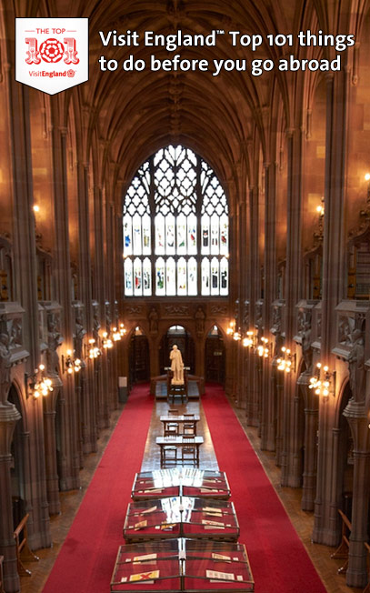
SC at the UML
Division of the University of Manchester Library
Internationally significant collections
The John Rylands Library
Research library
Visitor attraction

Slide 5
Survival factors
- Lack of vision and strategy
- Poor visibility and profile
- Punching below our weight
+ Expert, committed staff
+ Amazing collections
+ Stunning building
+ Ambitious University & Library

Slide 6
SC vision
Where are we now?
Where do we want to go?
What does SC do?
What do you love?
What is your strength?
What are you going to do?
What is your miracle?
What will stop us?
What are we good at?
What does the University need us to be good at?

Slide 10
SC Strategy Statement
Stimulating and enabling research and learning
Interpretation, access and discovery
Customers
Public engagement and social responsibility
Collections
The John Rylands Library
Innovation and sustainability
Income generation and finance
Marketing and communications
www.library.manchester.ac.uk/aboutus/strategy/_files3/SC_strategy_statement_final_20.10.11.pdf

Slide 12
Realising the vision
Engagement, outreach and partnership
Review and develop the offer
Visibility, value and profile
Culture change

Slide 13
Engagement, outreach & partnership
New teams, JDs and roles
Shift in focus and balance of activities
Breaking down the barriers
John Rylands Research Institute

Slide 14
Review and develop the offer
New opportunities
Education and Learning Programme
Challenge the status quo
Reading Room review
Commercial activity
Centre for Heritage Imaging & Collection Care
(CHICC); Weddings?

Slide 15
Visibility, value and profile
John Rylands Research Institute
Wow projects – augmented reality, email preservation
Wow events – Harry Potter, Dr Who, Blue Peter
Large Visitor Attraction of the Year Award, 2012
High profile University events

Slide 16
Reflections
Culture change (but…)
Professional tendencies
The burden of history
Surviving and thriving…..

Slide 17
Beyond survival…..
I'm not goin' give up (What?) I'm not goin' stop (What?) I'm goin' work harder (What?) (Survivor, Destiny’s Child)

