Slide 1
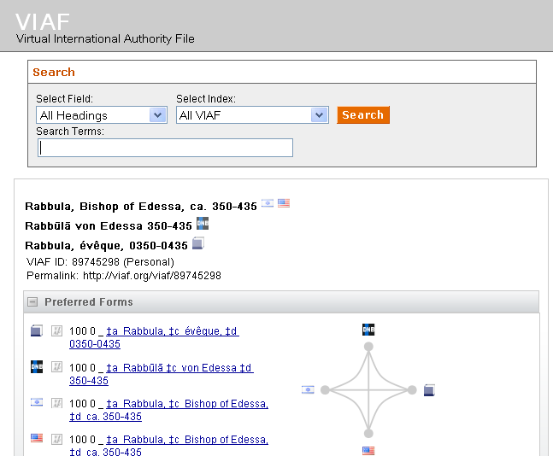
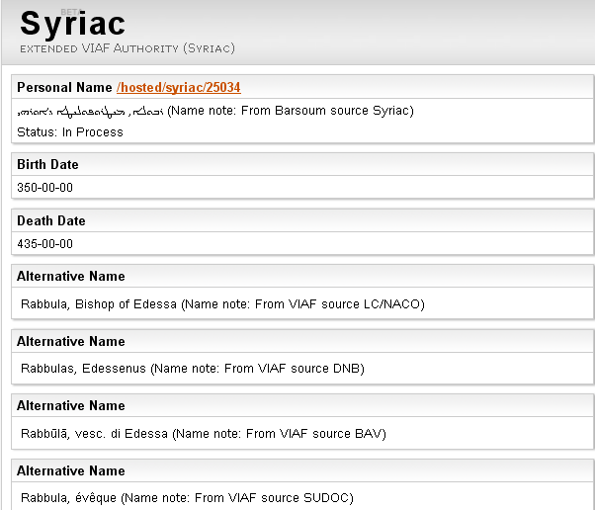
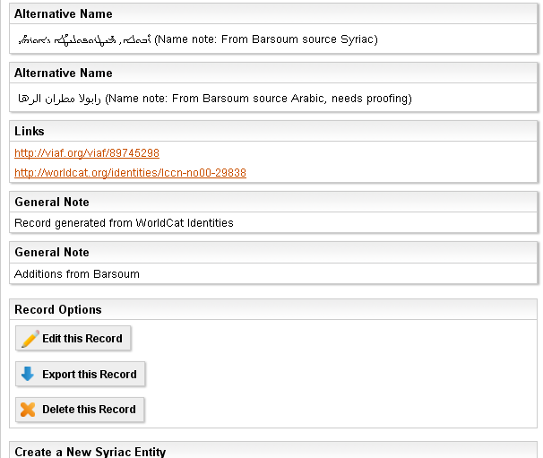

Slide 2
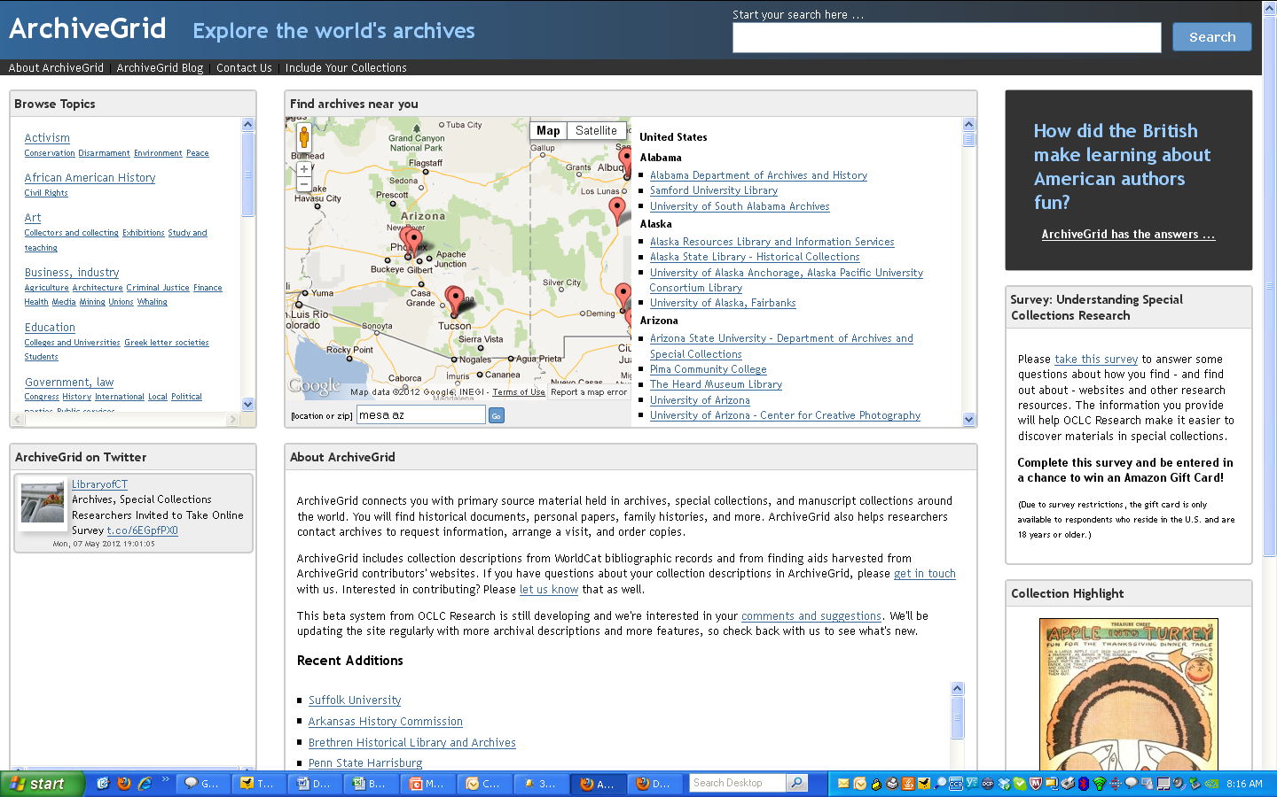
ArchiveGrid home page

Slide 3
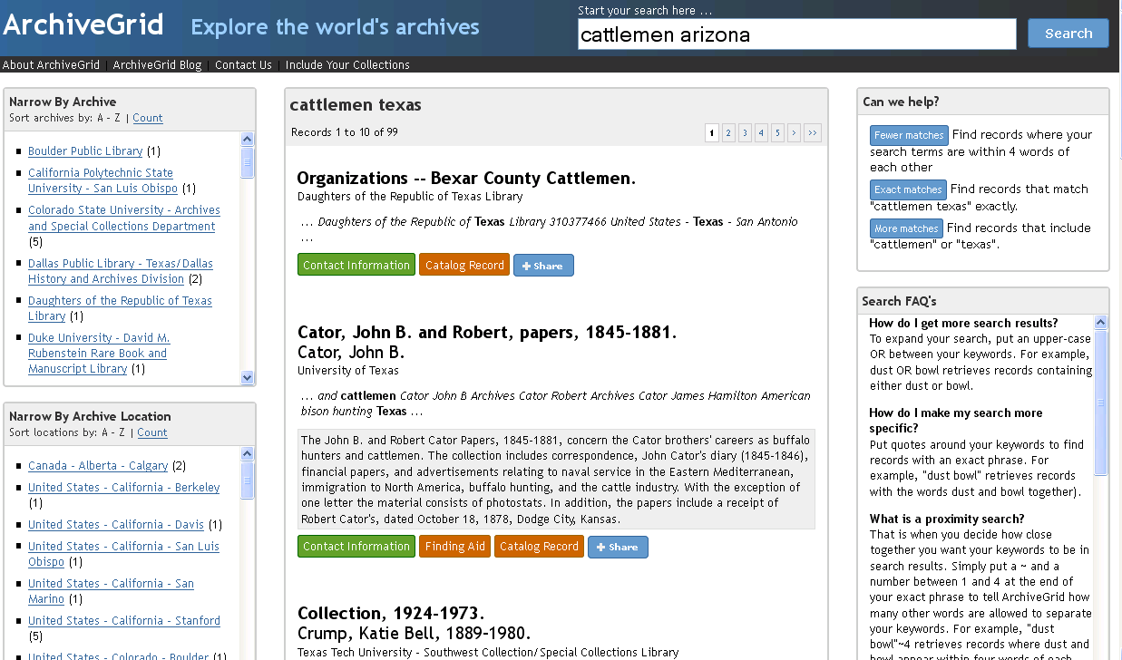
ArchiveGrid search results

Slide 4
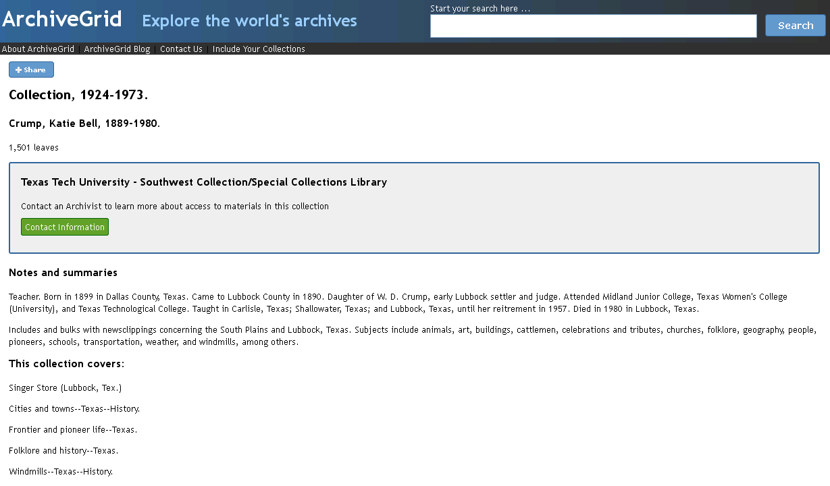
ArchiveGrid collection record

Slide 5
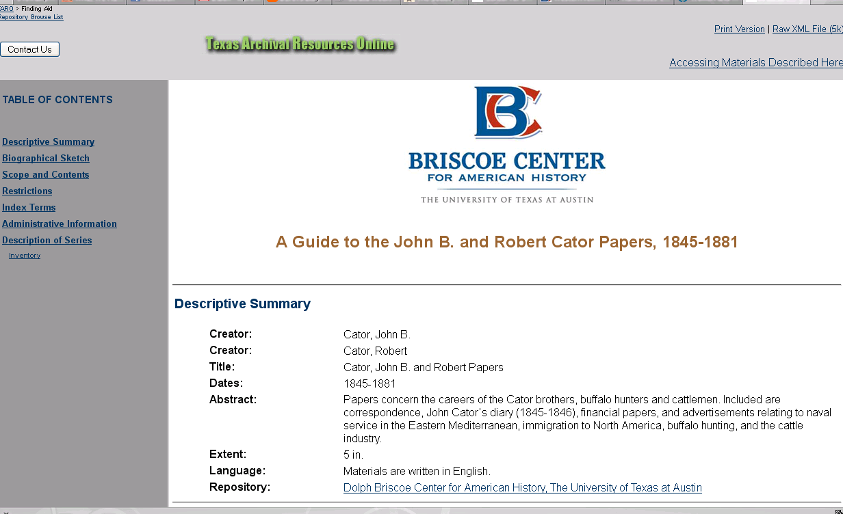
Finding aid via ArchiveGrid

Slide 6
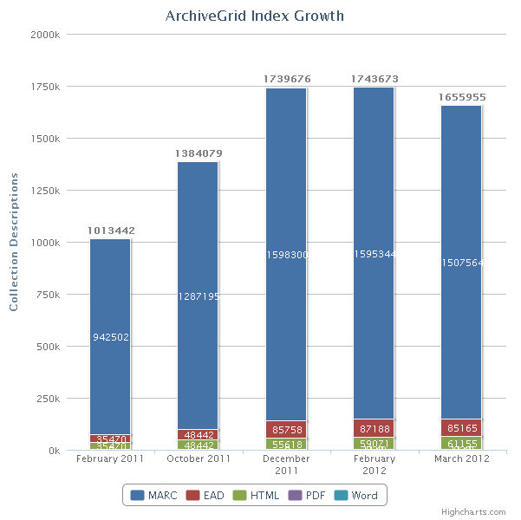
ArchiveGrid is active and growing
Total records
in the system
increased by
67% in the last year.

Slide 7
Work in Progress
Additional contributors and collections
Updated user and usability studies
Enhancements to ArchiveGrid
Connecting to the Social Graph
OCLC Research investigations in named entity recognition
A pilot project for scanning paper finding aids

Slide 8
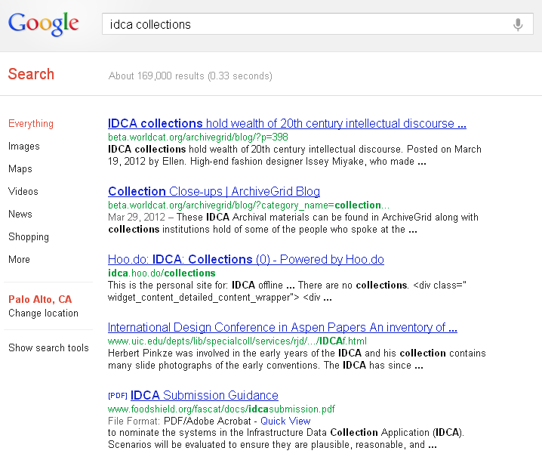
ArchiveGrid Blog

Slide 9
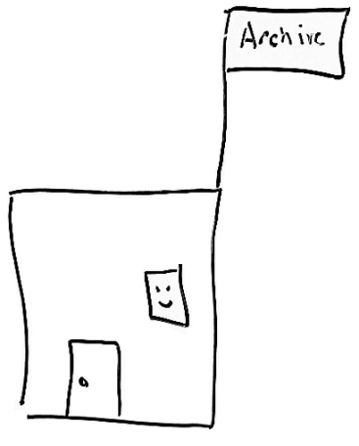
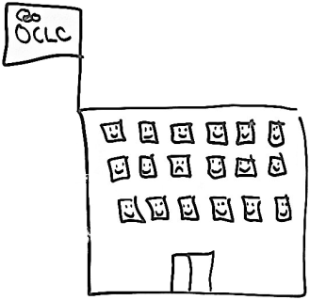
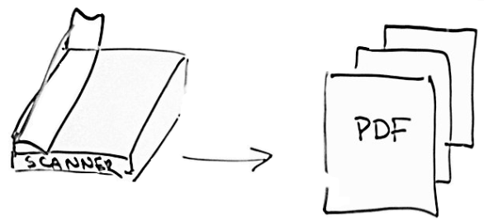
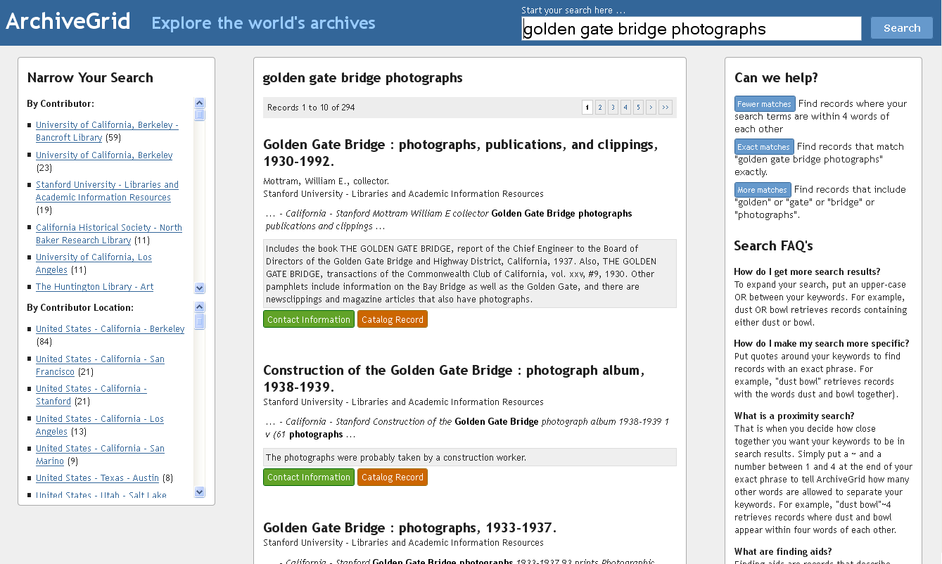
Scanning paper finding aids
Send
OCR
Convert
Index
Retrieve OCR text and metadata

Slide 10
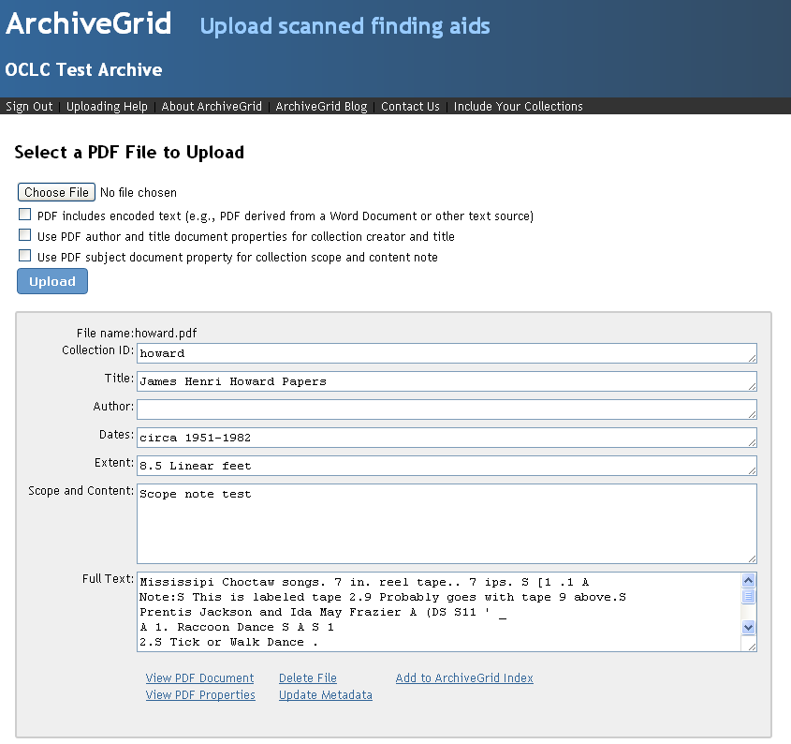

Slide 11
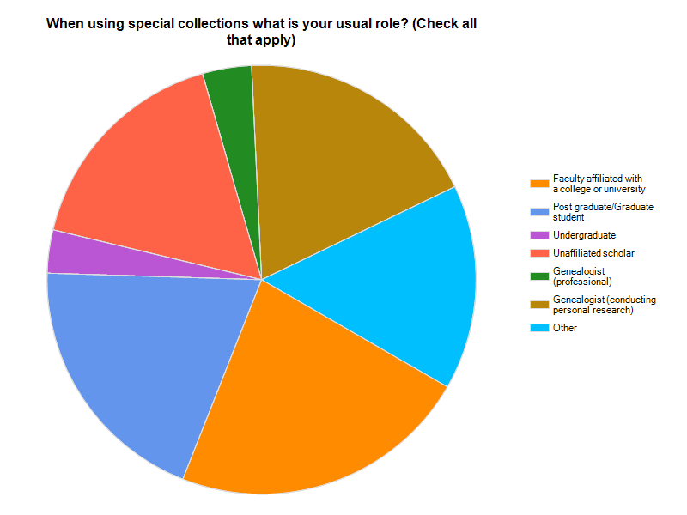
The secret lives of researchers (survey)

Slide 12
beta.worldcat.org/archivegrid

