Slide 1

Collections on Campus
Günter Waibel
OCLC Research
Nancy Gwinn
Smithsonian Institution
Jackie Bell
University of Calgary
Libraries
Archives
Museums
Notes:
Welcome to our session / seminar “Collections on Campus”. As you can see, I’ve enlisted some assistance to help us all contemplate how campus library, archive, museum collections can be leveraged to maximize the impact of this collective resource. Both Nancy and Jackie are at the forefront of their institutions efforts to integrated libraries, archives and museums, and they will both give you a brief overview of progress and challenges at the Smithsonian and the University of Calgary. I’ll set the stage by reviewing the activities of the RLG Partnership and OCLC Research in this arena. In total, our presentations should take up no more than the first half of our allotted time, and then we’d like to hear about your ambitions, hang-ups, and ideas for joint action.

Slide 2
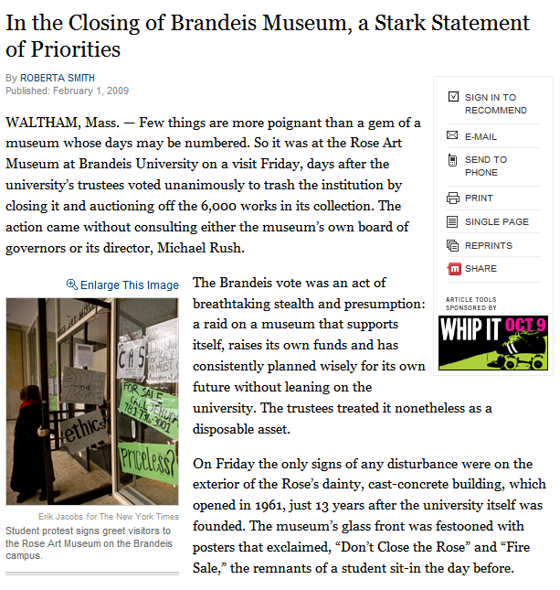
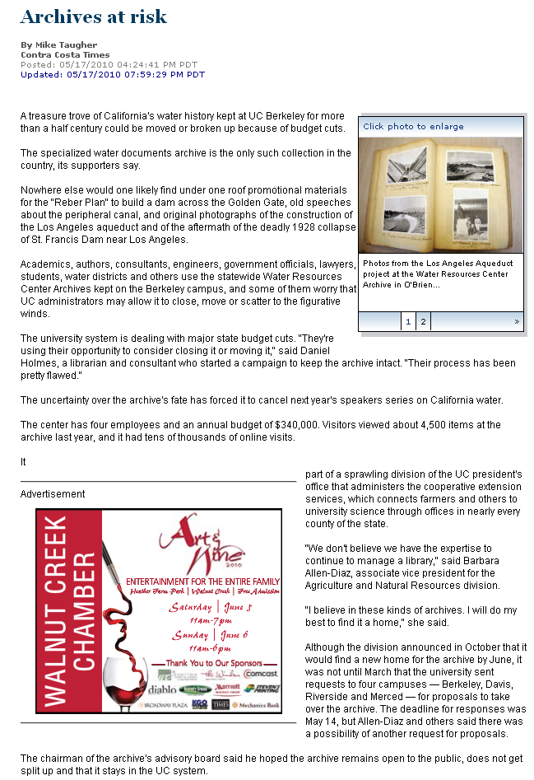
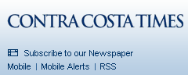
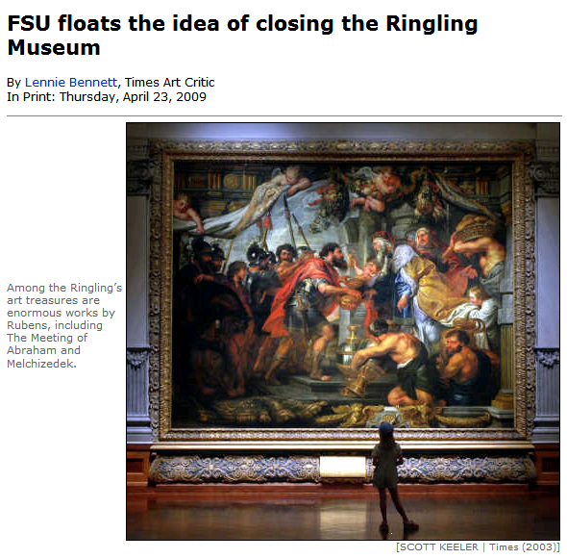
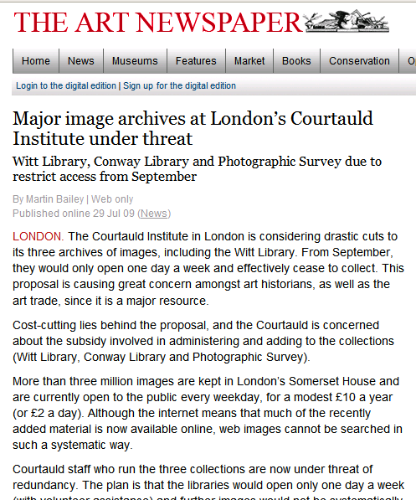
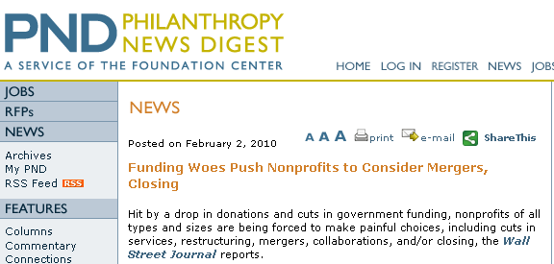
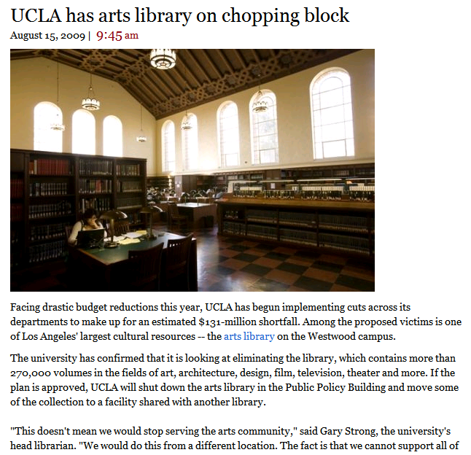
Notes:
I thought I’d set out by giving you an impressionistic view of what could be considered the bad news for Collections on Campus. Given the economic climate over the last couple of years, many institutions have seen themselves forced to re-evaluate their relationship to at least parts of their campus collections. These newspaper clippings document threatened closings of museums, archives, visual resources collections and libraries on university campuses. Not surprisingly, this makes us part of a larger trend of nonprofits considering service cuts, restructuring, mergers and collaborations to escape their funding woes.

Slide 3
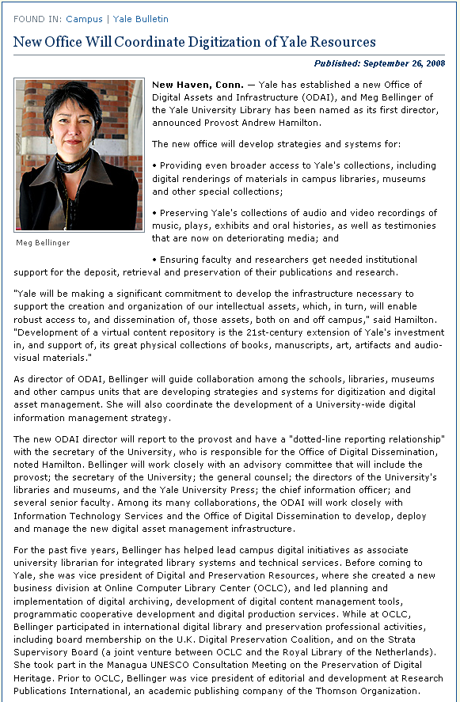
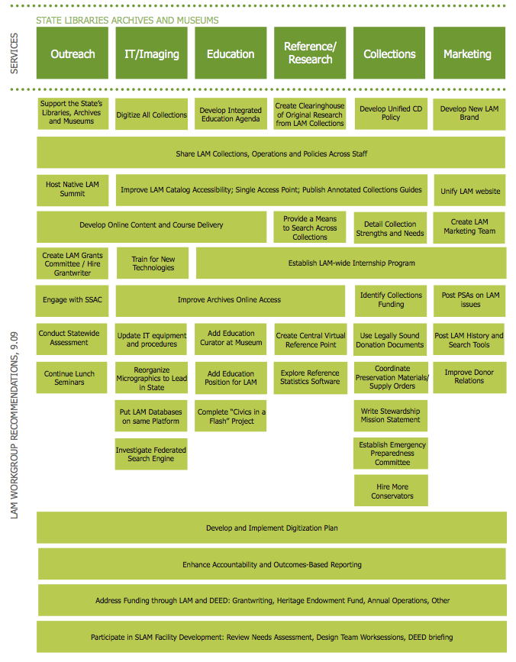
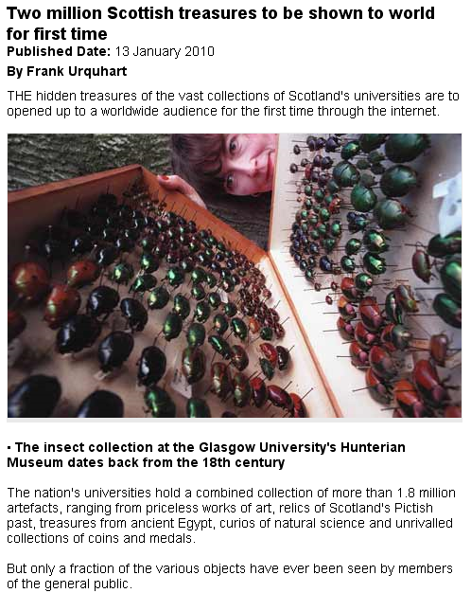
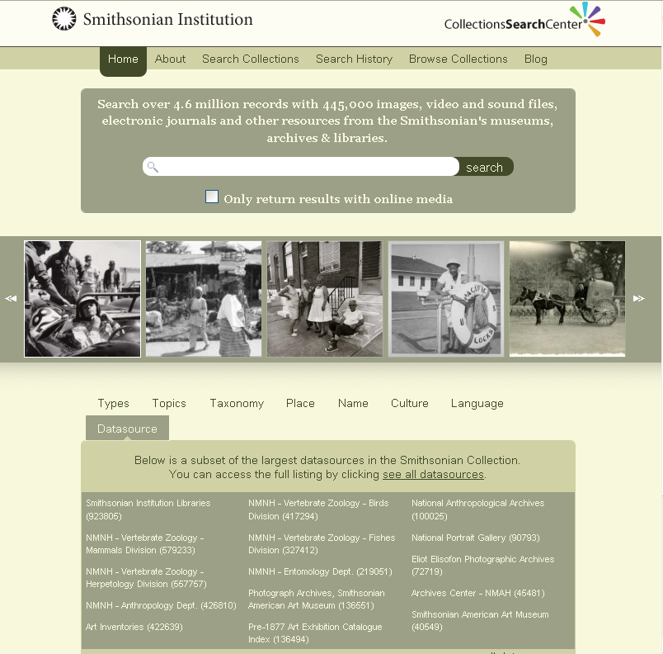
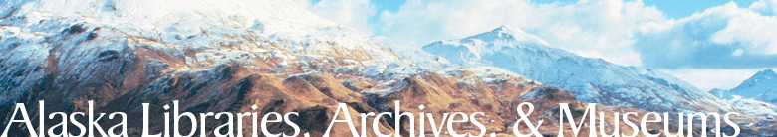
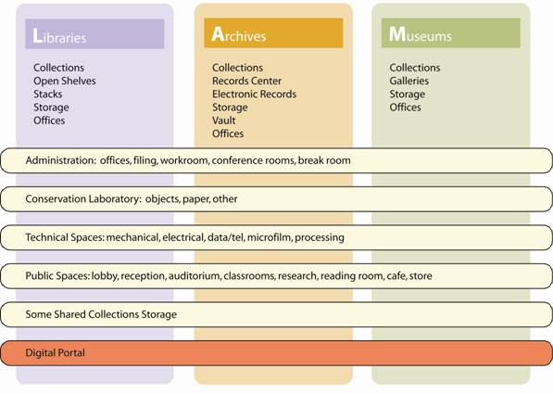
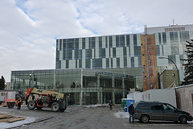
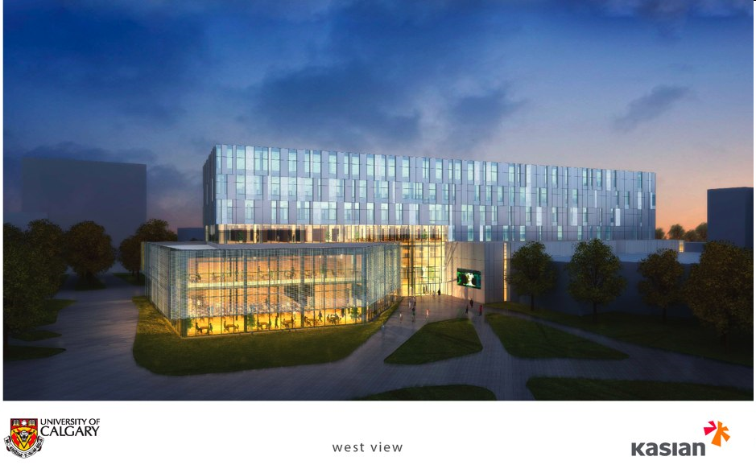
Notes:
In the same time-span when collections on campus have experienced sever budgetary pressure, new and more collaborative ways for supporting them and extracting value have emerged.

Slide 4
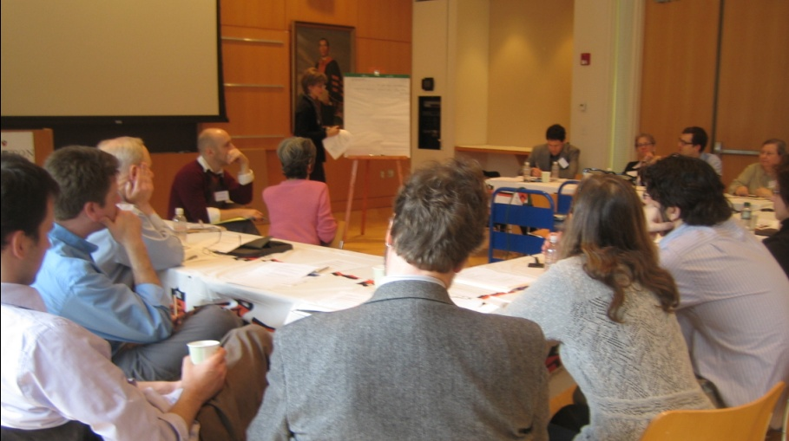
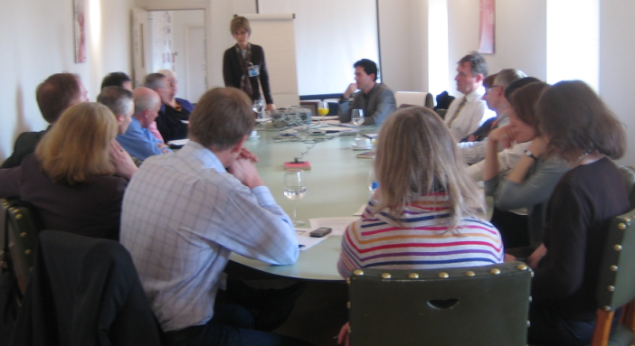
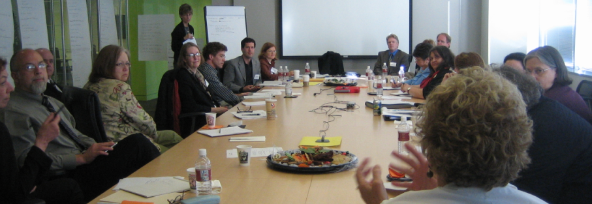
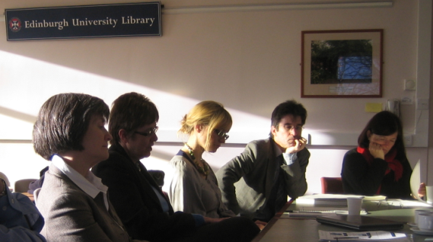
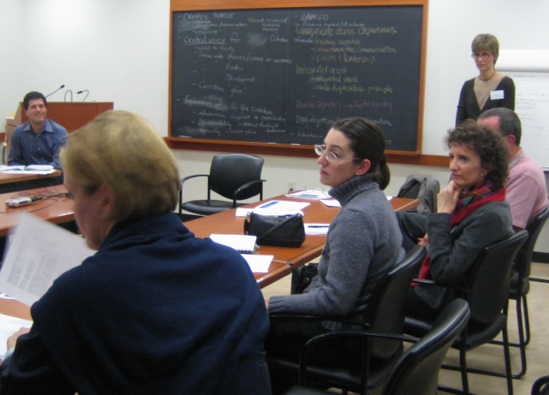
OCLC Research LAM Workshops
Princeton
Victoria & Albert
Smithsonian
U of Edinburgh
Yale
Notes:
Some of the developments I just spoke about were in part catalyzed by the Library, Archive and Museum workshops we held at five partner institutions in late 2007 / early 2008. During these day-long sessions with representatives from all three communities, we discussed existing collaborations as well as obstacles; we also defined a vision for the campus collections, from which specific projects flowed. The Smithsonian, for example, had already invested in cross-collection searching for some of its collections, but the workshop provided motivation and buy-in to go even further.

Slide 5
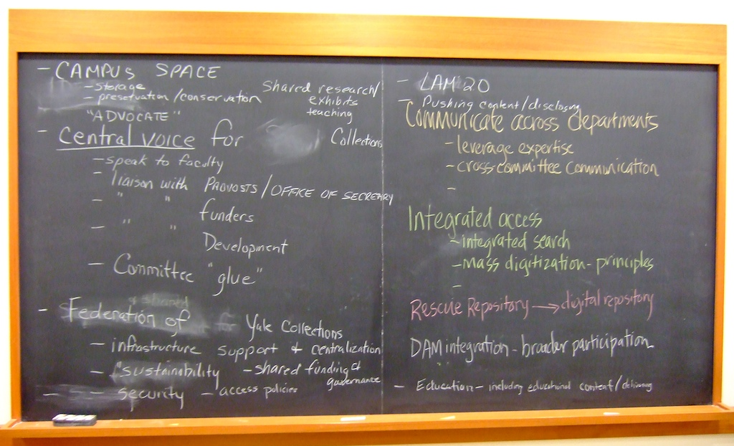
Example: Yale University
Notes:
Here are some notes taken on a Blackboard during the Yale LAM collaboration workshop. At Yale, collaboration projects had been supported by an Andrew W. Mellon Grant, and the university was looking for a way to make the existing collaborations sustainable beyond the grant funding and leverage the seed projects into new ventures. We discussed many discreet projects of merit during the workshop - you can see some of them reflected on the blackboard. At the end of the day, participants felt that what they needed the most to take collaboration to the next level was a central committee or office which they called the Federation of Yale Collections. Without this central body to coordinate, they feared that even the most innovative collaborative projects may eventually fall by the wayside as collecting units get distracted from joint work by their day-to-day operations.

Slide 6
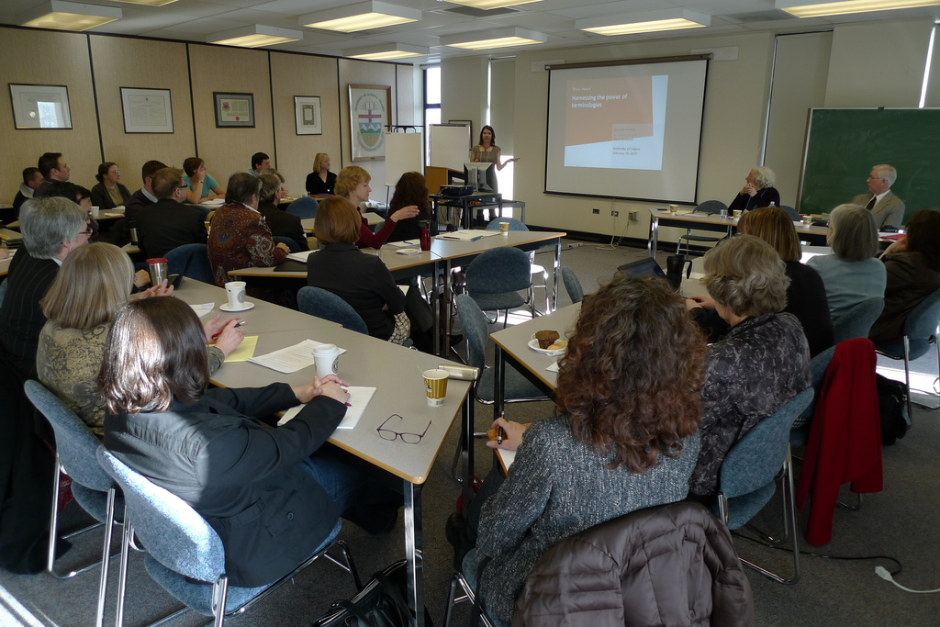
University of Calgary
Notes:
While the University of Calgary was not among our original workshop sites, we’ve used many of the lessons learned from the workshops in a day-long seminar bringing together librarians, archivists and museum professionals to flesh out their vision for a single search across campus resources.

Slide 7
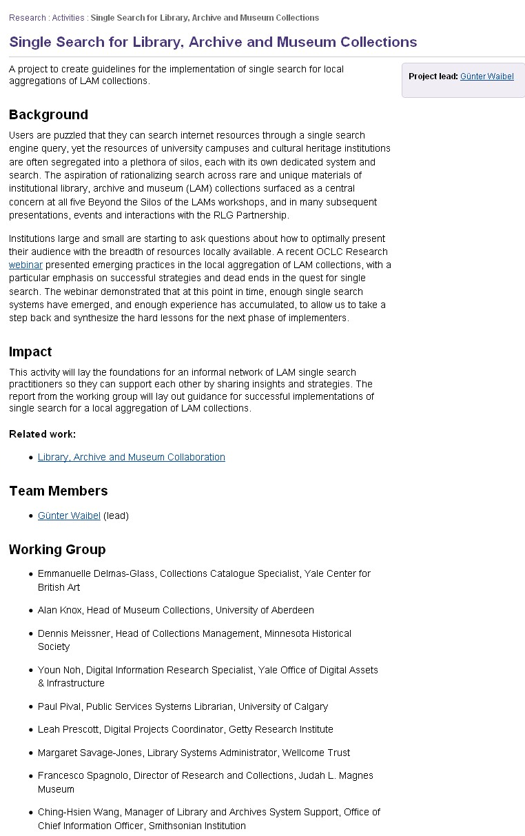
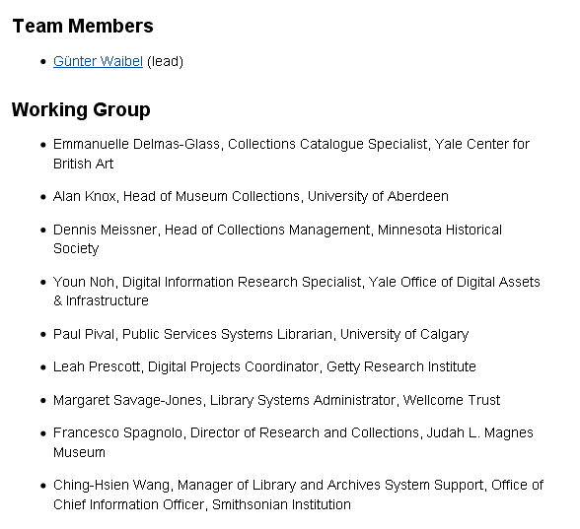
LAM Single Search
Working Group
Courtesy of Doug Dodds, V&A
Notes:
The University of Calgary is not alone in making an investment in Single Search across campus collections. At this point in time, we think enough experience exists to bring together a working group with the charge to issue a succinct guide to the do’s and don’ts of single search.

Slide 8
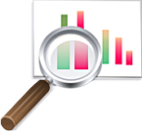
Museum Data Exchange
Harvard University Art Museums
Metropolitan Museum of Art
National Gallery of Art
Princeton University Art Museum
Yale University Art Gallery
Cleveland Museum of Art
Victoria & Albert Museum (UK)
National Gallery of Canada (CA)
Minneapolis Institute of Art
facilitated by OCLC Research
funded by Andrew W. Mellon Foundation
Analyze Data
Standards compliance?
Interoperability?
Harvest Data
Test tools
Create Research Aggregation
Create Tools
Extract CDWA Lite XML: COBOAT
Publish via OAI-PMH: OAICatMuseum
Notes:
Many times, in library, archive, museum discussion, the museums actually appear to be the most tenuous link. Libraries and archives do have a long history of working together, often under the same roof, while museums use different professional practices and, yes, jargon. They also don’t have the same history of sharing data as their library and archival friends. A Mellon-funded initiative called “Museum Data Exchange” aimed to bring museums further into the mix by creating an infrastructure for data sharing.

Slide 9
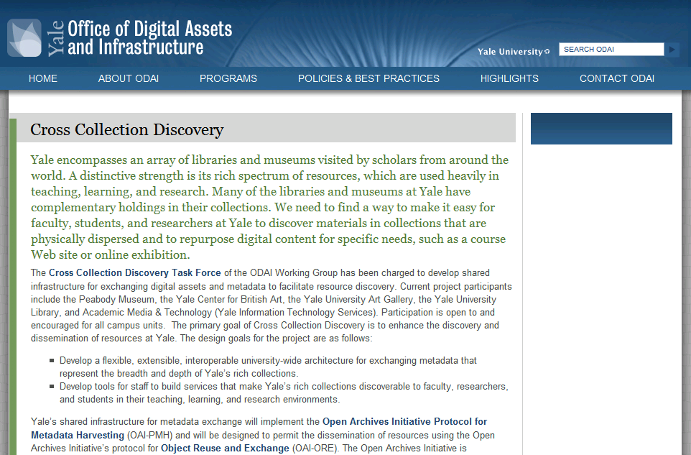
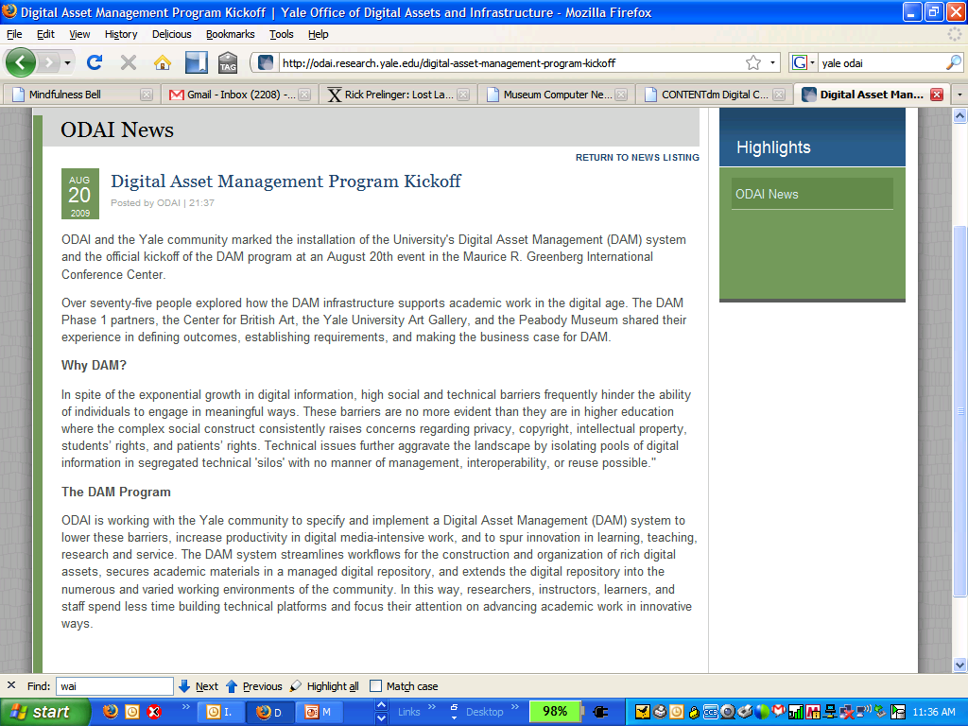
campus sharing infrastructure
Notes:
At Yale, both the Yale University Art Gallery (grant participant) and the Yale Center for British Art (an avid follower of the project) are implementing the Museum Data Exchange Tools with the goal of using this capacity for a variety of university-wide initiatives. The museums contribute data to a cross-collection search effort via OAI-PMH (Princeton has similar ambitions), and the Yale museums will also use the same set-up to sync data with OpenText’s Artesia, a university-wide digital assets management system.

Slide 10
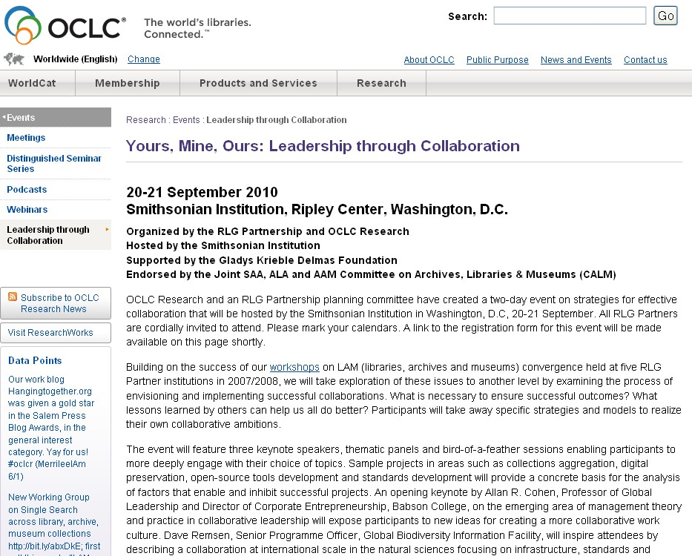
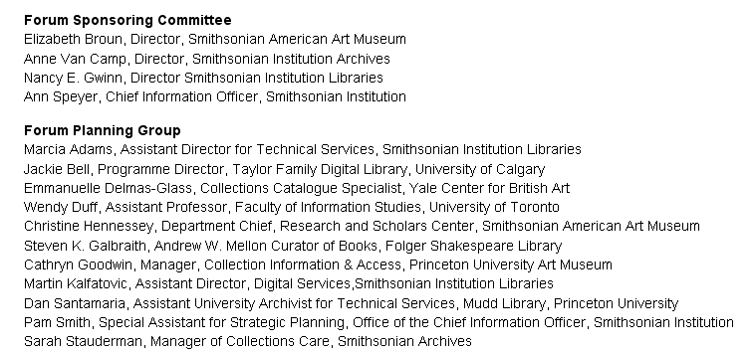
Collaboration Forum: September 20-21
Notes:
The confines of a campus-wide collection are a useful delimiter because it restricts discussion to a single organization, which makes it easier to act on ideas than cross-institutional collaboration. However, some challenges are best addressed in a larger setting of collaborators. For this reason, we’re busting out of the single-institution focus with our latest foray into collaboration. The 2 day event “Yours, Mine, Ours: Leadership through Collaboration” will be hosted by the Smithsonian Institution on 20-21 September 2010. In keeping with the collaboration theme, the agenda for the event has been created by a working group from the RLG Partnership.

Slide 11

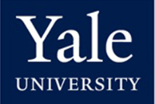
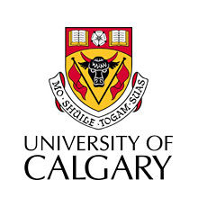

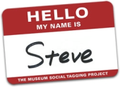


Collaboration Contexts
Local solutions - Common Administration
“We work together because we have the same employer”
Group Solutions - Common Interest
“We work together because we have common interests”
Global Solutions - Common Values
“Things work at scale because the community subscribes to the same values”
content
tools
standards
Notes:
And here is how we’d like to frame the discussion that day.

Slide 12
Partnership Investment
Collections on Campus
Completed -
  Library, Archive, Museum Workshops
  Final report: Beyond the Silos of the LAMs
  Museum Data Exchange
  Final report: Learning How to Share
In Progress -
  Working Group: Single Search across Library, Archive, Museum Collections
  Forum: Yours, Mine, Ours: Leadership through Collaboration

Slide 13
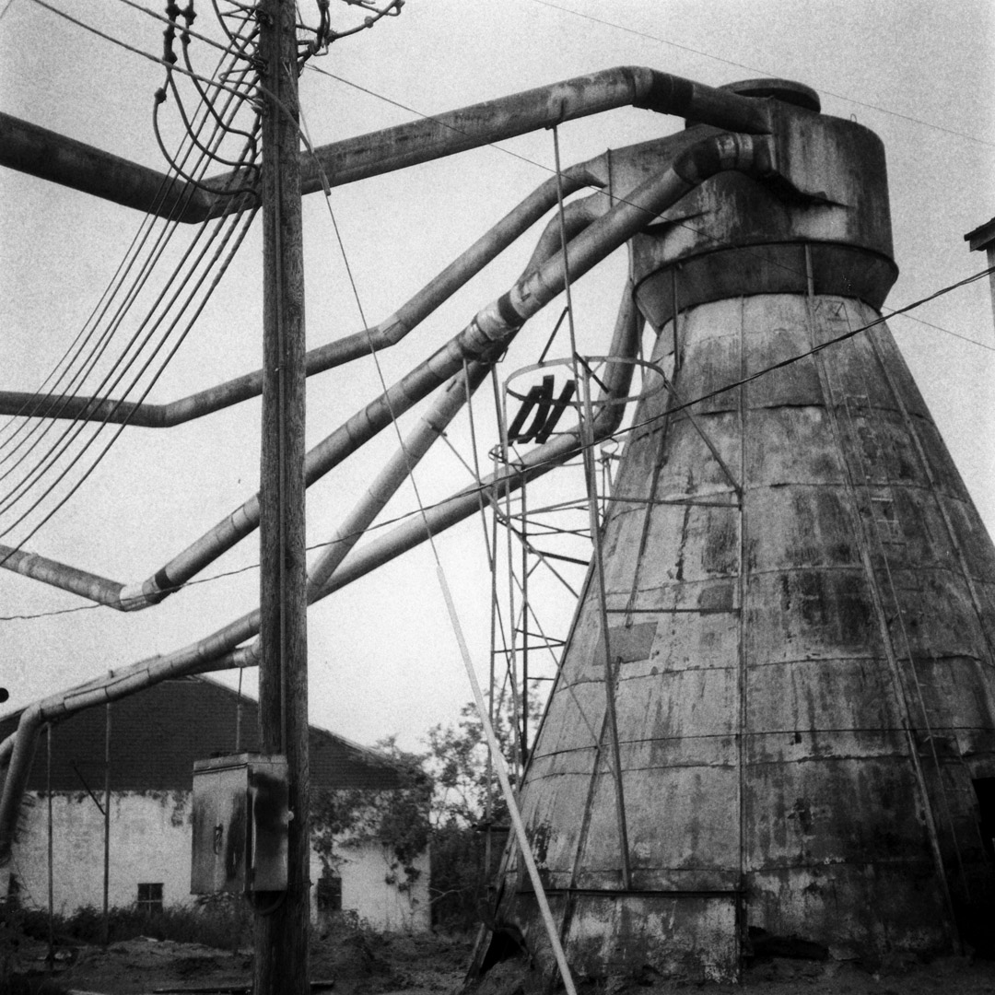

Thanks!
waibelg@oclc.org
Notes:
Fisheye photo by sandcastlematt, http://www.flickr.com/photos/sandcastlematt/820261230/
Historical photo by adhunt, http://www.flickr.com/photos/adunt/4004488205/

