Slide 1
Visitors and Residents: What Motivates Engagement with the Digital Information Environment?
Lynn Silipigni Connaway, Ph.D.
Senior Research Scientist, OCLC
David White
Co-manager, Technology Assisted Lifelong Learning, University of Oxford
Donna Lanclos, Ph.D.
Associate Professor for Anthropological Research, University of North Carolina, Charlotte
Alison Le Cornu, Ph.D.
Independent Consultant, University of Oxford
4th International Conference on QQML
Limerick, Ireland
May 24, 2012

Slide 2


Introduction
Many information options
Library resources not the first choice
Convenience rules
Must understand users’ engagement with digital environment to develop effective library systems & services
Notes:
Dempsey, Lorcan. 2010. 3 switches. Lorcan Dempsey’s Weblog (blog), June 13, 2010. http://orweblog.oclc.org/archives/002104.html.

Slide 3

Triangulation of Data
Several methods:
  Semi-structured interviews (qualitative)
  Diaries (qualitative)
  Online survey (quantitative)
Enables triangulation of data
Notes:
“Several methods of data collection are being utilized in this study: semi-structured interviews, diaries, and an online survey. The multi-method design enables triangulation, which provides a cross examination of the data analysis and results. The quantitative and qualitative methods, including ethnographic methods that devote individual attention to the subjects, yield a very rich data set enabling multiple methods of analysis.”
Connaway, Lynn Silipigni, Donna Lanclos, David White, Alison Le Cornu, and Erin M. Hood. Forthcoming. User-centered decision making: A new model for developing academic library services and systems. IFLA 2012 Conference Proceedings, August 11-17, 2012, Helsinki, Finland.

Slide 4

Ethnography
Rapport
Observations
Conversations
Diaries
Ethnography enables us to establish rapport with target communities & become immersed in other people’s existence
Notes:
Ethnography
(From Basic Research Methods 5th Edition, p. 175-176)
Ethnography involves establishing rapport, selecting research participants, transcribing observations and conversations, and keeping diaries, although Geertz believes that none of these techniques or procedures adequately defines the venture. He believes ethnography is defined by the kind of intellectual effort it is, “an elaborate venture in ‘thick description.’ ”
Reality, as perceived by the observer, is described in such detail that the reader can experience the total event as if he or she had actually been involved in it.
The goal of ethnography is to establish rapport with target communities, via a flexible toolkit of methods including participant observation, structured and unstructured interviews, reliance on selected research participants as “key informants,” and keeping diaries. The analytical intellectual work of ethnography involves being able to engage in a particular way of seeing (Wolcott 2008) that is informed by the ethnographer’s immersion in the reality of other people’s existence. Such qualitative data must be approached and interpreted in a way that recognizes and retains this richness (Connaway and Powell 2010).
Geertz, Clifford. 1973. The interpretation of cultures: selected essays. New York: Basic Books, 6.
Connaway, Lynn Silipigni, and Ronald R. Powell. 2010.Basic research methods for librarians. Santa Barbara, Calif: Libraries Unlimited.

Slide 5

Diaries
Ethnographic data collection technique
Get people to describe what has happened
Center on defined events or moments
Notes:
The diaries are an ethnographic data collection technique and a form of event sampling, which can focus participant attention on those areas which most interest researchers. Connaway and Powell (2010) point out that instruments (like diaries) that are intended to get people to describe what has just happened to them may be affected by distortions of memory and retrospection. They recommend that the question under review “center on discrete, defined events or moments so that such recording effort becomes reasonable and recall efforts are relatively straightforward” (Connaway and Powell 2010, 222).
Connaway, Lynn Silipigni, and Ronald R. Powell. 2010.Basic research methods for librarians. Santa Barbara, Calif: Libraries Unlimited.

Slide 6

Interviews
Allows for probing, clarification, new questions, focused questions, exploring
Enables data collection for extended period of time
Notes:
Interviews
(From Basic Research Methods 5th Edition, p. 218-220)
Interviewing’s primary strength is its ability to range over a time period, thereby capturing more than the single instant of an isolated action . This flexible technique allows the investigator to probe, to clarify, and to create new questions based on what has already been heard. Well conducted, in-depth interviews develop narratives along the lines of most immediacy for the participant while also providing the researcher with the opportunity to include focused questions that fill in gaps, clear up ambiguities, explore new lines of inquiry, and make connections among statements. The thoughtful sequencing of different mechanisms for eliciting information includes the use of direct questions when following up on topics that a participant has identified as critical, silence that allows people the time needed to reflect on a topic, and structured questions to pull an interview back on track.
Connaway, Lynn Silipigni, and Ronald R. Powell. 2010.Basic research methods for librarians. Santa Barbara, Calif: Libraries Unlimited.
Glaser, Barney G., and Anselm L. Strauss. 1967. The discovery of grounded theory; strategies for qualitative research. Chicago: Aldine Pub. Co., 273.
Kvale, Steinar. 1996. IntervVews: an introduction to qualitative research interviewing. Thousand Oaks, Calif: Sage Publications, 133-135.
Whyte, William F. “On Making the Most of Participant Observation,” The American Sociologist 14 (1979): 56-66.

Slide 7

Surveys/Questionnaires
Encourages frank answers
Eliminates variation in the question process
Can collect large amount of data in short period of time
Delivery
  In-person
  Telephone
  Mail
  Email
  Online
  Point of contact
Notes:
Basic Research Methods 5th Edition, p. 146-147
“The questionnaire, especially the mail, email, and Web-based questionnaire, tends to encourage frank answers. This is in large part because it is easier for the researcher to guarantee anonymity for the respondent when using a mail questionnaire.”
“Another way of stating the second advantage is that the fixed format of the questionnaire tends to eliminate variation in the questioning process. Once the questions have been written in their final version and included in the questionnaire, their contents and organization will not change.”
“Questionnaires can facilitate the collection of large amounts of data in a relatively short period of time. Questionnaire-based surveys of several thousand people are not unusual, and responses typically are expected within one to two weeks.”
Basic Research Methods 5th Edition, p. 221
“Questionnaires vary by means of delivery (in-person, telephone, mail, email, WWW, and point-of-contact) and format (open-ended questions, attitudinal
scales, multiple choice questions, ratings, and rankings). This is perhaps the most thoroughly studied form of data gathering.”

Slide 8
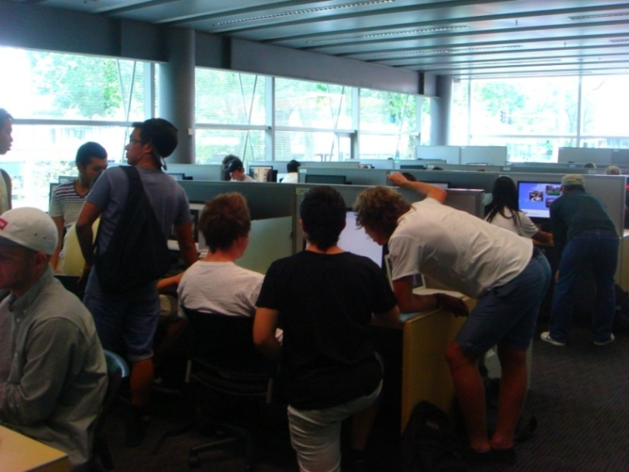
Visitors and Residents:
What motivates engagement with the digital information environment?
Funded by
  JISC
  OCLC
    Lynn Silipigni Connaway, Ph.D.
  Oxford University
    David White & Alison Le Cornu, Ph.D
  University of North Carolina, Charlotte
    Donna Lanclos, Ph.D.

Slide 9
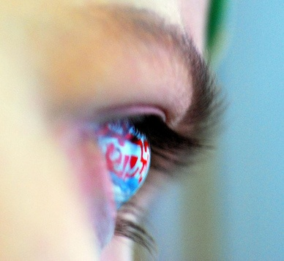
Residents
Significant online presence & usage
Collaborative activity online
Contribute online
Mobile device dependence
>10 hours online/week
Notes:
Residents: significant online presence and usage; high level of collaborative activity online; contributions to the online environment in the form of uploading materials, photos, videos; high dependence on a mobile device (smart phone, laptop, etc.); more than10 hours a week spent online.

Slide 10

Visitors
Functional use of technology
Formal need
Passive online presence
Favor FtF interactions
<6 hours online/week
Notes:
Visitors: functional use of technology, often linked to formal need (such as use of software for specific coursework, or organising meetings through email contact); less visible/more passive online presence, more likely to favour face- to- face interactions (even as they use the internet to organize/schedule those interactions); fewer than 6 hours spent online a week.

Slide 11

Project Phases
Phase 1:
  Interviewed Emerging educational stage individuals
    Last year of secondary/high school & first year of university
    Majority of students aged 18 & 19 with a few outliers
Phase 2:
    Interviewed individuals in
      Establishing (second/third year undergraduate),
      Embedding (postgraduates, PhD students), &
      Experienced (Scholars) stages
      Some Phase 1 participants agreed to submit monthly diaries
Notes:
The findings will be used to create a matrix of implementation options allowing those designing and delivering digital platforms and services to make informed decisions relative to engagement and motivation for individuals at each of the educational stages.
Work as an interdisciplinary team, bringing to bear our relative expertises in Educational Technology, Library Information and Science/Research Methodology (User behaviour), and Anthropology (Ethnography)

Slide 12

Project Phases, cont.
Phase 3
  In-depth survey
    50 participants from each educational stage in both US & UK
  Code, analyze, & compare data
Phase 4
  Interview a second group of 6 students in the Emerging stage
4
Notes:
Phase 3
Test interview and diary results with in-depth survey of 50 participants from each educational stage
Code data to refine emerging findings and explore possible trends
Phase 4
Interview a second group of 6 students in the Emerging stage
This will help to determine if methods of engagement are changing over time

Slide 13
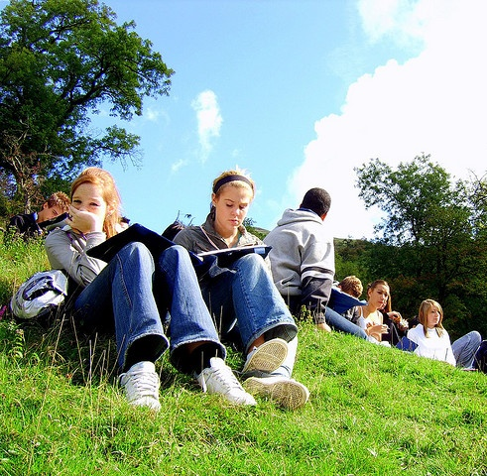
Phase 1
Emerging educational stage
30 participants
  15 US
  15 UK
Quantitative data:
  Demographics, number of occurrences of technologies, sources, & behaviours
Qualitative data:
  Themes & direct quotes
Notes:
The initial 6-month pilot stage focused on the Emerging educational stage to refine the research methodology and to establish the value of the work to the stakeholders. In the US the project worked in close partnership with the University of North Carolina, Charlotte (UNCC) to recruit participants, from different socio-economic groups from both private and public secondary schools as well as first-year university students. In the UK participants were drawn from Oxford Brooks University, Warwick University and secondary schools in Oxford and Leicester.
Thirty individuals in the Emerging Educational Stage (late stage secondary/high school and 1st year university) were recruited -15 in the US and 15 in the UK.
Of the 30 participants recruited 8 in the US and 6 in the UK were asked to document their information seeking activities for a 3-month period. They were closely facilitated through this process and communicated with the research team in the medium of their choice over this period.
The quantitative data include demographics; number of occurrences for different types of technologies, sources, and behaviours.
The qualitative data provide themes that identify behaviours and sources for different contexts and situations and include direct quotes and behaviours.

Slide 14

Phase I Participant Demographics
30 participants
  15 secondary students
  15 university students
  19 females
  11 males
  21 Caucasian
  3 African-American
  1 Caucasian-Thai
  1 Hispanic
  4 unidentified
Notes:
Economic class:
We recorded the residential post-code/zipcodes for the participants as a way to identify broad socio-economic categories (given what we knew about socio-economic homogeneity in the cities in which we were working).
Attempts were made to recruit secondary students from schools with a wide range of socio-economic backgrounds. This is basically a convenience sample of students—those who were willing to be interviewed by us, in institutions that allowed us entry.
We also asked questions about parents’ educational backgrounds, and current/past vocations, to enrich our picture of interviewee backgrounds.

Slide 15
US vs. UK Participant
Notes:
Need to have samples from UK and US to try to get a better fix on why the behaviours look the way they do.
Are they because of the technology?
Culture?
Living in town? Living in suburbs?
Living in US/UK?
Going to College?
US (15 of 30)
8 Females
7 Males
UK (15 of 30)
11 Females
4 Males

Slide 16
US vs. UK Participant Ages
Notes:
US (15 of 30)
5 are 17 years-old
2 are 18 years-old
7 are 19 years old
1 is 28 years old
UK (15 of 30)
1 is 16 years old
6 are 17 years old
1 is 18 years old
4 are 19 years old
1 is 34 years old
1 is 36 years old
1 is 57 years old

Slide 17
US vs. UK Participant Ethnicity
Notes:
US (15 of 30)
3 African American
11 Caucasian
1 Hispanic
UK (15 of 30)
1 Caucasian/Thai
10 Caucasian
4 Undeclared

Slide 18

US vs. UK Participant University Majors
US (9 of 16)
5 Engineering
1 Political Science
1 Pre-Business
2 Undeclared
UK (7 of 16)
3 Teaching
1 Chemical Biology
1 Chemistry
1 History
1 Languages
Notes:
This is the 16 of 30 Emerging who are already in college.
This was done to give us the potential to discuss behaviours in context
Are there certain things they do because they are engineers? Because they are education students?
If not, why not?

Slide 19

Participant Interview Questions
1. Describe the things you enjoy doing with technology and the web each week.
2. Think of the ways you have used technology and the web for your studies. Describe a typical week.
3. Think about the next stage of your education. Tell me what you think this will be like.
Notes:
For faculty, these are being slightly edited to ask about their preconceptions of academic life before the stage they currently occupy, as well as what they think the future might hold.

Slide 20
Participant Interview Questions, cont.
4. Think of a time when you had a situation where you needed answers or solutions and you did a quick search and made do with it. You knew there were other sources but you decided not to use them. Please include sources such as friends, family, teachers, coaches, etc.
5. Have there been times when you were told to use a library or virtual learning environment (or learning platform), and used other source(s) instead?
6. If you had a magic wand, what would your ideal way of getting information be? How would you go about using the systems and services? When? Where? How?
Notes:
These questions come from previous research
Institute for Museums and Library Services Research Grant, 2003-2005. “Sense-making the Information Confluence: The Hows and the Whys of College and University User Satisficing of Information Needs,” Brenda Dervin, Ohio State University, Principal Investigator; Lynn Silipigni Connaway and Chandra Prabha, Co-Investigators. $480,542, plus matching from OCLC and OSU. Project Website URL: http://www.oclc.org/research/activities/past/orprojects/imls/default.htm)
2. Institute for Museums and Library Services Research Grant, 2005-2007. “Seeking Synchronicity: Evaluating Virtual Reference Services from User, Non-User, and Librarian Perspectives.” Lynn Silipigni Connaway and Marie L. Radford, Rutgers University. Co-Principal Investigators. $684,996, plus matching from OCLC and Rutgers: $405,078. Project Website URL: http://www.oclc.org/research/activities/synchronicity/default.htm

Slide 21

Codebook
Place
Sources
Tools
Agency
Situation/context
Quotes
Contact
Technology Ownership
Network used
Notes:
How we used the codebook:
First: the 3 researchers and research assistant coded the same two transcripts, one US and one UK (both secondary school).
We met and re-met and coded and re-coded until there was agreement.
THEN we went our separate ways to code. BUT we still communicate with each other in our coding processes, because of the remote nature of our collaboration.
Coding is done on paper, for the most part, and then the codes are entered into word, or scanned and sent to research assistants, who enter the coding into NVivo9. When the research assistants are entering the coding, they notice discrepancies, document them, and generate a discussion about what was intended, and what should the final coding be.
This continuous communication provides more consistency in coding across the researchers.
We will, once all of the coding is input, measure inter-coder reliability as well.

Slide 22

Codebook
I. Place
A. Internet
1. Search engine
a. Google
b. Yahoo
2. Social Media
a. FaceBook
b. Twitter
c. You Tube
d. Flickr/image sharing
e. Blogging
B. Library
1. Academic
2. Public
3. School (K-12)
C. Home
D. School, classroom, computer lab
E. Other
Notes:
The codebook was created with a grounded analysis of the interviews of the Emerging group, and is to date one of our most significant research findings.
There was significant discussion among researchers about the content of the codebook, via emails and Skype conversations. We started writing the codebook in May, and the final version came about in mid-September.
The content of the codebook reveals the priorities and practices of the Emerging group, but can also be used to analyze the remaining groups we have yet to interview. (for instance, we can use the codebook to analyze faculty interviews even if we don’t have a code for LinkedIn)
Discuss the content of the codebook.

Slide 23
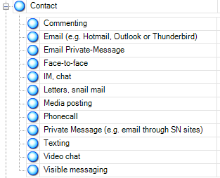
Nvivo 9
Qualitative research software
Upload documents, PDFs, & videos
Create nodes & code transcripts
Merge files
Queries
Reports
Models

Slide 24

Diaries
14 diarists
  8 US & 6 UK emerging stage students agreed to be diarists
  3 US & 3 UK completed diaries
Share information-seeking situations each month
Communicate in any format
diary
phone
videos
video chat
instant messenger
Notes:
Fourteen of the Phase 1 interviewees agreed to submit a monthly diary for 3 months during the summer of 2011:
8 from the US
6 from the UK.
The US participants were more faithful than the UK participants in submitting the diaries.
At the end of Phase 1, we have 7 complete sets of diaries
4 US participant
3 from UK participants
Several participants have submitted intermittent monthly diaries. Although we have not yet done a thorough analysis of the diaries, the team has begun to discuss whether they have been as effective a way as we’d hoped to gather data due to the difficulties, especially in the UK, of keeping contributors on task. We are discussing several options in lieu of the diaries, which may include individual monthly conversations with participants, participant video submissions, IM sessions with the participants, etc.

Slide 25

Diaries
All except one selected EMAIL
        Why?
“It’s for formal communication”
Notes:
We currently are analysing the diaries.

Slide 26
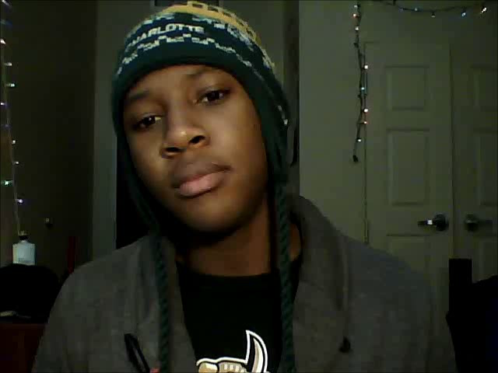
USU12 Video Diary
Notes:
Click on the image and it will play, click again to pause. This is not internally embedded, but linked. Video must be accessible to powerpoint.
USU12 (Establishing Educational Stage) Video Diary Log #2 (November2011). This clip is 1 minute 35 seconds.

Slide 27
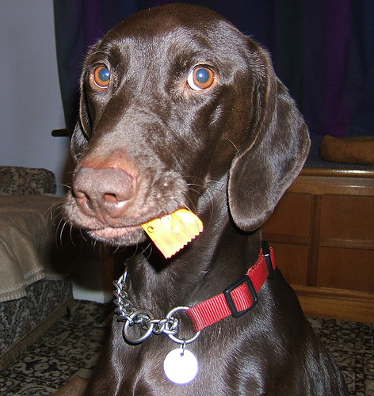
Preliminary Findings
Wikipedia
  Widely used
  Guilt
Some changes occur transitioning between stages
Information evaluation
  Popular = correct
Notes:
There are a number of ‘covert’ online study habits.
For example, Wikipedia is widely used but almost always with a sense of guilt or an eagerness to convey awareness of its ‘unreliability’
There is an assumption by students that teachers and lecturers value the authenticity of paper-based books rather than information found online through a browser, such as Google (the data also indicate that this assumption is unfounded).
Some changes are made when transitioning from one stage of academic life to another. For example, one interviewee cleared his Facebook site of his previous High School friends when he went to University, where he replaced them with new contacts.
A number of interviewees spoke about the way they evaluated information and sites from the internet. A typical way of doing this was to judge by sites by their popularity (as shown by their placement in the Google results list), i.e., popular = correct.

Slide 28
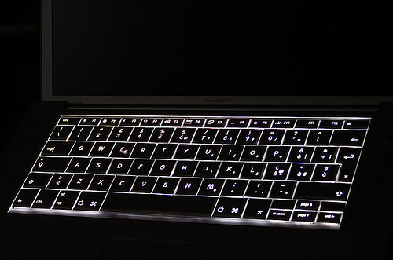
“I just type it into Google and see what comes up.” (UKS2)

Slide 29
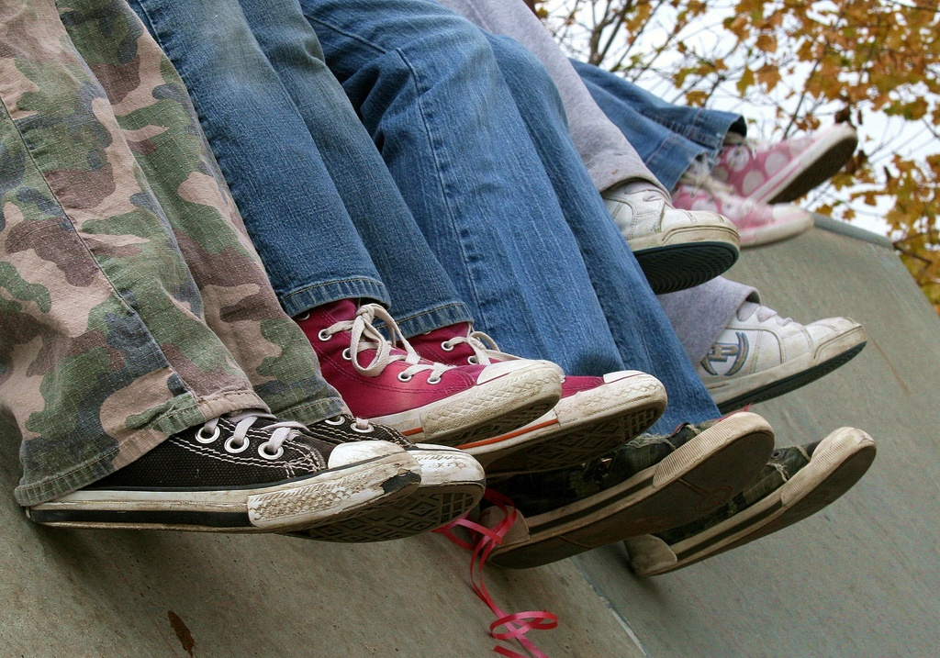
“I always stick with the first thing that comes up on Google because I think that’s the most popular site which means that’s the most correct.” (USS1)

Slide 30

“I knew that the internet wouldn’t give me a wrong answer.” (UKS4)

Slide 31

“I simply just type it into Google and just see what comes up.” (UKS4)

Slide 32
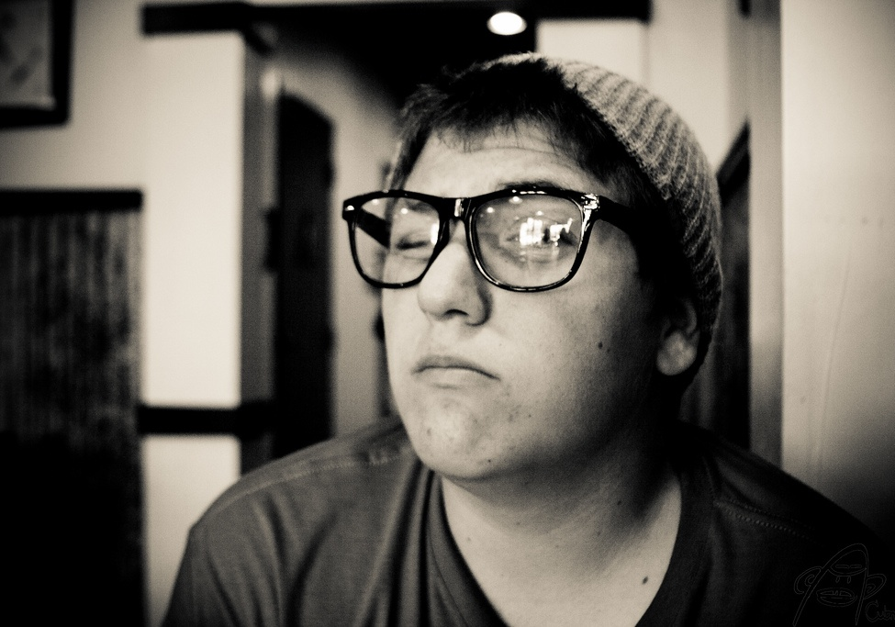
“Google doesn’t judge me” (UKF3)

Slide 33
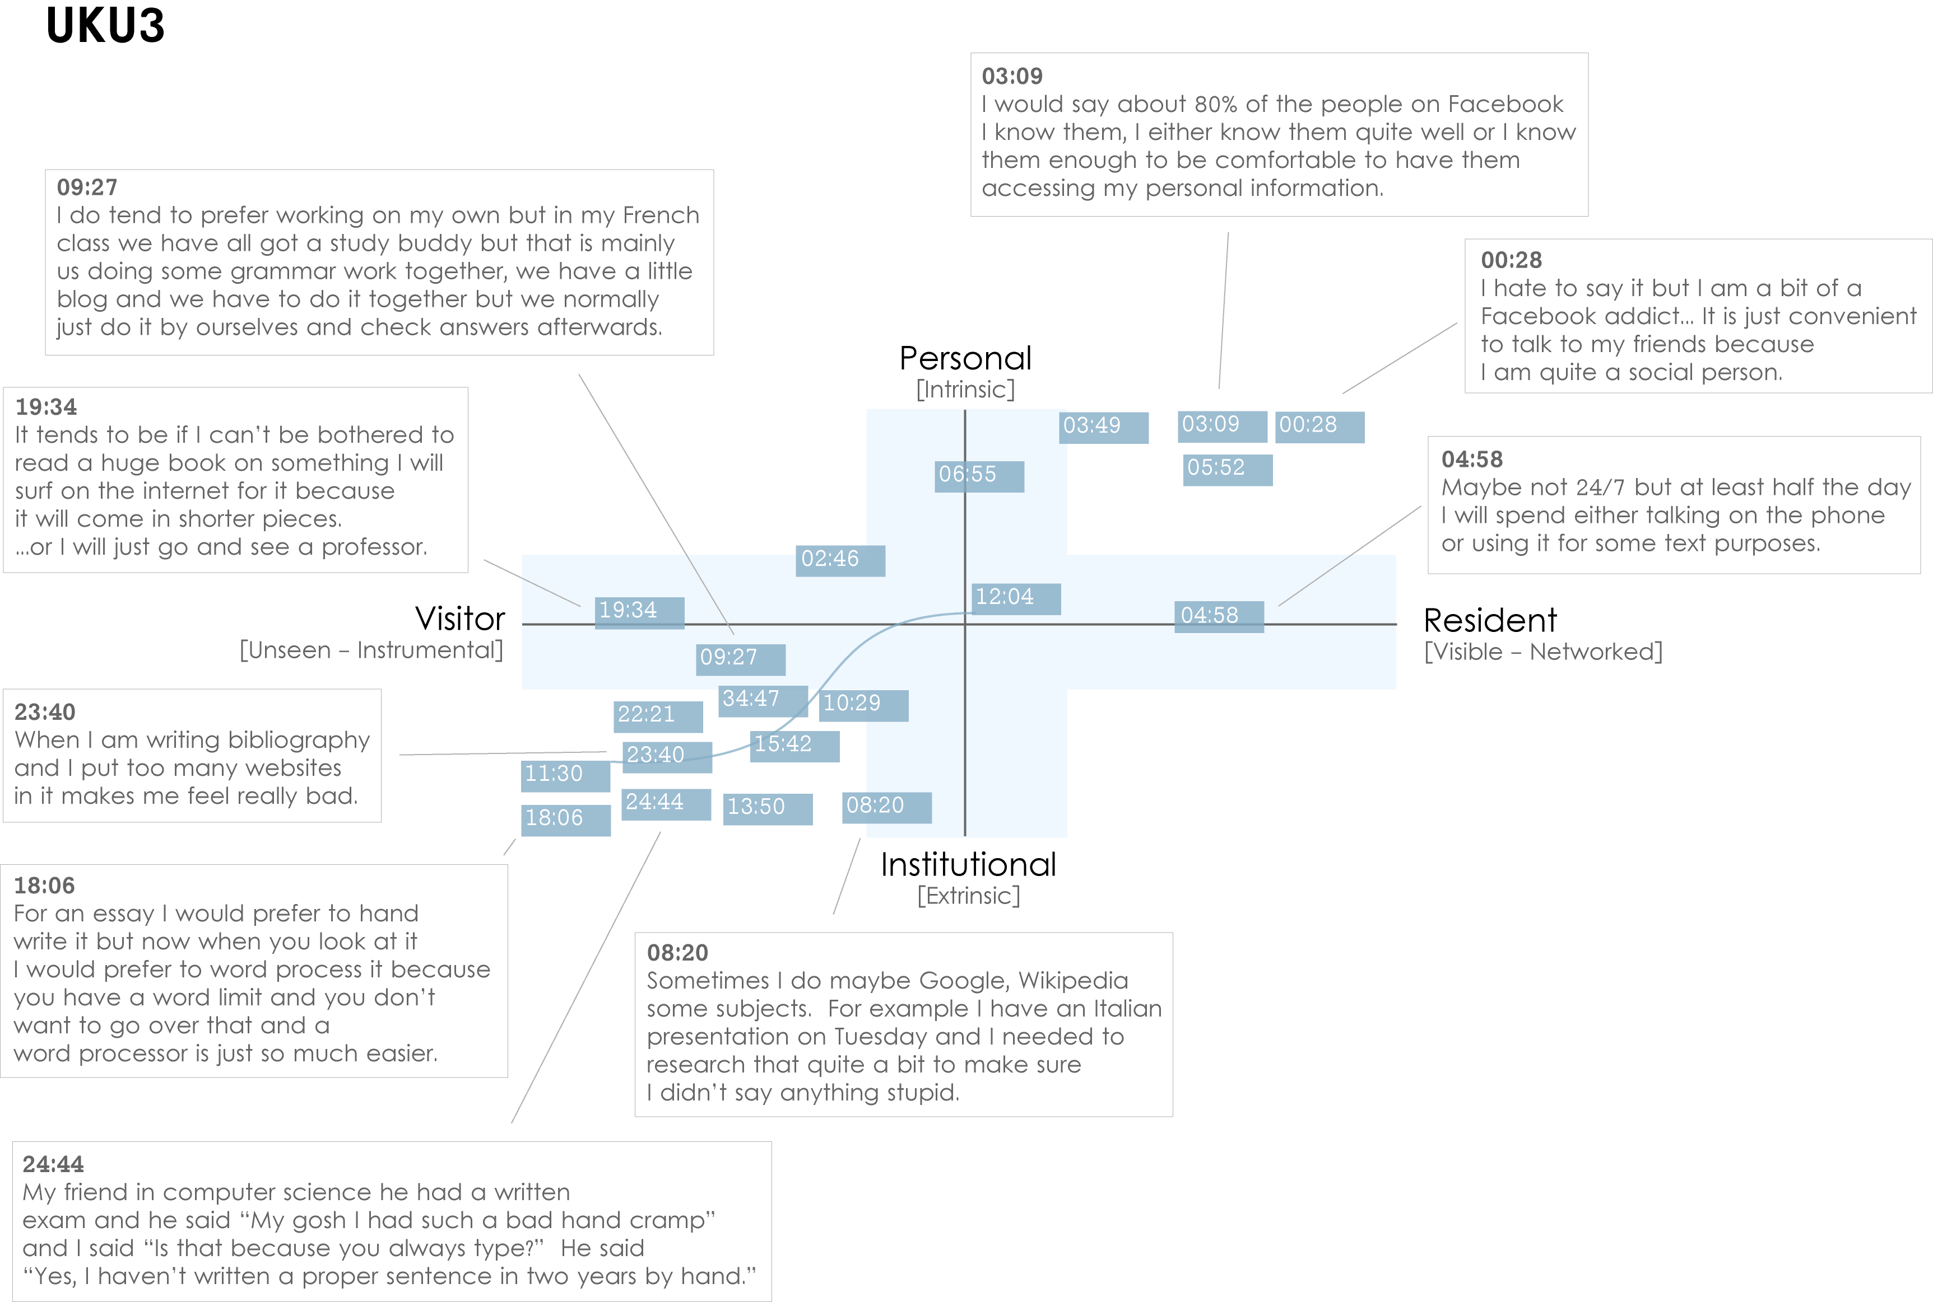
Notes:
UKU3 (UK 1st year undergraduate)
This participant has a clear demarcation between Resident modes of engagement in her personal life and Visitor modes of engagement for study.
The map is a mode of engagement landscape onto which individuals can be plotted. The limits of the map have been defined by the four major framing concepts of the project: V&R – Personal and Institutional. The Personal end of the axis encompasses an individual’s private life, and the Institutional is their professional and/or academic life.
The data from the Emerging educational stage seem to suggest that individuals were engaging with systems and materials not provided by their institutions to do institutional work (e.g., consulting Wikipedia to write an essay). Such user-owned literacies, when mapped as below, take a prominent role in the academic work of many of our research subjects. Given the effect that the internet is having on collapsing the relationship between certain modes of activity and specific physical spaces, it is important not to tie notions of the intuitional and the personal to ideas of “school/university/library” and “home” as buildings.

Slide 34
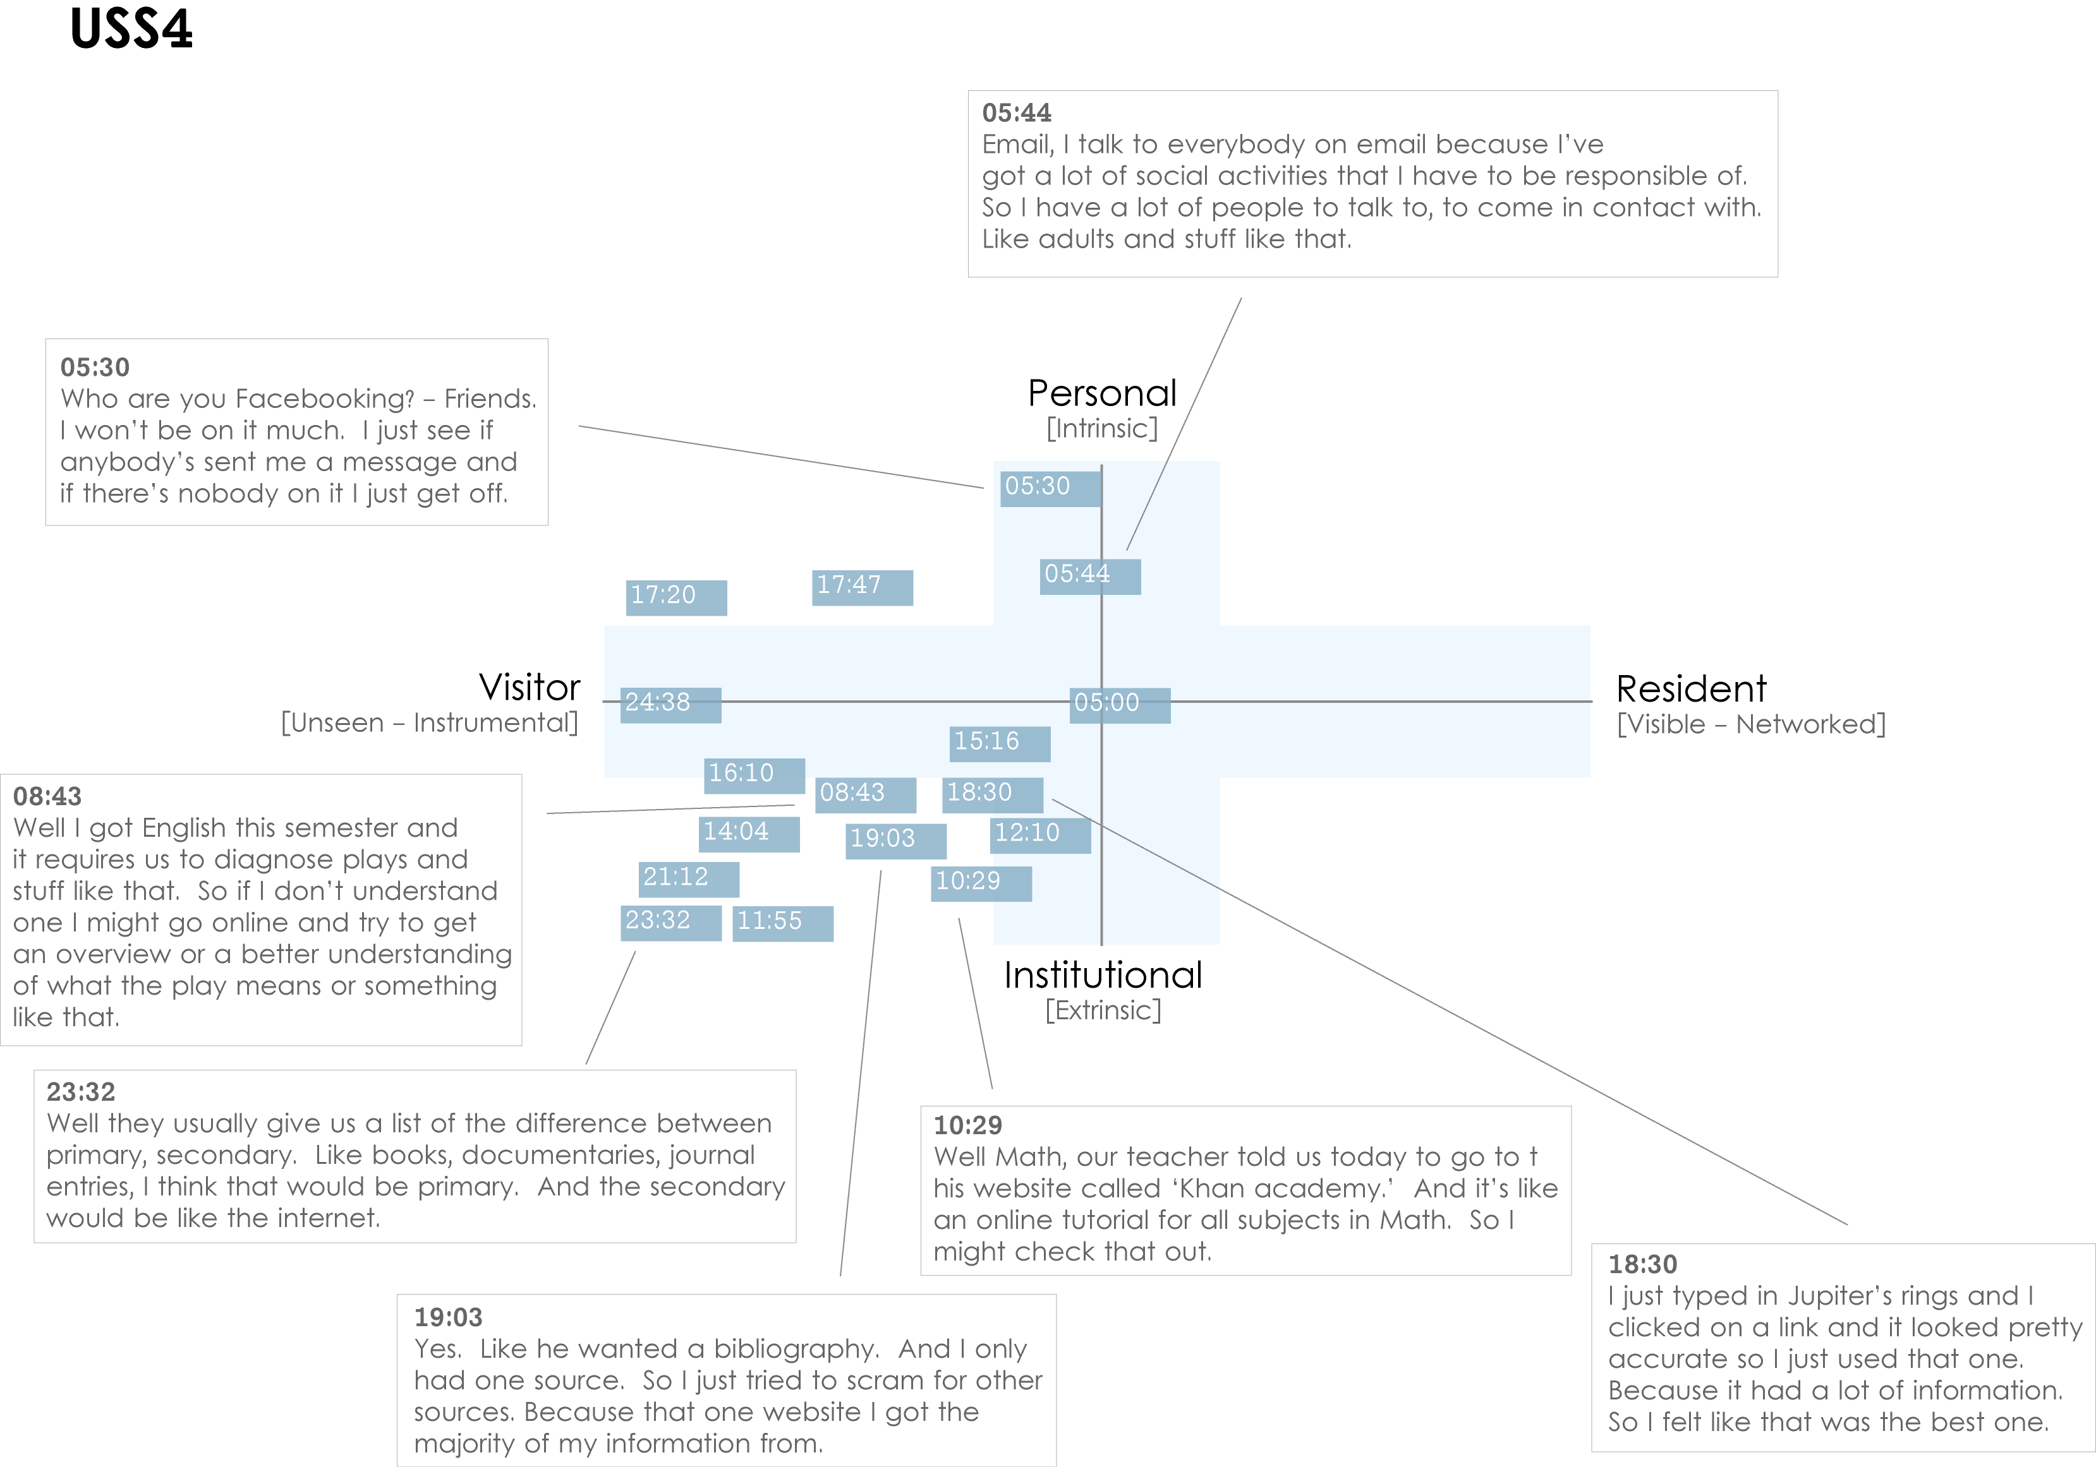
Notes:
USS4 (US high-school student)
This is an example of a participant who is predominantly engaging in a Visitor mode. The quotes illustrate that he does use the web regularly for his studies, but is not interested in being “visible” online.
The distinction between internal and external motivation can quickly become complicated. However, attempting to define why individuals engage with particular kinds of information can help identify substantive and relevant issues. For instance, the difference between the personal and the institutional diminishes as individuals become increasingly embedded in academic contexts. This convergence would be representative of the process of “becoming” an expert in a given discipline, and in the shift from predominantly consuming to constructing knowledge.
The numbers on the dark blue blocks represent the time-code point in the interview at which the participant discussed an activity or approach.

Slide 35
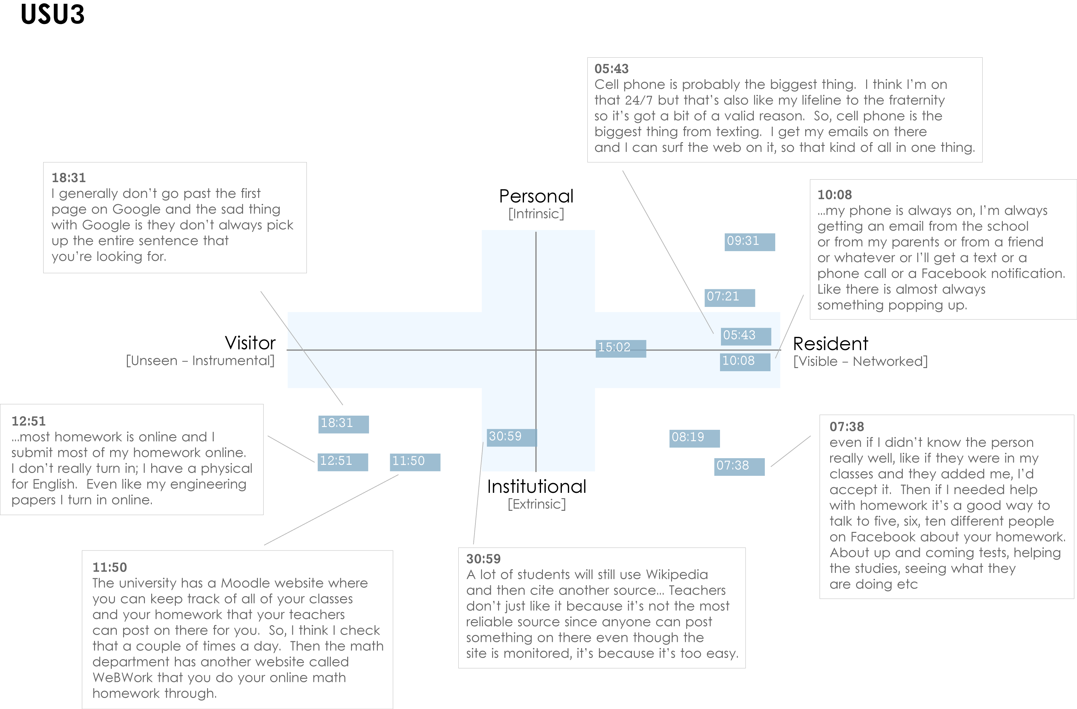
Notes:
USU3 (US 1st year undergraduate)
This participant is highly Resident, connected to friends, family and study related matters “24/7” via a smartphone. His willingness to “friend” fellow students with a view to discussing assignments in Facebook is the main form of activity that takes place in the Resident/Institutional quadrant. This tends to be the only activity that takes place in this quadrant amongst participants from the Emerging educational-stage.
It should be possible to plot our code book onto the map, which would provide the ability to automatically plot coded data from individuals or groups. For example, Extrinsic and Intrinsic motives have been coded in NVivo, which map directly to the vertical axis (Personal/Institutional). Other codes can be identified as more Resident in nature: “Visible messaging,” “Media posting,” “Connection: sharing with others;” or as more Visitor in nature: “Searching,” “Email,” “Word processing.”

Slide 36



Phase 2
Continued interviews
  Establishing (2nd-3rd year undergraduates)
  Embedding (postgraduates, PhD students)
  Experienced (scholars)
Began data analysis

Slide 37


Phase 2
30 participants
  -15 in the US
  -15 in the UK
  -10 Establishing (5 US, 5 UK)
  -10 Embedding (5 US, 5 UK)
  -10 Experienced (5 US, 5 UK)
Diary submissions via Google Docs
Video-diary submissions via Vimeo
Notes:
Phase 2, the researchers provided a Google doc form to make diary submission easier and they also started to get video-diary submissions via Vimeo from at least one participant.
The diaries are a form of event sampling, which can focus participant attention on those areas which most interest researchers. Connaway and Powell (2010) point out that instruments (like diaries) that are intended to get people to describe what has just happened to them may be affected by distortions of memory and retrospection. They recommend that the question under review “center on discrete, defined events or moments so that such recording effort becomes reasonable and recall efforts are relatively straightforward” (Connaway and Powell 2010, 222).

Slide 38
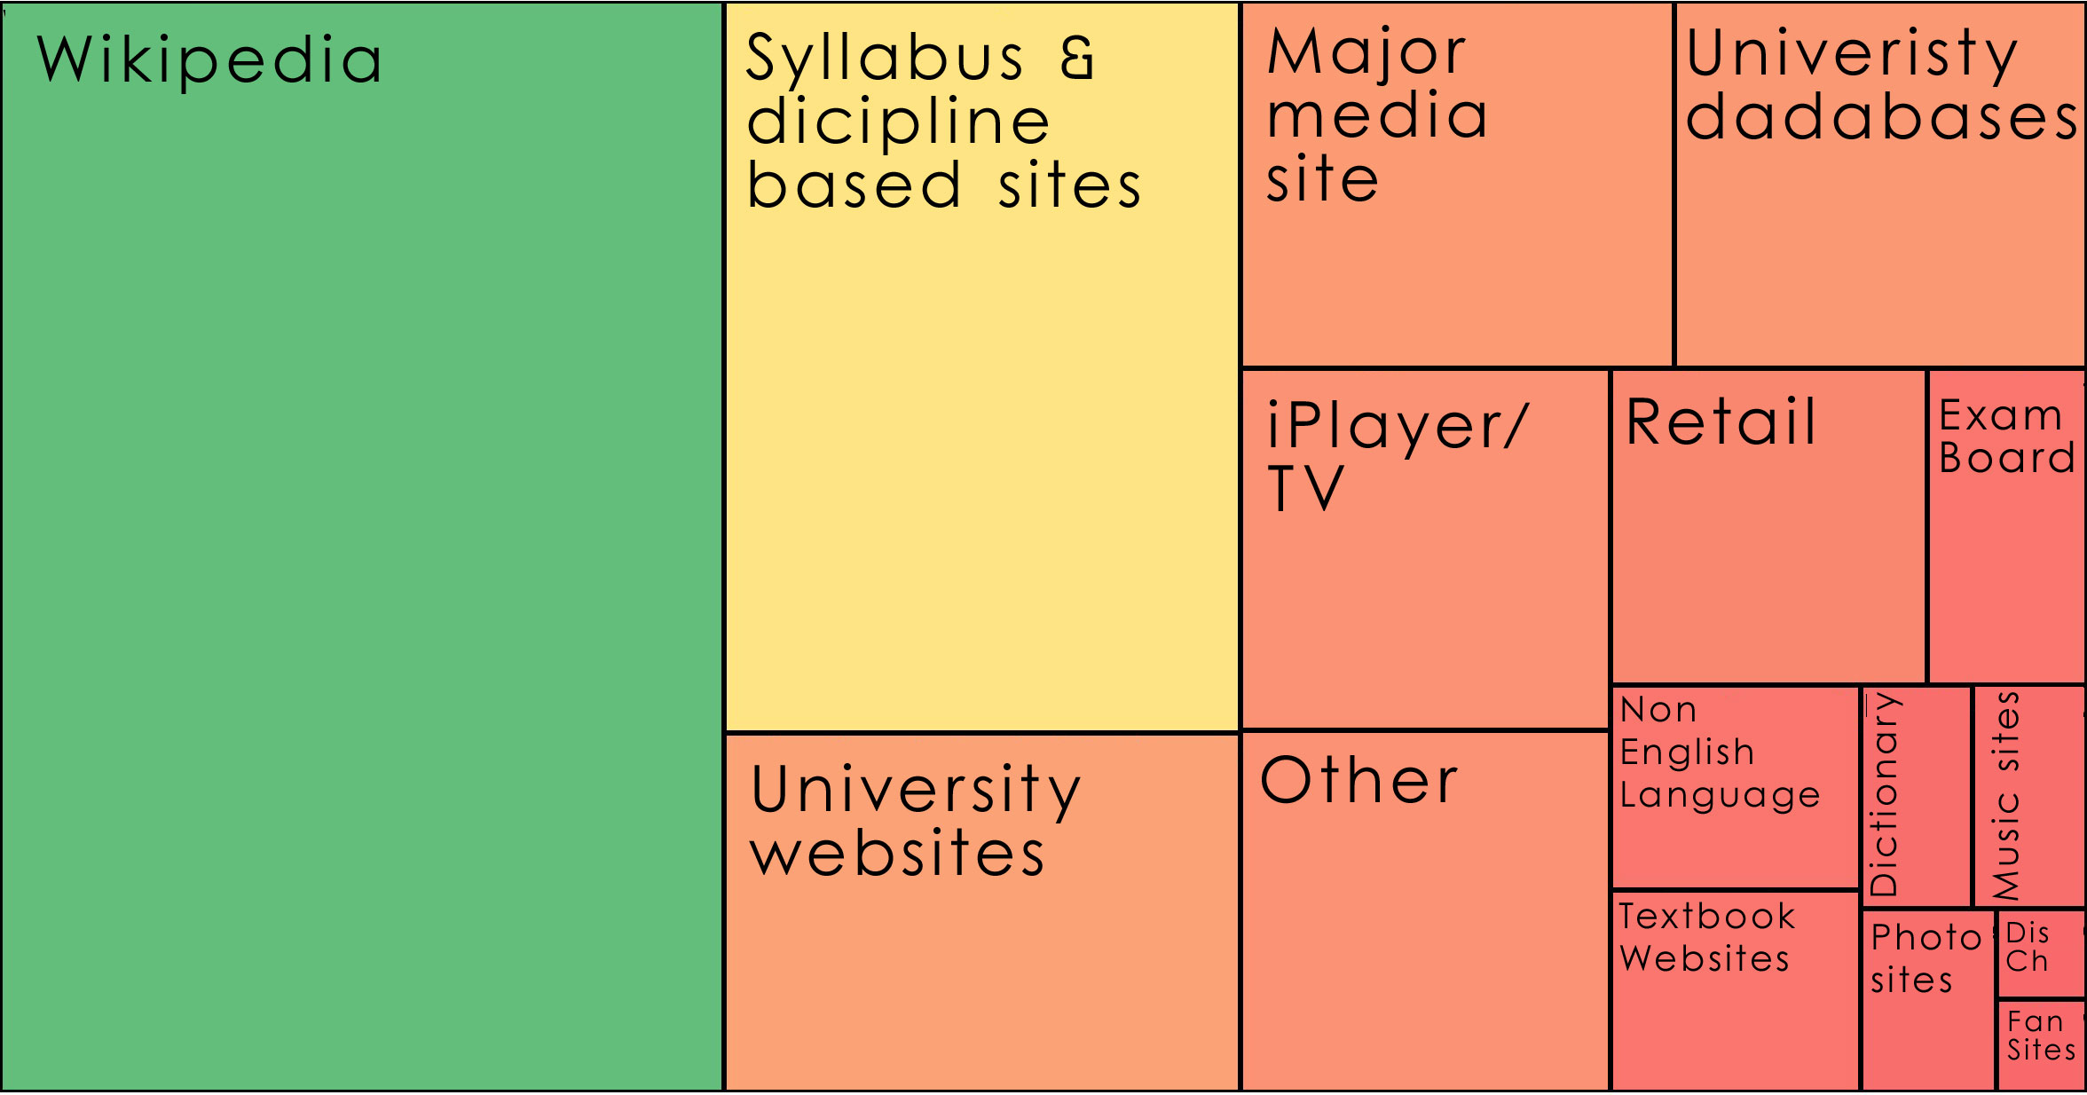
Sources
Notes:
Students’ Perceptions of Teachers’ opinions of Wikipedia:
“Avoid it.” (UKS8 0:28:28.3, Female Age 16)
“They used to tell us in high school not to use Wikipedia.” (USU1 0:34:59, Female Age 19)
“It’s like a taboo I guess with all teachers, they just all say – you know, when they explain the paper they always say, “Don’t use Wikipedia.”” (USU7 0:33:05, Female Age 19)
“They don’t fail you but you get ridiculed in front of everyone for sourcing Wikipedia.” (USS3 00:32:43, Female Age 17)
“They say it’s because anyone can make up – I mean, anyone can add information on there but I mean when I’ve actually looked into information it seemed the same as any information I find anywhere else. I mean, it’s not like if you look up fourth of July, it’s not like it gives you like some weird explanation of aliens or something.” (USU7 0:33:14, Female Age 19)
Students’ on Wikipedia:
“I use it, kind of like, I won't cite it on my papers but I, kind of, use it as a like, as a start off line. I go there and look up the general information, kind of, read through it so I get a general idea what it is. Then I start going through my research.” (USU7 0:33:49, Female Age 19)
“Everyone knows that you try not to use Wikipedia as a source because it is a cardinal sin.” (UKU3 0:31:03, Female Age 19)

Slide 39
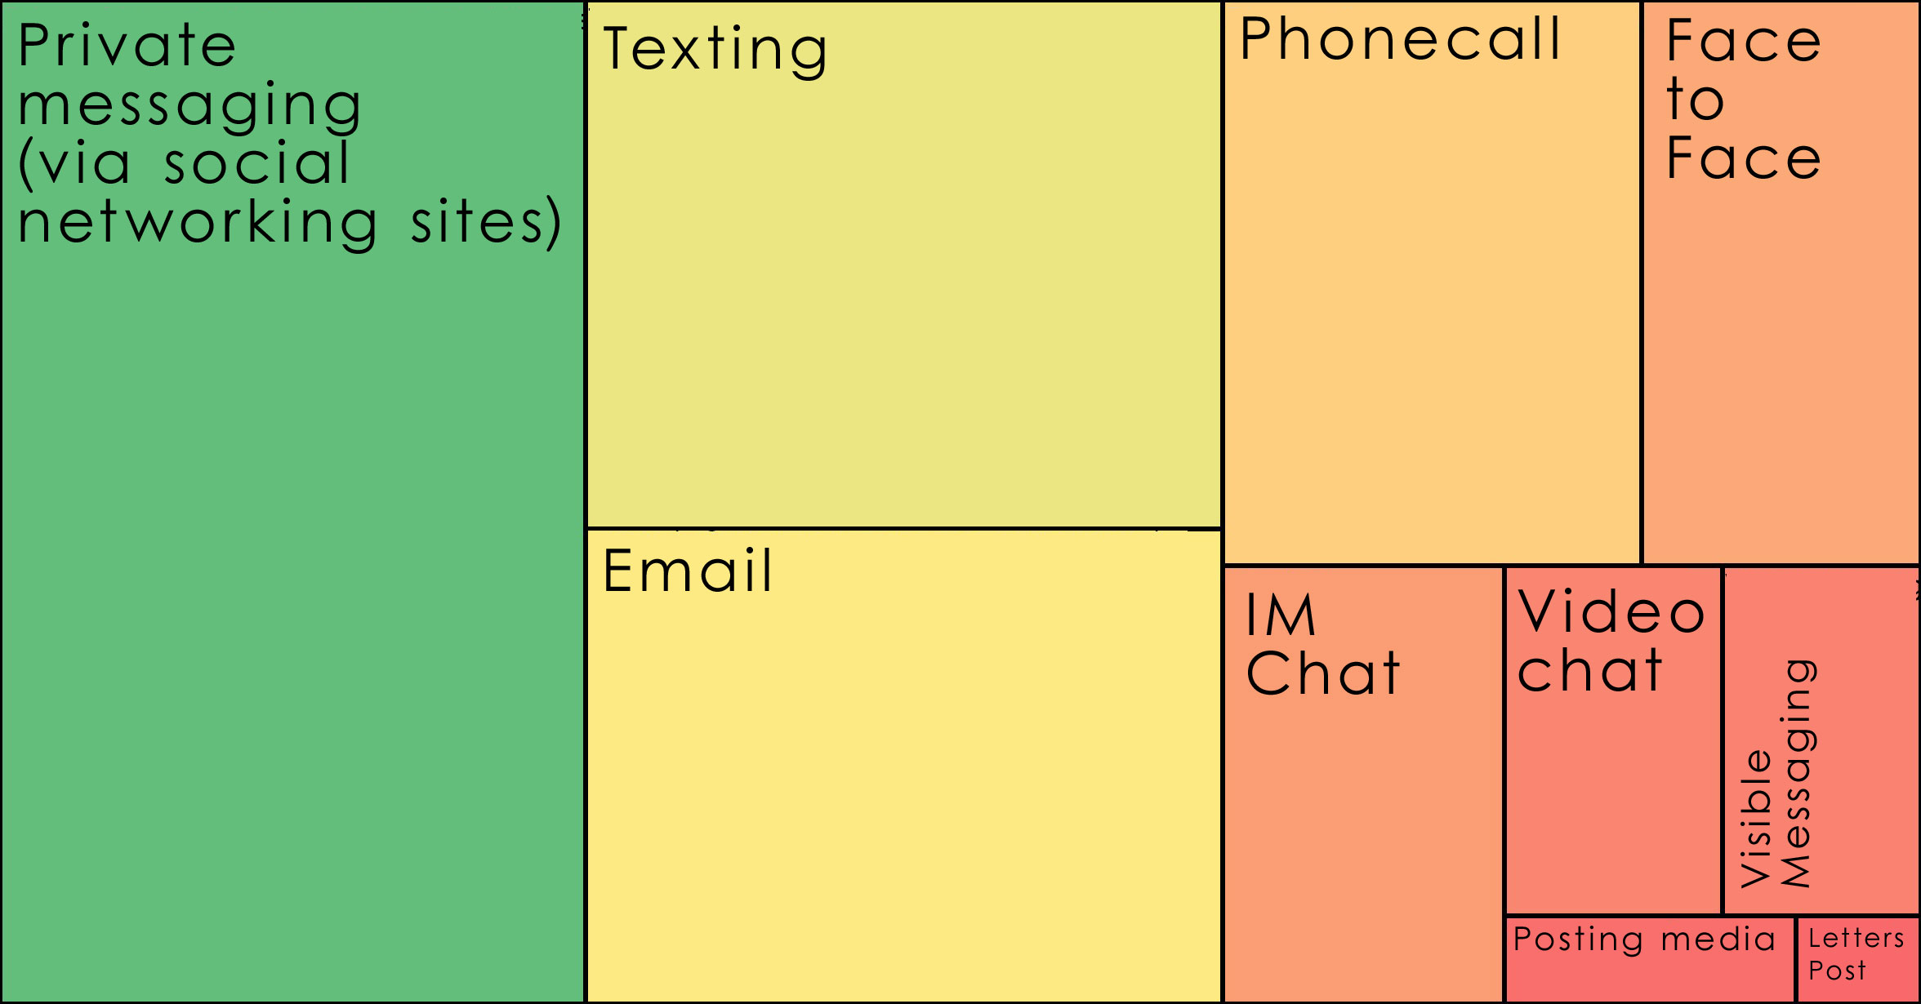
Contact
Notes:
Private Messaging
“I do do private messaging a fair amount because it’s easy and I can just keep in touch with people over Facebook for some reason, I have no idea why.” (UKS8 0:01:01.7, Female Age 16)
“Just because all my friends have it, it’s just an easy way to catch up and then, especially if I need some work to hand in for tomorrow, go and find out on Facebook, ask all my friends.” (UKS1 00:05:59, Male Age 18)
“…he was the only one who received it and the teacher told him to pass it on. And he sent a message to everyone in the calls on Facebook, so that helped.” (UKS1 00:12:22, Male Age 18)
Texting
“I do use texting a lot more than calling on the phone.” (USU1 0:05:59, Female Age 19)
“I don’t really talk that much on the phone. I just text a lot.” (USS4 00:06:59, Male Age 17)

Slide 40
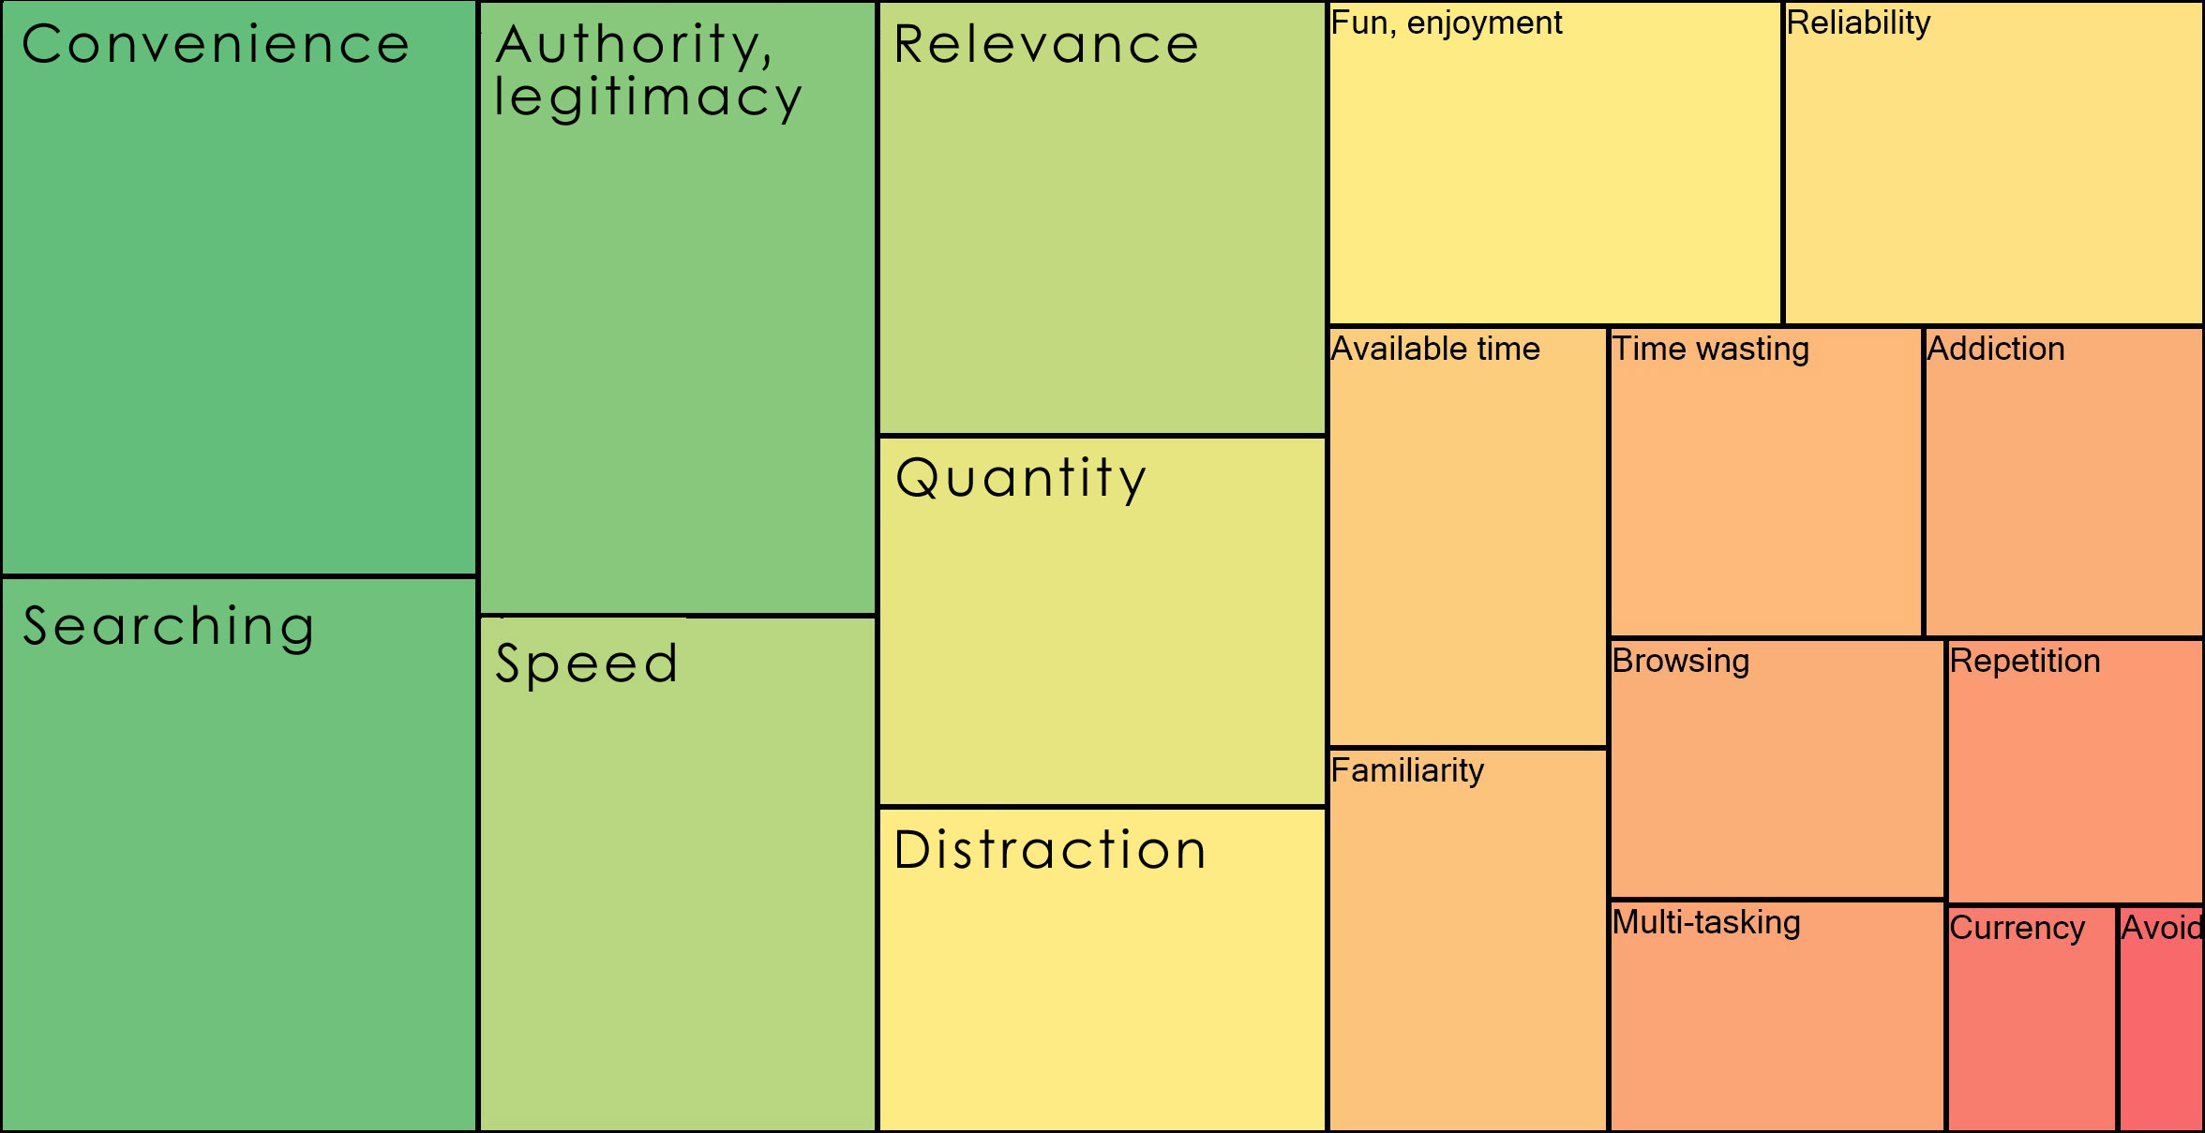
Agency
Notes:
“Well I probably actually use these things on emails because it’s an incredibly easy and quick way of getting information.” (UKS8 0:04:36.8, Female Age 16)
Wikipedia
“I just thought, because it was the easiest thing to do there and then, and I didn’t have a lot of time and I just though Wikipedia would be the best option.” (UKS1 00:16:49, Male Age 18)
“Probably not the best, but I think it’s the simplest and easiest way to get going. So if I needed to produce a much more detailed and developed essay I would probably explore further on the internet.” (UKS1 00:17:52, Male Age 18)

Slide 41
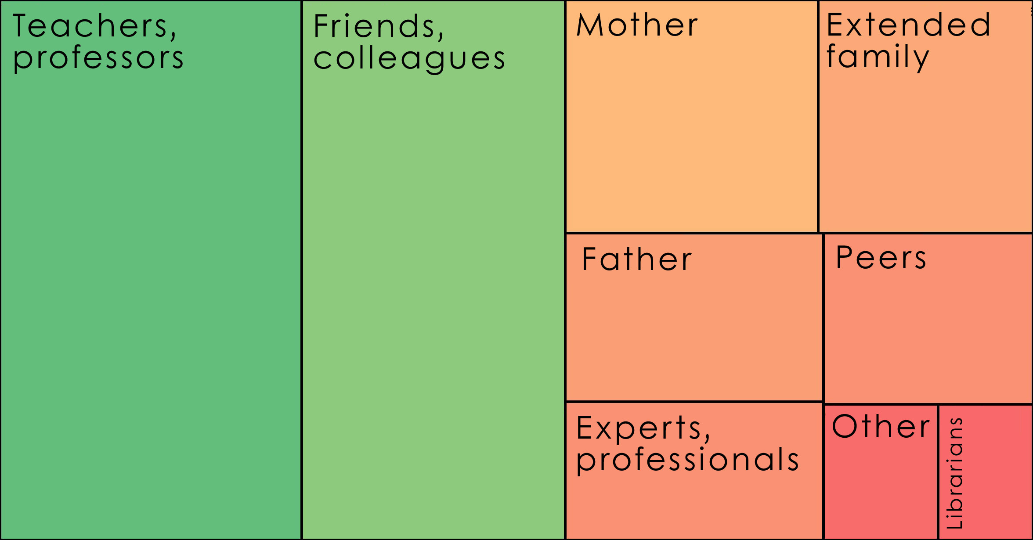
People
Notes:
“One of my favourite ways of getting information is by asking people. Instead of Googling the whole time I mostly have faith in the fact that people are actually learning, if I can go to a tutor and ask them something.” (UKU3 0:19:34, Female Age 19)

Slide 42

Conclusion
Understanding users’ motivation
  Inform librarians of users’ expectations of services & systems
  Enable educators & service providers to make informed decisions
  Position the role of the library within the workflows & information-seeking patterns of students & faculty
  Influence design & delivery of digital platforms & services
  Investigate & describe user-owned digital literacies

Slide 43
Selected Readings
Beetham, Helen, Lou McGill, and Allison Littlejohn. 2009. Thriving in the 21st century: Learning literacies for the digital age (LLiDA Project). Glasgow: The Caledonian Academy, Glasgow Caledonian University. http://www.academy.gcal.ac.uk/llida/LLiDAReportJune2009.pdf.
Bullen, Mark, Tannis Morgan, and Adnan Qayyum. 2011. Digital learners in higher education: Generation is not the issue. Canadian Journal of Learning and Technology 37, no. 1 (Spring), http://www.cjlt.ca/index.php/cjlt/article/view/550/298.
Centre for Information Behaviour and the Evaluation of Research. 2008. Information behaviour of the researcher of the future: A CIBER briefing paper. London: CIBER. http://www.jisc.ac.uk/media/documents/programmemes/reppres/gg_final_keynote_11012008.pdf.
Connaway, Lynn Silipigni, and Timothy J. Dickey. 2010. The digital information seeker: Report of the findings from selected OCLC, RIN, and JISC user behaviour projects. http://www.jisc.ac.uk/media/documents/publications/reports/2010/digitalinformationseekerreport.pdf.
Connaway, Lynn Silipigni, Timothy J. Dickey, and Marie L. Radford. 2011. “If it is too inconvenient I’m not going after it:” Convenience as a critical factor in information-seeking behaviors. Library & Information Science Research 33, no. 3: 179-90.

Slide 44
Selected Readings
Connaway, Lynn Silipigni, Donna Lanclos, David White, Alison Le Cornu, and Erin M. Hood. Forthcoming. User-centered decision making: A new model for developing academic library services and systems. IFLA 2012 Conference Proceedings, August 11-17, 2012, Helsinki, Finland.
Connaway, Lynn Silipigni, and Ronald R. Powell. 2010.Basic Research Methods for Librarians. Santa Barbara, CA: Libraries Unlimited.
Connaway, Lynn Silipigni, and Marie L. Radford. Seeking Synchronicity: Revelations and Recommendations for Virtual Reference. Dublin, OH: OCLC Research, 2011. http://www.oclc.org/reports/synchronicity/full.pdf.
Dempsey, Lorcan. 2010. 3 switches. Lorcan Dempsey’s Weblog (blog), June 13, 2010. http://orweblog.oclc.org/archives/002104.html.
Geertz, Clifford. 1973. The interpretation of cultures: Selected essays. New York: Basic Books, 6.
Glaser, Barney G., and Anselm L. Strauss. 1967. The discovery of grounded theory; strategies for qualitative research. Chicago: Aldine, 273.
Institute for Museums and Library Services Research Grant. Seeking Synchronicity: Evaluating Virtual Reference Services from User, Non-User, and Librarian Perspectives. Lynn Silipigni Connaway and Marie L. Radford, Rutgers University. Co-Principal Investigators. 2005-2007. http://www.oclc.org/research/activities/synchronicity/default.htm.

Slide 45
Selected Readings
Institute for Museums and Library Services Research Grant. Sense-making the Information Confluence: The Hows and the Whys of College and University User Satisficing of Information Needs. Brenda Dervin, Ohio State University, Principal Investigator; Lynn Silipigni Connaway and Chandra Prabha, Co-Investigators. 2003-2005.
Kvale, Steinar. 1996. InterViews: An introduction to qualitative research interviewing. Thousand Oaks, CA: Sage Publications, 133-135.
White, David and, Connaway, Lynn Silipigni. 2011. Visitors and Residents: What Motivates Engagement with the Digital Information Environment. Funded by JISC, OCLC, and Oxford University. http://www.oclc.org/research/activities/vandr/.
Whyte, William F. 1979. On making the most of participant observation. The American Sociologist 14: 56-66. http://www.oclc.org/research/activities/past/orprojects/imls/default.htm.

Slide 46
The researchers would like to thank Erin Hood for her assistance in keeping the team organized, analyzing the data, and disseminating the results.

Slide 47
Picture Credits
Introduction
http://www.vedupro.com/our_services.php
Ethnography
http://www.flickr.com/photos/insomnia90/3875374318/
Interviews
http://www.flickr.com/photos/myxi/4327438430/
Phase 1 Pilot stage: Months 1-6
http://www.flickr.com/photos/orangeacid/252090910
Phase I Participant Demographics
http://www.flickr.com/photos/doug88888/4570566630/
US vs. UK Participant University Majors
http://www.flickr.com/photos/kkoshy/2927378663/
Codebook
http://www.flickr.com/photos/themadguru/3546619930/
Diaries
http://www.flickr.com/photos/smemon/5167671844/
Phase 1 Data (Residents)
http://www.flickr.com/photos/nicocavallotto/363251198/

Slide 48
Picture Credits, cont.
Phase 1 Data, cont. (Guilty dog)
http://www.flickr.com/photos/59262640@N00/61264743/
Phase 2 Data (Google docs)
http://sites.fcps.org/trt/google_docs
Phase 2 Data (Vimeo)
http://filmfwd.com/tag/vimeo/
“I just type it into Google and see what comes up.” (UKS2)
http://www.flickr.com/photos/flod/26083507/
“I always stick with the first...” (USS1)
http://www.flickr.com/photos/pinksherbet/2001899627/
“I knew that the internet wouldn’t give me a wrong answer.” (UKS4)
http://www.flickr.com/photos/ravages/236981527/
“I simply just type it into Google and just see what comes up.” (UKS4)
http://www.flickr.com/photos/ana_cotta/2532911186/
“Google doesn’t judge me” (UKF3)
http://www.flickr.com/photos/cubmundo/6184306158/

