Slide 1
Print Management at ‘Mega’-scale
NITLE Shared Academics » Future of Libraries - 20 February 2013
NITLE Collections in a Mega-regional framework
Brian Lavoie
Constance Malpas
OCLC Research

Slide 2
Roadmap
The future of print management
Mega-regions and cooperative print management
System-wide perspective on NITLE libraries
Implications & takeaways
Discussion

Slide 3
Print Management: Future Strategies
NITLE Collections in a Mega-regional framework

Slide 4
Background: The future of print collection management
Opportunity cost:
Declining use of print collections (OCLC/Ohio Link study); ever-expanding array of digital alternatives
Resources supporting print needed for new service priorities
Reduce cost of print collections while leveraging more value from legacy print investment. Contours of a solution?
Print resource as a shared asset managed cooperatively
Regions are attractive scale for this cooperation
OCLC Research: “Cloud-Sourcing Research Collections”
ARL libraries: growing overlap with Hathi Trust, most of which widely held
Significant opportunity for collaboration in print management

Slide 5
Print Management at “Mega-scale”
NITLE Collections in a Mega-regional framework

Slide 6
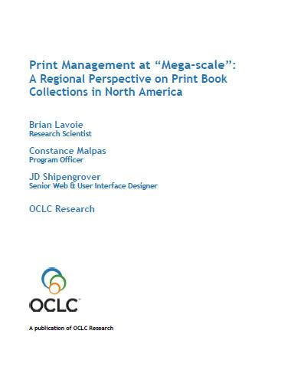
Print Management at “Mega-Scale”
OCLC Research report: characteristics and implications of a North American network of regional shared print book collections
Many current discussions around cooperative shared print organized at regional scale
Regional framework operationalized using mega-region concept
Not prescriptive: one model among many
www.oclc.org/research/publications/library/2012/2012-05.pdf

Slide 7
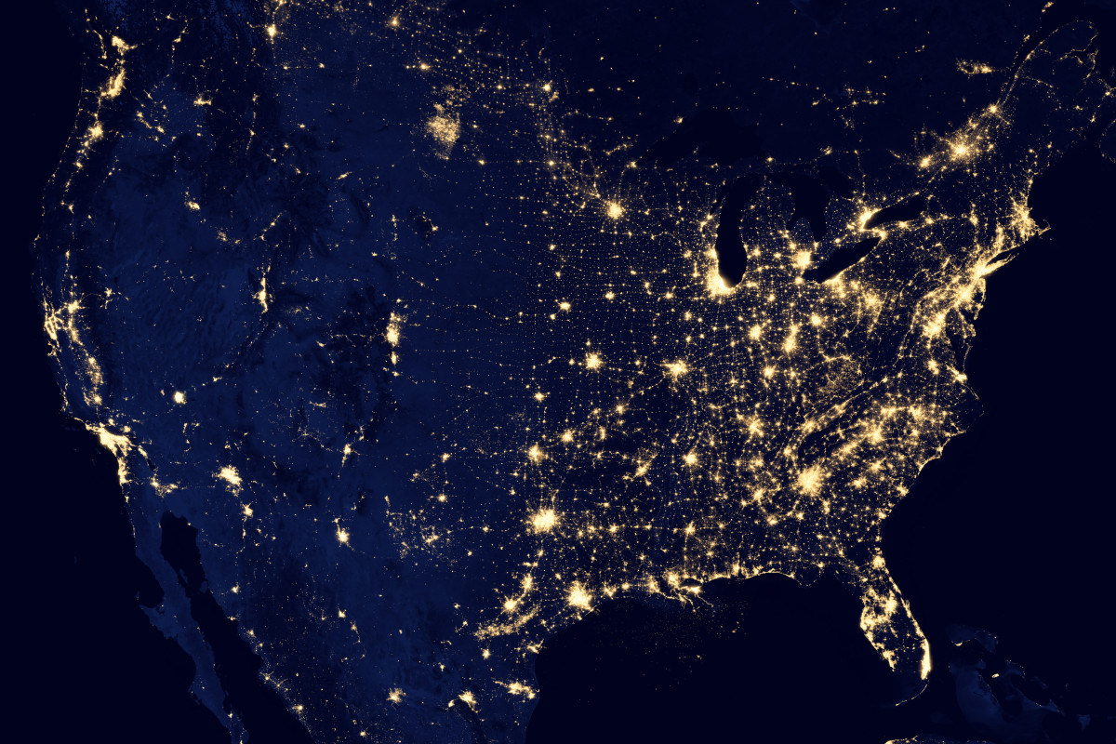
Mega-regions
Geographic area defined by high level of economic
integration, underpinned by robust supporting
infrastructure (transportation, logistics, etc.)
“Lights from space” definition (Richard Florida et al.)
In some respects, a
“natural” unit of analysis?

Slide 8
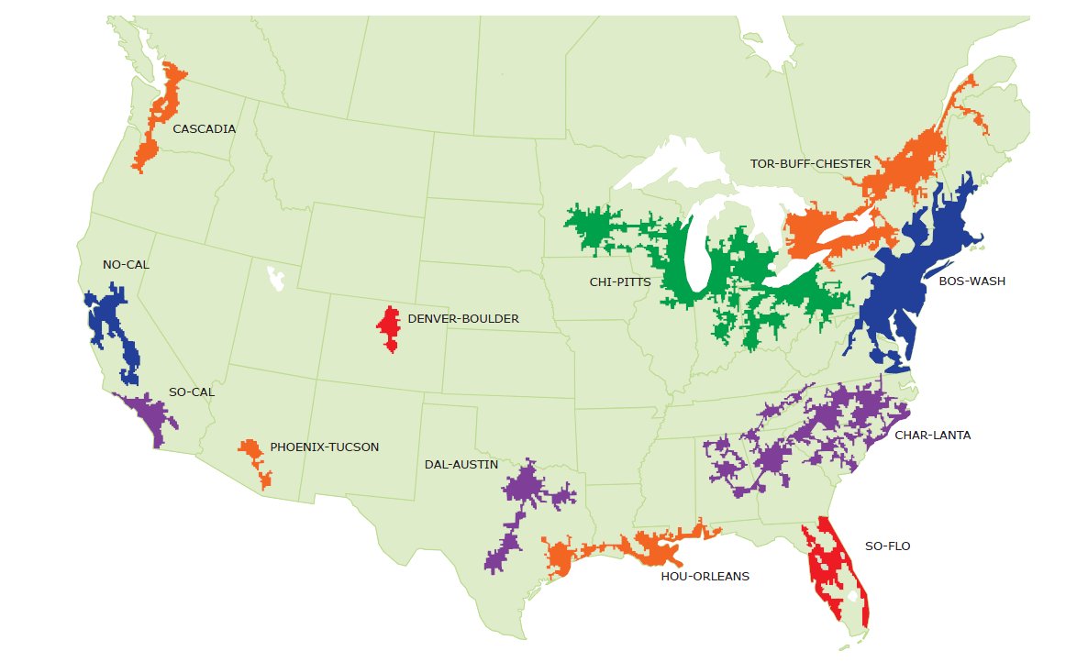
North American Mega-regions
OCLC Research, 2013

Slide 9
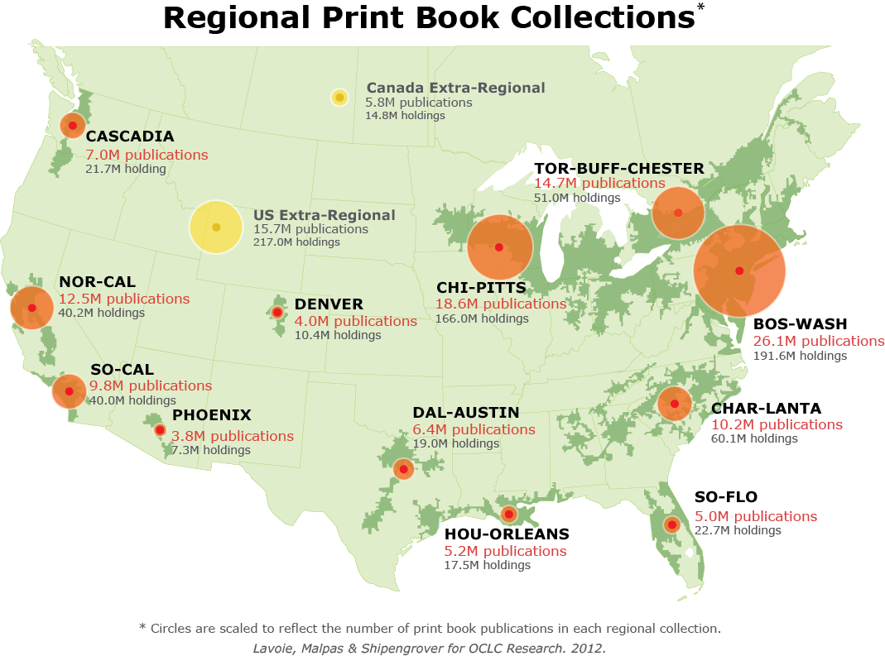
North American print book resource:
45.7 million distinct publications
889.5 million total library holdings
OCLC Research, 2013

Slide 10
Regional coverage of the North American print book resource
BOS-WASH | 57 %
CHI-PITTS | 41 %
TOR-BUFF-CHESTER | 32 %
NOR-CAL | 27 %
CHAR-LANTA | 22 %
SO-CAL | 21 %
CASCADIA | 15 %
DAL-AUSTIN | 14 %
HOU-ORLEANS | 11 %
SO-FLO | 11 %
DENVER | 9 %
PHOENIX | 8 %
OCLC Research, 2013

Slide 11
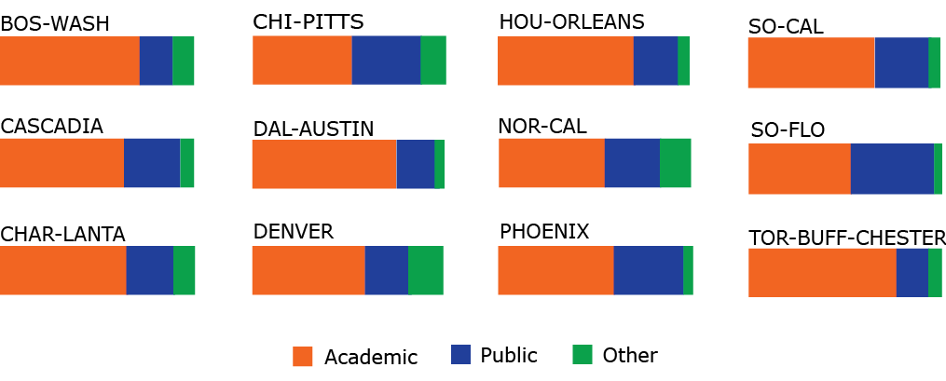
Share of regional print book holdings, by institution type
OCLC Research, 2013

Slide 12
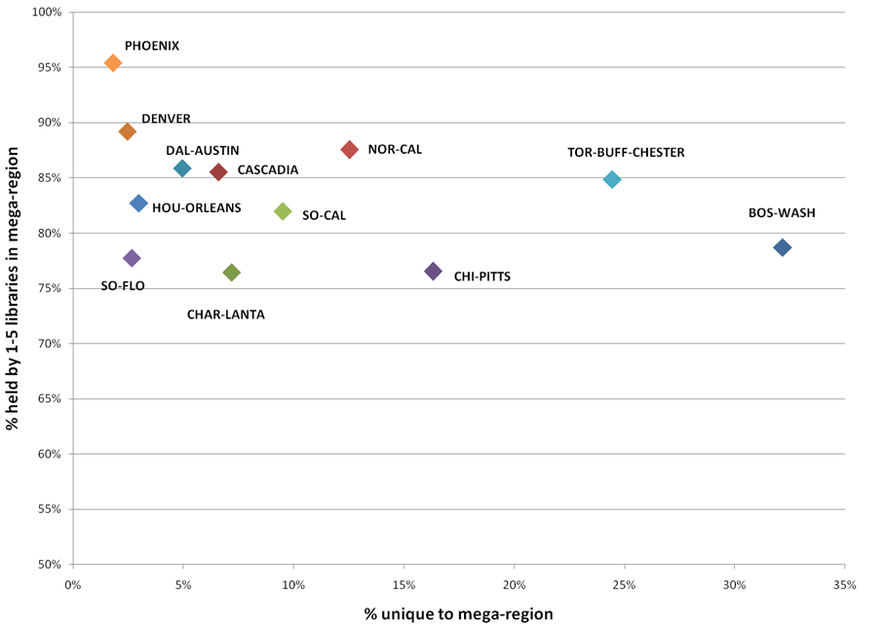
Rareness is common
OCLC Research, 2013

Slide 13
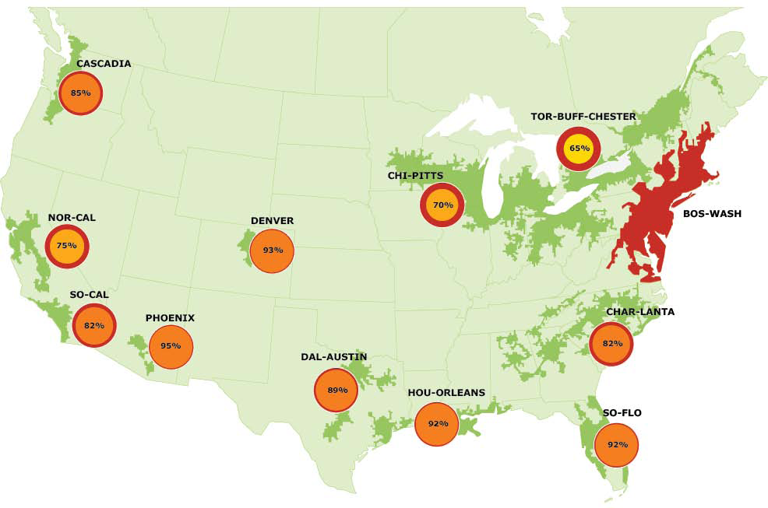
Overlap with BOS-WASH, by region
OCLC Research, 2013

Slide 14
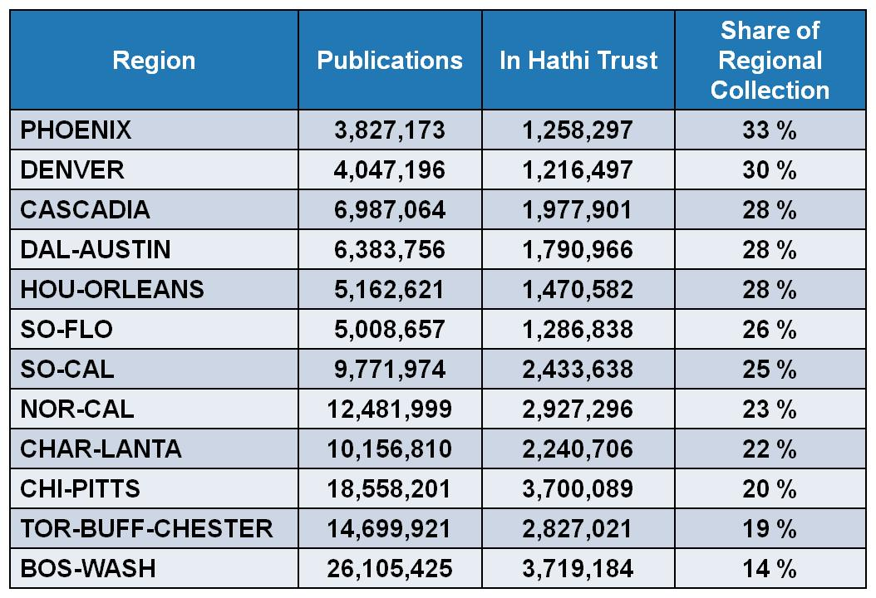
HathiTrust coverage of regional print book collections
OCLC Research, 2013

Slide 15
A System-wide Perspective on NITLE Libraries
NITLE Collections in a Mega-regional framework

Slide 16
34% of NITLE libraries with zero or negative growth in holdings between Jan 2011 and Jan 2012
OCLC Research, 2013

Slide 17
Based on average WorldCat holdings distribution for 122 NITLE libraries
OCLC Research, 2013

Slide 18
NITLE members in HathiTrust partnership = 4
contributing content = 2
OCLC Research, 2013

Slide 19
Liberal arts college libraries in perspective
Individual NITLE library collections
are comparatively small
and growing relatively s l o w l y
some appear to be shrinking
Much of the content held in NITLE libraries
is widely duplicated in other libraries
and shared digital repositories
How can NITLE members leverage collective library investment?
What is the role of cooperative infrastructure in the future of liberal arts college libraries?

Slide 20
Sourcing and Scaling: Stewardship of Print Books
NITLE Collections in a Mega-regional framework

Slide 21
NITLE Libraries as a collective resource: print books
122 NITLE libraries (holding symbols)
9,233,838 print book titles in NITLE collective collection
Represents 20% of print book titles in North America
38,577,725 print book holdings in NITLE libraries
Average NITLE holdings per print book title: <5
Scope and scale insufficient to secure long-term preservation of collective resource

Slide 22
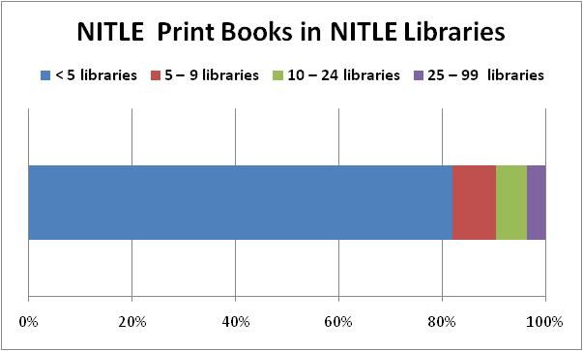
Scale matters: assessing print preservation risks
“rareness is common”
>80% of print books in NITLE collective collection are held by fewer than 5 libraries in the group
N = 9.23M titles (manifestations)
OCLC Research, 2013

Slide 23
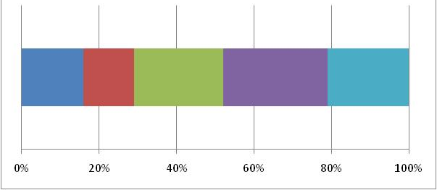
Scale matters: assessing print preservation risks
>80% of print books in NITLE collective collection are held by fewer than 5 libraries in group
~15% of print books in NITLE collective collection are held by fewer than 5 libraries in WorldCat
N = 9.23M titles (manifestations)
OCLC Research, 2013

Slide 24
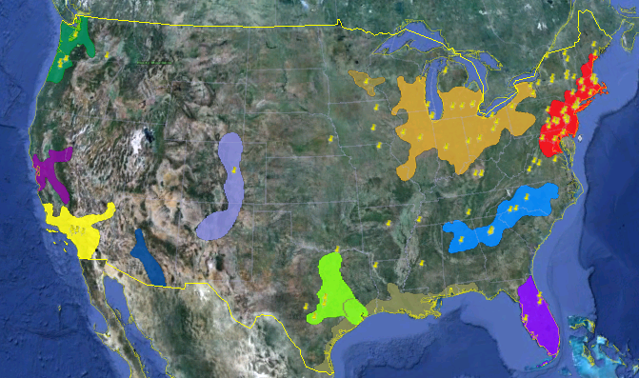
A Mega-regional Perspective on NITLE Libraries
>120 NITLE members distributed across 9 mega-regions
31% of NITLE libraries
93% of NITLE print book titles
45% of NITLE print book holdings
Source: Sean Johnson Andrews, NITLE

Slide 25
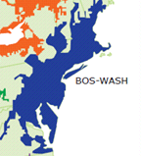
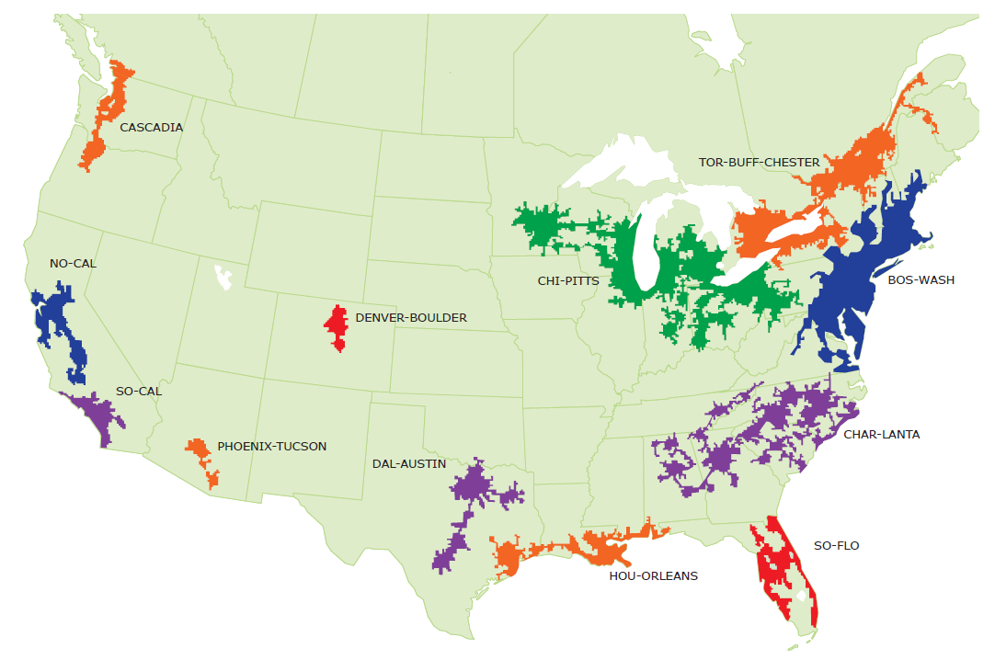
Bos-Wash
Largest collection by scope (titles)
Largest collection by size (holdings)
Fragmented cooperative infrastructure
OCLC Research, 2013

Slide 26
Print Books in Bos-Wash Libraries
Bos-Wash
Regional print book collection
26,105,425 discrete titles
21,160,220 discrete works
1.23 manifestations per work on average
191,574,175 holdings in Bos-Wash libraries
7.34 holdings per title on average
Median age: 34 (i.e. published 1977)
= 57% of titles (22% of holdings) in North American print book collection
including more than 8M titles unique to Bos-Wash
OCLC Research, 2013

Slide 27
‘Density’ of print book holdings in Bos-Wash
Bos-Wash
Majority of titles held by <5 libraries in region
75%
N = 26.1M titles
OCLC Research, 2013

Slide 28
In sum: supply-side view of regional resource
Evidence
Bos-Wash print book collection is the largest regional collection in North America
Bos-Wash library holdings provide coverage for nearly 60% of print book titles in North America
OPINION
A preservation strategy that recognizes inter-regional dependencies will maximize benefit
Need to coordinate regional management plan with other North American partners to ensure coverage
Long-term preservation of the Bos-Wash print book resource should be viewed as a collective preservation priority
Bos-Wash resource duplicates 93% of print books in NITLE libraries

Slide 29
Regional stewardship: institutional infrastructure
Bos-Wash
>4K libraries (holding symbols) in WorldCat
Type | Percent Bos-Wash library population
School libraries | 33%
Special libraries | 19%
Non-ARL academic libraries | 17%
Public libraries | 14%
Other | 13%
ARL libraries | 4%
*
(
)
*
*
Institutions with stewardship mandate and preservation capacity
OCLC Research, 2013

Slide 30
Distribution of Bos-Wash Print Books by Holding Library Type
Bos-Wash
Majority of holdings are managed in academic libraries
N = 192M holdings
OCLC Research, 2013

Slide 31
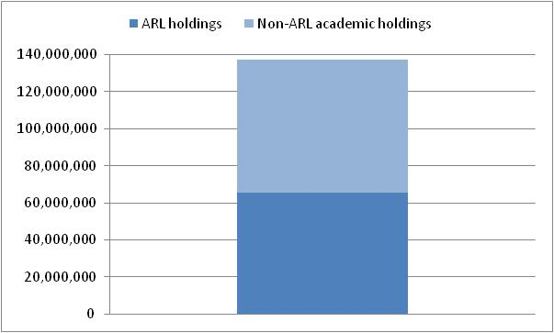
Distribution of Bos-Wash Print Books in Academic Libraries
Bos-Wash
… mostly non-ARL libraries
37%
of Bos-Wash holdings
Institutional responsibility for stewardship of scholarly record is shifting
34%
of Bos-Wash holdings
N = 137M holdings in Bos-Wash academic libraries
OCLC Research, 2013

Slide 32
In sum: institutional stewardship
Evidence
Nearly 3/4s of the Bos-Wash print book collection is held by academic libraries
Many are non-ARL institutions with limited preservation capacity or mandate
OPINION
As mid-tier HEI seek to adapt to competitive e-learning environment, local investment in print management is likely to decline; external cooperative or commercial strategies will be increasingly attractive to academic administrators
Unrealistic to imagine that a handful of ARL institutions can assume stewardship responsibility for regional print book resource
NITLE libraries have an important role to play

Slide 33
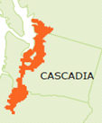
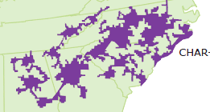
Mega-regional stewardship: cooperative infrastructure
9,233,838 print book titles in NITLE collective collection
Represents 20% of print book titles in North America
33% of print book titles in Bos-Wash
59% of print book titles in Cascadia
52% of print book titles in Char-lanta
OCLC Research, 2013

Slide 34
Regional stewardship: cooperative infrastructure
Bos-Wash
~30% of NITLE members are located in the Bos-Wash mega-region
represents <1% of libraries in mega-region
accounts for 24% of print book titles (9% of holdings) in region
i.e., a monographic preservation program among 40 NITLE libraries would secure nearly a quarter of the regional print book resource
… alone holds 15% of titles in the Bos-Wash mega-region – but is it solely responsible for stewardship of this resource?
Cooperative infrastructure enables broader (re)distribution of stewardship
OCLC Research, 2013

Slide 35
Sourcing and scaling: where does NITLE fit?
What?
Collectively accounts for 20% of North American print book resource
Who?
Composed primarily of institutions with limited preservation capacity
How?
Relatively limited duplication within NITLE membership
Membership distributed across North America
Where?
concentrated in existing mega-regions
Optimal scale of collaboration will depend on relative efficiency gains:
e.g. 30% of membership provides 24% coverage of Bos-Wash print books
100% of membership provides 33% coverage of same collection
Why?
NITLE is part of a larger, interdependent eco-system

Slide 36
Shared Print increasingly organized at regional scale
Members participating in several regional efforts
Affirms collective imperative for long-term preservation and access

Slide 37
In conclusion
Liberal arts college libraries have a shared interest in long-term preservation of print book collections
Collectively, these institutions hold a significant part of the national print book resource
Stewardship efforts that leverage (mega-) regional infrastructure and inter-regional synergies will maximize efficient redistribution of preservation costs and benefits
NITLE can provide a voice for liberal arts college libraries in regional and national planning efforts by increasing awareness of distinctive value of its ‘shared library’

Slide 38
lavoie@oclc.org malpasc@oclc.org www.oclc.org/research/activities/megascale.html www.oclc.org/research/activities/sharedcollections.html
Comments or Questions?

