Slide 1
A Preliminary View of Data Reuse in the Zoological Community
CollectionsWeb Stakeholders Workshop, May 2-3, 2013, Washington, D.C.
Ixchel M. Faniel, Ph.D.
OCLC Research
fanieli@oclc.org

Slide 2
Institute for Museum and Library Services (IMLS) funded project led by Drs. Ixchel Faniel (PI) & Elizabeth Yakel (co-PI)
Studying the intersection between data reuse and digital preservation in three academic disciplines to identify how contextual information about the data that supports reuse can best be created and preserved.
Focuses on research data produced and used by quantitative social scientists, archaeologists, and zoologists.
The intended audiences of this project are researchers who use secondary data and the digital curators, digital repository managers, data center staff, and others who collect, manage, and store digital information.
For more information, please visit http://www.dipir.org

Slide 3
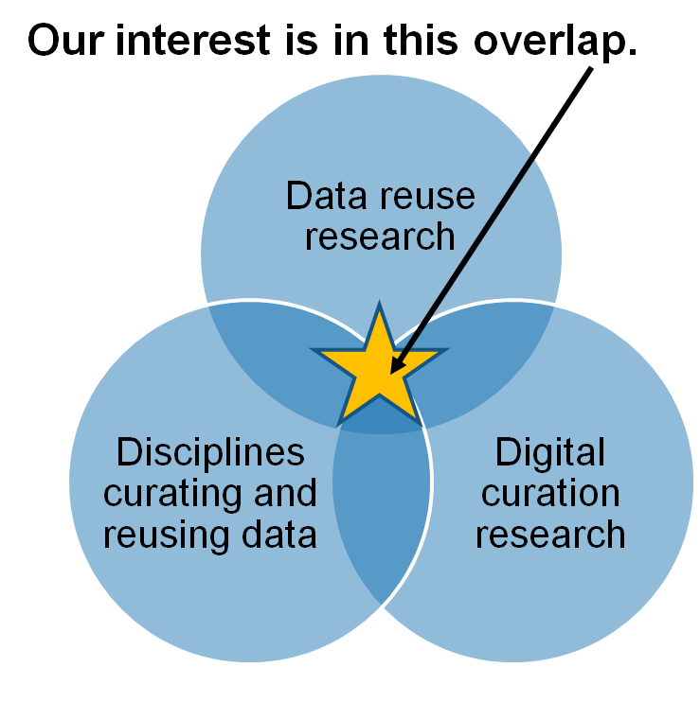
Research Motivations & Questions
What are the significant properties of quantitative social science, archaeological, and zoological data that facilitate reuse?
2. How can these significant properties be expressed as representation information to ensure the preservation of meaning and enable data reuse?
Faniel & Yakel 2011

Slide 4
The Research Team
DIPIR Project
Nancy McGovern
ICPSR/MIT
Ixchel Faniel
OCLC Research
(PI)
Eric Kansa Open Context
William Fink UM Museum of Zoology
Elizabeth Yakel University of Michigan (Co-PI)

Slide 5
Methods Overview
 | ICPSR | Open Context | UMMZ
Phase 1: Project Start up
Interviews Staff | 10 Winter 2011 | 4 Winter 2011 | 10 Spring 2011
Phase 2: Collecting and analyzing user data
Interviews data consumers | 44 Winter 2012 | 22 Winter 2012 | 27 Fall 2012
Survey data consumers | Over 1,600 Summer 2012
Web analytics data consumers |  | Server logs Ongoing
Observations data consumers |  |  | 10 Ongoing
Phase 3: Mapping significant properties as representation information

Slide 6
The Data Reusers
96%
reuse data from repositories and websites
93%
reuse data from museums and archives
63%
are systematists
37%
study ecological trends
26%
reuse data from colleagues
26%
reuse data from journal articles

Slide 7
Trusting the Data
Preliminary Findings

Slide 8
Trusting the Data
I can sort of qualitatively assess what the quality of taxonomic
data might be just by it being, having some mention of the
museum record. I know [a] …museum worker who is often... I don't know about an expert in say, my group, but at least has access to the relevant literature to make good taxonomic decisions about those fishes from which they took the tissue. (CAU02)
Or I see that the sequence has already been published and I can look at the authors, and I know that, say, so and so has published on this group before, has some experience with the fish systematics, and I can trust the taxonomic data, in other words. (CAU02)

Slide 9
Trusting the Data
…let's say, in the paper or any of the papers that use that sequence… Did the relationships break out… Was there good support for the relationships that were described in that paper based on those sequences? And if the results are kind of wacky then maybe I'm not going to trust that sequence when I download it. (CAU02)
…reading through his notebooks, it became very clear, essentially, in the diary aspect of them, that he knew what he was doing…some of them, through reading through them, I essentially did not fully trust the data they were collecting because they weren't... I could tell they weren't doing it quite systematically enough… (CAU11)

Slide 10
Trusting the Data
A lot of times, it's just a matter of looking at what the Latin name is that they supply because I can't really make a decision based on the information that I'm given. If I had a picture, I could use that when I'm taking into account their ability to identify something. But the main way that I do it is by looking at the geography of where they claim a specimen is located. (CAU17)
Well, if there's a voucher specimen available then I can request that specimen from the museum where it's housed,
re-examine it, confirm or deny that it is that particular species. If the voucher's there and it's the right species, then I have to go with it. If the voucher is not there, and I really question the identification…Because it's unreliable in my mind. (CAU20)

Slide 11
Acknowledgements
Institute of Museum and Library Services
Partners: Nancy McGovern, Ph.D. (MIT), Eric Kansa, Ph.D. (Open Context), William Fink, Ph.D. (University of Michigan Museum of Zoology)
OCLC Fellow: Julianna Barrera-Gomez
Students: Adam Kriesberg, Morgan Daniels, Rebecca Frank, Jessica Schaengold, Gavin Strassel, Michele DeLia, Kathleen Fear, Mallory Hood, Molly Haig, Annelise Doll, Monique Lowe

Slide 12
Questions?
Ixchel Faniel
fanieli@oclc.org
Notes:
12
12
12

