Slide 1
Stop Chasing Chickens and Let the Fences do the Work: Data Supported Service Policies in Action
Zheng ye (lan) Yang, Texas A&M University Libraries; Zack Lane, Columbia University;
Kurt Munson, Northwestern University

Slide 2
Zheng Ye (Lan) Yang
Director of Document Delivery Services Professor of Library Science

Slide 3
Let the Data Do the Talking

Slide 4
Background Information
Resource sharing is one of the most important services that our libraries offer
Our budget has its limits
Frustrated to notice many items are not picked up and checked out by our customers

Slide 5
Actions Taken
Record each item not picked up on a spreadsheet
Email the customers, asking why they did not pick up their requested items

Slide 6
Data Revealed
11,368 loans were filled during the spring semester of 2016
1,231 or 10.8% items were not picked up
Average cost of a filled borrowing loan request is $12.02
Waste of $14,580

Slide 7
Reasons for Not Picking up

Slide 8
How Long Is Considered Too Long

Slide 9
Policy Changes since June 1, 2016
If a requested item is found in the Course Reserve, following email message is sent:
“We do not retrieve textbooks kept in the Course Reserve. It could take weeks with no guarantees to get it from another library. Please respond to this email if you still want us to try.”

Slide 10
Policy Changes since June 1, 2016
If a customer requests a print book, but we have an e-version:
“For expediency, please use the following link to access this e-book owned by TAMU Libraries. If you would still like us to order the print version, please respond to this email. In the future, if you only want a print book, please leave a note in the note field as ‘print book only’”

Slide 11
Policy Changes since June 1, 2016
If the requested item is not on the shelves:
“The book is not on the shelves, do you want us to request it from another library?”

Slide 12
Benefits of Email Communications
Help the customers make a conscious, informed choice
Notice more customers using the note field when they first initiate the request

Slide 13
Policy Changes Made a Difference
Not picked up items rate was 10.8% from January – May 2016
After the policy change, it went down to 7.7% from June - December 2016
Not picked up rate has further decreased to 5.3% from June – December 2017, this is a 50% reduction overall

Slide 14
Reasons for Not Picking up After Policy Changes
Mirror the original findings
27% purchased a copy, mostly because it took too long
27% took too long, did not indicate they purchased a copy

Slide 15
Why TXA Allows Textbook Request
Filled rate has always been high
A stunning 97% filled rate during the study period
50% of our customers still asked us to get it from another library, even knowing it could take weeks with no guarantees of arrival
Only 4.7% (6 books out of 127) were not picked up during the study period

Slide 16
Customers’ Format Preference

Slide 17
E-books Found in TAMU Collection
In the fall semester of 2017, we cancelled 327 print book requests because we found e-book version in our collections
61% responded they still would like a print copy
95% of these requests were filled
14% not picked up rate compared to 5.3% overall not picked up rate

Slide 18
Upcoming Workflow Changes
If a request is in “Request Sent” status for 10 days and if it has not been updated to “Shipped”
Email the customer to confirm if it is still needed

Slide 19
References
Lars Leon, Nancy Kress, “Looking at resource sharing costs,” Interlending & Document Supply, Vol. 40, Issue 2, (2012): pp. 81-87
Zheng Ye (Lan) Yang, Douglas Hahn and Elaine Thornton, “Meeting our customers’ expectations: A follow-up customer satisfaction survey after 10 years of free document delivery and interlibrary loan services at Texas A&M University Libraries,” Journal of Interlibrary Loan, Document Delivery & Electronic Reserve, Vol. 22, Issue 2, (2012): pp. 95-110

Slide 20
Zack Lane
Head of Delivery Services
Columbia University Libraries

Slide 21
The Blockbuster Model in a Netflix World

Slide 22
…or, Listening to Sermons from Mystical Germans Who Preach from Ten to Four

Slide 23
…or, Letting the Punishment Fit the Crime

Slide 24
Actual Title:
Hit Them With the Carrot

Slide 25
Why Am I Here?
Everything is Dennis Massie’s fault
Data analysis led to policy change at Columbia
Same analysis contributed to changes within the Ivy Plus Consortium (Borrow Direct)
Dovetailing with SHARES themes:
Encourage Evidence-based Processes
Build in Flexibility
Enhance Access
Embrace Procedures that Add Value
Mitigate International Sharing Costs

Slide 26
Data With Purpose
Context: Columbia increasingly dependent as a borrower in resource sharing
Lending: Lending data strongly suggests Columbia can be a confident & generous lender
Borrowing: Fine distribution suggests preferred terms of use and/or vagaries of human behavior

Slide 27
The Carrot & The Stick
Past changes:
Borrow Direct loan period increased from 12 to 16 weeks
Columbia ILL 16-week, no renewal loan period
Future change:
How good must Columbia be to be bad?

Slide 28
Insight Into Context

Slide 29
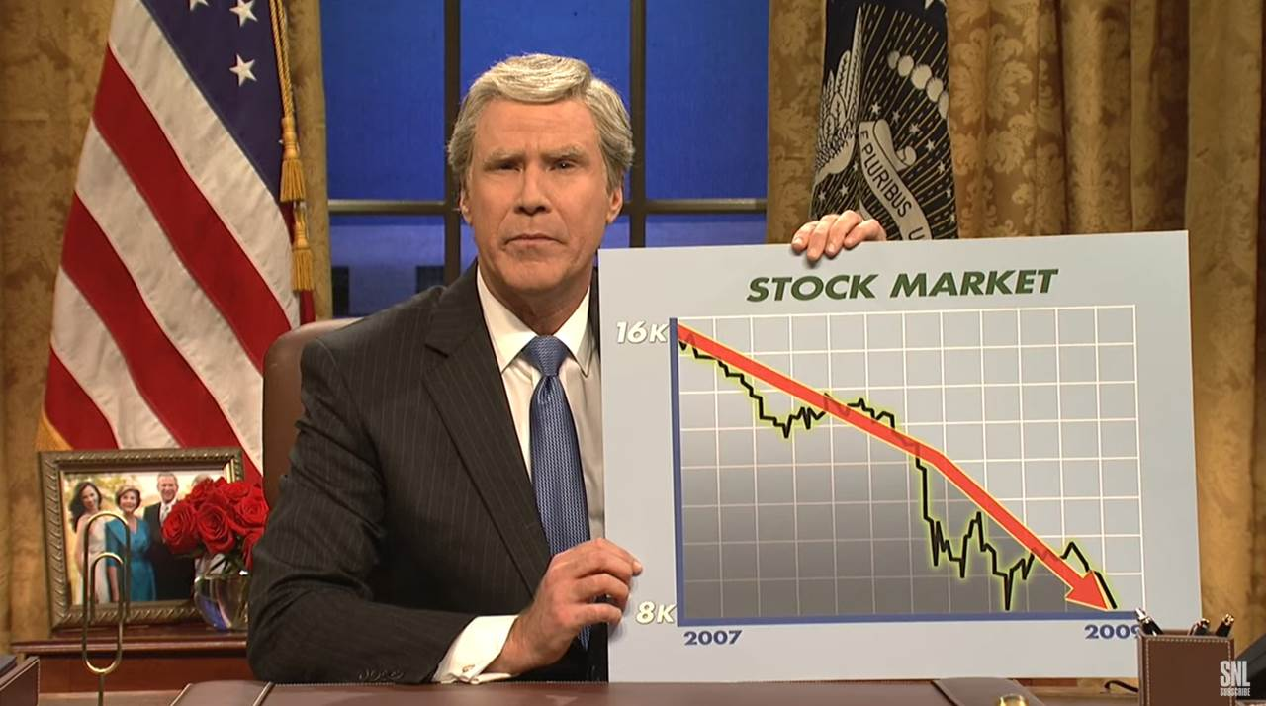

Slide 32
5.6%

Slide 33
11.6%

Slide 34
Borrow Direct
Consortial borrowing & lending activity among the Ivy Plus partners
Collections added in recent years:
Univ of Chicago
Duke
Johns Hopkins
Stanford
Users love Borrow Direct
Predictable & Consistent User Experience
Data shows: Users Are Good People (or People Are Not the Horrible Monsters We Fear)

Slide 37
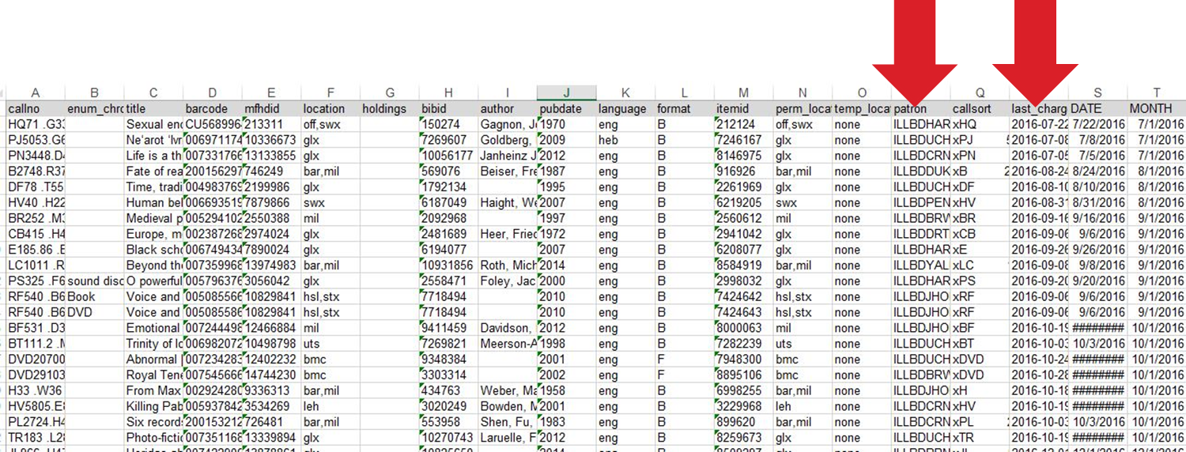
Insight into Lending
Original Destination: How to effectively invoice
Journey: Aggregate rate of use
New destination: Everybody chill out

Slide 38
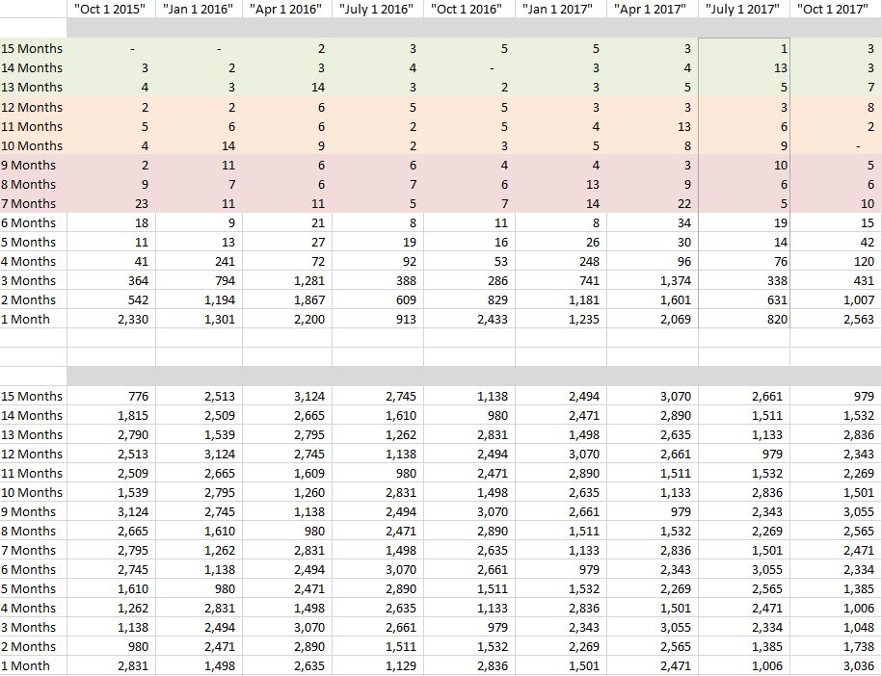
TIME
TIME

Slide 39
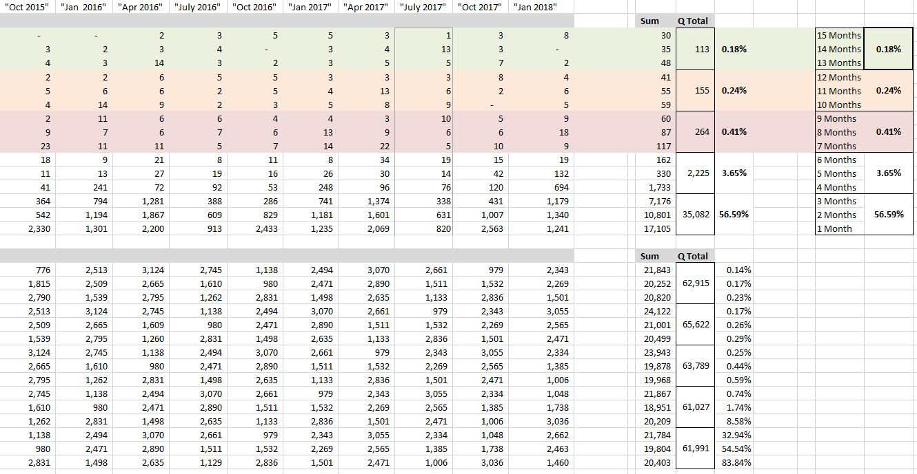
Aggregate

Slide 40
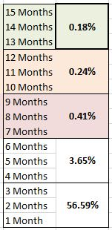
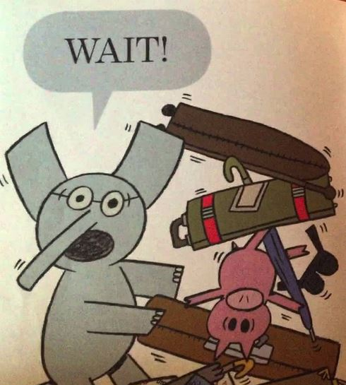

Slide 41
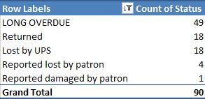
Average # of holdings in Worldcat = 409.2
6 titles with under 20 holdings in Worldcat
Average other copies in Borrow Direct = 6.5
8 titles with no other Borrow Direct holdings
TRUE SCOFFLAW = 0.10%

Slide 42
What Happened?
Consortium-wide increase loan period from 12- to 16-weeks
BD PG decision to seriously chill on invoicing
Rationalized local loan periods during shift to ReCAP Shared Collection (big deal, very boring)
Columbia changed ILL loan period from 6-weeks (perpetual renewals) to 16-weeks (no renewal)
Shift footing from renewal footstooling to the integrity of recall
Planned integration of acquisition routines

Slide 44
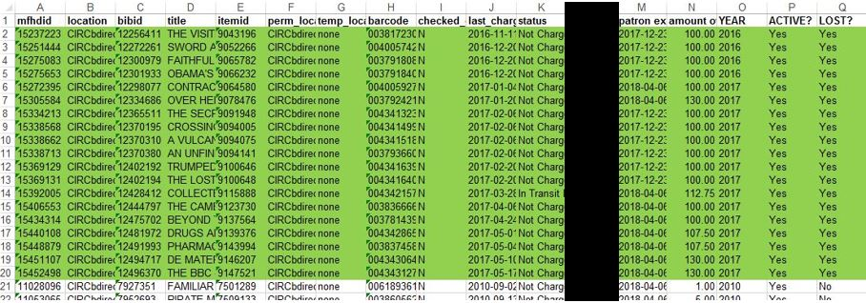
Borrowing Story
Original Destination: Forgive the blameless
Journey: Behavior distribution analysis
New destination: Extend the fences

Slide 45
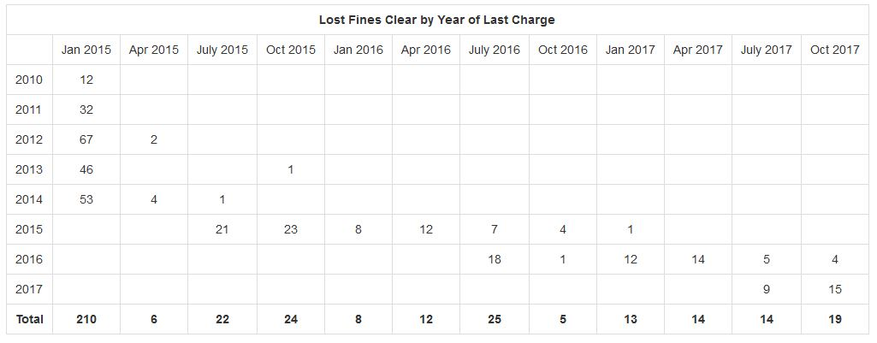
Original Purpose Has Merit…

Slide 46
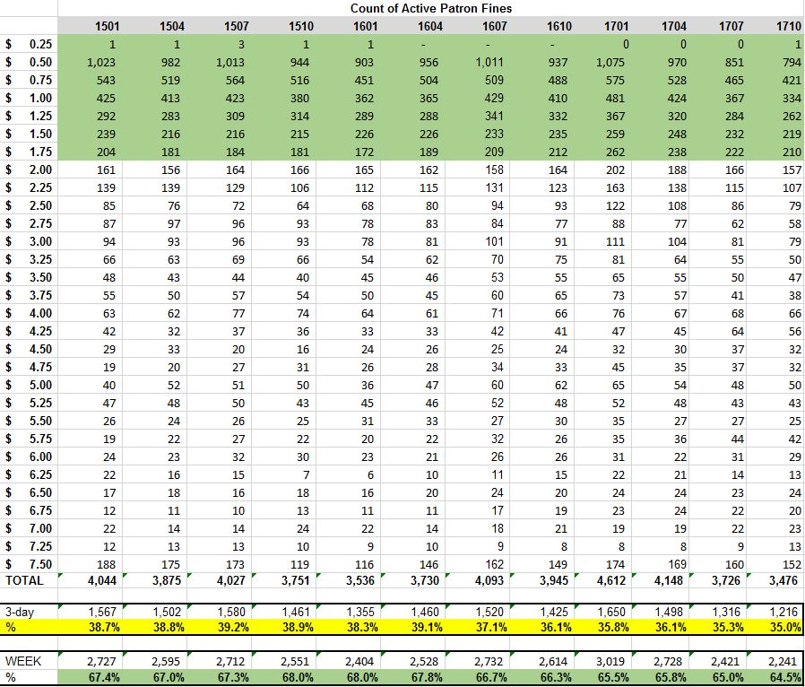
TIME

Slide 48
What Happened?
Eliminate Columbia’s renewal
Extend grace period from 1 to 3 days
Tightened time to Lost & block from 45 to 30 days
Empower service desk staff
Extend loan periods 1-2 weeks or negotiate
Place mediated request on patron’s behalf
Routinely clear fines from Inactive accounts
Strongly consider eliminating “casual” fines entirely
“We care about the book not the money”
Think about how ILL Borrowing can mimic BD

Slide 50
Kurt Munson
Assistant Head, Access Services
Northwestern University

Slide 51
Does Your Data Support your Policies? Or Is Everything You Think is True actually Wrong?

Slide 52
ILL Loans are just overly complicated circulations.

Slide 53
Think about it… Patrons (and library staff too) have no idea what restrictions will (or will not) be placed upon an ILL loan, particularly what the loan period will be. This complete inconsistency does not, will not (and frankly cannot) promote compliance by anyone.
“There are known unknowns”- D. Rumsfeld

Slide 54
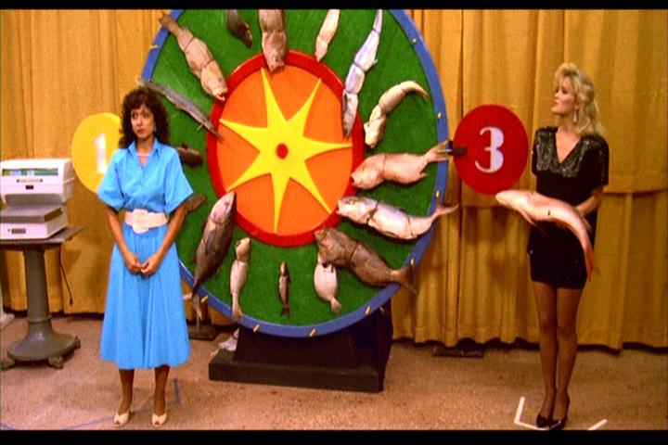
We need to agree upon and implement a standard national loan period so we can quit playing due date roulette.
http://www.filmbuffonline.com/FBOLNewsreel/wordpress/wp-content/uploads/2014/07/uhf03.jpg

Slide 55
Patrons provided with understandable, consistent and reasonable policies will follow them. Really. Why? Because this makes it easier for them to manage their loans. It reduces pointless busy work for staff too. It avoids bad feelings about overdues and fines. The data clearly show this.

Slide 56
Circulation Policies for Northwestern University Libraries : 1) Everything circulates in Alma (ill via NCIP) 2) 30 days after the due date, all items are marked lost and the patron is fined $125 plus a $10 processing fee. 3) Patrons are blocked from borrowing when they have $100 in fines or fees. 4) ILL access is blocked when an item is 30 overdue. 5) Transcript hold placed after 90 days. (understandable, consistent and hopefully reasonable)

Slide 57
Circulations by Month
3%
3%
3%
5%
1%
3%

Slide 58
Lost items and the patrons responsible

Slide 59
So in the end, how much is actually lost? Out of a total of 29,137 loans in 2016, patrons truly lost only 29 ILL items. In other words, just .0995% of the total were lost by patrons.

Slide 60
ILL number | replaceable? | ISBN | Total Holdings
152378966 | Y | 9780739123904
148666585 | y | 9781781681602
152090489 | y | 978-0316066525
 | y | 978-0896081291
137570490 | y | 052179126X
147081454 | y | 1843767937
 | y | 72465638
162643481 | y | 9780195338010
149222450 | y | 978-0970804211
154306681 | y | 978-0802144621
149913406 | y | 1452226032
143405684 | y | 9780807834305
149911780 | y | 9780807834305
164055311 | n |  | 6 copies
162588055 | y | 978-0470604458
145977264 | y | 415275814
150047181 | y | 852969619
161722177 | y | 9780446519267
164162219 | n | 978-9563519662
164378930 | n | 9789072627087
161844750 | n | 9789022319499
144928543 | n |  | 27 copies
164430456 | y | 155938445X
165692809 | y | 978-0472066292
163627792 | y | 9781847064455
166441393 | y | 415919800
166421677 | y | 9781444339130
165830473 | y | 231129866
163350532 | n |  | 7 copies
136879821 | y | 041593575X
Only 3 of those 29 ILL items could not be replaced via Amazon.

Slide 61
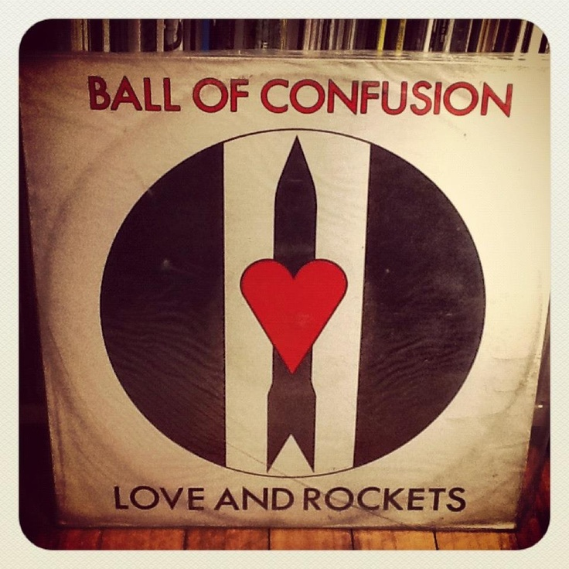
https://i.pinimg.com/736x/66/df/c8/66dfc81067c18d8cd93761878b5a3aa9--lp-cover-confusion.jpg
Avoid Confusion
If you apply consistent, understandable reasonable polices with consequences, you can effectively guide patron behavior.
And lets all agree to a minimum ILL loan period of 17 weeks!
https://images-na.ssl-images-amazon.com/images/I/618XHD1phBL._SX522_.jpg

Slide 62
The Lending Fallacy
AY17
31,073 total borrowing loan requests
6,112 for NU owned items already on loan
100 (1.6%) were out on ILL Lending
17 (17%) could not be filled via ILL borrowing. (That’s not even 1/10 of a percent!)
So a minimum ILL loan period of 17 weeks will not hurt your patrons!

Slide 63
Zheng Ye (Lan) Yang
Kurt Munson
Zack Lane
Texas A&M University libraries
Northwestern University
Columbia University Libraries
zyang@tamu.edu
kmunson@northwestern.edu
zl2114@columbia.edu

