Slide 1
Using Tipasa's patron request form to gather statistics in a library that serves multiple institutions
Teva Sweet, Atlanta university center, Robert w. woodruff library

Slide 2
Teva Sweet
ILL Unit Head

Slide 3
Serving four institutions

Slide 4
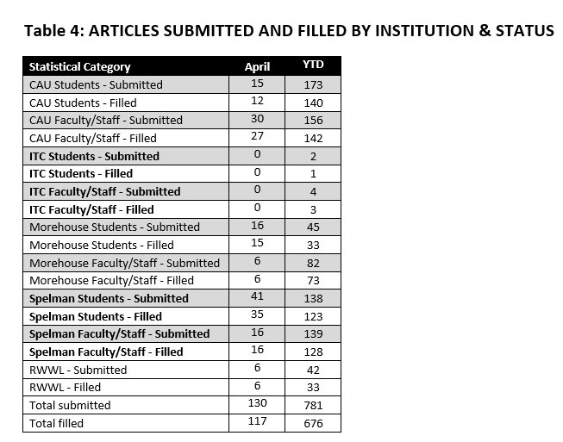
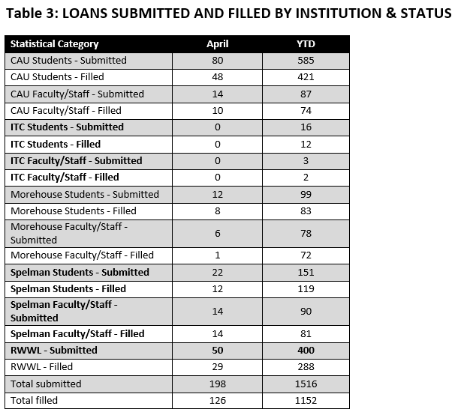
AUU ILL Unit Monthly Report - April 2017

Slide 5
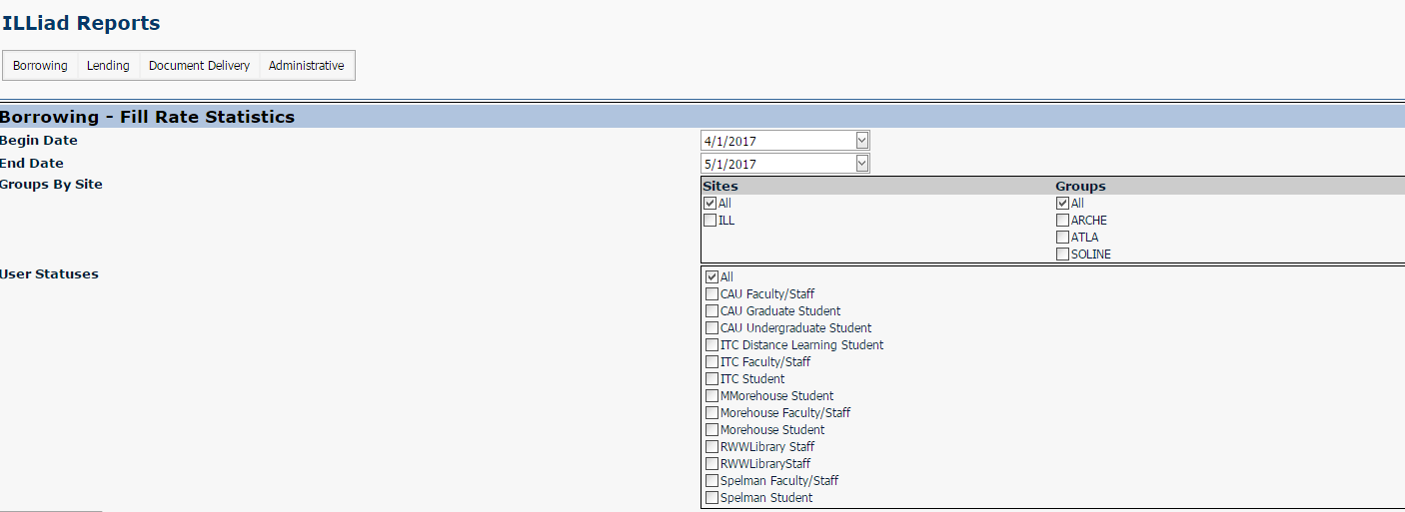
ILLiad Web Reports User Status April - 2017

Slide 6
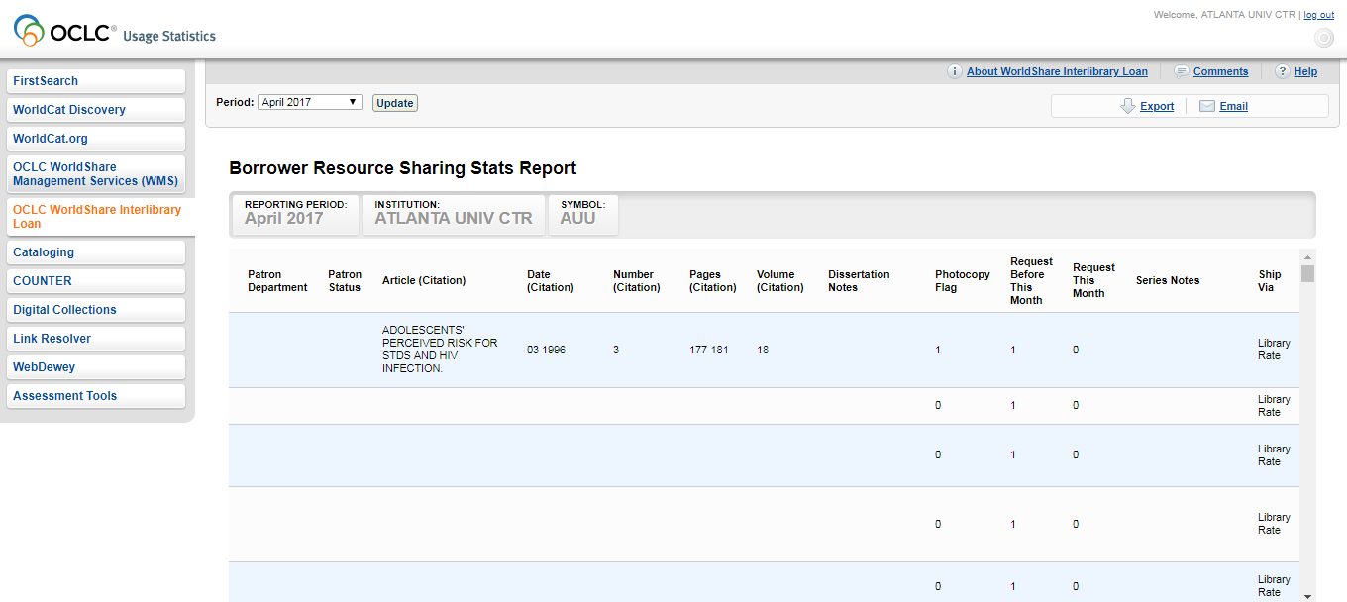
OCLC Stats without User Status and Department - April 2017

Slide 7
Editing the Tipasa Patron Request Form

Slide 8
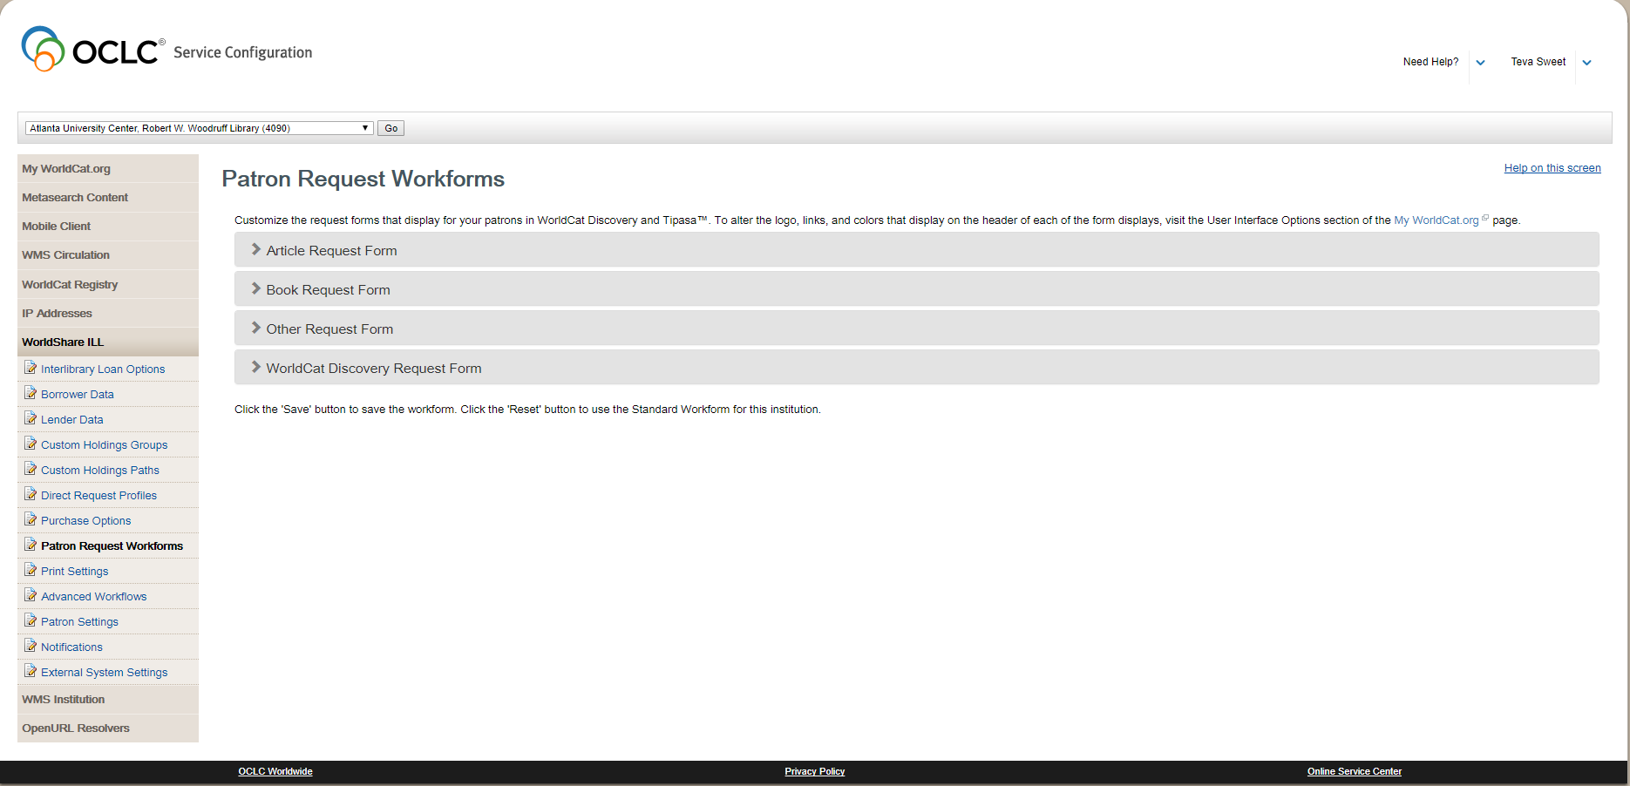

Slide 9
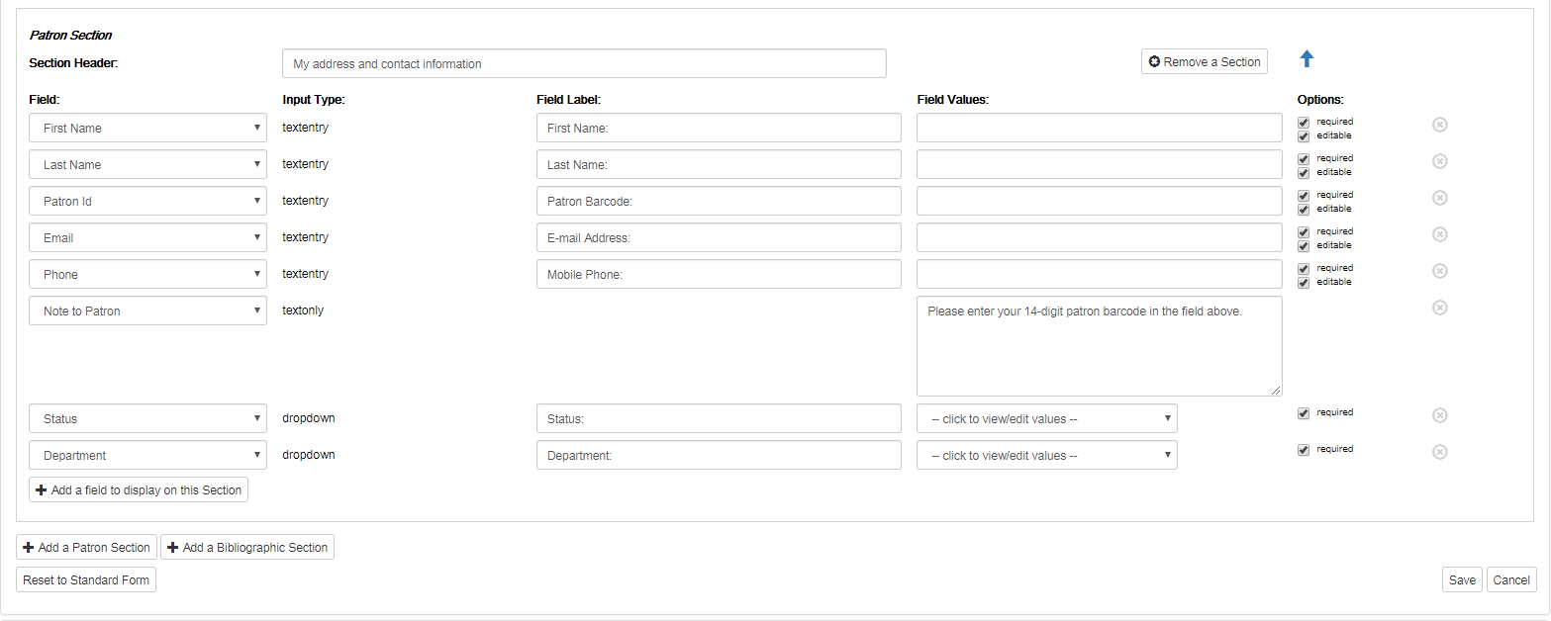

Slide 10
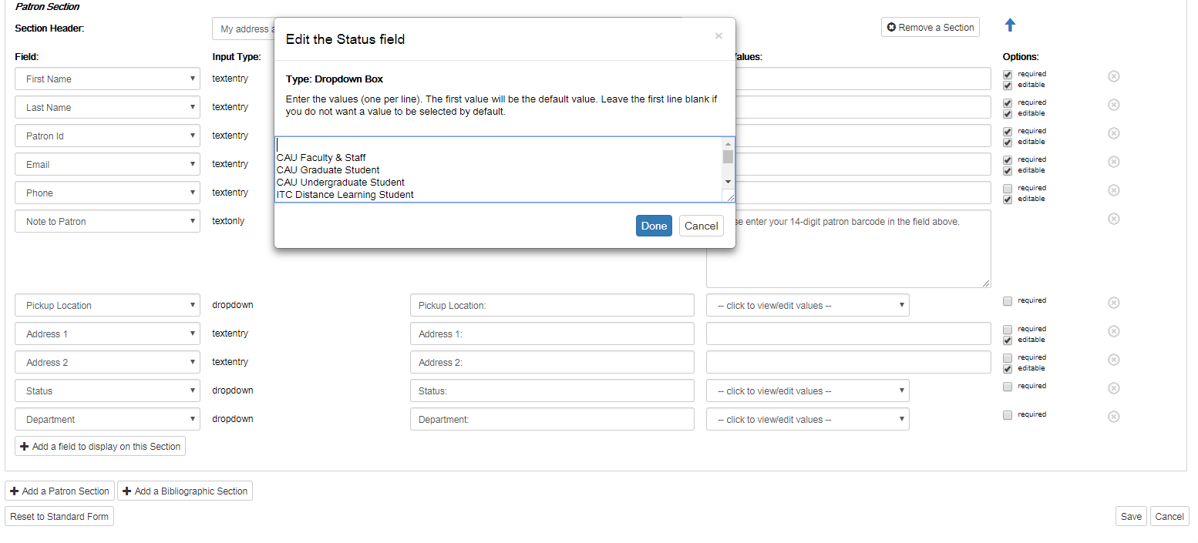
Status field

Slide 11
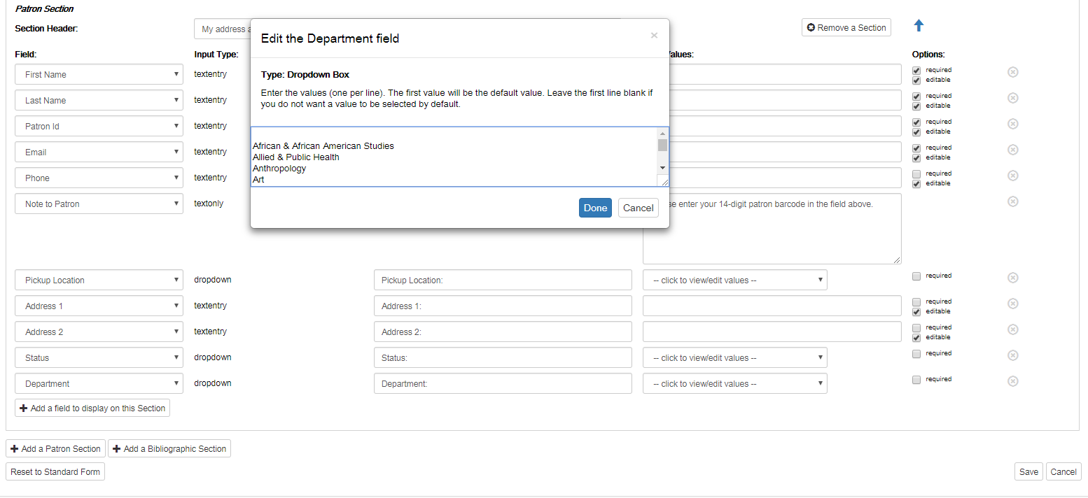
Department field

Slide 12
Patron input
The status and department fields are required.
Patrons select their status and department every time they submit a request.
OCLC plans to eventually have the status and department pulled directly from the patron record.

Slide 13
AUU Statistics
after update to
Patron Request Form

Slide 14
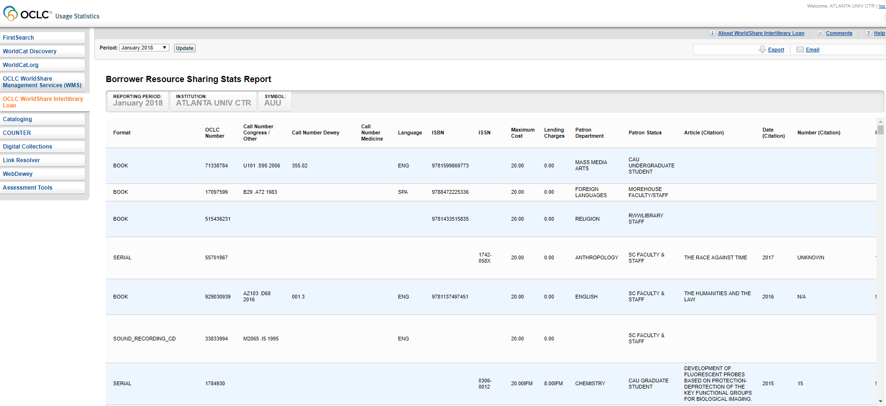
OCLC Stats with User Status and Department - Jan 2018

Slide 15
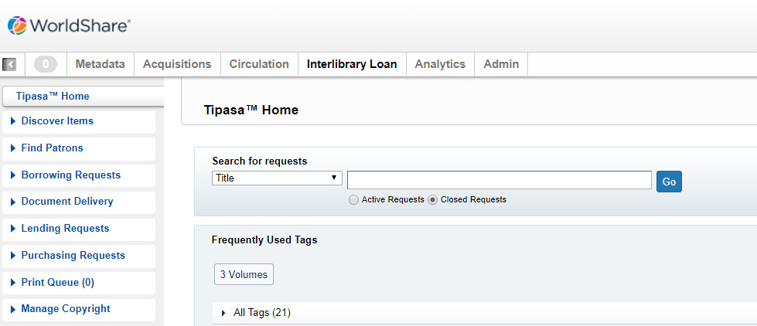
Analytics

Slide 16
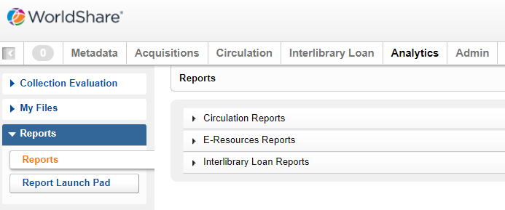
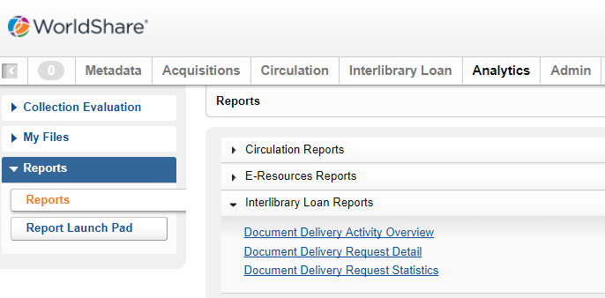

Slide 17
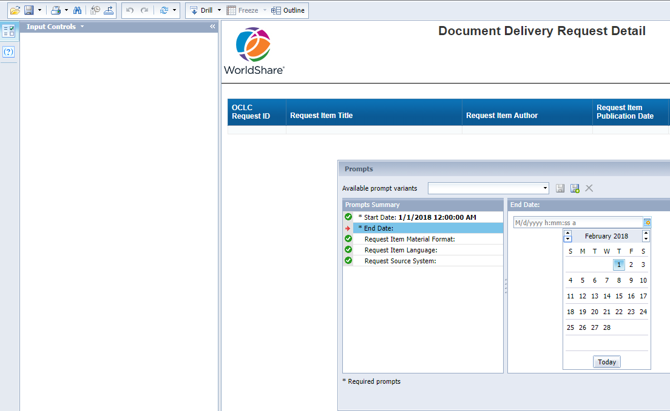

Slide 18
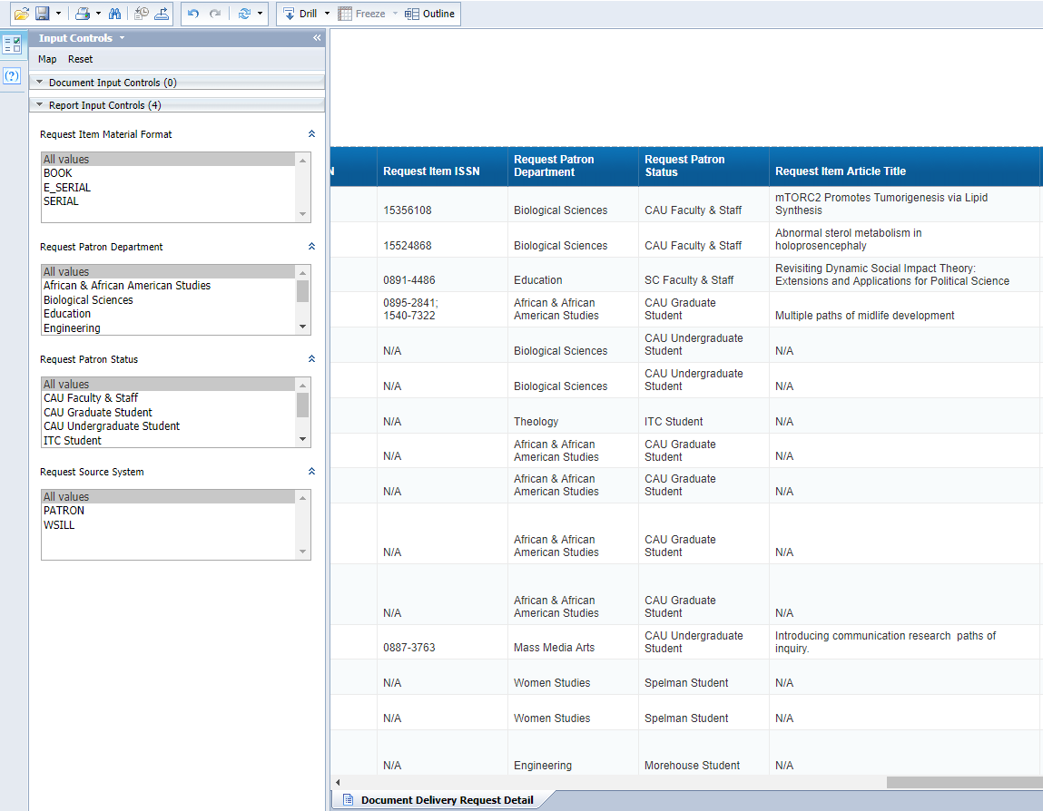

Slide 19
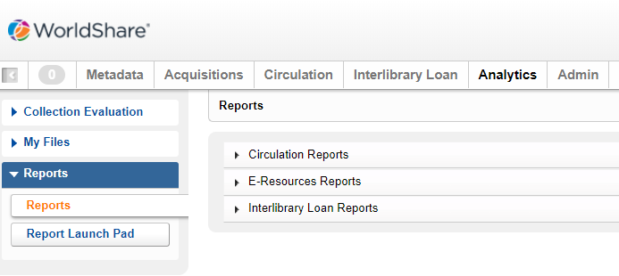

Slide 21
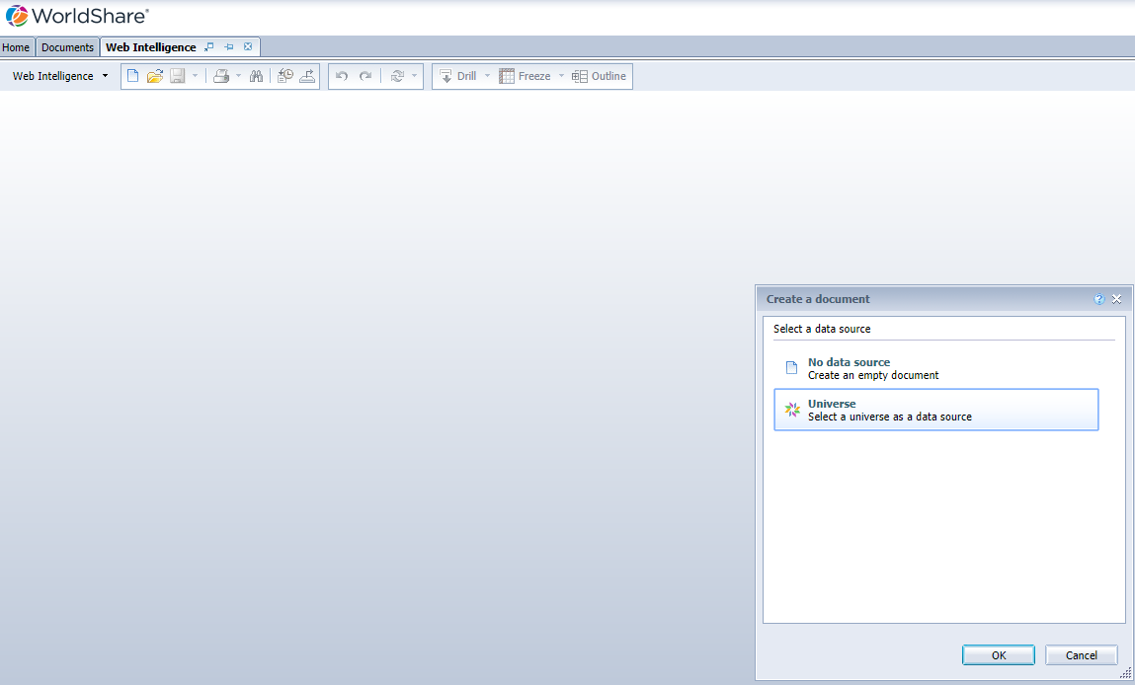
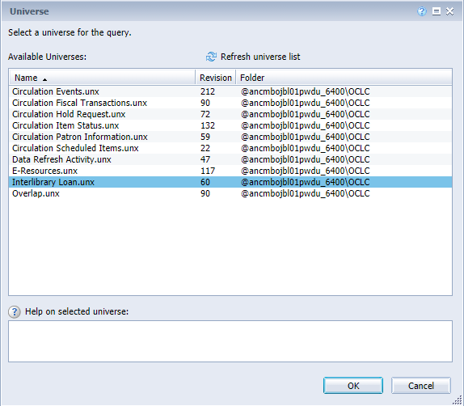

Slide 22
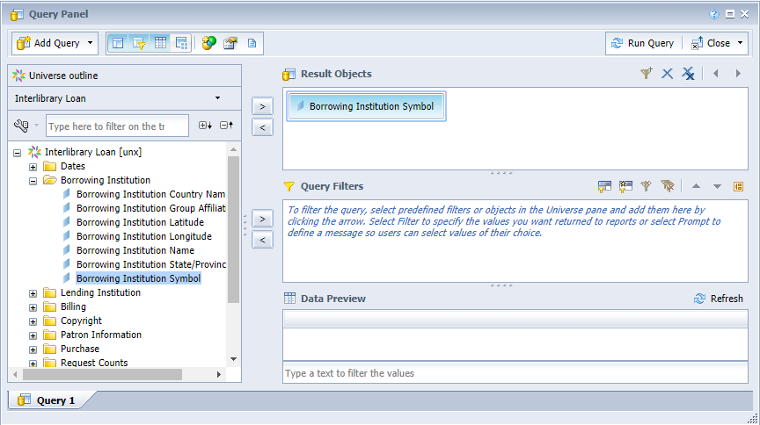
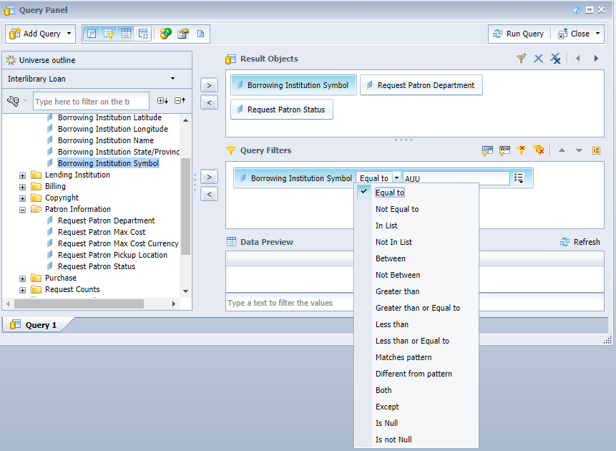

Slide 23
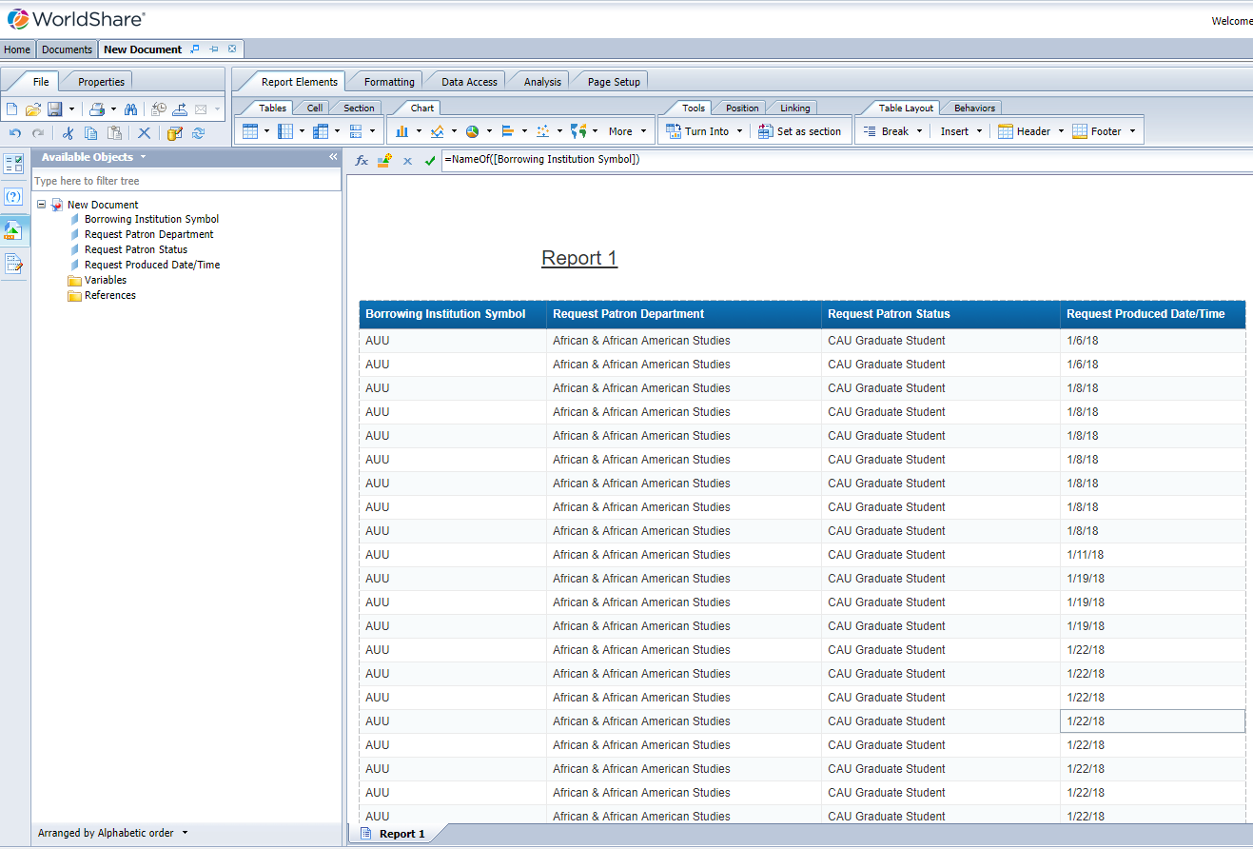

Slide 24
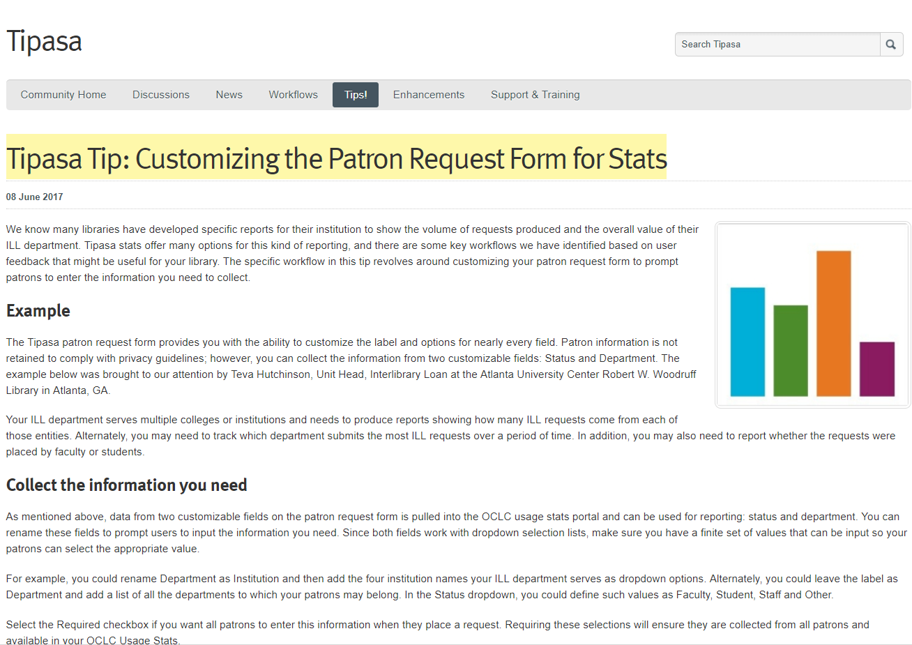

Slide 25
OCLC Community Center/Tipasa/Tips
Visit: https://www.oclc.org/community/home.en.html
Sign in
Select:
Select: Tips
Tipasa Tip: Customizing the Patron Request Form for Stats

Slide 26
Teva Sweet
Atlanta University Center Robert W. Woodruff library
thutchinson@auctr.edu

