Slide 1
Reformatting Library Services
Providing Services for Patrons with Disabilities
Ronald Figueroa, Syracuse University Libraries

Slide 2
Ronald Figueroa
Resource Sharing & Course Reserve Manager

Slide 3
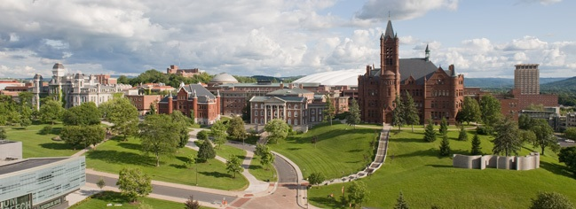
SYRACUSE UNIVERSITY
Private research university in Upstate New York
Founded in 1870
15,000 Undergraduate
5,000 Graduate
200 majors

Slide 4
What’s Pushing the Change

Slide 5
WHAT’S PUSHING THE CHANGE
The library is part of a larger campus effort to get Syracuse University beyond compliance.
Chancellor, Provost and University have new commitment to ADA issues, laws and obligations, and inclusion.
Well-known Disability Studies Program and Burton Blatt Institute.
Beginnings of some financial commitment to staffing, including within IT and the Library.
More self-advocacy from those with disabilities.
Larger national disability rights movements.

Slide 6
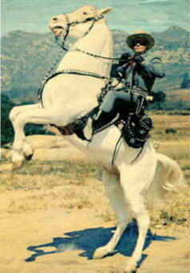
What is a cowboy without a horse?
What is a student without access to information?
What is a pirate without a ship?

Slide 7
Providing Services for Patrons with Disabilities

Slide 8
Everything begins with one patron and one request…

Slide 9
Planning & Implementation

Slide 10
PLANNING & IMPLEMENTATION
Establish Criteria.
Copyright.
Information on Request page.
Users (Faculty vs. Students).
Request workflow.
Request Options.
Request Type (Book, article, etc.)
File Type (PDF. ePub, Word, etc.)
Staff
Training.
Impact on Services.

Slide 11
CRITERIA
Alternate format for books and articles only.
Library materials only (no personal copies).
Accessible PDF.
Services for faculty, staff and students.
Requests submitted through ILLiad.
2 ILL FT – trained in Adobe Acrobat Pro.
ILL Scanner.

Slide 12
COPYRIGHT
ACCESSIBLIITY, THE CHAFEE AMENDMENT, AND FAIR USE
The Fifth Principle in the Code of Best Practices in Fair Use for Academic and Research libraries is entitled Reproducing material for use by disabled students, faculty, staff, and other appropriate users. It describes in some detail the circumstances in which making and providing copies of collection materials in formats that are accessible to persons with disabilities constitutes fair use, as well as certain limitations to which that general principle is subject.
http://www.arl.org/focus-areas/copyright-ip/fair-use/code-of-best-practices/2445-briefing-accessibility-the-chafee-amendment-and-fair-use#.Wgz_xUqnG00

Slide 13
COPYRIGHT
17 U.S. Code § 121 - Limitations on exclusive rights: Reproduction for blind or other people with disabilities
(a) Notwithstanding the provisions of section 106, it is not an infringement of copyright for an authorized entity to reproduce or to distribute copies or phonorecords of a previously published, nondramatic literary work if such copies or phonorecords are reproduced or distributed in specialized formats exclusively for use by blind or other persons with disabilities.
(b)
(1) Copies or phonorecords to which this section applies shall—
(A) not be reproduced or distributed in a format other than a specialized format exclusively for use by blind or other persons with disabilities;
(B) bear a notice that any further reproduction or distribution in a format other than a specialized format is an infringement; and
(C) include a copyright notice identifying the copyright owner and the date of the original publication.
https://www.law.cornell.edu/uscode/text/17/121

Slide 14
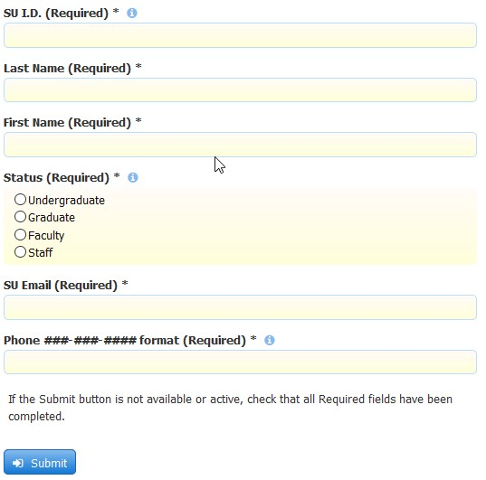
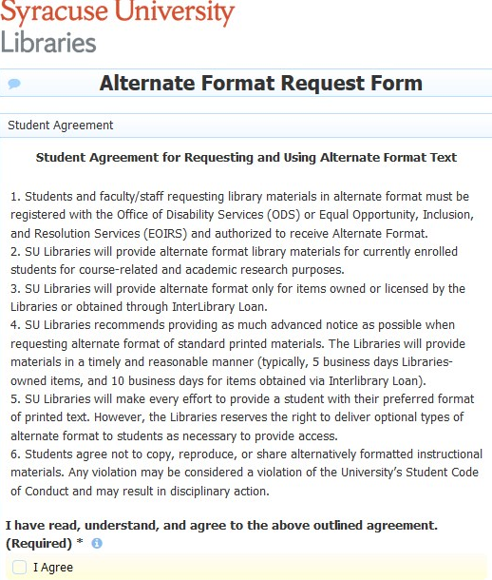
REQUEST PAGE

Slide 15
REQUEST PAGE
ILLiad:
New section added to all “New Request” pages in ILLiad.

Slide 16
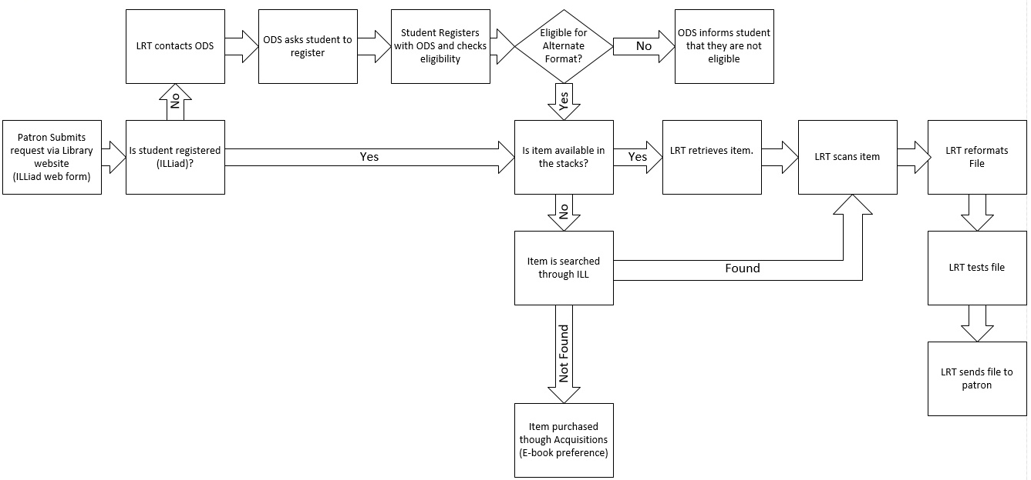
REQUEST FLOW

Slide 17
REQUEST FLOW
Patrons submit requests through ILLiad.
Request is verified for service.
IDS Logic Rule
Borrowing Availability checks if item is available in the OPAC and routes request to the Doc. Del Module.
Check Hathi Trust.
Item pulled from stacks.
Item scanned to create a PDF.
PDF is edited

Slide 18
EDITING
Editing PDF
Recognize Text.
Correct Page Numbers.
Insert Bookmarks:
Chapter headings.
Other headings.
Insert Reading Tags.
Touch up—reading order.
Editing could take more than 3 hours

Slide 19
PLANNING & IMPLEMENTATION
What about eBooks?

Slide 20
Lessons Learned

Slide 21
LESSONS LEARNED
Scanning
Recognizing the text for large, color files can take a long time, and often crashes before finishing.
Prevent any skewing, blurring.
Knowing color preferences of the patron—some prefer B&W scans to alter contrast colors in Adobe.
Scan clean text.
Editing could take more than 3 hours.
The entire process for a 500-page long book could take up to 20 hours a week.

Slide 22
LESSONS LEARNED
Adobe
OCR recognition of different fonts:
Reformat, Reformat, Reformat, Reformat
Editing words can sometimes warp the image—need to adjust the size and margins for the entire page to prevent text spilling off the page onto another page.
Editing elements that aren’t recognized at all.

Slide 23
LESSONS LEARNED
Word
Keeping elements contained on the page that are in the original.
Cleaning up Word’s impression of figures and images.
Re-creating tables and graphs.

Slide 24
LESSONS LEARNED
eBook
Is the ebook accessible?
Does the vendor require you to download a specific piece of software?
Is the patron willing/able to use that software?
Is the format preferred by the reader?

Slide 25
LESSONS LEARNED
In General
Timing.
Language.
Text orientation.
Alternate text for figures, graphs, other visual elements.
Every patron has different preferences and tools.

Slide 26
Current Service

Slide 27
CURRENT SERVICE
Services offered to faculty staff and students.
Library related materials.
Books and articles only.
Added 2 graduate students (course reserves).
Acquired one more scanner.
Added reformat services for Course Reserves materials.
Hired an Accessibility & Inclusion Librarian.
Outsourcing (depending on item length and file type).

Slide 28
FILE TYPES
Accessible PDF
(Original)
ePub
Word

Slide 29
OUTSOURCING
BlueLeaf
ePub
Word
http://www.blueleaf-book-scanning.com/
AMAC Accessibility Solutions and Research Center
PDF (item scanned by library staff)
http://www.amacusg.org/

Slide 30
CURRENT SERVICE
Request Type
Excerpt requests (Chapters & Articles) | 75
Full book requests | 49

Slide 31
CURRENT SERVICE
Request by Patron
Graduate | 70
Undergraduate | 26
Faculty | 28

Slide 32
CURRENT SERVICE
Requested Format
PDF | 93
ePub | 26
Word | 4
eBook | 1

Slide 33
CURRENT SERVICE
File Type/Patron Distribution
 | PDF | ePub | Word | eBook
Graduate | 66 | 0 | 4 | 0
Undergraduate | 25 | 0 | 0 | 1
Faculty | 2 | 26 | 0 | 0
Total | 93 | 26 | 4 | 1

Slide 34
What’s Next?

Slide 35
NEXT STEPS
Improve workflow and communication
Service is growing
ATLAS Concierge
Improve WebPages
Improve Ares – Course Reserves Management System

Slide 36
NEXT STEPS
Abbyy FineReader 14?
FineReader is an all-in-one OCR and PDF software application for increasing business productivity when working with documents. It provides powerful, yet easy-to-use tools to access and modify information locked in paper-based documents and PDFs.
Converts PDFs and scans.
Automates conversion.
Edits and comments PDFs.
https://www.abbyy.com

Slide 37
Conclusion

Slide 38
CONCLUSION
This is an amazing service!
There’s a lot to take in consideration: scanning, editing, file types, readers, resources, budget, etc., etc.
It is more difficult for a patron with disabilities to fulfill all academic needs.
One feels good when the job is well done and the patron is happy.
There’s a lot more that needs to be done in terms of alternate text.
After all…

Slide 39
One of the main missions of the library, as an institution, is to provide access…share knowledge to the patrons it serves. Remember…
It is not about the library. It is about the patron.

Slide 40
Ronald Figueroa
Stephanie Helsher
Syracuse University Libraries
Syracuse University Libraries
rfiguero@syr.edu
shhelshe@syr.edu

