Slide 1
E-resources and Interlibrary Loan

Slide 2
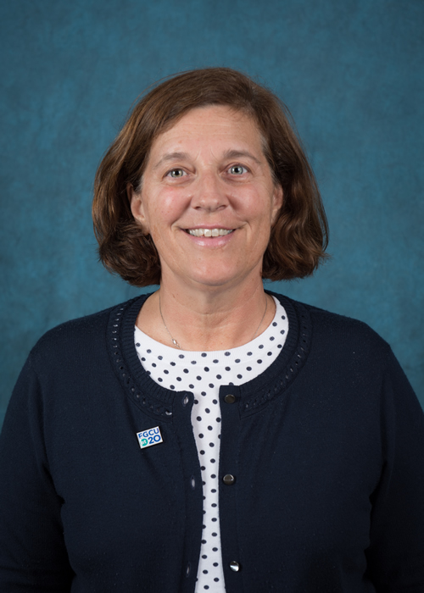
photo
Peggy Glatthaar
Head of Customer Services
Florida Gulf Coast University Library

Slide 3
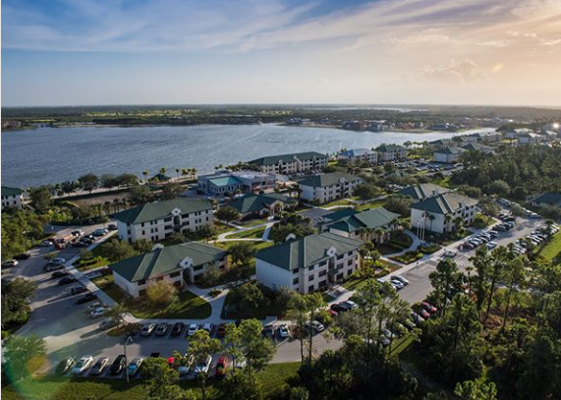
Intro/Background

Slide 4
I joined Florida Gulf Coast University Library in Fort Myers Florida 4 years ago.
Customer Services includes Circulation, Course Reserves, Interlibrary Loan.
FGCU enrollment - 15,000 students, and we just turned 20 years old.
FGCU library uses ILLiad/Rapid, and Aleph is our ILS.
FGCU Library has more digital resources than print resources. We have over 100,000 ebooks Over 128,000 unique journal titles through individual subscriptions, e-journal packages such as Science Direct, and databases.
Notes:
Last year we processed over 10,000 requests in borrowing/lending. Over 4,000 were electronic article requests.

Slide 5
How we do what we do...

Slide 6
At FGCU library -reference librarians work a few shifts at the Reference Desk - 9 out 10 students need help navigating how to use e-resources.
Incomplete citations in borrowing we refer to our subject librarians.
Recent update to a new discovery tool we needed Tech Services assistance.
Fill local request when we own the e-resources. (even when the patron is just a click away)
Notes:
This past year ILL has been working more closely with our subject librarians. We tried not to cancel our patrons borrowing requests until we had the patron connect with a subject librarian. Citations seem to be a challenge for some of our new users to ILL. We found over 100 of our borrowing requests were for items we owned online and the patron was usually just a click away from accessing the article.

Slide 7
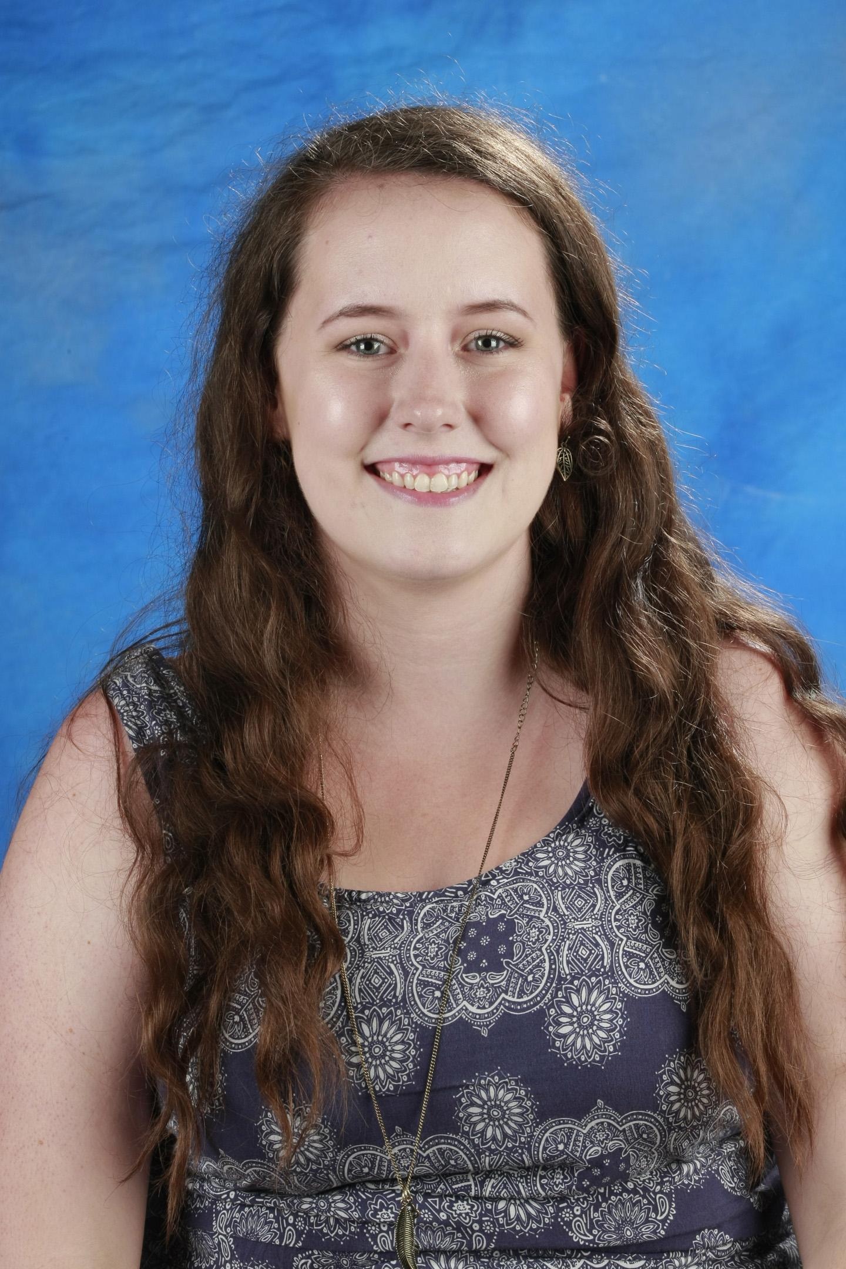
Sarah Damery
Interlibrary Loan and Fulfillment Associate
Butler University Libraries

Slide 8
Intro/Background

Slide 9
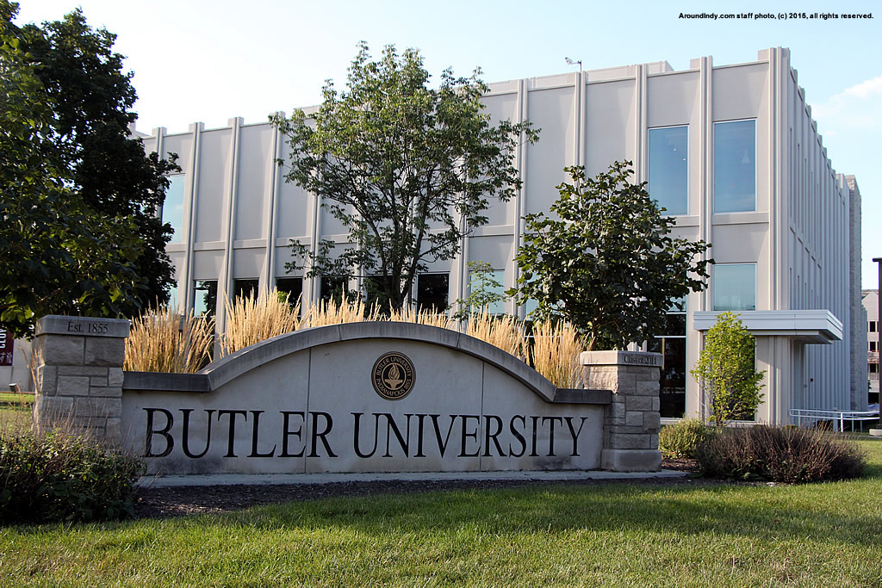
Located in Indianapolis, Indiana with almost 5,000 students currently enrolled.
Member of Private Academic Library Network of Indiana (PALNI) consortium, member libraries joined OCLC WorldShare Management Services in 2014.

Slide 10
Hike in ILL lending requests after move to WMS
2015 academic year: 7,500
2016 academic year: 12,069
2017 academic year: 9,239
No significant increase in borrowing requests
Moved interlibrary loan department from public services to technical services
Electronic Resources Librarian position hired in 2015
70% of materials budget spent on electronic resources

Slide 11
How we do what we do...

Slide 12
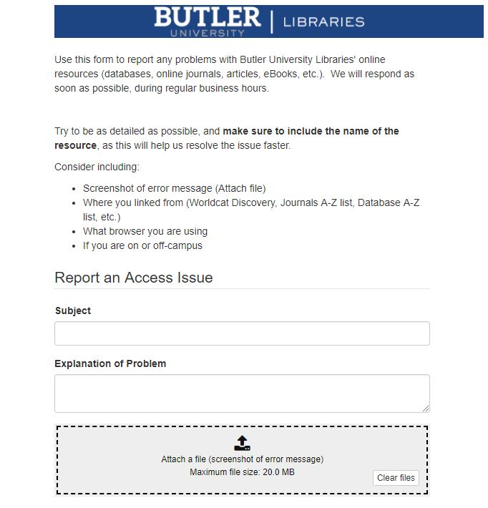
Work with your Electronic Resources Librarian or Department:
They negotiate your licenses
Ask them to make ILL a priority
Using SpringShare or other ticketing system for reporting access issues with an online resource.

Slide 13
Keeping up to date with new e-resources
Example: Testing out a new database or ebook package and usage stats will determine purchasing options
Track highly requested e-resources
If you own it, they will come

Slide 14
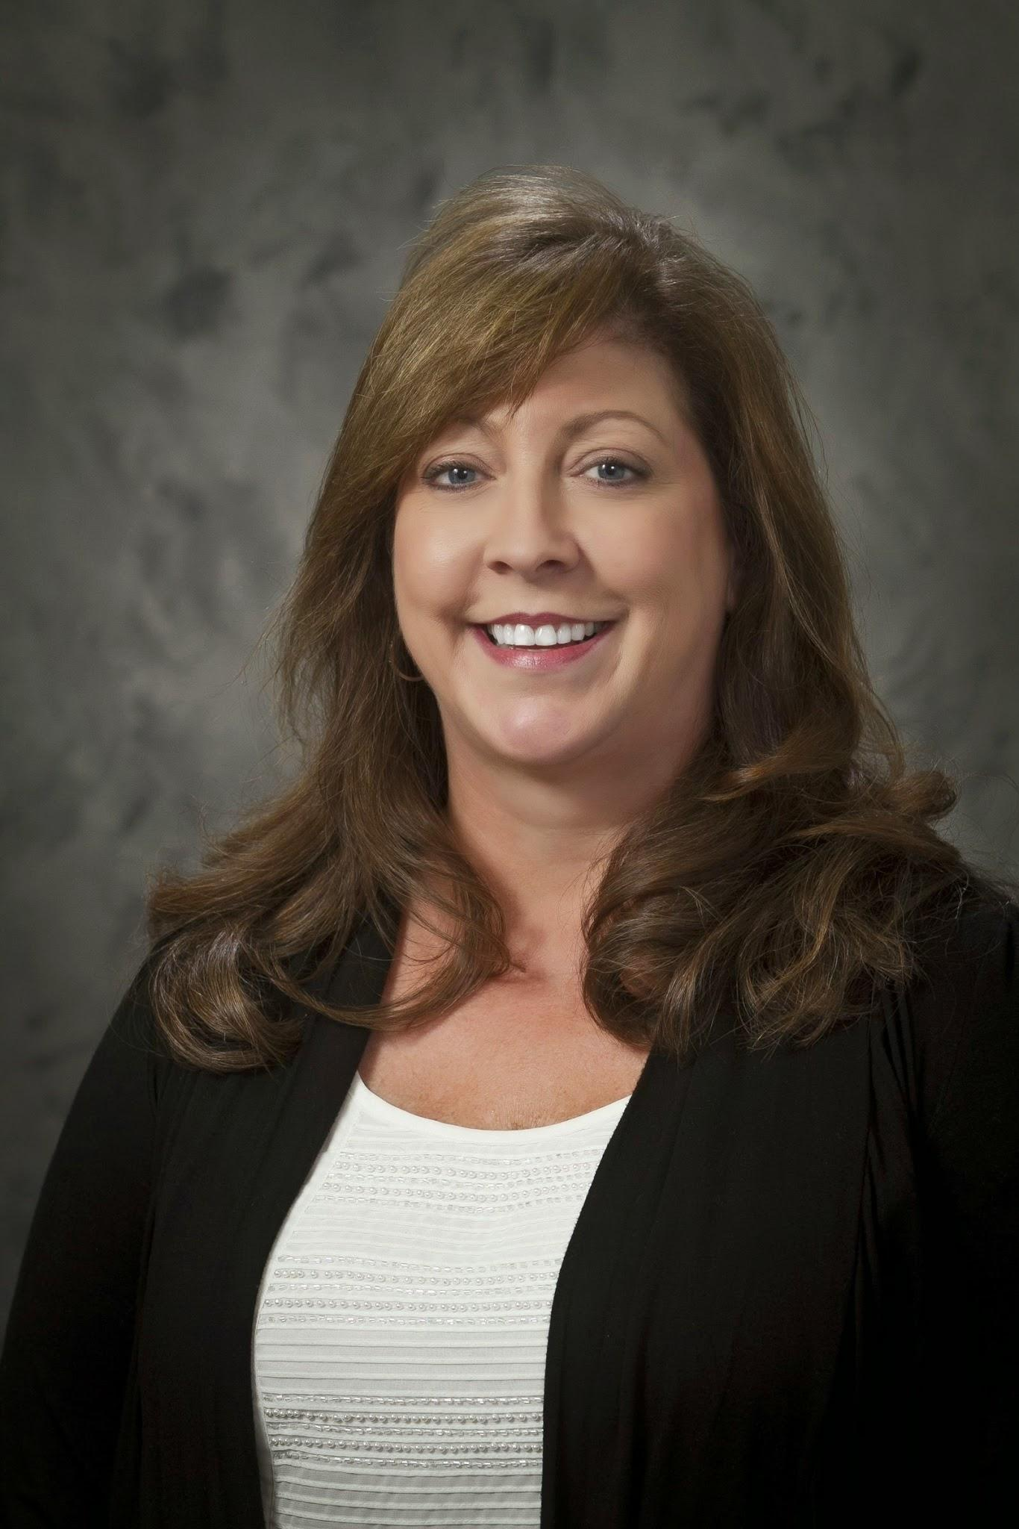
Mikki Butcher
Director, Interlibrary Loan and Course Reserves
James Madison University Libraries (VMC)

Slide 15
Intro/Background

Slide 16
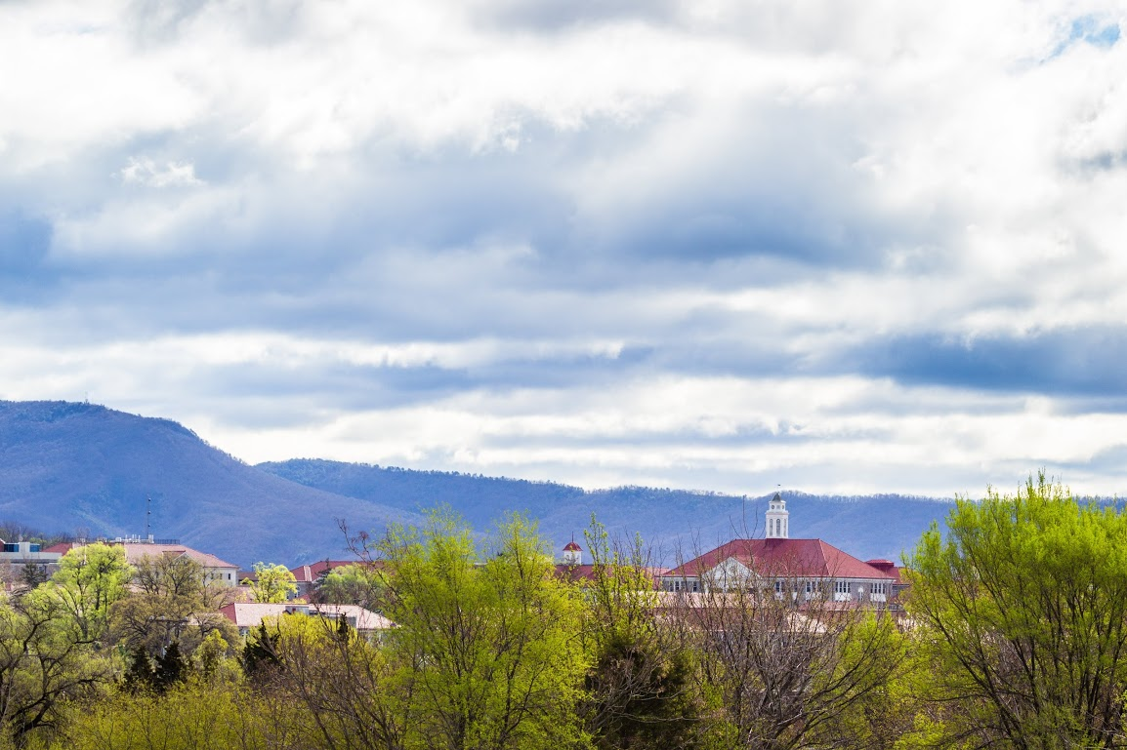
James Madison University is located in the beautiful Shenandoah Valley, 2 hours south of DC. Enrollment is currently 23,000.
I’ve been at JMU Libraries for 25 + years. During that time, I’ve worked in ILL, Serials, Microforms, and Course Reserves.
Our ILS is Sierra, currently in review for contract renewal.
We are an ILLiad library. We participate in OCLC Direct Request which allows for 30% of total borrowing requests being processed unmediated.
We process approx. 25,000 requests annually. Split evenly between Borrowing and Lending.
Notes:
JMU includes the following collection locations:
Carrier_Main
Rose_Science
Music
ETMC_Education
Offsite_Bound Journals, Micro, VHS
We offer Departmental delivery for faculty.
ILL facilitates Distance Learner materials through our Document Delivery module.
Free lenders within the US. We are International Lenders ($35.00 IFM), DHL used for shipping International.

Slide 17
How we do what we do...

Slide 18
We are a member of the VIVA consortia.
39 state-assisted colleges and universities
32 private colleges and universities.
During the FY17-19 Biennium, VIVA added 28,000 ebooks to shared collections, with an estimated 6,000 new titles to be added each year the contracts continue. Most notably, these collections include the rights for VIVA institutions to lend whole ebooks via Interlibrary Loan without the use of restrictive software, a first for libraries worldwide.
http://www.vivalib.org/index.html

Slide 19
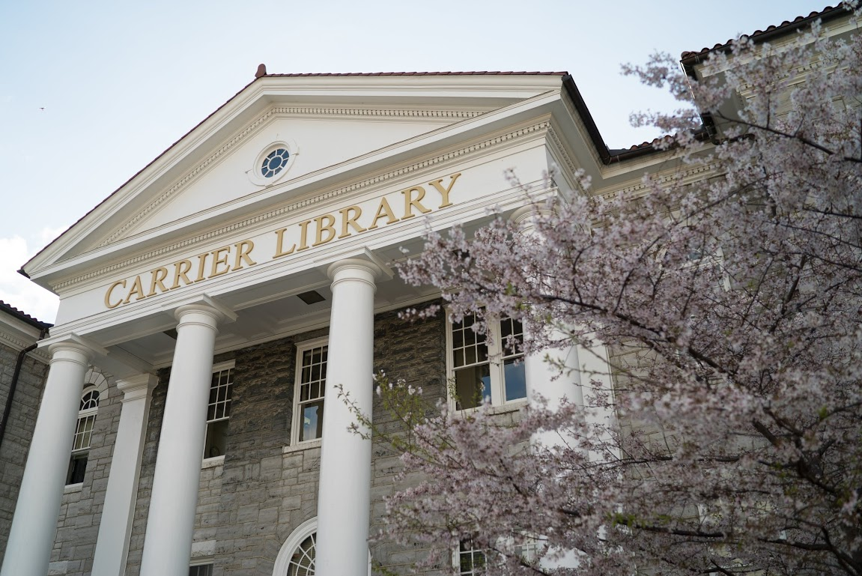
What does this mean?
January 2017, member libraries began lending whole ebooks from:
Brill
Oxford University Press
Taylor & Francis
Wiley
We fill Lending Loan requests as Articles by sending full ebook pdf’s.
Pros:
Immediate access for patrons.
Reduced shipping charges.
Cons:
Publisher platforms unique
Entire book as one pdf
Individual chapter pdf’s
Oxford does not provide full ebook download.
Requires individual chapters to be downloaded and stitched together.
Notes:
Created Conditionals alerting the requesting library that we own the title electronically, will they accept this format for fulfillment.
27 requests filled since that time as fulltext ebooks.
XXX requests filled since January 2017

Slide 20
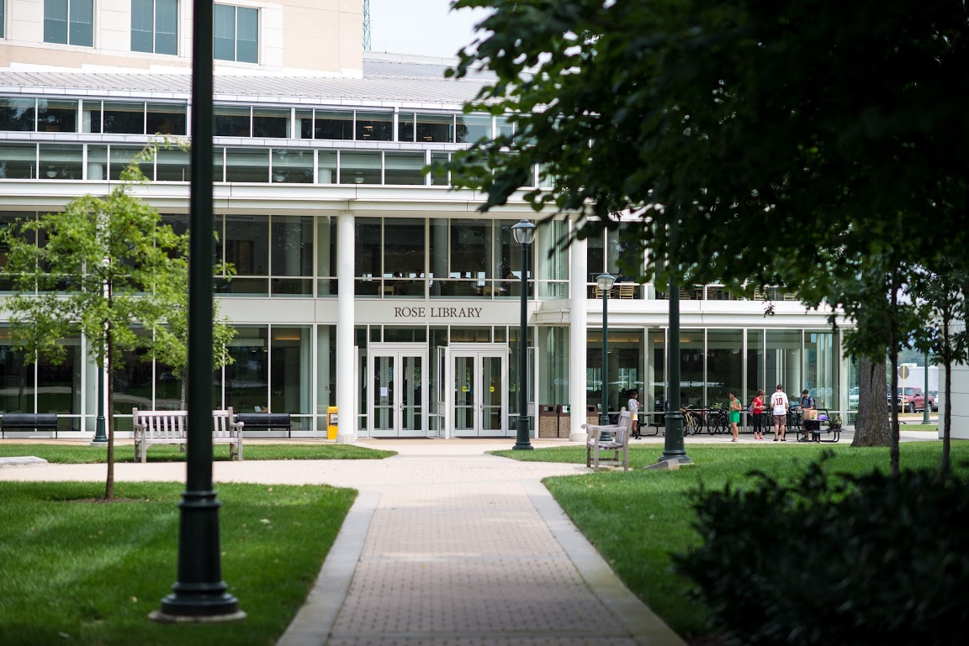
Borrowing article requests filled from our own electronic collections, we created a lender symbol = VMC-OWN.
FY17=22%
FY16=19%
Beginning FY18, we started tracking Borrowing article requests filled from fulltext online sources. (VMC-INT)
Borrowing article requests filled from our own electronic resources or via fulltext online are finished as a Borrowing request.
Requests filled from JMU Libraries print collections are routed through Document Delivery.

Slide 21
Wishlist

Slide 22
FGCU wishlist would be to lend/borrow eBooks for patrons.
We are eager to learn how our peers are making this happen for their patrons.
We are interested to know how other academic libraries collection maintenance processes for keeping eResource holdings current and up to date.
We are part of the collection maintenance process, but we are not the process.
Notes:
We recently changed our index in our discovery layer - our holdings have required much more tweaking

Slide 23
Questions from FGCU:
If you are loaning eBooks, how did you get started?
Who negotiated the contracts to begin lending eBooks?
Do publishers/vendors have similar criteria for licensing?

Slide 24
Wishlist

Slide 25
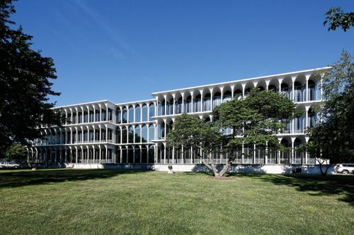
For Tipasa:
Internal notes
Flexibility
Seeing patron history after record is closed
Making a note of that hard to find ejournal
For eresources:
Cost effective models
Improved linking and discovery of OA & hybrid journals
Better handling of embargo periods

Slide 26
Wishlist

Slide 27
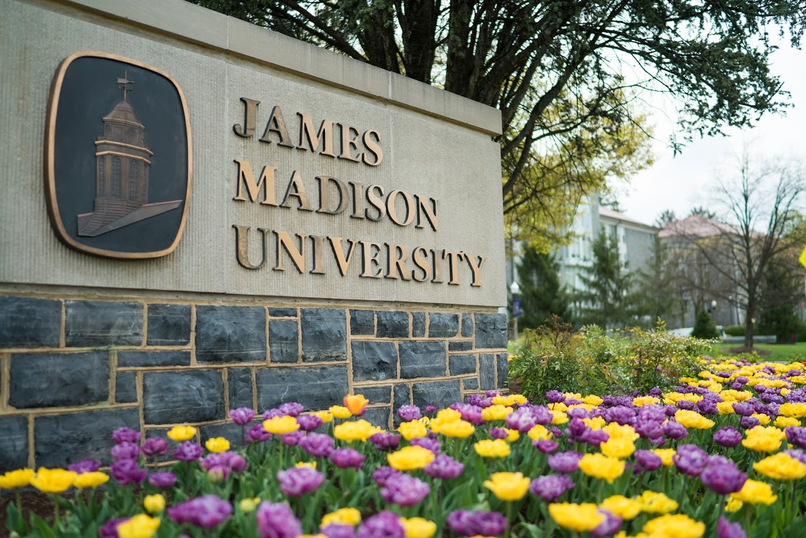
JMU’s wishlist:
Easier integration for borrowers creating a lender string recognizing that VIVA institutions can lend whole ebooks.
Additional publishers allowing whole ebook Interlibrary Loan rights, making it an industry norm.
Consortia and individual institutions request whole ebook lending ILL rights when renewing journal contracts.
Publishers who provide fulltext ILL rights, provide whole ebook pdf option, removing the need to stitch chapters.
Discovery system integrated to alert patron when they are ordering something currently available fulltext by your institution.
Notes:
IIB

Slide 28
Questions?

