Slide 1
ILL and German copyright - the solution of the ZBW
Nicole clasen, ZBW – Leibniz Information centre for economics

Slide 2
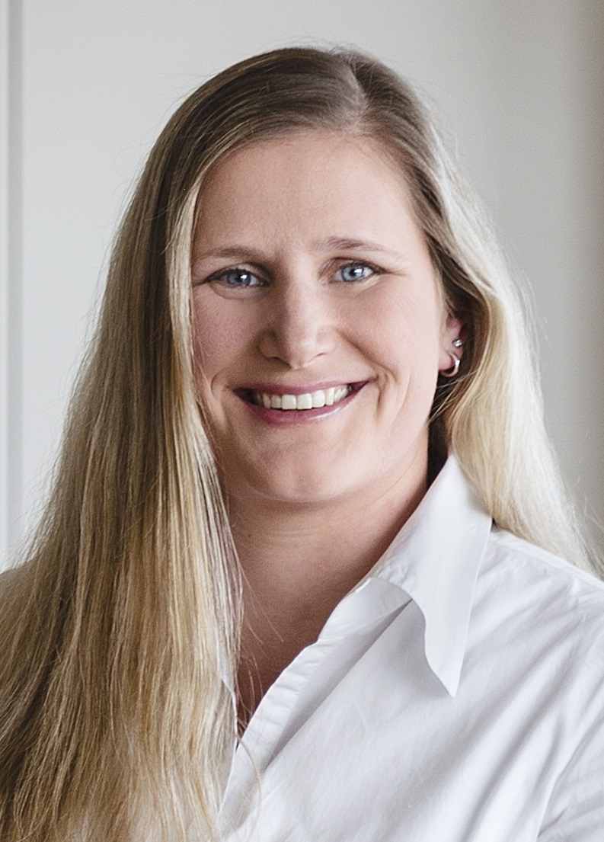
Nicole Clasen
Head of User Services and Document Delivery

Slide 3
The german copyright – a mystery for foreign librarians?

Slide 4
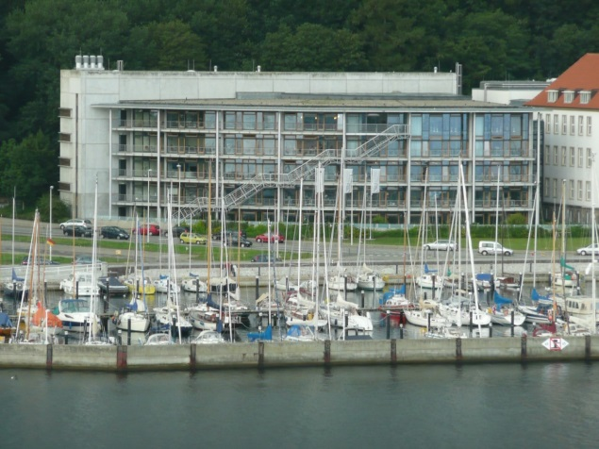
ZBW (DEGNL)
Founded in 1919
Two branches (Kiel, Hamburg)
Specialised in Economics and Business Studies
4,4 Mio Books
31.000 Periodicals, Journals
4,8 Mio Catalogue Items
5,6 Mio Downloads of Digital Full Texts
~ 270 Employees
Notes:
department of the Kiel Institute for the World Economy, whose name at the time was the “Royal Institute for Maritime Traffic and World Economy
Seat: The ZBW has two branches, one on the Firth of Kiel, the other on the Binnenalster in Hamburg. Legal form: foundation under public law.Founding year: 1919. Director: Professor Klaus TochtermannFinancing: The ZBW is financed jointly by the federal and state governments.Budget: 22.56 million EUR.The ZBW is a member of the Leibniz Association.

Slide 5
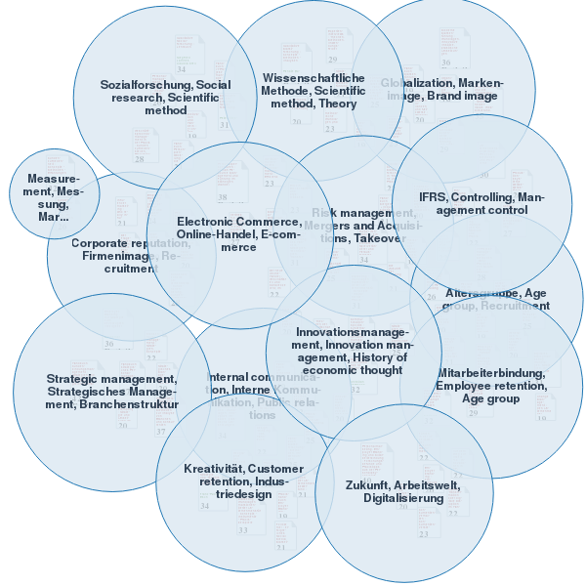
Bestseller

Slide 6
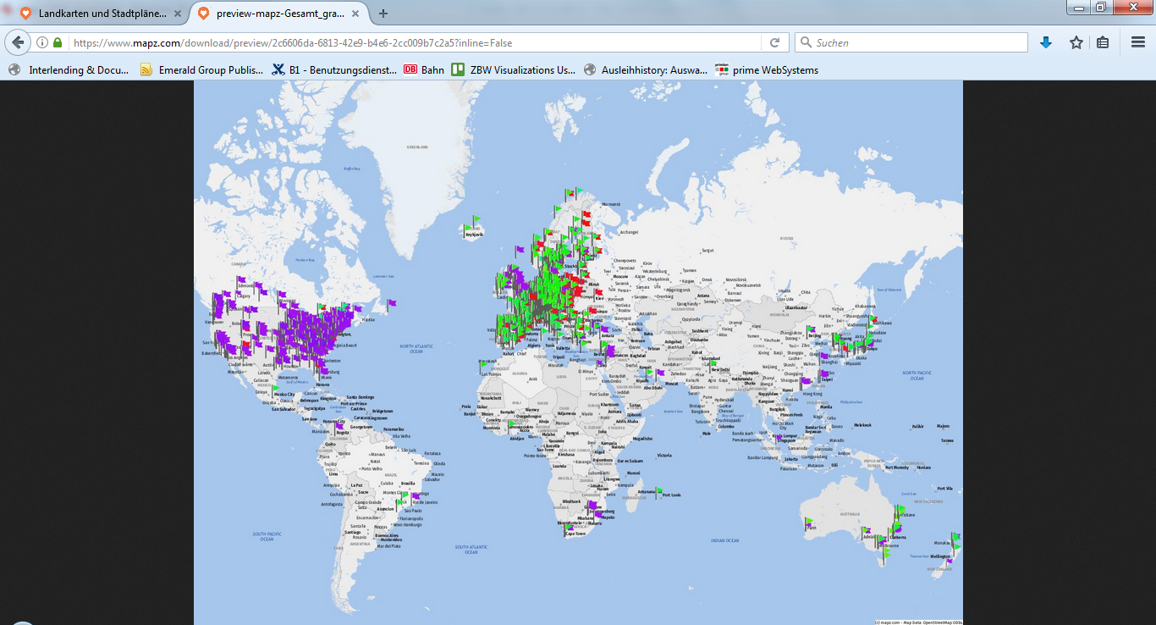

Slide 7
ILL facts

Slide 8
ILL and German Copyright
No uniform international regulations
German law includes interlibrary loan
General conditions
High level of explanation
No international direct delivery
Problem: international law

Slide 9
German Copyright Law
Urheber-Wissensgesellschafts-Gesetz (UrhWG)
Valid since 1st March 2018
Bundled in one single §
Limited to 2023, evaluate in 2021

Slide 10
10% instead of small parts
for non-commercial proposals only
Journals, books
No copies from magazines
No copies from newspapers
Direct delivery to end user (only in Germany)
Notes:
(copy order monos, compilations)

Slide 11
Newspapers
Delivery from public domain newspapers= yes
70 years after the death of the author
Anonymous post: 70 years after publication
Delivery from all other daily and weekly newspapers = no
Lending the duplication of the newspaper = yes

Slide 12
Journals / Magazines
Journals / scientific journals:
in their content assigned to one or more subject areas
Contributions are sufficient in form and content to the demands of scientific work
contain footnotes or endnotes contain a bibliography
contain editorial board / Advisory Board, consisting of experts from the respective scientific discipline
Magazines:
Hobby-, Lifestyle- und Magazine

Slide 13
International Interlibrary Loan with German libraries….
Modern
Fast
Comfortable
Service-orientated
Reality?

Slide 14
WorldShare ILL
WorldCat
WorldShare ILL
WorldShare ZBW
MyBib eDoc
Scan
Upload
eMail
MyBib eL
Print

Slide 15
Auftragsliste

Slide 16
MyBib eL
Copyright-compliant delivery of all copy orders via MyBib eL
Automatic upload of documents from MyBib eDoc to MyBib eL
Admin area for the delivery library

Slide 17
Mail

Slide 18
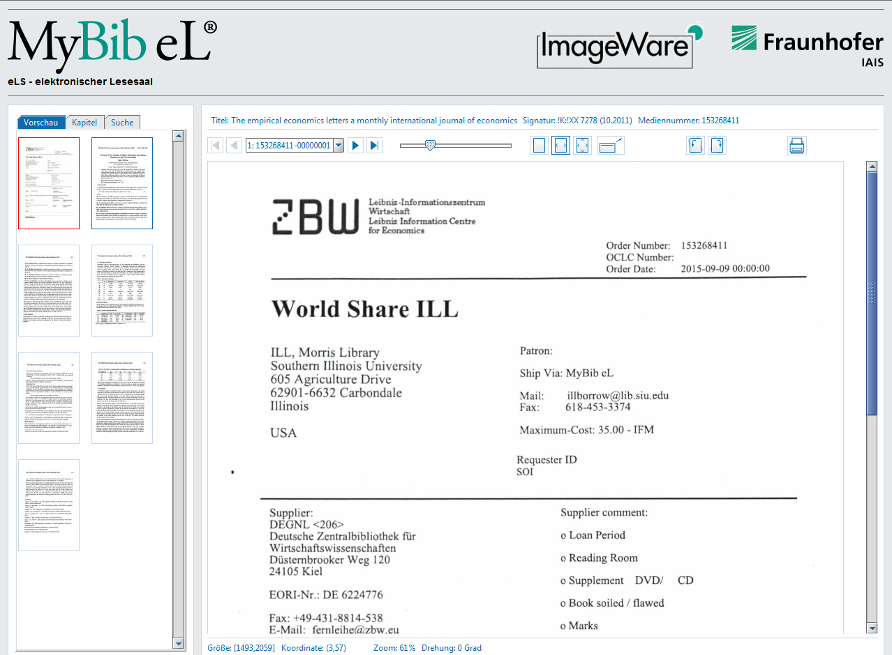

Slide 19
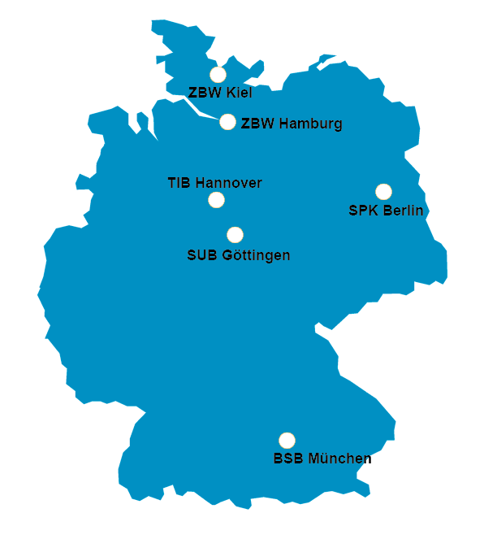
WorldShare in Germany

Slide 20
Loans
Copies
Journals
10%
Digital transfer via MyBib eL
Direct delivery in Germany
Newspapers, magazines (70 years after authors death)

Slide 21
Nicole Clasen
Zbw – Leibniz Information Center of Economics
n.clasen@zbw.eu

