Slide 1
Document Delivery and ILL in Discovery: making it easier for users
Melissa Eighmy Brown - University of Minnesota
Kate McCready – University of Minnesota

Slide 2
Melissa Eighmy Brown
Manager, Interlibrary Loan Borrowing

Slide 3
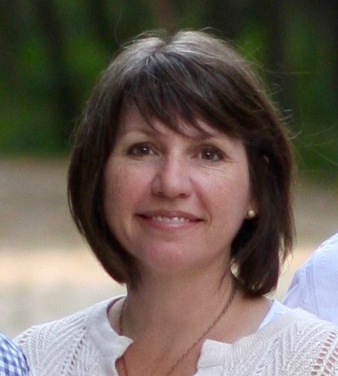
Kate McCready
Director, Content Services Department

Slide 4
University of Minnesota Overview
2017 Twin Cities Student Enrollment: 51,848
Libraries on the TC Campus: 12
Volumes in our Collections: 8,256,400
ILL Borrowing: 48,165
ILL Lending (total including state resource sharing program): 107,430

Slide 5
Agenda:
The Ideal
Feasibility Analysis
Implementation

Slide 6
The Ideal
Notes:
We have a new service approved (with staff allocation and a budget to pay for the scanning work) but now what….?
How do we present this to our patrons? What will users understand best? How can we shift decision making from the user to us to make the process ”smarter” and more intuitive? How do we remove the barriers that make this difficult for our affiliates?

Slide 7
A Short History…
2011: U of MN discontinues fee-based Doc Del Service
Implements soft-roll out of free service in 2016
2017: exploring options to incorporate new document delivery service into existing discovery environment

Slide 8
Delivery Services
Public Facing Recall for Books (Alma)
Local Paging (Alma)
Interlibrary Loan (ILLiad)
Document Delivery (ILLiad)
Notes:
2 different divisions
4 different campuses
Each service has a different name…

Slide 9
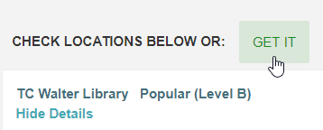
The Ideal
One Button Smart Fulfillment System
Request form with optional chapter fields
Availability check
ILL or Doc Del
Local Paging

Slide 10
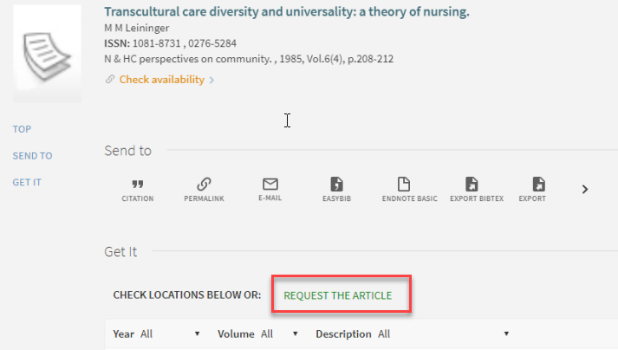
Removing Jargon

Slide 11
Feasibility Analysis

Slide 12
Road blocks and Issues
OpenURL
Multi-campus environment
User needs to sign in to see request options
System needs to know who the person is in order to route request to appropriate service locations.
Potential Costs
Can’t include the Alma record ID in order to check availability and create local paging request.
Will this increase use? More staffing for scanning and customer service? Impact of the removal of recalls?
Notes:
MMSID isn’t passed

Slide 13
Environmental Scan – DD Requests
Outside Discovery
Requests/User
.53
Inside Discovery
Requests/User
1.26
*User = Grad Students + Faculty
Notes:
Looked at BTAA DD Stats. Then used the user population of grad students and faculty as reported
Libraries with document delivery services presented in Discovery have significantly higher numbers of requests

Slide 14
Environmental Scan - Ratio of ILL:DD
Outside Discovery
.2 DD for every ILL
Inside Discovery
.4 DDs for every ILL
Notes:
25,000 ILL requests would translate to 5,000 DD requests.
25,000 ILL requests inside discovery would translate to 10,000 requests.

Slide 15
Estimates
High: 26,085 - Average of “In Discovery”
Medium: 16,924 - “UMN-Estimated w/in Discovery”
Low: 6,367 - Average of “Not in Discovery”
Notes:
MMSID isn’t passed

Slide 16
Potential Costs per 15,000 Requests
Mediation Staff Costs: 1 staff person = ~$40,000
Scanning Staff Costs: 15,000 requests = $24,000
An increase of 10,000 DD requests (medium estimate) would cost: ~$45K to $50K
Notes:
MMSID isn’t passed

Slide 17
Implementation

Slide 18
Revised Ideal
Notes:
Phased implementation
Naming Service
Promotion
Discovery
Allowing the service to grow
Potentially removing public facing recalls, improving technologies (Rapid, MMSID passing, etc.), expanding service to system campuses, etc.
Adding to discovery

Slide 19
Name the Service Survey
Table with iPads at 3 libraries
Emailed survey to students and faculty who had used ILL in the past year
Notes:
As our ideal became more complicated to implement, additional testing to name the overall service.

Slide 20
Results
“Anything but Scan and Deliver”

Slide 21
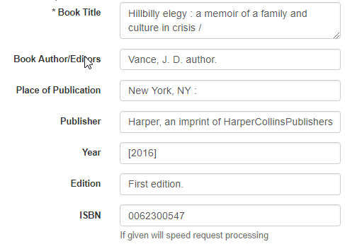
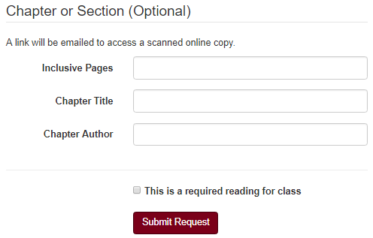
Simplifying the ILLiad Chapter Request
Modified book form to include optional chapter fields
Notes:
First step:
Improved the request form to allow for collecting the appropriate data about the item.

Slide 22
Usability: ILL and Doc Del in Discovery
Tested Get a Chapter and Get the Article
Results:
The word “Get” implies immediacy
ILL and Document Delivery are complicated in that they are siloed from other services.
Users expected ILL requests to be in their main Library Account (not in ILLiad), even after just having submit the request in ILLiad.
Notes:
Initial testing done within Discovery layer (Primo). Circling back to one of our first slides where we noted that we want to remove jargon.
Ensure words are chosen carefully and navigation works for users.

Slide 23
Item Available with Document Delivery

Slide 24
Item Checked Out, Recallable, with Document Delivery and ILL Option

Slide 25
Questions?

Slide 26
Melissa Eighmy-Brown
Kate McCready
University of Minnesota
University of Minnesota
eighm002@umn.edu
mccre008@umn.edu

