Slide 1
Right Under Their Noses:
Helping patrons identify the resources at their fingertips
Jessica C. Garner
Jessica Williams

Slide 2
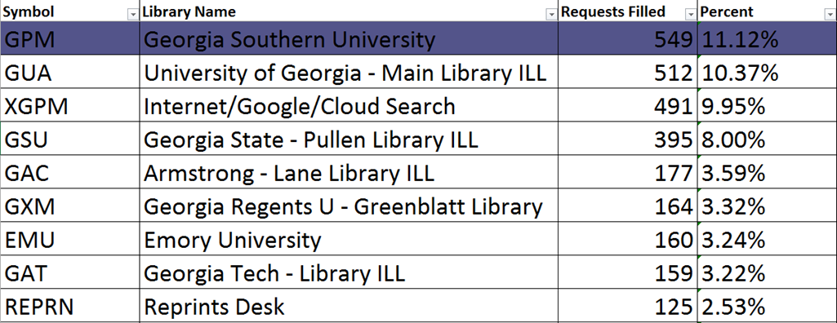
Interlibrary Loan: Where is my resource?
We fill
Our own
requests!
JG
Notes:
Jess GArner What was our problem: insert stats from last powerpoint with FIlled stats
Jess G 2
All interlibrary loan departments get many requests for materials in their collections, and Georgia Southern is no exception. Our policy is to fill these requests for the patrons. Our thinking is that we know our finding aids are not always easy to negotiate, and it seems to us bad public service not to connect well-meaning researchers with the material they are looking for. When we supply PDFs to them in this way, we credit ourselves -- GPM in OCLC - as the supplier. An ILLiad report of whom we borrow from based on our OCLC symbol shows we fill between 30 and 40 percent from our collection, but the number is really much higher.

Slide 3
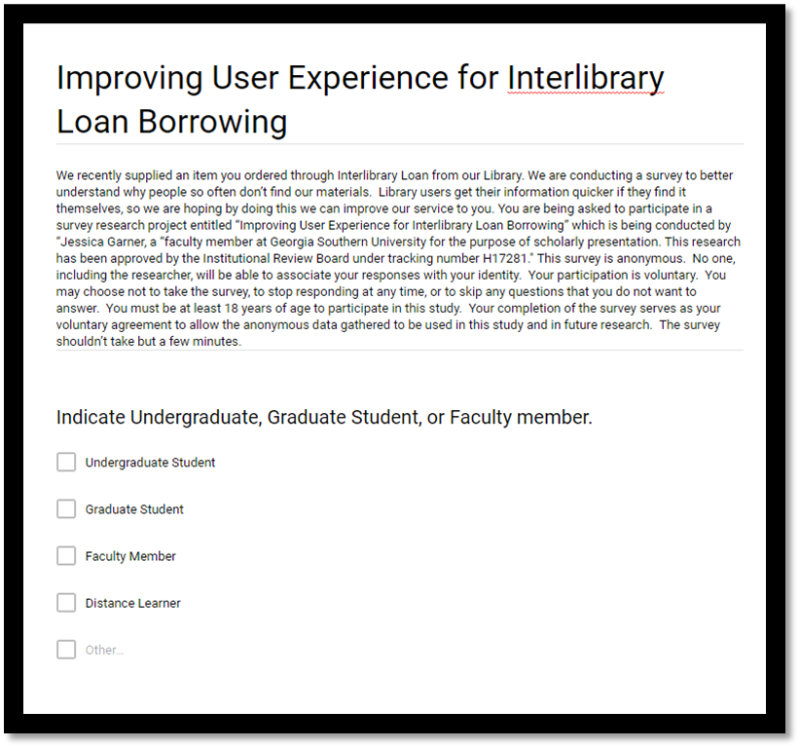
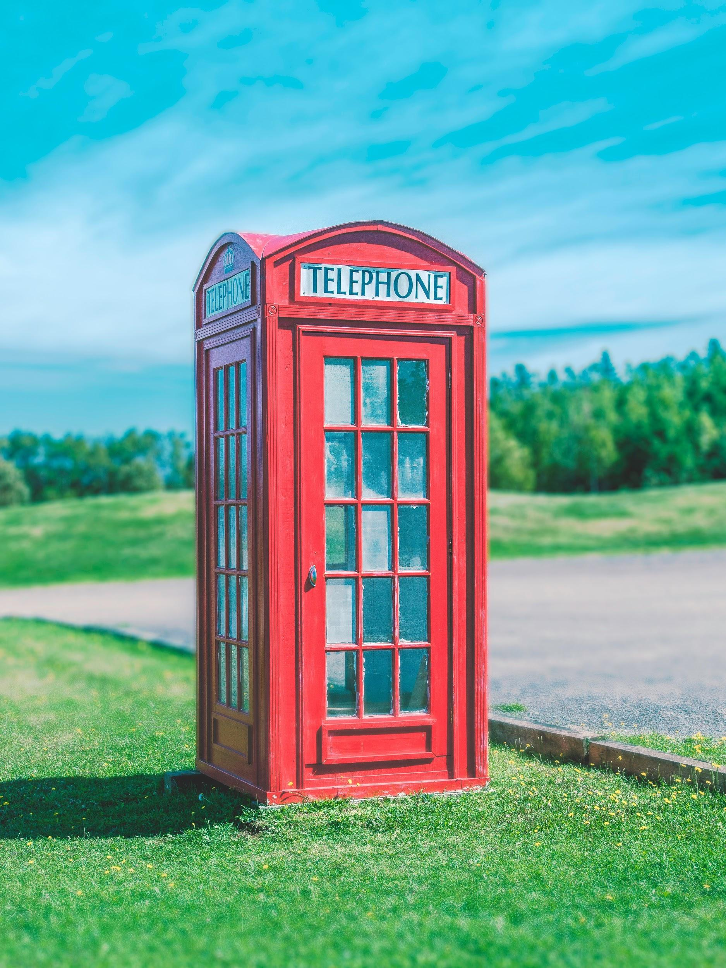
A Research Project is born!
Photo by Leo Roomets on Unplash
JG
Notes:
Fred & Jess Garner Talks about IRB approval Fred’s # 6
While we thought an online survey might be helpful, we decided that often patrons don’t understand what had gone wrong well enough to answer our questions. So we decided to telephone some of those experiencing difficulties and ask them to describe how they searched. We put together a list of what we thought were likely issues to assist us in our data collection, but we found as we began the project that the list wasn’t all that useful. There were too many nuances to what had gone wrong to fit our prepared list of categories in most cases. Because we were using human subjects, we sought and got IRB approval. [maybe some more about IRB approval]

Slide 4
Objectives
Satisfy our own curiosity
Assist those who manage our finding aids with improving access by patrons
Assist instruction Library faculty in knowing what to emphasize in classes
Provide reference service by way of Interlibrary Loan
Promote our liaison program
JG
Notes:
One reason we wanted to do this was to satisfy our own curiosity. Requesting when we have digital . Requesting when library owns and on the shelf. Getting close but failing to open full text in databases. 2) Our findings should be helpful to people who manage our finding aids. 3) Giving the info to instruction librarians helps them know what to emphasize 4) As we started making our calls, we realized we were providing reference service. As we found how they had searched, of course we explained what would have got them to the article right away. Very appreciative. 5) Later we thought to take it a step further and for many we began sending a prepared message about the liaison program with contact info. Esp. grad students. Not sure if good things will come of it, but we know of one incidence when it did. Lisa/Nursing grad student story

Slide 5
Lack of Key Information
Examples:
Patrons are unaware that there are multiple access points
Migration to ALMA ILS = patrons who previously were well-versed in navigating the library’s resources had to start over.
What is an e-journals title list?
JG
Notes:
One reason we wanted to do this was to satisfy our own curiosity. Requesting when we have digital . Requesting when library owns and on the shelf. Getting close but failing to open full text in databases. 2) Our findings should be helpful to people who manage our finding aids. 3) Giving the info to instruction librarians helps them know what to emphasize 4) As we started making our calls, we realized we were providing reference service. As we found how they had searched, of course we explained what would have got them to the article right away. Very appreciative. 5) Later we thought to take it a step further and for many we began sending a prepared message about the liaison program with contact info. Esp. grad students. Not sure if good things will come of it, but we know of one incidence when it did. Lisa/Nursing grad student story

Slide 6
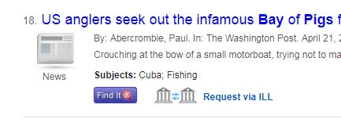
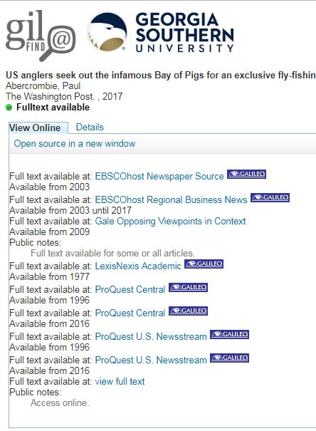
Problems with Find-It
JG
Notes:
We found a portion of the patrons didn’t want to click the Find-It button. After searching for the title find it leaves a person with the feeling they are looking for it all over again and it was much easier to click request through ILL.
We also found that a portion of patrons that did select the Find-It button wasn’t thrilled with the particular databases. They found the database confusing or too much of a hassle to search or the format of the article wasn’t what they needed.
One of our solutions is to have the library liaisons emphasize what the Find-It button means in our catalog.

Slide 7
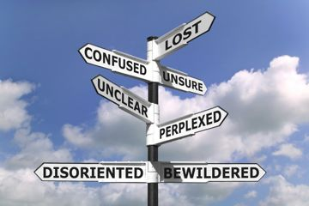
Atypical databases → patron searching problems
Examples
ProQuest Dissertations
MLA International Bibliography
Georgia Knowledge Repository
Difficulty navigating some
websites
JW
https://termcoord.wordpress.com/2013/05/14/how-can-a-lack-of-linguistic-knowledge-affect-political-credibility/
Notes:
In some cases there was a key piece of information which most patrons would not be aware of which they would have had to have known to have been successful. Dissertations turn up in some searches. Many patrons are not able to identify a reference as a dissertation, but even if they were, they would not know of the existence of ProQuest Dissertations and Theses Global, where a high percentage can be accessed full text.
MLA International Bibliography provides only citations. Today’s patrons are not used to any sort of search which doesn’t lead immediately to the information they are seeking. In order to obtain the information in the citations from MLA, they would need to take the bibliographic information MLA provides and search it either in our catalog or in the Journal Titles List.
A third common occurrence in the category of things we wouldn’t expect users to understand is citations from Georgia Knowledge Repository. This includes bibliographies of faculty publications, but seldom has links providing the text of the articles or books. The citations provide the article titles in large blue type, but they do not open. The article titles in blue type give the appearance of a link, compounding the problem. The rest of the citation -- journal title, issue date, and pages -- is in small gray type, and not linked to our holdings. Again, they would have to take the bibliographic information and search our holdings to see if we own the material. The resulting ILL requests often come in the form of loan requests which we will need to turn into article requests.
A minor issue had to do with some of the smaller databases or journal publisher’s web sites. In one case an Anthropology instructor had told her students to search in Anthrosource. In another, a student began in an IEEE database. While many of the databases and web sites which contain the full text can be a little difficult to navigate, these two proved particularly so. A PDF download was available, but the way the website was designed made it difficult to find how to download.

Slide 8
The Interlibrary Loan Department IS the Solution.
JG
Photo by Courtney Hedger on Unsplash
Notes:
We can refer them to the RSD department

Slide 9
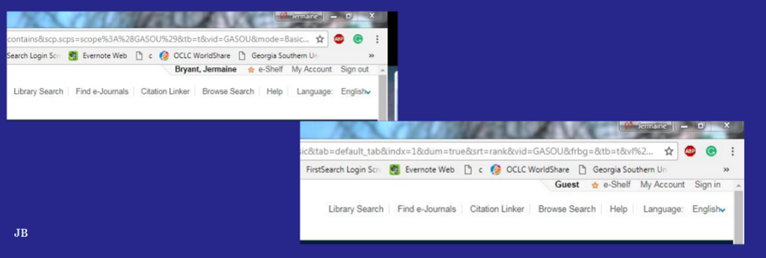
Problems with Authentication:
Primo Times Out
JW
Notes:
We found that many faculty, staff and students would start searching the catalog by signing in but was unaware that the system automatically signed them out after a certain time of inactivity. Although you would end up signed out there was no prompt to tell you to sign back in except at the very top right hand corner.

Slide 10
Problems with Authentication: No authentication through MyGeorgiasouthern.
JW
Notes:
We also think that some of our issues have to do with students not being authenticated to use our full text. Toward the end of our project we noticed that Discover had begun to make getting the article very clear in some cases. You would find the wording “Full Text from Science Direct” and other unambiguous language. When asked why they still chose to submit an ILL request, they said the full text would not open. They were not authenticated. There is a yellow line at the top of the opening screen which is easy to find if you are looking for it. But if you are not, it is easy to miss. You have two different experiences with searching on campus compared to off campus.

Slide 11
Digital is great but can I have the book?
Photo by James Tarbotton on Unsplash
Photo by João Silas on Unsplash
JG
Notes:
What did we find? We own digital copy but patron still want the print copy
One aspect we set out to explore was the question of print vs digital books. We have some frequent users of interlibrary loan who have explained to us that they prefer print and are not interested in our online books. And we get a substantial number of requests for books which are clearly available in digital form in our catalog. So we queried some who had placed such requests. As expected, some simply were not interested in an online book.

Slide 12
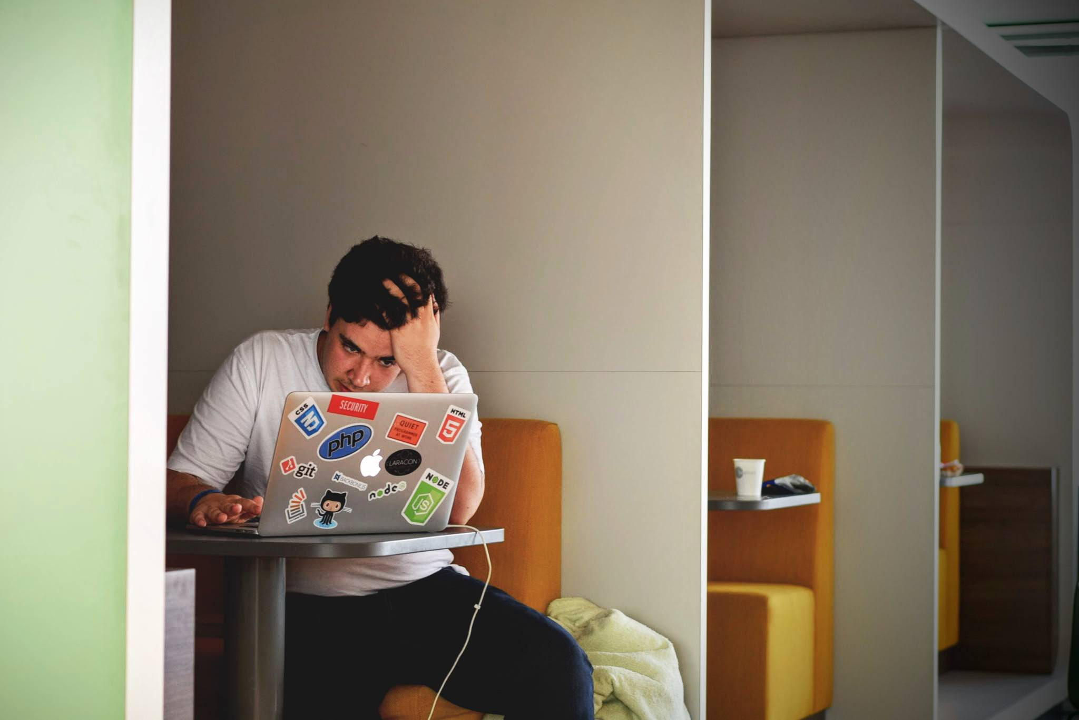
Downloading ebooks is hard!
Electronic Book Titles Downloaded =
23,886
Electronic Book Chapters or Sections
150,555
OverDrive
Book titles circulated a total of 1,091 times (600 ebooks and 491 audiobooks).
74.84 % have circulated at least once
Photo by Tim Gouw on Unsplash
JG
Notes:
Most of our digital books can be viewed in a straightforward manner, but in order to save a copy, you must take a number of preliminary steps, such as establishing an account and downloading a special Adobe file. Some patrons said they were not willing to do that; they would rather have us obtain a print copy through interlibrary loan.
The use statistics for our digital books in general is impressive, so the ILL experience is not instructive for the larger Library’s acquisition policy. In fact, occasionally we will have a patron tell us they are only interested in a digital copy.

Slide 13
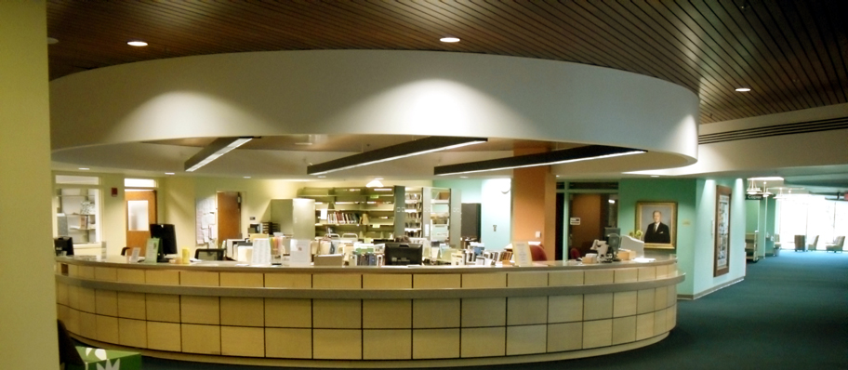
Can I pick that up after class?
Henderson Library Check-out desk
JG
Notes:
Books on our shelf. Students figured out that ILL would pull books for them.
We provide document delivery to faculty offices whether a book is in our collection or we borrow it from another library. Since we are going to provide it to them, whether from our collection or elsewhere, some faculty apparently hadn’t searched our holdings first. When told about the digital copy, they said they would definitely make use of it, but only until their print copy arrived. They still wanted us to borrow the print copy. So while they did make use of the digital copy, it did not substitute for the loan of the print copy.
The use statistics for our digital books in general is impressive, so the ILL experience is not instructive for the larger Library’s acquisition policy. In fact, occasionally we will have a patron tell us they are only interested in a digital copy.

Slide 14
Technology problems
Trouble with different devices
Browser issues
Broken links
JW
https://www.configurationconnection.com/do-these-common-technology-problems-make-you-inefficient/
Notes:
Different devices - Macs v. PCs; different handheld devices may work less effectively;
Ex. student that could only see a portion of the screen she was supposed to because of the device she was using. She couldn’t tell that she just needed to make what was on her screen much smaller.
Browser issues
Old browsers, especially IE, are often bad. Some databases work better or don’t work with different browsers.
Ex. of teacher using her work computer on very, very old version of Internet Explorer and couldn’t access articles.

Slide 15
Quiz Question
What groups of patrons frequently don’t find Henderson Library’s resources…
Undergraduates
Graduate students
Faculty/staff
Distance learners
All of the above
JW

Slide 16
Answer
E. All of the Above
JW
https://www.longislandpress.com/2016/12/16/college-major-quiz-what-should-your-college-major-be/

Slide 17
Solutions
Faculty & Staff
Undergraduate Students
Graduate Students
Distances Learners
Photo by Rita Morais on Unsplash
JG
Notes:
Last year we decided that we should make patrons aware when we supplied materials from our collections. We tried a number of ideas on how best to do that. We wanted to find a way to tell them that would be hard for them to miss, but we wanted to do it in such a way that it did not involve much new work for us. The best idea we could come up with was to delete the author line of the ILLiad request and add wording to the effect that we supplied it from our Library. There is not room for much else, but we often add “try our Journal Title List,” since it is usually the single most helpful advice.

Slide 18
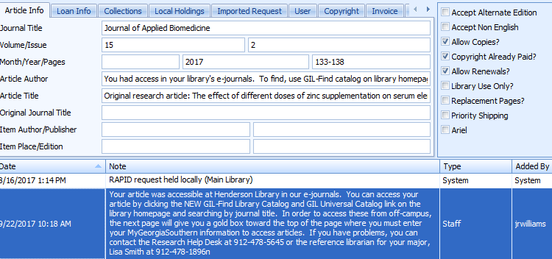
Instructing Users Through the ILLiad Form
Author field
Note field
JW
Notes:
Last year we decided that we should make patrons aware when we supplied materials from our collections. We tried a number of ideas on how best to do that. We wanted to find a way to tell them that would be hard for them to miss, but we wanted to do it in such a way that it did not involve much new work for us. The best idea we could come up with was to delete the author line of the ILLiad request and add wording to the effect that we supplied it from our Library. There is not room for much else, but we often add “try our Journal Title List,” since it is usually the single most helpful advice.

Slide 19
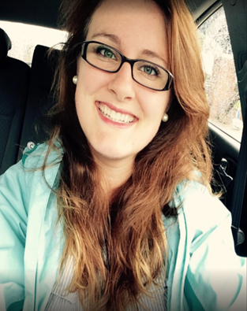
Interlibrary Loan Consultations
JG

Slide 20
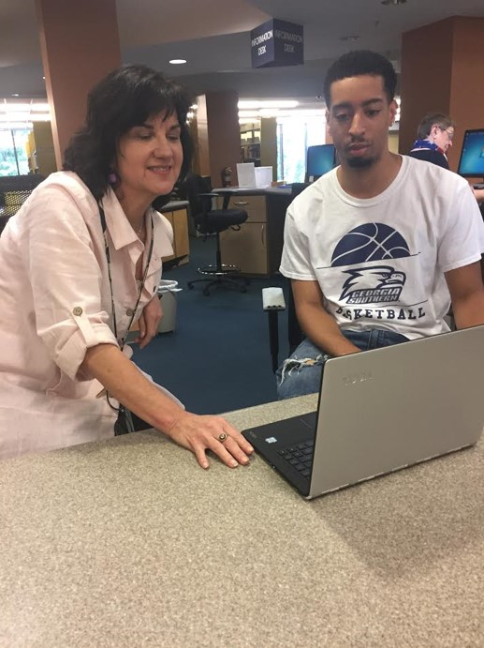
Promoting
the
Liaison
Program
JG
Notes:
About half way through the project we added another element. We began promoting our Liaison program. We emailed them a canned statement about the value of having a faculty librarian assist them with their information needs and gave them contact information for the liaison librarian for their major.
Your liaison librarian is a faculty member with particular expertise at finding information in your field of study. This person can direct you to the best sources to search and the best approaches for your searches, and can save your time. You can ask this person for help by email, by phone, or in person with a one-on-one consultation. We suggest you contact her by email to get research help the next time you need it. Your liaison is Ruth Baker, and her email address is baker@georgiasouthern.edu.
At this point we do not know how effective this has been. It might be some time before one of the researchers remembers her/his liaison and contacts that person. One exception was the researcher who talked to the liaison librarian just after answering the survey questions. When told about the Library’s Liaison program, she said she would like to talk to her liaison right then. So the person called the appropriate liaison who helped her with a specialized search of the Nursing literature. He said he know her quite well, since they were married.

Slide 21
Share our research!
Photo by Evan Kirby on Unsplash
JG
Notes:
Share our research with other departments and at conferences

Slide 22
Points Shared with Instruction Librarians
Authentication
“Find It” is not always understood.
Some of our databases don’t provide full text and don’t link to our holdings.
JW
Notes:
“Find It” is not always understood. Emphasize that clicking Find It is the next step to getting your article.
Some of our databases don’t provide full text and don’t link to our holdings. Three that come up regularly are MLA Bibliography, Georgia Knowledge Base, and ProQuest Theses and Dissertations Global. Please explain to students that if they get references from the first two databases, they will need to search in either the GIL Catalog or the Journal Titles List in order to determine if we have the material. The same is true for dissertations. If they find a reference to a dissertation, it will not link to ProQuest Dissertations. Of course most of the time students will not recognize that a source is a dissertation. There is no “see reference” to ProQuest from the word “Dissertations” in the database list.
Stress authentication. Explain that Alma times out. Remote patrons are not authenticated simply by coming in through MyGeorgiaSouthern. They must notice the yellow bar at the top of the page which is the pathway to authentication.

Slide 23
Can authentication be made harder to miss?
Can the timing out period be lengthened?
Is there a way to indicate that some databases do not link to our holdings?
Find It seems clear, but evidently it is not. Can a better term be found?
Suggestions for the
Collections and Resource Services Department
JG
Notes:
Points Shed Points Shared with Collections and Resource Services with Collections
Can authentication be made harder to miss?
Can the timing out period be lengthened?
Is there a way to indicate that some databases do not link to our holdings?
Find It seems clear, but evidently it is not. Can a better term be found? and Resource Services

Slide 24
Final Takeaways
If at first a patron doesn’t succeed, the next step is the ILL request.
The e-team is the greatest thing since sliced bread.
Patrons appreciated the help instead of feeling intruded upon.
Whenever possible, contacting patrons to help when we identify that they are having trouble should be standard procedure.
JG
Notes:
Last year we decided that we should make patrons aware when we supplied materials from our collections. We tried a number of ideas on how best to do that. We wanted to find a way to tell them that would be hard for them to miss, but we wanted to do it in such a way that it did not involve much new work for us. The best idea we could come up with was to delete the author line of the ILLiad request and add wording to the effect that we supplied it from our Library. There is not room for much else, but we often add “try our Journal Title List,” since it is usually the single most helpful advice.

Slide 25
Questions?
Photo by Clay Banks on Unsplash

